Slide 1

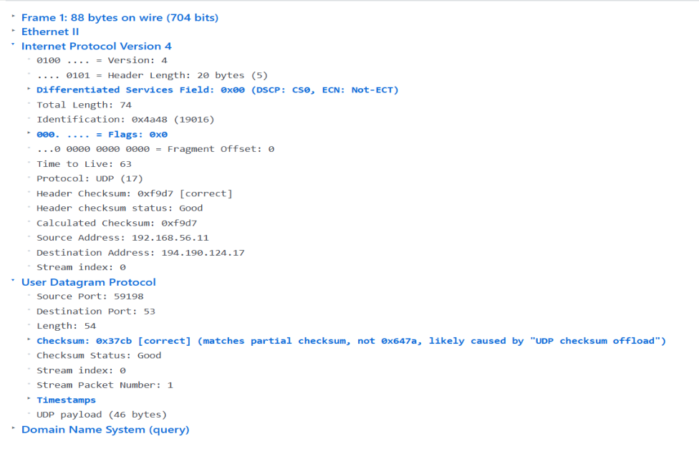
Assessment Tool 1 – Coding Challenge
Computer Networks (CSA07)
Student Name: K Abinayasri
Reg No: 1921260133
Course code: CSA0704
Challenge Set 1: UDP Analysis
Question 1: DNS Sample
Samples to use: DNS + NTP
1. Open the DNS sample.
o Locate the UDP header.
o Write down the Source Port and Destination Port.
o What is the Destination Port number and which well-known service does it
represent?

Slide 2
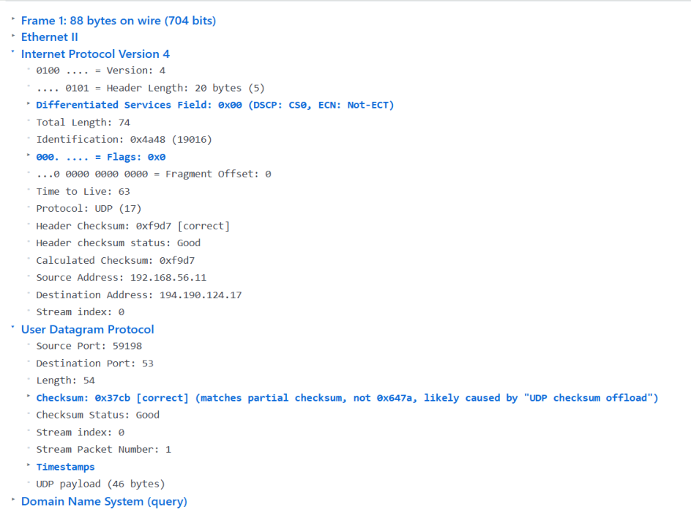
ANSWER
Source Port: 59198
Destination Port: 53
Well-Known Service: DNS (Domain Name System)
Explanation: Port 53 is used by DNS for domain name resolution.
2. Still in the DNS sample:
o Find the UDP Length and Checksum fields.
o Does this packet have any sequence number or acknowledgement number? What
does this tell
you about UDP?
UDP Length: 54 bytes
UDP Checksum: 0x37cb
Does this packet have any Sequence Number?​
No.

Slide 3
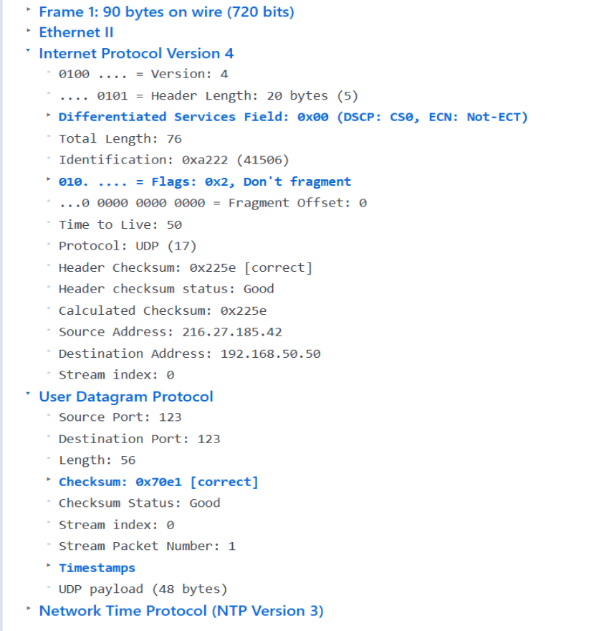
Does this packet have any Acknowledgement Number?​
No.
What does this tell you about UDP?
Answer:​
UDP is a connectionless protocol. It does not use sequence numbers or
acknowledgement numbers, making it faster but less reliable than TCP.
3. Open the NTP sample.
o Compare its UDP header with the DNS sample.
o Are the header fields the same size?
o Why is UDP suitable for both DNS and NTP?

Slide 4
ANSWER
Source Port: 123
Destination Port: 123
Length: 56 bytes
Checksum: 0x70e1
Compare its UDP header with the DNS sample:​
Both DNS and NTP use the UDP protocol. They contain the same UDP header
fields such as Source Port, Destination Port, Length, and Checksum.
Are the header fields the same size?​
Yes. The UDP header size is 8 bytes in both DNS and NTP.
Why is UDP suitable for both DNS and NTP?​
UDP is fast and has low overhead. DNS and NTP require quick communication, so
UDP is suitable for both protocols.
Challenge Set 2: TCP Analysis
Samples to use: FTP + MySQL
4. Open the FTP sample.
o Expand the TCP header.
o List the following fields with their values:
Source Port
Destination Port
Sequence Number
Acknowledgement Number
Flags (which flags are set?)

Slide 5
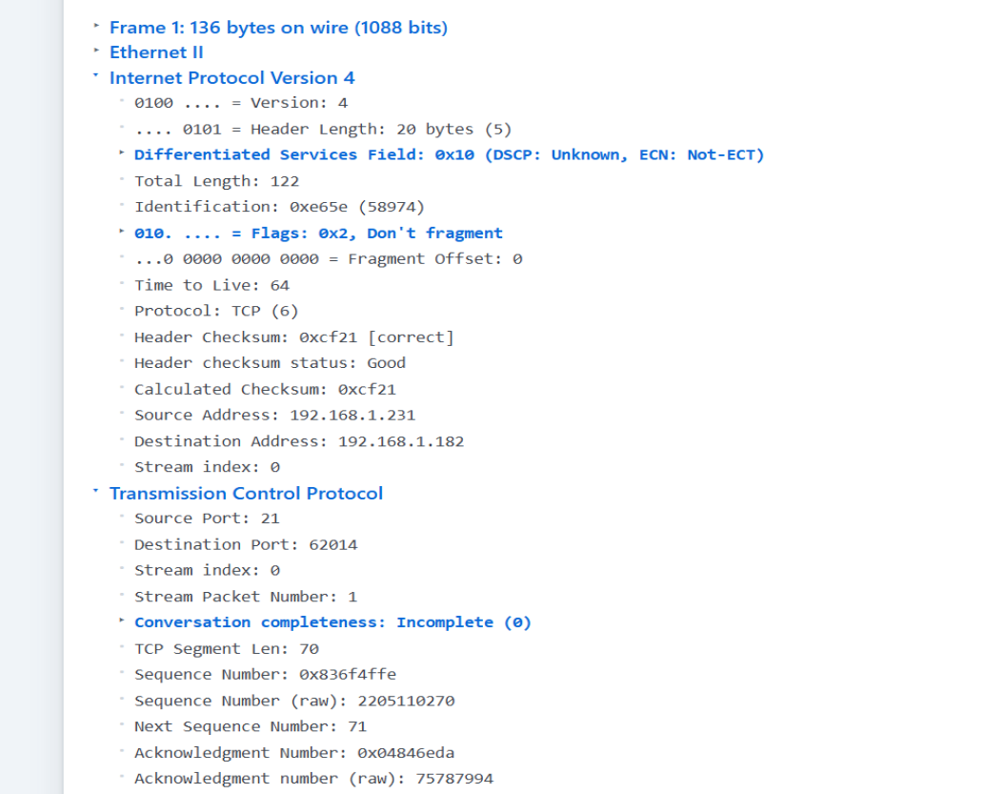
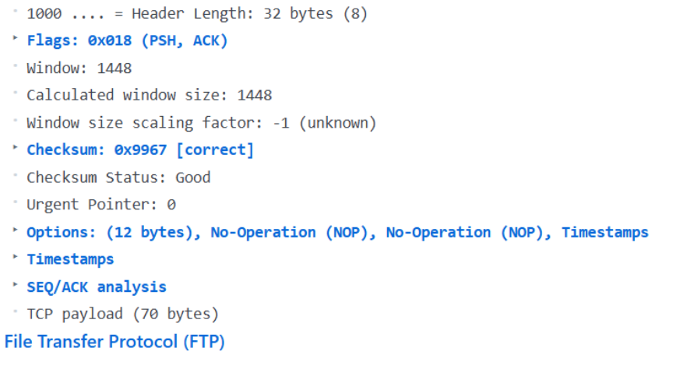

Slide 6

ANSWER
Protocol: TCP
Source Port: 21
Destination Port: 62014
Sequence Number: 0x836f4ffe (raw: 2105110270)
Acknowledgement Number: 0x04846eda (raw: 75787994)
Flags: PSH, ACK
Window Size: 1448
TCP Header Length: 32 bytes
Answer: TCP header has sequence number, acknowledgement number, flags and
window size, which support reliable and flow-controlled communication.
5. In the same FTP sample:
o What is the 4-tuple that uniquely identifies this TCP socket?
o Explain how this 4-tuple helps in demultiplexing.

Slide 7
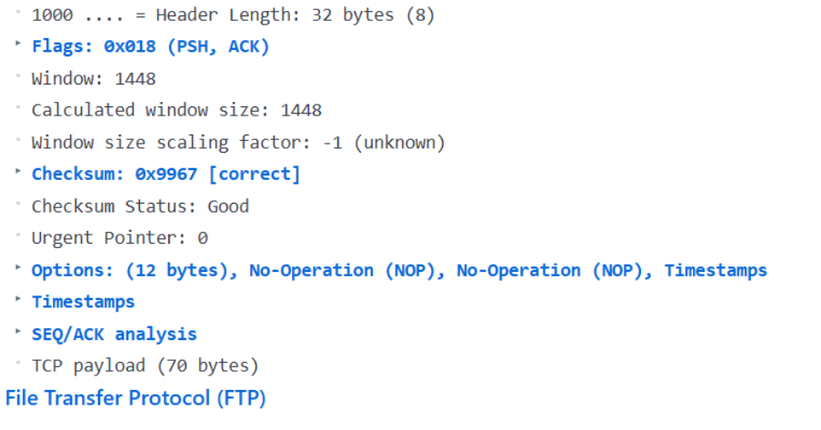
From the packet:
Source: 192.168.1.231 : 21
Destination: 192.168.1.182 : 62014
So the 4-tuple is:
(192.168.1.231, 21, 192.168.1.182, 62014)
It uniquely identifies the TCP connection. It helps multiplexing/demultiplexing by
allowing the OS to determine which application/socket should receive the packet.
6. Open the MySQL sample.
o Compare its TCP ports with the FTP sample.
o Are the Destination Ports the same or different?
o How does the operating system know which application should receive each
packet?
(Demultiplexing)

Slide 8
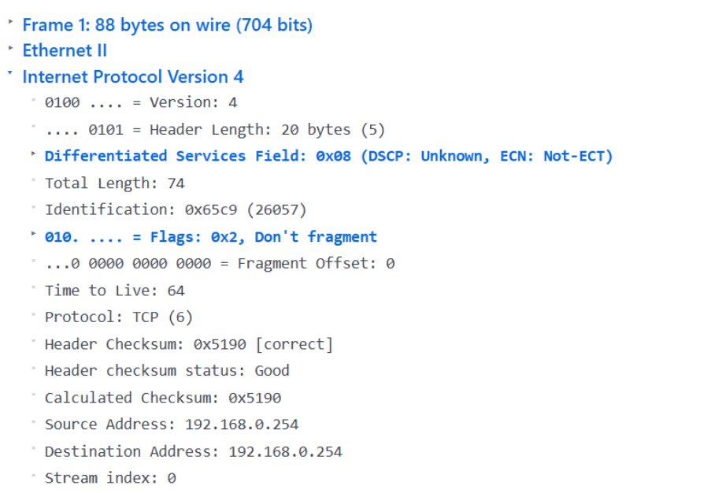
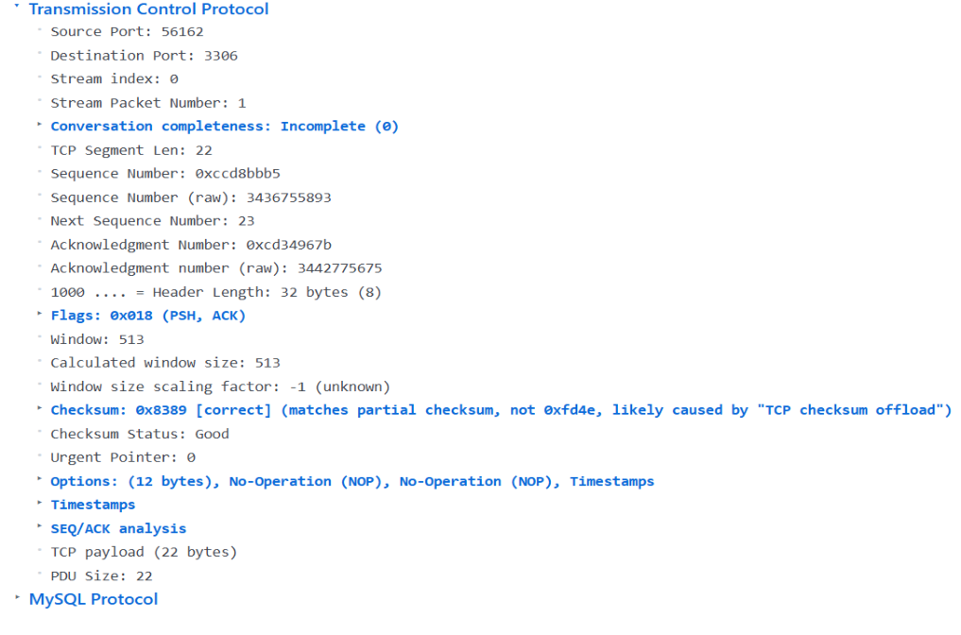
ANSWER

Slide 9
Source Port: 56162
Destination Port: 3306
FTP Destination Port: 62014
MySQL Destination Port: 3306
Are the Destination Ports the same?
No, they are different.
How does the OS know which application should receive each packet?
The OS uses the TCP 4-tuple (Source IP, Source Port, Destination IP, Destination
Port) to identify the correct TCP connection and deliver the packet to the correct
application. This is called demultiplexing.
Challenge Set 3: TCP vs UDP Comparison
Samples to use: DNS (UDP) + FTP (TCP)
7. Place the DNS and FTP samples side-by-side (open one after another).
o Which protocol has a larger header?
o Which protocol provides reliability features (sequence numbers, flags, window)?
o Which protocol is connection-oriented and which is connectionless? Give
evidence.
ANSWER
Which protocol has a larger header?
TCP — minimum 20 bytes. UDP is 8 bytes.
Which protocol provides reliability features?
TCP — it uses Sequence Number, Acknowledgement Number, Flags and Window
Size.
Which protocol is connection-oriented and which is connectionless?
TCP → Connection-oriented
UDP → Connectionless
Evidence:
FTP/TCP screenshot shows Sequence Number, ACK Number, Flags (PSH, ACK),
and Window Size. DNS/UDP has only Source Port, Destination Port, Length and
Checksum.
8. From the FTP sample:
o Point out any fields that show TCP’s duty of providing reliability and flow control.

Slide 10

ANSWER
TCP reliability and flow control fields:
Sequence Number → ensures data is delivered in the correct order.
Acknowledgement Number → confirms that data has been received.
Window Size: 1448 → provides flow control, telling the sender how much data can
be sent.
ACK flag → indicates acknowledgement of received data

Slide 11
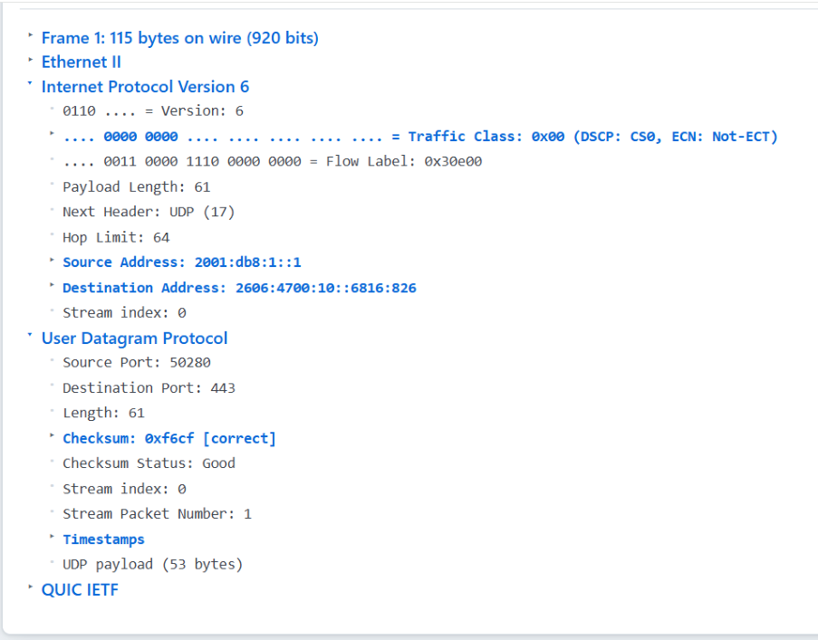
Challenge Set 4: Modern Transport
Sample to use: QUIC
9. Open the QUIC sample.
o Which underlying Transport protocol is QUIC using? (Look carefully)
o What is the Destination Port?
o How is QUIC different from classic TCP even though it runs over UDP?
ANSWER
Underlying Transport Protocol: UDP
Destination Port: 443
Evidence:
The screenshot shows “Next Header: UDP (17)” and “Destination Port: 443.”
Difference from classic TCP:
QUIC runs over UDP but provides reliability, flow control, congestion control, and
multiple streams at the QUIC layer.

