Slide 1

Comprehensive Analysis of Socio-Economic and Demographic Data

Slide 2
INTRODUCTION AND OBJECTIVE
The dataset consists of socio-economic and demographic data collected from individuals, likely through a survey or a census. This comprehensive dataset includes a wide range of attributes that describe various aspects of individuals' lives, such as their demographic information, socio-economic status, employment details, family and household dynamics, geographic mobility, and financial situation.
The primary objective of analyzing this dataset is to uncover insights that inform government policy making. The analysis aims to:
Identify Demographic Trends: Assess how age, gender, race, and other factors influence income levels.
Assess Socio-Economic Impacts: Evaluate the effects of education and employment type on financial well-being.
Analyze Family Dynamics: Explore the relationship between household structure, marital status, and income.
Investigate Geographic Mobility: Examine migration patterns and their economic implications.
Understand Financial Factors: Analyze the impact of investment income, capital gains, and losses on overall income.

Slide 3
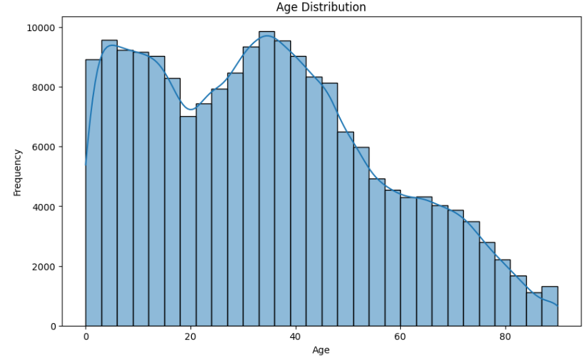
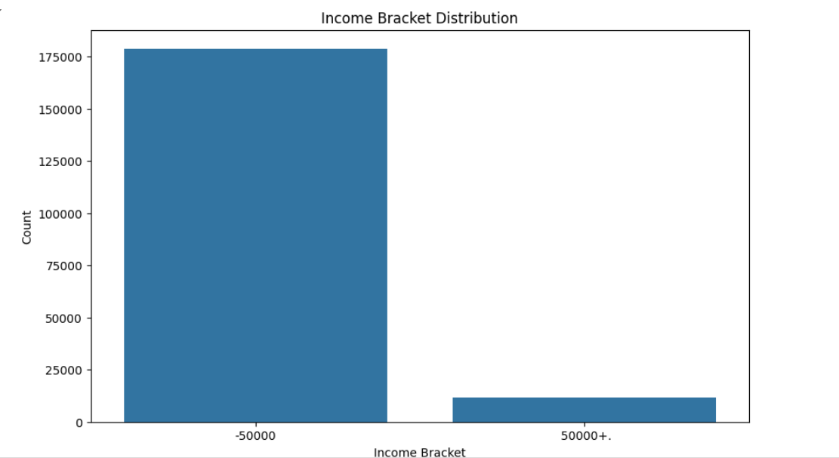
DATA OVERVIEW
Key Statistics:
Number of records: 199,523
Number of columns: 42
Key attributes: Age, Gender, Race, Education, Employment, Income
VISUALS:

Slide 4
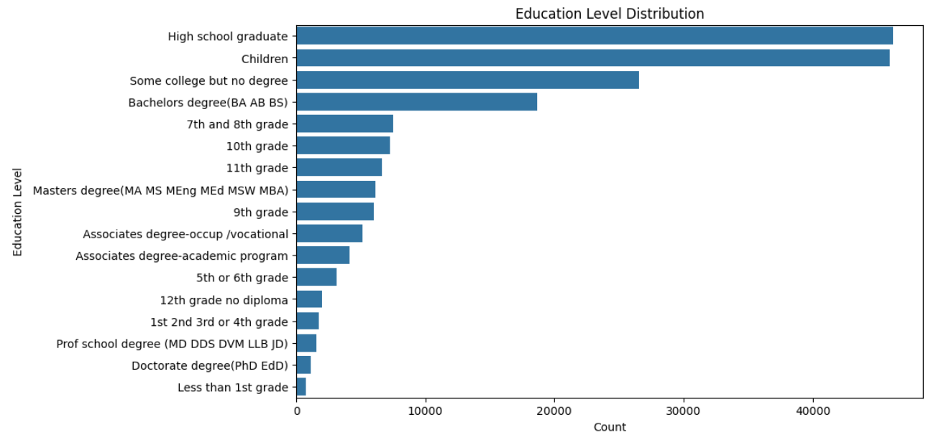
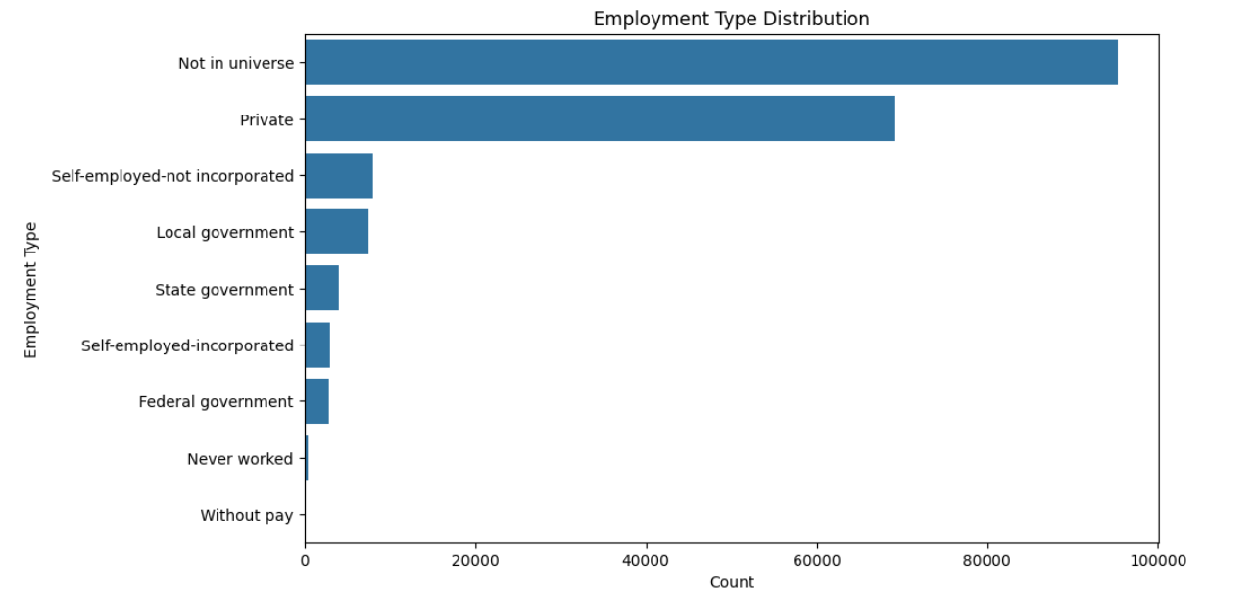
Initial Observations:
Age distribution skewed towards younger individuals.
Majority in <=50K income bracket.
Diverse education levels with a focus on high school and some college education.
Predominance of private sector employment.
Indications of a gender income gap.

Slide 5
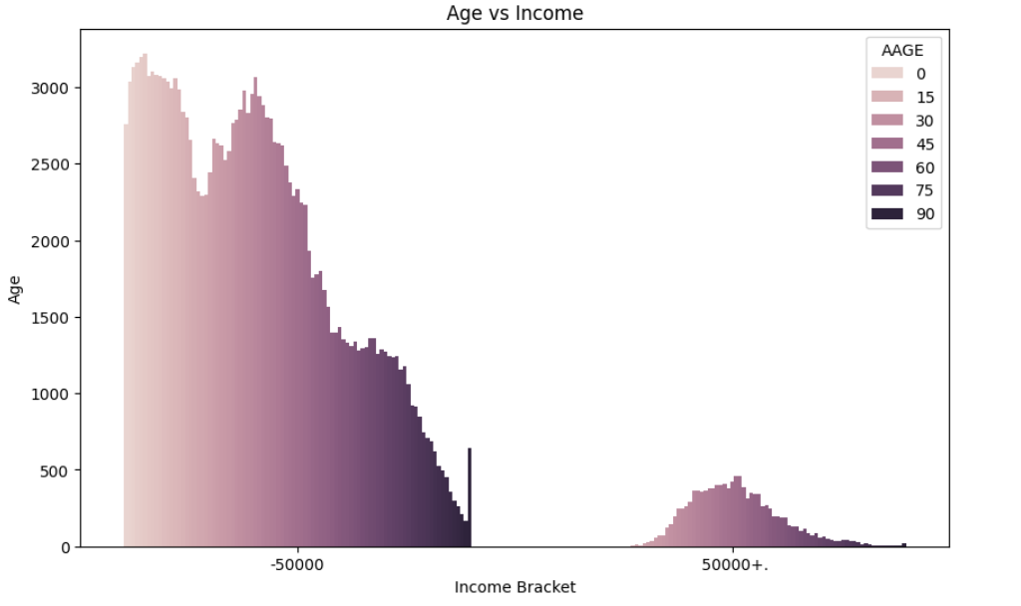
Detailed Analysis
Demographic Influences on Income
Age vs Income
Observation: Older individuals tend to have higher income levels.
Insight: Income generally increases with age, peaking around middle age
Visuals

Slide 6
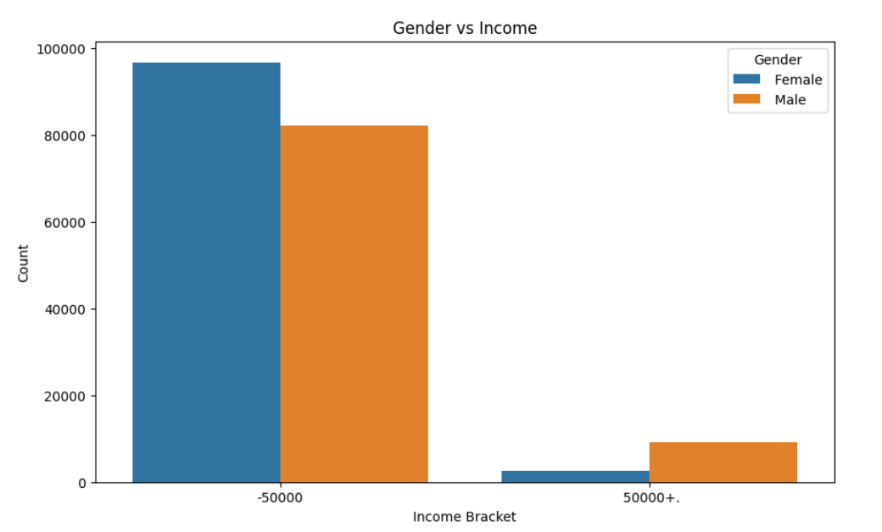
Gender vs Income
Observation: Men tend to have higher income levels than women.
Insight: There is a notable gender income gap
. Visual

Slide 7
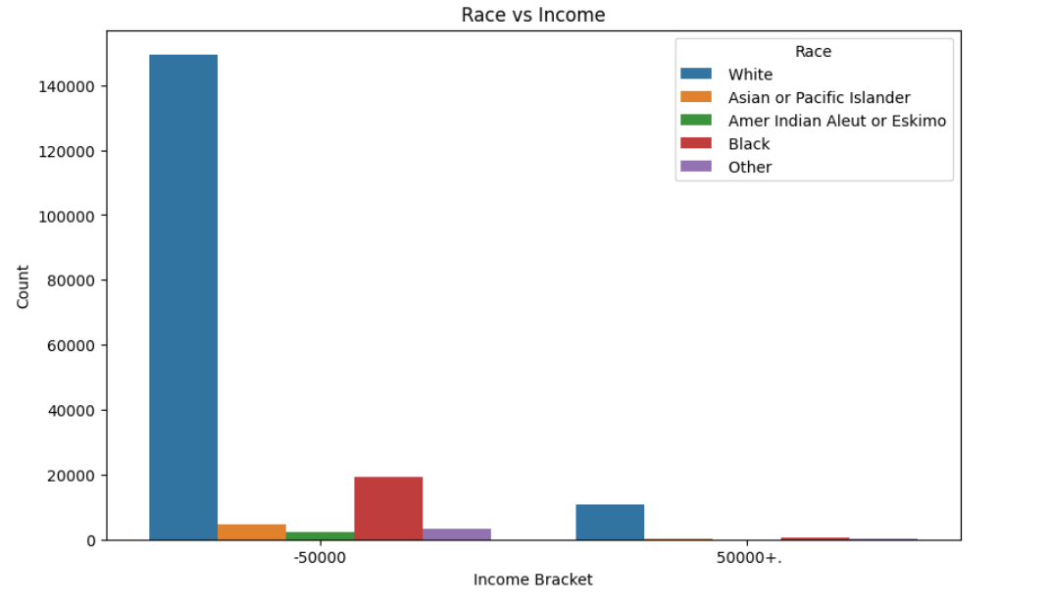
Race vs Income
Observation: Certain racial groups have lower income levels.
Insight: There are significant income disparities among different racial groups
Visuals

Slide 8
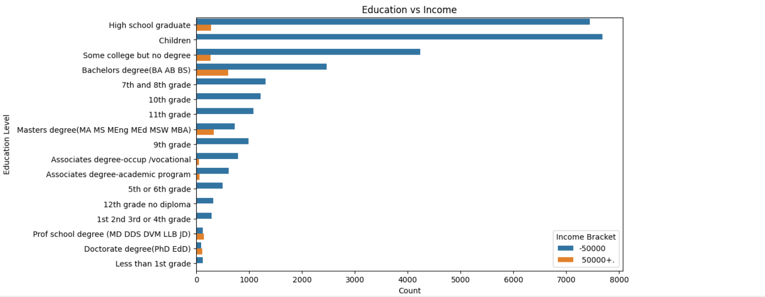
Socioeconomic Factors and Income
Education vs Income
Observation: Higher education levels correlate with higher income.
Insight: Education is a strong predictor of income level
Visuals

Slide 9
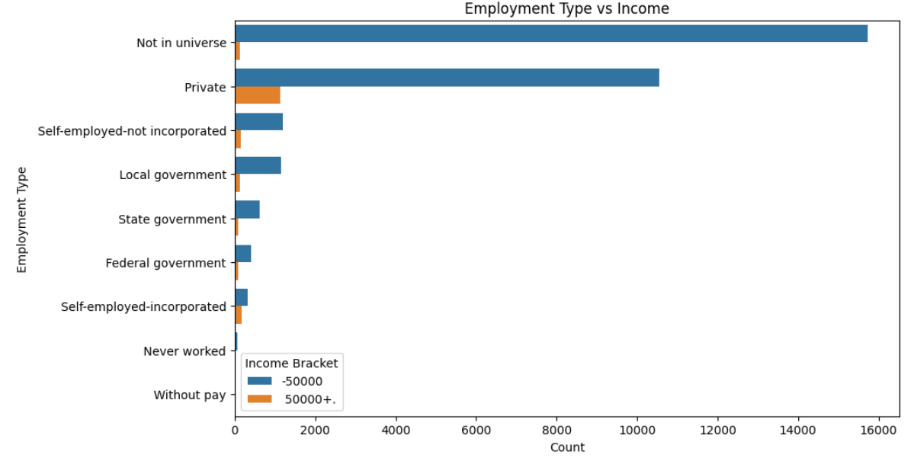
Employment Type vs Income
Observation: Government and private sector employees have higher income levels.
Insight: Employment type significantly impacts income.
visuals

Slide 10
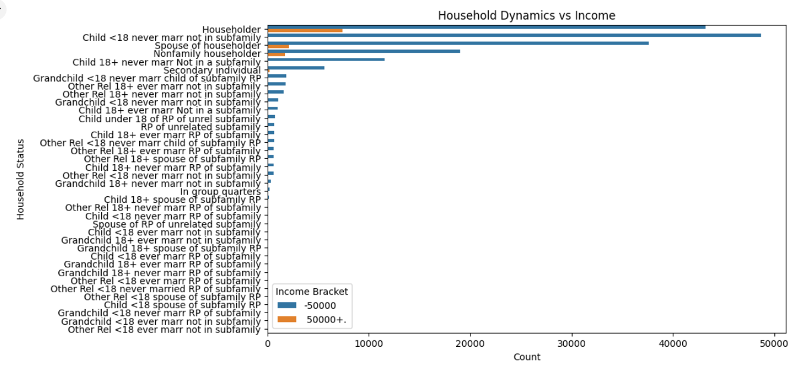
Family and Household Dynamics
Marital Status vs Income
Observation: Married individuals have higher income levels.
Insight: Marital status affects income, with married individuals typically earning more.
Visuals:

Slide 11
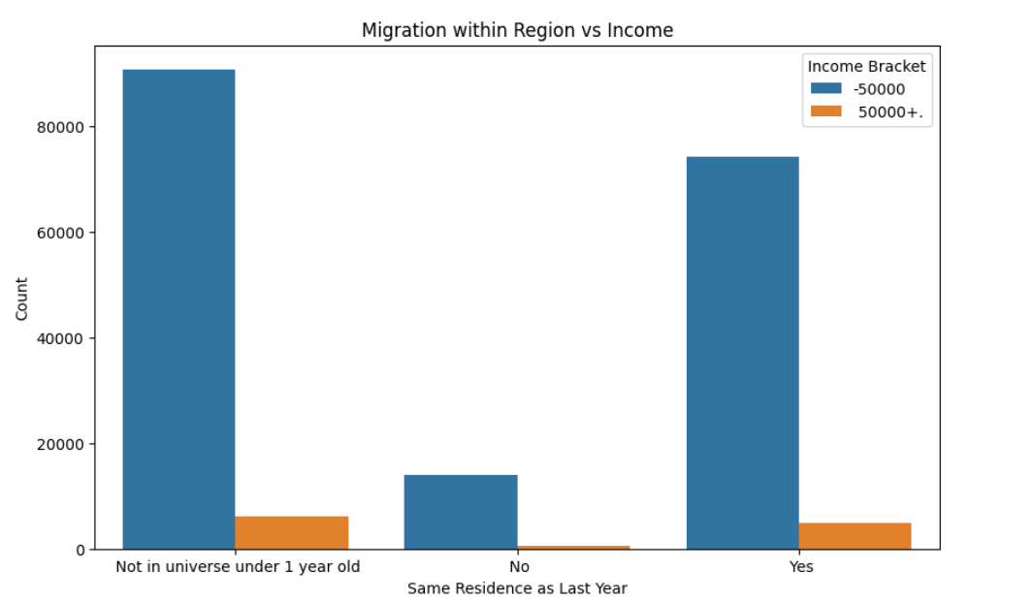
Migration Status vs Income
Observation: Migrants experience varied income levels based on their mobility.
Insight: Migration patterns affect economic stability and opportunities.
Visuals

Slide 12
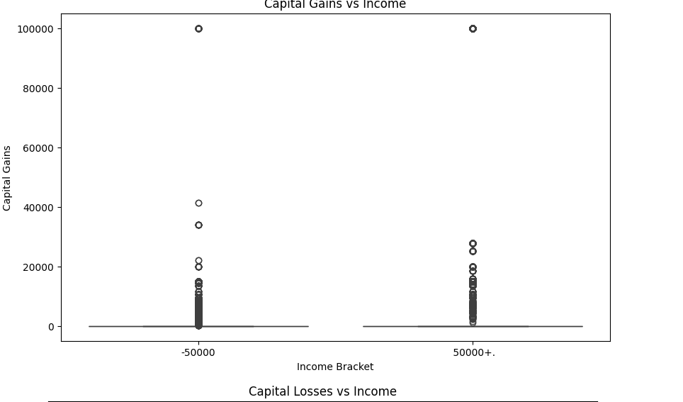
Economic Factors
Capital Gains vs Income
Observation: Higher capital gains correlate with higher income levels.
Insight: Investment income significantly boosts overall income
Visuals

Slide 13
Conclusion
Demographic Influences on Income:
Age: Older individuals tend to earn more, with income peaking around middle age.
Gender: Men generally earn more than women, highlighting a gender income gap.
Race: Significant income disparities exist among different racial groups.
Socioeconomic Factors:
Education: Higher education levels are strongly associated with higher income.
Employment Type: Government and private sector employees tend to have higher incomes compared to self-employed or unemployed individuals.
Family and Household Dynamics:
Marital Status: Married individuals typically earn more than single, divorced, or widowed individuals.
Household Composition: Households with more children under 18 tend to have lower incomes.
Geographic and Migration Insights:
Region: Individuals from certain regions, particularly urban areas, tend to have higher incomes.
Migration: Economic opportunities and income levels are influenced by migration patterns.
Economic Factors:
Capital Gains: Higher capital gains are associated with higher income levels, indicating the importance of investment income.
Capital Losses: Higher capital losses are more prevalent in lower income brackets, suggesting financial instability.

Slide 14
Credits
TOOLS USED:
.GOOGLE COLAB
. GITHUB

