Slide 1
Hot Reload and Hot Restart and Stateless Widgets in React Native
React Native App Development

Slide 2
What is HOT RELOAD?
allows you to see changes in your code almost instantly without losing the application’s state. It updates the code that has changed and keeps the rest of the application as is, which is especially useful when you are tweaking the UI or making minor adjustments.

Slide 3
How Hot Reloading Works:
When you save a file, only the changed modules are replaced.
The application’s state is preserved, so you don’t need to navigate back to the point where you were before the changes.

Slide 4
Enabling Hot Reloading:
Ensure your development server is running by using the command:
npx expo start or npm start
In your React Native app, shake your device or press Cmd + D (iOS) or Cmd + M (Android Emulator) to bring up the developer menu.
In the developer menu, enable “Fast Refresh”.

Slide 5
Hot Restart
Hot Restart restarts the entire application, losing the state but ensuring that all the code changes are applied fresh. This is necessary when you make changes that affect the state or the initialization of the application.

Slide 6
How Hot Restart Works:
The entire application is reloaded from scratch.
The state of the app is lost, and it starts from the initial state.

Slide 7
Enabling Hot Restart:
Ensure your development server is running by using the command:
npx expo start or npm start
In your React Native app, shake your device or press Cmd + D (iOS) or Cmd + M (Android Emulator) to bring up the developer menu.
n the developer menu, select “Reload” or use the shortcut R (double tap R for Android).

Slide 8
Differences Between Hot Reloading and Hot Restart:
State Preservation: Hot Reloading preserves the state of your app, while Hot Restart does not.
Speed: Hot Reloading is faster as it only updates changed modules, whereas Hot Restart reloads the entire application.
Use Cases: Hot Reloading is ideal for minor UI changes and adjustments, whereas Hot Restart is necessary for changes that affect the app’s state or initialization logic.

Slide 9
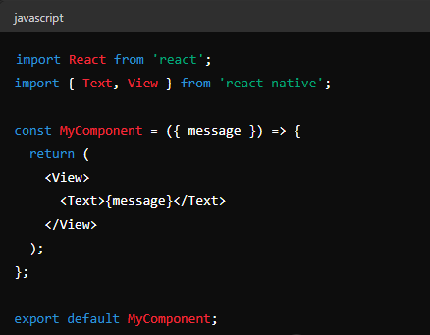
Stateless Widgets in React Native
In React Native, stateless widgets are equivalent to functional components in React. These components do not manage their own state; they receive data via props and render UI elements based on that data.

Slide 10
Summary
Hot Reloading: Preserves state, faster updates, good for minor changes.
Hot Restart: Does not preserve state, reloads the entire app, necessary for significant changes.
By leveraging both hot reloading and hot restart, React Native developers can streamline their development workflow, making it more efficient and productive.

