Slide 1



Supervised Learning Project by Abi Afolabi 22nd Aug 2023

Slide 2
Project Overview & Goals
Reinforce learning with hands-on experience
Use supervised learning techniques to build a machine learning model that can predict whether a patient has diabetes or not, based on certain diagnostic measurements.

Slide 3
Project Execution Steps
Import Python Libraries & Dataset
Perform Exploratory Data Analysis (EDA)
Build Model & Interpret
Perform Feature Engineering
Perform Data Preprocessing
Notes:
POIs are Restaurant & Employment Services

Slide 4
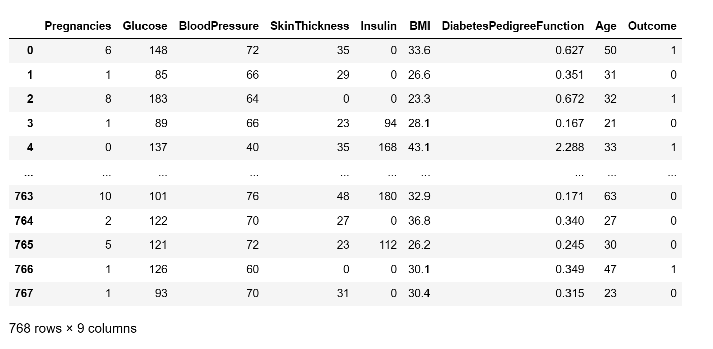
Dataset in Pandas DataFrame showing table columns and dimensions

Slide 5
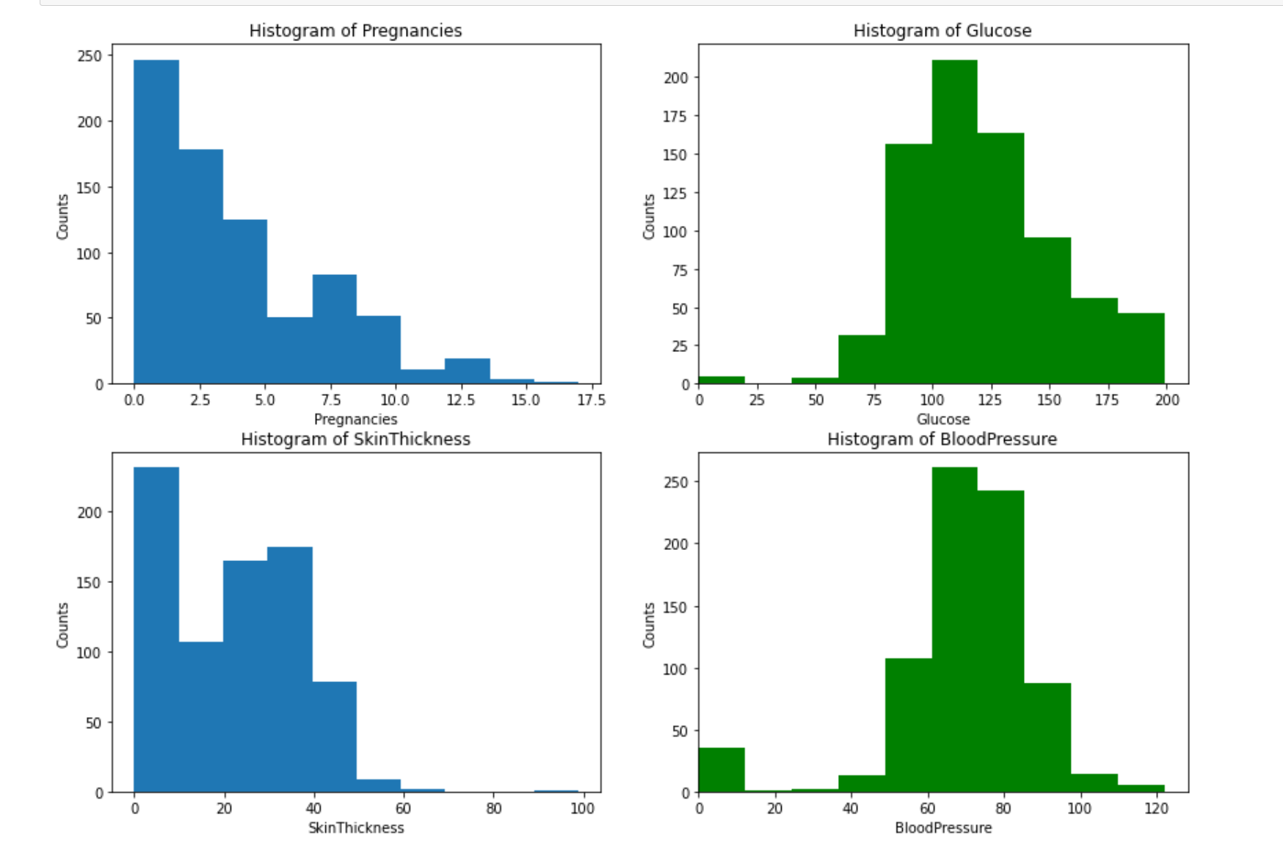
Discoveries from EDA – Histogram
Some of the dataset is mostly symmetrical around the mean and some right skewed

Slide 6
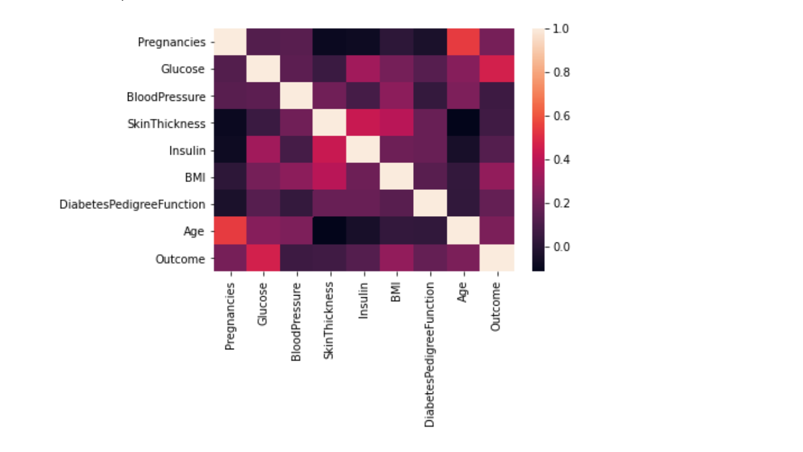
Discoveries from EDA – Correlation Matrix
Strong correlation Glucose levels and Outcome

Slide 7
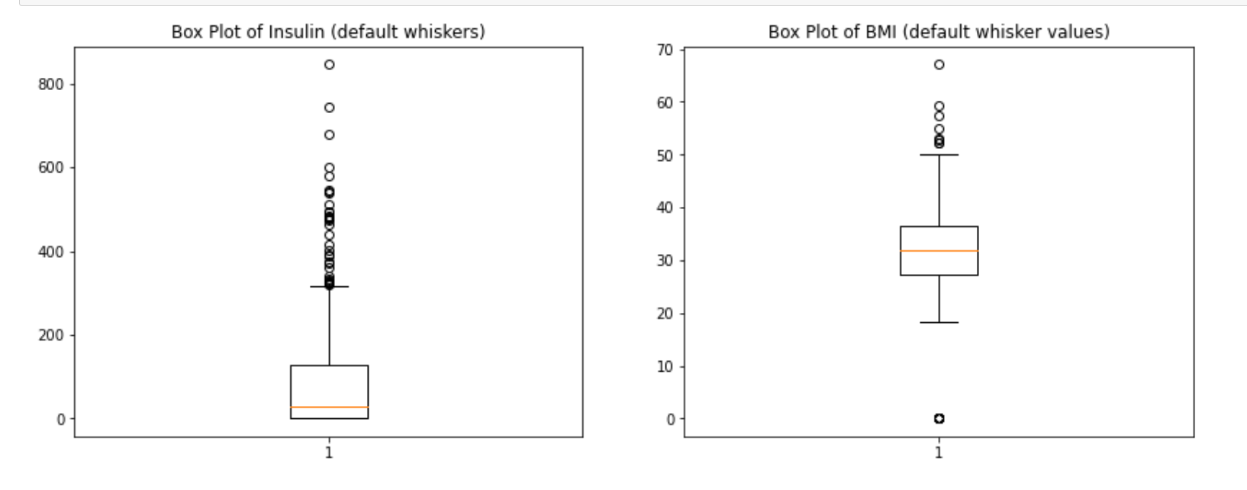
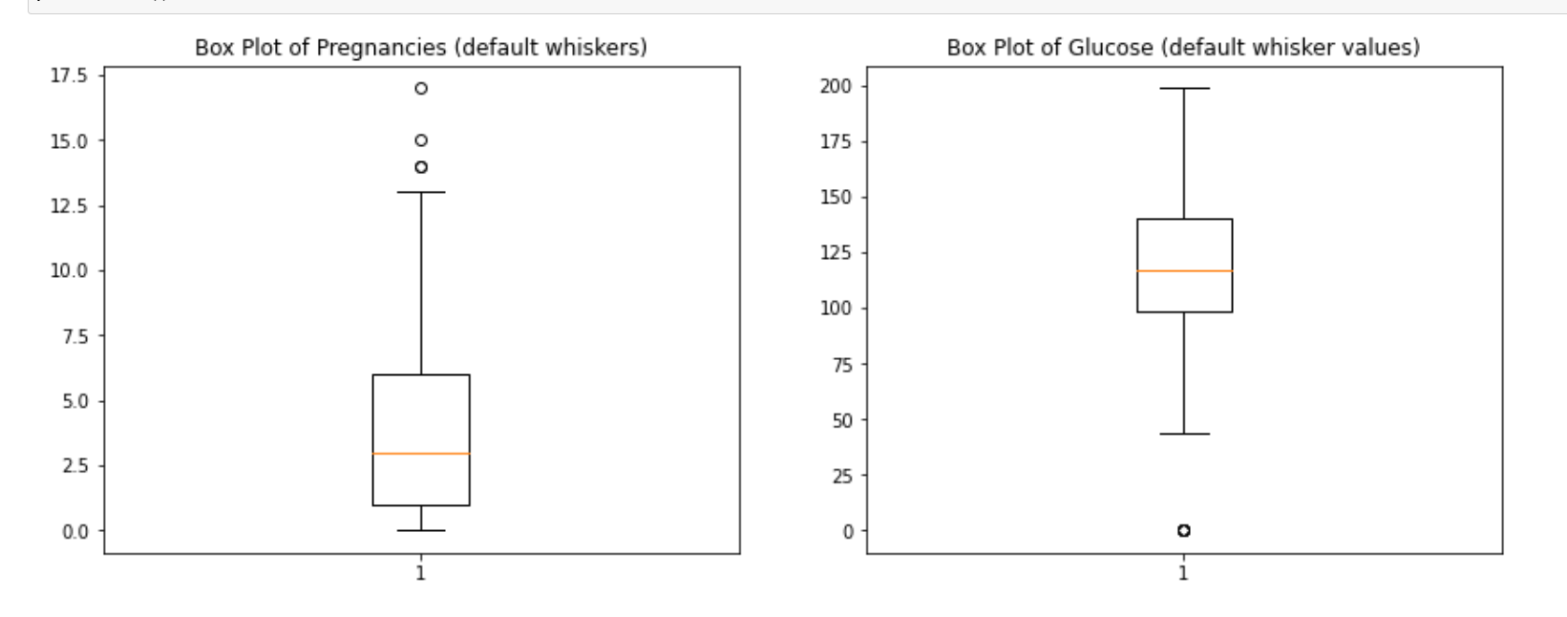
Discoveries from EDA – Box plots
Presence of outliers in dataset

Slide 8
Main Challenge – Very Little Time
With more time I will….
Explore the dataset with the EDA process.
Investigate if outliers in dataset are real or not, then address them accordingly.
Build a third model for further comparison

Slide 9
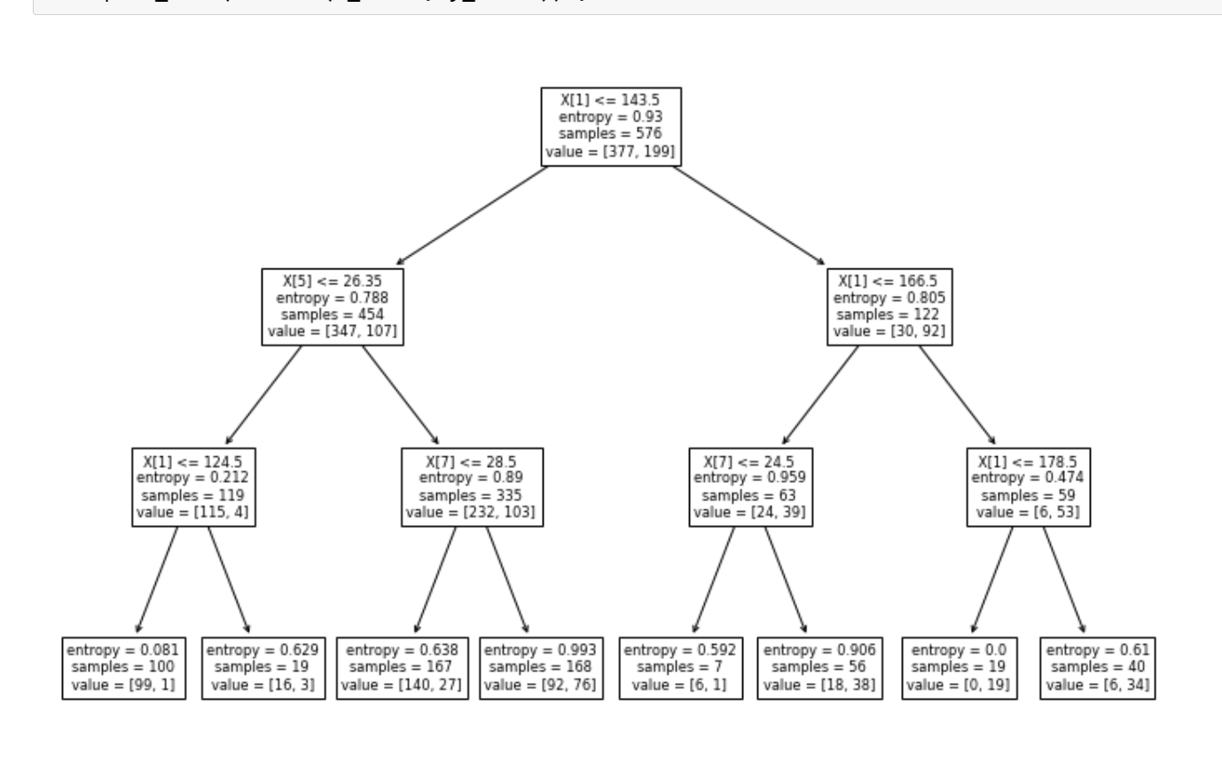
Decision Tree Model

Slide 10
Conclusion
Glucose levels in patients with corelation coefficient of ~0.7 is a strong indicator of being diabetic while BloodPressure & SkinThickness with correlation coeficient of ~0.1 are low indicators of diabetes
Adults in the age bracket between 30 and 44 years are mostly diabetic.
Interaction effect between the predictor variables is insignificant since the Variance Inflation Factor (VIF) is close to 1 ( far away from 5). Thus we can conclude that these parameters are good for model building.
Result of accuracy from Random Forest (75%) is higher than Decison Trees (71.3%) proving that it is a viable ensemble technique for improving model performance.
Notes:
The scatter plots do not really align with the linearity assumption of Linear regression. Therefore linear model might not be able to efficiently explain the data in terms of variability, prediction accuracy.¶

Slide 11

https://github.com/AbiAfolabi/ml-project-supervised-learning

