Slide 1
Three audiences, three surfaces
Each persona has its own surface; nobody is asked to learn another role's tools. Examples of real workflow snippets below.
Operator
What they touch
Chat composer + a row of suggested-prompt chips
What they get
A natural-language way to kick off pre-approved workflows or ad-hoc data queries against any registered source. No SQL or ontology authoring required.
Example prompt
“Override the SC-TC-001 sanctions block on order ORD-44216 — customer says they have an OFAC license.”
Reviewer
What they touch
A Teams Adaptive Card (or in-app card) per pending decision
What they get
Approve / Reject / Need more info with the full bound context: active policy, actor scope, master data, prior similar cases, SOPs — all attached automatically.
Example card
Sanctioned counterparty: Sanctioned Pharma Holdings · Product P-EL-9001 (ECCN 5A002) · Contract €4.2M → [Approve] [Reject] [Need info]
Engineer / scenario author
What they touch
YAML files + the Knowledge admin tile
What they get
Register a new system and every existing scenario picks it up through the ontology layer — no rewrites. Author one ontology, get many scenarios for free.
Example change
Add a Postgres governance source → click “Suggest mappings” → confirm Supplier.country → suppliers.country_code → done.
Same case object travels across all three surfaces — the audit trail stitches them together.

Slide 2
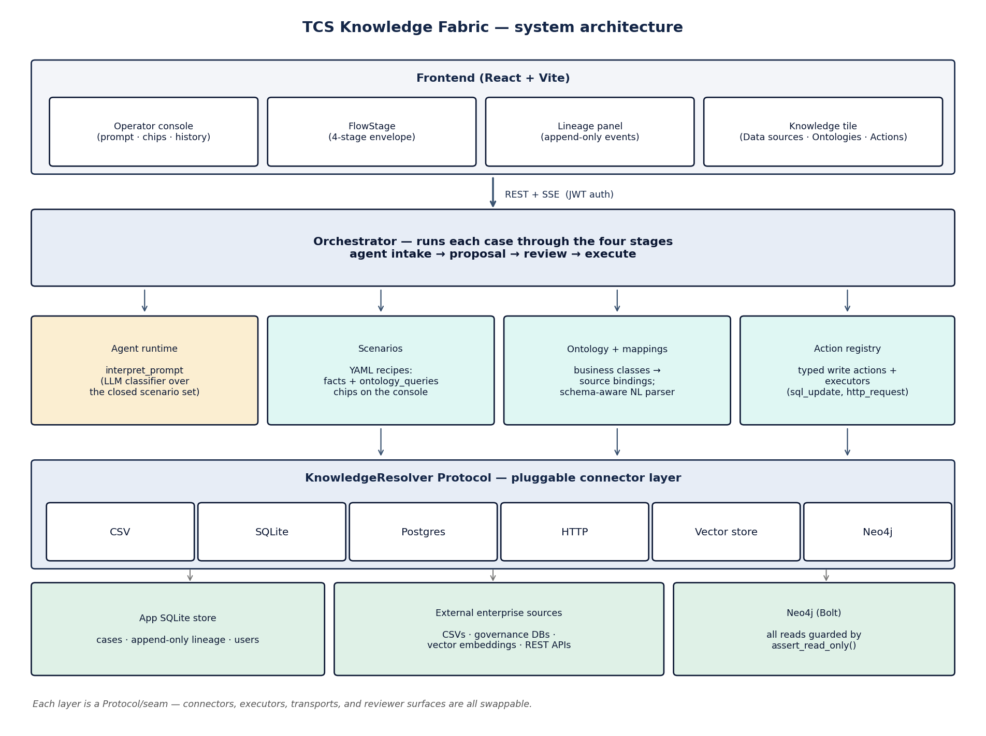
Architecture at a glance
Top of the diagram: what the operator sees. Bottom: connected enterprise systems. Each row is a swap-point.
The mental model
Three nouns + three verbs.
Three nouns (what it knows)
• Data sources — CSV, SQLite, Postgres, HTTP, vector, Neo4j
• Ontology — business classes mapped to source columns; authored once, reused everywhere
• Scenarios — YAML recipes the agent follows; one per pattern
Three verbs (what happens)
• Classify — LLM picks the scenario that matches the prompt
• Bind — framework gathers facts with provenance into a typed envelope
• Decide — auto-execute (low risk) or pause for a named reviewer
Everything else is implementation.

Slide 3
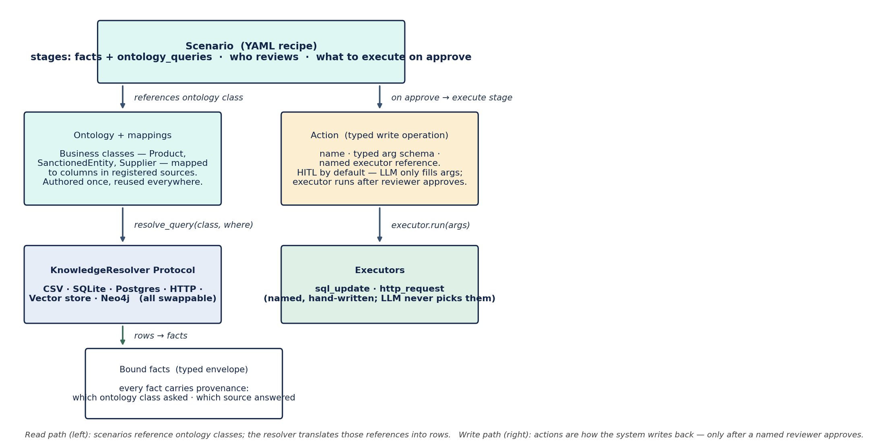
How scenarios, ontology, actions, and the resolver fit together
Scenarios are the recipes. Ontology + KnowledgeResolver are how the agent finds data. Actions are how it writes back — always behind a human approval.
Scenario
A YAML recipe naming the stages, what to bind at each, who reviews it, and what to execute on approve. Each scenario references ontology classes — no raw SQL.
SC-TC-007 binds Product, SanctionedEntity, PriorOverride.
Ontology + mappings
Business classes (Supplier, Product, …) mapped to physical columns in any registered source. Authored once; reused by every scenario.
SanctionedEntity → sanctions_csv.entity_name.
KnowledgeResolver
The Protocol every connector implements. Ontology passes it (class, filters) and gets back rows — without the scenario ever knowing CSV vs Postgres vs Neo4j.
Same Protocol serves CSV and the Neo4j supply graph.
Action + executor
A typed write op with a named hand-written executor (sql_update / http_request). The LLM only fills the args; the executor only runs after reviewer approval.
On approve: update_outcome_decided_by runs.
Deterministic classification
• LLM picks from the closed set of authored scenarios only
• No match → case is refused; operator picks a chip explicitly
• Write actions run only via hand-authored `_executor` blocks (no NL invention)
Adding a new data source = registration + a mapping. Every existing scenario picks it up — no rewrites.

Slide 4
How a request flows through the system
One real operator prompt, six steps. Each step names the layer from the diagram that activates and what it does.
Operator types: “Override the SC-TC-001 sanctions block on order ORD-44216 — customer says they have an OFAC license.”
1. Frontend → Orchestrator
Operator types it
The chat composer sends the prompt to the backend over REST. An SSE channel opens so the operator can watch each stage's facts populate live.
2. Agent runtime (LLM classifier)
Agent classifies the request
The LLM picks SC-TC-007 (Trade override — sanctioned counterparty) from the scenario catalog and rephrases it. Operator sees the rephrasing and clicks Confirm.
3. Scenarios + Ontology + Resolvers
Framework binds knowledge
Two stages run: intake pulls the active TC-override policy and the agent's IAM scope. Proposal pulls product master, the OFAC sanctions hit, and the contract value — each fact tagged with which ontology class asked and which source answered.
4. Orchestrator (policy gate)
Policy says: needs a human
Sanctions overrides require named compliance officer approval, so the case enters the review stage and the orchestrator pauses. A Teams Adaptive Card is rendered with all bound facts, prior similar overrides, and three SOP excerpts retrieved by semantic search.
5. Reviewer surface → Action registry
Reviewer decides
The compliance officer reads the card and clicks Approve / Reject / Need more info. On approve, the orchestrator wakes the paused case and dispatches the write action to its named executor (sql_update or http_request).
6. Lineage recorder
Audit trail finalizes
Every fact bound, every query issued, every decision made: appended to an immutable per-case log. Replayable later for compliance review — even with a forced reviewer decision to compare counterfactuals.
Autonomous cases finish in ~10 seconds; HITL cases pause indefinitely at step 4 until a named reviewer decides.

