Slide 1
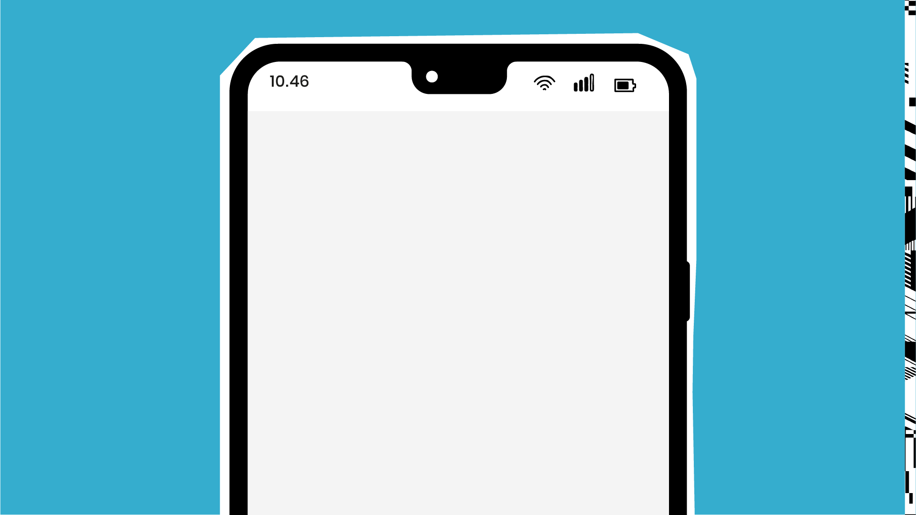
Test Ideas
2021

Slide 2
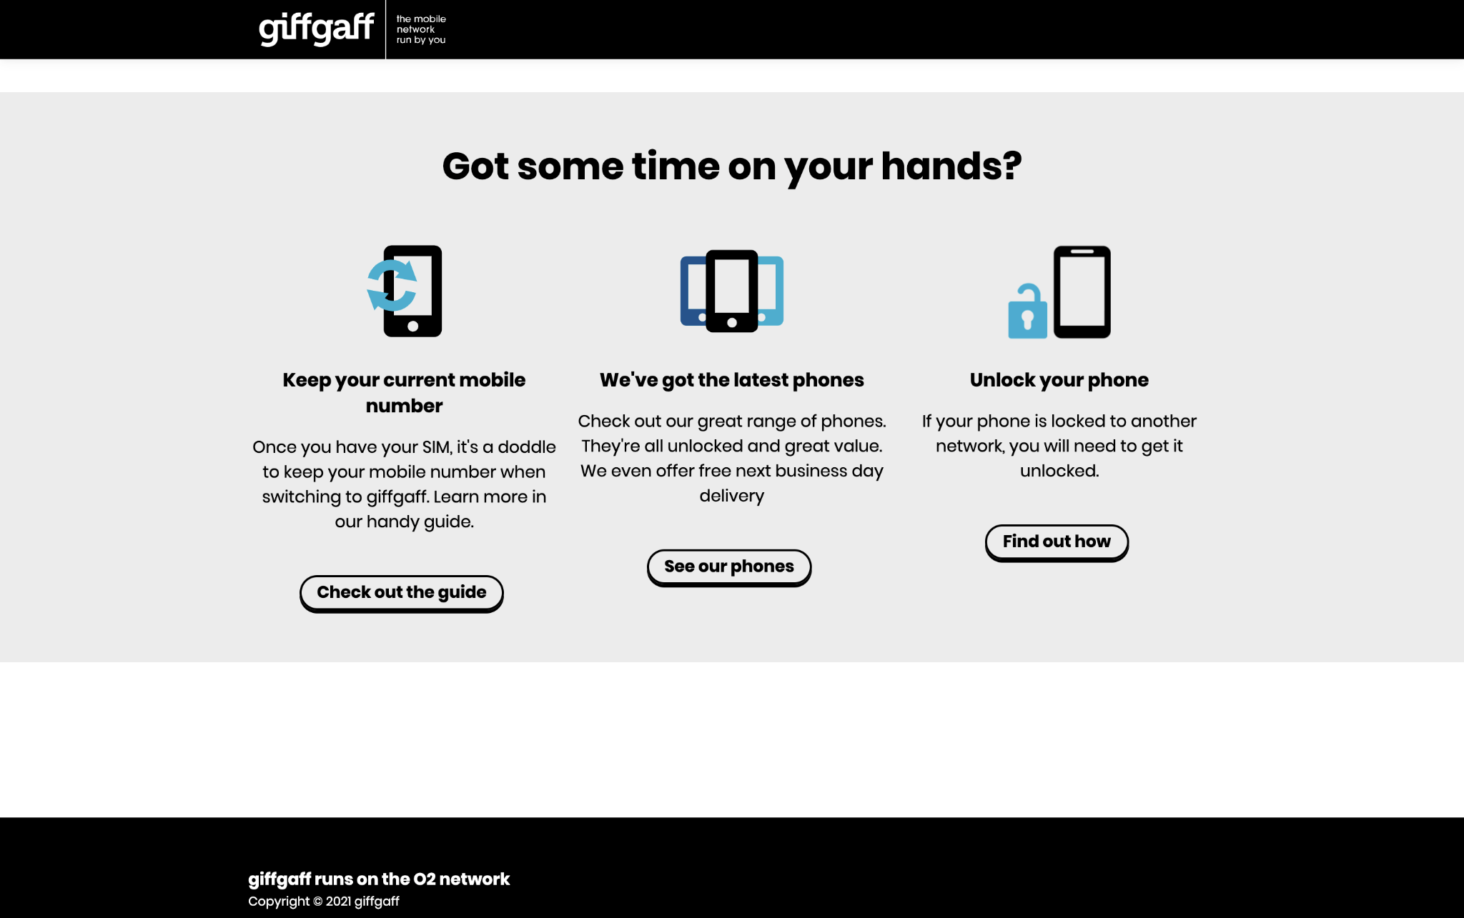
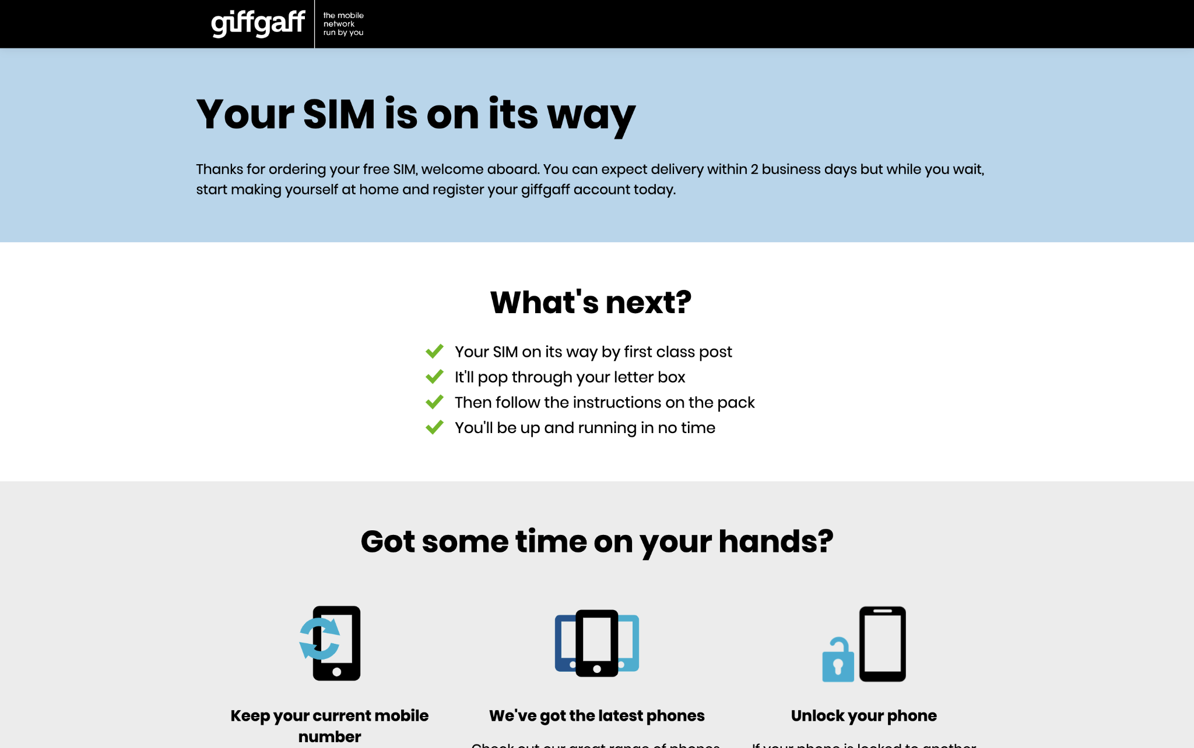
goodybags and freesim:
Ordering a SIM
Once users have ordered a SIM, there is no simple forwards route. 56% of users on goodybags and 57% of users on freesim exit the site immediately.
Of those that stay, 55% of users on goodybags and 64.5% of users on freesim press the back button (often then exiting the site afterwards).
Only 26% on freesim and 35% on goodybags click the current links after ordering.

Slide 3
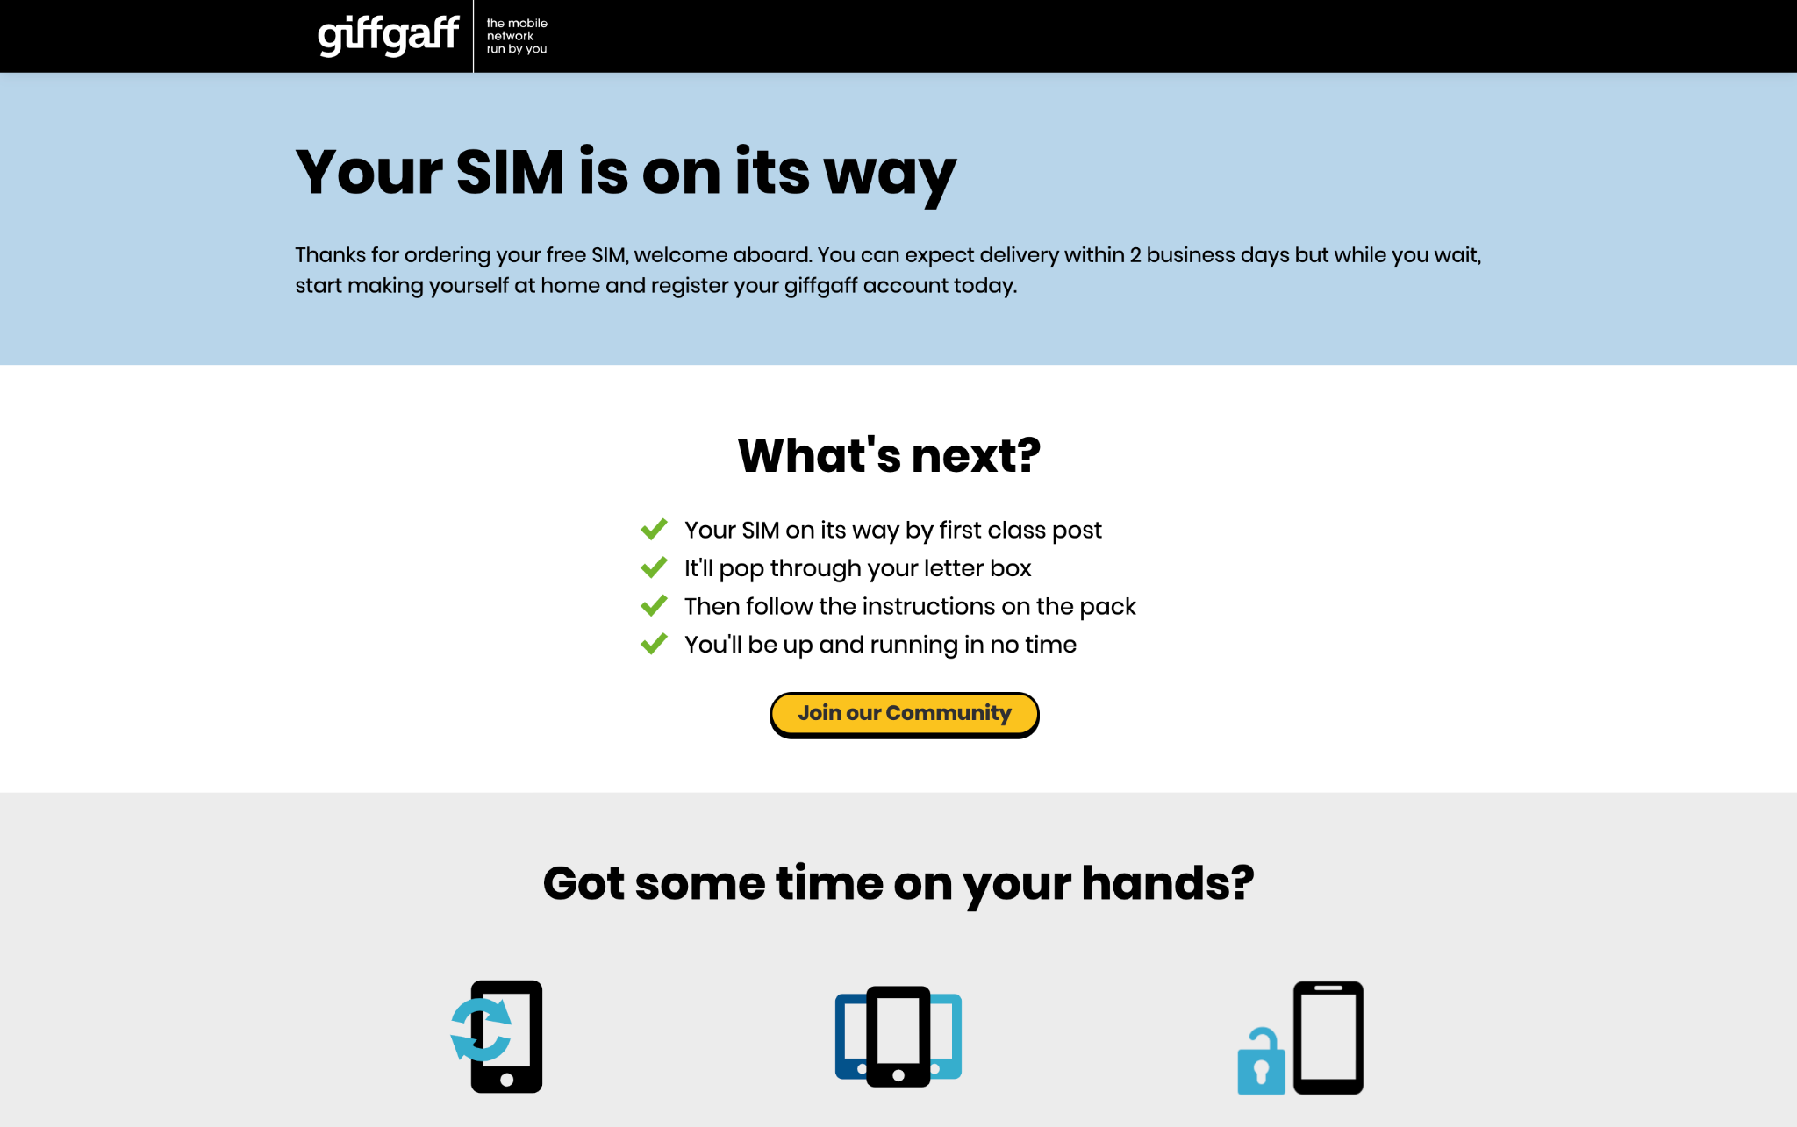
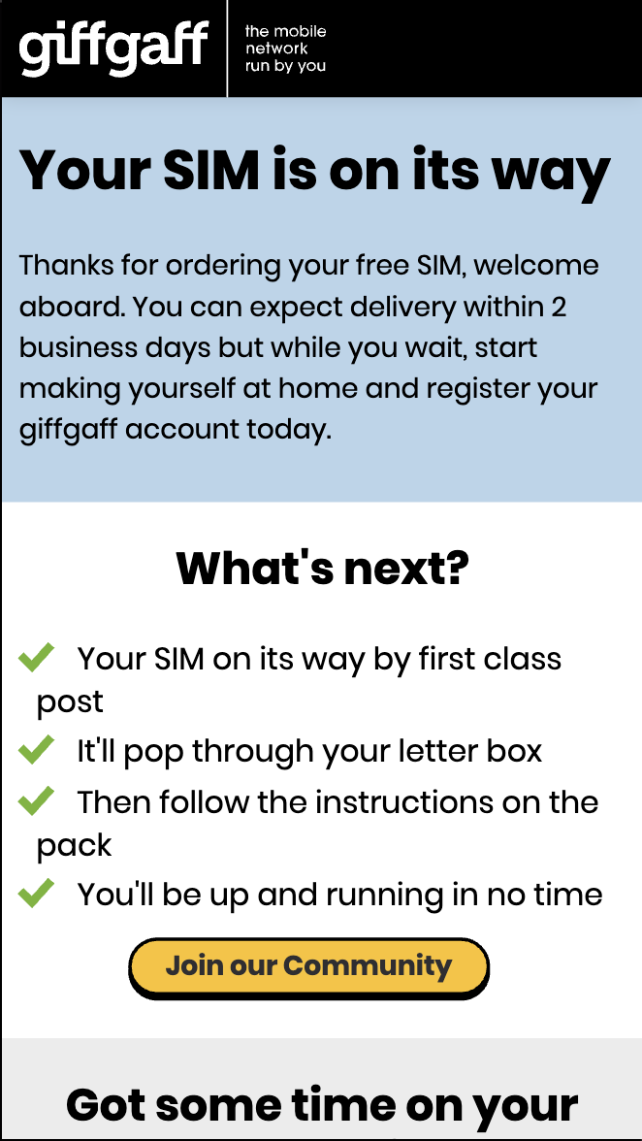
goodybags and freesim:
Ordering a SIM
Where do they go if they don’t want to look at information about keeping current number, getting a new phone, or unlocking their phone?
Why not direct them to our Community Hub with a CTA button?
We could add a CTA button to direct them to the Hub, so they stay on our site, becoming part of the community.
This could reduce our bounce rate, and increase our community.

Slide 4
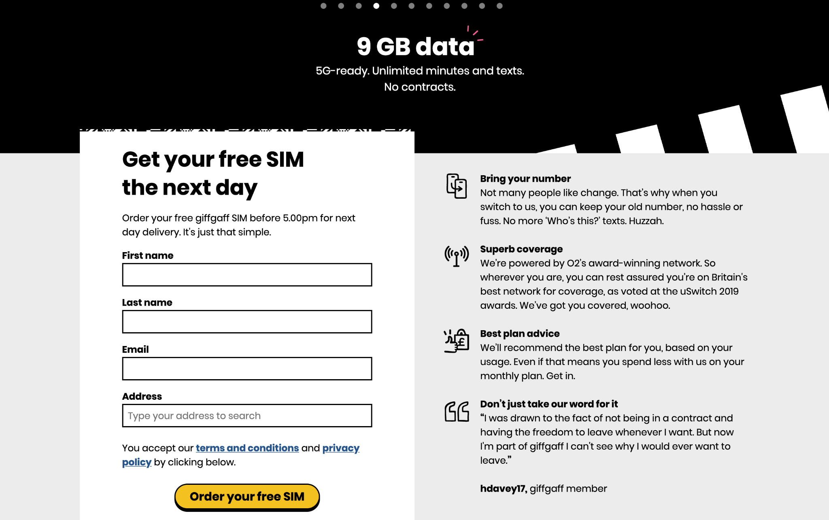
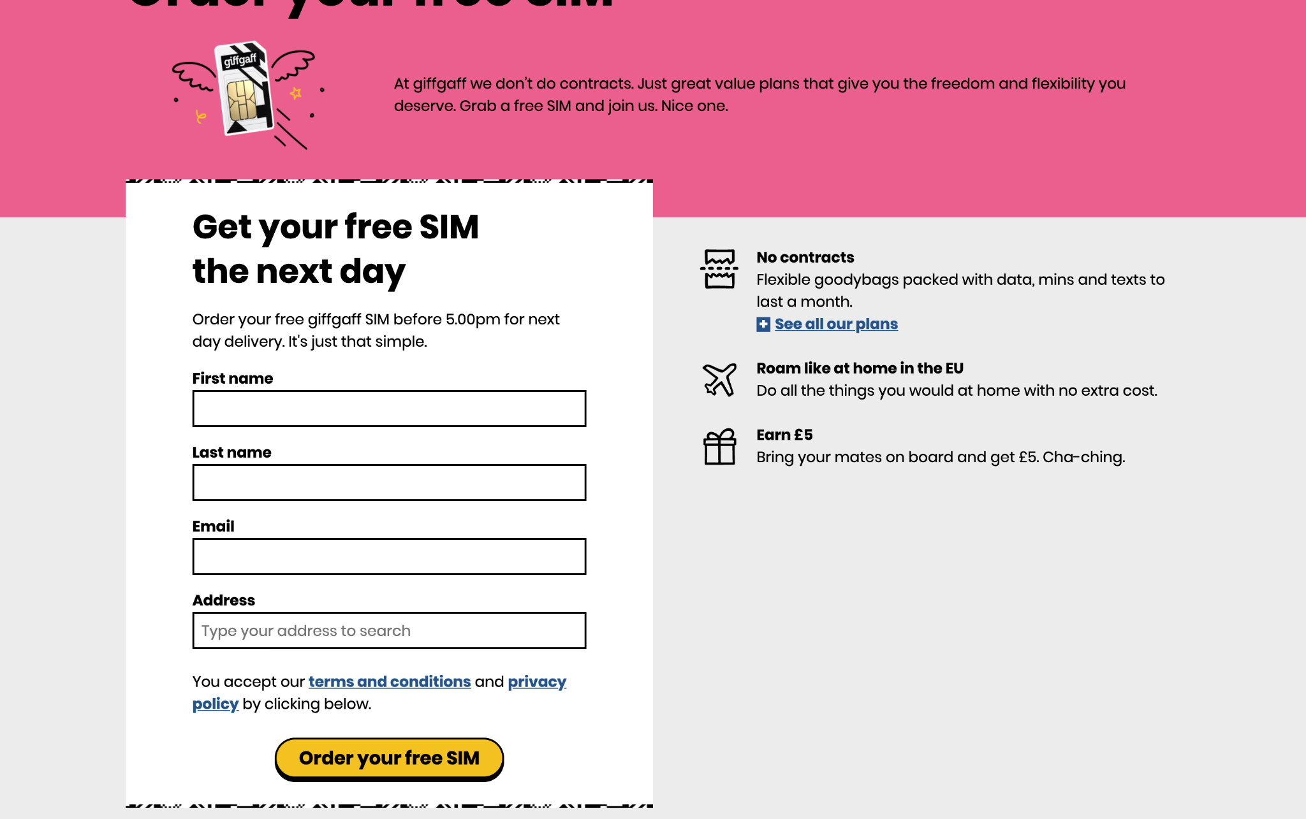
goodybags and freesim:
Scrolling down information
Of the users that access the Order a SIM pages, less than 5% of the users that scroll down then go on to order a SIM.
Are users ordering a SIM first, then pressing the back button to check the extra information?
If a large amount of users don’t read this information until after they’ve ordered a SIM, should we add it into the success page?

Slide 5
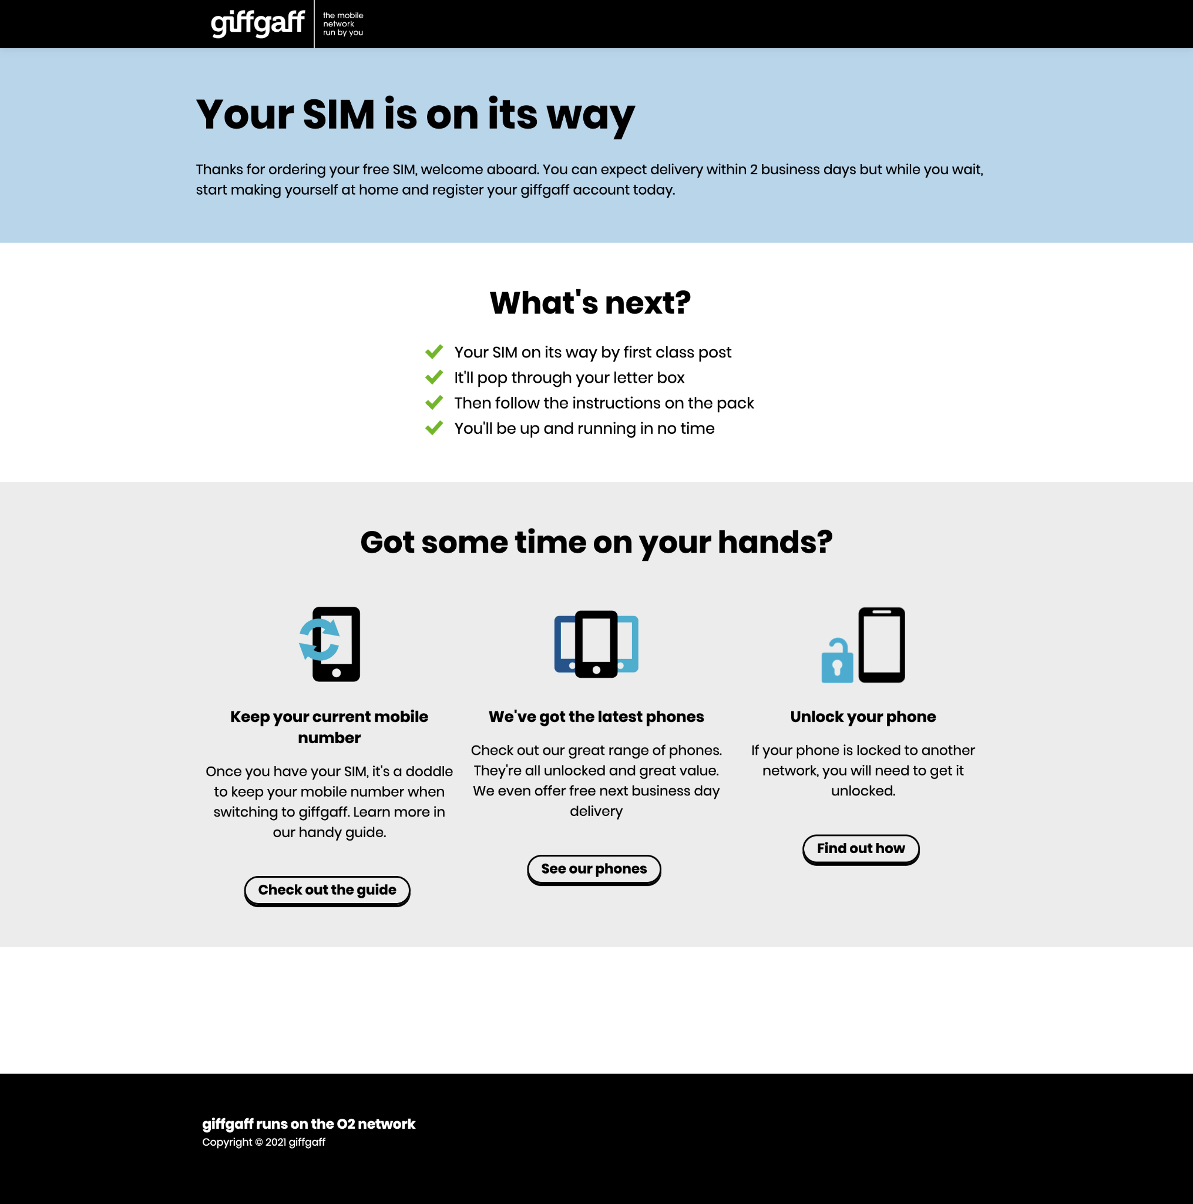
goodybags and freesim:
Scrolling down information
On the success pages, 63-65% of users scroll down.
This implies that they’re looking for more information after ordering a SIM.
This is approximately the same amount of users who press the back button to return to the Order a SIM page.

Slide 6
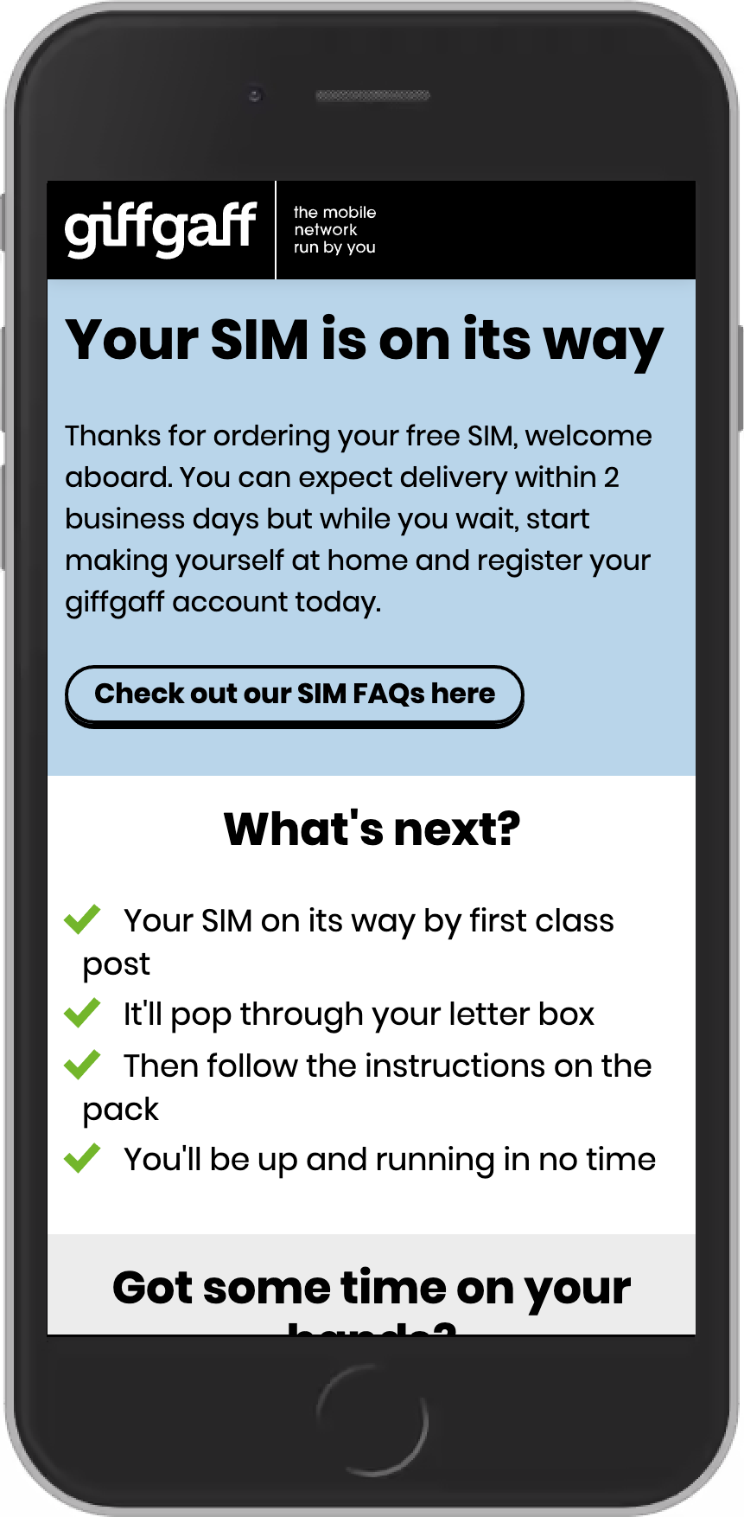
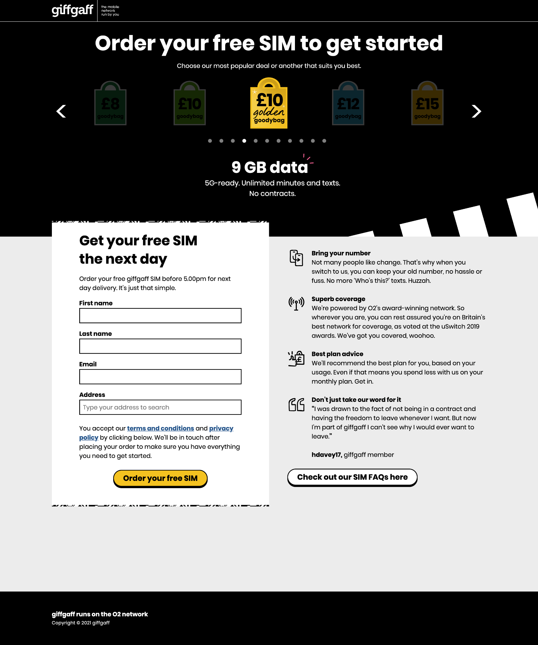
goodybags and freesim:
Scrolling down information
Based on this data, I’d advise including a link on the success page, leading to the SIM FAQs.
This makes the FAQs available at any point in the ordering a SIM process, and will avoid users having to press the back button to view the FAQs.

Slide 7
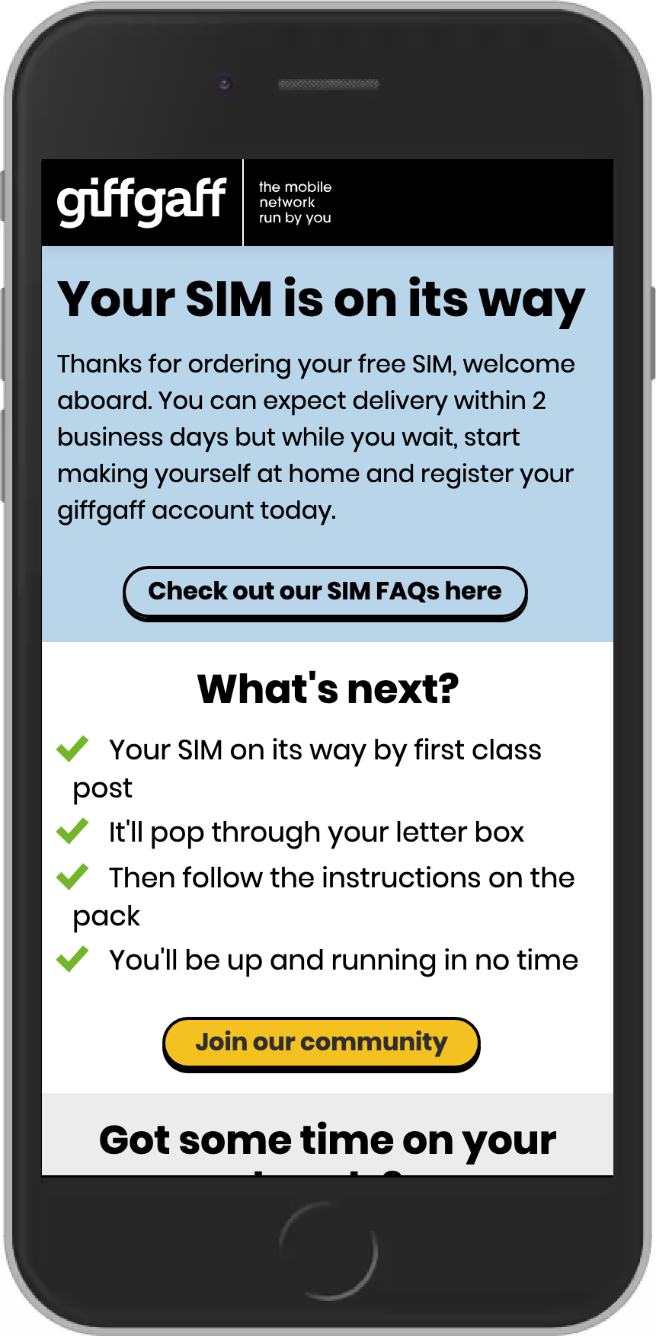
goodybags and freesim:
Conclusion
With both of these changes, I believe it will reduce our bounce rate from these sites, as well as giving us a more accurate view of the data for how many people actually order a SIM, as currently this data is being hidden under those that are pressing the back button.
That said, it makes our success page look quite text-heavy on mobile.

