Slide 1
Data Warehousing

Slide 2
Reference Books
Data Warehousing Fundamentals
  by Paulraj Ponniah
The Data Warehouse Toolkit
by Ralph Kimball, Margy Ross
Building a Data Warehouse With Examples in SQL Server
by Vincent Rainardi

Slide 3
Operational vs.
Informational Systems

Slide 4
Operational Systems:
Operational systems are designed to support day-to-day business operations.
These systems are transactional and are focused on the efficient processing of business transactions.
They are optimized for the speed and accuracy of transactional processing.

Slide 5
Characteristics of Operational system
Real-time processing: Operational systems are often designed for real-time or near-real-time transaction processing.
Data granularity: The ratio of computation time to communication time
They typically deal with detailed and granular data, capturing each individual transaction or event.
Current data: The data in operational systems is frequently updated to reflect the most recent transactions.

Slide 6
Informational Systems (Data Warehousing):
Informational systems, on the other hand, are designed to support decision-making processes by providing a consolidated and historical view of data.
They are optimized for reporting, analysis, and data retrieval.

Slide 7
Characteristics of Informational system
Historical data: Informational systems store historical data, allowing users to analyze trends and patterns over time.
Aggregated data: Data in data warehouses is often aggregated and summarized to facilitate analytical queries.
Subject-oriented: Data warehouses are organized around business subjects or themes, providing a cohesive view of data related to specific business areas.

Slide 8
Difference between operational and Informational Systems
Operational Systems make the wheels of business turn
e.g., Take an order
Process a claim
Make a shipment
Generate an invoice
Receive cash
Reserve an airline seat
Informational Systems watch the wheels of business turn
e.g., Show me the top-selling products
Show me the problem regions
Tell me why
Alert me when a district sells below target
Show me the highest margins

Slide 9
Difference between operational and Informational Systems
 | Operational | Informational
Data Content | Current values | Archived, derived, summarized
Data Structure | Optimized for transactions | Optimized for complex queries
Access frequency | High | Medium to low
Access type | Read, update, delete | Read
Usage | Predictable, repetitive | Ad hoc, random, heuristic
Users | Large number | Relatively small number
Response time | Sub-seconds | Several seconds to minutes

Slide 10
Simple Concept of Data warehousing
An information delivery system.
Take all the data that you already have in the organization, clean and transform it, and then provide useful strategic information.
Data warehouse is an environment, not a product. It is not a single hardware or software product you purchase to provide strategic information. It is, rather, a computing environment where users can find strategic information.

Slide 11
Building Blocks of the Data Warehouse
Subject Oriented Data
Integrated Data
Time-Variant Data
Nonvolatile Data
Validated
Data Granularity

Slide 12
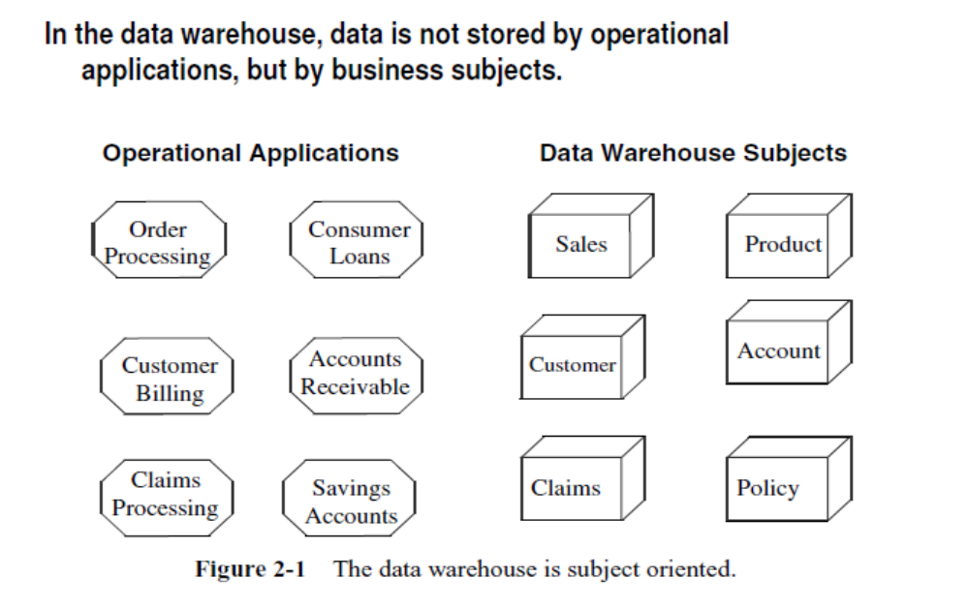
Subject Oriented Data

Slide 13
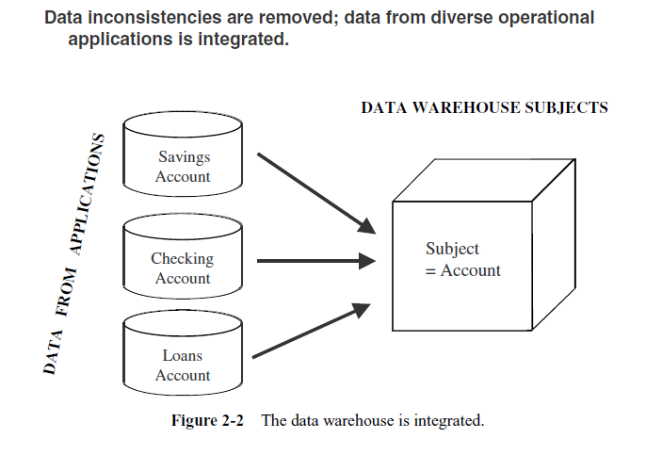
Integrated Data

Slide 14
Time-Variant Data
Operational system store only the latest value of a data item, old values are overwritten by the new values.
DW store multiple values of a data item corresponding to different time periods in history, i.e. it gives the time perspective on data

Slide 15
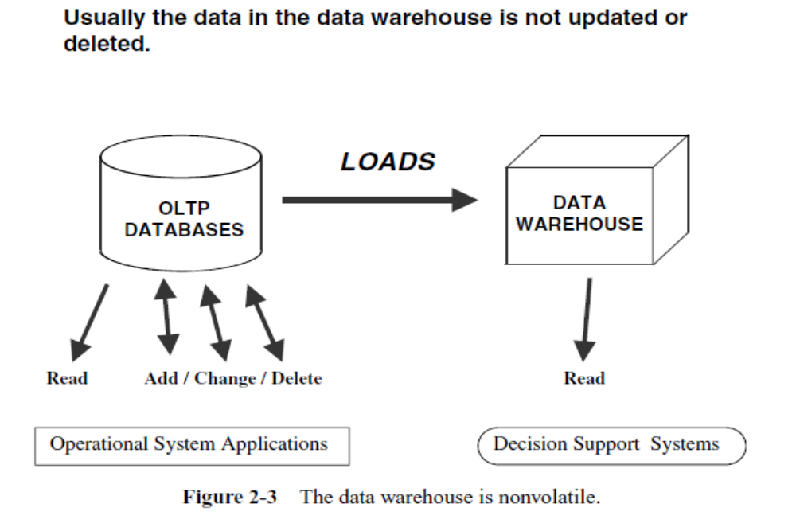
Nonvolatile Data

Slide 16
Validated
Data from various sources are validated before storing them in a data warehouse.
Data quality is crucial to the credibility of the warehouse

Slide 17
Data Granularity
Data granularity in the context of data warehousing refers to the level of detail or precision at which data is stored in a data warehouse.
It defines how finely data is categorized or the extent to which individual data records are kept.
Granularity is an important concept because it directly impacts the level of detail available for analysis and reporting in a data warehouse.

