Slide 1
Data Warehouse Architecture

Slide 2
Data Warehouse Architecture
Two main architectures:
Data Flow Architecture
It is about how the data stores are arranged within a data warehouse and how the data flows from the source systems to the users through these data stores
System Architecture
It is about the physical configuration of the servers, network, software, storage, and clients
Notes:
The data flow architecture is different from data architecture. Data architecture is about
how the data is arranged in each data store and how a data store is designed to reflect the
business processes. The activity to produce data architecture is known as data modeling.

Slide 3
Data Flow Architecture
First thing you need to decide when building a data warehouse system
Determines what components need to be built
Affects the project plan and costs
Based on the data requirements from the applications

Slide 4
Data Flow Architecture
Data warehouse applications require data in different formats:
Dimensional format (DDS)
Normalized format (NDS/ODS)
Multidimensional format (MDB)
These formats dictate the data stores you need to have.
Then you design the ETL to populate those data stores
Then you build a data quality mechanism to make sure the data in the data warehouse is correct and complete
Notes:
ETL stands for Extract, Transform, Load, and it refers to the processes involved in collecting, cleaning, transforming, and loading data from various sources into a data warehouse. ETL is a critical part of the data warehousing workflow, enabling organizations to consolidate and organize data for analysis and reporting. Here's a breakdown of each stage in the ETL process:
Extract:
In the "Extract" phase, data is gathered from different source systems, which can include databases, applications, logs, flat files, and more.
The extraction process involves reading and copying the relevant data from the source systems. This data is often in raw and varied formats.
Transform:
The "Transform" phase involves cleaning, structuring, and transforming the extracted data into a format suitable for analysis and reporting.
Transformation tasks may include data cleansing (fixing errors, handling missing values), data normalization, data enrichment (adding additional information), and aggregations.
The goal is to ensure consistency, accuracy, and a standardized structure across all the data being loaded into the data warehouse.
Load:
In the "Load" phase, the transformed data is loaded into the data warehouse, which is a centralized repository optimized for querying and reporting.
The data is organized into tables, and indexing may be applied to optimize query performance.
Loading can be done in different ways, such as full loading (loading all data from source to destination), incremental loading (only loading new or changed data), or a combination of both.

Slide 5
Data Stores
An important component of data flow architecture
One or more databases or files containing data warehouse data, arranged in a particular format
Types of Data Stores based on the user accessibility
A user-facing data store
Available and queried by the end users and end-user applications.
An internal data store
Used internally by data warehouse components for the purpose of integrating, cleansing, and preparing data
Not open for query by the end users and end-user applications
Example is a stage
A hybrid data store
Used for both internal data warehouse mechanisms and for query by the end users and end-user applications
Notes:
A stage is an internal data store used for transforming and preparing the data
obtained from the source systems, before the data is loaded to other data stores in
a data warehouse.
A master data store is a user-facing or hybrid data store containing a complete set of data in a data warehouse, including all versions and all historical data

Slide 6
Classification of Data Stores Based on Data Format
Normalized Data Store (NDS)
One or more normalized relational databases
Used to integrate data from various source systems and captured in a stage, before loading to a user-facing data store
Dimensional Data Store (DDS)
User-facing data store
One or more relational databases
Data is arranged in dimensional format for the purpose of supporting analytical queries
Notes:
A relational database is a database that consists of entity tables with parent-child relationships between them.
A normalized database is a database with little or no data redundancy in third normal form or higher.
A denormalized database is a database with some data redundancy that has not gone through a normalization process.
A dimensional database is a denormalized database consisting of fact tables and common dimension tables containing the measurements of business events, categorized by their dimensions.

Slide 7
Classification of Data Stores Based on Data Format
Operational data store (ODS)
An Operational Data Store (ODS) is an integrated database that provides a current, cleansed, and consistent view of operational data from various sources.
It serves as a temporary storage and processing layer between operational systems (e.g., transactional databases) and the data warehouse.
The primary purpose of an ODS is to support operational reporting and analysis.
Notes:
Supports real-time interactions, such as accessing your travel itinerary on a web site or your service history when you call into customer support. Data warehouses typically are not in a position to support the demand for near-real-time data

Slide 8
Operational data store (ODS)
Characteristics:
Consolidates and cleanses operational data in near-real-time.
Acts as an intermediary between operational systems and the data warehouse.
Supports detailed, granular data and may involve data transformations.
Provides a consistent view of operational data for reporting and analysis.
Often used to bridge the gap between real-time operational needs and historical analysis in the data warehouse.

Slide 9
Multidimensional Databases (MDBs)
Some applications require the data to be in the form of multidimensional databases (MDBs) which are also know as cubes, rather than a relational database
MDB is populated from DDS
Notes:
An MDB is a form of database where the data is stored in cells and the position of each cell is defined by a number of variables called dimensions. Each cell represents a business event, and the value of the dimensions shows when and where this event happened.

Slide 10
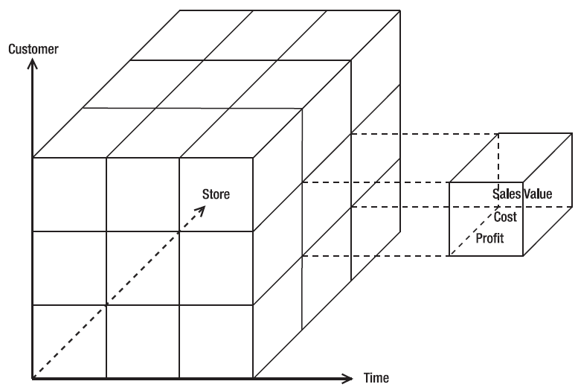
A cube with three dimensions
Notes:
An MDB is a form of database where the data is stored in cells and the position of each cell is defined by a number of variables called dimensions. Each cell represents a business event, and the value of the dimensions shows when and where this event happened.

Slide 11
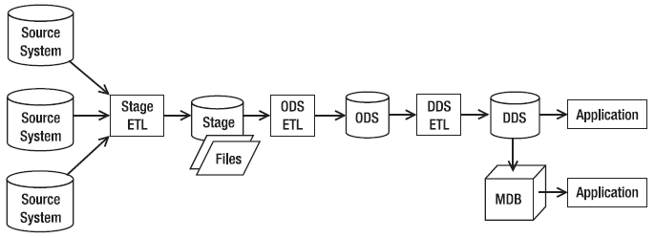
A data flow architecture with a stage, ODS, DDS, and MDB

Slide 12
ETL Package, Process, Step
ETL Package
Consists of several ETL processes
ETL Process
A program that is part of an ETL package that retrieves data from one or several sources and populates one target table
ETL Process Step
ETL process consists of several steps
A component of an ETL process that does a specific task
Notes:
An example of a step is extracting particular data from a source data store or performing certain data transformations

Slide 13
ETL Package
It's a process commonly used in data integration and data warehousing to move and transform data from source systems to a target destination.
The ETL process is crucial for consolidating, cleaning, and organizing data so that it can be effectively used for reporting and analysis.

Slide 14
Extract (E)
Definition: In this step, data is extracted from source systems, which could include databases, applications, flat files, APIs, or other data repositories.
Activities:
Identify and connect to source systems.
Extract data based on predefined criteria, such as specific tables, fields, or time periods.
Handle incremental extraction to retrieve only new or changed data since the last ETL run.
Validate and clean extracted data to ensure data quality.
Notes:
A flat file is a type of database that stores data in a plain text or binary file. Unlike relational databases, which use a structured format with tables, rows, and columns, flat files do not have a complex structure. Instead, they typically consist of a single table with a list of records, where each record has fields or attributes separated by delimiters such as commas, tabs, or fixed-width spaces.
Comma-Separated Values (CSV): A common format where each field is separated by a comma. For example:
Name, Age, City
John, 25, New York
Jane, 30, London
Tab-Separated Values (TSV): Similar to CSV, but fields are separated by tabs. For example:
Name Age City
John 25 New York
Jane 30 London

Slide 15
Transform (T)
Definition: The extracted data undergoes transformation to meet the requirements of the target system or data warehouse. Transformations include data cleaning, normalization, and restructuring.
Activities:
Apply business rules and data validation.
Cleanse and standardize data to ensure consistency.
Perform data calculations, aggregations, and derivations.
Handle data type conversions and format adjustments.
Handle data deduplication and error handling.

Slide 16
Load (L)
Definition: The transformed data is loaded into the target system, which could be a data warehouse, a data mart, or another storage system for analysis and reporting.
Activities:
Map transformed data to the target schema or data model.
Load data into the destination system using appropriate loading mechanisms (e.g., bulk loading, incremental loading).
Handle data loading errors and exceptions.
Maintain data lineage and audit information.

Slide 17
Control System
Manages the ETL packages in the data warehouse
Governs the sequence of execution of processes within an ETL package
Controls the timings of ETL packages
If a failure occurs, restarts the ETL packages from the point of failure

Slide 18
Audit
Auditing in data warehousing is a comprehensive process that involves monitoring, validating, and ensuring the quality, integrity, and security of data stored in the data warehouse.
It plays a crucial role in maintaining the trustworthiness of data for analytical purposes and supporting decision-making within an organization.

Slide 19
Audit
The mechanism to log the result of each step of an ETL process
Examples of the results logged by ETL audits are:
Number of records loaded in that step
the time the step started and finished
the step identifier to trace it down for debugging purposes

Slide 20
ETL Meta Data
The description of each ETL process is stored in metadata which is a data store of data warehouse
Includes
the source it extracts the data from
the target it loads the data into
the transformation applied
the parent process
the schedule each ETL process is supposed to run

Slide 21
Data Quality Processes
Mechanisms to make sure the data in the data warehouse is correct and complete
Reports the bad data
Corrects the bad data
A Data Firewall is a program that checks whether the incoming data complies with the data quality rules
A Data Quality Database is a database containing incoming data that fails data quality rules
Data quality reports are the data quality violation reports which are generated from the data quality (DQ) database

Slide 22
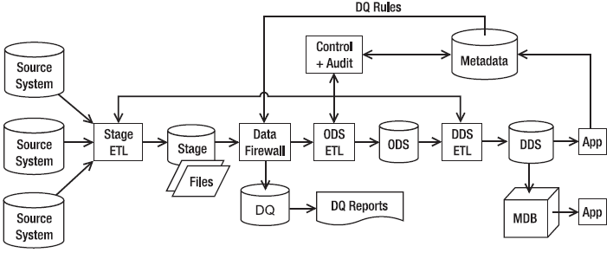
A data flow architecture with control system, metadata, and data quality process

Slide 23
Four Data Flow Architectures
The single DDS architecture has stage and DDS data stores
The NDS + DDS architecture has stage, NDS, and DDS data stores
The ODS + DDS architecture has stage, ODS, and DDS data stores
The federated data warehouse (FDW) architecture consists of several data warehouses integrated by a data retrieval layer
Notes:
These four data flow architectures are just examples. When building a data warehouse,
you need to design the data flow architecture to suit the data requirements and data quality
requirements of the project. These four architectures are by no means exhaustive; you should
design your own data flow architecture. For example, is it possible to have a data flow architecture
without a stage? Yes, it is possible, if you can do the transformation on the fly in the ETL
server’s memory, especially if you have a low data volume. Can you have a data flow architecture
without a DDS? Yes, you can have stage + NDS data stores only if you want to have a normalized
data warehouse rather than a dimensional one. Is it possible to have two DDSs? Yes,
of course you can have multiple DDSs—you can have as many as you need.

Slide 24
Single DDS Data Flow Architecture
A simple data flow architecture
Consists of only two data stores:
Stage
DDS
Core data warehouse store is in dimensional format
You have one multidimensional data store
Notes:
The DDS consists of one or several dimensional data marts (a group of related fact tables and their corresponding dimension tables containing the measurements of business events, categorized by their dimensions)

Slide 25
Stage
A place where you store the data you extracted from the source system temporarily, before processing it further
Used when:
the transformation is complex (in other words, cannot be done on the fly in a single step in memory)
the data volume is large (in other words, not enough to be put in memory)
data from several source systems arrive via different ETL processes
A stage is also necessary if you need to minimize the connectivity time to the source system. In other words, the ETL processes dump the extracted data on disk and disconnect from the source system as soon as possible, and then at their own time they can process the data
Physical form of a stage can be a database or files

Slide 26
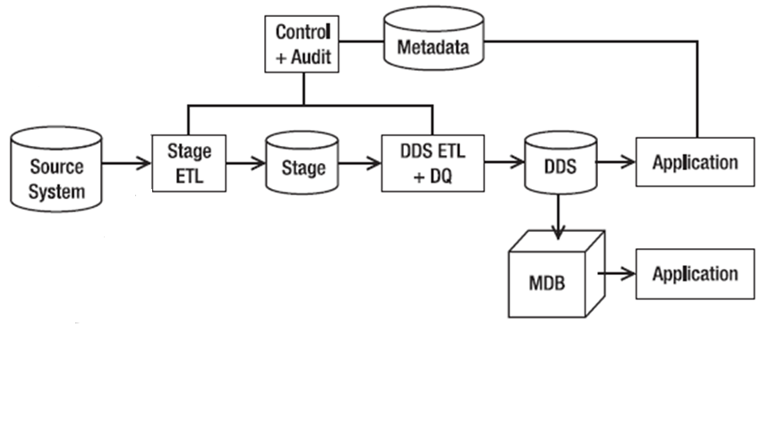
Single DDS Data Flow Architecture

Slide 27
Single DDS Data Flow Architecture
Simpler than other architectures
data from the stage is loaded straight into the dimensional data store, without going to any other kind of normalized store first (ODS)
Useful when you have only one source system
you don’t need additional NDS to integrate the data from different source systems
Has the quickest ETL run time

Slide 28
NDS + DDS Data Flow Architecture
Has three data stores:
Stage
NDS
DDS
Similar to Single DDS but it has a normalized data store in front of the DDS
Purposes of having NDS
Integrates data from several source systems
Loads data into several DDSs
Can have several DDSs

Slide 29
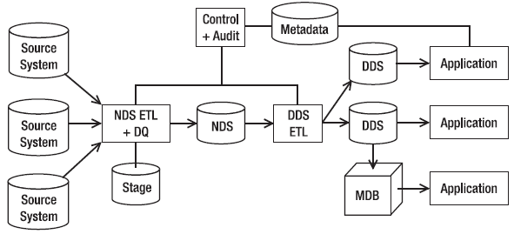
NDS + DDS Data Flow Architecture

Slide 30
NDS + DDS Data Flow Architecture
NDS is the master data store here, meaning NDS contains the complete data sets, including all historical transaction data and all historical versions of master data.
DDS is not the master data store and may not contain all transaction data for every single year
Notes:
Historical transaction data means the business transactions that happened in the past. Data from every single year is stored in the NDS
Master data : Master data refers to the foundational data shared across an organization, representing the core business entities and their attributes.
Examples: In an organization, master data can include customer information, product details, employee records, and other critical entities that are consistently used and referenced across different business processes.

Slide 31
NDS + DDS Data Flow Architecture
NDS is an Internal Data Store
Only application that is able to update NDS is the NDS ETL
DDS is the User-Facing Data Store
The flexibility of using a centralized NDS is that you can build a DDS that you need at any time with the scope of data as required

Slide 32
NDS + DDS Data Flow Architecture
Can have several DDSs
One DDS is obligatory; others are optional
Extra ETL effort
Extra Data Modeling effort (designing three data stores)

Slide 33
ODS + DDS Data Flow Architecture
This architecture is similar to an NDS + DDS architecture, but it has an ODS in the place of the NDS
Like NDS, ODS is in third normal form or higher
Unlike the NDS, the ODS contains only the current version of master data; it has no historical master data
The structure of its entities is like an OLTP database
The ODS integrates the data from various source systems
The data in the ODS is cleaned and integrated
The data flowing into the ODS has already passed the DQ screening

Slide 34
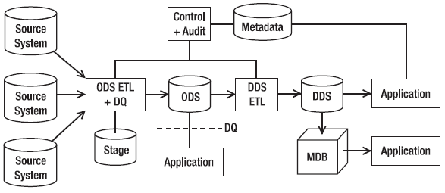
ODS + DDS Data Flow Architecture

Slide 35
ODS + DDS Data Flow Architecture
Unlike NDS, which is an internal data store, ODS is a hybrid data store
This means ODS is accessible by the end users and end-user applications

Slide 36
ODS + DDS Data Flow Architecture
In the ODS + DDS architecture, the DDS is the master data store
Unlike an NDS + DDS architecture, in an ODS + DDS architecture you have only one DDS
The DDS contains both the current version and all historical versions of master data
In the ODS + DDS architecture, applications can access the data warehouse in three places in three different formats: those that need the data in normalized form can access the ODS, those that need the data in relational dimensional format can access the DDS, and those that need the data in multidimensional format can access the MDBs

Slide 37
Federated Data Warehouse
The federated data warehouse architecture consists of several data warehouses integrated by a data retrieval layer.
A federated data warehouse retrieves data from existing data warehouses using an ETL and loads the data into a new dimensional data store

Slide 38
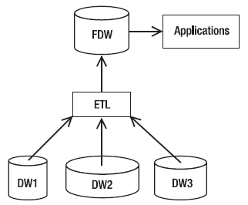
A federated data warehouse from several data warehouses

Slide 39
System Architecture
It is about the physical configuration of:
Servers (processors, memory)
Networking devices (switches, routers, communication media)
Software (OS, DBMS, ETL tools, BI tools, Reporting tools)
Storage (SAN, RAID, Backup drives)
Clients (PCs, laptops, smart phones, tablets)
Notes:
SAN: Storage Area Network
RAID: Redundant Array of Independent Disks

Slide 40
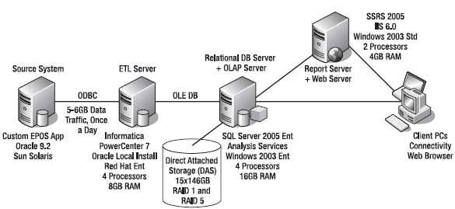
System Architecture

