Slide 1
K-Nearest Neighbor(KNN)

Slide 2
K-Nearest Neighbor(KNN)
KNN is one of the simplest machine learning algorithm for classification and regression problem but mainly used for classification.
In KNN classification, the output is a class membership.
The given data point is classified based on the majority of type of its neighbor’s.
The data point is assigned to the most frequent class among its k nearest neighbor’s.
Usually k is a small positive integer. If k=1, then the data point is simply assigned to the class of that single nearest neighbor.
In KNN regression, the output is simply some property value for the object.
This value is the average of the values of k nearest neighbors.

Slide 3
K-Nearest Neighbor(KNN)
The KNN algorithm intuition is very simple to understand.
It simply calculates the distance between a sample data point and all the other training data points.
The distance can be Euclidean distance or Manhattan distance.
Then, it selects the k nearest data points where k can be any integer.
Finally, it assigns the sample data point to the class to which the majority of the k data points belong.
In KNN “K” is the number of nearest neighbors and mostly we opt for K value as Odd because it helps to decide the majority of the class.

Slide 4
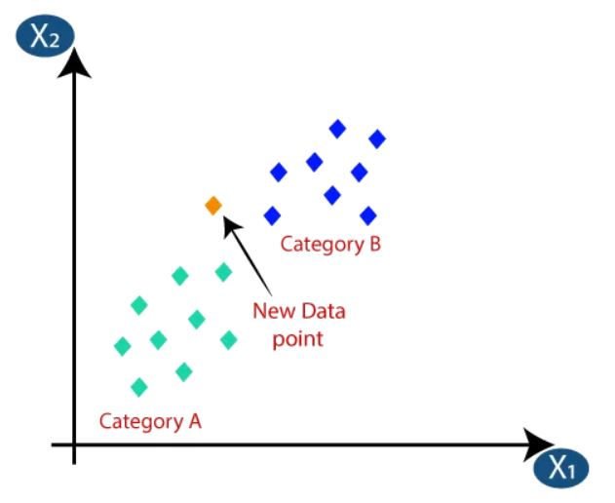
K-Nearest Neighbor(KNN)
The KNN algorithm intuition is very simple to understand.
It simply calculates the distance between a sample data point and all the other training data points.
The distance can be Euclidean distance or Manhattan distance.
Then, it selects the k nearest data points where k can be any integer.
Finally, it assigns the sample data point to the class to which the majority of the k data points belong.
In KNN “K” is the number of nearest neighbors and mostly we opt for K value as Odd because it helps to decide the majority of the class.

Slide 5
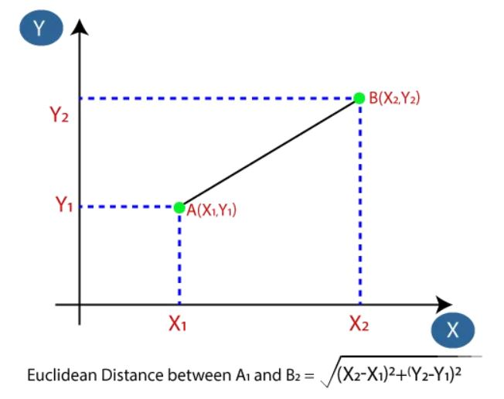
Distance Measurement
We mostly use this distance measurement technique to find the distance between consecutive points.
It is generally used to find the distance between two real-valued vectors.

Slide 6
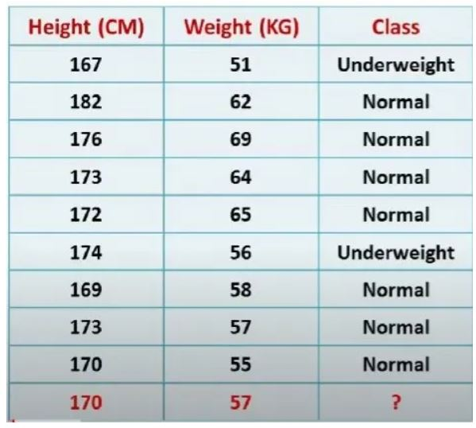
Numerical Example
Q. From the given data-set find (x,y) = 57,170 whether belongs to Under or Normal Weights

Slide 7
Solution:
In this approach we are going to use Euclidean distance formulae, n(no of records)=9 and assuming K value as 3
d1 = sqrt ((x2-x1)² + (y2-y1)²)
x1=167,y1=51 and x2=170,y2=57
d1 = sqrt ((170–167)² + (57–51)²)
d1 = 6.7

Slide 8
Solution:
d2 = sqrt ((x2-x1)² + (y2-y1)²)
x1=183,y1=56 and x2=170,y2=57
d2 = sqrt ((170–183)² + (57–56)²)
d2 = 13

Slide 9
Solution:
d3 = sqrt ((x2-x1)² + (y2-y1)²)
x1=176,y1=69 and x2=170,y2=57
d3 = sqrt ((170–176)² + (57–69)²)
d3 = 13.4

Slide 10
Solution:
d4 = sqrt ((x2-x1)² + (y2-y1)²)
x1=173,y1=64 and x2=170,y2=57
d4 = sqrt ((170–173)² + (57–64)²)
d4 = 7.6

Slide 11
Solution:
d5 = sqrt ((x2-x1)² + (y2-y1)²)
x1=172,y1=65 and x2=170,y2=57
d5 = sqrt ((170–172)² + (57–65)²)
d5 = 8.2

Slide 12
Solution:
d6 = sqrt ((x2-x1)² + (y2-y1)²)
x1=173,y1=64 and x2=170,y2=57
d6 = sqrt ((170–173)² + (57–64)²)
d6 = 4.1

Slide 13
Solution:
d7 = sqrt ((x2-x1)² + (y2-y1)²)
x1=169,y1=58 and x2=170,y2=57
d7 = sqrt ((170–169)² + (57–58)²)
d7 = 1.414

Slide 14
Solution:
d8 = sqrt ((x2-x1)² + (y2-y1)²)
x1=173,y1=57 and x2=170,y2=57
d8 = sqrt ((170–173)² + (57–57)²)
d8 = 3

Slide 15
Solution:
d9 = sqrt ((x2-x1)² + (y2-y1)²)
x1=170,y1=55 and x2=170,y2=57
d9 = sqrt ((170–170)² + (57–55)²)
d9 = 2

Slide 16
Result:
from above results
(57,170) → Given point
(56,174) → Under-Weight
(57,173) → Normal-Weight
(58,169) → Normal-Weight.
Hence out of three points two points are Normal-Weight and one point is Under-Weight due to which majority is Normal-Weight.
Final Conclusion is given point is Normal-Weight

