Slide 1
Programming Language:
MATLAB/SIMULINK.
MATLAB (Matrix Laboratory):
A high-level language and environment used for numerical computation, data visualization, signal processing, and algorithm development.
Especially popular in engineering, telecommunications, and control systems.
Works well with matrices, and has powerful toolboxes for specialized tasks.
Simulink:
An add-on to MATLAB that provides a graphical environment for modeling, simulating, and analyzing dynamic systems.
Ideal for control systems, signal processing, communications, and embedded systems.
Uses block diagrams for simulation instead of traditional coding.
Python - NumPy Package.
NumPy (Numerical Python):
A core scientific library in Python for efficient numerical computations.
Provides powerful multi-dimensional arrays (ndarrays), mathematical functions, linear algebra, and Fourier transforms.
It’s the foundation for many other Python libraries like SciPy, Pandas, and TensorFlow.
Known for being fast, open-source, and easy to integrate with C/C++ code.

Slide 2
Introduction
Wireless communications has been associated with cellular telephony, as this is the biggest market segment, and has had the highest impact on everyday lives.
In recent times, wireless computer networks have also led to a significant change in working habits and mobility
of workers – answering emails in a coffee shop has become an everyday occurrence.
But besides these widely publicized cases, a large number of less obvious applications have been developed, and are starting to change our lives.

Slide 3
Introduction
Wireless communication plays a crucial role in modern society, particularly in the field of cellular telephony, which represents the largest market segment. This technology has significantly impacted everyday life by enabling seamless communication across vast distances.
In recent years, wireless computer networks have transformed workplace mobility. Employees can now work remotely, access emails, and communicate efficiently from any location, such as coffee shops, without being restricted to a fixed workstation.
Beyond widely known applications like mobile phones and internet connectivity, wireless communication has also enabled less obvious but impactful innovations. These emerging applications continue to evolve, influencing various aspects of daily life and industries.

Slide 4
This variety of new applications causes the technical challenges for the wireless engineers to become bigger with each day.
To give an overview of the solution methods for current as well as future challenges.
There are two paths to developing new technical solutions:
Engineering Driven and Market Driven.
In the first case, the engineers come up with a brilliant scientific idea – without having an immediate application in mind.

Slide 5
Technical Challenges and Solution Approaches in Wireless Communication
The continuous evolution of wireless communication has led to various new applications, which in turn pose increasing technical challenges for wireless engineers. These challenges require innovative solutions to keep up with the growing demands of wireless technology.
To address current and future challenges, solution methods can be classified into two approaches:
Engineering-Driven Approach:
Engineers develop new scientific ideas without initially considering their immediate application.
This method focuses on pure research and innovation, which may later be adapted for practical use.
Market-Driven Approach:
Solutions are developed based on the current market demands and consumer needs.
Engineers work on refining and optimizing existing technologies to meet industry requirements.
Both approaches play a crucial role in shaping the future of wireless communication by balancing theoretical advancements with real-world applications.

Slide 6
As time progresses, the market finds applications enabled by this idea.
In the other approach, the market demands a specific product and the engineers try to develop a technical solution that fulfills this demand.

Slide 7
Market-Driven vs. Engineering-Driven Approach in Wireless Communication
In wireless communication, technological advancements arise from two primary approaches:
Engineering-Driven Approach:
Engineers develop innovative scientific ideas without immediate application.
Over time, markets identify practical applications for these innovations, leading to new products and solutions.
Market-Driven Approach:
The market has specific demands for products and services.
Engineers work towards developing solutions that fulfill these demands, ensuring that technology aligns with industry needs.
Both approaches play a significant role in technological evolution, as some breakthroughs originate from research, while others are driven by market needs.

Slide 8
Market Demands.
We start out with a brief history of wireless communications, in order to convey a feeling of how the science, as well as the market, has developed in the past 100 years.
Then follows a description of the types of services that constitute the majority of the wireless market today.
Each of these services makes specific demands in terms of data rate, range, number of users, energy consumption, mobility, and so on.
A description of the interaction between the engineering of
wireless devices and the behavioral changes induced by them
in society.

Slide 9
Market Demands in Wireless Communication
Historical Development:
Wireless communication has evolved significantly over the past 100 years.
Both scientific advancements and market growth have contributed to its development.
Types of Wireless Services:
The modern wireless market consists of various services, each designed to meet specific demands.
Service-Specific Demands:
Key factors influencing wireless services include:
Data Rate (speed of communication)
Range (coverage area)
Number of Users (network capacity)
Energy Consumption (battery efficiency)
Mobility (support for movement and handovers)
4.Impact on Society:
Wireless technology influences both engineering advancements and human behavior.
The increasing use of wireless devices has led to changes in communication habits, work culture, and social interactions.

Slide 10
How It A l Started
Wireless communication is the oldest form of communication like shouts and drums did not require any wires or cables to function.
Wireless communications started only with the work of Maxwell and Hertz, who laid the basis for the understanding of the transmission of electromagnetic waves.
In 1898, Marconi , made his well-publicized demonstration of wireless communications from a boat to the Isle of Wight in the English Channel.
It is noteworthy that while Tesla was the first to succeed in this important endeavor, Marconi had the better public relations, and is widely cited as the inventor of wireless communications,
receiving a Nobel prize in 1909.
16

Slide 11
How It A l Started
Early Forms of Wireless Communication:
The oldest forms included shouts, drum signals, and smoke signals, which did not rely on wires.
Scientific Foundation:
Wireless communication became feasible only after the work of James Clerk Maxwell and Heinrich Hertz, who established the principles of electromagnetic wave transmission.
Marconi's Contribution (1898):
Guglielmo Marconi conducted a famous demonstration of wireless communication.
He transmitted signals from a boat to the Isle of Wight in the English Channel.
Tesla vs. Marconi Controversy:
Nikola Tesla made earlier advancements in wireless transmission.
However, Marconi's superior public relations efforts led to him being recognized as the inventor of wireless communication.
Marconi received the Nobel Prize in 1909 for his contributions.
16

Slide 12
Types of Services
Broadcast
Paging
Cellular Telephony
Trunking Radio
Cordless Telephony
Wireless Local Area Networks
Personal Area Networks
Fixed Wireless Access

Slide 13
Types of Services
Types of Wireless Communication Services
Broadcast:
Used for radio and television transmission to a wide audience.
Paging:
One-way communication used for sending short messages or alerts to a receiver.
Cellular Telephony:
Mobile phone networks that provide voice, SMS, and data services.
Trunking Radio:
A specialized two-way radio system used for emergency services and public safety.
Cordless Telephony:
Short-range wireless telephony systems, such as landline phones with cordless handsets.
Wireless Local Area Networks (WLAN):
Enables internet and network access within a limited area (e.g., Wi-Fi).
Personal Area Networks (PAN):
Short-range communication for personal devices (e.g., Bluetooth, Zigbee).
Fixed Wireless Access:
Provides broadband internet using wireless technology as an alternative to fiber or cable connections.

Slide 14
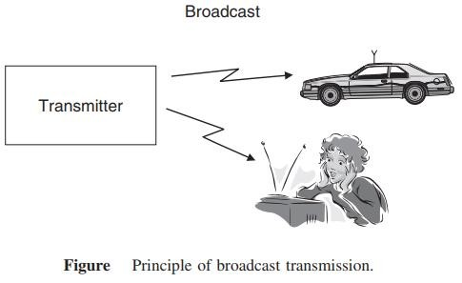
Broadcast
The first wireless service was broadcast radio. Four properties differentiate broadcast radio
The information is sent unidirectional, i.e., in one direction only.
The information transmitted is same for all receivers.
The information is transmitted continuously.
In many cases like TV
or radio, multiple transmitters send the same information

Slide 15
Broadcast
Broadcast Communication
Broadcast communication is the first wireless communication service, primarily used for radio and television transmissions.
Key Properties of Broadcast Radio:
Unidirectional Transmission: Information flows in one direction, from the transmitter to the receiver.
Same Information for All Receivers: Every receiver within range gets the same content.
Continuous Transmission: The broadcast signal is transmitted without interruption.
Multiple Transmitters: In cases like TV and radio, multiple transmitters send the same information to cover a larger area.
This makes broadcast communication ideal for mass media services like AM/FM radio and television.

Slide 16
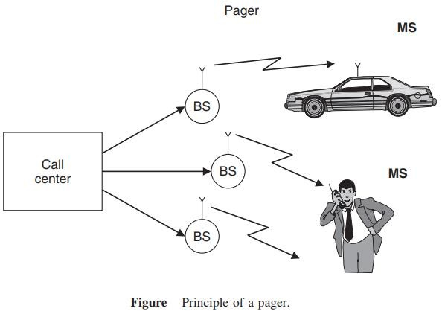
Paging
Similar to broadcast, paging systems are unidirectional wireless communications systems. The following properties characterize them:
The user can only receive information, but cannot transmit.
The information is intended for and received by, only a single user.
The amount of transmitted information is very small.

Slide 17
Paging
Paging systems are a type of unidirectional wireless communication, similar to broadcast but designed for individual users.
Key Properties of Paging Systems:
Receive-Only Communication: The user can only receive information but cannot transmit back.
Single-User Targeting: Unlike broadcast, paging messages are sent to specific individuals.
Small Data Transmission: The transmitted information is minimal, often just a short message or alert.
Paging was widely used before mobile phones became common, especially in emergency services and business communications.

Slide 18

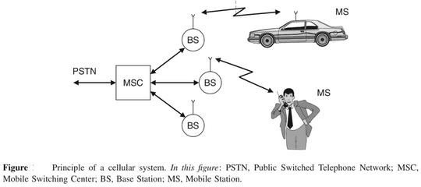
Cellular Telephony
Cellular telephony is the economically most important form of wireless communications. The information flow is bidirectional. A user can transmit and receive information at the same time.

Slide 19
Cellular Telephony
Cellular telephony is the most economically significant form of wireless communication. It allows bidirectional information flow, meaning users can both transmit and receive data simultaneously.
Key Features of Cellular Telephony:
Two-Way Communication: Users can talk and listen at the same time.
Cell-Based Infrastructure: Divides areas into "cells," each served by a Base Station (BS).
Mobile Switching Center (MSC): Manages connections between mobile users and the Public Switched Telephone Network (PSTN).
Mobility Support: Enables communication even while moving (e.g., in a car).
This system forms the backbone of modern mobile networks, enabling voice calls, SMS, and internet access.

Slide 20
Trunking Radio
Trunking radio systems are an important variant of cellular phones, where there is no connection between the wireless system and the public switched telephone network (PSTN); therefore, it allows the communications of closed user groups. Obvious applications include police departments, fire departments, taxis, and similar services. The closed user group allows following operations
Group calls
Call priorities
Relay networks

Slide 21
Trunking Radio
Trunking radio systems are a specialized form of wireless communication used primarily in public safety and critical communication sectors. Unlike traditional cellular networks, trunking radio does not connect to the Public Switched Telephone Network (PSTN), making it an independent communication system for closed user groups.
Key Features of Trunking Radio
Efficient Channel Utilization – Uses a pool of radio channels dynamically assigned to users as needed, ensuring optimal frequency usage.
Closed User Groups – Designed for organizations like police, fire departments, and emergency services that require secure and dedicated communication.
No PSTN Dependency – Works independently of public telephone networks, enhancing security and reliability.
Fast Call Setup – Offers near-instantaneous connectivity without the delays of conventional mobile networks.
Operations in Trunking Radio
Group Calls – Enables communication among multiple users in a closed group, useful for emergency and coordinated operations.
Call Priorities – Ensures priority access to channels for high-importance users, such as emergency responders.
Relay Networks – Extends communication range using relay stations to cover large geographical areas.

Slide 22
Trunking Radio
Applications
Public Safety – Used by police, fire, and medical emergency services.
Transportation – Taxis, railways, and aviation for seamless coordination.
Industrial Use – Factories, power plants, and military applications for secure communication.
In the Wireless and Mobile Communication course, trunking radio is studied as an alternative to cellular systems, focusing on resource allocation, spectrum efficiency, and reliability in mission-critical environments.

Slide 23
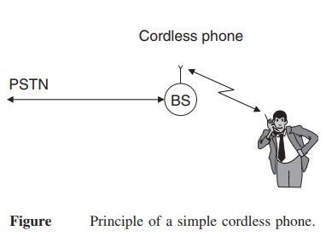
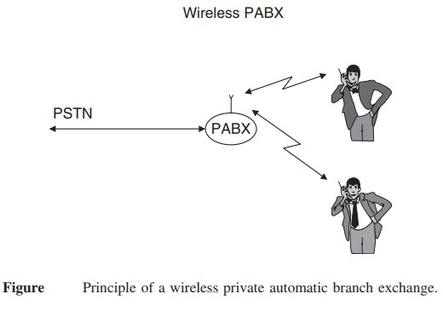

Slide 24
Cordless phones and wireless Private Automatic Branch Exchange (PABX) systems are fundamental concepts in Wireless and Mobile Communication, dealing with short-range communication within a specific area.
1. Cordless Phone
A cordless phone consists of a base station (BS) connected to the Public Switched Telephone Network (PSTN) and a wireless handset.
Principle: The BS acts as an interface between the PSTN and the cordless handset, enabling wireless communication within a limited range (typically within a home or office).
Technology: Operates on radio frequencies (e.g., DECT – Digital Enhanced Cordless Telecommunications).
Limitations: Works only within a small radius (typically 50–300 meters) and does not support mobility beyond the BS coverage.
2. Wireless PABX (Private Automatic Branch Exchange)
A wireless PABX extends the concept of a cordless phone by integrating multiple handsets within an organization's internal network.
Principle: The PABX system connects to the PSTN and manages multiple internal wireless extensions, allowing internal and external communication.
Features:
Supports multiple users within an enterprise.
Facilitates both internal (intercom) and external calls without wired connections.
Provides mobility within an office building or campus.
Advantages over Cordless Phones:
Supports multiple users.
Covers a larger area using multiple base stations.
Reduces wiring costs and enhances mobility.

Slide 25
Applications in Wireless Communication
Cordless Phones: Used in homes and small offices for landline communication with limited mobility.
Wireless PABX: Used in large offices, industries, and corporate buildings for efficient internal and external communication.
In Wireless and Mobile Communication, these systems are studied under short-range wireless communication, focusing on frequency allocation, mobility support, and spectrum efficiency.

Slide 26
Wireless Local Area Networks
The functionality of Wireless Local Area Networks (WLANs) is very similar to that of cordless phones connecting a single mobile user device to a public landline system.
A major difference between wireless LANs and cordless phones is the required data rate. While cordless phones need to transmit (digitized) speech, which requires at most 64 Kbit/s, wireless LANs should be at least as fast as the Internet that they are connected.

Slide 27
Wireless Local Area Networks
Wireless Local Area Networks (WLANs) provide high-speed wireless connectivity within a limited geographical area, such as homes, offices, and campuses. They operate similarly to cordless phones by connecting mobile devices to a fixed communication network, but with a much higher data rate.
Key Characteristics of WLANs
Functionality Similar to Cordless Phones: Like cordless phones, WLANs allow devices to communicate wirelessly with a central access point, which connects to a wired network (such as the internet or a local server).
High Data Rate Requirement:
Cordless phones primarily transmit digitized speech at a low data rate (≤64 Kbit/s).
WLANs must support high-speed data transmission to match internet speeds, typically in the range of Mbps to Gbps (e.g., Wi-Fi standards like IEEE 802.11ac, 802.11ax).
Operates on Unlicensed Frequency Bands: Uses ISM bands (2.4 GHz, 5 GHz, and 6 GHz) for communication.
Supports Multiple Devices: Unlike cordless phones, which usually support only one handset, WLANs allow multiple users to connect simultaneously.

Slide 28
Wireless Local Area Networks
Feature | WLANs | Cordless Phones
Purpose | Wireless internet access | Voice communication
Data Rate | Mbps to Gbps | ≤64 Kbit/s
Coverage | 30–100 meters | 50–300 meters
Network | Connects to the internet | Connects to PSTN
Applications of WLANs
Home and Office Networks – Provides seamless internet access to multiple users.
Public Wi-Fi Hotspots – Used in airports, cafes, and shopping malls.
Enterprise Networks – Supports internal communications and cloud-based applications.
In Wireless and Mobile Communication, WLANs are studied under wireless networking protocols, data transmission rates, frequency spectrum utilization, and security mechanisms like encryption (WPA2, WPA3).

Slide 29
Personal Area Networks
When the coverage area becomes even smaller than that of WLANs, we speak of Personal Area Networks (PANs).
Such networks are mostly intended for simple cable replacement duties.
For example, devices following the Bluetooth standard allow connecting a hands-free headset to a phone without requiring a cable; in that case, the distance between the two devices is less than a meter.

Slide 30
Personal Area Networks
Personal Area Networks (PANs) are the smallest type of wireless networks, designed for short-range communication between personal devices.
Characteristics of PANs
Smaller Coverage Area: Covers a few meters (typically 1–10 meters), much smaller than WLANs.
Purpose: Primarily used for cable replacement, enabling wireless communication between personal devices.
Technology Used:
Bluetooth (e.g., hands-free headsets, wireless keyboards, and smartwatches).
Infrared (IR) (e.g., TV remotes, old file transfer systems).
Zigbee (used in IoT devices for low-power, short-range communication).
Low Power Consumption: Optimized for low-energy communication between devices.
Example Applications
Wireless Accessories: Connecting Bluetooth headsets, speakers, keyboards, and mice.
IoT Devices: Smart home automation (e.g., smart bulbs, fitness bands).
File Transfer: Using Bluetooth to transfer files between mobile phones.

Slide 31
Personal Area Networks
Feature | PANs | WLANs
Coverage | 1–10 meters | 30–100 meters
Technology | Bluetooth, Zigbee, IR | Wi-Fi (IEEE 802.11)
Purpose | Personal device connectivity | Internet access for multiple users
Speed | Kbps to Mbps | Mbps to Gbps
PANs are crucial in short-range communication protocols and low-power wireless networks, especially in wearable technology, IoT, and smart devices.

Slide 32
Fixed Wireless Access
Fixed wireless access systems can also be considered as a derivative of cordless phones or WLANs, essentially replacing a dedicated cable connection between the user and the public landline system.
The main difference from a cordless system is that
there is no mobility of the user devices and
the BS almost always serves multiple users.

Slide 33
Fixed Wireless Access
Fixed Wireless Access (FWA) is a technology that provides wireless broadband connectivity to homes and businesses without requiring a physical cable connection.
Key Characteristics of Fixed Wireless Access (FWA)
Alternative to Wired Networks: Functions as a replacement for DSL, fiber, or cable broadband.
No Mobility: Unlike mobile networks, FWA devices remain stationary at a fixed location.
Base Station (BS) Serves Multiple Users: One BS can connect several homes, offices, or businesses.
High-Speed Internet: Often delivers broadband speeds comparable to fiber or DSL.
Uses Licensed & Unlicensed Spectrum: Operates on frequencies like 4G LTE, 5G, WiMAX, and mmWave bands.
Examples of Fixed Wireless Access Usage
5G Home Internet Services (e.g., Verizon 5G Home, T-Mobile 5G Home).
Rural Internet Providers using FWA to bridge the digital divide.
Enterprise Networks using FWA for backup internet connections.
Fixed Wireless Access is a crucial technology in next-generation broadband and is a key enabler of 5G networks.

Slide 34
Fixed Wireless Access
Feature | Fixed Wireless Access (FWA) | Cordless System
Mobility | No (Stationary devices) | Yes (Limited mobility within range)
Usage | Broadband internet | Voice communication
Base Station Role | Serves multiple users | Usually serves a single user
Technology | 4G, 5G, WiMAX | Analog/Digital cordless telephony
Advantages of FWA
Faster Deployment: No need for physical cables, reducing installation time.
Cost-Effective: Eliminates expensive fiber/cable laying.
Ideal for Rural & Remote Areas: Provides connectivity where fiber or DSL is unavailable.
Supports High Bandwidth Applications: Enables HD streaming, gaming, and remote work.

Slide 35
Requirements for the Services
Data Rate
Range and Number of Users
Mobility
Energy Consumption
Use of Spectrum
26

Slide 36
Data Rate
Data rates for wireless services ranges from few bits per second to several gigabits per second, depending on the application.
Type of application | Data rate | 27
Sensor networks | 1 Kbit/s
Speech communications | 5 and 64 Kbit/s
Elementary data services | 10 and 100 Kbit/s
Computer peripherals and similar devices | 1Mbit/s
High-speed data services | 0.5 to 100 Mbit/s
Personal Area Networks | 100 Mbit/s

Slide 37
Data Rate
The data rate in wireless communication varies based on the application, ranging from a few bits per second to several gigabits per second
Key Observations:
Low data rates are used in sensor networks and speech communication.
Medium data rates support elementary data services and computer peripherals.
High-speed applications like Wi-Fi, mobile networks, and PANs require much higher data rates.
The choice of data rate depends on the network type, application requirements, and technology used.

Slide 38
Range and Number of Users
Another distinction among the different networks is the range and the number of users that they serve. By range, we mean here the distance between transmitter and receiver.
The coverage area of a system can be made almost independent of the range by just combining a larger number of BSs into one big network.
Type of network | Range | 28
Body Area Networks (BANs) | 1meter
Personal Area Networks | 10 meter
WLANs | up to 100 meter
Cellular systems | 10 or even 30 km
Satellite systems | 1,000 km radius
Fixed wireless access services | 100 m and several tens of kilometers

Slide 39
Range and Number of Users
The range of a wireless network refers to the distance between the transmitter and receiver, while the number of users depends on the network type and capacity.
Key Insights:
Short-range networks (BANs, PANs) are suitable for wearables and Bluetooth devices.
Medium-range networks (WLANs, Fixed Wireless) cater to homes, offices, and urban setups.
Long-range networks (Cellular, Satellite) serve large areas, including rural and remote regions.
Network coverage can be expanded by using multiple Base Stations (BSs) to form a larger network.
Choosing the right network depends on range, user capacity, and application requirements.

Slide 40
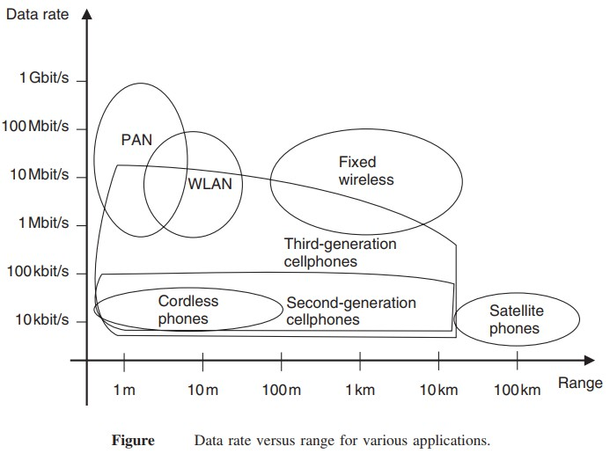
29

Slide 41
Data Rate vs. Range for Wireless Networks
The figure illustrates the relationship between data rate and range for various wireless technologies.
Observations:
Higher data rates are typically achieved in short-range networks, like PANs and WLANs.
Long-range networks (Satellite, Cellular) provide wider coverage but offer lower data rates.
Fixed wireless networks strike a balance between range and data rate.
Cellular networks (2G, 3G, etc.) expand their range but sacrifice speed.
29

Slide 42
Data Rate vs. Range Trends:
Technology | Range | Data Rate
PAN(Bluetooth/Infrared | ~1-10m | 10Mbit/s-1Gbit/s
WLAN (Wi-Fi) | ~100m | 1-100 Mbit/s
Cordless Phones | ~10m | ~10 kbit/s – 100 kbit/s
2G Cellular | ~1-10km | 10 kbit/s – 100 kbit/s
3G Cellular | ~1-10km | 1 Mbit/s – 10 Mbit/s
Fixed Wireless | ~1-10km | 10 Mbits/s-100Mbits/s
Satellite Phones | >100km | ~10 kbit/s – 100 kbit/s
29

Slide 43
Key Takeaways:
Short-range technologies (PAN, WLAN) prioritize speed over range. Cellular and fixed wireless networks balance coverage and data rates. Satellite networks focus on global coverage but with low data rates.
This trade-off between range and speed is a key factor in choosing the right wireless technology for different applications.
29

Slide 44
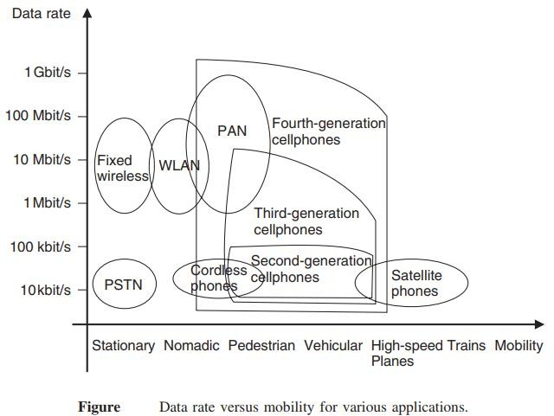
Mobility
Wireless systems also differ of mobility that they have to allow for the users.
The ability to move around while communicating is one of the main factors of wireless communication
for the user.

Slide 45
Mobility
Wireless networks differ in their mobility support, allowing users to move around while communicating. Mobility is a crucial factor for wireless communication.
Key Observations from the Graph:
Higher mobility networks (e.g., Cellular & Satellite) allow users to move freely across large distances.
Low mobility networks (e.g., WLAN, PAN) are better for stationary or nomadic users.
High-speed mobility (e.g., planes, high-speed trains) sacrifices data rate for connectivity.
Key Takeaways:
Wired networks (PSTN) support only stationary users. Wi-Fi and PAN allow movement but work best for nomadic or pedestrian users. Cellular networks (2G, 3G, 4G, 5G) enable vehicular and high-speed mobility. Satellite phones are ideal for extreme mobility (e.g., planes, remote areas) but offer lower speeds.
Mobility plays a crucial role in choosing the right wireless technology based on user movement needs.

Slide 46
Mobility
Data Rate vs. Mobility Trends:
Technology | Mobility Support | Data Rate
PSTN (Fixed line) | Stationary only | ~10 kbit/s – 1 Mbit/s
Cordless Phones | Nomadic | ~10 kbit/s – 100 kbit/s
WLAN (Wi-Fi) | Pedestrian, Nomadic | 1 – 100 Mbit/s
PAN (Bluetooth, Infrared) | Pedestrian, Nomadic | 10 Mbit/s – 1 Gbit/s
2G Cellular | Vehicular, Nomadic | 10 kbit/s – 100 kbit/s
3G Cellular | Vehicular | 1 Mbit/s – 10 Mbit/s
4G Cellular | Vehicular, High-speed trains | 10 Mbit/s – 1 Gbit/s
Satellite Phones | Planes, High-speed trains | ~10 kbit/s – 100 kbit/s

Slide 47
Energy Consumption
Energy consumption is a critical aspect of wireless devices. Most wireless devices use (one way or rechargeable) batteries, as they should be free of any wires both the ones used for communication and the ones providing the power supply.
Rechargeable batteries
One way batteries
Power mains

Slide 48
Energy Consumption
Energy consumption is an important factor in the design and usage of wireless devices. Since these devices are expected to work without wired connections, they typically rely on batteries or alternative power sources. Efficient energy use ensures long operating time and reduced maintenance.
Wireless devices are powered using the following methods:
Rechargeable Batteries: These can be reused multiple times after charging. They are suitable for devices that need regular usage, like mobile phones and laptops.
One-way (Disposable) Batteries: These are non-rechargeable and must be replaced after use. They are used in low-power or infrequent-use devices like remote controls or some IoT sensors.
Power Mains: Some fixed-position wireless devices are connected directly to the power supply (mains electricity). These are less common in mobile environments but used in routers, base stations, etc.
To maintain portability and usability, wireless devices must be designed to consume as little energy as possible while maintaining performance.

Slide 49
Use of Spectrum
Spectrum can be assigned on an exclusive basis, or on a shared basis. That determines to a large degree the multiple access scheme and the interference resistance that the system has to provide:
Spectrum dedicated to service and operator
Spectrum allowing multiple operators
Spectrum dedicated to a service
free spectrum
Adaptive spectral usage

Slide 50
Use of Spectrum
Spectrum refers to the range of electromagnetic frequencies used for transmitting data in wireless communication. Efficient spectrum usage is vital to avoid interference and ensure seamless communication.
Spectrum can be allocated in two major ways:
Exclusively: Only one operator or service has access.
Shared: Multiple operators or services use the same spectrum.
The method of allocation impacts:
The multiple access technique used (e.g., TDMA, FDMA, CDMA).
The interference resistance and overall system performance.
Types of spectrum usage include:
Dedicated Spectrum for Service and Operator: Specific frequencies are assigned to a particular operator for a specific service.
Spectrum for Multiple Operators: Allows different operators to share the same frequency band with coordination.
Service-Specific Spectrum: Frequencies are assigned based on the type of service, like mobile, TV, or satellite.
Free (Unlicensed) Spectrum: Open to all users without exclusive licensing (e.g., Wi-Fi operates on 2.4 GHz and 5 GHz).
Adaptive Spectrum Usage: Systems dynamically select and utilize available spectrum based on current network conditions (used in cognitive radio networks).

Slide 51
Direction of Transmission (The duplex concept )
Simplex systems– e.g., broadcast systems and pagers.
Semi-duplex systems – e.g.,Walkie-talkies
Full-duplex systems – e.g., cellphones and cordless phones.
FDD uses two separate frequencies for the uplink (from the mobile to the BS) and the downlink (from the BS to the mobile).
TDD uses a single frequency to transmit signals in both the downlink and uplink directions.
Frequency(Mhz)
Base Station(Tx), Mobile Station(Rx
Frequency(Mhz)
Base Station(Tx), Mobile Station(Rx)
Mobile station (tx), Base station(Rx)
Mobile station (tx), Base station(Rx)
Time (ms)
BITS Pilani, Deemed to be UniversityTuinmdeer S(emctison) 3 of UGC Act, 1956

Slide 52
Direction of Transmission (The duplex concept )
In wireless communication, data transmission can occur in different directions depending on the type of system. This concept is called duplexing and is categorized as:
1. Simplex Systems
Data flows in only one direction.
Example: Radio broadcast, pagers.
2. Semi-Duplex Systems
Data flows in both directions, but only one at a time.
Example: Walkie-talkies.
3. Full-Duplex Systems
Data flows in both directions simultaneously.
Example: Mobile phones, cordless phones.
Time (ms)
BITS Pilani, Deemed to be UniversityTuinmdeer S(emctison) 3 of UGC Act, 1956

Slide 53
Direction of Transmission (The duplex concept )
Types of Duplexing Techniques
🔹 FDD (Frequency Division Duplex):
Uses two separate frequencies:
One for uplink (mobile to base station).
One for downlink (base station to mobile).
Allows simultaneous transmission and reception.
🔹 TDD (Time Division Duplex):
Uses a single frequency, but transmission is divided in time slots.
One time slot for uplink, another for downlink.
No simultaneous communication—alternates direction over time.
In FDD, uplink and downlink happen at the same time but on different frequencies.
In TDD, the same frequency is used but alternates over time for uplink and downlink.
The choice of simplex, semi-duplex, or full-duplex depends on the application needs. FDD is suitable for continuous high-data services, while TDD is more flexible and cost-effective.
Time (ms)
BITS Pilani, Deemed to be UniversityTuinmdeer S(emctison) 3 of UGC Act, 1956

Slide 54
Wireless communication systems
Antenna
Information to
be transmitted
coding
Modulator
Transmitter
carrier
Antenna
Information
Received
decoding
DeModulator
Receiver
carrier

Slide 55
Wireless communication systems
Wireless communication systems transfer data without physical connection using radio waves. The process involves two main stages: Transmission and Reception.
Transmission Chain (Transmitter Side):
Information to be transmitted:
Raw data or signal to be sent (e.g., voice, video, text).
Coding:
Adds redundancy for error detection and correction.
Modulator:
Combines the coded data with a carrier signal (high-frequency wave).
Converts baseband signals to radio frequencies.
Transmitter:
Amplifies the modulated signal and sends it to the antenna.
Antenna:
Converts electrical signal into electromagnetic waves and radiates it into the air.

Slide 56
Wireless communication systems
Reception Chain (Receiver Side):
Antenna:
Captures the transmitted signal from the air.
Receiver:
Picks up and amplifies the incoming signal.
Demodulator:
Extracts the original data from the modulated signal using the carrier.
Decoding:
Removes redundancy and corrects any transmission errors.
Information Received:
Final recovered message, ideally identical to the original transmitted data.
The modulator/demodulator handles signal transformation using a carrier.
Coding/decoding ensures the reliability of communication.
Antennas are essential for converting between electrical and electromagnetic signals.

Slide 57
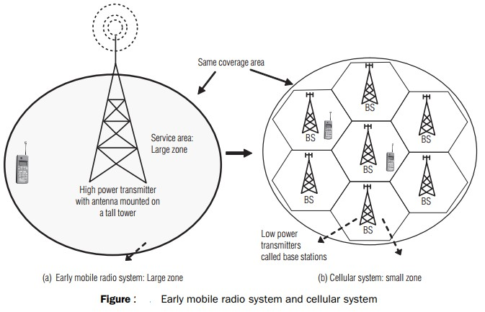

Slide 58
(a) Early Mobile Radio System – Large Zone
Uses a high-power transmitter with a tall antenna tower.
Covers a large area using just one base station.
All users in the zone connect to the same transmitter.
Limitations:
Signal quality degrades with distance.
Supports fewer users due to spectrum limitations.
Harder to reuse frequencies efficiently.
(b) Cellular System – Small Zone
Entire area is divided into multiple small zones (cells).
Each cell has a Base Station (BS) with a low-power transmitter.
Same overall coverage area as the large zone system.
Advantages:
Efficient frequency reuse (adjacent cells use different frequencies).
Supports more users within the same area.
Better signal quality and call reliability.
Allows seamless handoff of mobile users between cells.

Slide 59
Feature | Early Mobile Radio | Cellular System
Coverage | Single large zone | Multiple small zones
Power | High | Low
Scalability | Limited | High
Frequency Reuse | Poor | Efficient
User Capacity | Low | High
The cellular concept revolutionized mobile communication by improving coverage, capacity, and spectral efficiency.

Slide 60
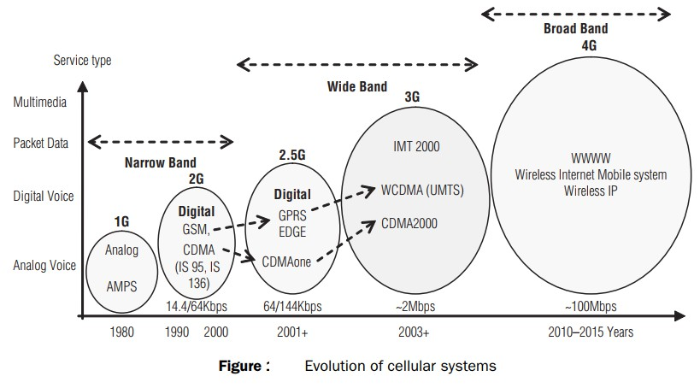

Slide 61
1G – Analog Voice (1980s)
Technology: AMPS (Advanced Mobile Phone System)
Service: Analog voice only
Data Rate: Very low (no digital data)
Limitations: Poor voice quality, no security, no data
2G – Digital Voice (1990s)
Technology: GSM, CDMA (IS-95, IS-136)
Service: Digital voice, basic SMS
Data Rate: 14.4 to 64 kbps
Advantage: Better security, efficiency, battery life
2.5G – Packet Data (2001+)
Technology: GPRS, EDGE, CDMAone
Service: Voice + Packet Data (Internet, email)
Data Rate: 64–144 kbps
Role: Bridge between 2G and 3G, introduced mobile data

Slide 62
3G – Wide Band (2003+)
Technology: IMT-2000, WCDMA (UMTS), CDMA2000
Service: Voice, SMS, multimedia, video calling
Data Rate: ~2 Mbps
Advancement: Global roaming, faster internet, mobile apps
4G – Broad Band (2010–2015+)
Technology: Wireless Internet Mobile System, Wireless IP (e.g., LTE)
Service: High-speed data, HD video streaming, VoIP
Data Rate: ~100 Mbps
Revolution: Internet-first approach, enabled mobile broadband

Slide 63
Generation | Service Type | Data Rate | Key Feature
1G | Analog voice | Very low | Basic mobile voice
2G | Digital voice, SMS | 14.4–64 kbps | Better quality & security
2.5G | Voice + Packet Data | 64–144 kbps | Internet access introduced
3G | Multimedia, Internet | ~2 Mbps | Video calling, faster data
4G | Broadband Internet | ~100 Mbps | Streaming, VoIP, full mobile internet

Slide 64
Cellular Network- 1G
Goal: To develop a working system that could provide basic service
Time frame: 1980s in US Technology: FDMA/FDD Speed: 2.4Kbps
voice
1G network used Analogue circuit-switched technology with FDMA
800–900 MHz frequency bands.
Example Systems:
Analogue Mobile Phone System (AMPS-USA)
Total Access Communication System (TACS-UK)
Nordic Mobile Telephone (NMT-Europe)
37

Slide 65
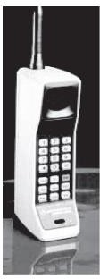
In AMPS, two 25-MHz bands are allocated. One 25-MHz band is for communication from BS to mobile unit and the other for communication from mobile unit to BS.
The following are the limitations of 1G:
Supports only speech
Low traffic capacity
Unreliable handover
Long-call setup time and frequent call drops
Inefficient use of bandwidth and poor battery life
Poor voice quality and large phone size
Allows users to make voice calls in 1 country only
the first handheld device from Motorola Company which was available in 1984
38
in 1G network.

Slide 66
Cellular Network-2G
Goal: Digital voice service with improved quality and also provide better services
Time Frame: Launched in Finland in 1991
2G technology supports data, speech, FAX, SMS, and WAP services.
The frequency bands used by GSM are 890–960 MHz and
1710–1880 MHz. (890–915 MHz - uplink MS to BS, 935–
960 MHz downlink BS to MS)
Used digital signals

Slide 67

Digital modulation formats were introduced in this generation with the main technology as TDMA/FDD
Data Speed: upto 64kbps
Services like text message, picture message was included. Example Systems:
Global System for Mobile Communications (GSM) (TDMA and FDMA)
IS-95(Interim Standard) (CDMA)
Ericsson GH218 which was introduced in 1994 and
operated in 2G networks.

Slide 68
The following are limitations of 2G:
Provides low data rates ranging from 9.6 kbps to 28.8 kbps.
Circuit-switched network, where the end systems are dedicated for the entire call session. This causes reduction in usage of bandwidth and resources.
Too many 2G standards globally (e.g. GSM, CDMA, PDC,
and PHS )

Slide 69
Interim generation (2.5G )
Goal: To provide better data rates and wider range of data services and it was a transition from 2G to 3G
Time frame: 2000-2002
The mobile technology using GPRS standard has been termed as 2.5G.
The 2.5G was started in 1998 with added GPRS and enhanced
data rates for GSM evolution (EDGE).

Slide 70
Cellular Network- 3G
The aim of 3G systems is to provide communication services from person-to-person at any place (global roaming) and at any time through any medium with guaranteed quality of service.
high-speed internet access, live video communications, and simultaneous data and voice transmission .
The 3G technology has added multimedia facilities to 2.5G
phones.
3G operates in the frequency band of 1710–2170 MHz.
It provides high transmission rates from 348 Kbps in a moving vehicle to 2 Mbps for stationary or mobile users.

Slide 71
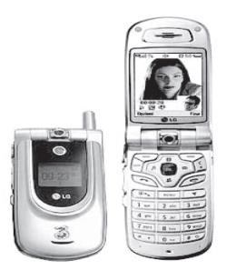
Examples of 3G system are universal mobile telecommunication systems (UMTS) and international mobile telecommunications at 2,000 MHz (IMT-2000).
UMTS are designed to provide different types of data rates, based on the following circumstances:
up to 144 kbps for moving vehicles 384 kbps for pedestrians
2 Mbps for indoor or stationary users
LG U8110 that was introduced in 2004 and is operating in 3G networks.

Slide 72
The following are the drawbacks of 3G system:
High bandwidth requirement
High spectrum licensing fees
Expense and bulk size of 3G phones
Lack of 2G mobile user buy in for 3G wireless service
Lack of network coverage because it is still a new service
High prices of 3G mobile services in some countries

Slide 73
Cellular Network- 4G
Goal: High mobility, High data rate
Frequency Band: 2 to 8 Ghz.
Download speed is upto 100 Mbps for moving users and 1GPS for stationary users.
The following modulation techniques are proposed to be used in the 4G cellular phones.
Variable spreading factor-orthogonal frequency and code
division multiplexing (VSF-OFCDM).
Variable spreading factor code-division multiple access (VSF- CDMA).
LTE (Long Term Evolution)
Uses Orthogonal Frequency Division Multiplexing (OFDM)
Uses Multi-input Multi-output(MIMO) for enhanced throughput
46

Slide 74
Features of 4G
Support for interactive multimedia, voice, streaming video, Internet, and other broadband services
Fully IP based mobile system
High speed, high capacity, and low cost‐per‐bit
Global access, service portability, and scalable mobile services
Seamless switching, and a variety of Quality of Service
Better scheduling and call‐admission‐control techniques
Better spectral efficiency
Interoperability with existing wireless standards
Packet switched network

Slide 75
Advantages of 4G
Affordable communication services.
High speed, high capacity and low cost per bit.
Support for interactive multimedia, voice , streaming video, Internet and other broadband services.
Global access, Service portability and scalable mobile services and variety of quality of services provided.
Better spectral efficiency.
seamless network of multiple protocol and air interfaces.

Slide 76
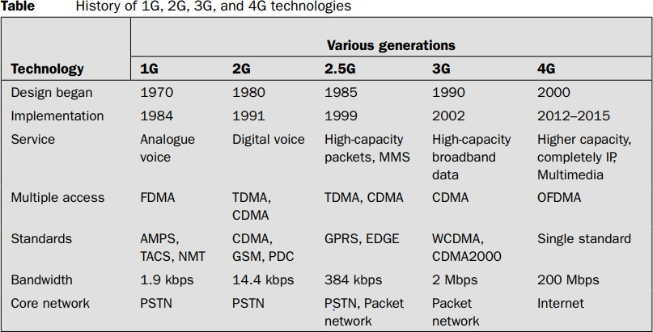

Slide 77
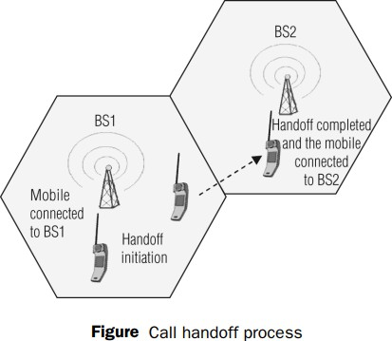
Handoff: A crucial component of the cellular concept is the notion of handoffs. Handoff is the process of transferring an active call from one cell to another as the mobile unit moves from one cell to the other.
Handoff operation involves identifying a new BS and
allocation of voice and
control signals associated.

Slide 78
Handoff (or handover) is the process of transferring an active call or data session from one cell (base station) to another without interrupting the service as the user moves.
Why Handoff is Needed
When a mobile user moves out of the coverage area of one cell and into another.
To maintain call quality and avoid dropped calls.
Steps in the Handoff Process
Detection: Mobile device or base station (BS1) detects weakening signal.
Initiation: System identifies a stronger signal from a nearby base station (BS2).
Transfer: Mobile switches connection from BS1 to BS2.
Completion: Mobile unit is now connected to BS2, call continues seamlessly.
Involves:
Identifying a new base station (BS)
Allocating voice and control signals
Maintaining call continuity

Slide 79
Step | Description
BS1 | Mobile initially connected to BS1
Handoff Initiation | Mobile moves away from BS1
BS2 | Handoff completed, mobile connected to BS2
Key Points to Remember
Seamless call experience is the goal.
It is triggered when signal quality drops.
Crucial for user mobility and network reliability.

Slide 80
Handoff –
high priority over call initiation requests
must be performed successfully
Infrequently
be imperceptible.
The margin ∆= 𝑃_{𝑟 ℎ𝑎𝑛𝑑𝑜𝑓𝑓} − 𝑃_{𝑟 𝑚𝑖𝑛𝑖𝑚𝑢𝑚 𝑢𝑠𝑎𝑏𝑙𝑒} cannot be
too large or too small.

Slide 81
Important Characteristics of a Good Handoff:
High Priority
Handoffs are given higher priority than new call initiations.
Reason: Ongoing calls must not be dropped.
Successful Execution
Handoffs must be executed reliably to avoid call drops or poor service.
Infrequent
They should not happen too often; frequent handoffs can degrade user experience.
Imperceptible to User
The transition should be smooth and unnoticed by the user.

Slide 82
Handoff Margin Concept
Handoff Margin (Δ):
Δ=Prhandoff​−Prminimumusable​
Explanation:
Prhandoff​: Received power level at which handoff is triggered.
Prminimumusable​: Minimum signal strength required for acceptable communication.
Design Rule:
This margin must not be too small or too large:
Too small → Late handoff, call might drop.
Too large → Unnecessary handoff, wasting resources.

Slide 83
Requirement | Why It's Important
High priority | To prevent ongoing calls from dropping
Successful & infrequent | For quality service and reduced signaling load
Imperceptible | Smooth user experience
Balanced margin (Δ) | Ensures handoff happens at the right time

Slide 84
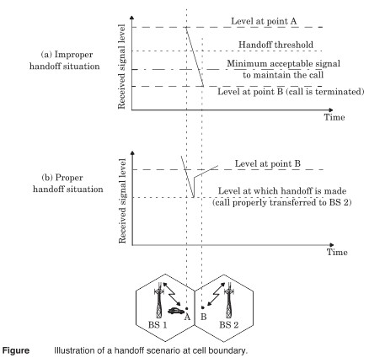

Slide 85
In deciding when to handoff, it is important to ensure that the drop in the measured signal level is not due to momentary fading.
Information about the vehicle speed is useful in handoff decisions.
Dwell time –The time over which a call may be maintained within a cell without handoff.
The statistics of dwell time are important in the practical design of handoff algorithm.

Slide 86
(a) Improper Handoff Situation
The handoff decision is delayed.
The signal strength from Base Station 1 (BS1) falls below the minimum acceptable signal level before a handoff is initiated.
As a result, the call is dropped at point B because the signal becomes too weak to maintain the call.
Conclusion: Handoff occurred too late, resulting in call termination.
(b) Proper Handoff Situation
The handoff is triggered in advance, before the signal drops below the minimum acceptable level.
When the signal from BS1 falls to the handoff threshold, the mobile is transferred to Base Station 2 (BS2).
The signal strength from BS2 at this point is sufficient to maintain the call.
Conclusion: Handoff occurred at the right time, allowing seamless call transfer and avoiding call drop.

Slide 87
Two adjacent cells are shown: one served by BS1 and the other by BS2.
A mobile user moves from point A (in BS1’s coverage) to point B (towards BS2).
Handoff must be performed near the cell boundary to ensure uninterrupted service.
Key Terms
Handoff Threshold: Signal level at which a handoff should ideally occur.
Minimum Acceptable Signal: Lowest signal level at which a call can still be maintained.
Call Dropped: Happens when the signal falls below the minimum acceptable level before handoff.
Proper handoff management ensures that the user experiences no service disruption while moving across cells. Delayed handoff may lead to call drops, affecting user experience.

Slide 88
In first generation analog cellular system, the locator receiver is used for handoff.
In second generation system, handoff decisions are mobile assisted –mobile assisted handoff (MAHO).
Intersystem handoff –different cellular systems –roamer.

Slide 89
Mobile Assisted Handoff (MAHO)
Mobile Assisted Handoff (MAHO) is a technique used in 2G cellular systems (like GSM) where the mobile device helps the network in making handoff decisions.
How it works:
The mobile station (MS) continuously measures:
Signal strength of the serving base station (BS).
Signal strength of neighboring base stations.
The mobile sends this measurement data to the serving base station at regular intervals.
The network (Base Station Controller or BSC) uses these reports to decide:
Whether a handoff is needed.
Which neighboring BS has the strongest signal for a smooth transition.
If the signal of a neighbor BS is stronger than the current one, the handoff is triggered to that BS.
Why MAHO is useful:
Reduces the handoff delay, as signal strength is monitored in advance.
Provides better decision-making as the mobile has a better view of its surrounding signal environment.
Improves call quality and reduces the chances of call drops.

Slide 90
Prioritizing Handoffs
Guard channel concept –can be used with dynamic channel assignment strategies to increase spectrum utilization.
Queuing of handoff –possible due to the fact that there is a finite time interval between handoff threshold time and call- terminated time

Slide 91
Prioritizing Handoffs
To maintain call continuity and improve network efficiency, handoffs are often prioritized using specific techniques:
1. Guard Channel Concept
A certain number of channels in each cell are reserved only for handoffs.
These reserved channels are not used for new call initiations.
This ensures that ongoing calls can be handed off smoothly without dropping, especially in high-traffic areas.
Can be combined with dynamic channel assignment to improve spectrum utilization.
2. Queuing of Handoff Requests
Not all handoff requests need to be processed instantly.
There is a small time interval between when a handoff is needed (handoff threshold) and when the call would actually drop (call-terminated time).
During this interval, handoff requests can be queued, especially if no channel is currently available.
If a channel becomes available shortly, the handoff can be executed in time to avoid call drop.

Slide 92
Practical Handoff Considerations
Several handoff schemes have been devised to handle the simultaneous traffic of high speed and low speed users – minimizing the handoff intervention from the MSC
Guard channels protect ongoing calls during handoff.
Handoff queuing uses the delay tolerance between threshold and drop.
Both techniques prioritize handoffs over new calls to minimize call drops.

Slide 93
HOME WORK
1.2 If 0 dBm is equal to 1 mW (10⁻³ W) over a 50Ω load; express 10W in units of dBm.
1.5 In simulcasting paging systems, there usually is one dominant signal arriving at the paging receiver. In most, but not all cases, the dominant signal arrives from the transmitter closest to the paging receiver. Explain how the FM capture effect could help reception of the paging receiver. Could the FM capture effect help cellular radio systems? Explain how
1.9 Assume a I Amp-hour battery is used on a cellular telephone (often called a cellular subscriber unit). Also assume that the cellular telephone draws 35 mAin idle mode and 250 mA during a call. How long would the phone work (i.e., what is the battery life) if the user leaves the phone on continually and has one 3-minute call every day? Every 6 hours? Every hour? What is the maximum talk time available on the cellular phone in this example?

Slide 94
1.16 Discuss the similarities and differences between a conventional cellular radio system and a space-based (satellite) cellular radio system. What are the advantages and disadvantages of each system? Which system could support a larger number of users for a given frequency allocation? Why? How would this impact the cost of service for each subscriber?

Slide 95
In your place of work, how many modern wireless communications networks are available to you? Identify the types of services, the types of technologies, the commercial names of the service providers, and the commercial names of the equipment manufacturers that offer these wireless access capabilities.
In your home, how many modern wireless communications networks are available to you? Identify the types of services, the types of technologies, the commercial names of the service providers, and the commercial names of the equipment manufacturers that offer these wireless access capabilities.
2.8 How would multicarrier transmissions impact an operator’s approach to allocating resources to accommodate a growing subscriber database that increasingly desires data connectivity over voice? How would heavy HSCSD usage impact a cellular carrier’s strategy in allocating channels in the base stations of a cellular network? How would the rapid adoption of
Voice over Internet Protocol (VoIP) impact cellular congestion? Explain.

Slide 96
Introduction to wireless communication systems
It is the Transfer of data between 2 points that aren’t connected by an electrical conductor.
They typically use electromagnetic waves.
Transmitting voice and data using electromagnetic waves in open space (atmosphere)
The information from the sender to the receiver is carried over a well-defined frequency band.
Each Channel has a fixed bandwidth. Different channels can be used to transmit information in parallel and independently.

Slide 97
Why Wireless Communication
Mobility
- Radio waves travel freely through the air, wireless modes of communication give a great deal of mobility.
Freedom from wires
-Wired networks can be inflexible in terms of mobility.
- Extra cables and switches to connect a device to the network and use in
different location
- Installation can be lengthy and complex
- Maintenance costly.

Slide 98
Why Wireless Communication
Global Coverage
Communication can reach where wiring is infeasible or costly(e.g. hazardous areas, long distances etc.).
Scalability
- Problems with a wired network is coping with expansion and can be expensive.
- Addition of new users is fast and relatively convenient in wireless communication.
Stay Connected any where any time.

Slide 99
High costs for setting up the infrastructure
Security vulnerabilities.
Efficient use of Finite Radio Spectrum
Efficient Hardware
Low power transmitter, receivers
-Many devices are battery operated. We need to have low power transmitters and receivers
Low power signal processing tools
Challenges of wireless communication system

Slide 100
Challenges of wireless communication system
Multipath propagation and fading
Fading is caused by destructive interference of two or more versions of the transmitted signal arriving at the receiver in different times with different amplitude and phases
Integrated services
Voice, data, multimedia over a single network

Slide 101
wireless communication is influenced by
Physical obstructions
climatic conditions
Interference from other wireless devices
Maintaining quality of service over unreliable links
Challenges of wireless communication system

Slide 102
Summary
Wireless communication is the transmission of voice and data in free space(atmosphere)
Stay connected any where any time, mobility, scalability, wide coverage are some of the advantages of wireless network and hence preferred.
Challenges of wireless communication in terms of security of the data transferred, setting up of the infrastructure, efficient use of radio spectrum etc need to be addressed.
.

Slide 103
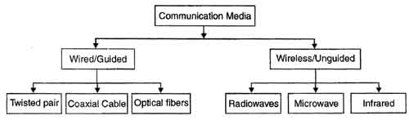
Wireless Communication
Easily generated, Omni-directionally travel long distances, easily penetrate buildings
Used for long distance communication, high SNR, point to point- line of sight
Short range communication, unable to pass through solid objects

Slide 104
Types of wireless communication
Wireless communication
Point to Point communication
Multipoint Communication
Broadcast communication
radio service
wireless computer network
radio service
cellular
wireless computer network
cellular

Slide 105
Wireless Systems: Range
1m 10m 100m 1Km 10Km 100Km 1000Km
Bluetooth
WLAN
Mobile telephony
MW Radio
SW Radio
Satellite Links

Slide 106
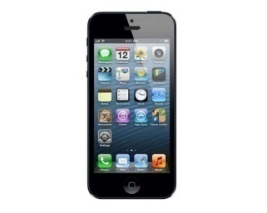
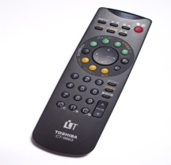
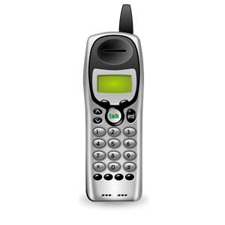
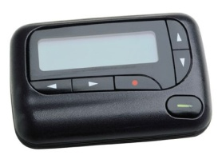
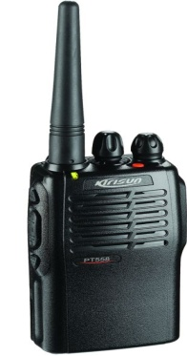
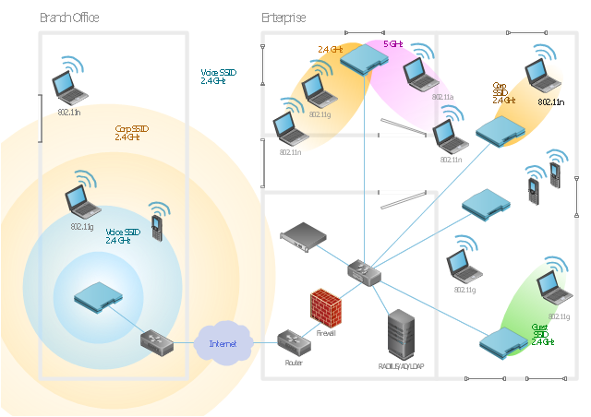
Example of Mobile Radio Systems
Examples
Cordless phone
Remote controller
Hand-held walkie-talkies
Pagers
Cellular telephone
Wireless LAN

Slide 107
Wireless communication systems
Antenna
Information to be transmitted
coding
Modulator
Transmitter
carrier
Antenna
Information Received
decoding
DeModulator
Receiver
carrier

Slide 108
Wireless Communication System Definitions
Base Station: A fixed station in a mobile radio system used for radio communication with mobile stations
Control Channel : Radio channels used for transmission of call setup, call request, call initiation, and other beacon or control purposes.
Subscriber : A user who pays subscription charges for using a mobile communications system.
Transceiver : A device capable of simultaneously transmitting and receiving radio signals.

Slide 109
Wireless Communication System Definitions
Handoff: The process of transferring a mobile station from one channel or base station to another.
Mobile Station : A station in the cellular radio service intended for use while in motion at unspecified locations.
Mobile Switching Center : coordinates the routing of calls in a large Center service area. An MSC is also called a mobile telephone switching office (MTSO).

Slide 110
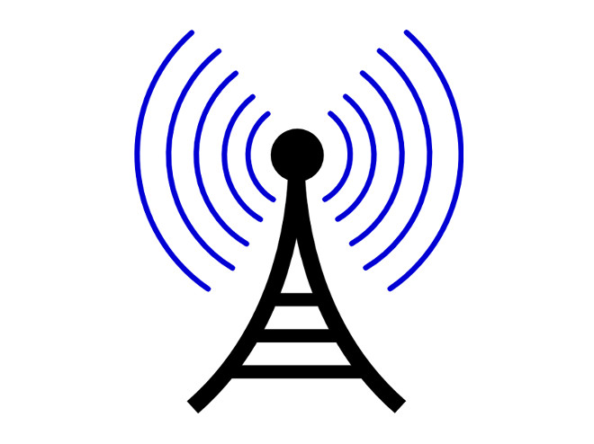
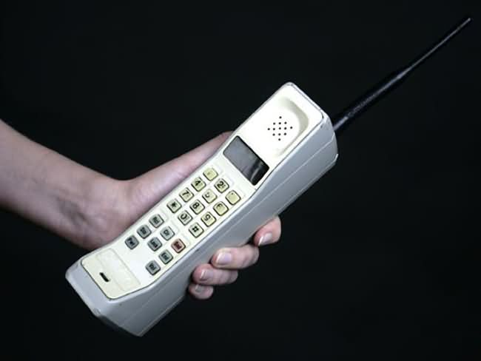
Forward and Reverse Channel
Radio channel used for transmission of information from the base station to the mobile.
Forward Channel
Reverse Channel
Radio channel used for transmission of information from the mobile to base stations

Slide 111
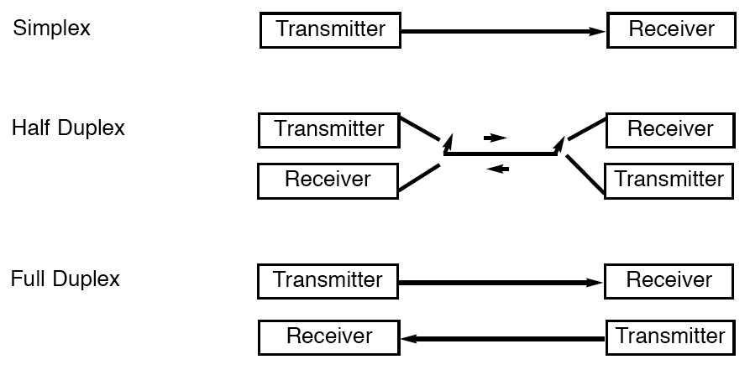
Classification of Mobile Radio Transmission
Classification of mobile radio transmission system

Slide 112
Forms of Full Duplexing
Two forms of Full Duplexing
Frequency division duplexing uses two radio channel
Forward channel: base station to mobile user
Reverse channel: mobile user to base station
Base Station(Tx), Mobile Station(Rx
Frequency(Mhz)
Mobile station (tx), Base station(Rx)
Time (ms)

Slide 113
Forms of Full Duplexing
Time division duplexing shares a single radio channel in time.
Receives for half the frame and transmits for half the frame.
Base Station(Tx), Mobile Station(Rx)
Mobile station (tx), Base station(Rx)
Frequency(Mhz)
Time (ms)

Slide 114
Summary
Point to point communication, multipoint communication, broadcast communication are some of the types of wireless communication.
In wireless communication system, the data is modulated before the transmission and demodulated at the receiver.
In cellular communication, reverse channel is used for communication from mobile to base station and forward channel for communication between the base station to Mobile station.
Simplex, half duplex and full duplex are various ways of mobile radio transmission
Frequency division duplexing and time division duplexing are the forms of full duplex.

Slide 115
Cellular Network- 1G
Goal: To develop a working system that could provide basic voice service
Time frame: 1980s
Technology: FDMA/FDD
Speed: 2.4Kbps
1G network used Analog signal
Example Systems:
Advanced Mobile Phone System (AMPS-USA)
Total Access Communication System (TACS-UK)
Nordic Mobile Telephone (NMT-Europe)

Slide 116
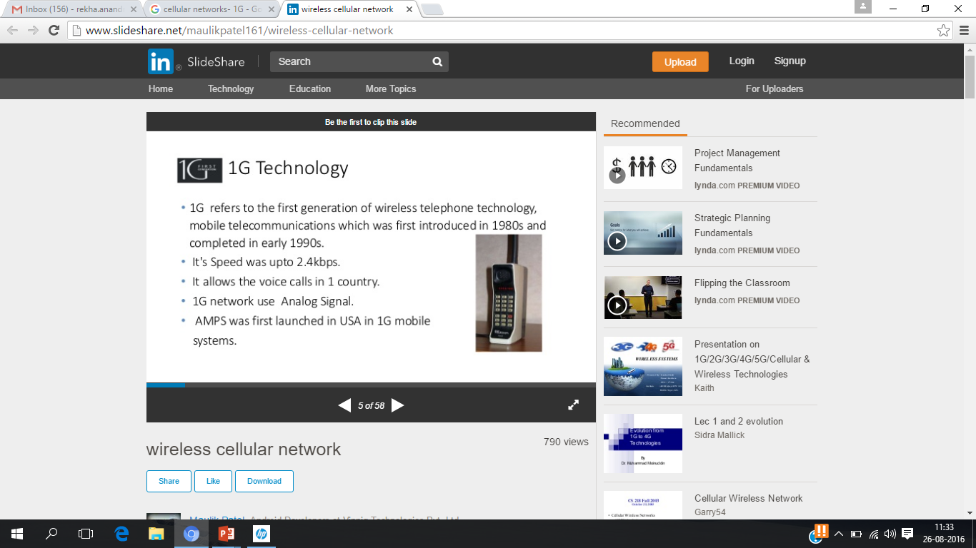
Draw backs of 1G
Poor voice quality
Poor battery life
Large phone size
Limited capacity
Poor handoff reliability

Slide 117
Cellular Network-2G
Goal: Digital voice service with improved quality and also provide better services
Time Frame: Launched in Finland in 1991
Used digital signals
Digital modulation formats were introduced in this generation with the main technology as TDMA/FDD
Data Speed: upto 64kbps
Services like text message, picture message was included.
Example Systems:
Global System for Mobile Communications (GSM) (TDMA and FDMA)
IS-95(Interim Standard) (CDMA)

Slide 118
Cellular Network- 2.5G
Goal: To provide better data rates and wider range of data services and it was a transition from 2G to 3G
Time frame: 2000-2002
Features
Phone calls
Send/receive e-mail
Speed: 64-144kbps
Camera phones
Example Systems:
General Packet Radio Service (GPRS)
Enhanced Data rates for GSM Evolution (EDGE)

Slide 119
Drawbacks of 2G
Requires strong digital signals to help mobile phones work. If there is no network coverage in any specific area, digital signals would be weak.
2G The GSM is a circuit switched, connection oriented technology, where the end systems are dedicated for the entire call session. This causes inefficiency in usage of bandwidth and resources.
The GSM-enabled systems do not support high data rates.
They are unable to handle complex data such as video.

Slide 120
Cellular Network- 3G
Goal: High speed wireless data access
3rd Generation Partnership Project (3GPP) is the standard
Technology used: TD- CDMA
Enhanced data rates of 2- 20Mpbs
Service flexibility
Global roaming across networks
Improved security

Slide 121
3G Applications
3G mobile is the major opportunity for business, commerce and consumers
Higher bandwidth enables a range of new applications.
For the consumer
 Video seamless roaming, TV broadcast
 Video calls, video clips – news, music, sports
 Enhanced gaming, chat, location services…
For business
 High speed teleworking / VPN access
 Sales force automation
 Video conferencing
 Real-time financial information

Slide 122
Cellular Network- 4G
Goal:
High mobility, High data rate
Frequency Band: 2 to 8 Ghz.
Download speed is upto 100 Mbps for moving users and 1GPS for stationary users.
LTE (Long Term Evolution)
Uses Orthogonal Frequency Division Multiplexing (OFDM)
Uses Multi-input Multi-output(MIMO) for enhanced throughput

Slide 123
Features of 4G
Support for interactive multimedia, voice, streaming video, Internet, and other broadband services
• Fully IP based mobile system
• High speed, high capacity, and low cost‐per‐bit
• Global access, service portability, and scalable mobile services
• Seamless switching, and a variety of Quality of Service
• Better scheduling and call‐admission‐control techniques
• Better spectral efficiency
• Interoperability with existing wireless standards
• Packet switched network

Slide 124
Advantages of 4G
Affordable communication services.
High speed, high capacity and low cost per bit.
Support for interactive multimedia, voice , streaming video, Internet and other broadband services.
Global access, Service portability and scalable mobile services and variety of quality of services provided.
Better spectral efficiency.
seamless network of multiple protocol and air interfaces.

Slide 125
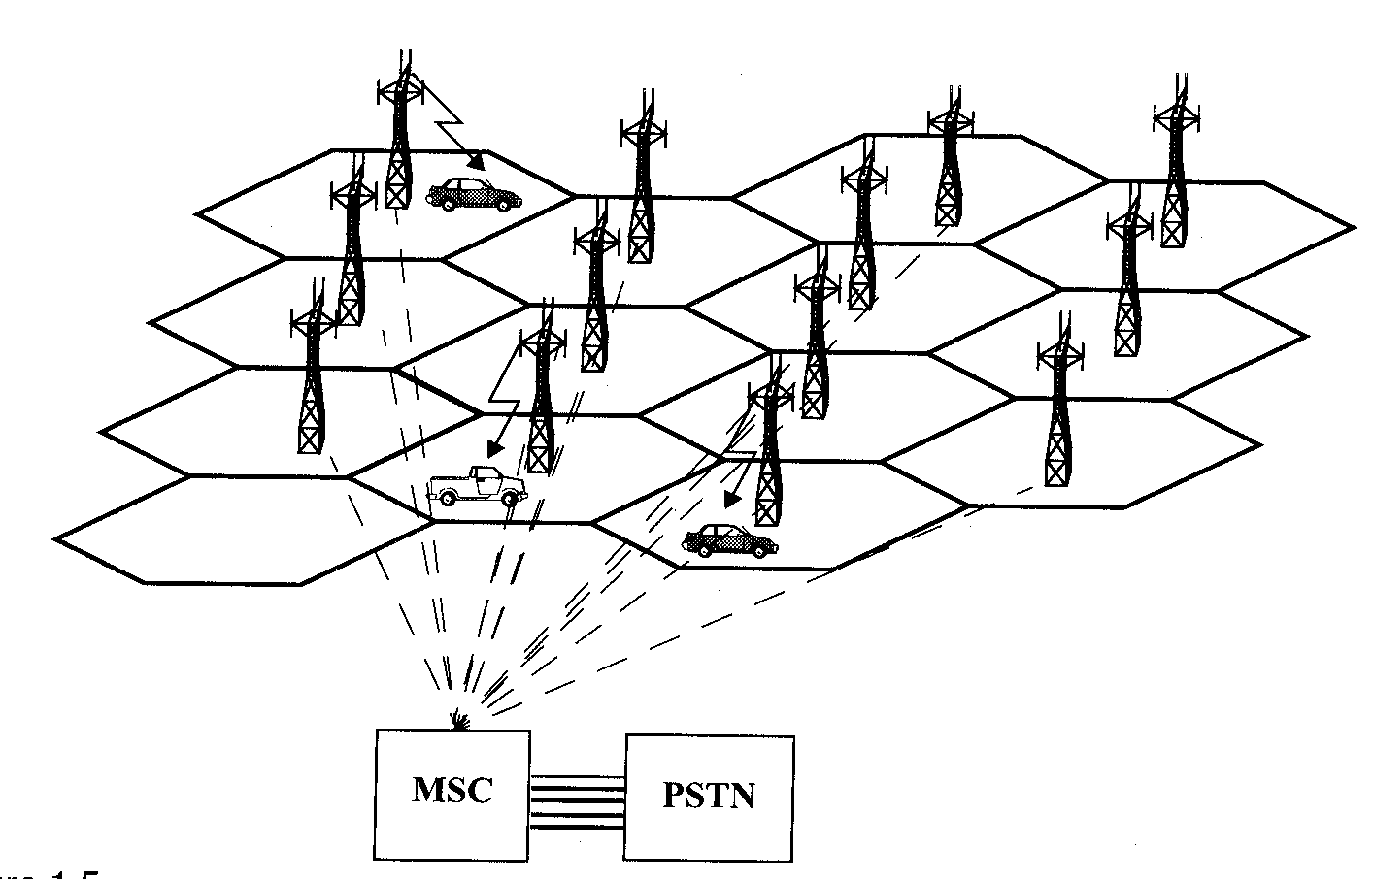
Example of Wireless Communication- Cellular Telephone Systems
Fig: A cellular system
Courtesy to Theodore S. Rappaport
©2002, 1996 Prentice Hall PTR

Slide 126
Example of Wireless Communication- Cellular Telephone Systems
Communication between the base station and mobiles is defined by the standard Common Air Interface (CAI)
forward voice channel (FVC): voice transmission from base station to mobile
reverse voice channel (RVC): voice transmission from mobile to base station
forward control channels (FCC): initiating mobile call from base station to mobile
reverse control channel (RCC): initiating mobile call from mobile to base station

Slide 127
How a Cellular Call is Made
A cell phone when turned on(even when it is not engaged with the call) , scans the group of Control Channels to determine the one with the strongest signal.
Typically the control channels use up to 5% of the total number of channels

Slide 128
Call initiated by Mobile
MSC |  |  | Receives call initiation request from base station and verifies mobile has valid MIN and ESN | Instructs originating base station to allot voice channels |  | connects the mobile with the called party on PSTN
Base Station | FCC |  |  |  | Instruct mobile to move to voice channel
 | RCC | Receives call initiation request and MIN
 | FVC |  |  |  |  |  | Begin voice transmission
 | RVC |  |  |  |  |  | Begin voice reception
Mobile station | FCC |  |  |  | Receives instruction to move to voice channel
 | RCC | Sends a call initiation request along with MIN and number of called party
 | FVC |  |  |  |  |  | Begin voice reception
 | RVC |  |  |  |  |  | Begin voice transmission

Slide 129
MSC |  |  | Receives call initiation request from base station and verifies mobile has valid MIN and ESN | Instructs originating base station to allot voice channels |  | connects the mobile with the called party on PSTN
Base Station | FCC |  |  |  | Instruct mobile to move to voice channel
 | RCC | Receives call initiation request and MIN
 | FVC |  |  |  |  |  | Begin voice transmission
 | RVC |  |  |  |  |  | Begin voice reception
Mobile station | FCC |  |  |  | Receives instruction to move to voice channel
 | RCC | Sends a call initiation request along with MIN and number of called party
 | FVC |  |  |  |  |  | Begin voice reception
 | RVC |  |  |  |  |  | Begin voice transmission

Slide 130
Summary
1G cellular network was developed to provide basic voice service. It was analog in nature.
2G was developed to provide digital voice service with improved quality.
To achieve high speed data access, 3G was developed. 3G mobile provided major opportunity for business, commerce and consumers
Next generation 4G was developed for very high data rates and Support for interactive multimedia, voice, streaming video, Internet, and other broadband services
CS - 2

Slide 131
Wireless communication systems
Antenna
Information to
be transmitted
coding
Modulator
Transmitter
carrier
Antenna
Information
Received
decoding
DeModulator
Receiver
carrier

Slide 132
Direction of Transmission (The duplex concept )
Simplex systems– e.g., broadcast systems and pagers.
Semi-duplex systems – e.g.,Walkie-talkies
Full-duplex systems – e.g., cellphones and cordless phones.
FDD uses two separate frequencies for the uplink (from the mobile to the BS) and the downlink (from the BS to the mobile).
TDD uses a single frequency to transmit signals in both the downlink and uplink directions.
Frequency(Mhz)
Base Station(Tx), Mobile Station(Rx
Frequency(Mhz)
Base Station(Tx), Mobile Station(Rx)
Mobile station (tx), Base station(Rx)
Mobile station (tx), Base station(Rx)
Time (ms)
BITS Pilani, Deemed to be UniversityTuinmdeer S(emctison) 3 of UGC Act, 1956

Slide 133
Ce lular Geometry
The main reason for defining cells in a cellular land mobile radio system is to outline areas in which specific channels and specific cell sites are used.
Designers have realized that visualizing all cells as having the same geometrical shape helps to ease the design of cellular systems.
cellular geometry helps to ease the assessment of spectral efficiency of various cellular systems, in particular to calculate the significant co-channel interference (CCI) in the system.
11

Slide 134
Ce l Shapes
Shapes: Regular Hexagon, Square, Circle & Triangle. The regular hexagon is favoured by system designers for the following reasons:
It provides the best approximation to the circular omni- directional radio patterns achieved in practice.
It is more economical to use since a hexagonal layout requires
fewer cells and hence fewer stations.
It combines ease of geometry with the practical realization of overlapping circles.
For a given distance between the centre of a polygon and its farthest perimeter points, the hexagon has the largest area, and it almost approximates a circular radiation pattern.
12

Slide 135
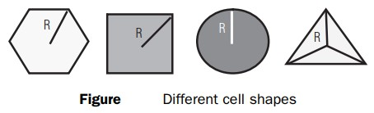
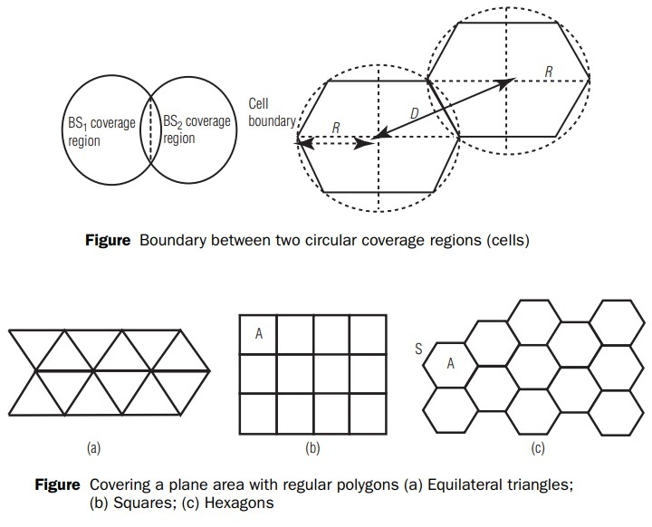
13

Slide 136
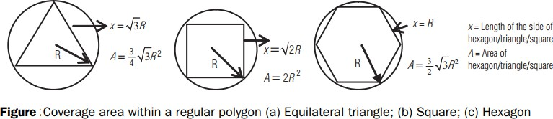
14

Slide 137
Introduction to ce lular concept
The cellular concept was developed in response to the limitations of conventional mobile radio services.
The main limitations of the previous mobile communication systems are as follows:
High-power transmitters were used to cover very large area.
Inefficient use of allocated radio spectrum.
If a user leaves the coverage area, they had to reinitiate the call on a different frequency channel.

Slide 139
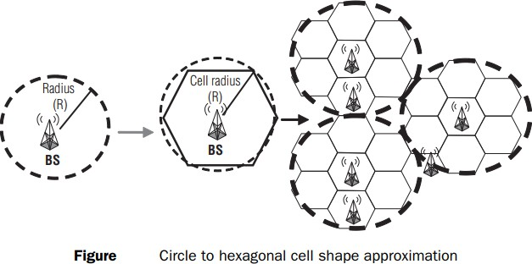

Slide 140
Frequency reuse: This is the process in which the same set of frequencies (channels) can be allocated to more than one cell to increase the system capacity. Instead of deploying a powerful BS in a large coverage area, the area is divided into multiple smaller cells and a BS deployed in each cell can use smaller transmit power. Thus, two transmissions can employ the same frequency if they are far away enough such that the CCI level is below a desired threshold.

Slide 141
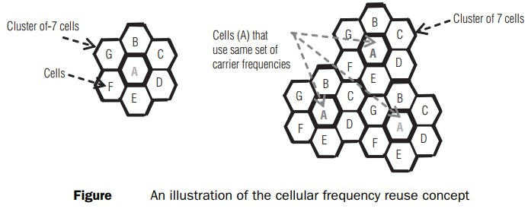
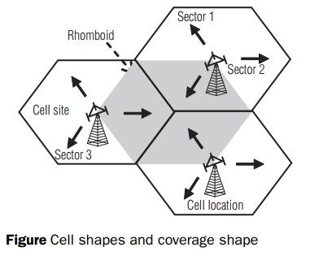

Slide 142
EX: The bandwidth allocated to a particular FDD cellular system is 33 MHz. It uses two 25 kHz simplex channels to provide full duplex voice and control channels, compute the number of channels available per cell if a system uses
(a) 4 cell reuse and (b) 7 cell reuse

Slide 143
Solution
Total bandwidth allocated to cellular system = 33 MHz Channel bandwidth required for duplex channel (uplink and downlink) = 25 kHz × 2 = 50 kHz
Total number of available channels = 33,000,000/50,000 = 660
For cluster size N = 4, number of channels available per cell
= 660/4 = 165
For cluster size N = 7, number of channels available per cell
= 660/7 = 95

Slide 144
To understand the frequency reuse concept,
Consider a cellular system which has a total of S duplex channels available for use in a cluster
Cellular system capacity and frequency reuse for a cluster size of “N” with each cell allocated a group of “K” channels
If each cell is allocated a set of k channels (k < S) and the cluster size is N
The total number of available radio channels can be expressed as
S = kN

Slide 145
The N cells which collectively use the complete set of available frequencies is called a cluster.
If a cluster is replicated M times with in the system,
The total number of duplex channels, C, can be used as a measure of capacity and is given by
C = MkN = MS
the capacity of a cellular system is directly proportional to
the number of times a cluster is replicated in a fixed service area.

Slide 146
The factor of N is called the cluster size and is typically equal to 4, 7, or 12.
For the same cell size at a given area, N decreases ⇒ M increases
⇒ C increases.
The frequency reuse factor of a cellular system is given by 1/N.
N can only have values which satisfy Equation
𝑁 = 𝑖² + 𝑖𝑗 + 𝑗²
where i and j are non-negative integers. To find the nearest co- channel neighbors of a particular cell, one must do the following:
move i cells along any chain of hexagons and
Turn 60 degrees counter-clockwise and move j cells.

Slide 147
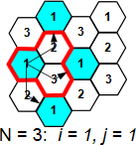
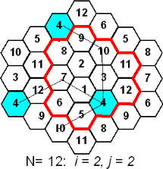

Slide 148
Co-channel Interference
Interference between signals from co-channels
Increasing the signal-to-noise ratio (SNR) to overcome thermal noise does not work
Physically separate co-channel cells
Co-channel reuse ratio
𝑄 = ^{𝐷} = 3𝑁
𝑅
Condition: same cell size, same transmitter power
R: radius of the cell
D: distance between centers of the nearest co-channel cells

Slide 149
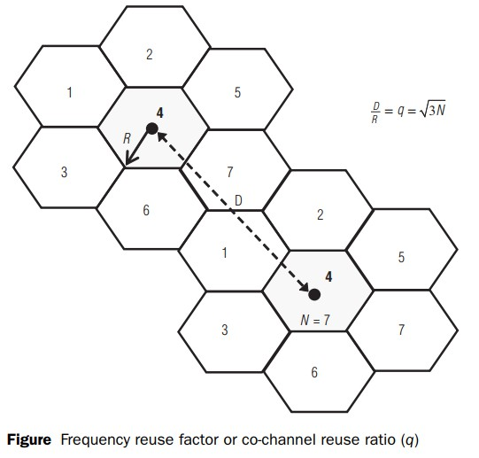
Relationship between frequency reuse factor (D/R) and cluster size (N)

Slide 150
Determination of relation between frequency reuse factor (D/R ratio) and the cluster size (N) involves mainly two steps:
finding the relation between the distance D (two co-channel cells)
and R
locating the co-channel cells.
First let us derive the relation between distance (D) (two co-channel
cells) and R in a hexagonal geometry
The actual centre-to-centre distance between two adjacent hexagonal cells is
𝑑 = 2𝑅 cos 30 or 3𝑅
where R is the centre to vertex distance

Slide 151
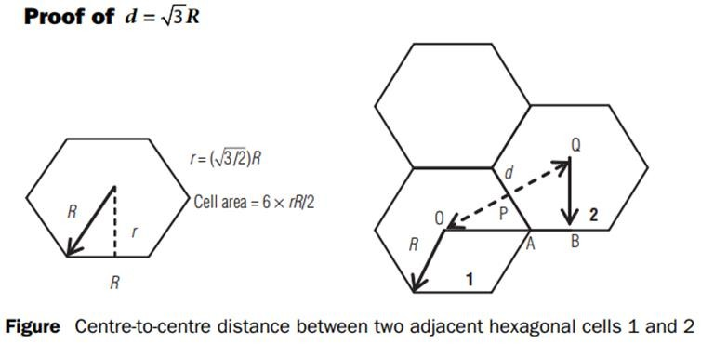
OA = R, AB = R/2 and OAP is a right-angled triangle
In the OAP triangle, OP = OA Sin 60° = (√3/2) R.
OQ = OP + PQ 𝑑 =
3 3
𝑅 + 𝑅 = 3𝑅
2 2
Area of a small hexagon with radius R=6xrR/2=((3√3)/2)R² = 2√3𝑟²

Slide 152
Channel Assignment Strategies
The objectives of channel assignment strategies are to increase capacity and minimize interference.
Channel assignment strategies are classified as either fixed and dynamic.
In a fixed channel assignment strategy, each cell is allocated a predetermined set of voice channel.
If all the channels in that cell are occupied, the call is blocked. A variation is the borrowing strategy.

Slide 153
In a dynamic channel strategy, voice channels are not allocated to different cells permanently.
This strategy reduces the likelihood of blocking.
Mobile switching center (MSC)must collect real-time data on channel occupancy, traffic distribution, and radio signal strength
indications (RSSI)of all channels.

Slide 154
Handoff: A crucial component of the cellular concept is the notion of handoffs. Handoff is the process of transferring an active call from one cell to another as the mobile unit moves from one cell to the other.
Handoff operation involves identifying a new BS and
allocation of voice and
control signals associated.

Slide 155
Handoff –
high priority over call initiation requests
must be performed successfully
Infrequently
be imperceptible.
The margin ∆= 𝑃_{𝑟 ℎ𝑎𝑛𝑑𝑜𝑓𝑓} − 𝑃_{𝑟 𝑚𝑖𝑛𝑖𝑚𝑢𝑚 𝑢𝑠𝑎𝑏𝑙𝑒} cannot be
too large or too small.

Slide 157
In deciding when to handoff, it is important to ensure that the drop in the measured signal level is not due to momentary fading.
Information about the vehicle speed is useful in handoff decisions.
Dwell time –The time over which a call may be maintained within a cell without handoff.
The statistics of dwell time are important in the practical design of handoff algorithm.

Slide 158
In first generation analog cellular system, the locator receiver is used for handoff.
In second generation system, handoff decisions are mobile assisted –mobile assisted handoff (MAHO).
Intersystem handoff –different cellular systems –roamer.

Slide 159
Prioritizing Handoffs
Guard channel concept –can be used with dynamic channel assignment strategies to increase spectrum utilization.
Queuing of handoff –possible due to the fact that there is a finite time interval between handoff threshold time and call- terminated time

Slide 160
Practical Handoff Considerations
Several handoff schemes have been devised to handle the simultaneous traffic of high speed and low speed users – minimizing the handoff intervention from the MSC

Slide 161
HOME WORK
Prove that for a hexagonal geometry, the co-channel reuse ratio is given by
𝑄 = 3𝑁 , where 𝑁 = 𝑖² + 𝑖𝑗 + 𝑗². Hint: Use the cosine law and the
hexagonal cell geometry.
If two independent voltage signals, v1(t) and v2(t), are added together to provide a new resulting signal, prove that under certain conditions the resulting signal has the same power
as the sum of the individual powers. What are these conditions? What special conditions must apply for this result to be valid when the signals are uncorrelated?

Slide 162
3.3 Show that the frequency reuse factor for a cellular system is given by k/S, where k is the average number of channels per cell and S is the total number of channels available to the cellular service provider.
3.5 A cellular service provider decides to use a digital TDMA scheme which can tolerate a signalto-interference ratio of 15 dB in the worst case. Find the optimal value of N for (a) omnidirectional antennas, (b) 120° sectoring, and (c) 60° sectoring. Should sectoring be used? If so, which case (60° or 120°) should be used? (Assume a path loss exponent ofn =4 and consider trunking efficiency.)

Slide 163
3.6 You are asked to determine the signal-to-interference ratio (SIR or C/1) on the forward link of a cellular system, when the mobile is located on the fringe of its serving cell. Assume that all cells have equal radii, and that base stations have equal power and are located in the centers of each cell. Also assume that each cell transmits an independent signal, such that interfering signal powers may be added. Let us define a ''tier" of cells as being the collection of co-channel cells that are more-or-less the same distance away from the mobile in the serving cell. This problem explores the impact of the cluster size (i.e., frequency reuse distance), the number of tiers used in the calculation of Cll and the effect of the propagation path loss exponent on C/I.
What is the average distance (in terms of R) between the mobile on the fringe of the serving cell and the first tier of co-channel cells? (These cells are called the "nearest neighbors.") How many cells are located in the first tier? Solve for the case of N = 1,
N=3, N =4, N =7, and N =12 cluster sizes. How does the average distance compare to the value of D = QR, where Q = J3N?
What is the average distance (in terms of R) between the mobile on the fringe of the serving cell and the second and third tier of co-channel cells, and how many cells are in the second and third tier of co-channel cells for the cases of N = 1, N = 3, N =4, N =7,
and N = 12 cluster sizes?

Slide 164
Determine the forward link Cll for the following frequency reuse designs: N =1, N = 3, N =4, N = 7, and N = 12. Assume that the propagation path loss exponent is four, and evaluate the S/1 contribution due to just the first tier and then due to additional outer tiers of co-channel cells. Indicate the number oftiers at which there is a diminishing contribution to the interference at the mobile.
Repeat part (c), except now consider a line-of-sight path loss exponent of n =2. Notice the huge impact that the propagation path loss exponent has on CII. What can you say about the cluster size, path loss exponent, and the C/1 values which result? How would this impact practical wireless system design?

Slide 165
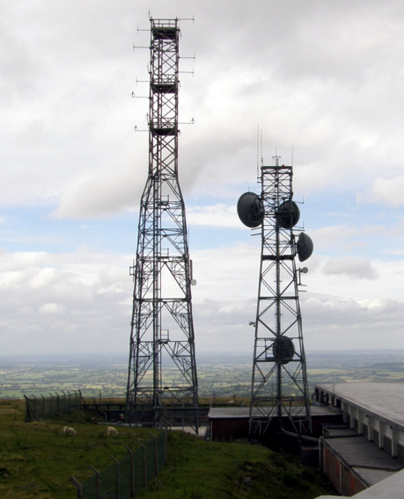
Cellular Concept
Why not a large Radio tower and Large Service area?
The design objective of early mobile radio systems was to achieve a large coverage area by using a single, high powered transmitter with an antenna mounted on a tall tower.
Good coverage, but it was not possible to reuse those same frequencies throughout the system
Limitation in the Number of simultaneous users.
Mobile Handsets would have greater power requirements.

Slide 166
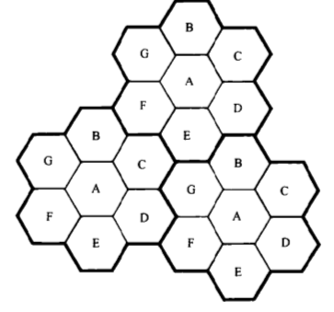
Cellular Concept
Major break through in solving the problem of spectral congestion and limited capacity
Cellular concept- small cells with frequency reuse
Advantages:
Low power handsets
Increases system capacity with frequency reuse.
Drawbacks
Cost of the cells
Handoffs between the cells must be provided.
Adjacent Channels
4
5
3
1
6
2
7
Courtesy to Theodore S. Rappaport
©2002, 1996 Prentice Hall PTR
Co- Channels

Slide 167
Cellular Systems – Basic Concepts
Each base station is allocated a portion of the total number of channels .
Neighboring base stations are assigned different groups of channels so that the interference between base stations is minimized.
A switching technique called Handoff enables a call to proceed uninterrupted when user moves from one cell to another.
Cell size can be reduced if the transmitted power is reduced. (Transmitted power is a factor which will decide how big the cell size should be)

Slide 168
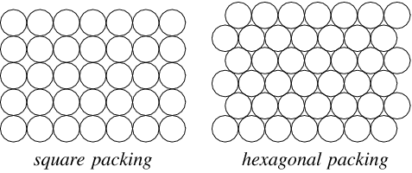
Choosing Shape for a Cell
Circle Shape
Gaps

Slide 169
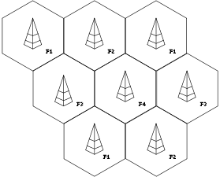
Choosing Shape for a Cell
Hexagon has the largest area .
Approximates the shape of circle
It has been universally adopted .
It also permits easy and manageable analysis of a cellular system.
Hexagon Shape
Courtesy to Theodore S. Rappaport
©2002, 1996 Prentice Hall PTR

Slide 170
Frequency Reuse
Cellular radio systems rely on reuse of the channels through out the coverage area.
Each base station is allocated a group of radio channels to be used with in the small geographic area of its cell.
Neighboring base stations are given different channel allocation.
The same group of frequencies is re used to cover another cell separated by a large distance to minimize co-channel interference .
Illustration of Cellular Frequency
Reuse concept.
Courtesy to Theodore S. Rappaport
©2002, 1996 Prentice Hall PTR

Slide 171
Let T = Total number of Duplex channels.
K cells = Size of each cluster
N= T/k = number of channels per cell.
For a specific geographic area, if clusters are replicated M times , then the total number of channels
- System capacity = M x T (Proportional to M)
- K depends on how much interference can be tolerated by base stations while maintaining a sufficient quality of communication
- If the cluster size is reduced, more clusters are required to cover a given area and hence more capacity.
Cellular Capacity

Slide 172
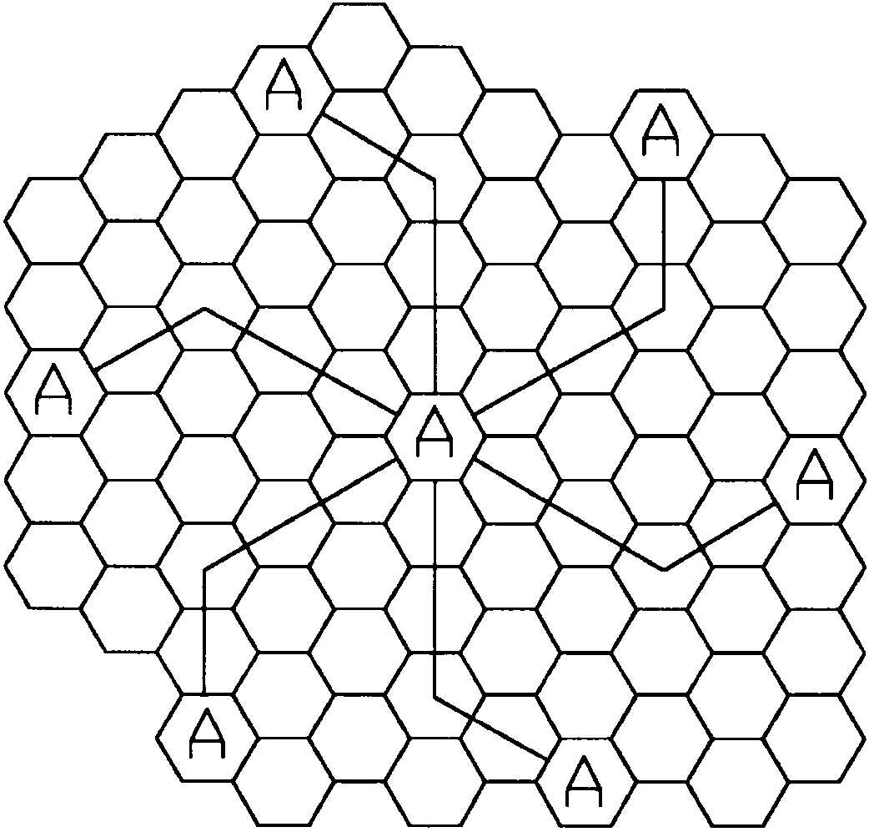
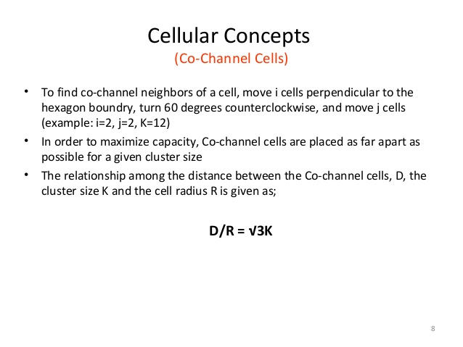
Co-channel cells in a cellular system
K= i²+ij+j²
i=3 and j=2
Method of co-channel cells in a cellular system
Courtesy to Theodore S. Rappaport
©2002, 1996 Prentice Hall PTR

Slide 173
Problems
Spectrum allocated to wireless system- 40Mhz
Simplex channel bandwidth for voice and control channel -25Khz
Cluster size =4
Bandwidth allocated for control channel = 1Mhz
Number of channels per cell ?
Number of control and voice channels in each cell?
Solution.
Channel bandwidth = 25KHz * 2 simplex channels = 50KHz duplex channels.
No. of available channels = 40000/50 = 800
For N = 4, total number of channels available per cell = 800/4= 200.
1MHz – control channels.
There fore 1000/50 = 20 control channels out of 800 channels are available.
For N=4, we can have 5 control channels and 195 voice channels.

Slide 174
Summary
Cellular concept increases the system capacity with frequency re-use.
Hexagonal cell is the shape considered for the cell as it is close to circle and has large area compared to other shapes.
Method of placing the co-channel cells in a geographical area to reduce the co-channel interference.

Slide 175
Channel Assignment Strategies
For efficient utilization of the radio spectrum, a frequency reuse was adopted with the objectives of increasing capacity of the cellular system and minimizing interference .
Two approaches :
Fixed Channel assignment
Dynamic channel assignment

Slide 176
Fixed Channel Assignment
Each cell is allocated a predetermined set of voice channels.
Any call attempt within the cell can only be served by the unused channels in that particular cell.
If all the channels in that cell are occupied, the call is blocked and the subscriber does not receive service.
Many Variations in the fixed channel assignment.
- Borrowing strategy
- Cells borrow channels from neighboring cells
- MSC supervise the borrowing activity
- Borrowing of a channel does not interfere with any of the calls in the donor
cell

Slide 177
Dynamic Channel Assignment
Voice channels are not allocated to different cells permanently.
Each time a call request is made, the serving base station requests a channel from the MSC.
The switch then allocates a channel to the requested cell following an algorithm that takes into account the likelihood of fixture blocking within the cell, the frequency of use of the candidate channel, the reuse distance of the channel.
Advantage of increased channel utilization and decreased probability of blocked call.
MSC continuously collect the data on real time occupancy, traffic distribution , radio signal strength indications(RSSI)of all channels.
Disadvantage: Increases the computational load , storage on the MSC.
Courtesy to Theodore S. Rappaport
©2002, 1996 Prentice Hall PTR

Slide 178
Handoff In a Cellular Network
Handoff is the transition for any given user of signal transmission from one base station to a geographically adjacent base station as the user moves around.
Handover, in which the source and the target are different cells (even if they are on the same cell site) is called inter-cell handover.
Source and target are one and the same cell- Intra-cell Handover
- Interference in the channel causes the change of channel with in the cell.

Slide 179
Purpose of Handoff
In telecommunications there may be different reasons why a handover might be conducted:
When the user is moving away from the area covered by one cell and entering the area covered by another cell.
In non-CDMA networks when the channel used by the phone becomes interfered by another phone using the same channel in a different cell, the call is transferred to a different channel in the same cell or to a different channel in another cell in order to avoid the interference
In CDMA networks a handover may be induced in order to reduce the interference to a smaller neighboring cell .

Slide 180
Summary
Channel assignment strategies involved two approaches namely fixed channel and dynamic channel assignment.
Variations in the fixed channel assignment strategy called borrowing strategy where the channel is borrowed from the neighboring cell.
Handoff is the transition for any given user of signal transmission from one base station to a geographically adjacent base station as the user moves around.
Purpose of handoff is induced in order to reduce the interference to a smaller neighboring cell .

Slide 181
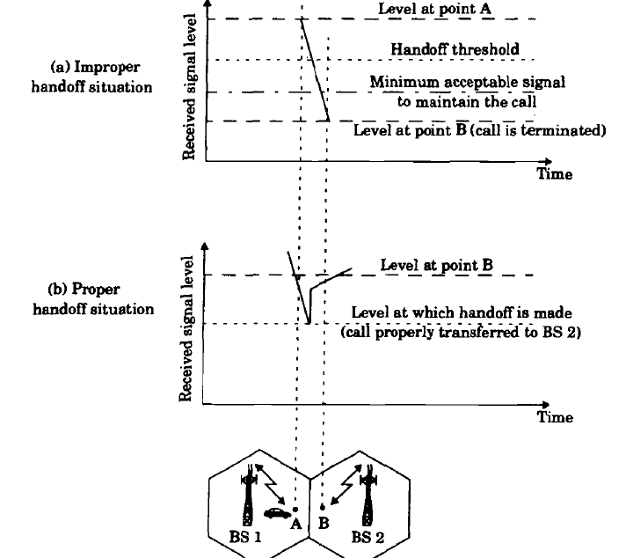
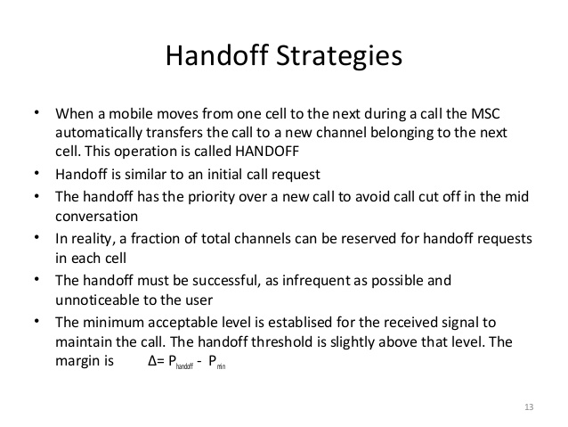
Handoff Strategies
Fig: Handoff Strategies
Courtesy to Theodore S. Rappaport
©2002, 1996 Prentice Hall PTR

Slide 182
Handoff Strategies contd..
In deciding when to handoff, it is important to ensure that the drop in the measured signal level is not due to momentary fading and that the mobile is actually moving away from the serving base station.
In order to ensure this, the base station monitors the signal level for a certain period of time before a handoff is initiated.
Running average measurement of signal strength should be optimized so that unnecessary handoffs are avoided, while ensuring that necessary handoffs are completed before a call is terminated due to poor signal level.

Slide 183
Handoff Strategies
Dwell Time: Time over which a call may be maintained with in a cell, with out Handoff.
First generation analog cellular systems
Base stations monitors the signal strength of all mobile users
MSC decides Handoff

Slide 184
Handoff Strategies
Present cellular systems
Mobile assist handoff (MAHO)
Mobile measures received power from neighbouring base station and reports to the serving base station.
Handover is fast
Computation load on MSC is reduced.

Slide 185
Prioritizing Handoffs
2 methods for giving priority to Handoff
Guard channel concept
Queuing of handoff

Slide 186
Prioritizing Handoffs
Guard channel -Fraction of the total available channels in a cell is reserved exclusively for handoff requests from ongoing calls which may be handed off into the cell.
Advantage:
Efficient spectrum utilization when dynamic channel assignment strategies are used which minimizes the number of required guard channels by efficient demand based allocation.
Disadvantage:
Reduction in the total traffic carried.
Fewer channels are allocated to originating calls.

Slide 187
Prioritizing Handoffs
Queuing of handoff
Decrease the probability of forced termination of a call due to lack of available channels.
Queuing of handoffs is possible due to a finite time interval between the time the received signal level drops below the handoff threshold and the time the call is terminated due to insufficient signal level.
Time delay and the size of the queue depends on the traffic of the particular service area.
Queuing does not guarantee a zero probability of forced termination.

Slide 188
Types of Handoff
Hard Handoff - Channel in the source cell is released and only then the channel in the target cell is engaged
- It is a break-before-make.
Soft Handoff - one in which the channel in the source cell is retained and used for a while in parallel with the channel in the target cell
-It is a make-before-break.

Slide 189
Summary
Handoff is necessary to keep call in progress as the mobile is moving from one cell to another cell.
Prioritizing the handoff is required so that fraction of the total available channels in a cell is reserved exclusively for handoff requests from ongoing calls which may be handed off into the cell.
Various ways of handoff like soft and hard handoff are implemented to provide handoff service.

Slide 190
Co-Channel Interference and System Capacity
The interference between signals from Co channel cells is called Co-channel Interference.
To reduce co-channel interference, co-channel cells must be physically separated by a minimum distance to provide sufficient isolation.
Adjacent Channels
4
5
3
1
6
2
7
Co- Channels
Courtesy to Theodore S. Rappaport
©2002, 1996 Prentice Hall PTR

Slide 191
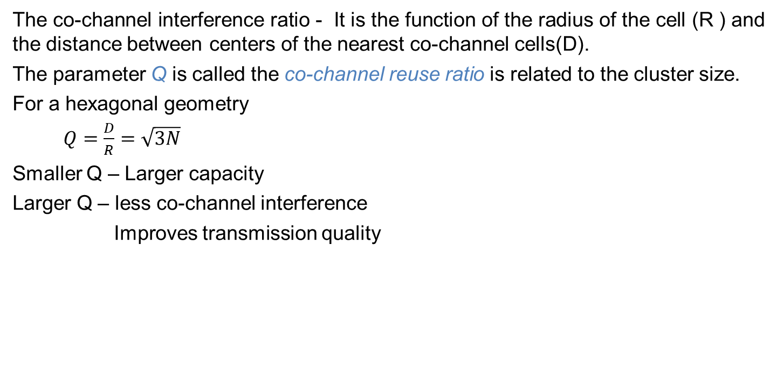
Co-Channel Interference and System Capacity
The co-channel interference ratio - It is the function of the radius of the cell (R ) and the distance between centers of the nearest co-channel cells(D).
The parameter Q is called the co-channel reuse ratio is related to the cluster size.
For a hexagonal geometry
$Q=\frac{D}{R}=\sqrt{3N}$
Smaller Q – Larger capacity
Larger Q – less co-channel interference
Improves transmission quality

Slide 192
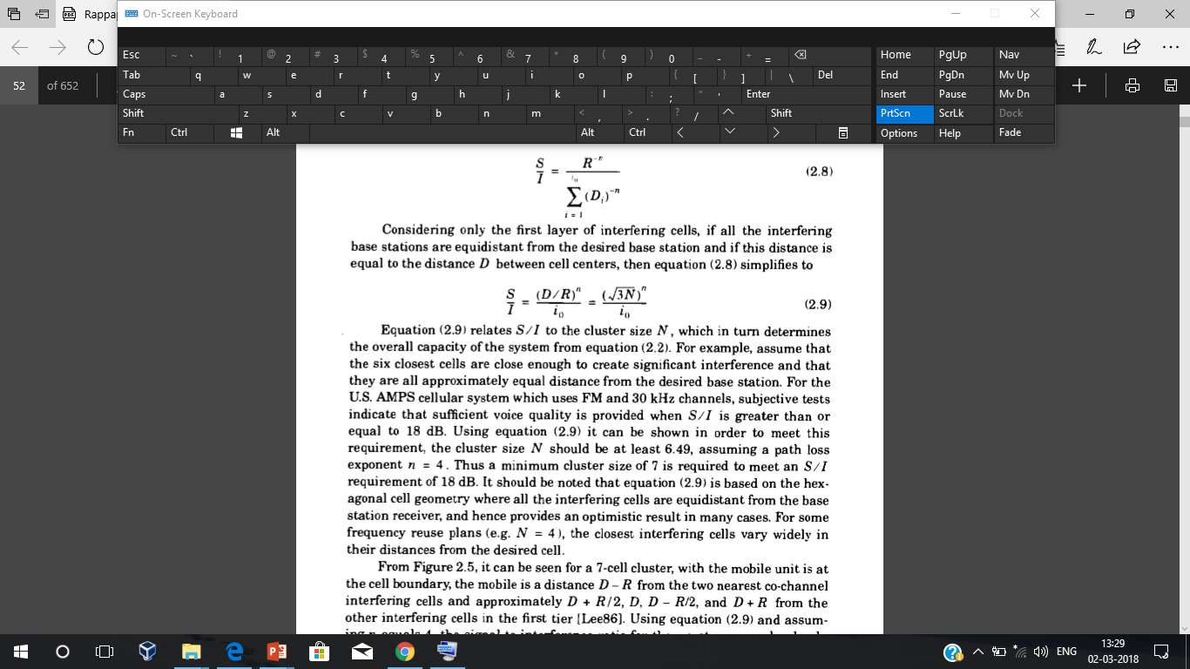
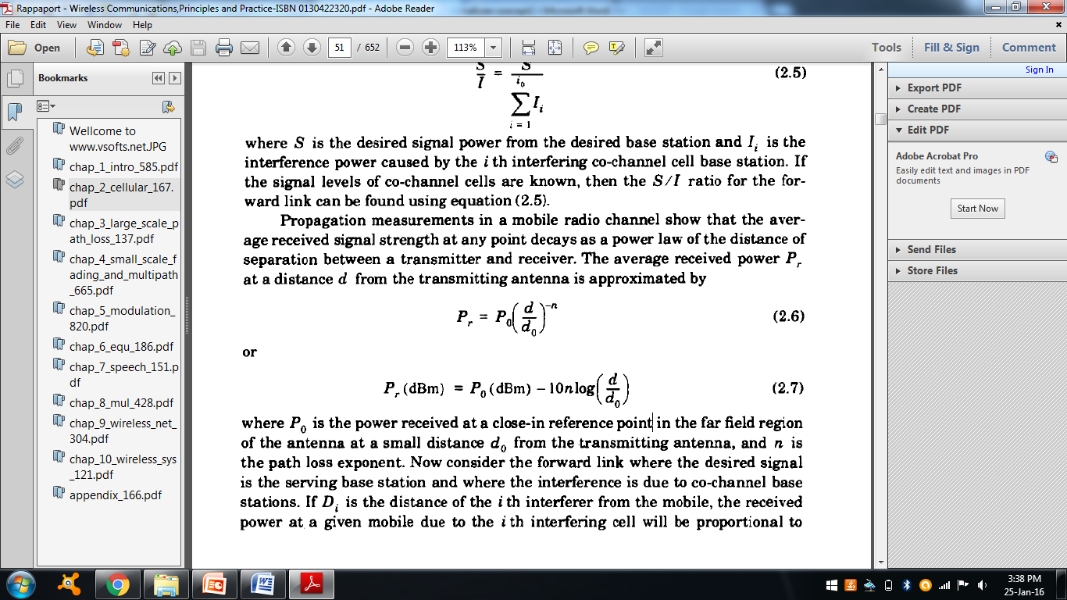
Co-Channel Interference and System Capacity
i0 - number of co-channel interfering cells
The average power received at a distance d from the transmitting antenna is
Power received at a reference point in the far field region of an antenna at a distance d0

Slide 193
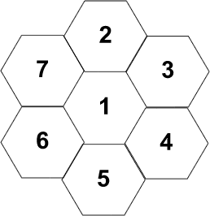
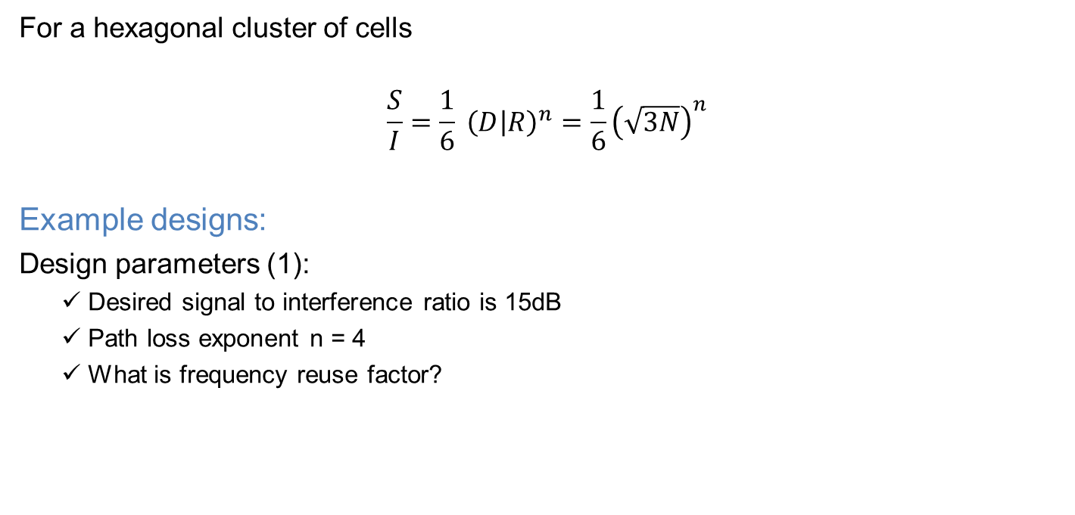
Calculation of SIR
For a hexagonal cluster of cells
$$\frac{S}{I}=\frac{1}{6} {\left(D | R\right)}^{n}=\frac{1}{6}{\left(\sqrt{3N}\right)}^{n}$$
Example designs:
Design parameters (1):
Desired signal to interference ratio is 15dB
Path loss exponent n = 4
What is frequency reuse factor?

Slide 194
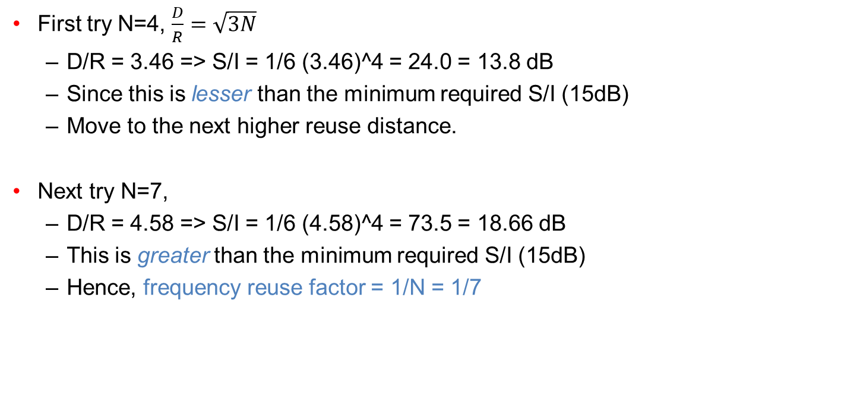
Calculation of SIR
First try N=4, $\frac{D}{R}=\sqrt{3N}$
D/R = 3.46 => S/I = 1/6 (3.46)^4 = 24.0 = 13.8 dB
Since this is lesser than the minimum required S/I (15dB)
Move to the next higher reuse distance.
Next try N=7,
D/R = 4.58 => S/I = 1/6 (4.58)^4 = 73.5 = 18.66 dB
This is greater than the minimum required S/I (15dB)
Hence, frequency reuse factor = 1/N = 1/7

Slide 195
Adjacent Channel interference (ACI)
ACI results from signals that are adjacent in the frequency to the desired signal.
This results from imperfect receiver filters that allow nearby frequencies to leak in.

Slide 196



Adjacent Channel interference (ACI)
Near far effect: An interferer close to the BS radiates in the adjacent channel while the subscriber is far away from the BS.
To overcome ACI, the frequency separation between each channel in cell should be made as large as possible.
Block entire cell
Overpowered by strong signals
Interferer
To overcome ACI, the frequency separation between each channel in cell should be made as large as possible.
BS
Subscriber

Slide 197

Adjacent Channel interference (ACI)
If a subscriber is at a distance d1 and the interferer is at a distance d2, then the signal to interference ratio is given by
$\frac{S}{I}= {\left(\frac{d1}{d2}\right)}^{−n}$
Example:
Suppose the subscriber is at a distance of 1000 m from the base station
Another mobile which is using an adjacent channel is at a distance of only 100 m from the base station.
Path loss exponent n = 3.

Slide 198
Power control
Reduction of interference is possible by having the power level transmitted by user are under constant control by the serving base station.
Power control improves long life of battery for the user
Reduces the reverse channel S/I in the system.

Slide 199
Summary
co-channel cells must be physically separated by a minimum distance to provide sufficient isolation and avoid co-channel interference.
Imperfect receiver filters and also the near far effect are the cause for the adjacent channel interference.
Power control improves battery life and also help in reducing the reverse channel S/I ratio.

Slide 200
Trunking & Grade of Service
Cellular radio systems rely on trunking to accommodate a large number of users in a limited radio spectrum.
What is Trunking?
It is a technique that allows a large number of users to share a relatively small number of channels in a cell by providing access to each user, on demand from a pool of available channels.
In a trunked radio system(TRS) each user is allocated a channel on a per call basis, upon termination of the call, the previously occupied channel is immediately returned to the pool of available channels.
Grade Of Service(GOS)
It is a measure of ability of the user to access a trunked system during the busiest hour.

Slide 201
Key Definitions
Set up time: Time required to allocate a radio channel to a requesting user.
Blocked call: A call which cannot be completed at the time of request, due to congestion(lost call).
Holding Time: Average duration of a call. Denoted by H (in Seconds)
Request Rate: The average number of calls request per unit time (λ).
Traffic Intensity: Measure of channel time utilization or the average channel occupancy measured in Erlangs. Denoted by A.
Load: Traffic intensity across the entire Trunked Radio System.

Slide 202
Trunking and Grade Of Service
Traffic Intensity offered by each user (Au): Average call arrival rate multiplied by the holding time
Au= λH (Erlangs)
Total Offered traffic intensity for a system of U users(A): Traffic intensity offered by each user multiplied by the total number of user expressed in Erlangs
A= U* Au (Erlangs)
Traffic Intensity per channel, in a C channel trunked system is given by
Ac= U*Au/C (Erlangs)

Slide 203
Types of Trunked Systems
Blocked call cleared System
Blocked call delayed System

Slide 204

Blocked Call Cleared System
When a user request service, there is a minimal call set up time and the user is given immediate access to a channel if one is available.
If the channels are already in use and no new channels are available, call is blocked with out access to the system.
The user does not receive Service, but is free to try again.
Erlang B Formula determines the probability that a call is blocked is given by
C is the number of trunked Channels .
A is the total traffic offered.

Slide 205
Blocked Call Delayed System
Queues are used to hold call request that are initially blocked.
When a user attempts a call and a channel is not immediately available, the call request may be delayed until a channel becomes available.
If call cannot be assigned a channel, it is placed in a queue.
Each call is then serviced in the order of its arrival.

Slide 206

Blocked Call Delayed System
The probability that the call not having the immediate access to a channel is determined by Erlang C formula
The probability that the call is forced to wait for more than t seconds is given by
C is the number of trunked Channels .
A is the total traffic offered, H – Holding time.

Slide 207

Blocked Call Delayed System
The average delay for all the calls in a queued system is

Slide 208
Problems
394 cells in trunked radio system with 19 channels each
Each user averages 2 calls per hour
Average call duration 3 minutes
Number of users supported at 2% blocking?
Total number of users supported by system
Solution:
From Erlang B chart, Total traffic carried,A= 12.33
Traffic intensity offered by each user : Au= λH = 2*(3/60) = 0.1 erlang
U= A/Au= 12.33/0.1= 123.3
There are 394 cells , the total number of subscribers that can be supported is 123.3*394 = 48580

Slide 209
Summary
Trunking is used to accommodate a large number of users in a limited radio spectrum.
In a blocked call clear system, the probability that a call is blocked depend on the number of trunked channels and the total traffic offered.
In a block called delay system queues are used to hold call request that are initially blocked.

Slide 210
Improving coverage and capacity in cellular System
Constantly there is a rise in demand for wireless service
Need to have more channels per coverage area
How do we do?
Use of techniques to expand the capacity of cellular systems
Cell Splitting
Cell Sectoring
Microcell zone concept

Slide 211

Cell Splitting (re-scaling of the system)
Improving coverage and capacity in cellular System
Cell splitting is the process of subdividing a congested cell into smaller cells.
Cell splitting increases the capacity of a cellular system since it increases the number of times that channels are reused.
Microcell
Fig: Illustration of cell splitting
Courtesy to T G palanivelu and R Nakkeeran
©2009 PHI Learning Limited,Delhi

Slide 212

Cell Sectoring
The co-channel interference may be decreased by replacing the single omni directional antenna by several directional antennas, each radiating with in a specified sector. A Cell has same coverage area space.
A cell is normally partitioned into three 120⁰ sectors or six 60⁰ sectors.
Fig: Illustration of cell sectoring
Courtesy to Theodore S. Rappaport
©2002, 1996 Prentice Hall PTR

Slide 213
Cell Sectoring
Advantages:
Cells are divided into a number of wedge shaped sectors, each with their own set of channels.
Decrease in CCI.
Disadvantages:
Each sector is limited to only using 1/3 or 1/6 of the available channels. Therefore decrease in trunking efficiency.
Increase in the number of required antenna.
Antennas are expensive , have to be maintained.
Increased number of Handoffs (sector to sector)

Slide 214
Microcell Zone concept
A cell is divided into microcells or zones.
Each microcell is connected to the same base station.
Each zone uses a directional antenna.
As a mobile travels from one zone to another, it retains the same channel. i.e no hand off.
MS is served by the strongest zone.

Slide 215

Microcell Zone Concept
Fig: The Microcell Concept

Slide 216
Repeaters for Range Expansion
Radio Re-transmitters are called Repeaters.
Used in hard to reach areas such as valleys, tunnels etc.
A repeater consists of a radio receiver, an amplifier ,a transmitter.
Repeaters are bidirectional
Receive signals from the base station,
Amplify the signals and
Re-radiate the signals.

Slide 217
Summary
In order to improve the coverage and capacity of the cellular systems many techniques sectoring, cell splitting and microcell zone concept .
Repeaters are used in hard to reach areas and also for range extension .

Slide 218
Interference and System Capacity
Source of interference include: another mobile in the same cell, a call in progress in a neighboring cell, other base station, any non cellular systems.
The two major types of system-generated cellular interference are co-channel interference and adjacent channel interference.

Slide 219
Co-channel Interference and System Capacity
Frequency reuse implies that in a given coverage area there are several cells that use the same set of frequencies. These cells are called co-channel cells.
The interference between signals from these cells is called
co-channel interference.
To reduce co-channel interference, co-channel cells must be physically separated by a minimum distance.

Slide 220
The co-channel interference ratio is a function of the radius of the cell (R) and the distance between centers of the nearest
co-channel cell (D) .
D/R increased, co-channel interference decreased.
The co-channel reuse ratio is related to the cluster size. For a hexagonal geometry
𝐷
𝑅
𝑄 =
= 3𝑁

Slide 221
Q ↓, capacity ↑
Q ↓ , co-channel interference ↑
A trade-off must be made between these two objectives in actual cellular
design.
The signal-to-interference ratio (S/I or SIR) for a mobile receiver can be expressed as
𝑆 𝑆
=
_{𝐼 ∑}𝑖₀
𝐼
𝑖
𝑖=1
where S is the desired signal power from the desired base station
𝐼_{𝑖} is the interference power caused by the i^{th} interfering co-channel cell
base station.

Slide 222
The average received power 𝑃_{𝑟} at a distance d is from the transmitting antenna is
𝑑
−𝑛
𝑃_{𝑟} = 𝑃₀
𝑑
0
Or
𝑑
𝑃_{𝑟} 𝑑𝐵𝑚 = 𝑃₀ 𝑑𝐵𝑚 − 10𝑛𝑙𝑜𝑔
𝑑
0
Where 𝑃₀ is the power received at a close-in reference point in the far field region of the antenna at a small distance 𝑑₀ from the transmitting antenna and n is the path loss exponent.

Slide 223
_{𝑅}−𝑛
𝑆
=
_{𝐼 ∑}𝑖₀
𝐷
−𝑛
𝑖=1
𝑖
if all the interfering base stations are equidistant from the desired base station and if this distance is equal to the distance D between
cell centers
𝑆 𝐷/𝑅
𝐼 𝑖₀ 𝑖₀
𝑛
𝑛
3𝑁
= =
relates S/I to the cluster size N, which in turn determines the overall capacity of the system

Slide 224


Slide 225
SIR for the worst case can be approximated as
𝑆
_{𝑅}−4
=
𝐼 2 𝐷 − 𝑅 ⁻⁴ + 2 𝐷 + 𝑅
−4 _{+ 2𝐷}−4
𝑆 1
=
𝐼 2 𝑄 − 1 ⁻⁴ + 2 𝑄 + 1 ⁻⁴ + 2𝑄⁻⁴
For N=7, Q is 4.6, the worst case S/I is 49.56 (17dB) less than 18dB requirement Hence, choose N = 9
This entails a significant decrease in capacity. From 1/7 spectrum utilization to 1/9

Slide 226
In practice, a capacity reduction of 7/9 would not be tolerable to accommodate for the worst case situation which rarely occurs.

Slide 227
Ex: If a signal-to-interference ratio of 15 dB is required for satisfactory forward channel performance of a cellular system, what is the frequency reuse factor and cluster size that should be used for maximum capacity if the path loss exponent is (a) n = 4, (b) n = 3? Assume that there are six co-channel cells in the first tier, and all of them are at the same distance from the mobile. Use suitable approximations.

Slide 228
let us consider a seven-cell reuse pattern.
(a) n = 4
Using Eq. (3.4), co-channel reuse ratio D/R = 4.583 Using Eq. (3.9), signal-to-noise interference ratio
S / I = (1/6)×(4.583)⁴ = 75.3 = 18.66 dB
N = 7 can be used.
(b) n = 3
S / I = (1/6) ×(4.583)³ = 16.04 = 12.05dB
when N = 12, D/R = 6.0
S / I = (1/6) ×(6)³ = 36 = 15.56dB
19
so, N = 12 is used.
BITS Pilani, Deemed to be University under Section 3 of UGC Act, 1956

Slide 229
Channel Planning for Wireless System
Typically, about 5% of the entire mobile spectrum is devoted to control channels (vital for initiating, requesting, or paging a call) , while 95% of the spectrum is dedicated to voice channel (carrying revenue – generating calls).
Since control channels are vital, the frequency reuse strategy for them is generally more conservative than for voice channels.
In example 3.3, 21-cell reuse for control channels, whereas 7- cell reuse for voice channels.

Slide 230
Adjacent Channel Interference
Resulting from signals which are adjacent in frequency to the desired signal.
The near-far effect: a nearby transmitter captures the receiver of the subscriber or the base station.
Adjacent channel interference can be minimized through careful filtering and channel assignments.
A cell need not be assigned channels which are all adjacent in frequency. Neighboring cells avoid the use of adjacent channels.

Slide 231
Ex: This example illustrates how channels are divided into subsets and allocated to different cells so that adjacent channel interference is minimized.
The United States AMPS system initially operated with 666 duplex channels. In 1989, the FCC allocated an additional 10 MHz (166 channels) of spectrum for cellular services.
There are now 832 channels used in AMPS.
The extended band has channels number as 667 through 799, and 990 through 1023.

Slide 232


Slide 233
In order to encourage competition, the FCC licensed the channels to two competing operators in every service area.
The channels used by the two operators are distinguished as block A and
block B channels.
Block B is operated by companies which have traditionally provided telephone services ( called wireline operators).
Block A is operated by companies that have nottraditionally provided telephone services ( called nonwireline operators).
Out of the 416 channels used by each operator, 395 are voice channels and the remaining 21 are control channels.
Block A – voice channels control channels
Block B – voice channels
1~312, 667~716, 991~1023.
313~333.
355~666, 717~799.
▪
control channels 334~354.
24

Slide 234
One control channel is provided for each bank of trunked voice channels.
For an AMPS system, a single cell is assigned a single control channel.
Thus, control channels obey a 21-cell reuse scheme and are assigned over three clusters before being reused, even through the voice channels may be assigned using a seven-cell reuse scheme.

Slide 235
Each of the 395 voice channels are divided into 21 subsets, each
containing about 19 channels.
In each subset, the closest adjacent channel is 21 channels away.
In a seven-cell reuse system, each cell uses three subsets of
channels.
This channel assignment scheme is illustrated in Table 3.2.
The total number of voice channels in a cell is about 57.
The shaded set of numbers correspond to the control channels.

Slide 236


Slide 237
Power Control for Reducing Interference
The power levels transmitted by every subscriber unit are under constant control by the serving base stations.
To ensure that each mobile transmits the smallest power necessary to maintain a good quality link on the reverse channel.
Prolong battery life and reduce the reverse channel S/I .

Slide 238
Trunking and Grade of Service
The concept of trunking allows a large number of user to share the relatively small number of channels in a cell by providing access to each user, on demand, from a pool of available channels.
A user is blocked, i.e., denied access to the system.
In some system, a queue may be used to hold the requesting users until a channel becomes available.

Slide 239
One Erlang represents the amount of traffic intensity carried by a channel that is completely occupied (i.e. one call-hour per hour or one call-minute per minute).
For example:
0.5 Erlangs of traffic – a radio channel that is occupied for 30 minutes during an hour.

Slide 240
The grade of service (GOS) is a measure of the ability of a user to access a trunked system during the busiest hour, and is typically given as the likelihood that a call is blocked, or the likelihood of a call experiencing a delay greater than a certain queuing time.

Slide 241
Definitions of Common Terms Used in Trunking Theory
Set-up Time – The time required to allocate a trunked radio channel to a requesting user.
Blocked Call – Call which cannot be completed at time of request, due to congestion. Also referred to as a lost call.
Holding Time – Average duration of a typical call. Denoted be
H(in seconds).
Traffic Intensity – Measure of channel time utilization, which is the average channel occupancy measured in Erlangs. This is a dimensionless quantity and may be used to measure the time utilization of single or multiple channels. Denoted by A.

Slide 242
Grade of Service (GOS) – A measure of congestion which is specified as the probability of a call being blocked (for Erlang B), or the probability of a call being delayed beyond a certain amount of time (for Erlang C).
Load – Traffic intensity across the entire trunked radio system, measured in Eelang.
Request Rate – The average number of call requests per unit time. Denoted by λ seconds⁻¹

Slide 243
A_{u} = λ H
Traffic intensity A_{u} of each user is given by
Total traffic intensity A for U users
A = UA_{u}
Traffic intensity per channel A_{c}
A_{c} = UA_{u} /C
The maximum possible carried traffic is the total number of channels, C, in Erlangs.

Slide 244
There are two types of trunked systems.
1. Blocked calls cleared: This is known as an M/M/m/m queue and leads to the derivation of the Erlang B formula.
_{𝐴}𝑐
𝑃_{𝑟} 𝑏𝑙𝑜𝑐𝑘𝑖𝑛𝑔 = ^{𝐶!} = 𝐺𝑂𝑆
_{𝐴}𝑘
∑𝑐
𝑘=0 _{𝑘!}
where C is the number of trunked channels offered by a trunked radio system and A is the total offered traffic

Slide 245


Slide 246
2. Blocked calls delayed Erlang C formula
_{𝐴}𝐶
𝑃_{𝑟} 𝑑𝑒𝑙𝑎𝑦 > 0 =
_{𝐴}𝑘
𝐴
𝐶
∑𝐶−1
𝐴^{𝐶} + 𝐶! 1 −
𝑘=0 _{𝑘!}

Slide 247
The GOS of a trunked system is given by
𝑃_{𝑟} 𝑑𝑒𝑙𝑎𝑦 > 𝑡 = 𝑃_{𝑟} 𝑑𝑒𝑙𝑎𝑦 > 0 𝑃_{𝑟} 𝑑𝑒𝑙𝑎𝑦 > 𝑡|𝑑𝑒𝑙𝑎𝑦 > 0
= 𝑃_{𝑟} 𝑑𝑒𝑙𝑎𝑦 > 0 𝑒𝑥𝑝 − 𝐶 − 𝐴 𝑡/𝐻
The average delay D for all calls is
𝐻
𝐷 = 𝑃_{𝑟} 𝑑𝑒𝑙𝑎𝑦 > 0 _{𝐶 − 𝐴}
where the average delay for those calls which are queued by H/(C-A) .
is given

Slide 248
Improving Coverage and Capacity in Cellular Systems
Cell Splitting
Cell splitting is the process of subdividing a congested cell into smaller cells.
Since it increases the number of times that channels are reused ( or decreases the cluster area ). Cell splitting increases the capacity of a cellular system.
Cell splitting generally does not upset the channel allocation scheme required to maintain the minimum co-channel reuse ratio Q between co-channel cells.

Slide 249

𝑃_{𝑟} 𝑎𝑡 𝑜𝑙𝑑 𝑐𝑒𝑙𝑙 𝑏𝑜𝑢𝑛𝑑𝑟𝑦
= 𝑃_{𝑟} 𝑎𝑡 𝑜𝑙𝑑 𝑐𝑒𝑙𝑙 𝑏𝑜𝑢𝑛𝑑𝑟𝑦
∝ 𝑃_{𝑡1}𝑅^{−𝑛}
∝ 𝑃_{𝑡2} 𝑅/2 ^{−𝑛}
^{𝑃}𝑡1
𝑃 =
𝑡2
16
The transmit power must be reduced by 12 dB in order to fill in the original coverage area with microcells, while maintaining the S/I requirement.

Slide 250

Sectoring
By decreasing the cell radius R and keeping the co-channel reuse ratio D/R unchanged, cell splitting increases the number of channels per unit area.
Another way to increase capacity is to keep the cell radius unchanged and seek methods to decrease the D/R ratio.
Sectoring increases SIR so that the cluster size may be reduced.

Slide 251

S/I increases to 24.2 dB.
BITS Pilani, Deemed to be University under Section 3 of UGC
Act, 25156

Slide 252
The penalty from sectoring:
an increased number of antennas at each base station. a decrease in trunkung efficiency due to the channel
sectoring.
the increased number of handoffs – usually is not a major concern.
Some operators shy away from sectoring approach, because it breaks up the available trunked pool into several small pools, and decreases trunking efficiency.
BITS Pilani, Deemed to be University under Section 3 of UGC Act, 25256

Slide 253

Repeaters for Range Extension
Repeaters – to provide dedicated coverage for hard-to-reach areas, such as within buildings, or in valleys or tunnels.
BITS Pilani, Deemed to be University under Section 3 of UGC Act, 25356

Slide 254

Microcell Zone Concept
When sectoring is employed, the increased number of
handoffs results in an increased load in MSC. A solution to this problem is a Microcell Zone Concept.
BITS Pilani, Deemed to be University under Section 3 of UGC Act, 25456

Slide 255
Antennas are placed at the outer edges of the cell. Each of the three zone sites are connected to a base station. Any base station channel may be assigned to any zone.
As a mobile travels from one zone to another within the cell, it retains the same channel. The base station simply switches the channel to a different zone site.
The advantage of the zone cell technique is that the co- channel interference in the cellular system is reduced
S/I ≥18 dB ⇒ N = 7 ⇒ D/R = 4.6
BITS Pilani, Deemed to be University under Section 3 of UGC Act, 25556

Slide 256

BITS Pilani, Deemed to be University under Section 3 of UGC Act, 25656

Slide 257
D_{Z} / R_{Z} = 4.6
From the geometry
D/ R =3⇒N =3
7/3=2.33 Times increase in capacity
No loss in trunking efficiency is experienced.
Many communication system use this technique.
BITS Pilani, Deemed to be University under Section 3 of UGC Act, 25756

Slide 258
HOME WORK 2.1
3.8. If an intensive propagation measurement campaign showed that the mobile radio channel provided a propagation path loss exponent of n = 3 instead of four, how would your design decisions in Problem 3.5 change? What is the optimal value of N for the case of n = 3?
BITS Pilani, Deemed to be University under Section 3 of UGC Act, 25856

Slide 259
HOME WORK 2.1
3.10: A total of 24 MHz of bandwidth is allocated to a particular FDD cellular telephone system that uses two 30kHz simplex channels to provide full duplex voice and control channels. Assume each cell phone user generates 0.1 Erlangs of traffic. Assume Erlang B is used.
(a) Find the number of channels in each cell for a four-cell reuse system.
(b) If each cell is to offer capacity that is 90% of perfect scheduling, find the maximum number of users that can be supported per cell where omnidirectional antennas are used at each base station.
(c) What is the blocking probability of the system in (b) when the maximum number of users are available in the user pool?
(d) If each new cell now uses 120" sectoring instead of omnidirectional for each base station, what is the new total number of users that can be supported per cell for the same blocking probability as in (c)?
(e) If each cell covers five square kilometers, then how many subscribers could be supported in an urban market that is 50 km x 50 km for the case of omnidirectional base station antennas?
(f) If each cell covers five square kilometers, then how many subscribers could be supported in an urban market that is 50 km x 50 km for the case of 120" sectored antennas?
BITS Pilani, Deemed to be University under Section 3 of UGC Act, 25956

Slide 260
HOME WORK 2.1
3.12: Assume that a cell named "Radio Knob" has 57 channels, each with an effective radiated power of 32 Wand a cell radius of 10 km. The path loss is 40 dB per decade. The grade of service is established to be a probability of blocking of 5% (assuming blocked calls are cleared). Assume the average call length is two minutes, and each user averages two calls per hour. Further, assume the cell has just reached its maximum capacity and must be split into four new microcells to provide four times the capacity in the same area.
(a) What is the current capacity of the "Radio Knob" cell?
(b) What is the radius and transmit power of the new cells?
(c) How many channels are needed in each of the new cells to maintain frequency reuse stability in the system?
(d) If traffic is uniformly distributed, what is the new traffic carried by each new cell? Will the probability of blocking in these new cells be below 0.1% after the split? Assume 57 channels are used at the original base station and the split cells.
BITS Pilani, Deemed to be University under Section 3 of UGC Act, 26056

Slide 261



Radio Wave Propagation
Radio waves are a type of electromagnetic radiation with wavelengths in the Radio spectrum (3 kHz to 300GHz)
Broadcast
Radars
Navigation

Slide 262

Electromagnetic Spectrum

Slide 263

ITU(International Telecommunication Union) Radio Bands

Slide 264



Introduction- Mobile Radio Propagation Path
The Wireless Transmission Path may be
Radio Channels are random and time varying.
Line of Sight (LOS)
Non Line of Sight (NLOS)
Fresnel Zone
Fresnel Zone
Line of Sight
Line of Sight
Direct and unobstructed path between a transmitting device and a receiving or reflecting device. Microwaves are propagated in this manner and repeaters can be utilized to extend their range.
communication path is obstructed by buildings, foliage, hills etc.

Slide 265
Basics of Propagation
When electrons moves they create electromagnetic waves that can propagate through space.
By attaching an antenna of appropriate size to an electrical circuit, the electromagnetic waves can be broadcast efficiently and received by receiver some distance away.
Information can be sent by modulating the Amplitude, Frequency or phase of the waves.

Slide 266
Easy to generate.
- When electrons moves they create electromagnetic waves that can propagate through space. By attaching an antenna of appropriate size to an electrical circuit, the electromagnetic waves can be broadcast efficiently and received by receiver some distance away
Can travel Long distances.
Can penetrate buildings.
Used for both indoor and Outdoor Communications.
They are omni directional
Can be narrowly focused at high frequency(greater than 100MHz) using parabolic antennas.
Properties of Radio waves

Slide 267
Properties of Radio waves
Frequency dependence
- radio waves behave more like light at higher frequencies. Difficult in Passing obstacles. Absorbed by Rain.
- At lower frequencies ,it can pass obstacles but the power falls sharply with distance from Source.
Subject to interference from other Radio wave sources.

Slide 268
Summary
Radio waves are electromagnetic radiation in the frequency range (3KHz to 300KHz)
Radio waves are used in Broadcast, Navigation, cellular systems, Radars etc.
ITU has divided the radio spectrum into various frequency bands to avoid interference and effective use of radio spectrum.
Radio waves generation is easy, it can penetrate buildings, travel long distances etc.

Slide 269





Propagation Mechanism
Diffraction
Reflection from mountains
Direct ray
Reflection from tall building
Fig: Multipath Signal at Outdoor

Slide 270

Propagation Mechanism
Reflection
Reflection occurs when the Electromagnetic waves impinge on objects which are much greater than the wavelength of the traveling wave.
Reflection from Dielectrics
Ɛ – Permittivity
σ- Conductance
μ- Permeability
Courtesy to Theodore S. Rappaport
©2002, 1996 Prentice Hall PTR

Slide 271
Propagation Mechanism
Brewster angle: Brewster's angle (also known as the polarization angle) is an angle of incidence at which wave is perfectly transmitted through surface, with no reflection.
Sin (θ_{B})= (ε₁ / (ε₁ + ε₂ )) ^{1/2}
First medium is free space:
sin (θ_{B})= (ε_{r}-1)^{1/2}/(ε_{r}²-1)^{1/2}
Reflection from perfect conductors
- EM energy cannot pass through perfect conductor
- All of its energy is reflected
Occurs only for Vertical polarization

Slide 272
Example
Calculate the Brewster angle for a wave impinging on the ground with a permittivity of 7. Assume the frequency to 200MHz.
Solution: sin (θ_{B})= (ε_{r}-1)^{1/2}/(ε_{r}²-1)^{1/2}

Slide 273

Propagation Mechanism
Scattering
This occurs when the size of the objects is less than the wavelength of the travelling wave.
Occurs when a radio wave impinges on a rough surface, the reflected energy is spread out in all directions.
Surface roughness is tested using Critical height h_{c} of surface perturbance for a given angle of incidence θi.
h_{c}= λ/8 sin θ_{i}.
A surface is considered smooth if h <h_{c} and rough if h>h_{c}.

Slide 274
Propagation Mechanism
Diffraction:
Occurs when the radio path between the transmitter and the receiver is obstructed by a surface that has sharp irregularities.
It results in bending of the waves around the object.
Diffraction from roof
Reflection from mountains
Direct ray
Reflection from tall building

Slide 275


Mobile Radio Propagation
Atmosphere
At VLF, LF, MF bands, radio waves follow the ground.
Radio Tower
Earth
Ground Wave Propagation
Home
Area between the surface of the earth and the ionosphere for transmission.
Ground wave radio signal propagation is ideal for relatively short distance propagation as the wave front of the ground wave travels along the Earth's surface it is attenuated.
Frequency of the radio signal is one of the major determining factor as losses rise with increasing frequency.
The type of antenna and its polarization has a major effect on ground wave propagation. Vertical polarization is subject to considerably less attenuation than horizontally polarized signals.

Slide 276

Ionospheric Propagation
F₂
F₁
Ionospheric Layers
HF Bands
E
D
Earth Surface
Sky wave propagation
D layer- Lowest layer existing at an average height of 70Km.It reflects VLF , LF.
E layer- Exists at an average height of 100km. It reflects MF waves.
F1 and F2 layer- Exists at a average height of 180 Km. Reflects HF waves.

Slide 277

Space Wave Propagation
The radio waves having high frequencies are basically called as space waves.
Occur within the lower 20 km of the atmosphere (troposphere), and are comprised of a direct and reflected wave(Tropospherical Propagation).
Space waves can travel directly or can travel after reflecting from earth’s surface to the troposphere surface of earth.
Transmitter
Direct wave
Receiver
Frequency Bands VHF, UHF, SHF, EHF use space wave propagation.
Reflected wave
Earth Surface

Slide 278
Space wave Propagation
Limitations of space wave propagation
Space waves are limited to the curvature of the earth.
These waves have line of sight propagation, means their propagation is along the line of sight distance.
Increase the transmission distance can be done by simply extending the heights of both the sender as well as the receiver antenna.
This type of propagation is used basically in radar and television communication.
Directional antennas are used for space wave propagation.

Slide 279
Summary
The radio waves take multipath during the propagation
Radio waves get reflected, diffracted, scattered before reaching the receiver
Radio waves propagate through various modes of propagation like ground wave, Ionosphere propagation and Space wave propagation.

Slide 280
Free Space Propagation Model
Why free space propagation model?
Predict received signal strength when the transmitter and receiver have a clear, unobstructed line-of-sight path between them.
Satellite communication systems and microwave line-of-sight radio links undergo free space propagation.

Slide 281


Free Space Propagation Model
Equation for the Free space received power by a receiver antenna (Friis Free Space Equation)
The power density p, flowing through the surface of a sphere of radius R centered at the transmitter
Notes:
the energy radiated by an omni-directional antenna is spread over the surface of a sphere. Transmit antenna modelled as a point source. Transmit power is spread over the surface area of a hypothetical sphere. Electromagnetic Radiation implies that the energy radiates uniformly in all directions, at the speed of light (3×108 m/s or 3.3 µs/km) [1]. This may be viewed as a sphere, expanding in time and space

Slide 282


Free Space Propagation Model
The Power received the by the receiving antenna is
Gain of antenna: Antenna’s ability to direct or concentrate radio frequency energy in a particular direction.
A_{ER} is the antenna aperture or effective area which is a measure of how effective an antenna is at receiving the power of radio waves
Notes:
Antenna gain:A relative measure of an antenna'sability to direct or concentrate radio frequency energy in a particular direction or pattern

Slide 283


Free Space Propagation Model
The effective aperture for any antenna can be expressed as
The resulting received power can be written as:
Received power decays at the rate 20db/decade with distance

Slide 284
Free Space Propagation Model
An isotropic antenna is an ideal antenna which radiates power with unit gain uniformly in all directions.
Effective isotropic radiated power is
EIRP = P_{t}G_{t}
Magnitude of the received E field
ΙEΙ = ( P_{r}(d)120π/A_{e})^{1/2}

Slide 285

Free Space Propagation Model
Path loss represents the signal attenuation and is measured in dB.
If unit gain antennas are considered ,

Slide 286
Fields of Antenna
The fields of an antenna can broadly be classified in two regions
Far field
Near field
The Friis free space model is only a valid for values of d which are in the far-field of the transmitting antenna.
It is in the far field that the propagating waves act as plane waves and the power decays inversely with distance.
The far field region is also termed as Fraunhofer region

Slide 287

Free Space Propagation Model
The Fraunhofer distance is given by
df = 2D²/λ.
D- largest physical linear dimension of the antenna
Large-scale propagation models use a close-in distance, d0, as a known received power reference point.
Received power in free space at a distance greater than d0 is given by

Slide 288


Two Ray Ground Reflection Model
if d>> ht+hr

Slide 289


Two Ray Ground Reflection Model
Received power at a distance d from the transmitting antenna is

Slide 290
Summary
Free space propagation model is used to predict received signal strength when the transmitter and receiver have a clear, unobstructed line-of-sight path between them .
The Friis free space model is only a valid for values of d which are in the far-field of the transmitting antenna.
The power received in a two way ground reflection model is dependent on the height of the transmitting and receiving antenna.

Slide 291
Fresnel Zone
Fresnel zones are concentric ellipses centered on the direct transmission path.
The zone surrounding the RF LoS is said to be the Fresnel zone
Line of Sight (LOS)
Fresnel Zone
Line of Sight

Slide 292
Fresnel Zone
Non Line of Sight (NLOS)
Fresnel Zone
Line of Sight
d1
d2
Fig: Fresnel Zone obstructed by Obstacle

Slide 293

Fresnel Zone
The first Fresnel zone is the region where the transmission energy is the most intense.
The obstruction in the Fresnel zone should be as little as possible.
When planning a new link try to maintain good clearance between two stations, avoiding obstruct the first Fresnel zone.
At least 55% of the first Fresnel zone should be kept clear so that the loss is not much.

Slide 294

Fresnel Zone
The general equation for calculating the Fresnel zone radius at any point P in between the endpoints of the link
F_{n} = The nth Fresnel Zone radius in metres
d₁ = The distance of P from one end in metres
d₂ = The distance of P from the other end in metres
λ= The wavelength of the transmitted signal in metres.

Slide 295
Problems
Frequency of the transmitted signal =900Mhz
Distance from transmitter to point P= 1Km
Distance from receiver to Point P =2 Km
Radius of point P of 3rd Fresnel zone?
Solution:
= 1.5

Slide 296

Knife Edge Diffraction Model
Estimating signal attenuation due to knife edge diffraction
Courtesy to Theodore S. Rappaport
©2002, 1996 Prentice Hall PTR

Slide 297


Knife Edge Diffraction Model
consider that there’s an obstruction of height h at a distance of d1 from the transmitter and d2 from the receiver. The path
Difference between direct path and the diffracted path is

Slide 298

Knife Edge Diffraction Model
Tan α = tan β + tan γ
Tan α ≈ α
α = h/d1 + h/d2 = h(d1 + d2)/d1d2.
V is the fresnel diffraction parameter
φ= πv²/2

Slide 299

Knife Edge Diffraction Model
Courtesy to Theodore S. Rappaport
©2002, 1996 Prentice Hall PTR

Slide 300

Multiple knife-edge diffraction
Multiple Knife-edge diffraction : For the presence of two knife edges, replace it by an equivalent knife edge.
Courtesy to Theodore S. Rappaport
©2002, 1996 Prentice Hall PTR

Slide 301
Example
Compute the diffraction parameter for h=25m. Assume wavelength as 1/3m, d1= 2 km, d2=2km. Identify the fresnel zone within which the tip of the obstruction lies.
Solution:
Δ=
Δ= nλ/2. Therefore n= 2 Δ / λ.

Slide 302
Problem
Frequency of signal =1000Mhz, ht = 50m, hr= 25m, Knife edge= 125 m
Distance from transmitter to obstacle= 15km, Distance from receiver to obstacle = 2Km
Loss due to diffraction parameter
Solution:
Find wavelength from frequency given.
Redraw the geometry.
Find β and γ values . α =β + γ in radians.
β = tan⁻¹((100-25)/15000)
γ= tan⁻¹ (75/2000)
h
T
25m
R

Slide 303
Problem
Use equation of V to find the diffraction parameter.
With the value of V, find the diffraction loss.

Slide 304
Summary
Fresnel zones are concentric ellipses centered on the direct transmission path.
Estimating the signal attenuation in case of knife edge diffraction.
In Hilly area, propagation path may have multiple obstacles. The total diffraction loss is due to all the obstacles. Bullington suggested a single equivalent obstacle to compute the same.

Slide 305

Log-distance Path Loss Model
Path Loss models to estimate the received signal level as a function of distance, it is possible to predict the SNR for a mobile communication.
The average signal power received decreases logarithmically with distance.
d- distance between the transmitter and receiver
d₀-Close-in reference distance
n- Path loss exponent which indicates rate at which the pass loss increases with distance
PL(d) $∝\left(\frac{d}{do}\right)\text{n}$
PL(dB)= PL(d₀) +10 nlog(d/d₀)

Slide 306
Log-distance Path Loss Model
Value of n depends on propagation environment.
n increases when obstructions are present.
Environment | Path loss Exponent n
Free Space | 2
Urban area cellular radio | 2.7 to 3.5
Shadowed urban area | 3 to 5
In building Line of sight | 1.6 to 1.8
Obstructed in building | 4 to 6
Obstructed in factories | 2 to 3

Slide 307
Log-normal Shadowing
Log distance does not consider the fact that surrounding environment clutter may be different at two different locations having same T-R distance.
Hence measured signals vary than the average value predicted.
Log-normal shadowing model used.

Slide 308
Shadowing
What is shadowing?
shadowing is deviation of the power of the received electromagnetic signal from an average value.
Causes for Shadowing
Caused by obstacles affecting the wave propagation.
May vary with geographical position and/or radio frequency.
Usually modelled as a random process.

Slide 309

Log-normal Shadowing
Path loss at a particular location is random and distributed log-normal about the mean distance
$$PL\left(d\right)\left[dB\right]=PL\left(d\right)+Xσ=PL\left(d0\right)+10 n\log\left(\frac{d}{d0}\right)+Xσ$$
$Xσ$- Zero Mean Gaussian distributed random variable
σ- Standard deviation

Slide 310
Summary
Two path loss models considered for estimation of the received signal.
Log distance model does not take into consideration the surrounding environmental clutter at two different locations with same T-R distance.
Log-normal shadowing model, path loss at a particular location is random and is distributed log-normal about the mean distance.

Slide 311
Propagation Models
Radio transmission takes place over a variety of irregular terrain.
The terrain profile need to be taken into account for estimating the path loss.
Different Models have been developed to meet the needs of realizing the propagation behavior in different conditions.
Types of models for radio propagation include
Outdoor Propagation Model
Indoor Propagation Model.

Slide 312
Outdoor Propagation Models
Types of outdoor Propagation model
Terrain Models
- Longley Rice Model
Parametric Models
- Okumura Model
- Hata Model

Slide 313
Outdoor Propagation Models
Terrain Models
Longley-Rice Model
- Also called as Irregular Terrain model.
-Applicable to point to point communication.
- Frequency range from 40MHz to 100GHz over
various different kinds of terrain
- Applicable only for Irregular Terrain.
- It doesn’t take into account buildings or trees.
Two Modes of operation:
Point to point mode Prediction - Terrain path profile available, easy to determine path specific parameters.
Area Mode prediction: Terrain path profile not available

Slide 314
Okumura Model
Widely used for signal prediction in urban areas.
The Okumura model for urban areas is a Radio propagation model that was built using the data collected in the city of Tokyo, Japan.
Developed during the mid 1960's
Applicable for:
frequency f: 150 MHz - 1920 MHz
distance d: 1 km - 100 km
Free Space path loss is given by
[L] = L_{f} + A_{mu}(f,d) – G(h_{te}) – G(h_{re}) -G_{area}
L_{f} is the free space propagation loss
A_{mu} is the median attenuation relative to free space
G(h_{te})- Base station antenna height gain factor
G(h_{re})- Mobile antenna height gain factor.
G_{area} - Gain due to type of environment
This model is based only on the measured data.

Slide 315
Okumura Model
G(h_{te}) –varies at rate 20dB/decade
G(h_{re})- varies at the rate 10dB/decade Heights < 3m
G(h_{te})= 20 log(h_{te}/200) 1000m>h_{t}>30m
G(h_{re} )=10 log (h_{re}/3) h_{re}≤ 3m
G(h_{re}) = 20log(h_{re})/3) 10m>h_{te}>3m

Slide 316

Hata Model
The Hata model is an empirical formulation of the graphical path loss data provided by Okumura.
It is valid from 150 MHz to 1500 MHz.
fc - frequency (in MHz) from 150 MHz to 1500 MHz.
h_{te} –effective transmitter (base station) antenna height
h_{re} - effective receiver (mobile) antenna height
d - T-R separation distance.
α_{hre}- correction factor for effective mobile antenna height (Function of the size of the coverage area)

Slide 317
Hata Model
Small to medium size city,
α_{hre} = (1.1logf_{c}-0.7)h_{re} – (1.56logf_{c}-0.8) dB
For Large Cities,
α_{hre} = 8.29(log 1.54h_{re})2 – 1.1 dB f_{c} ≤ 300Mz
α_{hre} = 3.2(log11.75h_{re})2- 4.97dB f_{c}>300Mhz
The predictions of HATA model compare closely with okumura model as long as d exceeds 1KM
Model is suited for large cell mobile systems but not personal communication systems which have cells of radius 1Km.

Slide 318
Indoor Propagation Losses
Partition Losses
Partitions that are formed as a part of the building structure are called hard partitions.
Partitions that may be moved are called soft partitions.
Partitions vary in their physical and electrical characteristics and hence variations in loss depending on the material .
Example:
Alluminum sliding 20.4dB at 815 MHz
Concrete wall – 13dB at 1300Mhz
Heavy textile inventory- 8-11dB at 1300Mz

Slide 319

Indoor Propagation Losses
Losses between the floors:
The losses between the floors of a building are determined
- Materials of the building
Courtesy to Theodore S. Rappaport
©2002, 1996 Prentice Hall PTR

Slide 320
Log Distance Path Loss Model
Indoor propagation loss obey the distance power law equation
PL(dB)= PL(d₀) +10nlog(d/d₀) +x_{σ}
n – depends on surrounding and building type.
x_{σ :} Normal random variable in dB having standard deviation of σ.

Slide 321

Log Distance Path Loss Model
Courtesy to Theodore S. Rappaport
©2002, 1996 Prentice Hall PTR

Slide 322
Summary
Longley rice model is the terrain model suitable in the range of frequency 400MHz to 100GHz
Various Parametric models like Okumura model and Hata model for urban areas.
Indoor propagation losses like partition loss, floor loss depends on the material used, their physical and electrical characteristics.
CS - 5

Slide 323

Wave Propagation
Radio, microwave, infrared and visible light portions of the spectrum can all be used to transmit information
By modulating the amplitude, frequency, or phase of the waves.
The amount of information a wireless channel can carry is related to its bandwidth
Wavelength dictates the optimum size of the receiving antenna

Slide 324
Introduction to Radio Wave Propagation
The mobile radio channel places fundamental limitations on the performance of wireless communication systems.
Radio channels are extremely random and do not offer easy analysis.
Modeling radio channel is important for:
Determining the coverage area of a transmitter
Determine the transmitter power requirement
Determine the battery lifetime
Finding modulation and coding schemes to improve the
channel quality
Determine the maximum channel capacity

Slide 325
Introduction to Radio Wave Propagation
The mechanisms behind electromagnetic wave propagation are diverse, but can generally be attributed to reflection, diffraction, and scattering.
Propagation models have traditionally focused on predicting the average received signal strength at a given distance from the transmitter, as well as the variability of the signal strength in close spatial proximity to a particular location.

Slide 326
Introduction to Radio Wave Propagation
Propagation models that predict the mean signal strength for an arbitrary transmitter-receiver (T- R) separation distance are useful in estimating the radio coverage area of a transmitter and are called large-scale propagation models.
On the other hand, propagation models that characterize the rapid fluctuations of the received signal strength over very short travel distances (a few wavelengths) or short time durations (on the order of seconds) are called small-scale or fading models.

Slide 327




Basics - Propagation
At VLF, LF, and MF bands, radio waves follow the ground. AM radio broadcasting uses MF band
reflection
At HF bands, the ground
waves tend to be absorbed by the earth. The waves that reach ionosphere (100-500km above earth surface),
are refracted and sent back to
earth.
Ionosphere
absorption

Slide 328

Basics - Propagation
VHF Transmission
LOS path
Reflected Wave
-Directional antennas are used
-Waves follow more direct paths
- LOS: Line-of-Sight Communication
-Reflected wave interfere with the original signal

Slide 329
Basics - Propagation
Waves behave more like light at higher frequencies
Difficulty in passing obstacles
More direct paths
They behave more like radio at lower frequencies
Can pass obstacles

Slide 330
Radio Propagation Models
Transmission path between sender and receiver could be
Line-of-Sight (LOS)
Obstructed by buildings, mountains and foliage
Even speed of motion effects the fading characteristics of the channel

Slide 331
Free-Space Propagation Model
Predict the received signal strength when transmitter and receiver have clear, unobstructed LOS
path between them.
Ex: Satellite communication system, microwave LOS system
The received power decays as a function of T-R separation raised to some power.
Free space power received by a receiver antenna is given by
Friis free-space equation
𝑃_{𝑟}(𝑑) = (𝑃_{𝑡}𝐺_{𝑡}𝐺_{𝑟}𝜆²) / ((4𝜋)²𝑑²𝐿)

Slide 332
Free-Space Propagation Model (cont.)
P_{t} is transmited power
P_{r}(d) is the received power
G_{t} is the trasmitter antenna gain (dimensionless quantity)
G_{r} is the receiver antenna gain (dimensionless quantity)
d is T-R separation distance in meters
L is system loss factor not related to propagation (L >= 1)
L = 1 indicates no loss in system hardware (for our purposes we will take
L = 1, so we will igonore it in our calculations).
λis wavelength in meters.

Slide 333
Free-Space Propagation Model (cont.)
The gain of an antenna G is related to its affective aperture A_{e} by G = 4πA_{e} / λ²
A_{e} is related to the physical size of the antenna
λ is related to the carrier frequency (λ = c/f = 2πc / ω_{c} ) where
where
f is carrier frequency in Hertz
c is speed of light in meters/sec
ω_{c} is carrier frequency in radians per second
Isotropic radiator generally considered an reference antenna in wireless systems; radiates
power with unit gain uniformly in all directions.
Effective isotropic radiated power (EIRP) is the amount of power that a theoretical isotropic antenna emits to produce peak power density in the direction of maximum antenna gain.
EIRP = P_{t}G_{t}
Antenna gains are given in units of dBi (dB gain with respect to an isotropic antenna)

Slide 334
What is Decibel (dB)
A logarithmic unit used to describe a ratio between two values of a physical quantity (usually measured in units of power or intensity)
oThe ratio of two values 𝑃₁ and 𝑃₂ in dB is
10 log (𝑃₁/𝑃₂) dB
oExample: 𝑃₁= 100 𝑊 and 𝑃₂ = 1 𝑊
The ratio is 10 log(100/1) = 𝟐𝟎 𝒅𝑩
dB unit is generally used to describe ratios of numbers with modest size.

Slide 335
dBm
Indicates power ratio in dB with 1mW as the reference power
Example: Transmit power = 100𝑊 in dBm is
Transmit power (dBm) = 10 log(100 𝑊 / 1 𝑚𝑊)
= 10 log(100,000)
= 50 𝑑𝐵𝑚
Similarly
1 mW = 0 dBm
100 W = 50 dBm
1 W = 30 dBm
6
10 W = 90 dBm
10 W = 40 dBm

Slide 336
dBW
Indicates power ratio in dB with 1 𝑊 as the reference power level.
Example: Transmit power = 100 𝑊 in dBW is Transmit power (𝑑𝐵𝑊) = 10 log(100𝑊 / 1𝑊)
= 10 log 100
= 20 𝑑𝐵𝑊
Similarly
1 mW = -30 dBm
100 W = 20 dBm
1 W = 0 dBm
6
10 W = 60 dBm
10 W = 10 dBm

Slide 337
Free-Space Path Loss
Path loss is defined as the difference (in dB) between the effective transmitted power and the received power
Free-space path loss is defined as the path loss of the free-space
model
𝑃𝐿(𝑑𝐵) = 10 𝑙𝑜𝑔(𝑃𝑡/𝑃_{𝑟}) = −10𝑙𝑜𝑔[(𝐺𝑡𝐺𝑟𝜆²)/(4𝜋)²𝑑²]
Friis equation holds when distance 𝑑 is in the far-field of the transmitting antenna
The far-field or Fraunhofer region of a transmitting antenna is defined as the region beyond the far-field distance 𝑑_{𝑓} given by:
𝑑_{𝑓} = 2𝐷²/𝜆 , 𝐷 is the largest physical dimension of the antenna
Additionally 𝑑_{𝑓} >> 𝐷 𝑎𝑛𝑑 𝑑_{𝑓} >> 𝜆

Slide 338
Reference Distance, 𝑑₀
Friis free space eq. does not hold for 𝑑 = 0
Received power reference point, 𝑑₀ is used
𝑑_{𝑓} ≤ 𝑑₀ ≤ 𝑑
𝑑₀ should be smaller than any practical distance a mobile system uses
The power received in free space at a distance greater than d₀ is
P_{r}(𝑑) = P_{r}(𝑑₀)(𝑑₀/𝑑)^{𝑛} where
Reference distance d₀ for practical systems:
For frequncies in the range 1 to 2 GHz
1 m in indoor environments
100 m to 1 km in outdoor environments
𝑑_{𝑓} ≤ 𝑑₀ ≤ 𝑑

Slide 339
Ex: A transmitter produces 50W of power.
A) Express the transmit power in dBm
B) Express the transmit power in dBW
C) If d₀ is 100m and the received power at that distance is 0.0035mW, then find the received power level at a distance of 10km.
Assume that the transmit and receive antennas have unity gains.

Slide 340
Sol
A)
Pt(W) is 50W.
Pt(dBm) = 10log[Pt(mW)/1mW)] Pt(dBm) = 10log(50x1000) Pt(dBm) = 47 dBm
B)
Pt(dBW) = 10log[Pt(W)/1W)] Pt(dBW) = 10log(50) Pt(dBW) = 17 dBW
P_{r}(d) = P_{r}(d₀)(d₀/d)²
Substitute the values into the equation:
P_{r}(10km) = P_{r}(100m)(100m/10km)² P_{r}(10km) = 0.0035mW(10⁻⁴) P_{r}(10km) = 3.5x10⁻¹⁰W
Pr(10km) [dBm] = 10log(3.5x10⁻¹⁰W/1mW)
= 10log(3.5x10⁻⁷)
= -64.5dBm

Slide 341

Radio propagation mechanisms
Source: Radio Frequency and Wireless Communications - Scientific Figure on
Research Gate
27

Slide 342

Source: https://physicsweekly.weebly.com/uploads/2/5/8/4/25849299/6320607.jpg?332

Slide 343
Propagation Mechanism
Reflection, Diffraction and Scattering
Reflection occurs when a propagating electromagnetic wave impinges upon an object which has very large dimensions when compared to the wavelength of the propagating wave.
Diffraction occurs when the radio path between the transmitter and receiver is obstructed by a surface that has sharp irregularities
(edges).
Scattering occurs when the medium through which the wave travels consists of objects with dimensions that are small compared to the wavelength, and where the number of obstacles per unit volume is large.

Slide 344

Three Radio Propagation Mechanisms
R
transmitter
Street
S
D
D
Building Blocks
R: Reflection D: Diffraction S: Scattering
receiver

Slide 345
Reflection
Fresnel Reflection Coefficient (Γ)
It gives the relationship between the electric field intensity of the reflected and transmitted waves to the incident wave in the medium of origin.
The Reflection Coefficient is a function of the material properties It depends on
Wave Polarization Angle of Incidence
Frequency of the propagating wave

Slide 346

Reflection from Dielectric
The behavior for arbitrary directions of polarization can be studied by considering the two distinct cases.

Slide 347
The behavior for arbitrary directions of polarization is illustrated through the two distinct cases in the figure
Case 1: The E - field polarization is parallel with the plane of Incidence i.e. the E - field has a vertical polarization, or normal component with respect to the reflecting surface
Case 2: The E - field polarization is perpendicular to the plane of incidence i.e. the E - field is parallel to the reflecting surface ( normal to the page and pointing out of it towards the reader)

Slide 348
The dielectric constant ε of a perfect (lossless) dielectric is given by
ε = ε₀ ε_{r}
where ε_{r} is the relative permittivity
and ε = 8.85 * 10⁻¹² F/ m
0
The dielectric constant ε for a power absorbing, lossy
dielectric is
ε = ε₀ ε_{r} - j ε’ where ε’ = σ / 2π f

Slide 349


Slide 350
In the case when the first medium is free space and μ₁ = μ₂
the Reflection coefficients for the two cases of vertical and horizontal polarization can be simplified to
−ε sinθ + ε − cos² θ
_{Γ =} r i r i
||
ε _{r}sinθ_{i} + ε − cos² θ
r i
sinθ − ε − cos² θ
_{Γ⊥ =} i r i
sinθ + ε − cos² θ
i r i

Slide 351
Brewster Angle
It is the angle at which no reflection occurs in the medium of origin
It occurs when the incident angle θ_{B} is such that the Reflection
Coefficient = 0
^{Γ}| |
ε₁
ε + ε
sin(θ ) =
B
1 2
For the case when the first medium is free space and the second medium has a relative permittivity ε_{r} , the above
equation can be expressed as
(i.e., ε₁ = ε₀ , ε ₂ = ε₀ε_{r})
ε_{r} − 1
sin(θ ) =
B
2
ε_{r} − 1
37

Slide 352
Ground Reflection (Two-Ray) Model
In a mobile radio channel, a single direct path between the BS and a mobile is seldom the only physical means for propagation and the Free space propagation model is inaccurate in most cases when used alone. Two-ray model is
Based on geometric optics and it considers both the direct path and a ground reflected propagation path
Reasonably accurate for predicting the large scale signal strength over distances of several kilometers for mobile radio systems that use tall towers.

Slide 353

Ground Reflection Model (cont.)
The total received E-field, E_{TOT} is a result of the direct LOS component 𝐸_{𝐿𝑂𝑆} and the ground reflected component 𝐸_{𝑟}
^{𝐸}𝑇𝑂𝑇
⁼ 𝐸_{𝐿𝑂𝑆} + 𝐸𝑟

Slide 354

Ground Reflection (Two- Ray) Model

Slide 355
^{E}TOT ^{= E}LOS ^{+ E}g
If E₀ is the free space E-field at a reference distance d₀ from
the transmitter, then for d > d₀ ,
E d
d
c
E(d ,t) =
⇒
0 0
cos(
ω (t −
)) (d > d )
d
c
0
E₀d₀
_{d} '
_{d} '
'
cos(ω_{c} (t − _{c} ))
E_{LOS} (d ,t) =
E₀d₀
_{d} ''
_{d} ''
''
cos(ω_{c} (t − _{c} ))
E_{g} (d ,t) =Γ

Slide 356
The laws of reflection give
θ_{i} = θ₀ E_{g} = ΓE_{i}
E_{t} = (1+ Γ)E_{i}
For small values of θ_{i} (i.e., grazing incidence), as shown in
Assuming perfect horizontal E-field polarization
E₀d₀
_{d} '
E₀d₀
_{d} ''
E_{TOT} (d,t) =
cos(ω_{c} (t − _{c} )) + (−1)
cos(ω_{c} (t − _{c} ))
_{d} ' _{d} ''
using the method of images in next page,

Slide 357

The method of images is used to find the path difference between the line-of-sight and the ground reflected paths.
43

Slide 358
Δ＝d '' − d' = (h_{t} + h_{r} )² + d ² − (h_{t} − h_{r} )² + d²
≈ 2h_{t}h_{r}
(d >> (h_{t} + h_{r} ))
d
_{θΔ＝}2πΔ ₌ Δω_{c}
λ
c
₌ Δ ₌ θ_{Δ}
τ
d
c 2πf_{c}

Slide 359



As d becomes large, the difference between the distances d’
and d’’ becomes verysmall
E_{LOS} and E_{g}
At t = d′′/c
differ only in phase.

Slide 360



E_{TOT}(d) decays in an oscillatory fashion, with local maxima being 6dB greater than the free space value and the local minima plummeting to −∞ dB (although in reality this never happens).

Slide 361
When ever
_{d >} 20πh₁h_{2 ≈} 20h_{t} h_{r 3}
3λ λ
The received E- field can be approximated
2πh_{t} h_{r}
d λd
E (d ) ≈ ^{2E0d0}
≈ ^{k} V / m
TOT
_{d} 2
The power received at distance d is given by
_{h}2_{h}2
P_{r} = P_{t}G_{t}G_{r} ^{t r}
_{d} 4
For large T- R distances
d >>
h_{t} h_{r} so received power falls
off to the 4th power of d, or at 40 db/ decade
47

Slide 362
This power loss is much more than that in free space
At large values of d, the received power and path loss become independent of frequency.
The path loss for the 2- ray model in db
PL(dB) = 40 log d − (10log G_{t} +10 log G_{r} + 20 log h_{t} + 20 log h_{r} )

Slide 363


Slide 364
Radar cross section model
The radar cross section (RCS) of a scattering object is defined as the ratio of the power density of the signal scattered in the direction of the receiver to the power density of the radio wave incident upon the scattering object, and has units of square meters.
Bistatic radar equation
λ) + RCS[dBm ]
P (dBm) = P (dBm) + G (dBi) + 20log(
2
R T T
- 30log(4π ) - 20logd_{T} - 20logd_{R}

Slide 365
Practical link budget design using path loss models
Log –distance Path Loss Model
⎛ d ⎞^{n}
PL(d ) ∝ ⎜ ⎟
d
⎝ 0 ⎠
or
⎛ d ⎞
PL(dB) = PL(d ) + 10n log
⎜ ⎟
0
d
⎝ 0 ⎠
n is the path loss exponent which indicates the rate at which the path loss increases with distance,
51

Slide 366
Log-normal Shadowing:
⎛ d ⎞
PL(d )[dB] = PL(d ) + X = PL(d
) + 10n log
⎜ ⎟ + X
σ
0
d
σ
⎝ 0 ⎠
X_{σ} is the Zero –mean Gaussian distributed random variable with standard deviation σ(also in dB)
PL(d) is a random variable with a normal distribution.Define
1
∞
⎛
x
2
⎞
1 ⎡ ⎛ z ⎞⎤
Q(z) =
∫exp⎜−
⎟dx =
⎢1− erf⎜ ⎟⎥
2π
⎜ 2 ⎟
2 ⎣
⎝
2 ⎠⎦
z
⎝ ⎠
The probability that the received signal level will exceed a certain value γ can be calculated from the cumulative density
function as
Pr[P_{r} (d ) > γ ]= Q⎜
⎝
⎛ γ − P (d ) ⎞
r
σ
⎟
⎠

Slide 367
Determination of Percentage of Coverage Area
₁ 2π R
1
Pr[P (r) > γ ]dA =
Pr[P (r) > γ ] θ
U (γ ) = _{πR2}
∫
∫ ∫
0 0
rdrd
r
πR
2
r
1 ⎛
⎛ 1 ⎞⎡
⎛ 1 ⎞⎤⎞
U (γ ) =
⎜
⎝
1+ exp
⎜ ⎟
1− erf
⎜ ⎟
⎟
⎢
⎥
2
b
2
b
⎝ ⎠⎣
⎝ ⎠⎦⎠

Slide 368


Slide 369
Problems
Q: Calculate the Brewster angle for a wave impinging on ground having a permittivity of ε_{r} = 4.
(4) −1 ₌
3 ₌ 1
15 5
sin(θ ) =
i
(4)² −1
θ = sin
−1
¹ =26.56∘
5
i

Slide 370
Q: A mobile is located 5 km away from a base station and uses a vertical λ/4 monopole antenna with a gain of 2.55 dB to receive cellular radio signals. The E-field at 1 km from the transmitter is measured to be 3 V/m. The carrier frequency used for this system is 900 MHz.
Find the length and the effective aperture of the receiving antenna.
Find the received power at the mobile using the two-ray ground reflection model assuming the height of the transmitting antenna is 50 m and the receiving antenna is
1.5 m above ground.

Slide 371
T-R separation distance = 5 km ,
E-field at a distance of 1km=10⁻³ V/m
Frequency of operation, f = 900MHz
3×10⁸
λ = ^{c} =
= 0.333m
f 900×10⁶
(a) L = λ / 4 = 0.333 / 4 = 0.0833m = 8.33cm Effective aperatureof antenna = 0.016m²
(b) since d >> h_{t}h_{r}
2πh_{t}h_{r ≈} k
E (d) ≈ ^{2E0 d0}
_{d} 2
V/m
R
d λd
₌ 2 ×10⁻³ ×1×10³ [ 2π (50)(1.5) _{] = 113.1×10−6 V/m} 5×10³ 0.333(5×10³ )
(113.1×10⁻⁶ )²
1.8(0.333)²
4π
P_{r}(d ) =
[
]
377
P (d = 5km) = 5.4 ×10 ⁻¹³ W = −122.68 dBW or − 92.68 dBm
r

Slide 372
Q:
Compute the diffraction loss for the three cases shown in Figure. Assume λ=1/3 m, d₁ =1 km, d₂ = 1 km ,and (a) h
= 25 m, (b) h = 0, (c) h = −25 m.
Compare your answers using values from Figure, as well as the approximate solution given by Equation. For each of these cases, identify the Fresnel zone within which the tip of the obstruction lies.

Slide 373



Graphical representation of

Slide 374

Lee’s approximate solution:

Slide 375
Solution:
λ = 1/3, d₁ = 1 km, d₂ = 1km.
(a) h =25m,
2(d₁ + d₂ ) ₌ ₂₅
2(1000 +1000)
v = h
= 2.74
λd₁d₂
(1/ 3)×1000×1000
The diffraction loss is 22 dB.
The pathlength difference between the direct and diffraction raysis
_{h}2 (d + d ) 25² (1000+1000)
Δ ≈
1 2 ₌
2 d₁d₂ 2 1000×1000
= 0.625m
_{n =} 2Δ ₌ 2× 0.625 _{= 3.75}
Δ = nλ / 2 ⇒
λ 0.3333

Slide 376
(b) h = 0 m, the Fresnel diffraction parameter v = 0.
From Figure 4.14 the diffraction loss is 6 dB.
For this case h = 0 and Δ = 0, the tip of the obstruction lies in the middle of the first Fresnel zone.
(c) h = -25 m , the Fresnel diffraction parameter v = -2.74. From Figure 4.14 the diffraction loss is 1 dB.
Using the numerical approximation in Equation(4.61a), the diffraction loss is equal to 0 dB.

Slide 377

Q: Given the following geometry, determine (a) the loss due to knife- edge diffraction ,and (b) the height of the obstacle required to induce 6 dB diffraction loss. Assume f = 900 MHz.
63

Slide 378
c 3×10⁸ 1
f 900 ×10⁶ 3
(a) The wavelengt h λ =
=
= m
β = tan⁻¹ ( ⁷⁵ ⁻ ²⁵) = 0.2865∘
10000
γ = tan⁻¹ ( ⁷⁵ ) = 2.15∘
2000
α = β + γ = 2.434∘ = 0.0424 rad
2 ×10000 × 2000
(1/ 3) × (10000 + 2000)
v = 0.0424
= 4.24
The diffraction loss is 25.5 dB.
(b) For 6 dB loss, v = 0.
h 25
= , h = 4.16m.
2000 12000
64

Slide 379
Q: Four received power measurements were taken at distance of 100 m, 200 m, 1 km, and 3 km from a transmitter. These measured values are given in the following table. It is assumed that the path loss for these measurements follows the model in Equation(4.69a), where d₀ = 100 m:
Find the minimum mean square error (MMSE) estimate for the path loss exponent, n ;
Calculate the standard deviation about the mean value;
Estimate the received power at d = 2 km using the resulting model;
Predict the likelihood that the received signal level at 2 km will be greater than -60 dBm;
Predict the percentage of area within a 2 km radius cell that
receives signals greater than -60 dBm.

Slide 380
J (n)= ∑( p − pˆ)
Thesum of squared errors between the measured and estimated value is
k
2
i i
i
(a) We find pˆ_{i}= p_{i} (d₀ ) −10n log( d_{i} /100m).
pˆ₁ = 0, pˆ₂ = −3n, pˆ₃= −10n, pˆ₄= −14.77n.
J (n) = (0 - 0)² + (−20 − (−3n))² + (−35 − (−10n))²
= 6525 - 2887.8n + 327.153n²
^{dJ (n)} = 654.306n − 2887.8.
dn
n = 4.
+ (−70 − (−14.77n))²

Slide 381
(b) σ ² = J (n) / 4 at n = 4.
J (n) = (0 + 0) + (−20 +13.2)² + (−35 + 44)² + (−70 + 64.988)²
=152.36.
σ ² = 152.36 / 4 = 38.09 dB² , σ = 6.17dB.
(c) d = 2 km,
pˆ(d = 2km) = 0 −10(4.4) log( 2000 /100) = −57.24dBm.
γ − P (d )
− 60 + 57.24
(d) P [ P (d ) > −60dBm] = Q(
r
) = Q( ) = 67.4%
r r
σ
6.17
(e) Equation (4.78) or Figure 4.18 may be used to determine that 88% of
the cell area receives coverage above -60 dB.

Slide 382

HOME WORK 4.1
T1: Problems:
4.1 If $P_{t}$ = 10 W , $G_{t}$, = 0 dB, $G_{r}$ = 0 dB, and. $f_{c}$ = 900 MHz, find $P_{r}$ in Watts at a free space distance of 1 km.
4.2 Assume a receiver is located 10 km from a 50 W transmitter. The carrier frequency is 6 GHz and free space propagation is assumed, $G_{t}$ = 1 and $G_{r}$ = 1.
Find the power at the receiver.
Find the magnitude of the E-field at the receiver antenna.
Find the rms voltage applied to the receiver input, assuming that the receiver antenna has a purely real impedance of 50 Ω .Q and is matched to the receiver.
4.3 Fraunhofer distance: Calculate the gain, half power beamwidth (HPBW), and Fraunhofer distance for a uniformly illuminated horn antenna at 60 GHz with dimensions of 4.6 cm x 3.5 cm.
Hint: HPBW for the horn antenna can be estimated as HPBW = 51 $λ/a$, where a is the aperture width.

Slide 383
HOME WORK 4.1
4.4 Free space propagation: Assume the transmitter power is 1 W at 60 GHz fed into the transmitter antenna. Using the horn antenna from Problem 4.3 at both the transmitter and receiver:
Calculate the free space path loss at 1m, 100m, and 1000 m.
Calculate the received signal power at these distances.
What is the rms voltage received at the antenna if the receiver antenna has purely real impedance of 50 Ω.Q and is matched to the receiver?
4.5 Reflection coefficients: Find the reflection coefficients for typical ground, brick, limestone, glass, and water from data given in Table 4.1 at an incident angle of 30•. Assume lossless dielectrics. Present your final answers in a table.

Slide 384

HOME WORK 4.1
4.6 Surface roughness: Explain the dependence of surface roughness on the frequency and angle of incidence.
CS - 6

Slide 385

Diffraction
Phenomena: Radio signal can propagate around the curved surface of the earth, beyond the horizon and behind obstructions.
Huygen’s principle: All points on a wavefront can be considered as point sources for the production of secondary wavelets and these wavelets combine to produce a new wavefront in the direction of propagation.
The field strength of a diffracted wave in the shadowed region is the vector sum of the electric field components of all the secondary wavelets in the space around the obstacles.

Slide 386

Fresnel Zone Geometry
The wave propagating from the transmitter to the receiver via the top of the screen travels a longer distance than if a direct line-of-sight path exists.
10

Slide 387



When tan 𝑥 ≈ 𝑥 , then 𝛼 = 𝛽 + 𝛾
Angle α
𝑑₁ + 𝑑₂
𝛼 ≈ ℎ
𝑑₁𝑑₂
Fresnel-Kirchoff diffraction parameter
Normalizing
When tan 𝑥
≈ 𝑥 , then 𝛼 = 𝛽 + 𝛾

Slide 388

The concentric circles on the plane are Fresnel Zones.

Slide 389


The radius of the nth Fresnel zone circle
The excess total path length traversed by a ray passing through each circle is

Slide 390

Diffraction
Fresnel zones (cont.)
Source: http://www.cdt21.com/resources/Java_file/Applet2/pk_FresnelZoneE/fresnelzone01e.gif ¹⁴
BITS Pilani, Deemed to be University under Section 3 of UGC Act, 1956

Slide 391

Consider a receiver at point R, located in the shadowed
region.
Illustration of knife-edge diffraction geometry. The receiver
R is located in the shadow region.

Slide 392


The diffraction gain:
Graphical representation of

Slide 393
Lee’s approximate solution:

Slide 394

Multiple Knife-edge Diffraction

Slide 395
Scattering
When does Scattering occur?
When the medium through which the wave travels consists of objects with dimensions that are small compared to wavelength
The number of obstacles per unit volume is large
How are these waves produced:
By rough surfaces, small objects or by other irregularities in the channel
Normally street signs, lamp posts, trees induce scattering in mobile communication system

Slide 396
Rayleigh Criterion
Surface roughness is tested using the Rayleigh criterion,its given by
h_{c}= λ/8sinθ_{I}
where, θ _{i} is the angle of incidence, h_{c} is the critical height of surface protuberance for a given θ _{I}
The surface is considered smooth if the minimum to maximum protuberance h <= h_{c} and rough if h> h_{c}

Slide 397
Radar cross section model
The radar cross section (RCS) of a scattering object is defined as the ratio of the power density of the signal scattered in the direction of the receiver to the power density of the radio wave incident upon the scattering object, and has units of square meters.
Bistatic radar equation
λ) + RCS[dBm ]
P (dBm) = P (dBm) + G (dBi) + 20log(
2
R T T
- 30log(4π ) - 20logd_{T} - 20logd_{R}

Slide 398
Practical link budget design using path loss models
Log –distance Path Loss Model
⎛ d ⎞^{n}
PL(d ) ∝ ⎜ ⎟
d
⎝ 0 ⎠
or
⎛ d ⎞
PL(dB) = PL(d ) + 10n log
⎜ ⎟
0
d
⎝ 0 ⎠
n is the path loss exponent which indicates the rate at which the path loss increases with distance,
22

Slide 399

23

Slide 400
Log-normal Shadowing:
⎛ d ⎞
PL(d )[dB] = PL(d ) + X = PL(d
) + 10n log
⎜ ⎟ + X
σ
0
d
σ
⎝ 0 ⎠
X_{σ} is the Zero –mean Gaussian distributed random variable with standard deviation σ(also in dB)
PL(d) is a random variable with a normal distribution.Define
1
∞
⎛
x
2
⎞
1 ⎡ ⎛ z ⎞⎤
Q(z) =
∫exp⎜−
⎟dx =
⎢1− erf⎜ ⎟⎥
2π
⎜ 2 ⎟
2 ⎣
⎝
2 ⎠⎦
z
⎝ ⎠
The probability that the received signal level will exceed a certain value γ can be calculated from the cumulative density
function as
Pr[P_{r} (d ) > γ ]= Q⎜
⎝
⎛ γ − P (d ) ⎞
r
σ
⎟
⎠

Slide 401
Determination of Percentage of Coverage Area
₁ 2π R
1
Pr[P (r) > γ ]dA =
Pr[P (r) > γ ] θ
U (γ ) = _{πR2}
∫
∫ ∫
0 0
rdrd
r
πR
2
r
1 ⎛
⎛ 1 ⎞⎡
⎛ 1 ⎞⎤⎞
U (γ ) =
⎜
⎝
1+ exp
⎜ ⎟
1− erf
⎜ ⎟
⎟
⎢
⎥
2
b
2
b
⎝ ⎠⎣
⎝ ⎠⎦⎠

Slide 403
Problems
Q: Calculate the Brewster angle for a wave impinging on ground having a permittivity of ε_{r} = 4.
(4) −1 ₌
3 ₌ 1
15 5
sin(θ ) =
i
(4)² −1
θ = sin
−1
¹ =26.56∘
5
i

Slide 404
Q: A mobile is located 5 km away from a base station and uses a vertical λ/4 monopole antenna with a gain of 2.55 dB to receive cellular radio signals. The E-field at 1 km from the transmitter is measured to be 3 V/m. The carrier frequency used for this system is 900 MHz.
Find the length and the effective aperture of the receiving antenna.
Find the received power at the mobile using the two-ray ground reflection model assuming the height of the transmitting antenna is 50 m and the receiving antenna is
1.5 m above ground.

Slide 405
T-R separation distance = 5 km ,
E-field at a distance of 1km=10⁻³ V/m
Frequency of operation, f = 900MHz
3×10⁸
λ = ^{c} =
= 0.333m
f 900×10⁶
(a) L = λ / 4 = 0.333 / 4 = 0.0833m = 8.33cm Effective aperatureof antenna = 0.016m²
(b) since d >> h_{t}h_{r}
2πh_{t}h_{r ≈} k
E (d) ≈ ^{2E0 d0}
_{d} 2
V/m
R
d λd
₌ 2 ×10⁻³ ×1×10³ [ 2π (50)(1.5) _{] = 113.1×10−6 V/m} 5×10³ 0.333(5×10³ )
(113.1×10⁻⁶ )²
1.8(0.333)²
4π
P_{r}(d ) =
[
]
377
P (d = 5km) = 5.4 ×10 ⁻¹³ W = −122.68 dBW or − 92.68 dBm
r

Slide 406
Q:
Compute the diffraction loss for the three cases shown in Figure. Assume λ=1/3 m, d₁ =1 km, d₂ = 1 km ,and (a) h
= 25 m, (b) h = 0, (c) h = −25 m.
Compare your answers using values from Figure, as well as the approximate solution given by Equation. For each of these cases, identify the Fresnel zone within which the tip of the obstruction lies.

Slide 407
Graphical representation of

Slide 408
Lee’s approximate solution:

Slide 409
Solution:
λ = 1/3, d₁ = 1 km, d₂ = 1km.
(a) h =25m,
2(d₁ + d₂ ) ₌ ₂₅
2(1000 +1000)
v = h
= 2.74
λd₁d₂
(1/ 3)×1000×1000
The diffraction loss is 22 dB.
The pathlength difference between the direct and diffraction raysis
_{h}2 (d + d ) 25² (1000+1000)
Δ ≈
1 2 ₌
2 d₁d₂ 2 1000×1000
= 0.625m
_{n =} 2Δ ₌ 2× 0.625 _{= 3.75}
Δ = nλ / 2 ⇒
λ 0.3333

Slide 410
(b) h = 0 m, the Fresnel diffraction parameter v = 0.
From Figure 4.14 the diffraction loss is 6 dB.
For this case h = 0 and Δ = 0, the tip of the obstruction lies in the middle of the first Fresnel zone.
(c) h = -25 m , the Fresnel diffraction parameter v = -2.74. From Figure 4.14 the diffraction loss is 1 dB.
Using the numerical approximation in Equation(4.61a), the diffraction loss is equal to 0 dB.

Slide 411
Q: Given the following geometry, determine (a) the loss due to knife- edge diffraction ,and (b) the height of the obstacle required to induce 6 dB diffraction loss. Assume f = 900 MHz.
35

Slide 412
c 3×10⁸ 1
f 900 ×10⁶ 3
(a) The wavelengt h λ =
=
= m
β = tan⁻¹ ( ⁷⁵ ⁻ ²⁵) = 0.2865∘
10000
γ = tan⁻¹ ( ⁷⁵ ) = 2.15∘
2000
α = β + γ = 2.434∘ = 0.0424 rad
2 ×10000 × 2000
(1/ 3) × (10000 + 2000)
v = 0.0424
= 4.24
The diffraction loss is 25.5 dB.
(b) For 6 dB loss, v = 0.
h 25
= , h = 4.16m.
2000 12000
36

Slide 413
Q: Four received power measurements were taken at distance of 100 m, 200 m, 1 km, and 3 km from a transmitter. These measured values are given in the following table. It is assumed that the path loss for these measurements follows the model in Equation(4.69a), where d₀ = 100 m:
Find the minimum mean square error (MMSE) estimate for the path loss exponent, n ;
Calculate the standard deviation about the mean value;
Estimate the received power at d = 2 km using the resulting model;
Predict the likelihood that the received signal level at 2 km will be greater than -60 dBm;
Predict the percentage of area within a 2 km radius cell that
receives signals greater than -60 dBm.

Slide 414
J (n)= ∑( p − pˆ)
Thesum of squared errors between the measured and estimated value is
k
2
i i
i
(a) We find pˆ_{i}= p_{i} (d₀ ) −10n log( d_{i} /100m).
pˆ₁ = 0, pˆ₂ = −3n, pˆ₃= −10n, pˆ₄= −14.77n.
J (n) = (0 - 0)² + (−20 − (−3n))² + (−35 − (−10n))²
= 6525 - 2887.8n + 327.153n²
^{dJ (n)} = 654.306n − 2887.8.
dn
n = 4.
+ (−70 − (−14.77n))²

Slide 415
(b) σ ² = J (n) / 4 at n = 4.
J (n) = (0 + 0) + (−20 +13.2)² + (−35 + 44)² + (−70 + 64.988)²
=152.36.
σ ² = 152.36 / 4 = 38.09 dB² , σ = 6.17dB.
(c) d = 2 km,
pˆ(d = 2km) = 0 −10(4.4) log( 2000 /100) = −57.24dBm.
γ − P (d )
− 60 + 57.24
(d) P [ P (d ) > −60dBm] = Q(
r
) = Q( ) = 67.4%
r r
σ
6.17
(e) Equation (4.78) or Figure 4.18 may be used to determine that 88% of
the cell area receives coverage above -60 dB.

Slide 416


Homework
4.9 Prove that in the two-ray ground reflected model, . Show when this holds as a good approximation. Hint: Use the geometry of Figure P4.9.

Slide 417


Homework
4.10 In a two-ray ground reflected model, assume that $θ_{∆}$ must be kept below 6.261 radians for phase cancellation reasons. Assuming a receiver height of 2 m, and given a requirement that ai be less than $5^{°}$, what are the minimum allowable values for the T-R separation distance and the height of the transmitter antenna? The carrier frequency is 900 MHz. Refer to Figure P4.9.
4.17 A general design rule for microwave links is 55% clearance of the first Fresnel zone. For a 1 km link at 2.5 GHz, what is the maximum first Fresnel zone radius? What clearance is required for this system?
4.18 Diffraction: From the knife-edge diffraction model, show how the diffracted power depends on frequency. Assume d 1 = dz = 500 m and h = 10m in Figure P4.16. Hint: You may need to calculate Fresnel's integral or use Lee's approximation, Equations (4.59) and (4.61), respectively.

Slide 418

Homework
CS-6

