Slide 1
Programming Language:
MATLAB/SIMULINK.
MATLAB (Matrix Laboratory):
A high-level language and environment used for numerical computation, data visualization, signal processing, and algorithm development.
Especially popular in engineering, telecommunications, and control systems.
Works well with matrices, and has powerful toolboxes for specialized tasks.
Simulink:
An add-on to MATLAB that provides a graphical environment for modeling, simulating, and analyzing dynamic systems.
Ideal for control systems, signal processing, communications, and embedded systems.
Uses block diagrams for simulation instead of traditional coding.
Python - NumPy Package.
NumPy (Numerical Python):
A core scientific library in Python for efficient numerical computations.
Provides powerful multi-dimensional arrays (ndarrays), mathematical functions, linear algebra, and Fourier transforms.
It’s the foundation for many other Python libraries like SciPy, Pandas, and TensorFlow.
Known for being fast, open-source, and easy to integrate with C/C++ code.

Slide 2
Introduction
Wireless communications has been associated with cellular telephony, as this is the biggest market segment, and has had the highest impact on everyday lives.
In recent times, wireless computer networks have also led to a significant change in working habits and mobility
of workers – answering emails in a coffee shop has become an everyday occurrence.
But besides these widely publicized cases, a large number of less obvious applications have been developed, and are starting to change our lives.

Slide 3
Introduction
Wireless communication plays a crucial role in modern society, particularly in the field of cellular telephony, which represents the largest market segment. This technology has significantly impacted everyday life by enabling seamless communication across vast distances.
In recent years, wireless computer networks have transformed workplace mobility. Employees can now work remotely, access emails, and communicate efficiently from any location, such as coffee shops, without being restricted to a fixed workstation.
Beyond widely known applications like mobile phones and internet connectivity, wireless communication has also enabled less obvious but impactful innovations. These emerging applications continue to evolve, influencing various aspects of daily life and industries.

Slide 4
This variety of new applications causes the technical challenges for the wireless engineers to become bigger with each day.
To give an overview of the solution methods for current as well as future challenges.
There are two paths to developing new technical solutions:
Engineering Driven and Market Driven.
In the first case, the engineers come up with a brilliant scientific idea – without having an immediate application in mind.

Slide 5
Technical Challenges and Solution Approaches in Wireless Communication
The continuous evolution of wireless communication has led to various new applications, which in turn pose increasing technical challenges for wireless engineers. These challenges require innovative solutions to keep up with the growing demands of wireless technology.
To address current and future challenges, solution methods can be classified into two approaches:
Engineering-Driven Approach:
Engineers develop new scientific ideas without initially considering their immediate application.
This method focuses on pure research and innovation, which may later be adapted for practical use.
Market-Driven Approach:
Solutions are developed based on the current market demands and consumer needs.
Engineers work on refining and optimizing existing technologies to meet industry requirements.
Both approaches play a crucial role in shaping the future of wireless communication by balancing theoretical advancements with real-world applications.

Slide 6
As time progresses, the market finds applications enabled by this idea.
In the other approach, the market demands a specific product and the engineers try to develop a technical solution that fulfills this demand.

Slide 7
Market-Driven vs. Engineering-Driven Approach in Wireless Communication
In wireless communication, technological advancements arise from two primary approaches:
Engineering-Driven Approach:
Engineers develop innovative scientific ideas without immediate application.
Over time, markets identify practical applications for these innovations, leading to new products and solutions.
Market-Driven Approach:
The market has specific demands for products and services.
Engineers work towards developing solutions that fulfill these demands, ensuring that technology aligns with industry needs.
Both approaches play a significant role in technological evolution, as some breakthroughs originate from research, while others are driven by market needs.

Slide 8
Market Demands.
We start out with a brief history of wireless communications, in order to convey a feeling of how the science, as well as the market, has developed in the past 100 years.
Then follows a description of the types of services that constitute the majority of the wireless market today.
Each of these services makes specific demands in terms of data rate, range, number of users, energy consumption, mobility, and so on.
A description of the interaction between the engineering of
wireless devices and the behavioral changes induced by them
in society.

Slide 9
Market Demands in Wireless Communication
Historical Development:
Wireless communication has evolved significantly over the past 100 years.
Both scientific advancements and market growth have contributed to its development.
Types of Wireless Services:
The modern wireless market consists of various services, each designed to meet specific demands.
Service-Specific Demands:
Key factors influencing wireless services include:
Data Rate (speed of communication)
Range (coverage area)
Number of Users (network capacity)
Energy Consumption (battery efficiency)
Mobility (support for movement and handovers)
4.Impact on Society:
Wireless technology influences both engineering advancements and human behavior.
The increasing use of wireless devices has led to changes in communication habits, work culture, and social interactions.

Slide 10
How It A l Started
Wireless communication is the oldest form of communication like shouts and drums did not require any wires or cables to function.
Wireless communications started only with the work of Maxwell and Hertz, who laid the basis for the understanding of the transmission of electromagnetic waves.
In 1898, Marconi , made his well-publicized demonstration of wireless communications from a boat to the Isle of Wight in the English Channel.
It is noteworthy that while Tesla was the first to succeed in this important endeavor, Marconi had the better public relations, and is widely cited as the inventor of wireless communications,
receiving a Nobel prize in 1909.
16

Slide 11
How It A l Started
Early Forms of Wireless Communication:
The oldest forms included shouts, drum signals, and smoke signals, which did not rely on wires.
Scientific Foundation:
Wireless communication became feasible only after the work of James Clerk Maxwell and Heinrich Hertz, who established the principles of electromagnetic wave transmission.
Marconi's Contribution (1898):
Guglielmo Marconi conducted a famous demonstration of wireless communication.
He transmitted signals from a boat to the Isle of Wight in the English Channel.
Tesla vs. Marconi Controversy:
Nikola Tesla made earlier advancements in wireless transmission.
However, Marconi's superior public relations efforts led to him being recognized as the inventor of wireless communication.
Marconi received the Nobel Prize in 1909 for his contributions.
16

Slide 12
Types of Services
Broadcast
Paging
Cellular Telephony
Trunking Radio
Cordless Telephony
Wireless Local Area Networks
Personal Area Networks
Fixed Wireless Access

Slide 13
Types of Services
Types of Wireless Communication Services
Broadcast:
Used for radio and television transmission to a wide audience.
Paging:
One-way communication used for sending short messages or alerts to a receiver.
Cellular Telephony:
Mobile phone networks that provide voice, SMS, and data services.
Trunking Radio:
A specialized two-way radio system used for emergency services and public safety.
Cordless Telephony:
Short-range wireless telephony systems, such as landline phones with cordless handsets.
Wireless Local Area Networks (WLAN):
Enables internet and network access within a limited area (e.g., Wi-Fi).
Personal Area Networks (PAN):
Short-range communication for personal devices (e.g., Bluetooth, Zigbee).
Fixed Wireless Access:
Provides broadband internet using wireless technology as an alternative to fiber or cable connections.

Slide 14
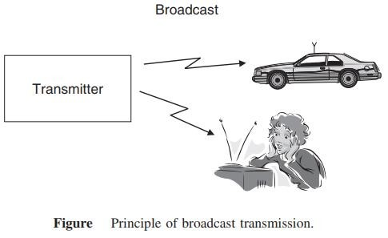
Broadcast
The first wireless service was broadcast radio. Four properties differentiate broadcast radio
The information is sent unidirectional, i.e., in one direction only.
The information transmitted is same for all receivers.
The information is transmitted continuously.
In many cases like TV
or radio, multiple transmitters send the same information

Slide 15
Broadcast
Broadcast Communication
Broadcast communication is the first wireless communication service, primarily used for radio and television transmissions.
Key Properties of Broadcast Radio:
Unidirectional Transmission: Information flows in one direction, from the transmitter to the receiver.
Same Information for All Receivers: Every receiver within range gets the same content.
Continuous Transmission: The broadcast signal is transmitted without interruption.
Multiple Transmitters: In cases like TV and radio, multiple transmitters send the same information to cover a larger area.
This makes broadcast communication ideal for mass media services like AM/FM radio and television.

Slide 16
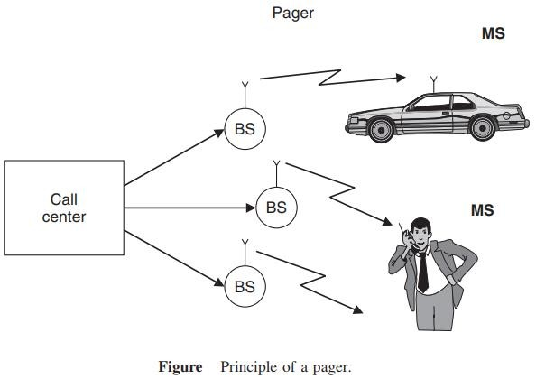
Paging
Similar to broadcast, paging systems are unidirectional wireless communications systems. The following properties characterize them:
The user can only receive information, but cannot transmit.
The information is intended for and received by, only a single user.
The amount of transmitted information is very small.

Slide 17
Paging
Paging systems are a type of unidirectional wireless communication, similar to broadcast but designed for individual users.
Key Properties of Paging Systems:
Receive-Only Communication: The user can only receive information but cannot transmit back.
Single-User Targeting: Unlike broadcast, paging messages are sent to specific individuals.
Small Data Transmission: The transmitted information is minimal, often just a short message or alert.
Paging was widely used before mobile phones became common, especially in emergency services and business communications.

Slide 18

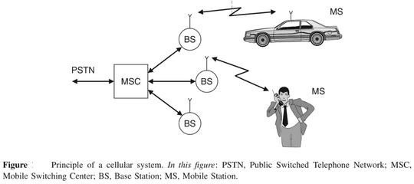
Cellular Telephony
Cellular telephony is the economically most important form of wireless communications. The information flow is bidirectional. A user can transmit and receive information at the same time.

Slide 19
Cellular Telephony
Cellular telephony is the most economically significant form of wireless communication. It allows bidirectional information flow, meaning users can both transmit and receive data simultaneously.
Key Features of Cellular Telephony:
Two-Way Communication: Users can talk and listen at the same time.
Cell-Based Infrastructure: Divides areas into "cells," each served by a Base Station (BS).
Mobile Switching Center (MSC): Manages connections between mobile users and the Public Switched Telephone Network (PSTN).
Mobility Support: Enables communication even while moving (e.g., in a car).
This system forms the backbone of modern mobile networks, enabling voice calls, SMS, and internet access.

Slide 20
Trunking Radio
Trunking radio systems are an important variant of cellular phones, where there is no connection between the wireless system and the public switched telephone network (PSTN); therefore, it allows the communications of closed user groups. Obvious applications include police departments, fire departments, taxis, and similar services. The closed user group allows following operations
Group calls
Call priorities
Relay networks

Slide 21
Trunking Radio
Trunking radio systems are a specialized form of wireless communication used primarily in public safety and critical communication sectors. Unlike traditional cellular networks, trunking radio does not connect to the Public Switched Telephone Network (PSTN), making it an independent communication system for closed user groups.
Key Features of Trunking Radio
Efficient Channel Utilization – Uses a pool of radio channels dynamically assigned to users as needed, ensuring optimal frequency usage.
Closed User Groups – Designed for organizations like police, fire departments, and emergency services that require secure and dedicated communication.
No PSTN Dependency – Works independently of public telephone networks, enhancing security and reliability.
Fast Call Setup – Offers near-instantaneous connectivity without the delays of conventional mobile networks.
Operations in Trunking Radio
Group Calls – Enables communication among multiple users in a closed group, useful for emergency and coordinated operations.
Call Priorities – Ensures priority access to channels for high-importance users, such as emergency responders.
Relay Networks – Extends communication range using relay stations to cover large geographical areas.

Slide 22
Trunking Radio
Applications
Public Safety – Used by police, fire, and medical emergency services.
Transportation – Taxis, railways, and aviation for seamless coordination.
Industrial Use – Factories, power plants, and military applications for secure communication.
In the Wireless and Mobile Communication course, trunking radio is studied as an alternative to cellular systems, focusing on resource allocation, spectrum efficiency, and reliability in mission-critical environments.

Slide 23
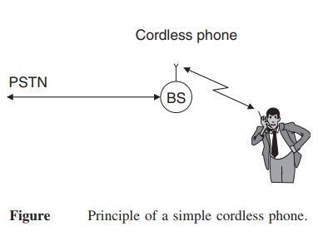
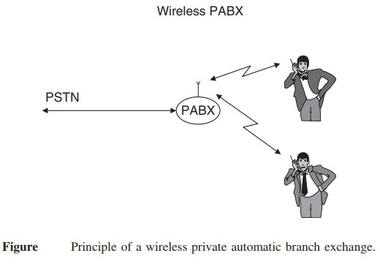

Slide 24
Cordless phones and wireless Private Automatic Branch Exchange (PABX) systems are fundamental concepts in Wireless and Mobile Communication, dealing with short-range communication within a specific area.
1. Cordless Phone
A cordless phone consists of a base station (BS) connected to the Public Switched Telephone Network (PSTN) and a wireless handset.
Principle: The BS acts as an interface between the PSTN and the cordless handset, enabling wireless communication within a limited range (typically within a home or office).
Technology: Operates on radio frequencies (e.g., DECT – Digital Enhanced Cordless Telecommunications).
Limitations: Works only within a small radius (typically 50–300 meters) and does not support mobility beyond the BS coverage.
2. Wireless PABX (Private Automatic Branch Exchange)
A wireless PABX extends the concept of a cordless phone by integrating multiple handsets within an organization's internal network.
Principle: The PABX system connects to the PSTN and manages multiple internal wireless extensions, allowing internal and external communication.
Features:
Supports multiple users within an enterprise.
Facilitates both internal (intercom) and external calls without wired connections.
Provides mobility within an office building or campus.
Advantages over Cordless Phones:
Supports multiple users.
Covers a larger area using multiple base stations.
Reduces wiring costs and enhances mobility.

Slide 25
Applications in Wireless Communication
Cordless Phones: Used in homes and small offices for landline communication with limited mobility.
Wireless PABX: Used in large offices, industries, and corporate buildings for efficient internal and external communication.
In Wireless and Mobile Communication, these systems are studied under short-range wireless communication, focusing on frequency allocation, mobility support, and spectrum efficiency.

Slide 26
Wireless Local Area Networks
The functionality of Wireless Local Area Networks (WLANs) is very similar to that of cordless phones connecting a single mobile user device to a public landline system.
A major difference between wireless LANs and cordless phones is the required data rate. While cordless phones need to transmit (digitized) speech, which requires at most 64 Kbit/s, wireless LANs should be at least as fast as the Internet that they are connected.

Slide 27
Wireless Local Area Networks
Wireless Local Area Networks (WLANs) provide high-speed wireless connectivity within a limited geographical area, such as homes, offices, and campuses. They operate similarly to cordless phones by connecting mobile devices to a fixed communication network, but with a much higher data rate.
Key Characteristics of WLANs
Functionality Similar to Cordless Phones: Like cordless phones, WLANs allow devices to communicate wirelessly with a central access point, which connects to a wired network (such as the internet or a local server).
High Data Rate Requirement:
Cordless phones primarily transmit digitized speech at a low data rate (≤64 Kbit/s).
WLANs must support high-speed data transmission to match internet speeds, typically in the range of Mbps to Gbps (e.g., Wi-Fi standards like IEEE 802.11ac, 802.11ax).
Operates on Unlicensed Frequency Bands: Uses ISM bands (2.4 GHz, 5 GHz, and 6 GHz) for communication.
Supports Multiple Devices: Unlike cordless phones, which usually support only one handset, WLANs allow multiple users to connect simultaneously.

Slide 28
Wireless Local Area Networks
Feature | WLANs | Cordless Phones
Purpose | Wireless internet access | Voice communication
Data Rate | Mbps to Gbps | ≤64 Kbit/s
Coverage | 30–100 meters | 50–300 meters
Network | Connects to the internet | Connects to PSTN
Applications of WLANs
Home and Office Networks – Provides seamless internet access to multiple users.
Public Wi-Fi Hotspots – Used in airports, cafes, and shopping malls.
Enterprise Networks – Supports internal communications and cloud-based applications.
In Wireless and Mobile Communication, WLANs are studied under wireless networking protocols, data transmission rates, frequency spectrum utilization, and security mechanisms like encryption (WPA2, WPA3).

Slide 29
Personal Area Networks
When the coverage area becomes even smaller than that of WLANs, we speak of Personal Area Networks (PANs).
Such networks are mostly intended for simple cable replacement duties.
For example, devices following the Bluetooth standard allow connecting a hands-free headset to a phone without requiring a cable; in that case, the distance between the two devices is less than a meter.

Slide 30
Personal Area Networks
Personal Area Networks (PANs) are the smallest type of wireless networks, designed for short-range communication between personal devices.
Characteristics of PANs
Smaller Coverage Area: Covers a few meters (typically 1–10 meters), much smaller than WLANs.
Purpose: Primarily used for cable replacement, enabling wireless communication between personal devices.
Technology Used:
Bluetooth (e.g., hands-free headsets, wireless keyboards, and smartwatches).
Infrared (IR) (e.g., TV remotes, old file transfer systems).
Zigbee (used in IoT devices for low-power, short-range communication).
Low Power Consumption: Optimized for low-energy communication between devices.
Example Applications
Wireless Accessories: Connecting Bluetooth headsets, speakers, keyboards, and mice.
IoT Devices: Smart home automation (e.g., smart bulbs, fitness bands).
File Transfer: Using Bluetooth to transfer files between mobile phones.

Slide 31
Personal Area Networks
Feature | PANs | WLANs
Coverage | 1–10 meters | 30–100 meters
Technology | Bluetooth, Zigbee, IR | Wi-Fi (IEEE 802.11)
Purpose | Personal device connectivity | Internet access for multiple users
Speed | Kbps to Mbps | Mbps to Gbps
PANs are crucial in short-range communication protocols and low-power wireless networks, especially in wearable technology, IoT, and smart devices.

Slide 32
Fixed Wireless Access
Fixed wireless access systems can also be considered as a derivative of cordless phones or WLANs, essentially replacing a dedicated cable connection between the user and the public landline system.
The main difference from a cordless system is that
there is no mobility of the user devices and
the BS almost always serves multiple users.

Slide 33
Fixed Wireless Access
Fixed Wireless Access (FWA) is a technology that provides wireless broadband connectivity to homes and businesses without requiring a physical cable connection.
Key Characteristics of Fixed Wireless Access (FWA)
Alternative to Wired Networks: Functions as a replacement for DSL, fiber, or cable broadband.
No Mobility: Unlike mobile networks, FWA devices remain stationary at a fixed location.
Base Station (BS) Serves Multiple Users: One BS can connect several homes, offices, or businesses.
High-Speed Internet: Often delivers broadband speeds comparable to fiber or DSL.
Uses Licensed & Unlicensed Spectrum: Operates on frequencies like 4G LTE, 5G, WiMAX, and mmWave bands.
Examples of Fixed Wireless Access Usage
5G Home Internet Services (e.g., Verizon 5G Home, T-Mobile 5G Home).
Rural Internet Providers using FWA to bridge the digital divide.
Enterprise Networks using FWA for backup internet connections.
Fixed Wireless Access is a crucial technology in next-generation broadband and is a key enabler of 5G networks.

Slide 34
Fixed Wireless Access
Feature | Fixed Wireless Access (FWA) | Cordless System
Mobility | No (Stationary devices) | Yes (Limited mobility within range)
Usage | Broadband internet | Voice communication
Base Station Role | Serves multiple users | Usually serves a single user
Technology | 4G, 5G, WiMAX | Analog/Digital cordless telephony
Advantages of FWA
Faster Deployment: No need for physical cables, reducing installation time.
Cost-Effective: Eliminates expensive fiber/cable laying.
Ideal for Rural & Remote Areas: Provides connectivity where fiber or DSL is unavailable.
Supports High Bandwidth Applications: Enables HD streaming, gaming, and remote work.

Slide 35
Requirements for the Services
Data Rate
Range and Number of Users
Mobility
Energy Consumption
Use of Spectrum
26

Slide 36
Data Rate
Data rates for wireless services ranges from few bits per second to several gigabits per second, depending on the application.
Type of application | Data rate | 27
Sensor networks | 1 Kbit/s
Speech communications | 5 and 64 Kbit/s
Elementary data services | 10 and 100 Kbit/s
Computer peripherals and similar devices | 1Mbit/s
High-speed data services | 0.5 to 100 Mbit/s
Personal Area Networks | 100 Mbit/s

Slide 37
Data Rate
The data rate in wireless communication varies based on the application, ranging from a few bits per second to several gigabits per second
Key Observations:
Low data rates are used in sensor networks and speech communication.
Medium data rates support elementary data services and computer peripherals.
High-speed applications like Wi-Fi, mobile networks, and PANs require much higher data rates.
The choice of data rate depends on the network type, application requirements, and technology used.

Slide 38
Range and Number of Users
Another distinction among the different networks is the range and the number of users that they serve. By range, we mean here the distance between transmitter and receiver.
The coverage area of a system can be made almost independent of the range by just combining a larger number of BSs into one big network.
Type of network | Range | 28
Body Area Networks (BANs) | 1meter
Personal Area Networks | 10 meter
WLANs | up to 100 meter
Cellular systems | 10 or even 30 km
Satellite systems | 1,000 km radius
Fixed wireless access services | 100 m and several tens of kilometers

Slide 39
Range and Number of Users
The range of a wireless network refers to the distance between the transmitter and receiver, while the number of users depends on the network type and capacity.
Key Insights:
Short-range networks (BANs, PANs) are suitable for wearables and Bluetooth devices.
Medium-range networks (WLANs, Fixed Wireless) cater to homes, offices, and urban setups.
Long-range networks (Cellular, Satellite) serve large areas, including rural and remote regions.
Network coverage can be expanded by using multiple Base Stations (BSs) to form a larger network.
Choosing the right network depends on range, user capacity, and application requirements.

Slide 40
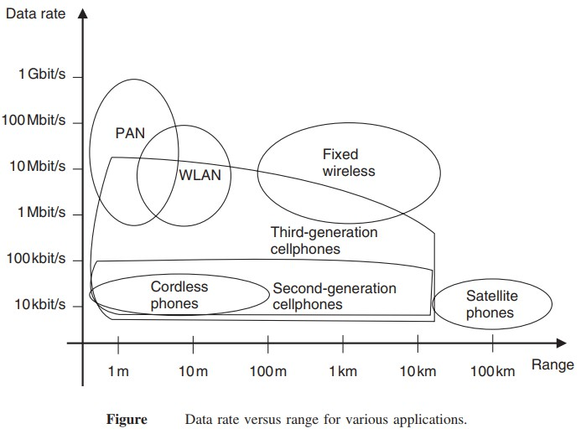
29

Slide 41
Data Rate vs. Range for Wireless Networks
The figure illustrates the relationship between data rate and range for various wireless technologies.
Observations:
Higher data rates are typically achieved in short-range networks, like PANs and WLANs.
Long-range networks (Satellite, Cellular) provide wider coverage but offer lower data rates.
Fixed wireless networks strike a balance between range and data rate.
Cellular networks (2G, 3G, etc.) expand their range but sacrifice speed.
29

Slide 42
Data Rate vs. Range Trends:
Technology | Range | Data Rate
PAN(Bluetooth/Infrared | ~1-10m | 10Mbit/s-1Gbit/s
WLAN (Wi-Fi) | ~100m | 1-100 Mbit/s
Cordless Phones | ~10m | ~10 kbit/s – 100 kbit/s
2G Cellular | ~1-10km | 10 kbit/s – 100 kbit/s
3G Cellular | ~1-10km | 1 Mbit/s – 10 Mbit/s
Fixed Wireless | ~1-10km | 10 Mbits/s-100Mbits/s
Satellite Phones | >100km | ~10 kbit/s – 100 kbit/s
29

Slide 43
Key Takeaways:
Short-range technologies (PAN, WLAN) prioritize speed over range. Cellular and fixed wireless networks balance coverage and data rates. Satellite networks focus on global coverage but with low data rates.
This trade-off between range and speed is a key factor in choosing the right wireless technology for different applications.
29

Slide 44
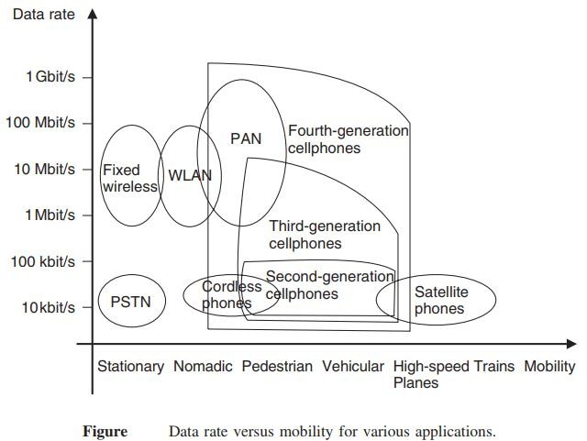
Mobility
Wireless systems also differ of mobility that they have to allow for the users.
The ability to move around while communicating is one of the main factors of wireless communication
for the user.

Slide 45
Mobility
Wireless networks differ in their mobility support, allowing users to move around while communicating. Mobility is a crucial factor for wireless communication.
Key Observations from the Graph:
Higher mobility networks (e.g., Cellular & Satellite) allow users to move freely across large distances.
Low mobility networks (e.g., WLAN, PAN) are better for stationary or nomadic users.
High-speed mobility (e.g., planes, high-speed trains) sacrifices data rate for connectivity.
Key Takeaways:
Wired networks (PSTN) support only stationary users. Wi-Fi and PAN allow movement but work best for nomadic or pedestrian users. Cellular networks (2G, 3G, 4G, 5G) enable vehicular and high-speed mobility. Satellite phones are ideal for extreme mobility (e.g., planes, remote areas) but offer lower speeds.
Mobility plays a crucial role in choosing the right wireless technology based on user movement needs.

Slide 46
Mobility
Data Rate vs. Mobility Trends:
Technology | Mobility Support | Data Rate
PSTN (Fixed line) | Stationary only | ~10 kbit/s – 1 Mbit/s
Cordless Phones | Nomadic | ~10 kbit/s – 100 kbit/s
WLAN (Wi-Fi) | Pedestrian, Nomadic | 1 – 100 Mbit/s
PAN (Bluetooth, Infrared) | Pedestrian, Nomadic | 10 Mbit/s – 1 Gbit/s
2G Cellular | Vehicular, Nomadic | 10 kbit/s – 100 kbit/s
3G Cellular | Vehicular | 1 Mbit/s – 10 Mbit/s
4G Cellular | Vehicular, High-speed trains | 10 Mbit/s – 1 Gbit/s
Satellite Phones | Planes, High-speed trains | ~10 kbit/s – 100 kbit/s

Slide 47
Energy Consumption
Energy consumption is a critical aspect of wireless devices. Most wireless devices use (one way or rechargeable) batteries, as they should be free of any wires both the ones used for communication and the ones providing the power supply.
Rechargeable batteries
One way batteries
Power mains
47 - Remains

Slide 48
Use of Spectrum
Spectrum can be assigned on an exclusive basis, or on a shared basis. That determines to a large degree the multiple access scheme and the interference resistance that the system has to provide:
Spectrum dedicated to service and operator
Spectrum allowing multiple operators
Spectrum dedicated to a service
free spectrum
Adaptive spectral usage

Slide 49
Direction of Transmission (The duplex concept )
Simplex systems– e.g., broadcast systems and pagers.
Semi-duplex systems – e.g.,Walkie-talkies
Full-duplex systems – e.g., cellphones and cordless phones.
FDD uses two separate frequencies for the uplink (from the mobile to the BS) and the downlink (from the BS to the mobile).
TDD uses a single frequency to transmit signals in both the downlink and uplink directions.
Frequency(Mhz)
Base Station(Tx), Mobile Station(Rx
Frequency(Mhz)
Base Station(Tx), Mobile Station(Rx)
Mobile station (tx), Base station(Rx)
Mobile station (tx), Base station(Rx)
Time (ms)
BITS Pilani, Deemed to be UniversityTuinmdeer S(emctison) 3 of UGC Act, 1956

Slide 50
Wireless communication systems
Antenna
Information to
be transmitted
coding
Modulator
Transmitter
carrier
Antenna
Information
Received
decoding
DeModulator
Receiver
carrier

Slide 51
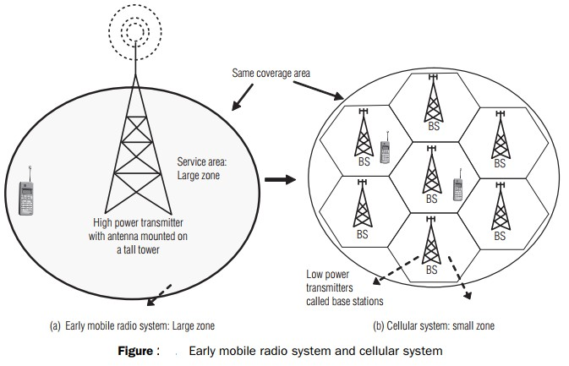

Slide 52
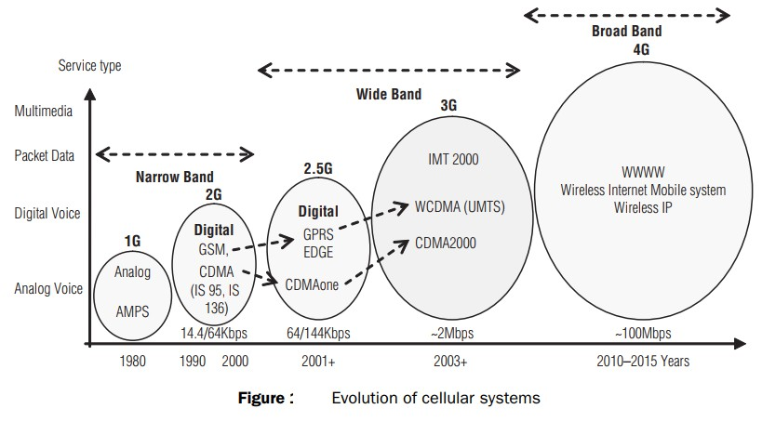

Slide 53
Cellular Network- 1G
Goal: To develop a working system that could provide basic service
Time frame: 1980s in US Technology: FDMA/FDD Speed: 2.4Kbps
voice
1G network used Analogue circuit-switched technology with FDMA
800–900 MHz frequency bands.
Example Systems:
Analogue Mobile Phone System (AMPS-USA)
Total Access Communication System (TACS-UK)
Nordic Mobile Telephone (NMT-Europe)
37

Slide 54
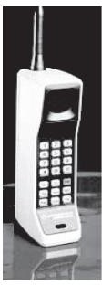
In AMPS, two 25-MHz bands are allocated. One 25-MHz band is for communication from BS to mobile unit and the other for communication from mobile unit to BS.
The following are the limitations of 1G:
Supports only speech
Low traffic capacity
Unreliable handover
Long-call setup time and frequent call drops
Inefficient use of bandwidth and poor battery life
Poor voice quality and large phone size
Allows users to make voice calls in 1 country only
the first handheld device from Motorola Company which was available in 1984
38
in 1G network.

Slide 55
Cellular Network-2G
Goal: Digital voice service with improved quality and also provide better services
Time Frame: Launched in Finland in 1991
2G technology supports data, speech, FAX, SMS, and WAP services.
The frequency bands used by GSM are 890–960 MHz and
1710–1880 MHz. (890–915 MHz - uplink MS to BS, 935–
960 MHz downlink BS to MS)
Used digital signals

Slide 56

Digital modulation formats were introduced in this generation with the main technology as TDMA/FDD
Data Speed: upto 64kbps
Services like text message, picture message was included. Example Systems:
Global System for Mobile Communications (GSM) (TDMA and FDMA)
IS-95(Interim Standard) (CDMA)
Ericsson GH218 which was introduced in 1994 and
operated in 2G networks.

Slide 57
The following are limitations of 2G:
Provides low data rates ranging from 9.6 kbps to 28.8 kbps.
Circuit-switched network, where the end systems are dedicated for the entire call session. This causes reduction in usage of bandwidth and resources.
Too many 2G standards globally (e.g. GSM, CDMA, PDC,
and PHS )

Slide 58
Interim generation (2.5G )
Goal: To provide better data rates and wider range of data services and it was a transition from 2G to 3G
Time frame: 2000-2002
The mobile technology using GPRS standard has been termed as 2.5G.
The 2.5G was started in 1998 with added GPRS and enhanced
data rates for GSM evolution (EDGE).

Slide 59
Cellular Network- 3G
The aim of 3G systems is to provide communication services from person-to-person at any place (global roaming) and at any time through any medium with guaranteed quality of service.
high-speed internet access, live video communications, and simultaneous data and voice transmission .
The 3G technology has added multimedia facilities to 2.5G
phones.
3G operates in the frequency band of 1710–2170 MHz.
It provides high transmission rates from 348 Kbps in a moving vehicle to 2 Mbps for stationary or mobile users.

Slide 60
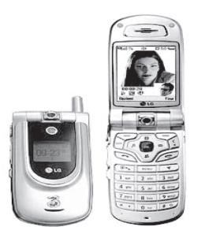
Examples of 3G system are universal mobile telecommunication systems (UMTS) and international mobile telecommunications at 2,000 MHz (IMT-2000).
UMTS are designed to provide different types of data rates, based on the following circumstances:
up to 144 kbps for moving vehicles 384 kbps for pedestrians
2 Mbps for indoor or stationary users
LG U8110 that was introduced in 2004 and is operating in 3G networks.

Slide 61
The following are the drawbacks of 3G system:
High bandwidth requirement
High spectrum licensing fees
Expense and bulk size of 3G phones
Lack of 2G mobile user buy in for 3G wireless service
Lack of network coverage because it is still a new service
High prices of 3G mobile services in some countries

Slide 62
Cellular Network- 4G
Goal: High mobility, High data rate
Frequency Band: 2 to 8 Ghz.
Download speed is upto 100 Mbps for moving users and 1GPS for stationary users.
The following modulation techniques are proposed to be used in the 4G cellular phones.
Variable spreading factor-orthogonal frequency and code
division multiplexing (VSF-OFCDM).
Variable spreading factor code-division multiple access (VSF- CDMA).
LTE (Long Term Evolution)
Uses Orthogonal Frequency Division Multiplexing (OFDM)
Uses Multi-input Multi-output(MIMO) for enhanced throughput
46

Slide 63
Features of 4G
Support for interactive multimedia, voice, streaming video, Internet, and other broadband services
Fully IP based mobile system
High speed, high capacity, and low cost‐per‐bit
Global access, service portability, and scalable mobile services
Seamless switching, and a variety of Quality of Service
Better scheduling and call‐admission‐control techniques
Better spectral efficiency
Interoperability with existing wireless standards
Packet switched network

Slide 64
Advantages of 4G
Affordable communication services.
High speed, high capacity and low cost per bit.
Support for interactive multimedia, voice , streaming video, Internet and other broadband services.
Global access, Service portability and scalable mobile services and variety of quality of services provided.
Better spectral efficiency.
seamless network of multiple protocol and air interfaces.

Slide 65
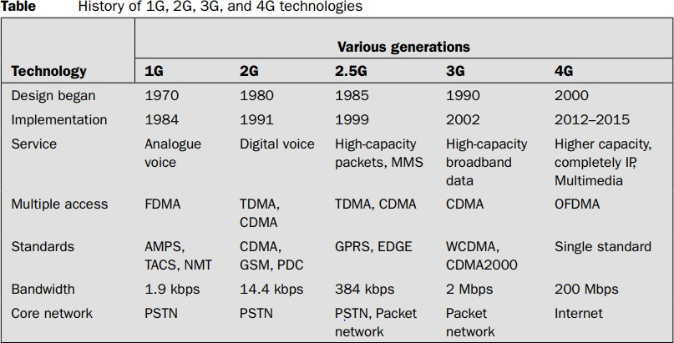

Slide 66
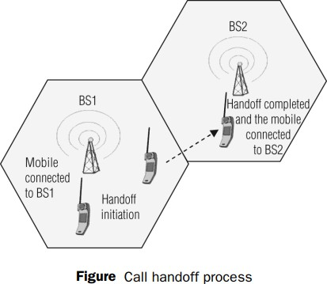
Handoff: A crucial component of the cellular concept is the notion of handoffs. Handoff is the process of transferring an active call from one cell to another as the mobile unit moves from one cell to the other.
Handoff operation involves identifying a new BS and
allocation of voice and
control signals associated.

Slide 67
Handoff –
high priority over call initiation requests
must be performed successfully
Infrequently
be imperceptible.
The margin ∆= 𝑃_{𝑟 ℎ𝑎𝑛𝑑𝑜𝑓𝑓} − 𝑃_{𝑟 𝑚𝑖𝑛𝑖𝑚𝑢𝑚 𝑢𝑠𝑎𝑏𝑙𝑒} cannot be
too large or too small.

Slide 68
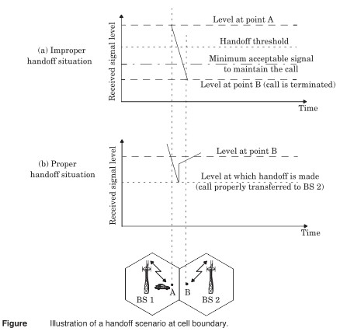

Slide 69
In deciding when to handoff, it is important to ensure that the drop in the measured signal level is not due to momentary fading.
Information about the vehicle speed is useful in handoff decisions.
Dwell time –The time over which a call may be maintained within a cell without handoff.
The statistics of dwell time are important in the practical design of handoff algorithm.

Slide 70
In first generation analog cellular system, the locator receiver is used for handoff.
In second generation system, handoff decisions are mobile assisted –mobile assisted handoff (MAHO).
Intersystem handoff –different cellular systems –roamer.

Slide 71
Prioritizing Handoffs
Guard channel concept –can be used with dynamic channel assignment strategies to increase spectrum utilization.
Queuing of handoff –possible due to the fact that there is a finite time interval between handoff threshold time and call- terminated time

Slide 72
Practical Handoff Considerations
Several handoff schemes have been devised to handle the simultaneous traffic of high speed and low speed users – minimizing the handoff intervention from the MSC

Slide 73
HOME WORK
1.2 If 0 dBm is equal to 1 mW (10⁻³ W) over a 50Ω load; express 10W in units of dBm.
1.5 In simulcasting paging systems, there usually is one dominant signal arriving at the paging receiver. In most, but not all cases, the dominant signal arrives from the transmitter closest to the paging receiver. Explain how the FM capture effect could help reception of the paging receiver. Could the FM capture effect help cellular radio systems? Explain how
1.9 Assume a I Amp-hour battery is used on a cellular telephone (often called a cellular subscriber unit). Also assume that the cellular telephone draws 35 mAin idle mode and 250 mA during a call. How long would the phone work (i.e., what is the battery life) if the user leaves the phone on continually and has one 3-minute call every day? Every 6 hours? Every hour? What is the maximum talk time available on the cellular phone in this example?

Slide 74
1.16 Discuss the similarities and differences between a conventional cellular radio system and a space-based (satellite) cellular radio system. What are the advantages and disadvantages of each system? Which system could support a larger number of users for a given frequency allocation? Why? How would this impact the cost of service for each subscriber?

Slide 75
In your place of work, how many modern wireless communications networks are available to you? Identify the types of services, the types of technologies, the commercial names of the service providers, and the commercial names of the equipment manufacturers that offer these wireless access capabilities.
In your home, how many modern wireless communications networks are available to you? Identify the types of services, the types of technologies, the commercial names of the service providers, and the commercial names of the equipment manufacturers that offer these wireless access capabilities.
2.8 How would multicarrier transmissions impact an operator’s approach to allocating resources to accommodate a growing subscriber database that increasingly desires data connectivity over voice? How would heavy HSCSD usage impact a cellular carrier’s strategy in allocating channels in the base stations of a cellular network? How would the rapid adoption of
Voice over Internet Protocol (VoIP) impact cellular congestion? Explain.

Slide 76
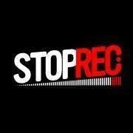
IMP Note to Self

