Slide 1

Industry 4.0
1. Origin & Definition
The Fourth Industrial Revolution is a term coined by Klaus Schwab, the founder of the World Economic Forum (WEF). He introduced this concept in his book titled The Fourth Industrial Revolution, and first presented it at the World Economic Forum’s annual meeting in Davos in 2016.
This revolution is characterized by the blurring of boundaries between the physical, digital, and biological worlds, driven by advanced technologies like Artificial Intelligence (AI), the Internet of Things (IoT), robotics, 3D printing, and biotechnology. Unlike previous industrial revolutions, which introduced new machines and production methods, this revolution is integrating technology directly into human lives, industries, and even the human body.

Slide 2

Industry 4.0
2. Comparison with Previous Industrial Revolutions
To understand the Fourth Industrial Revolution, it is essential to look at the three previous industrial revolutions:
First Industrial Revolution (1760s - Early 1800s)
Started in Great Britain and spread to Europe and North America.
Powered by the steam engine, which led to the creation of factories.
Key industries: Textiles, iron production, mechanized agriculture.
Second Industrial Revolution (Late 1800s - Early 1900s)
Introduced mass production and new sources of energy like electricity, oil, and steel.
Innovations included the light bulb, telephone, and internal combustion engine.
Led to the expansion of railroads, automobiles, and industrialization.
Third Industrial Revolution (Mid-20th Century - 2000s)
Known as the Digital Revolution, marked by the invention of computers, semiconductors, and the Internet.
Allowed for automation in industries, leading to increased efficiency and connectivity.
Fourth Industrial Revolution (2000s - Present)
Characterized by AI, IoT, cloud computing, robotics, biotechnology, and 3D printing.
Technology is becoming deeply integrated into human life, including smart assistants, autonomous vehicles, and wearable health sensors.
The pace of change is faster than ever before.

Slide 3
Industry 4.0
3. Key Technologies in the Fourth Industrial Revolution
The Fourth Industrial Revolution is fueled by several cutting-edge technologies, including:
Artificial Intelligence (AI): AI is being used in self-driving cars, smart virtual assistants (Alexa, Siri), and predictive analytics.
Autonomous Vehicles: Cars, drones, and even robots are becoming self-operating using AI-based decision-making.
Internet of Things (IoT): Everyday objects (smartphones, smartwatches, home security cameras) are connected to the Internet and can communicate with each other.
3D Printing: Advances in 3D printing have made it possible to create prosthetic limbs, bionic arms, and even houses.
Biotechnology: Innovations like gene editing, lab-grown organs, and AI-assisted drug discovery are transforming healthcare.

Slide 4
Industry 4.0
4. Speed of Technological Adoption
One of the biggest differences between the Fourth Industrial Revolution and previous ones is the speed at which technology is being adopted. The following statistics highlight this rapid growth:
The telephone took 75 years to reach 100 million users.
Instagram reached 100 million users in just 2 years.
Pokémon Go achieved 100 million users in 1 month.

Slide 5
Industry 4.0
5. Business & Economic Impact
The Fourth Industrial Revolution has significant effects on businesses and economies:
Increase in Patents & Innovation: The number of patents related to AI, 3D printing, and automation has rapidly increased since the early 2000s.
Automation in Industries: Businesses are adopting automation and AI-based systems to increase efficiency, reduce costs, and improve decision-making.
Challenges in Keeping Up: While some businesses are quick to adopt these technologies, many struggle to keep pace with rapid advancements. Companies that fail to innovate risk falling behind.

Slide 6
Industry 4.0
6. Challenges & Risks of the Fourth Industrial Revolution
Despite its many benefits, the Fourth Industrial Revolution also poses several challenges:
a. Job Displacement & Workforce Skills Gap
AI and automation are replacing low-skilled jobs, leading to job losses in traditional industries.
New technologies create demand for new skills, but many workers lack the necessary training.
A highly skilled workforce is required to benefit from these innovations.
b. Economic Inequality
The wealth generated by new technologies is concentrated among a small percentage of people (tech innovators, investors, and business owners).
A study found that billionaires have driven nearly 80% of major innovations in the last 40 years.
The richest 1% of households own nearly half of the world’s wealth, leading to a winner-takes-all economy.

Slide 7
Industry 4.0
c. Privacy & Security Concerns
As industries move towards digitalization, companies are collecting large amounts of personal data.
Many users fear that corporations know too much about their private digital lives.
Cybersecurity threats are increasing, with hacking, identity theft, and data breaches becoming major risks.

Slide 8
Industry 4.0
7. Future Outlook & Need for Adaptation
The Fourth Industrial Revolution is unstoppable, and organizations need to prepare for continuous technological evolution:
Governments, businesses, and individuals must adapt to rapid changes by investing in education, training, and digital literacy.
Ethical considerations need to be addressed, ensuring that AI and automation benefit everyone, not just a few.
Regulations and policies must be updated to protect user data, ensure job security, and reduce inequality.
As technology continues to advance, staying informed and adapting is the key to thriving in the era of the Fourth Industrial Revolution.

Slide 9
What is IoT?
1. Definition & Meaning
The Internet of Things (IoT) refers to the interconnection of physical devices through the Internet, allowing them to collect, share, and analyze data. These devices can range from smartphones, home appliances, and cars to industrial machines, healthcare equipment, and city infrastructure.
IoT is considered an evolution of mobile, home, and embedded applications, integrating greater computing power and advanced data analytics to extract valuable insights.

Slide 10
What is IoT?
2. Growth of IoT – Billions of Devices
Currently, billions of devices are connected to the Internet.
In the near future, hundreds of billions of devices are expected to be connected.
As devices interact, they form an intelligent system of systems, enabling automation, efficiency, and real-time decision-making.

Slide 11
What is IoT?
3. How IoT Works – The Intelligent System of Systems
IoT is not just about connecting devices, but about creating intelligent networks that communicate, share data, and make decisions.
Step 1: Devices collect real-time data from their surroundings (e.g., sensors in smart homes, health monitors, or smart traffic cameras).
Step 2: Data is sent to a centralized system or cloud for storage and processing.
Step 3: Advanced analytics and AI process the data to extract useful insights.
Step 4: The system takes automated actions or provides recommendations to users.
This process can optimize industries, improve daily life, and enhance overall efficiency.

Slide 12
What is IoT?
4. Applications of IoT – Transforming the World
IoT is revolutionizing multiple industries by enabling data-driven decision-making and automation:
a) Healthcare
Smart medical devices can monitor patients' health in real time and send data to doctors.
Wearable fitness trackers help users manage their physical activity and detect health issues early.
AI-based diagnostic tools can analyze medical data for faster disease detection.
b) Manufacturing & Business
Smart factories use IoT sensors to monitor equipment, reduce maintenance costs, and prevent breakdowns.
Supply chain tracking allows businesses to monitor shipments, reduce losses, and improve efficiency.
Retail stores use IoT for automated inventory tracking and smart checkout systems.

Slide 13
What is IoT?
c) Smart Cities & Infrastructure
Smart traffic management systems can monitor road congestion and accidents to improve city traffic flow.
IoT-enabled streetlights adjust brightness based on real-time activity, reducing energy consumption.
Waste management systems use sensors to optimize garbage collection and reduce pollution.
d) Transportation & Logistics
Autonomous vehicles rely on IoT to communicate with roads, traffic signals, and other vehicles.
Fleet management systems optimize delivery routes using real-time traffic data.
Airports and railways use IoT to track passengers, luggage, and schedules.
e) Energy & Environment
Smart grids improve electricity distribution by predicting energy demand.
IoT sensors help detect leaks in water pipelines to prevent wastage.
Agriculture benefits from IoT through automated irrigation systems, monitoring soil conditions and weather patterns.

Slide 14
What is IoT?
5. Real-Life IoT Example – Smart Traffic System
To illustrate the power of IoT, consider a smart traffic system:
Smart Traffic Cameras:
Cameras monitor the road for congestion, accidents, and weather conditions.
They send real-time updates to a central traffic management system.
Citywide Intelligent Traffic Network:
The system combines data from multiple cameras, traffic sensors, and GPS devices.
AI analyzes this data to detect problems and predict future congestion.
Integration with Other Systems:
If an accident occurs, the system automatically updates digital road signs to guide drivers around the blocked area.
The system can inform airports, schools, and emergency services to adjust schedules accordingly.
This example shows how IoT forms an ever-expanding "system of systems", making cities smarter and more efficient.

Slide 15
What is IoT?
6. The Big Picture – Benefits of IoT
The real power of IoT comes from analyzing end-to-end data across multiple connected systems. This enables real-time decision-making, resulting in:
Improved safety & security – Smart surveillance, emergency alerts, and predictive analytics reduce risks.
Better resource management – Optimized energy, water, and traffic systems save costs.
Enhanced user experiences – Personalized shopping, healthcare, and transportation improve convenience.
Faster problem detection & resolution – Predictive maintenance prevents failures in critical infrastructure.

Slide 16
What is IoT?
7. Challenges & Future Outlook of IoT
While IoT offers huge benefits, it also presents challenges:
Privacy & Security Risks
IoT devices collect vast amounts of personal data, raising concerns about data privacy.
Hacking threats increase, as cybercriminals can target connected systems.
High Implementation Costs
Businesses and cities need significant investment to install and maintain IoT infrastructure.
Interoperability Issues
Different IoT devices and systems must be able to communicate seamlessly, but lack of standardization can create compatibility problems.
Data Overload & Processing Challenges
IoT generates massive amounts of data, requiring powerful cloud computing and AI systems to process and extract insights efficiently.
Despite these challenges, IoT will continue to grow, shaping the future of smart homes, industries, healthcare, and cities.

Slide 17
What is IoT?
The Internet of Things (IoT) is revolutionizing the way devices, industries, and systems interact. By integrating sensors, AI, and cloud computing, IoT enables real-time decision-making, automation, and efficiency improvements. From smart cities and healthcare to transportation and energy, IoT is reshaping industries and daily life.
However, to fully utilize IoT’s potential, challenges like privacy concerns, cybersecurity, and high implementation costs must be addressed. As IoT continues to advance, it will play a critical role in the future of technology and human life.

Slide 18
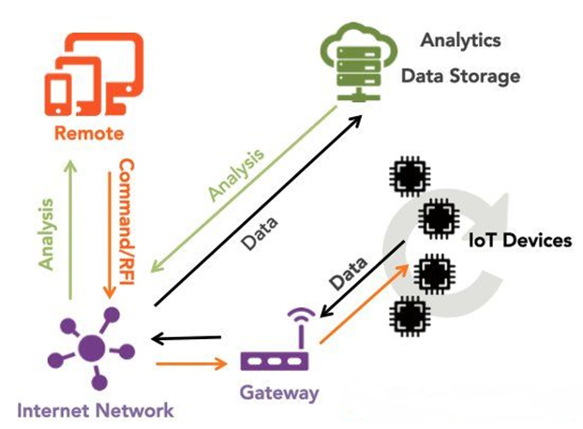
IoT Ecosystem
1. IoT Devices (Edge Devices)
These are the physical sensors, actuators, and smart devices that collect real-world data.
Examples: Smart thermostats, wearable health monitors, industrial machines, security cameras.
These devices generate data and send it to the gateway.

Slide 19
IoT Ecosystem
2. Gateway
The gateway acts as a bridge between IoT devices and the cloud.
It collects data from multiple IoT devices and forwards it to cloud-based analytics platforms.
Sometimes, it performs basic processing to filter unnecessary data before sending it to the cloud.
Examples: Edge computing hubs, local processing units, industrial IoT gateways.
3. Internet Network
IoT devices communicate over the Internet or private networks using different protocols such as Wi-Fi, Bluetooth, Zigbee, LPWAN, and 5G.
This network ensures seamless connectivity between all components of the IoT system.
It transmits data from IoT devices to the cloud and remote applications.

Slide 20
IoT Ecosystem
4. Analytics & Data Storage (Cloud)
IoT data is stored and analyzed in cloud-based platforms.
The cloud enables:
Big data processing for identifying trends, patterns, and insights.
AI & Machine Learning for predictive analytics.
Scalability to handle large volumes of IoT-generated data.
Example: AWS IoT Core, Google Cloud IoT, Microsoft Azure IoT.
5. Remote Monitoring & Control
The Remote section (represented by mobile/tablet icons) refers to users or administrators who access IoT data remotely.
Users can:
Monitor device status in real-time (e.g., checking smart home cameras).
Control IoT devices remotely (e.g., adjusting a thermostat).
Receive alerts & notifications about important events (e.g., security breach alerts).
Example: Smartphone apps for smart homes, industrial dashboards for factory monitoring.

Slide 21
IoT Ecosystem
6. Data Flow and Communication
Data is first generated by IoT devices and sent to the gateway.
The gateway transmits data via the Internet network to the cloud analytics & storage.
The cloud processes the data and sends analysis results to remote users.
Based on analysis, users can send commands back to IoT devices for control actions.
Key Takeaways from the Image
IoT Devices collect and send data.
Gateways process and transmit data.
Internet Network facilitates communication.
Cloud Storage & Analytics process data for insights.
Remote Control & Monitoring allows users to interact with IoT devices.
This ecosystem enables automation, efficiency, and real-time decision-making in smart homes, healthcare, industries, and cities.

Slide 22
IoT Layers
Visualization (representation in graphs)
Storage, Analytics and Query (also called Edge IT)
Data integration (data cleaning, normalization and structuring)
Network & Connectivity elements (wired/ wireless gateways, protocol converters)
Devices / sensors / things / remote data providers

Slide 23
IoT Layers
1. Devices / Sensors / Things / Remote Data Providers
This is the lowest layer in the IoT architecture.
It includes physical devices such as:
Sensors (temperature, humidity, motion, etc.)
Actuators (motors, relays)
Embedded systems (Raspberry Pi, Arduino)
Smart devices (wearables, industrial machines)
These components collect real-world data and send it to the next layer for processing.

Slide 24
IoT Layers
2. Network & Connectivity Elements
This layer ensures communication between IoT devices and cloud systems.
It includes:
Wired networks (Ethernet, Fiber optics)
Wireless networks (Wi-Fi, Bluetooth, Zigbee, LoRaWAN, 5G)
Gateways (IoT edge devices that manage data traffic)
Protocol converters (translate data formats for compatibility)
This layer transmits data from IoT devices to storage and processing systems.

Slide 25
IoT Layers
4. Storage, Analytics, and Query (Edge IT)
Once the data is structured, it needs to be stored and analyzed.
This layer consists of:
Databases (SQL, NoSQL)
Cloud storage (AWS S3, Google Cloud Storage)
Edge computing (processing data closer to the source, reducing latency)
Data query systems (searching and retrieving data efficiently)
The main goal is to extract useful insights from IoT data.

Slide 26
IoT Layers
5. Visualization (Representation in Graphs)
The final layer is data representation for decision-making.
It includes:
Graphs & dashboards (for real-time monitoring)
Reports & charts (for business insights)
AI-powered predictions (future trend analysis)
This layer helps users and businesses interpret IoT data effectively

Slide 27
IoT Layers
Key Takeaways from the Image
Devices & Sensors collect real-world data.
Network & Connectivity ensures data transmission.
Data Integration cleans and structures raw data.
Storage & Analytics processes and analyzes IoT data.
Visualization presents data insights for decision-making.
This layered approach ensures efficient IoT system operations in industries like smart cities, healthcare, agriculture, and industrial automation.

Slide 28
IoT Model
Devices
Send and receive data interacting with the
Network
Where the data is transmitted, normalised and filtered using
Edge Computing
Before landing in
Data Storage / Databases
Accessible by
Applications
Which process it and provide it to people who will
Act & Collaborate

Slide 29
IoT Model
1. Devices
Role: These devices send and receive data while interacting with their environment.
Examples:
Sensors (temperature, motion, humidity, GPS, etc.)
Actuators (motors, relays, robotic arms)
Smart appliances (wearables, industrial machines)
Purpose: These devices generate real-time data for processing.
2. Network
Role: Ensures data transmission, normalization, and filtering before processing.
Examples:
Wireless networks (Wi-Fi, Zigbee, LoRaWAN, Bluetooth)
Wired connections (Ethernet, fiber optics)
Protocols (MQTT, CoAP, HTTP)
Purpose: Transfers data from devices to the computing layer securely and efficiently.

Slide 30
IoT Model
3. Edge Computing
Role: Performs local data processing before sending it to centralized storage.
Examples:
Edge devices (Raspberry Pi, NVIDIA Jetson, industrial controllers)
AI/ML models for real-time decision-making
Purpose: Reduces latency, bandwidth usage, and dependency on cloud processing.
4. Data Storage / Databases
Role: Stores processed IoT data for future retrieval and analytics.
Examples:
Cloud databases (AWS RDS, Google BigQuery)
Local databases (PostgreSQL, MongoDB, InfluxDB)
Time-series databases (for IoT logs)
Purpose: Ensures scalability and accessibility of IoT data.

Slide 31
IoT Model
5. Applications
Role: Processes stored data and provides insights to users.
Examples:
IoT dashboards for visualization
AI-driven predictive analytics
Automation applications (smart homes, industrial IoT)
Purpose: Helps businesses and users make data-driven decisions.
6. Act & Collaborate
Role: Enables human decision-making and automated responses based on processed data.
Examples:
Smart agriculture (automatically watering plants based on soil moisture data)
Healthcare monitoring (alerting doctors in case of abnormal vitals)
Industrial automation (predicting and preventing machine failures)
Purpose: Ensures that data insights lead to real-world actions.

Slide 32
IoT Model
Key Takeaways from the IoT Model
Devices collect data.
Network transmits data securely.
Edge Computing pre-processes data in real-time.
Data Storage organizes and stores IoT data.
Applications analyze and visualize IoT data.
Act & Collaborate transforms insights into real-world actions.
This IoT model ensures efficient data processing and decision-making across industries like healthcare, smart cities, industrial automation, and agriculture.

Slide 33
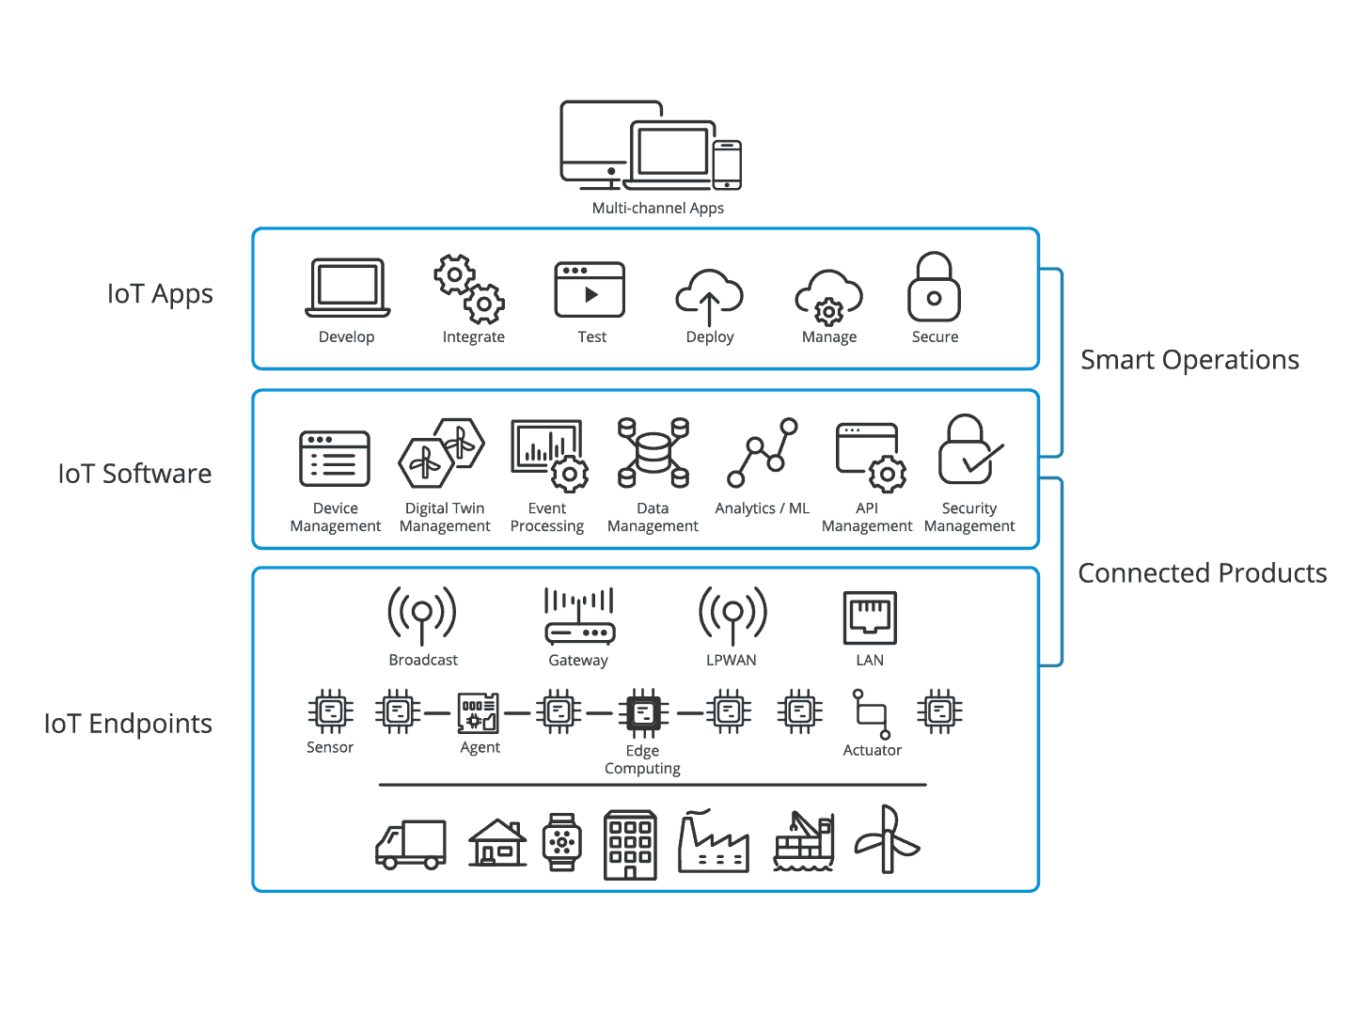
IoT 3 Layer model

Slide 34
IoT 3 Layer model
The image represents the IoT 3-Layer Model, which explains how IoT systems function by dividing them into three main layers: IoT Endpoints, IoT Software, and IoT Apps. Below is a detailed breakdown of each layer and its role in the IoT ecosystem.
1. IoT Endpoints (Connected Products)
Role: This layer consists of physical IoT devices that collect and transmit data.
Examples:
Sensors (temperature, motion, GPS, pressure)
Agents (IoT gateways that facilitate communication)
Edge Computing (processes data locally before sending it to the cloud)
Actuators (motors, valves, and other control devices)
Communication Technologies:
Broadcasting
Gateway connections
LPWAN (Low-Power Wide-Area Network)
LAN (Local Area Network)
Purpose: This layer captures real-world data and forwards it for processing.

Slide 35
IoT 3 Layer model
2. IoT Software (Connected Products)
Role: The software layer processes and manages IoT data collected from endpoints.
Key Functions:
Device Management (monitoring and controlling connected devices)
Digital Twin Management (creating virtual models of physical devices)
Event Processing (real-time data handling and triggers)
Data Management (storing and organizing IoT-generated data)
Analytics & Machine Learning (AI-powered insights from data)
API Management (enabling communication between IoT components)
Security Management (protecting IoT networks from cyber threats)
Purpose: This layer ensures that IoT data is structured, analyzed, and secure.

Slide 36
IoT 3 Layer model
3. IoT Apps (Smart Operations)
Role: The application layer provides user interfaces and tools to interact with IoT data.
Key Components:
Develop (creating IoT applications)
Integrate (connecting different IoT services)
Test (validating IoT applications)
Deploy (launching IoT solutions)
Manage (monitoring system health)
Secure (ensuring compliance and data protection)
Purpose: This layer enables businesses and users to visualize and act on IoT data via multi-channel applications.

Slide 37
IoT 3 Layer model
Key Takeaways from the IoT 3-Layer Model
IoT Endpoints: The foundation of IoT, consisting of sensors, actuators, and edge computing devices.
IoT Software: The intelligence layer that processes, analyzes, and secures IoT data.
IoT Apps: The interface layer that allows users to interact with and manage IoT solutions.
This model helps in scaling IoT systems efficiently, ensuring seamless data flow and secure communication across devices and applications.

Slide 38

Sensors
Types of Sensors:
Digital Sensors (Binary Sensors)
Return ON/OFF signals.
Used for limit detection, such as position, fullness, and operational status.
Examples:
Limit switches – Mechanical contact switches.
Proximity sensors – Detect metal objects using magnetic fields.
Optical sensors – Use light, but can be affected by dirt.
Capacitive sensors – Detect non-conductive materials but are sensitive to contamination.
Ultrasonic sensors – Use sound waves to detect objects.
Auxiliary contacts – Indicate relay status.
Push buttons – Detect operator input.

Slide 39
Sensors
RTD = Resistance Temperature Device
Analog Sensors
Convert physical quantities (e.g., temperature, pressure) into electrical signals (voltage or current).
Examples:
Thermocouples – Produce millivolt signals for temperature measurement.
Resistance Temperature Detectors (RTDs) – More accurate, use resistance changes.
Pressure sensors, humidity sensors, distance sensors, speed sensors – Convert values into standard electrical signals (often 4-20mA for noise immunity).
Industrial Applications:
Digital sensors help with detecting positions, operational status, and presence of objects.
Analog sensors allow precise measurement of environmental factors like temperature and pressure.
The combination of these sensors, hardware, and software enables automation and control of industrial processes.

Slide 40
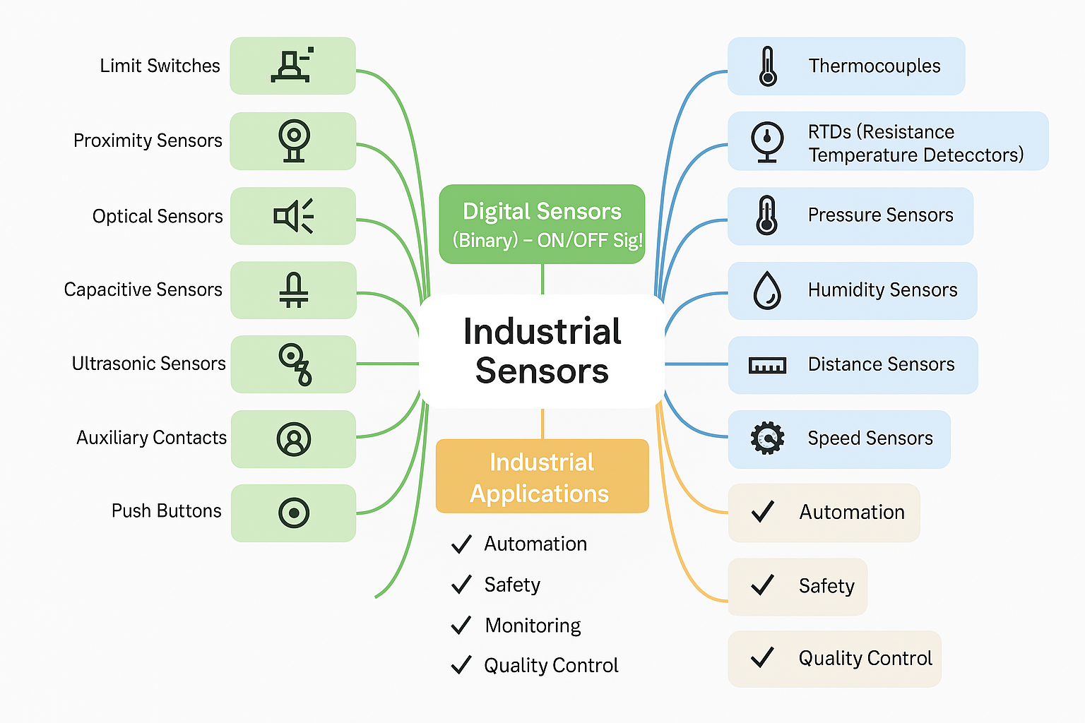
Sensors

Slide 41
IoT Sensors
15 IoT sensors used in Industry->
1. Temperature Sensors
Temperature sensors are designed to monitor the temperature of various devices, including smartphones, industrial machinery, and medical equipment. They help prevent overheating by providing real-time data for temperature regulation. These sensors use thermistors, thermocouples, or resistance temperature detectors (RTDs) to measure heat variations.
2. Proximity Sensors
Proximity sensors emit electromagnetic radiation or an infrared beam to detect the presence of nearby objects without physical contact. These are commonly used in touchscreens, automotive parking sensors, and industrial automation to detect objects' positions.
3. Pressure Sensors
Pressure sensors measure the pressure of gases or liquids and are also used to monitor the flow of fluids and gases. They find applications in automotive systems (e.g., tire pressure monitoring), industrial processes, and medical devices like blood pressure monitors.
4. Water Quality Sensors
Water quality sensors detect pH levels and other properties of water, making them useful for ion monitoring in environmental studies, water treatment plants, and laboratory research. They help ensure safe drinking water and maintain chemical balance in industrial processes.
5. Chemical Sensors
Chemical sensors identify changes in liquids to detect air chemical changes. These sensors are commonly used in industrial safety, environmental monitoring, and medical diagnostics, where they help detect pollutants, toxins, and other hazardous chemicals.

Slide 42
IoT Sensors
6. Gas Sensors
Gas sensors function similarly to chemical sensors but specifically detect the presence and concentration of gases. They are widely used in industrial safety, air quality monitoring, and gas leakage detection to prevent hazardous situations.
7. Smoke Sensors
Smoke sensors detect airborne particulates and gases, making them essential components of fire detection systems. They are commonly found in residential and commercial fire alarms, using either ionization or photoelectric technology to detect smoke levels.
8. Infrared (IR) Sensors
Infrared sensors detect infrared radiation, which is emitted by objects based on their temperature. These sensors play a significant role in healthcare, especially in laparoscopic surgery, thermal imaging, and remote temperature monitoring.
9. Level Sensors
Level sensors are used to detect the level of fluids or other substances in tanks and reservoirs. They are widely used in hydraulic systems, fuel storage tanks, and industrial applications to monitor and control liquid levels.
10. Image Sensors
Image sensors convert optical images into electronic signals, enabling digital cameras and vision-based applications to capture and process images. They are used in smartphones, security cameras, medical imaging, and industrial automation.

Slide 43
IoT Sensors
11. Motion Detectors
Motion detectors sense movement using various technologies, including microwave, infrared, and ultrasonic waves. They are used in security systems, automatic doors, smart lighting, and other applications that require movement detection.
12. Accelerometer Sensors
Accelerometer sensors measure acceleration forces, which may be static (gravity) or dynamic (movement). Their adoption in defense applications has significantly increased, particularly in the development of small-diameter missiles, as well as in smartphones and fitness tracking devices.
13. Gyroscope Sensors
Gyroscope sensors detect angular velocity and orientation, making them essential for navigation purposes. These sensors are widely used in smartphones, gaming controllers, aerospace systems, and navigation apps.
14. Humidity Sensors
Humidity sensors measure moisture levels in the air and are primarily used in heating, ventilation, and air conditioning (HVAC) systems. They help regulate indoor air quality, prevent mold growth, and optimize industrial drying processes.
15. Optical Sensors
Optical sensors detect light rays and convert them into electrical signals for electronic devices. They are widely used in fiber optics, automatic lighting systems, medical diagnostics, and barcode scanning technology.

Slide 44
Wireless Sensor Networks
Wireless Sensor Networks are networks that consists of sensors which are distributed in an ad hoc manner.
These sensors work with each other to sense some physical phenomenon and then the information gathered is processed to get relevant results.
Wireless sensor networks consists of protocols and algorithms with self-organizing capabilities.

Slide 45
Wireless Sensor Networks
Wireless Sensor Networks (WSNs) are networks composed of spatially distributed sensors that collect, process, and transmit data wirelessly. These sensors communicate with each other to monitor and analyze environmental or physical conditions such as temperature, humidity, pressure, motion, and pollutants.
2. Key Characteristics of WSNs
Ad hoc Deployment: Sensors are randomly deployed without a fixed infrastructure.
Self-Organizing: Nodes (sensors) autonomously form a network, adjusting to changes dynamically.
Energy Efficiency: Since sensors run on limited battery power, energy-efficient communication and processing are crucial.
Scalability: Can support a large number of sensor nodes.
Fault Tolerance: The network continues functioning even if some sensors fail.

Slide 46
Wireless Sensor Networks
3. Components of WSNs
Sensor Nodes: Small, energy-efficient devices that detect and transmit data.
Sink Node (Base Station): Collects data from multiple sensor nodes and forwards it to a central system for analysis.
Communication Module: Uses wireless protocols like Zigbee, Bluetooth, or Wi-Fi for data transmission.
Processing Unit: Performs basic computations on collected data before transmission.
Power Supply: Typically battery-powered with energy-harvesting options like solar cells.
4. Working Mechanism
Sensors detect changes in environmental conditions.
The detected data is processed locally at the node level.
Data is transmitted wirelessly through multi-hop routing.
The sink node aggregates and forwards data to a central server or cloud.
Data is analyzed for decision-making or further processing.

Slide 47
Wireless Sensor Networks
5. Communication Protocols in WSNs
MAC Protocols: Optimize power consumption by controlling when nodes transmit/receive data.
Routing Protocols: Determine efficient data transfer paths (e.g., LEACH, Directed Diffusion).
6. Applications of Wireless Sensor Networks
Environmental Monitoring: Weather prediction, pollution control, forest fire detection.
Industrial Automation: Monitoring machinery, detecting leaks or faults.
Smart Cities: Traffic monitoring, smart street lighting, waste management.
Healthcare: Remote patient monitoring, wearable health devices.
Military and Surveillance: Border security, intrusion detection.
Agriculture: Soil moisture monitoring, precision farming.
7. Challenges in Wireless Sensor Networks
Limited Energy: Battery-powered sensors require efficient energy management.
Security Issues: Vulnerable to hacking, jamming, and data breaches.
Data Reliability: Wireless transmission may cause data loss or corruption.
Scalability: Managing large-scale deployments can be complex.
Wireless Sensor Networks are intelligent and efficient systems used for remote monitoring and automation in various industries. Their self-organizing, energy-efficient, and scalable nature makes them an essential technology for IoT (Internet of Things) and smart infrastructure development.

Slide 48
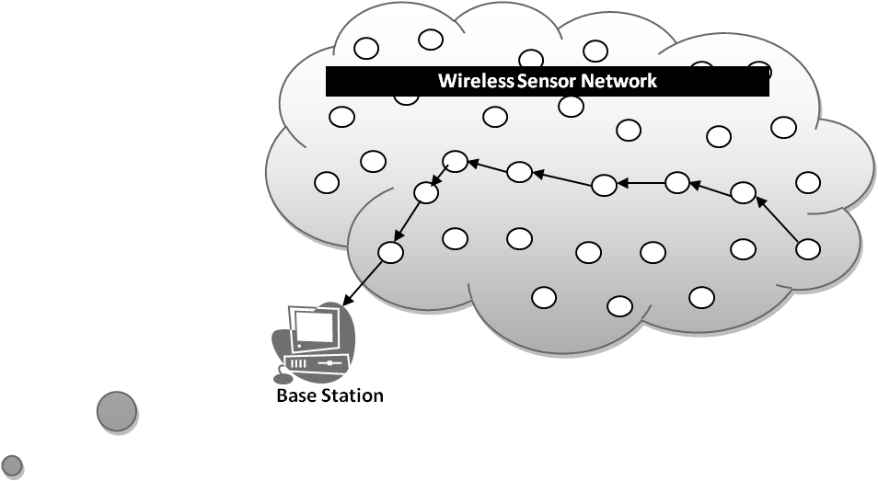
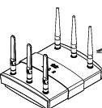
Wireless Sensor Network
Base station
A sensor network is a wireless network that consists of thousands of very small nodes called sensors.

Slide 49
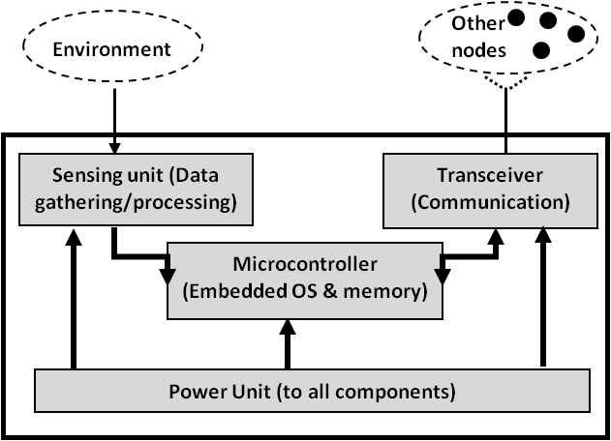
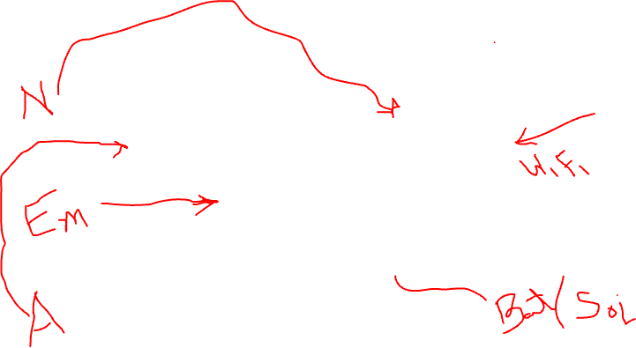
Wireless Sensor Network
WSN Sensors are equipped with sensing, limited computation, and wireless communication capabilities.

Slide 50
WSN V/S Ad-Hoc network
Wireless sensor networks mainly use broadcast communication while ad hoc networks use point-to-point communication.
Unlike ad hoc networks wireless sensor networks are limited by sensors limited power, energy and computational capability.
Sensor nodes may not have global ID because of the large amount of overhead and large number of sensors.

Slide 51
WSN V/S Ad-Hoc network
Both Wireless Sensor Networks (WSNs) and Ad-Hoc Networks are decentralized networks that operate without a fixed infrastructure. However, they differ in communication methods, resource constraints, and network structure.
1. Communication Method
WSN: Uses broadcast communication, where sensor nodes send data to multiple nodes in the network, typically to a central base station or sink node.
Ad-Hoc Networks: Use point-to-point communication, where data is transmitted between specific nodes in a more structured routing manner.
2. Resource Constraints
WSN: Nodes have limited power, energy, and computational capacity since they are small, battery-operated, and often deployed in remote areas.
Ad-Hoc Networks: Devices (such as mobile phones or laptops) have higher power and processing capabilities, making them more suitable for direct communication.

Slide 52
WSN V/S Ad-Hoc network
3. Node Identification
WSN: Sensor nodes may not have a global ID because of the large number of nodes and the high communication overhead required to maintain unique identifiers.
Ad-Hoc Networks: Nodes usually have a global or unique ID, making it easier to manage communication and routing.
4. Network Purpose
WSN: Primarily designed for data collection, environmental monitoring, and event detection. The focus is on sensing and transmitting data efficiently.
Ad-Hoc Networks: Designed for general communication between devices, such as military applications, emergency response, or mobile peer-to-peer networking.
5. Network Structure & Scalability
WSN: Highly scalable but lacks complex routing due to power constraints. Nodes communicate in a multi-hop fashion to forward data to a base station.
Ad-Hoc Networks: May have a structured routing mechanism with predefined communication paths, but scalability is dependent on device capacity and network load.

Slide 53
WSN V/S Ad-Hoc network
6. Energy Efficiency
WSN: Energy consumption is a major concern, and protocols are designed to minimize power usage (e.g., sleep modes, data aggregation techniques).
Ad-Hoc Networks: While energy efficiency is considered, devices often have rechargeable batteries, making power management less critical compared to WSNs.
Wireless Sensor Networks (WSNs) and Ad-Hoc Networks share some similarities but serve different purposes. WSNs are optimized for sensing and data collection with limited resources, whereas Ad-Hoc Networks are more flexible for peer-to-peer communication with better computational capabilities.

Slide 54
Characteristics of WSN
Wireless Sensor Networks mainly consists of sensors. Sensors are -
low power
limited memory
energy constrained due to their small size.
Wireless networks can also be deployed in extreme environmental conditions and may be prone to enemy attacks.
Although deployed in an ad hoc manner they need to be self organized and self healing and can face constant reconfiguration.

Slide 55
Design Challenges
Heterogeneity
The devices deployed maybe of various types and need to collaborate with each other.
Distributed Processing
The algorithms need to be centralized as the processing is carried out on different nodes.
Low Bandwidth Communication
The data should be transferred efficiently between sensors

Slide 56
Design Challenges
Design Challenges in Wireless Sensor Networks (WSN)
Wireless Sensor Networks (WSNs) face several challenges due to their unique structure, resource constraints, and operational requirements. Below are some key challenges:
1. Heterogeneity
The devices deployed may belong to different types, manufacturers, or have varied hardware and software configurations.
These diverse devices need to collaborate efficiently to form a functional network.
2. Distributed Processing
Unlike traditional networks, processing in WSNs is distributed across multiple sensor nodes.
Algorithms must ensure data processing is efficient while minimizing power consumption.
3. Low Bandwidth Communication
Wireless sensors operate on limited bandwidth, making data transmission a challenge.
Efficient data compression and aggregation techniques are needed to optimize communication.

Slide 57
Design Challenges…
Large Scale Coordination
The sensors need to coordinate with each other to produce required results.
Utilization of Sensors
The sensors should be utilized in a ways that produce the maximum performance and use less energy.
Real Time Computation
The computation should be done quickly as new data is always being generated.

Slide 58
Design Challenges…
8. Security & Privacy
WSNs are vulnerable to attacks such as eavesdropping, data tampering, and node compromise.
Secure communication protocols are required to protect data integrity and confidentiality.
9. Fault Tolerance & Scalability
Nodes in WSNs may fail due to battery depletion or harsh environmental conditions.
The network should be resilient and adaptive to node failures while maintaining functionality.
10. Data Redundancy & Aggregation
Sensors often generate overlapping data, leading to redundancy.
Data aggregation techniques help reduce redundancy and improve efficiency.
Addressing these challenges requires innovative solutions in network design, routing, energy management, and security. By overcoming these limitations, WSNs can be effectively deployed for applications like smart cities, healthcare monitoring, industrial automation, and environmental sensing.

Slide 59
Operational Challenges
Energy Efficiency
Limited storage and computation
Low bandwidth and high error rates
Errors are common
Wireless communication
Noisy measurements
Node failure are expected
Scalability to a large number of sensor nodes
Survivability in harsh environments
Experiments are time- and space-intensive

Slide 60
Operational Challenges
Operational Challenges in Wireless Sensor Networks (WSN)
Wireless Sensor Networks (WSNs) face several operational challenges due to their limited resources and harsh deployment environments. Below are key challenges:
1. Energy Efficiency
Sensor nodes have limited battery power, and replacing or recharging them is difficult.
Energy-efficient communication protocols and duty-cycling mechanisms are essential.
2. Limited Storage and Computation
Sensor nodes have restricted memory and processing power.
Optimization techniques are needed to handle data efficiently with minimal processing.
3. Low Bandwidth and High Error Rates
Wireless communication in WSNs often operates at low bandwidth, limiting data transfer rates.
High error rates occur due to interference, congestion, and weak signals.

Slide 61
Operational Challenges
4. Errors in Data Collection
Wireless Communication Errors: Packet loss and delays due to weak signals.
Noisy Measurements: Sensor readings can be inaccurate due to environmental factors.
Node Failures: Sensor nodes may fail due to battery depletion or hardware issues.
5. Scalability Challenges
WSNs need to support a large number of nodes while maintaining efficiency.
Managing data flow and routing becomes complex as the network size grows.
6. Survivability in Harsh Environments
Many WSNs are deployed in extreme conditions (e.g., industrial sites, underwater, or disaster zones).
The network must withstand temperature variations, moisture, and physical damage.
7. Time- and Space-Intensive Experimentation
Real-world testing of WSNs requires significant time and physical deployment space.
Simulations and testbeds are often used but may not fully replicate real conditions.

Slide 62
Operational Challenges
8. Security and Privacy Risks
WSNs are vulnerable to eavesdropping, jamming, and node compromise.
Secure authentication and encryption methods must be implemented.
9. Network Latency and Synchronization
Due to low processing power and wireless interference, delays in data transmission can occur.
Synchronizing nodes efficiently is a challenge, especially in time-sensitive applications.
Addressing these operational challenges requires innovative solutions in network architecture, power management, error detection, and security. Continuous research and development are essential to enhance the reliability and efficiency of WSNs in real-world applications.

Slide 63
WSN Enablers
Embed numerous distributed devices to monitor and interact with physical world
Network devices to coordinate and perform higher-level tasks
Embedded
Networked
Control system w/
Small form factor
Untethered nodes
Exploit collaborative
Sensing, action
Sensing
Tightly coupled to physical world
Exploit spatially and temporally dense, in situ, sensing and actuation

Slide 64
WSN Enablers
Wireless Sensor Network (WSN) Enablers
Wireless Sensor Networks (WSNs) consist of numerous distributed devices designed to monitor and interact with the physical world. The key enablers of WSNs can be categorized into three main components:
1. Embedded Systems
Small form-factor control systems that integrate sensors, processors, and actuators.
Operate as untethered nodes (battery-powered and autonomous).
Designed for low power consumption and high efficiency.
2. Sensing
Tightly coupled with the physical world to capture real-time data.
Sensors collect environmental parameters such as temperature, humidity, motion, and pressure.
Spatially and temporally dense sensing for accurate data acquisition and processing.
3. Networked Communication
Enables coordination between sensor nodes for higher-level tasks like data aggregation and decision-making.
Exploits collaborative sensing and action to improve system efficiency.
Uses wireless protocols such as Zigbee, Bluetooth, LoRa, and Wi-Fi for data transmission.

Slide 65
WSN Enablers
Key Benefits of WSN Enablers
✔ Real-time monitoring of environmental and industrial conditions. ✔ Scalability for large deployments in IoT, healthcare, smart cities, and industrial automation. ✔ Energy-efficient designs to ensure long-term operation with minimal maintenance.
By integrating these enablers, WSNs enhance automation, precision monitoring, and efficient decision-making across various applications.

Slide 66
WSN Application
Wireless Sensor Network (WSN) Applications
Wireless Sensor Networks (WSNs) have a wide range of applications across different domains due to their ability to collect, process, and transmit data efficiently. Some of the key applications include:
1. Environmental Monitoring
Weather forecasting: Monitoring temperature, humidity, and air pressure.
Disaster detection: Early warning systems for earthquakes, landslides, and floods.
Air and water quality monitoring: Detecting pollution levels in urban areas.
2. Industrial Automation
Smart factories: Real-time machine monitoring and predictive maintenance.
Supply chain management: Tracking goods and assets using RFID sensors.
Energy efficiency: Automated lighting, heating, and power management.
3. Smart Cities & Infrastructure
Traffic management: Intelligent transportation systems for optimizing routes.
Smart grids: Efficient power distribution and fault detection.
Building automation: Smart HVAC (heating, ventilation, and air conditioning).

Slide 67
WSN Application
4. Healthcare & Wearables
Patient monitoring: Wireless biosensors for tracking vitals like heart rate and glucose levels.
Smart prosthetics: Wearable sensor technology for rehabilitation.
Remote health monitoring: Assisting elderly and disabled individuals.
5. Agriculture & Precision Farming
Soil and crop monitoring: Measuring moisture, nutrients, and pest detection.
Livestock tracking: Monitoring health and movement of animals.
Automated irrigation: Efficient water usage based on real-time soil conditions.
6. Defense & Surveillance
Border security: Wireless sensors for intrusion detection.
Battlefield monitoring: Real-time soldier health and environmental analysis.
Drone surveillance: Coordinated aerial monitoring of critical areas.

Slide 68
WSN Application
7. Home Automation & IoT
Smart homes: Automated security, lighting, and appliances.
Voice-assisted systems: Integration with AI-based home assistants.
Energy conservation: Real-time usage tracking for better efficiency.
Key Benefits of WSN Applications
✔ Real-time decision making with automated data collection. ✔ Cost-effective solutions for large-scale monitoring. ✔ Scalability and adaptability for various industries.
WSNs are revolutionizing how we interact with technology, making systems more intelligent, efficient, and responsive to real-world challenges.

Slide 69
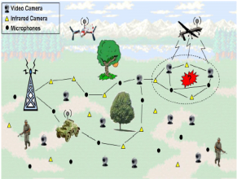
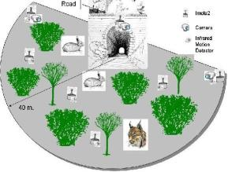
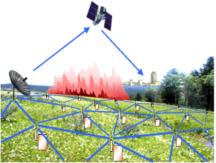
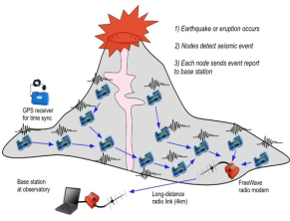
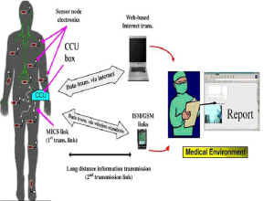
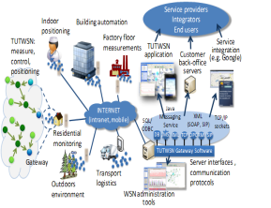

WSN Applications

Slide 70
WSN Applications…
The applications can be divided in three categories:
Monitoring of objects.
Monitoring of an area.
Monitoring of both area and objects.

Slide 71
WSN Applications…
Categories of WSN Applications
Wireless Sensor Network (WSN) applications can be classified into three main categories:
1. Monitoring of Objects
Asset tracking: Monitoring the location and status of goods in supply chains.
Structural health monitoring: Detecting stress and damage in buildings and bridges.
Industrial machine monitoring: Predictive maintenance in manufacturing.
2. Monitoring of an Area
Environmental sensing: Measuring temperature, humidity, and air pollution.
Disaster prevention: Detecting early signs of landslides, earthquakes, and floods.
Smart agriculture: Monitoring soil moisture, weather conditions, and crop health.
3. Monitoring of Both Area and Objects
Surveillance and security: Motion and intrusion detection in restricted areas.
Wildlife tracking: Observing animal movements and behaviors in natural habitats.
Healthcare monitoring: Remote patient monitoring combined with environmental conditions.
WSNs enable real-time data collection, efficient decision-making, and automation across multiple fields, improving safety, productivity, and environmental sustainability.

Slide 72
Area Monitoring
Environmental and Habitat Monitoring
Precision Agriculture
Indoor Climate Control
Military Surveillance
Treaty Verification
Intelligent Alarms

Slide 73
Area Monitoring
Area Monitoring Using WSN
Wireless Sensor Networks (WSNs) are widely used for area monitoring in various fields:
Environmental and Habitat Monitoring
Detects changes in ecosystems, wildlife behavior, and pollution levels.
Helps in biodiversity conservation and early disaster warnings.
Precision Agriculture
Monitors soil moisture, temperature, and nutrient levels.
Optimizes irrigation and fertilizer use to improve crop yield.
Indoor Climate Control
Regulates temperature, humidity, and air quality in smart buildings.
Enhances energy efficiency and occupant comfort.
Military Surveillance
Deploys sensors for perimeter security and enemy movement detection.
Enables real-time battlefield monitoring and intelligence gathering.

Slide 74
Area Monitoring
5. Treaty Verification
Ensures compliance with arms control and disarmament agreements.
Detects unauthorized activities in restricted areas.
6. Intelligent Alarms
Uses sensor-based alerts for fire, gas leaks, or intrusion detection.
Enhances safety in industrial, residential, and commercial spaces.
WSNs make area monitoring cost-effective, scalable, and efficient, enabling real-time data collection and automated responses across different applications.

Slide 75
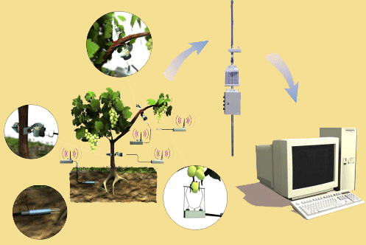
Area monitoring Example
Precision agriculture aims at making cultural operations more efficient, while reducing environmental impact.
The information collected from sensors is used to evaluate optimum sowing density, estimate fertilizers and other input needs, and to more accurately predict crop yields.

Slide 76
Monitoring Objects
Structural Monitoring
Eco-physiology
Condition-based Maintenance
Medical Diagnostics
Urban terrain mapping

Slide 77
Monitoring Objects
Monitoring Objects
Monitoring objects refer to various domains where continuous observation, data collection, and analysis are performed to ensure safety, efficiency, and performance. The key areas of monitoring include:
Structural Monitoring Structural monitoring involves tracking the health and stability of infrastructure such as bridges, buildings, and dams. Sensors are used to detect stress, vibrations, and possible damages to prevent failures and ensure safety.
Eco-physiology This field focuses on studying the physiological responses of living organisms to environmental conditions. It helps in understanding how plants and animals adapt to climate changes, pollution, and other ecological factors.
Condition-based Maintenance Condition-based maintenance is a proactive approach where machinery and equipment are continuously monitored to predict failures before they occur. This technique improves efficiency, reduces unexpected breakdowns, and minimizes maintenance costs.

Slide 78
Monitoring Objects
4. Medical Diagnostics Medical diagnostics involve using monitoring technologies like wearable devices, imaging systems, and biosensors to track vital signs, detect diseases, and assist in early diagnosis. This plays a crucial role in improving patient care and treatment outcomes.
5. Urban Terrain Mapping Urban terrain mapping involves the use of technologies like LiDAR, satellite imagery, and GIS (Geographic Information Systems) to analyze and map urban areas. It is widely used in urban planning, disaster management, and infrastructure development.
Monitoring objects play a crucial role in various fields by providing real-time data, improving efficiency, and enhancing decision-making processes.

Slide 79
Monitoring Interactions between Objects and Space
Wildlife Habitats
Disaster Management
Emergency Response
Ubiquitous Computing
Asset Tracking
Health Care
Manufacturing Process Flows

Slide 80
Monitoring Interactions between Objects and Space
Monitoring Interactions between Objects and Space
Monitoring interactions between objects and space refers to tracking and analyzing how different entities interact with their environment. This monitoring is crucial for improving safety, efficiency, and decision-making in various fields. The key areas include:
Wildlife Habitats Monitoring wildlife habitats helps track animal movements, population changes, and environmental conditions. It aids in conservation efforts, studying biodiversity, and preventing human-wildlife conflicts.
Disaster Management This involves monitoring natural disasters like earthquakes, floods, and hurricanes using sensors and satellite data. It helps in early warning systems, risk assessment, and efficient disaster response.
Emergency Response Emergency response monitoring ensures quick and effective actions during critical situations such as accidents, medical emergencies, or fire outbreaks. Technologies like GPS tracking and real-time communication enhance response efficiency.

Slide 81
Monitoring Interactions between Objects and Space
4. Ubiquitous Computing Ubiquitous computing refers to embedding computing devices in everyday objects to enable continuous monitoring. Examples include smart homes, wearable technology, and IoT-based automation.
5. Asset Tracking Asset tracking involves monitoring the location and status of valuable resources, such as vehicles, equipment, or shipments. RFID, GPS, and IoT sensors are commonly used for real-time tracking and inventory management.
6. Health Care Healthcare monitoring includes tracking patient health through wearable devices, remote monitoring systems, and smart medical equipment. It improves diagnosis, treatment, and personalized healthcare services.
7. Manufacturing Process Flows In manufacturing, monitoring process flows helps optimize production efficiency, detect defects, and ensure quality control. Technologies like automation, sensors, and AI-driven analytics enhance productivity and reduce downtime.
Monitoring these interactions enables better decision-making, increased efficiency, and improved safety across various domains.

Slide 82
Example
1. Car-to-X Communication
Car-to-X (C2X) communication is an advanced vehicle communication technology that extends the capabilities of traditional onboard sensors. Unlike conventional sensors that detect obstacles within a limited range, Car-to-X allows vehicles to exchange information in real time. This means that vehicles can share data about road conditions, traffic congestion, accidents, or hazards ahead, improving road safety and driving efficiency.
For example, if a car detects slippery roads due to ice, it can transmit this information to other vehicles approaching the same route, allowing them to slow down or take necessary precautions in advance.

Slide 83
Example
2. Cellular Network-Based Technology
This system operates over a cellular communication network, such as 4G or 5G, to ensure a seamless exchange of information between vehicles. Unlike traditional Vehicle-to-Vehicle (V2V) systems, which may rely on short-range wireless communication, cellular-based Car-to-X technology enables broader coverage, allowing cars to receive alerts even from vehicles that are not directly nearby.
For instance, if an accident occurs a few kilometers ahead, a connected vehicle will receive an alert in real-time through the cellular network, helping the driver take necessary actions beforehand.

Slide 84
Example
3. Vehicle as Transmitter and Receiver
A key aspect of Car-to-X technology is that a vehicle does not only receive information but also transmits it. Every vehicle in the network acts as both a sensor and a data source, making the system more effective in detecting and preventing road hazards.
For example:
If a vehicle detects fog or heavy rain, it can send a warning to nearby vehicles.
Similarly, if a driver experiences a breakdown, their car can send an automatic alert to other road users to warn them of a potential obstruction.
This interconnected network ensures that real-time data is shared efficiently, reducing accidents and improving traffic flow.

Slide 85
Example
4. Cloud-Based Data Exchange
To ensure seamless communication, detected hazards are uploaded to a cloud server (such as the Mercedes-Benz cloud in this case). The cloud acts as a central data repository where all warning messages and road condition reports are stored and distributed to other vehicles in the network.
Advantages of cloud integration:
Faster communication: Vehicles do not need to be directly connected; they can access hazard information from any connected car via the cloud.
Data persistence: Important data (such as accident reports) remains available for a longer duration, even if the original sender moves away.
Scalability: The cloud can aggregate data from multiple sources, including other vehicles, traffic management centers, and weather stations.

Slide 86
Example
5. Navigation and Voice Alerts
To assist drivers, warning messages are displayed directly on the navigation system’s map. This allows drivers to visually see the location of reported hazards, helping them make informed decisions about their route.
Additionally, some warnings are provided via voice output to minimize distraction while driving. This is particularly useful in situations where the driver needs to focus on the road, such as in foggy conditions or when navigating sharp turns where visibility is low.
For example, if there is an accident around a blind curve, the system will warn the driver using voice alerts before they reach the hazard.

Slide 87
Example
6. Hazard Detection and Reporting
One of the most critical applications of Car-to-X technology is automatic hazard detection. The system is designed to detect various road hazards, including:
Accidents (e.g., a car crash ahead)
Weather hazards (e.g., ice, fog, or heavy rain)
Traffic issues (e.g., stalled vehicles or sudden slowdowns)
Additionally, the system can incorporate data from external sources, such as:
Road construction agencies (to provide real-time information on mobile road works).
Traffic control centers (to update drivers on detours or lane closures).
This feature ensures that drivers are not only warned about natural hazards but also about human-made disruptions on the road, improving travel efficiency and safety.

Slide 88
Example
Car-to-X communication is a perfect example of Network Embedded Applications in action. It integrates real-time networking, cloud computing, and embedded sensor technologies to improve road safety and driving efficiency. The combination of cellular networks, cloud-based data exchange, onboard sensors, and hazard reporting creates a smarter, more connected transportation system.

Slide 89
LoRaWAN
1. LoRaWAN and the Internet of Things (IoT)
LoRaWAN (Long Range Wide Area Network) is a key networking standard that enables the Internet of Things (IoT). The goal of IoT is to create smarter, more efficient choices that contribute to sustainability in areas such as environmental monitoring, healthcare, and social well-being.
However, implementing IoT solutions requires efficient sensor communication, which is where LoRa technology plays a critical role. LoRa allows devices to communicate over long distances with minimal power consumption, making IoT networks scalable, cost-effective, and energy-efficient.

Slide 90
LoRaWAN
2. LoRa Technology for Sensor Communication
Every IoT system consists of three core components:
Sensors: Collect real-world data (e.g., temperature, air quality, or movement).
Network: Transmits the collected data to a central system.
Data Processing: Converts raw sensor data into actionable insights.
LoRa technology enables sensors to communicate wirelessly over long distances while consuming very little power. This makes LoRa the preferred choice for IoT applications where battery life and coverage area are critical.

Slide 91
LoRaWAN
3. LoRaWAN as a Global Standard
LoRaWAN is an open standard recognized by the International Telecommunication Union (ITU) and operates on an unlicensed radio spectrum. This means businesses and individuals can deploy their own LoRa networks without requiring a government license or relying on commercial network providers.
Key benefits include:
Global Adoption: Over 160 network operators and 3 million+ LoRa gateways are deployed worldwide.
Scalability: LoRaWAN can support up to 5 billion connected devices, making it ideal for large-scale IoT deployments.
Unlike Wi-Fi, which has a limited range, and cellular networks, which require high power consumption and costly provider services, LoRaWAN enables wide coverage with low power consumption, making it ideal for IoT networks.

Slide 92
LoRaWAN
4. LoRa for Asset Tracking
One of the most practical applications of LoRaWAN is asset tracking. Many businesses need to monitor the location and condition of their assets in supply chains, warehouses, and industrial operations.
Challenges with existing technologies:
Wi-Fi: Short range, not suitable for large-scale tracking.
Cellular networks: Higher power consumption and dependency on mobile network providers.
LoRa solves these issues by providing:
Long-range communication (even in remote areas).
Low power consumption, allowing sensors to last for years on a single battery.
GPS-free geolocation, enabling tracking without using energy-intensive GPS technology.
Example: A small business owner can attach LoRa-based sensors to their products to track them without needing expensive cellular connectivity.

Slide 93
LoRaWAN
5. LoRa’s Applications in Different Industries
LoRa technology is already being used in various industries to improve efficiency and sustainability.
✔ Environmental Monitoring
Helps monitor water systems to detect shortages, floods, and compliance with regulations.
Supports smart agriculture, where sensors track soil moisture, weather conditions, and irrigation efficiency.
✔ Healthcare
Provides real-time alerts for Alzheimer’s patients who wander outside designated safe zones, ensuring their safety.
Enables remote health monitoring for elderly and at-risk patients.
✔ Smart Cities & Infrastructure
Used in waste management systems to optimize garbage collection routes.
Helps reduce food waste in restaurants by monitoring storage conditions and minimizing spoilage.
✔ Industrial IoT & Smart Manufacturing
Used for predictive maintenance, where machines detect faults before they fail, reducing downtime.
Enables warehouse automation, where sensors track inventory levels and optimize supply chains.

Slide 94
LoRaWAN
6. The Growing LoRa Ecosystem
With over 200 million devices already using LoRa, the ecosystem is continuously growing. Businesses and governments worldwide are leveraging LoRa to build smart, connected solutions that enhance efficiency and sustainability.
Semtech, the company behind LoRa, envisions a future where IoT-powered insights help drive better decisions across industries. By reducing energy waste, optimizing resource use, and improving automation, LoRa contributes to a smarter and more sustainable world.
LoRaWAN is a prime example of Network Embedded Applications in action. It provides a scalable, low-power, and long-range IoT connectivity solution that enables real-time monitoring, automation, and efficiency across multiple industries.

Slide 95
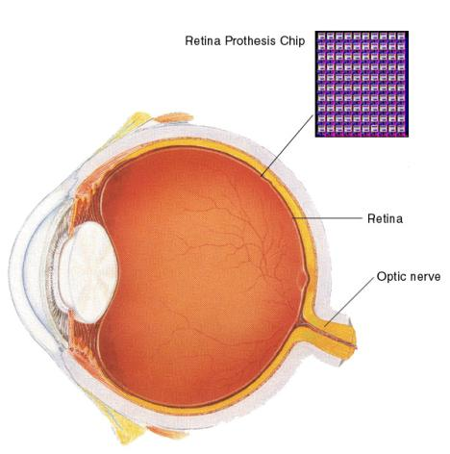
Biomedical
Health Monitors
Glucose
Heart rate
Cancer detection
Chronic Diseases
Artificial retina
Cochlear implants
Hospital Sensors
Monitor vital signs
Record anomalies

Slide 96
Biomedical
Biomedical Monitoring
Biomedical monitoring involves the use of technology to track and improve human health. It plays a crucial role in diagnosing diseases, managing chronic conditions, and enhancing hospital care. The key areas covered in the slide are:
Health Monitors
Glucose Monitoring: Devices that track blood sugar levels for diabetic patients, ensuring proper management and timely interventions.
Heart Rate Monitoring: Wearable devices and medical equipment that continuously measure heart rate to detect irregularities and cardiovascular risks.
Cancer Detection: Advanced imaging techniques and biosensors used for early diagnosis and monitoring of cancer progression.
Chronic Diseases
Artificial Retina: A retinal prosthesis chip that helps restore vision in visually impaired individuals by replacing damaged photoreceptor cells.
Cochlear Implants: Electronic devices that aid hearing by directly stimulating the auditory nerve, benefiting people with severe hearing loss.

Slide 97
Biomedical
4. Hospital Sensors
Monitor Vital Signs: Sensors used in hospitals to continuously track parameters such as blood pressure, oxygen levels, and temperature.
Record Anomalies: Systems that detect abnormalities in patient health and alert medical professionals for quick response.

Slide 98

Military
Remote deployment of sensors for tactical monitoring of enemy troop movements.

Slide 99
Military
Military Applications of Network Embedded Systems
Network Embedded Applications play a crucial role in modern military operations by enabling remote deployment of sensors for tactical monitoring. These systems can be used to track enemy troop movements in real-time, providing critical intelligence for strategic decision-making.
Deployment of Sensor Networks: Military aircraft or ground forces can disperse sensor nodes across a battlefield to monitor activity.
Data Collection & Communication: These sensors relay real-time data back to command centers for analysis.
Enhanced Surveillance: Enables continuous monitoring without direct human intervention, improving operational safety.

Slide 100
Traffic Management
Future cars could use wireless sensors to:
Handle Accidents
Handle Thefts
Sensors embedded in the roads to:
Monitor traffic flows
Provide real-time route updates

Slide 101
Traffic Management
Traffic Management using Network Embedded Applications
In the field of traffic management, Network Embedded Systems enhance road safety and efficiency through wireless sensor networks. These sensors help in monitoring, decision-making, and automation.
Sensors Embedded in Roads:
Monitor traffic flows.
Provide real-time route updates to vehicles and traffic control systems.
Future Cars & Wireless Sensors:
Improve accident detection and enable faster emergency responses.
Prevent thefts by integrating smart vehicle tracking and security features.
These applications contribute to smart city infrastructure, reducing congestion and enhancing road safety.
CS-2 -> Wireless Sensor Networks

Slide 102
Wireless Sensor Network
1. Introduction to Wireless Sensor Networks (WSN)
Wireless Sensor Networks (WSNs) are a network of interconnected sensor nodes that can communicate wirelessly to monitor and control various urban and industrial functions. Toshiba’s technology enables these sensor networks to enhance social safety and infrastructure monitoring by providing real-time data without requiring physical connections like power or network cables.
2. Wireless Sensor Networks for Infrastructure Monitoring
One of the major applications of WSNs is in monitoring critical infrastructure such as: ✔ Bridges – Sensors can detect structural stress, cracks, and corrosion over time. ✔ Tunnels – Monitoring for vibrations, gas leaks, or environmental changes to ensure safety. ✔ Buildings – Sensors detect temperature fluctuations, movement, and foundation shifts.
🔹 Key Benefit: Since no power or network cables are required, sensors can be deployed in hard-to-reach or remote locations for long-term observation without constant maintenance.

Slide 103
Wireless Sensor Network
3. Autonomous & Maintenance-Free Sensor Network
Toshiba’s WSN technology allows sensor nodes to self-organize into a mesh network, enabling: ✔ Autonomous Communication – Each sensor adapts to its surroundings, detects ambient conditions, and adjusts communication timing accordingly. ✔ Bucket Relay Format – Data is transmitted node-to-node (like a relay race) until it reaches the destination, ensuring wide-area coverage without requiring a direct connection to a central hub. ✔ Self-Healing Network – If one sensor fails, the network automatically re-routes the data through alternative paths, maintaining reliability.
🔹 Key Benefit: The system maximizes reliability while minimizing manual setup and maintenance efforts.

Slide 104
Wireless Sensor Network
4. Energy-Efficient and Long-Lasting Network
A critical aspect of WSNs is low power consumption, ensuring that sensor nodes can operate for extended periods on battery power alone. Toshiba’s system achieves this by: ✔ Minimizing Standby Power – Sensors only activate when needed based on environmental triggers. ✔ Optimized Communication – Sensors adjust transmission timing to reduce unnecessary energy use. ✔ Long-Term Battery Life – The network can function for years without requiring battery replacements, making it ideal for remote and inaccessible locations.
🔹 Key Benefit: This ensures continuous monitoring with minimal human intervention, making it cost-effective and sustainable.

Slide 105
Wireless Sensor Network
5. Maximizing Social Safety with WSNs
Toshiba envisions Wireless Sensor Networks as a foundation for future smart cities by: ✔ Enhancing Public Safety – Detecting earthquake tremors, environmental pollution, and fire hazards in real-time. ✔ Traffic & Transportation Management – Monitoring traffic flow, road conditions, and railway infrastructure for improved efficiency. ✔ Disaster Prevention – Sending early warnings about floods, landslides, or structural failures before they become catastrophic.
🔹 Key Benefit: These networks will proactively protect people and society by detecting potential risks before they escalate into disasters.

Slide 106
Wireless Sensor Network
6. The Future of Wireless Sensor Networks
Toshiba’s vision for WSNs aligns with the idea of smart, connected cities where sensors seamlessly integrate into daily life to enhance efficiency, safety, and sustainability. Their technology supports: ✔ Scalability – The network can grow dynamically without requiring major infrastructure upgrades. ✔ Reliability – Self-healing and self-configuring properties ensure uninterrupted operation. ✔ Energy Efficiency – Ensuring long-term viability without excessive power consumption.
🔹 Key Message: “Imagine the Future. Create the Future.” Wireless Sensor Networks will be at the heart of tomorrow’s smart, sustainable, and safer societies.
Wireless Sensor Networks (WSNs) are a prime example of Network Embedded Applications, leveraging autonomous communication, low power consumption, and wide-area connectivity to enhance urban infrastructure, public safety, and environmental monitoring.

Slide 107
Wireless Sensor Networks
Wireless Sensor Networks are networks that consists of sensors which are distributed in an ad hoc manner.
These sensors work with each other to sense some physical phenomenon and then the information gathered is processed to get relevant results.
Wireless sensor networks consists of protocols and algorithms with self-organizing capabilities.

Slide 108
Wireless Sensor Network
Base station
A sensor network is a wireless network that consists of thousands of very small nodes called sensors.

Slide 109
Wireless Sensor Network
Concept: A sensor network is a type of wireless network that consists of thousands of small nodes called sensors.
Functionality: These sensors communicate with each other and relay data through multiple hops until it reaches a base station.
Diagram Explanation:
The cloud represents the wireless sensor network.
The small circles inside the cloud are sensor nodes.
Arrows show how data is transmitted from node to node.
The base station (bottom left) collects data from the sensors.

Slide 110
Wireless Sensor Network
WSN Sensors are equipped with sensing, limited computation, and wireless communication capabilities.

Slide 111
Wireless Sensor Network
Main Components:
Sensing Unit: Responsible for data gathering and processing from the environment.
Transceiver (Communication): Sends and receives data to/from other nodes.
Microcontroller: Manages data processing, decision-making, and memory storage with an embedded operating system.
Power Unit: Provides energy to all components.
How it Works:
The sensor collects data from the environment.
The microcontroller processes the data.
The transceiver communicates with other sensors.
The power unit ensures the system operates efficiently.
Key Features of Wireless Sensor Networks:
Self-organizing: No need for pre-configured settings; nodes automatically form a network.
Low Power Consumption: Sensors are designed to work for long periods using minimal energy.
Scalability: Can cover a wide area with many sensors.
Applications: Used in smart cities, environmental monitoring, industrial automation, healthcare, and security.

Slide 112
WSN V/S Ad-Hoc network
Wireless sensor networks mainly use broadcast communication while ad hoc networks use point-to-point communication.
Unlike ad hoc networks wireless sensor networks are limited by sensors limited power, energy and computational capability.
Sensor nodes may not have global ID because of the large amount of overhead and large number of sensors.

Slide 113
WSN V/S Ad-Hoc network
A Wireless Sensor Network (WSN) is a specialized network consisting of numerous small, low-power sensor nodes that are primarily used for monitoring environmental conditions such as temperature, humidity, motion, or structural integrity. These nodes communicate wirelessly and typically send data to a central base station for processing. WSNs are designed to be energy-efficient, as they often operate on limited battery power and need to function for long periods without human intervention. The topology of a WSN is usually a star, tree, or mesh network, and nodes are generally static. Common applications include smart cities, disaster management, environmental monitoring, and industrial automation.
In contrast, an Ad-Hoc Network is a decentralized, infrastructure-less network where nodes communicate directly with each other. These networks are highly dynamic and can be used in situations where a fixed network infrastructure is unavailable, such as in military operations, emergency response, or vehicular networks. Unlike WSNs, ad-hoc network nodes are usually more powerful, capable of handling complex tasks like data forwarding and routing. Since mobility is a key feature, nodes frequently change positions, making the network topology highly dynamic. Ad-hoc networks consume more power due to constant communication and network reconfiguration.

Slide 114
WSN V/S Ad-Hoc network
Key Differences
Purpose: WSNs focus on data collection and monitoring, while ad-hoc networks enable peer-to-peer communication.
Node Characteristics: WSN nodes are low-power and optimized for sensing, whereas ad-hoc nodes are more powerful and designed for general communication.
Energy Consumption: WSNs are highly energy-efficient, while ad-hoc networks consume more power due to continuous connectivity.
Mobility: WSN nodes are usually static, while ad-hoc network nodes are highly mobile.
Applications: WSNs are used in environmental sensing, smart infrastructure, and industrial automation, whereas ad-hoc networks are used in military communication, disaster recovery, and mobile networking.

Slide 115
Protocol Stack
Appln
Transport
ISM – 2.4GHz
ZigBee
LoRa, UWB
Simple Modulation Technique
Energy Aware - Short Range
Network
Data Link
Physical

Slide 116
Protocol Stack
Network Embedded Applications use Wireless Sensor Networks (WSNs) and other low-power communication protocols for real-time monitoring, automation, and control. The protocol stack shown in the image represents the layered architecture for communication in such applications.
1. Layers of the Protocol Stack
Application Layer (Appln):
Handles data collection, processing, and user interaction.
Examples: Environmental monitoring, smart agriculture, industrial automation.
Transport Layer:
Ensures reliable data transmission with protocols like TCP/UDP.
Used in scenarios needing acknowledgment and retransmission control.
Network Layer:
Manages routing and addressing of sensor nodes.
Adapts to energy constraints by using efficient routing algorithms (e.g., AODV, LEACH).
Data Link Layer:
Provides error detection, data framing, and MAC (Medium Access Control) mechanisms.
Optimized for low-power consumption using TDMA, CSMA, or other MAC protocols.

Slide 117
Protocol Stack
Physical Layer:
Defines frequency bands, transmission power, and modulation techniques.
Uses ISM bands (2.4 GHz) and protocols like ZigBee, LoRa, UWB.
2. Protocols for Network Embedded Applications
ISM – 2.4GHz: Unlicensed Industrial, Scientific, and Medical (ISM) band used for wireless communication.
ZigBee: Low-power, short-range communication for IoT and WSNs.
LoRa (Long Range): Used for long-range, low-power IoT applications.
UWB (Ultra-Wideband): Provides high data rate, low power, and precise localization.
Simple Modulation Technique: Ensures minimal energy consumption, crucial for battery-powered sensor nodes.
Energy Aware – Short Range: Optimizes power usage for energy-constrained embedded systems.

Slide 118
Protocol Stack
Appln
Energy Aware
Collisions
Idle Listening
Overhearing
Sleep state
Over- emitting
Multi Channel
Transport
Network
Data Link
Physical

Slide 119
Protocol Stack
Energy efficiency is a critical concern in network-embedded applications like Wireless Sensor Networks (WSNs) and IoT systems, where nodes are often battery-powered. The image highlights key challenges and techniques related to energy-aware communication.
1. Energy Awareness Factors
Collisions:
When multiple nodes transmit at the same time, data packets collide, causing retransmissions and wasting energy.
Solution: Collision avoidance mechanisms (e.g., TDMA, CSMA/CA).
Idle Listening:
Nodes consume power while listening for incoming data, even when no transmission occurs.
Solution: Duty cycling (nodes wake up only when necessary).
Overhearing:
A node unnecessarily receives packets not meant for it, wasting energy.
Solution: Filtering mechanisms at the MAC layer to ignore irrelevant traffic.

Slide 120
Protocol Stack
Sleep State & Over-Emitting:
Sleep Mode: Nodes enter low-power mode when idle to conserve energy.
Over-Emitting: Unnecessary or long-range transmissions drain battery power.
Solution: Adaptive transmission power control and efficient wake-up scheduling.
2. Multi-Channel Communication
Why Multi-Channel?
Reduces congestion, minimizes collisions, and improves throughput.
Enhances reliability in dense networks by distributing traffic.
Implementation:
Nodes can dynamically switch between multiple frequency channels to avoid interference.
Used in ZigBee, LoRa, and cognitive radio networks for efficient spectrum usage.
Impact on Network Embedded Applications
Smart Grids & Smart Cities: Efficient energy-aware protocols improve communication in large-scale sensor networks.
Industrial IoT: Reduces power consumption in remote monitoring applications.
Environmental Sensing: Enables long-term operation in harsh, battery-restricted environments.

Slide 121
Protocol Stack
Appln
Transport
Data Centric
Energy Aware
Data Aggregation
Query- Response
Network
Data Link
Physical

Slide 122
Protocol Stack
The network layer in network-embedded applications focuses on efficient data-centric communication while maintaining energy efficiency. The image highlights three key aspects:
1. Data-Centric Approach
Traditional networks route packets based on source and destination addresses.
Data-centric networks in embedded systems focus on the content rather than the source.
Nodes process, filter, and forward only relevant data, reducing redundant transmissions.
Example: Instead of querying a specific node, a sink node may request “temperature data from all sensors above 30°C.”
2. Data Aggregation
Instead of forwarding raw data from all nodes, intermediate nodes aggregate and compress the data to reduce redundancy.
Benefits:
Minimizes packet transmissions, reducing energy consumption.
Reduces network congestion and improves scalability.
Example: In a smart irrigation system, multiple sensors measuring soil moisture in the same region send an average value instead of individual readings.

Slide 123
Protocol Stack
3. Query-Response Model
Unlike continuous data transmission, embedded networks often use an on-demand model, where data is sent only when requested.
Two types of queries:
Event-driven: Nodes transmit data when a specific event occurs (e.g., motion detected in surveillance).
Periodic queries: Data is collected at regular intervals for monitoring applications.
This approach reduces unnecessary transmissions, saving bandwidth and power.
Impact on Network Embedded Applications
Smart Homes & Cities: Efficient environmental monitoring with on-demand sensor queries.
Healthcare IoT: Patient monitoring systems transmit aggregated vitals instead of raw sensor readings.
Industrial Automation: Energy-efficient predictive maintenance using data aggregation techniques.
By optimizing data routing, reducing redundancy, and enabling on-demand data retrieval, network-layer protocols in embedded applications improve efficiency, conserve energy, and enhance real-time decision-making.

Slide 124
Protocol Stack
Appln
Transport
Appears only when WSN connects to standard infrastructure
Nodes – Gateway
Gateway needs Transport
Network
Data Link
Physical

Slide 125
Protocol Stack
The transport layer plays a crucial role in wireless sensor networks (WSNs) only when they need to connect to a standard infrastructure such as the internet or cloud platforms. In typical embedded systems, WSNs may not always require a transport layer, but it becomes essential in the following scenarios:
1. Role in WSN to Infrastructure Communication
When sensor networks operate independently, they often rely on lightweight, application-specific communication.
However, when they need to integrate with traditional networks, a gateway is used.
The transport layer ensures reliable end-to-end communication between WSN nodes and external networks.
2. Nodes-to-Gateway Communication
In many WSNs, nodes communicate locally using lightweight protocols without transport-layer features.
When data needs to be relayed to a central system or cloud services, it passes through a gateway.
The gateway translates and forwards data between the WSN and external networks.

Slide 126
Protocol Stack
3. Why the Gateway Needs the Transport Layer
The gateway connects WSNs to standard communication networks (e.g., the Internet).
The transport layer enables error recovery, congestion control, and reliable data transmission over IP-based networks.
Common transport layer protocols:
TCP (Transmission Control Protocol): Ensures reliable, ordered, and error-checked delivery of data.
UDP (User Datagram Protocol): Used when low latency is prioritized over reliability (e.g., real-time applications).
Impact on Network Embedded Applications
Smart Cities: WSNs in traffic monitoring or environmental sensing connect to cloud servers via a gateway.
Healthcare IoT: Patient monitoring devices in hospitals use gateways to transmit data securely to cloud databases.
Industrial IoT: Factory sensor networks send predictive maintenance data to remote servers through transport-layer-enabled gateways.
Thus, the transport layer ensures WSNs can seamlessly integrate with larger, internet-based systems, enabling real-time monitoring, data analytics, and remote control in embedded applications.

Slide 127
Protocol stack
One single application
Whole protocol stack designed for a special appln
Whole network is seen as an instrument
Application layer distributed along the whole protocol stack
Not appear explicitly
Explicit application
Sensor management
Task management
Data advertisement
sensor query & data extraction
Appln
Transport
Network
Data Link
Physical

Slide 128
Protocol stack
The application layer in network-embedded systems is designed to cater to a specific application rather than being a general-purpose layer, as in traditional networks. This design approach ensures optimized performance, efficiency, and energy conservation in wireless sensor networks (WSNs) and other embedded applications.
1. Single Application Focus
Unlike traditional networks that support multiple applications, WSNs are usually designed for a specific purpose, such as environmental monitoring, healthcare, or industrial automation.
The entire protocol stack is tailored to meet the needs of this single application.
2. Network as an Instrument
In WSNs, the entire network is treated as a unified instrument rather than as individual nodes performing separate tasks.
This allows seamless data collection, processing, and transmission across multiple sensor nodes.

Slide 129
Protocol stack
3. Distributed Application Layer
Instead of existing as a separate layer, the application layer is distributed across the entire protocol stack.
This means that application-specific functionalities are integrated into lower layers, optimizing data processing and communication.
The application logic is embedded at multiple points to reduce energy consumption and improve efficiency.
4. Explicit Functionalities of the Application Layer
The application layer in embedded systems plays a direct role in:
Sensor Management: Controlling and configuring sensor nodes to optimize performance.
Task Management: Assigning and scheduling tasks dynamically to ensure efficient network operation.
Data Advertisement: Announcing available data to interested nodes, reducing redundant transmissions.
Sensor Query & Data Extraction: Enabling queries from external users to retrieve relevant sensor data.

Slide 130
Protocol stack
In embedded network systems, the application layer is deeply integrated with the entire protocol stack, ensuring optimized, energy-efficient, and task-specific communication. Instead of being an independent layer, it operates at all levels, enabling seamless sensor management, task execution, and data handling for real-world applications like IoT, smart cities, and industrial automation.

Slide 131
Protocol Stack - Issues
Dynamic environment
Power control - Longetivity
Protocol place in the sensor node architecture
Protocol availability

Slide 132
Dynamic Environment
Sensor nodes address a dynamic environment
Nodes have to reconfigure themselves –
to adapt to the changes.
resources are very limited
Network - adapts its functionality to a new situation -lower the use of the scarce energy & memory - maintain the integrity of its operation

Slide 133
Dynamic Environment
1. Dynamic Environment
WSNs are often deployed in outdoor and uncontrolled environments, such as forests, battlefields, industrial areas, or underwater. These environments are subject to frequent changes that impact network stability.
Factors affecting communication:
Node mobility – Some sensor nodes may move due to external factors like wind or water currents.
Environmental conditions – Weather changes (rain, fog, storms) can interfere with wireless signals.
Obstacles and interference – Physical obstructions like buildings or trees, as well as electromagnetic interference from other devices, can weaken signals.
Solution: Protocols must be designed to adapt dynamically to changing network conditions by incorporating techniques like self-healing, fault tolerance, and adaptive routing to maintain stable communication.

Slide 134
Error Control
Normally resides in all protocol layers – worst case scenarios are handled
WSN this redundancy- too expensive
Adopting a central view on how error control is performed and cross-layer design reduces the resources spent for error control

Slide 135
Power Control
Traditionally done only at the physical layer,
Energy consumption- is a major design constraint - found in all

Slide 136
Power Control
Sensor nodes are typically powered by batteries, and in many cases, replacing or recharging them is difficult or impossible (e.g., in remote areas or hazardous environments).
Challenges related to power consumption:
Radio transmission & reception – Wireless communication consumes the most power, especially long-range transmissions.
Idle listening – Keeping the radio receiver ON continuously drains battery life.
Data processing – Computation within the node consumes power, especially for complex processing tasks.
Sensing operations – Continuously collecting data from sensors can be energy-intensive.
Solution:
Duty cycling – Turning off the radio when not needed to save energy.
Energy-efficient routing protocols – Using power-aware routing methods to extend network life.
Data aggregation – Reducing redundant data transmission by processing data at intermediate nodes.
Harvesting energy – Some advanced WSNs use solar, vibration, or thermal energy to recharge batteries.

Slide 137





Protocol Place
Habitat Monitoring

Slide 138
Protocol Place
Time synchronization, localization, calibration.
Shift their place in the protocol stack - transient phase is over
Data produced by some of these algorithms might make a different protocol stack more suited for the sensor node
Localization algorithm for static sensor networks might enable a better routing algorithm

Slide 139
Protocol Place
A sensor node consists of different components such as a processor, memory, sensors, communication module, and power source. The protocol stack must be designed in a way that efficiently integrates with these hardware components.
Challenges in placing protocols within the architecture:
Limited resources – Sensor nodes have low memory, limited CPU power, and constrained bandwidth, so protocols must be lightweight.
Trade-off between complexity and efficiency – A complex protocol may improve performance but can drain energy quickly.
Modularity – Protocols should be designed so they can be updated or replaced without affecting the entire network.
Solution:
Using a cross-layer design, where different layers of the protocol stack share information to improve efficiency.
Implementing lightweight encryption and compression techniques to optimize processing power and memory use.

Slide 140
Protocol Availability
New protocols might become available after network deployment
In specific conditions- some of the sensor nodes might use a different protocol stack that better suits their goal & the environment
Changing or Updating at run time parts of the software on the nodes is important

Slide 141
Protocol Availability
The effectiveness of a protocol depends on the network conditions, hardware capabilities, and application requirements. Some protocols might not be applicable in all situations.
Challenges related to protocol availability:
Application-Specific Design – Some WSN applications (e.g., healthcare monitoring, military surveillance, industrial automation) require customized protocols.
Interoperability – Different WSNs may use different standards, making communication between networks difficult.
Security & reliability – Ensuring the protocol is secure against attacks while maintaining efficient performance.
Solution:
Developing adaptive protocols that can switch between different operating modes based on network conditions.
Using standardized communication protocols like Zigbee, Bluetooth Low Energy (BLE), or IEEE 802.15.4 to improve compatibility.
Implementing failover mechanisms to maintain connectivity in case of node failures.

Slide 142
3D Protocol Stack
M
a
n
a
g
e
m
e
n
t
M
a
n
a
g
e
m
e
n
t
T
a
s
k
Application Layer
M
a
n
a
g
e
m
e
n
t
M
o
b
i
l
i
t
y
P
o
w
e
r
Transport Layer
Network Layer
Data Link Layer
Physical Layer

Slide 143
3D Protocol Stack
Management Planes in the 3D Stack
Power Management
Controls energy consumption at each layer to prolong node lifetime.
Includes sleep scheduling, energy harvesting, and duty cycling techniques.
Mobility Management
Deals with node movement and network topology changes.
Ensures continuous communication despite dynamic node positioning.
Task Management
Optimizes sensor task execution by assigning roles dynamically.
Helps in load balancing and efficient resource utilization.
General Management
Oversees the overall operation and coordination among all layers.
Implements self-configuration, fault tolerance, and security mechanisms.

Slide 144
3D Protocol Stack
Key Benefits of the 3D Protocol Stack
✅ Energy Efficiency – Reduces power consumption through optimized protocols. ✅ Scalability – Supports dynamic sensor networks with changing topologies. ✅ Reliability – Ensures stable communication despite node failures. ✅ Flexibility – Adapts to diverse applications like healthcare, industrial IoT, and military networks.
This model enhances the performance and longevity of WSNs, making them more robust and adaptive to real-world applications.

Slide 145
Protocol Placement
Appln
Aggregation
Addressing
Security
Transport
Localization
Network
Routing
Clustering
Timing
Link
Physical

Slide 146
Protocol Placement
The protocol placement in WSNs ensures the efficient functioning of different network layers by organizing essential functionalities at appropriate levels. Each protocol serves a specific role in communication, energy efficiency, security, and data management.
Key Protocols and Their Placement
Localization (Network & Link Layer)
Helps sensor nodes determine their position within the network.
Essential for applications requiring geographic awareness, such as environmental monitoring and tracking systems.
Routing (Network Layer)
Manages how data packets move through the network.
Uses energy-efficient routing protocols like AODV, LEACH, and DSR to extend network lifetime.
Aggregation (Application & Transport Layer)
Combines data from multiple nodes to reduce redundancy and minimize transmission overhead.
Improves energy efficiency and network performance by preventing unnecessary data transmission.

Slide 147
Protocol Placement
4. Clustering (Network Layer)
Groups nodes into clusters with a leader (Cluster Head) to manage communication efficiently.
Reduces network congestion and extends sensor node lifespan.
5. Timing (Data Link & Network Layer)
Synchronizes communication schedules between nodes.
Prevents collisions and delays, ensuring efficient data transmission in real-time applications.
6. Addressing (Network Layer)
Assigns unique identifiers to sensor nodes for proper communication.
Supports multi-hop routing and node discovery processes.
7. Security (Across All Layers)
Protects data from unauthorized access, tampering, and attacks like eavesdropping and node compromise.
Uses encryption, authentication, and intrusion detection to maintain network integrity.

Slide 148
Protocol Placement
Importance of Protocol Placement in WSNs
✅ Optimizes Energy Usage – Reduces redundant transmissions and enhances network lifetime. ✅ Improves Data Accuracy – Aggregation and clustering minimize errors and redundant data. ✅ Enhances Security – Addressing and security mechanisms prevent unauthorized access. ✅ Supports Scalability – Well-placed protocols allow networks to handle large-scale deployments efficiently.
Each protocol serves a critical role in making WSNs efficient, reliable, and scalable, ensuring smooth communication and data management.

Slide 149
Sensor Management Protocol
Rules related to data aggregation, attribute based naming, clustering of sensor nodes
Data related to sensor location algorithm
Time synchronisation of sensor nodes
Turning sensors on and off
Querying sensor network configuration, status of nodes and reconfiguration of sensor network
Security management

Slide 150
Sensor Management Protocol
The Sensor Management Protocol (SMP) ensures efficient operation and coordination of sensor nodes in a Wireless Sensor Network (WSN). It helps in resource optimization, energy conservation, data accuracy, and network stability.
Key Functions of Sensor Management Protocol
Rules Related to Data Aggregation, Attribute-Based Naming, and Clustering of Sensor Nodes
Data Aggregation: Combines data from multiple sensor nodes to eliminate redundancy and reduce communication overhead.
Attribute-Based Naming: Assigns meaningful names to data packets (e.g., "Temperature_Sensor_1") to ease retrieval and processing.
Clustering: Groups sensor nodes into clusters, where a Cluster Head manages local communication and reduces energy consumption.
2.Data Related to Sensor Location Algorithm
Helps in determining the geographical position of each sensor node.
Uses localization algorithms (e.g., GPS-based, range-free, or range-based techniques) to enhance network efficiency.
Essential for applications like environmental monitoring, military surveillance, and object tracking.

Slide 151
Sensor Management Protocol
3.Time Synchronization of Sensor Nodes
Ensures that all nodes in the network have a common time reference for data transmission and event tracking.
Prevents issues like packet collision and out-of-sync data timestamps.
Uses protocols like TPSN (Timing-sync Protocol for Sensor Networks) for synchronization.
4.Turning Sensors On and Off
Controls power consumption by dynamically switching sensor nodes on or off based on network conditions.
Extends the lifetime of the network by keeping only essential nodes active.
Helps in maintaining a balaAnce between energy efficiency and network performance.
5.Querying Sensor Network Configuration, Status of Nodes, and Reconfiguration of Sensor Network
Retrieves information about the current state of the network (e.g., node status, connectivity, and battery levels).
Allows dynamic reconfiguration of sensor nodes when changes occur, such as node failure or environmental shifts.
Ensures continuous network operation with self-healing mechanisms.

Slide 152
Sensor Management Protocol
6. Security Management
Protects the network from malicious attacks, unauthorized access, and data breaches.
Implements encryption, authentication, and access control mechanisms.
Defends against common WSN attacks, such as eavesdropping, jamming, and node compromise.
Why is the Sensor Management Protocol Important?
✅ Enhances Network Efficiency – Reduces communication overhead and optimizes data processing. ✅ Prolongs Sensor Lifetime – Minimizes energy consumption through effective power management. ✅ Ensures Accurate Data Transmission – Synchronization prevents delays and ensures timely reporting. ✅ Improves Network Security – Prevents unauthorized access and protects sensitive data.

Slide 153
Power management plane
Manage sensor power
Alert neighbours to low power status
Does not participate in routing
Power is used for sensing

Slide 154
Power management plane
The Power Management Plane is responsible for efficiently managing energy consumption in a Wireless Sensor Network (WSN). Since sensor nodes typically operate on battery power, energy conservation is critical for prolonging the network’s lifespan.
Key Functions of the Power Management Plane
Manage Sensor Power
Controls when and how a sensor node consumes power.
Implements power-saving mechanisms such as sleep scheduling, where nodes enter a low-power mode when not in use.
Dynamically adjusts transmission power based on communication distance to reduce energy wastage.
Alert Neighbors to Low Power Status
When a node is running low on energy, it notifies neighboring nodes so they can adjust their operations.
Helps the network dynamically reroute data through healthier nodes to prevent communication failures.
Ensures that nodes do not abruptly shut down without warning, which could disrupt network operations.

Slide 155
Power management plane
3.Does Not Participate in Routing
A sensor node in a low-power state avoids acting as an intermediary for data transmission.
This prevents additional energy drain from handling and forwarding packets for other nodes.
Reduces network congestion and ensures that critical sensing functions are prioritized over communication tasks.
4.Power is Used for Sensing
When a node’s power is critically low, it focuses only on its primary sensing task rather than participating in data routing.
Helps maintain the network’s core function of environmental monitoring, object detection, or other sensing operations.
Ensures that essential data collection continues even if communication efficiency is reduced.

Slide 156
Power management plane
Importance of Power Management in WSNs
Extends the overall lifetime of the sensor network.
Prevents sudden failures due to battery depletion.
Ensures reliable data collection by prioritizing sensing over unnecessary communication.
Supports efficient network reconfiguration by allowing other nodes to compensate for low-power nodes.
The Power Management Plane plays a crucial role in ensuring energy-efficient operation of Wireless Sensor Networks, balancing sensing, communication, and power conservation strategies.

Slide 157
Mobility management plane
Detects and registers movements of nodes
Keep track of neighbours
Balance power and task usage

Slide 158
Mobility management plane
In Network Embedded Systems, especially those involving wireless sensor networks (WSNs), IoT, and mobile ad hoc networks (MANETs), mobility management ensures seamless communication and efficient resource utilization. The mobility management plane is responsible for handling node movement, maintaining connectivity, and optimizing performance.
Key Functions:
Detects and Registers Movements of Nodes (Red Icon)
Monitors mobile nodes (sensors, devices, or vehicles) as they change locations.
Ensures seamless handovers and routing adjustments in dynamic environments.
Used in applications like vehicular networks, military surveillance, and mobile healthcare systems.
Keeps Track of Neighbours (Green Icon)
Maintains an updated list of nearby nodes to facilitate data exchange.
Helps in forming ad-hoc networks, optimizing routing, and avoiding isolation of nodes.
Critical in disaster recovery systems, drone communication networks, and industrial IoT.

Slide 159
Mobility management plane
Balances Power and Task Usage (Purple Icon)
Distributes tasks efficiently among nodes to extend battery life and prevent overloading.
Ensures network longevity by adapting power consumption based on workload.
Essential for smart grids, environmental monitoring, and healthcare sensor networks.
The mobility management plane plays a crucial role in ensuring the efficiency, reliability, and sustainability of Network Embedded Applications by tracking node movements, maintaining connectivity, and optimizing power consumption.

Slide 160
Task management plane
Balances and schedules the sensing tasks in the region
Not all sensor nodes in the region participate in tasks

Slide 161
Task management plane
In Network Embedded Systems, particularly Wireless Sensor Networks (WSNs) and IoT-based applications, the task management plane is responsible for optimizing sensing operations while conserving energy and improving efficiency.
Key Functions:
Balances and Schedules the Sensing Tasks in the Region
Not all sensor nodes need to be active at the same time.
A coordinator node or central control system assigns sensing tasks to specific nodes, ensuring optimal data collection while reducing redundancy.
Used in applications like environmental monitoring, industrial automation, and smart cities, where sensor networks must operate efficiently without excessive power consumption.
Not All Sensor Nodes in the Region Participate in Tasks
To save energy and prolong network lifespan, only a subset of sensor nodes may be actively sensing at any time, while others remain in a low-power or sleep mode.
Nodes can rotate between active and inactive states to ensure network longevity and balanced workload distribution.
This is crucial in applications like wildlife tracking, battlefield surveillance, and smart agriculture, where continuous operation is necessary, but energy resources are limited.

Slide 162
Cross Layer Protocol
Appln
Cross Layer
Transport
Network
Data Link
Physical

Slide 163
Cross Layer Protocol
In traditional network architectures, protocols follow a layered approach (as seen in the OSI model), where each layer operates independently, following strict rules for communication with adjacent layers. However, in Network Embedded Applications, such as Wireless Sensor Networks (WSNs), IoT, and Cyber-Physical Systems, this rigid structure can lead to inefficiencies in resource-constrained environments.
Why Cross-Layer Protocols?
Network embedded systems often operate in environments with limited power, bandwidth, and computational resources. To optimize performance, a cross-layer approach is adopted, where different layers of the protocol stack share information and adapt dynamically to changing conditions.
Cross-Layer Communication in Embedded Networks:
Energy Efficiency:
The physical layer can communicate power levels to the network layer, helping in energy-aware routing.
Nodes can adjust their transmission power dynamically based on network congestion and distance to the receiver.

Slide 164
Cross Layer Protocol
Adaptive QoS (Quality of Service):
In multimedia applications over sensor networks, the application layer can request the transport layer to adjust data transmission rates depending on network congestion.
Used in real-time monitoring systems, video surveillance in IoT, and industrial automation.
Dynamic Network Configuration:
The network layer can communicate with the MAC layer (data link) to optimize routing based on link reliability and mobility.
This is particularly useful in vehicular networks, drone-based communication, and military applications.
Improved Security:
By integrating security mechanisms across layers, threats like jamming and packet drops can be handled dynamically.
Used in critical infrastructure protection and smart grid communication networks.

Slide 165
Cross layer protocols
APP
QOS requirement
NET
MAC
CSI
PHY

Slide 166
Cross layer protocols
In Network Embedded Applications, cross-layer protocols allow direct interaction between non-adjacent layers to enhance performance, adaptability, and efficiency. Unlike traditional layered architectures, cross-layer communication enables real-time optimizations for Quality of Service (QoS), energy efficiency, and network reliability.
Key Components in the Diagram:
Application (APP) Layer
Defines QoS (Quality of Service) requirements such as latency, bandwidth, and reliability.
In a sensor network, an application could require real-time data transmission for medical monitoring.
Network (NET) Layer
Uses the QoS requirements from the application layer to select optimal routing paths.
Example: In IoT networks, it prioritizes routing to low-latency or energy-efficient paths.

Slide 167
Cross layer protocols
3.Medium Access Control (MAC) Layer
Manages channel access and scheduling.
It dynamically adjusts transmission rates and scheduling based on QoS needs and network congestion.
Example: Wireless Sensor Networks (WSNs) use adaptive MAC protocols to conserve power.
4.Physical (PHY) Layer
Provides Channel State Information (CSI), such as signal strength and interference levels.
This information helps higher layers in adapting transmission power and selecting efficient routes.

Slide 168
Cross layer protocols
Cross-Layer Interactions:
QoS Requirements Flow Downward:
The application layer sets QoS needs (e.g., low delay for real-time applications).
These requirements influence the network, MAC, and physical layers to optimize routing and transmission.
Channel State Information (CSI) Flows Upward:
The physical layer reports CSI to the MAC and network layers, allowing adaptive transmission power control and dynamic routing.
Example: If the wireless channel is poor, the network layer may switch to a more stable route.

Slide 169
Cross layer protocols
Applications in Embedded Networks:
Wireless Sensor Networks (WSN)
Cross-layer interaction helps in energy-aware routing and adaptive data transmission.
Example: In an environmental monitoring system, sensors reduce transmission power when the channel is stable.
IoT and Smart Grid
Ensures reliable, low-latency communication between IoT devices.
Example: In smart homes, cross-layer protocols optimize energy-efficient communication between devices.
Vehicular Ad-Hoc Networks (VANETs)
Ensures seamless data exchange in fast-moving networks.
Example: In autonomous vehicle networks, CSI helps in adjusting transmission power for maintaining connectivity.

Slide 170
Cross Layer Protocol
Non adjacent layers interact
Application layer – MAC layer interact to achieve better scheduling
Physical layer exchanges Channel Status Information to improve routing

Slide 171
Cross Layer Protocol
Cross-layer protocols in Network Embedded Applications allow direct communication between non-adjacent layers, improving network efficiency, adaptability, and real-time performance. This approach breaks the traditional layered structure to optimize energy consumption, scheduling, and routing.
Key Concepts in the Slide:
Non-adjacent layers interact
Unlike traditional architectures, cross-layer design allows direct interaction between layers that are not next to each other.
Example: The application layer can communicate directly with the MAC or physical layer to adjust data transmission strategies.
Application layer – MAC layer interaction for better scheduling
In Wireless Sensor Networks (WSNs) and IoT systems, the application layer can instruct the MAC layer to adjust transmission schedules based on data importance and network conditions.
Example:
In a smart city traffic monitoring system, the application layer prioritizes real-time traffic alerts.
The MAC layer adjusts medium access schedules to give priority to urgent packets.

Slide 172
Cross Layer Protocol
3. Physical layer exchanges Channel Status Information (CSI) to improve routing
The physical layer monitors channel conditions (e.g., interference, signal strength).
This CSI (Channel Status Information) is passed to higher layers, helping the network layer select the best routing paths.
Example:
In vehicular ad-hoc networks (VANETs), cars moving through tunnels experience weak signals.
The physical layer detects this and informs the network layer, which reroutes data through more stable connections.
How This Helps in Network Embedded Applications
Improves energy efficiency → Reduces unnecessary transmissions.
Enhances reliability → Adapts to dynamic environments like sensor networks and IoT.
Reduces latency → Real-time applications (e.g., healthcare monitoring, industrial automation) benefit from faster responses.
Cross-layer protocols dynamically optimize network performance by enabling flexible, real-time communication between layers. This is crucial for Network Embedded Applications, where energy efficiency, low latency, and adaptive routing are essential.

Slide 173
Challenges of cross layer protocols
Complexity – increased system design effort
Scalability Issues – Does not work for large network
Interoperability – May face integration issues with standardised systems
Security risks – Potential security risk due to open layer communication

Slide 174
Challenges of cross layer protocols
While cross-layer protocols provide efficiency and adaptability, they also introduce several challenges in Network Embedded Applications due to the complex nature of embedded systems.
Key Challenges and Their Impact:
Complexity – Increased system design effort
In traditional network models, each layer functions independently, simplifying design and maintenance.
Cross-layer protocols break this structure, requiring custom interactions between layers, increasing system complexity.
Example:
In IoT-based smart grids, the application layer must interact with the physical layer to optimize energy distribution.
This requires custom algorithms and additional processing power, making system design harder.

Slide 175
Challenges of cross layer protocols
2. Scalability Issues – Does not work for large networks
Large-scale networks (e.g., smart cities, industrial IoT) require standardized communication protocols for efficiency.
Cross-layer protocols rely on dynamic interactions, making them difficult to scale.
Example:
In a wireless sensor network (WSN) deployed in a smart agriculture system, cross-layer communication can work well for a small farm.
However, expanding the network to a nationwide system increases overhead, leading to latency and inefficiencies.

Slide 176
Challenges of cross layer protocols
3. Interoperability – May face integration issues with standardized systems
Many embedded applications use standardized communication stacks (e.g., TCP/IP, IEEE 802.15.4 for IoT).
Cross-layer designs may not be compatible with existing commercial and industrial solutions.
Example:
A healthcare monitoring system using cross-layer communication may not integrate well with hospital IT systems, which rely on traditional TCP/IP networking.
4. Security Risks – Potential security vulnerabilities due to open-layer communication
Breaking traditional layer boundaries can expose sensitive data to attacks.
Unprotected direct interactions between layers increase risks such as eavesdropping, injection attacks, or unauthorized access.
Example:
In a mission-critical embedded system (e.g., military drone communication), cross-layer design may expose physical layer vulnerabilities to higher layers, making the entire system susceptible to cyber-attacks.

Slide 177
Challenges of cross layer protocols
Despite its advantages, cross-layer protocols in Network Embedded Applications require careful design considerations. Solutions like hybrid approaches (partial cross-layer optimization), encryption, and standardized API interfaces can help overcome these challenges while maintaining performance efficiency.
CS 3 ->

