Slide 1
Wireless communication systems
Antenna
Information to
be transmitted
coding
Modulator
Transmitter
carrier
Antenna
Information
Received
decoding
DeModulator
Receiver
carrier

Slide 2
Direction of Transmission (The duplex concept )
Simplex systems– e.g., broadcast systems and pagers.
Semi-duplex systems – e.g.,Walkie-talkies
Full-duplex systems – e.g., cellphones and cordless phones.
FDD uses two separate frequencies for the uplink (from the mobile to the BS) and the downlink (from the BS to the mobile).
TDD uses a single frequency to transmit signals in both the downlink and uplink directions.
Frequency(Mhz)
Base Station(Tx), Mobile Station(Rx
Frequency(Mhz)
Base Station(Tx), Mobile Station(Rx)
Mobile station (tx), Base station(Rx)
Mobile station (tx), Base station(Rx)
Time (ms)
BITS Pilani, Deemed to be UniversityTuinmdeer S(emctison) 3 of UGC Act, 1956

Slide 3
Ce lular Geometry
The main reason for defining cells in a cellular land mobile radio system is to outline areas in which specific channels and specific cell sites are used.
Designers have realized that visualizing all cells as having the same geometrical shape helps to ease the design of cellular systems.
cellular geometry helps to ease the assessment of spectral efficiency of various cellular systems, in particular to calculate the significant co-channel interference (CCI) in the system.
11

Slide 4
Ce l Shapes
Shapes: Regular Hexagon, Square, Circle & Triangle. The regular hexagon is favoured by system designers for the following reasons:
It provides the best approximation to the circular omni- directional radio patterns achieved in practice.
It is more economical to use since a hexagonal layout requires
fewer cells and hence fewer stations.
It combines ease of geometry with the practical realization of overlapping circles.
For a given distance between the centre of a polygon and its farthest perimeter points, the hexagon has the largest area, and it almost approximates a circular radiation pattern.
12

Slide 5
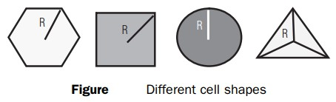
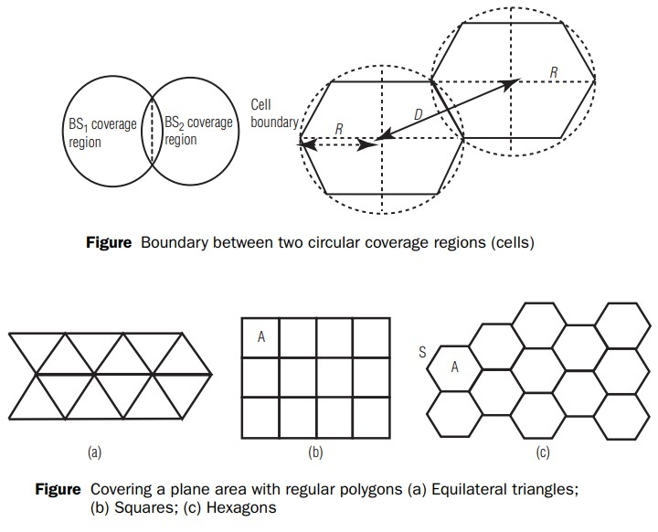
13

Slide 6
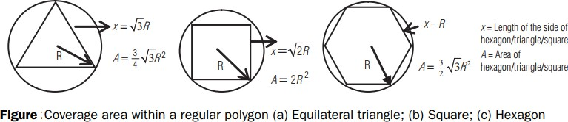
14

Slide 7
Introduction to ce lular concept
The cellular concept was developed in response to the limitations of conventional mobile radio services.
The main limitations of the previous mobile communication systems are as follows:
High-power transmitters were used to cover very large area.
Inefficient use of allocated radio spectrum.
If a user leaves the coverage area, they had to reinitiate the call on a different frequency channel.

Slide 8

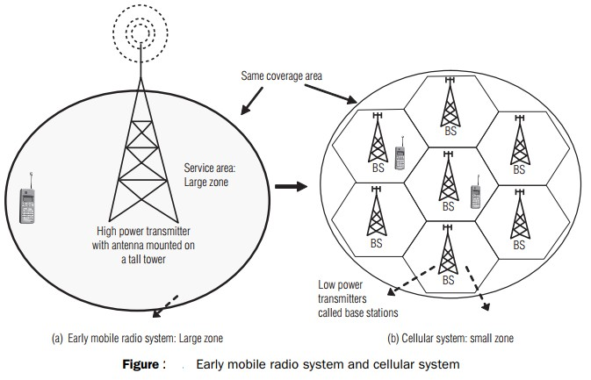

Slide 9
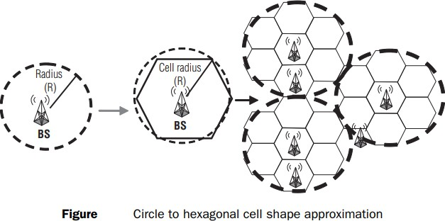

Slide 10
Frequency reuse: This is the process in which the same set of frequencies (channels) can be allocated to more than one cell to increase the system capacity. Instead of deploying a powerful BS in a large coverage area, the area is divided into multiple smaller cells and a BS deployed in each cell can use smaller transmit power. Thus, two transmissions can employ the same frequency if they are far away enough such that the CCI level is below a desired threshold.

Slide 11
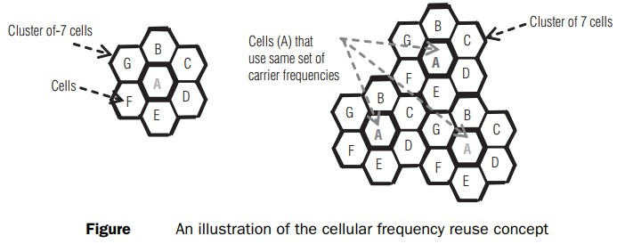
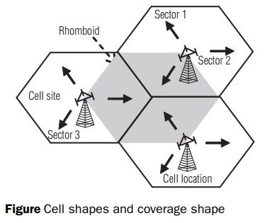

Slide 12
EX: The bandwidth allocated to a particular FDD cellular system is 33 MHz. It uses two 25 kHz simplex channels to provide full duplex voice and control channels, compute the number of channels available per cell if a system uses
(a) 4 cell reuse and (b) 7 cell reuse

Slide 13
Solution
Total bandwidth allocated to cellular system = 33 MHz Channel bandwidth required for duplex channel (uplink and downlink) = 25 kHz × 2 = 50 kHz
Total number of available channels = 33,000,000/50,000 = 660
For cluster size N = 4, number of channels available per cell
= 660/4 = 165
For cluster size N = 7, number of channels available per cell
= 660/7 = 95

Slide 14
To understand the frequency reuse concept,
Consider a cellular system which has a total of S duplex channels available for use in a cluster
Cellular system capacity and frequency reuse for a cluster size of “N” with each cell allocated a group of “K” channels
If each cell is allocated a set of k channels (k < S) and the cluster size is N
The total number of available radio channels can be expressed as
S = kN

Slide 15
The N cells which collectively use the complete set of available frequencies is called a cluster.
If a cluster is replicated M times with in the system,
The total number of duplex channels, C, can be used as a measure of capacity and is given by
C = MkN = MS
the capacity of a cellular system is directly proportional to
the number of times a cluster is replicated in a fixed service area.

Slide 16
The factor of N is called the cluster size and is typically equal to 4, 7, or 12.
For the same cell size at a given area, N decreases ⇒ M increases
⇒ C increases.
The frequency reuse factor of a cellular system is given by 1/N.
N can only have values which satisfy Equation
𝑁 = 𝑖² + 𝑖𝑗 + 𝑗²
where i and j are non-negative integers. To find the nearest co- channel neighbors of a particular cell, one must do the following:
move i cells along any chain of hexagons and
Turn 60 degrees counter-clockwise and move j cells.

Slide 17
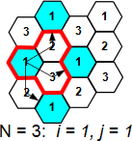
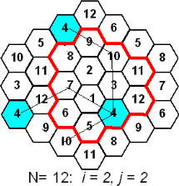

Slide 18
Co-channel Interference
Interference between signals from co-channels
Increasing the signal-to-noise ratio (SNR) to overcome thermal noise does not work
Physically separate co-channel cells
Co-channel reuse ratio
𝑄 = ^{𝐷} = 3𝑁
𝑅
Condition: same cell size, same transmitter power
R: radius of the cell
D: distance between centers of the nearest co-channel cells

Slide 19
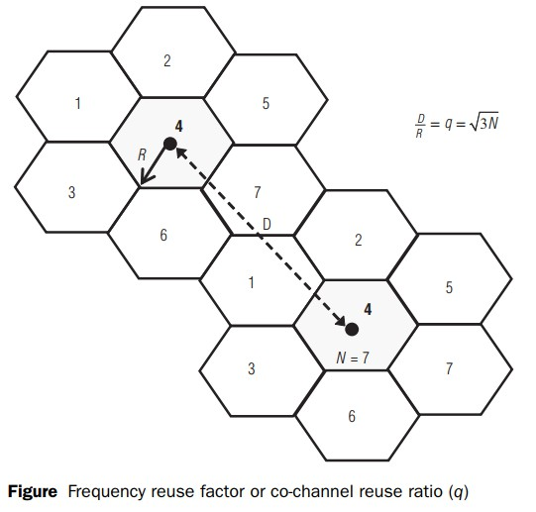
Relationship between frequency reuse factor (D/R) and cluster size (N)

Slide 20
Determination of relation between frequency reuse factor (D/R ratio) and the cluster size (N) involves mainly two steps:
finding the relation between the distance D (two co-channel cells)
and R
locating the co-channel cells.
First let us derive the relation between distance (D) (two co-channel
cells) and R in a hexagonal geometry
The actual centre-to-centre distance between two adjacent hexagonal cells is
𝑑 = 2𝑅 cos 30 or 3𝑅
where R is the centre to vertex distance

Slide 21
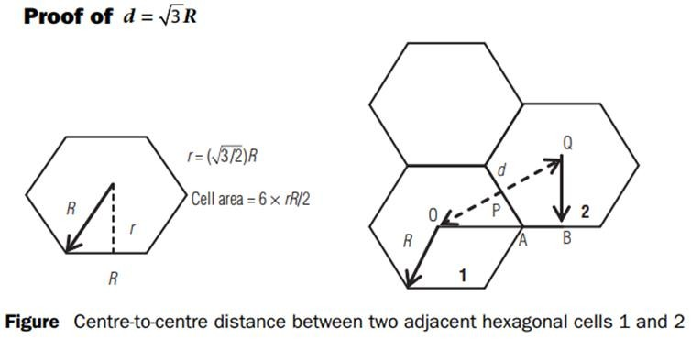
OA = R, AB = R/2 and OAP is a right-angled triangle
In the OAP triangle, OP = OA Sin 60° = (√3/2) R.
OQ = OP + PQ 𝑑 =
3 3
𝑅 + 𝑅 = 3𝑅
2 2
Area of a small hexagon with radius R=6xrR/2=((3√3)/2)R² = 2√3𝑟²

Slide 22
Channel Assignment Strategies
The objectives of channel assignment strategies are to increase capacity and minimize interference.
Channel assignment strategies are classified as either fixed and dynamic.
In a fixed channel assignment strategy, each cell is allocated a predetermined set of voice channel.
If all the channels in that cell are occupied, the call is blocked. A variation is the borrowing strategy.

Slide 23
In a dynamic channel strategy, voice channels are not allocated to different cells permanently.
This strategy reduces the likelihood of blocking.
Mobile switching center (MSC)must collect real-time data on channel occupancy, traffic distribution, and radio signal strength
indications (RSSI)of all channels.

Slide 24
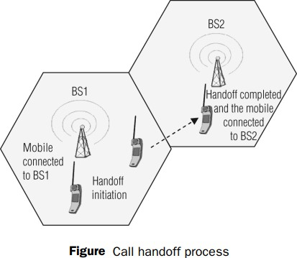
Handoff: A crucial component of the cellular concept is the notion of handoffs. Handoff is the process of transferring an active call from one cell to another as the mobile unit moves from one cell to the other.
Handoff operation involves identifying a new BS and
allocation of voice and
control signals associated.

Slide 25
Handoff –
high priority over call initiation requests
must be performed successfully
Infrequently
be imperceptible.
The margin ∆= 𝑃_{𝑟 ℎ𝑎𝑛𝑑𝑜𝑓𝑓} − 𝑃_{𝑟 𝑚𝑖𝑛𝑖𝑚𝑢𝑚 𝑢𝑠𝑎𝑏𝑙𝑒} cannot be
too large or too small.

Slide 26
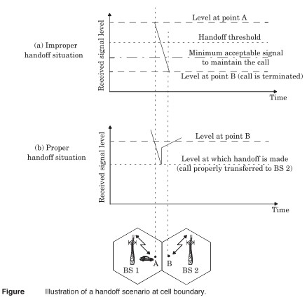

Slide 27
In deciding when to handoff, it is important to ensure that the drop in the measured signal level is not due to momentary fading.
Information about the vehicle speed is useful in handoff decisions.
Dwell time –The time over which a call may be maintained within a cell without handoff.
The statistics of dwell time are important in the practical design of handoff algorithm.

Slide 28
In first generation analog cellular system, the locator receiver is used for handoff.
In second generation system, handoff decisions are mobile assisted –mobile assisted handoff (MAHO).
Intersystem handoff –different cellular systems –roamer.

Slide 29
Prioritizing Handoffs
Guard channel concept –can be used with dynamic channel assignment strategies to increase spectrum utilization.
Queuing of handoff –possible due to the fact that there is a finite time interval between handoff threshold time and call- terminated time

Slide 30
Practical Handoff Considerations
Several handoff schemes have been devised to handle the simultaneous traffic of high speed and low speed users – minimizing the handoff intervention from the MSC

Slide 31
HOME WORK
Prove that for a hexagonal geometry, the co-channel reuse ratio is given by
𝑄 = 3𝑁 , where 𝑁 = 𝑖² + 𝑖𝑗 + 𝑗². Hint: Use the cosine law and the
hexagonal cell geometry.
If two independent voltage signals, v1(t) and v2(t), are added together to provide a new resulting signal, prove that under certain conditions the resulting signal has the same power
as the sum of the individual powers. What are these conditions? What special conditions must apply for this result to be valid when the signals are uncorrelated?

Slide 32
3.3 Show that the frequency reuse factor for a cellular system is given by k/S, where k is the average number of channels per cell and S is the total number of channels available to the cellular service provider.
3.5 A cellular service provider decides to use a digital TDMA scheme which can tolerate a signalto-interference ratio of 15 dB in the worst case. Find the optimal value of N for (a) omnidirectional antennas, (b) 120° sectoring, and (c) 60° sectoring. Should sectoring be used? If so, which case (60° or 120°) should be used? (Assume a path loss exponent ofn =4 and consider trunking efficiency.)

Slide 33
3.6 You are asked to determine the signal-to-interference ratio (SIR or C/1) on the forward link of a cellular system, when the mobile is located on the fringe of its serving cell. Assume that all cells have equal radii, and that base stations have equal power and are located in the centers of each cell. Also assume that each cell transmits an independent signal, such that interfering signal powers may be added. Let us define a ''tier" of cells as being the collection of co-channel cells that are more-or-less the same distance away from the mobile in the serving cell. This problem explores the impact of the cluster size (i.e., frequency reuse distance), the number of tiers used in the calculation of Cll and the effect of the propagation path loss exponent on C/I.
What is the average distance (in terms of R) between the mobile on the fringe of the serving cell and the first tier of co-channel cells? (These cells are called the "nearest neighbors.") How many cells are located in the first tier? Solve for the case of N = 1,
N=3, N =4, N =7, and N =12 cluster sizes. How does the average distance compare to the value of D = QR, where Q = J3N?
What is the average distance (in terms of R) between the mobile on the fringe of the serving cell and the second and third tier of co-channel cells, and how many cells are in the second and third tier of co-channel cells for the cases of N = 1, N = 3, N =4, N =7,
and N = 12 cluster sizes?

Slide 34
Determine the forward link Cll for the following frequency reuse designs: N =1, N = 3, N =4, N = 7, and N = 12. Assume that the propagation path loss exponent is four, and evaluate the S/1 contribution due to just the first tier and then due to additional outer tiers of co-channel cells. Indicate the number oftiers at which there is a diminishing contribution to the interference at the mobile.
Repeat part (c), except now consider a line-of-sight path loss exponent of n =2. Notice the huge impact that the propagation path loss exponent has on CII. What can you say about the cluster size, path loss exponent, and the C/1 values which result? How would this impact practical wireless system design?

