Slide 1
Programming Language:
MATLAB/SIMULINK.
MATLAB (Matrix Laboratory):
A high-level language and environment used for numerical computation, data visualization, signal processing, and algorithm development.
Especially popular in engineering, telecommunications, and control systems.
Works well with matrices, and has powerful toolboxes for specialized tasks.
Simulink:
An add-on to MATLAB that provides a graphical environment for modeling, simulating, and analyzing dynamic systems.
Ideal for control systems, signal processing, communications, and embedded systems.
Uses block diagrams for simulation instead of traditional coding.
Python - NumPy Package.
NumPy (Numerical Python):
A core scientific library in Python for efficient numerical computations.
Provides powerful multi-dimensional arrays (ndarrays), mathematical functions, linear algebra, and Fourier transforms.
It’s the foundation for many other Python libraries like SciPy, Pandas, and TensorFlow.
Known for being fast, open-source, and easy to integrate with C/C++ code.

Slide 2
Introduction
Wireless communications has been associated with cellular telephony, as this is the biggest market segment, and has had the highest impact on everyday lives.
In recent times, wireless computer networks have also led to a significant change in working habits and mobility
of workers – answering emails in a coffee shop has become an everyday occurrence.
But besides these widely publicized cases, a large number of less obvious applications have been developed, and are starting to change our lives.

Slide 3
Introduction
Wireless communication plays a crucial role in modern society, particularly in the field of cellular telephony, which represents the largest market segment. This technology has significantly impacted everyday life by enabling seamless communication across vast distances.
In recent years, wireless computer networks have transformed workplace mobility. Employees can now work remotely, access emails, and communicate efficiently from any location, such as coffee shops, without being restricted to a fixed workstation.
Beyond widely known applications like mobile phones and internet connectivity, wireless communication has also enabled less obvious but impactful innovations. These emerging applications continue to evolve, influencing various aspects of daily life and industries.

Slide 4
This variety of new applications causes the technical challenges for the wireless engineers to become bigger with each day.
To give an overview of the solution methods for current as well as future challenges.
There are two paths to developing new technical solutions:
Engineering Driven and Market Driven.
In the first case, the engineers come up with a brilliant scientific idea – without having an immediate application in mind.

Slide 5
Technical Challenges and Solution Approaches in Wireless Communication
The continuous evolution of wireless communication has led to various new applications, which in turn pose increasing technical challenges for wireless engineers. These challenges require innovative solutions to keep up with the growing demands of wireless technology.
To address current and future challenges, solution methods can be classified into two approaches:
Engineering-Driven Approach:
Engineers develop new scientific ideas without initially considering their immediate application.
This method focuses on pure research and innovation, which may later be adapted for practical use.
Market-Driven Approach:
Solutions are developed based on the current market demands and consumer needs.
Engineers work on refining and optimizing existing technologies to meet industry requirements.
Both approaches play a crucial role in shaping the future of wireless communication by balancing theoretical advancements with real-world applications.

Slide 6
As time progresses, the market finds applications enabled by this idea.
In the other approach, the market demands a specific product and the engineers try to develop a technical solution that fulfills this demand.

Slide 7
Market-Driven vs. Engineering-Driven Approach in Wireless Communication
In wireless communication, technological advancements arise from two primary approaches:
Engineering-Driven Approach:
Engineers develop innovative scientific ideas without immediate application.
Over time, markets identify practical applications for these innovations, leading to new products and solutions.
Market-Driven Approach:
The market has specific demands for products and services.
Engineers work towards developing solutions that fulfill these demands, ensuring that technology aligns with industry needs.
Both approaches play a significant role in technological evolution, as some breakthroughs originate from research, while others are driven by market needs.

Slide 8
Market Demands.
We start out with a brief history of wireless communications, in order to convey a feeling of how the science, as well as the market, has developed in the past 100 years.
Then follows a description of the types of services that constitute the majority of the wireless market today.
Each of these services makes specific demands in terms of data rate, range, number of users, energy consumption, mobility, and so on.
A description of the interaction between the engineering of
wireless devices and the behavioral changes induced by them
in society.

Slide 9
Market Demands in Wireless Communication
Historical Development:
Wireless communication has evolved significantly over the past 100 years.
Both scientific advancements and market growth have contributed to its development.
Types of Wireless Services:
The modern wireless market consists of various services, each designed to meet specific demands.
Service-Specific Demands:
Key factors influencing wireless services include:
Data Rate (speed of communication)
Range (coverage area)
Number of Users (network capacity)
Energy Consumption (battery efficiency)
Mobility (support for movement and handovers)
4.Impact on Society:
Wireless technology influences both engineering advancements and human behavior.
The increasing use of wireless devices has led to changes in communication habits, work culture, and social interactions.

Slide 10
How It A l Started
Wireless communication is the oldest form of communication like shouts and drums did not require any wires or cables to function.
Wireless communications started only with the work of Maxwell and Hertz, who laid the basis for the understanding of the transmission of electromagnetic waves.
In 1898, Marconi , made his well-publicized demonstration of wireless communications from a boat to the Isle of Wight in the English Channel.
It is noteworthy that while Tesla was the first to succeed in this important endeavor, Marconi had the better public relations, and is widely cited as the inventor of wireless communications,
receiving a Nobel prize in 1909.
16

Slide 11
How It A l Started
Early Forms of Wireless Communication:
The oldest forms included shouts, drum signals, and smoke signals, which did not rely on wires.
Scientific Foundation:
Wireless communication became feasible only after the work of James Clerk Maxwell and Heinrich Hertz, who established the principles of electromagnetic wave transmission.
Marconi's Contribution (1898):
Guglielmo Marconi conducted a famous demonstration of wireless communication.
He transmitted signals from a boat to the Isle of Wight in the English Channel.
Tesla vs. Marconi Controversy:
Nikola Tesla made earlier advancements in wireless transmission.
However, Marconi's superior public relations efforts led to him being recognized as the inventor of wireless communication.
Marconi received the Nobel Prize in 1909 for his contributions.
16

Slide 12
Types of Services
Broadcast
Paging
Cellular Telephony
Trunking Radio
Cordless Telephony
Wireless Local Area Networks
Personal Area Networks
Fixed Wireless Access

Slide 13
Types of Services
Types of Wireless Communication Services
Broadcast:
Used for radio and television transmission to a wide audience.
Paging:
One-way communication used for sending short messages or alerts to a receiver.
Cellular Telephony:
Mobile phone networks that provide voice, SMS, and data services.
Trunking Radio:
A specialized two-way radio system used for emergency services and public safety.
Cordless Telephony:
Short-range wireless telephony systems, such as landline phones with cordless handsets.
Wireless Local Area Networks (WLAN):
Enables internet and network access within a limited area (e.g., Wi-Fi).
Personal Area Networks (PAN):
Short-range communication for personal devices (e.g., Bluetooth, Zigbee).
Fixed Wireless Access:
Provides broadband internet using wireless technology as an alternative to fiber or cable connections.

Slide 14
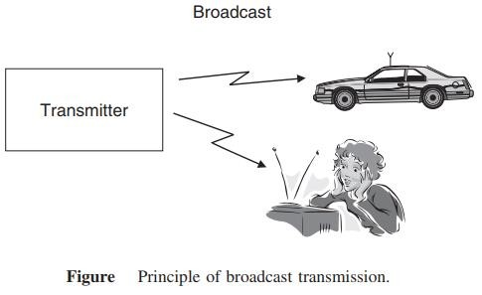
Broadcast
The first wireless service was broadcast radio. Four properties differentiate broadcast radio
The information is sent unidirectional, i.e., in one direction only.
The information transmitted is same for all receivers.
The information is transmitted continuously.
In many cases like TV
or radio, multiple transmitters send the same information

Slide 15
Broadcast
Broadcast Communication
Broadcast communication is the first wireless communication service, primarily used for radio and television transmissions.
Key Properties of Broadcast Radio:
Unidirectional Transmission: Information flows in one direction, from the transmitter to the receiver.
Same Information for All Receivers: Every receiver within range gets the same content.
Continuous Transmission: The broadcast signal is transmitted without interruption.
Multiple Transmitters: In cases like TV and radio, multiple transmitters send the same information to cover a larger area.
This makes broadcast communication ideal for mass media services like AM/FM radio and television.

Slide 16
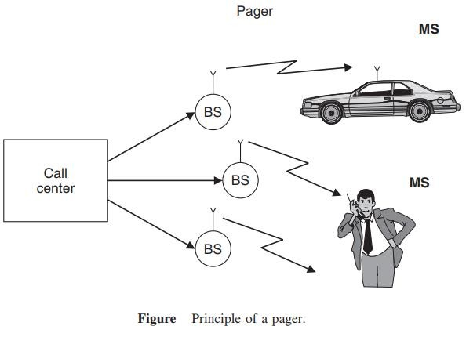
Paging
Similar to broadcast, paging systems are unidirectional wireless communications systems. The following properties characterize them:
The user can only receive information, but cannot transmit.
The information is intended for and received by, only a single user.
The amount of transmitted information is very small.

Slide 17
Paging
Paging systems are a type of unidirectional wireless communication, similar to broadcast but designed for individual users.
Key Properties of Paging Systems:
Receive-Only Communication: The user can only receive information but cannot transmit back.
Single-User Targeting: Unlike broadcast, paging messages are sent to specific individuals.
Small Data Transmission: The transmitted information is minimal, often just a short message or alert.
Paging was widely used before mobile phones became common, especially in emergency services and business communications.

Slide 18
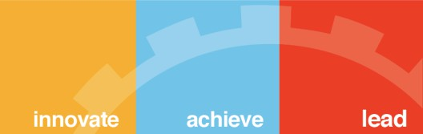
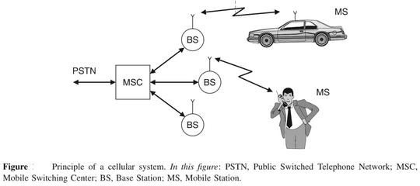
Cellular Telephony
Cellular telephony is the economically most important form of wireless communications. The information flow is bidirectional. A user can transmit and receive information at the same time.

Slide 19
Cellular Telephony
Cellular telephony is the most economically significant form of wireless communication. It allows bidirectional information flow, meaning users can both transmit and receive data simultaneously.
Key Features of Cellular Telephony:
Two-Way Communication: Users can talk and listen at the same time.
Cell-Based Infrastructure: Divides areas into "cells," each served by a Base Station (BS).
Mobile Switching Center (MSC): Manages connections between mobile users and the Public Switched Telephone Network (PSTN).
Mobility Support: Enables communication even while moving (e.g., in a car).
This system forms the backbone of modern mobile networks, enabling voice calls, SMS, and internet access.

Slide 20
Trunking Radio
Trunking radio systems are an important variant of cellular phones, where there is no connection between the wireless system and the public switched telephone network (PSTN); therefore, it allows the communications of closed user groups. Obvious applications include police departments, fire departments, taxis, and similar services. The closed user group allows following operations
Group calls
Call priorities
Relay networks

Slide 21
Trunking Radio
Trunking radio systems are a specialized form of wireless communication used primarily in public safety and critical communication sectors. Unlike traditional cellular networks, trunking radio does not connect to the Public Switched Telephone Network (PSTN), making it an independent communication system for closed user groups.
Key Features of Trunking Radio
Efficient Channel Utilization – Uses a pool of radio channels dynamically assigned to users as needed, ensuring optimal frequency usage.
Closed User Groups – Designed for organizations like police, fire departments, and emergency services that require secure and dedicated communication.
No PSTN Dependency – Works independently of public telephone networks, enhancing security and reliability.
Fast Call Setup – Offers near-instantaneous connectivity without the delays of conventional mobile networks.
Operations in Trunking Radio
Group Calls – Enables communication among multiple users in a closed group, useful for emergency and coordinated operations.
Call Priorities – Ensures priority access to channels for high-importance users, such as emergency responders.
Relay Networks – Extends communication range using relay stations to cover large geographical areas.

Slide 22
Trunking Radio
Applications
Public Safety – Used by police, fire, and medical emergency services.
Transportation – Taxis, railways, and aviation for seamless coordination.
Industrial Use – Factories, power plants, and military applications for secure communication.
In the Wireless and Mobile Communication course, trunking radio is studied as an alternative to cellular systems, focusing on resource allocation, spectrum efficiency, and reliability in mission-critical environments.

Slide 23
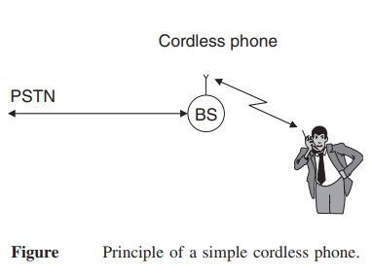
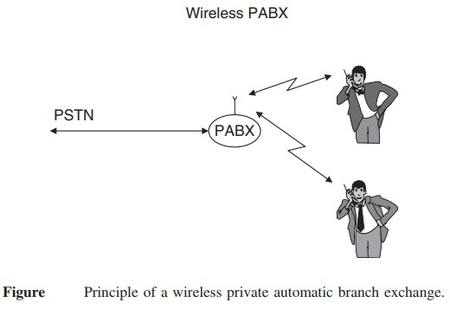

Slide 24
Cordless phones and wireless Private Automatic Branch Exchange (PABX) systems are fundamental concepts in Wireless and Mobile Communication, dealing with short-range communication within a specific area.
1. Cordless Phone
A cordless phone consists of a base station (BS) connected to the Public Switched Telephone Network (PSTN) and a wireless handset.
Principle: The BS acts as an interface between the PSTN and the cordless handset, enabling wireless communication within a limited range (typically within a home or office).
Technology: Operates on radio frequencies (e.g., DECT – Digital Enhanced Cordless Telecommunications).
Limitations: Works only within a small radius (typically 50–300 meters) and does not support mobility beyond the BS coverage.
2. Wireless PABX (Private Automatic Branch Exchange)
A wireless PABX extends the concept of a cordless phone by integrating multiple handsets within an organization's internal network.
Principle: The PABX system connects to the PSTN and manages multiple internal wireless extensions, allowing internal and external communication.
Features:
Supports multiple users within an enterprise.
Facilitates both internal (intercom) and external calls without wired connections.
Provides mobility within an office building or campus.
Advantages over Cordless Phones:
Supports multiple users.
Covers a larger area using multiple base stations.
Reduces wiring costs and enhances mobility.

Slide 25
Applications in Wireless Communication
Cordless Phones: Used in homes and small offices for landline communication with limited mobility.
Wireless PABX: Used in large offices, industries, and corporate buildings for efficient internal and external communication.
In Wireless and Mobile Communication, these systems are studied under short-range wireless communication, focusing on frequency allocation, mobility support, and spectrum efficiency.

Slide 26
Wireless Local Area Networks
The functionality of Wireless Local Area Networks (WLANs) is very similar to that of cordless phones connecting a single mobile user device to a public landline system.
A major difference between wireless LANs and cordless phones is the required data rate. While cordless phones need to transmit (digitized) speech, which requires at most 64 Kbit/s, wireless LANs should be at least as fast as the Internet that they are connected.

Slide 27
Wireless Local Area Networks
Wireless Local Area Networks (WLANs) provide high-speed wireless connectivity within a limited geographical area, such as homes, offices, and campuses. They operate similarly to cordless phones by connecting mobile devices to a fixed communication network, but with a much higher data rate.
Key Characteristics of WLANs
Functionality Similar to Cordless Phones: Like cordless phones, WLANs allow devices to communicate wirelessly with a central access point, which connects to a wired network (such as the internet or a local server).
High Data Rate Requirement:
Cordless phones primarily transmit digitized speech at a low data rate (≤64 Kbit/s).
WLANs must support high-speed data transmission to match internet speeds, typically in the range of Mbps to Gbps (e.g., Wi-Fi standards like IEEE 802.11ac, 802.11ax).
Operates on Unlicensed Frequency Bands: Uses ISM bands (2.4 GHz, 5 GHz, and 6 GHz) for communication.
Supports Multiple Devices: Unlike cordless phones, which usually support only one handset, WLANs allow multiple users to connect simultaneously.

Slide 28
Wireless Local Area Networks
Feature | WLANs | Cordless Phones
Purpose | Wireless internet access | Voice communication
Data Rate | Mbps to Gbps | ≤64 Kbit/s
Coverage | 30–100 meters | 50–300 meters
Network | Connects to the internet | Connects to PSTN
Applications of WLANs
Home and Office Networks – Provides seamless internet access to multiple users.
Public Wi-Fi Hotspots – Used in airports, cafes, and shopping malls.
Enterprise Networks – Supports internal communications and cloud-based applications.
In Wireless and Mobile Communication, WLANs are studied under wireless networking protocols, data transmission rates, frequency spectrum utilization, and security mechanisms like encryption (WPA2, WPA3).

Slide 29
Personal Area Networks
When the coverage area becomes even smaller than that of WLANs, we speak of Personal Area Networks (PANs).
Such networks are mostly intended for simple cable replacement duties.
For example, devices following the Bluetooth standard allow connecting a hands-free headset to a phone without requiring a cable; in that case, the distance between the two devices is less than a meter.

Slide 30
Personal Area Networks
Personal Area Networks (PANs) are the smallest type of wireless networks, designed for short-range communication between personal devices.
Characteristics of PANs
Smaller Coverage Area: Covers a few meters (typically 1–10 meters), much smaller than WLANs.
Purpose: Primarily used for cable replacement, enabling wireless communication between personal devices.
Technology Used:
Bluetooth (e.g., hands-free headsets, wireless keyboards, and smartwatches).
Infrared (IR) (e.g., TV remotes, old file transfer systems).
Zigbee (used in IoT devices for low-power, short-range communication).
Low Power Consumption: Optimized for low-energy communication between devices.
Example Applications
Wireless Accessories: Connecting Bluetooth headsets, speakers, keyboards, and mice.
IoT Devices: Smart home automation (e.g., smart bulbs, fitness bands).
File Transfer: Using Bluetooth to transfer files between mobile phones.

Slide 31
Personal Area Networks
Feature | PANs | WLANs
Coverage | 1–10 meters | 30–100 meters
Technology | Bluetooth, Zigbee, IR | Wi-Fi (IEEE 802.11)
Purpose | Personal device connectivity | Internet access for multiple users
Speed | Kbps to Mbps | Mbps to Gbps
PANs are crucial in short-range communication protocols and low-power wireless networks, especially in wearable technology, IoT, and smart devices.

Slide 32
Fixed Wireless Access
Fixed wireless access systems can also be considered as a derivative of cordless phones or WLANs, essentially replacing a dedicated cable connection between the user and the public landline system.
The main difference from a cordless system is that
there is no mobility of the user devices and
the BS almost always serves multiple users.

Slide 33
Fixed Wireless Access
Fixed Wireless Access (FWA) is a technology that provides wireless broadband connectivity to homes and businesses without requiring a physical cable connection.
Key Characteristics of Fixed Wireless Access (FWA)
Alternative to Wired Networks: Functions as a replacement for DSL, fiber, or cable broadband.
No Mobility: Unlike mobile networks, FWA devices remain stationary at a fixed location.
Base Station (BS) Serves Multiple Users: One BS can connect several homes, offices, or businesses.
High-Speed Internet: Often delivers broadband speeds comparable to fiber or DSL.
Uses Licensed & Unlicensed Spectrum: Operates on frequencies like 4G LTE, 5G, WiMAX, and mmWave bands.
Examples of Fixed Wireless Access Usage
5G Home Internet Services (e.g., Verizon 5G Home, T-Mobile 5G Home).
Rural Internet Providers using FWA to bridge the digital divide.
Enterprise Networks using FWA for backup internet connections.
Fixed Wireless Access is a crucial technology in next-generation broadband and is a key enabler of 5G networks.

Slide 34
Fixed Wireless Access
Feature | Fixed Wireless Access (FWA) | Cordless System
Mobility | No (Stationary devices) | Yes (Limited mobility within range)
Usage | Broadband internet | Voice communication
Base Station Role | Serves multiple users | Usually serves a single user
Technology | 4G, 5G, WiMAX | Analog/Digital cordless telephony
Advantages of FWA
Faster Deployment: No need for physical cables, reducing installation time.
Cost-Effective: Eliminates expensive fiber/cable laying.
Ideal for Rural & Remote Areas: Provides connectivity where fiber or DSL is unavailable.
Supports High Bandwidth Applications: Enables HD streaming, gaming, and remote work.

Slide 35
Requirements for the Services
Data Rate
Range and Number of Users
Mobility
Energy Consumption
Use of Spectrum
26

Slide 36
Data Rate
Data rates for wireless services ranges from few bits per second to several gigabits per second, depending on the application.
Type of application | Data rate | 27
Sensor networks | 1 Kbit/s
Speech communications | 5 and 64 Kbit/s
Elementary data services | 10 and 100 Kbit/s
Computer peripherals and similar devices | 1Mbit/s
High-speed data services | 0.5 to 100 Mbit/s
Personal Area Networks | 100 Mbit/s

Slide 37
Data Rate
The data rate in wireless communication varies based on the application, ranging from a few bits per second to several gigabits per second
Key Observations:
Low data rates are used in sensor networks and speech communication.
Medium data rates support elementary data services and computer peripherals.
High-speed applications like Wi-Fi, mobile networks, and PANs require much higher data rates.
The choice of data rate depends on the network type, application requirements, and technology used.

Slide 38
Range and Number of Users
Another distinction among the different networks is the range and the number of users that they serve. By range, we mean here the distance between transmitter and receiver.
The coverage area of a system can be made almost independent of the range by just combining a larger number of BSs into one big network.
Type of network | Range | 28
Body Area Networks (BANs) | 1meter
Personal Area Networks | 10 meter
WLANs | up to 100 meter
Cellular systems | 10 or even 30 km
Satellite systems | 1,000 km radius
Fixed wireless access services | 100 m and several tens of kilometers

Slide 39
Range and Number of Users
The range of a wireless network refers to the distance between the transmitter and receiver, while the number of users depends on the network type and capacity.
Key Insights:
Short-range networks (BANs, PANs) are suitable for wearables and Bluetooth devices.
Medium-range networks (WLANs, Fixed Wireless) cater to homes, offices, and urban setups.
Long-range networks (Cellular, Satellite) serve large areas, including rural and remote regions.
Network coverage can be expanded by using multiple Base Stations (BSs) to form a larger network.
Choosing the right network depends on range, user capacity, and application requirements.

Slide 40
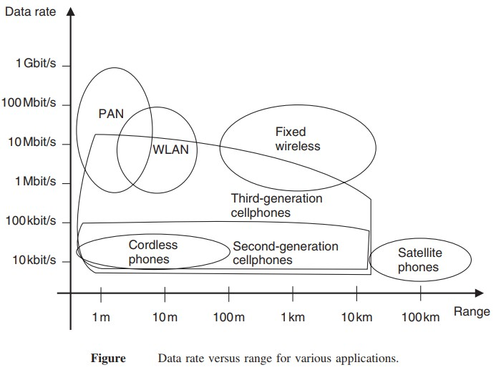
29

Slide 41
Data Rate vs. Range for Wireless Networks
The figure illustrates the relationship between data rate and range for various wireless technologies.
Observations:
Higher data rates are typically achieved in short-range networks, like PANs and WLANs.
Long-range networks (Satellite, Cellular) provide wider coverage but offer lower data rates.
Fixed wireless networks strike a balance between range and data rate.
Cellular networks (2G, 3G, etc.) expand their range but sacrifice speed.
29

Slide 42
Data Rate vs. Range Trends:
Technology | Range | Data Rate
PAN(Bluetooth/Infrared | ~1-10m | 10Mbit/s-1Gbit/s
WLAN (Wi-Fi) | ~100m | 1-100 Mbit/s
Cordless Phones | ~10m | ~10 kbit/s – 100 kbit/s
2G Cellular | ~1-10km | 10 kbit/s – 100 kbit/s
3G Cellular | ~1-10km | 1 Mbit/s – 10 Mbit/s
Fixed Wireless | ~1-10km | 10 Mbits/s-100Mbits/s
Satellite Phones | >100km | ~10 kbit/s – 100 kbit/s
29

Slide 43
Key Takeaways:
Short-range technologies (PAN, WLAN) prioritize speed over range. Cellular and fixed wireless networks balance coverage and data rates. Satellite networks focus on global coverage but with low data rates.
This trade-off between range and speed is a key factor in choosing the right wireless technology for different applications.
29

Slide 44
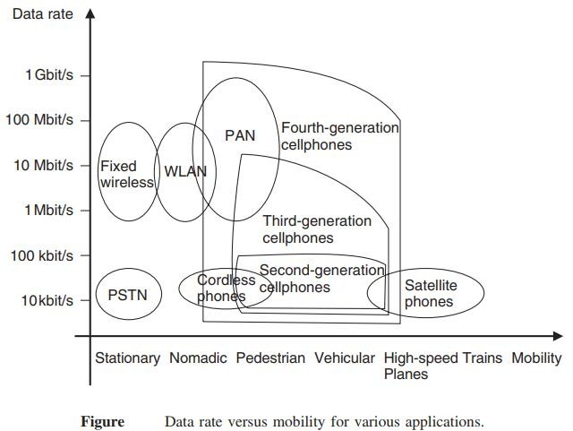
Mobility
Wireless systems also differ of mobility that they have to allow for the users.
The ability to move around while communicating is one of the main factors of wireless communication
for the user.

Slide 45
Mobility
Wireless networks differ in their mobility support, allowing users to move around while communicating. Mobility is a crucial factor for wireless communication.
Key Observations from the Graph:
Higher mobility networks (e.g., Cellular & Satellite) allow users to move freely across large distances.
Low mobility networks (e.g., WLAN, PAN) are better for stationary or nomadic users.
High-speed mobility (e.g., planes, high-speed trains) sacrifices data rate for connectivity.
Key Takeaways:
Wired networks (PSTN) support only stationary users. Wi-Fi and PAN allow movement but work best for nomadic or pedestrian users. Cellular networks (2G, 3G, 4G, 5G) enable vehicular and high-speed mobility. Satellite phones are ideal for extreme mobility (e.g., planes, remote areas) but offer lower speeds.
Mobility plays a crucial role in choosing the right wireless technology based on user movement needs.

Slide 46
Mobility
Data Rate vs. Mobility Trends:
Technology | Mobility Support | Data Rate
PSTN (Fixed line) | Stationary only | ~10 kbit/s – 1 Mbit/s
Cordless Phones | Nomadic | ~10 kbit/s – 100 kbit/s
WLAN (Wi-Fi) | Pedestrian, Nomadic | 1 – 100 Mbit/s
PAN (Bluetooth, Infrared) | Pedestrian, Nomadic | 10 Mbit/s – 1 Gbit/s
2G Cellular | Vehicular, Nomadic | 10 kbit/s – 100 kbit/s
3G Cellular | Vehicular | 1 Mbit/s – 10 Mbit/s
4G Cellular | Vehicular, High-speed trains | 10 Mbit/s – 1 Gbit/s
Satellite Phones | Planes, High-speed trains | ~10 kbit/s – 100 kbit/s

Slide 47
Energy Consumption
Energy consumption is a critical aspect of wireless devices. Most wireless devices use (one way or rechargeable) batteries, as they should be free of any wires both the ones used for communication and the ones providing the power supply.
Rechargeable batteries
One way batteries
Power mains

Slide 48
Energy Consumption
Energy consumption is an important factor in the design and usage of wireless devices. Since these devices are expected to work without wired connections, they typically rely on batteries or alternative power sources. Efficient energy use ensures long operating time and reduced maintenance.
Wireless devices are powered using the following methods:
Rechargeable Batteries: These can be reused multiple times after charging. They are suitable for devices that need regular usage, like mobile phones and laptops.
One-way (Disposable) Batteries: These are non-rechargeable and must be replaced after use. They are used in low-power or infrequent-use devices like remote controls or some IoT sensors.
Power Mains: Some fixed-position wireless devices are connected directly to the power supply (mains electricity). These are less common in mobile environments but used in routers, base stations, etc.
To maintain portability and usability, wireless devices must be designed to consume as little energy as possible while maintaining performance.

Slide 49
Use of Spectrum
Spectrum can be assigned on an exclusive basis, or on a shared basis. That determines to a large degree the multiple access scheme and the interference resistance that the system has to provide:
Spectrum dedicated to service and operator
Spectrum allowing multiple operators
Spectrum dedicated to a service
free spectrum
Adaptive spectral usage

Slide 50
Use of Spectrum
Spectrum refers to the range of electromagnetic frequencies used for transmitting data in wireless communication. Efficient spectrum usage is vital to avoid interference and ensure seamless communication.
Spectrum can be allocated in two major ways:
Exclusively: Only one operator or service has access.
Shared: Multiple operators or services use the same spectrum.
The method of allocation impacts:
The multiple access technique used (e.g., TDMA, FDMA, CDMA).
The interference resistance and overall system performance.
Types of spectrum usage include:
Dedicated Spectrum for Service and Operator: Specific frequencies are assigned to a particular operator for a specific service.
Spectrum for Multiple Operators: Allows different operators to share the same frequency band with coordination.
Service-Specific Spectrum: Frequencies are assigned based on the type of service, like mobile, TV, or satellite.
Free (Unlicensed) Spectrum: Open to all users without exclusive licensing (e.g., Wi-Fi operates on 2.4 GHz and 5 GHz).
Adaptive Spectrum Usage: Systems dynamically select and utilize available spectrum based on current network conditions (used in cognitive radio networks).

Slide 51
Direction of Transmission (The duplex concept )
Simplex systems– e.g., broadcast systems and pagers.
Semi-duplex systems – e.g.,Walkie-talkies
Full-duplex systems – e.g., cellphones and cordless phones.
FDD uses two separate frequencies for the uplink (from the mobile to the BS) and the downlink (from the BS to the mobile).
TDD uses a single frequency to transmit signals in both the downlink and uplink directions.
Frequency(Mhz)
Base Station(Tx), Mobile Station(Rx
Frequency(Mhz)
Base Station(Tx), Mobile Station(Rx)
Mobile station (tx), Base station(Rx)
Mobile station (tx), Base station(Rx)
Time (ms)
BITS Pilani, Deemed to be UniversityTuinmdeer S(emctison) 3 of UGC Act, 1956

Slide 52
Direction of Transmission (The duplex concept )
In wireless communication, data transmission can occur in different directions depending on the type of system. This concept is called duplexing and is categorized as:
1. Simplex Systems
Data flows in only one direction.
Example: Radio broadcast, pagers.
2. Semi-Duplex Systems
Data flows in both directions, but only one at a time.
Example: Walkie-talkies.
3. Full-Duplex Systems
Data flows in both directions simultaneously.
Example: Mobile phones, cordless phones.
Time (ms)
BITS Pilani, Deemed to be UniversityTuinmdeer S(emctison) 3 of UGC Act, 1956

Slide 53
Direction of Transmission (The duplex concept )
Types of Duplexing Techniques
🔹 FDD (Frequency Division Duplex):
Uses two separate frequencies:
One for uplink (mobile to base station).
One for downlink (base station to mobile).
Allows simultaneous transmission and reception.
🔹 TDD (Time Division Duplex):
Uses a single frequency, but transmission is divided in time slots.
One time slot for uplink, another for downlink.
No simultaneous communication—alternates direction over time.
In FDD, uplink and downlink happen at the same time but on different frequencies.
In TDD, the same frequency is used but alternates over time for uplink and downlink.
The choice of simplex, semi-duplex, or full-duplex depends on the application needs. FDD is suitable for continuous high-data services, while TDD is more flexible and cost-effective.
Time (ms)
BITS Pilani, Deemed to be UniversityTuinmdeer S(emctison) 3 of UGC Act, 1956

Slide 54
Wireless communication systems
Antenna
Information to
be transmitted
coding
Modulator
Transmitter
carrier
Antenna
Information
Received
decoding
DeModulator
Receiver
carrier

Slide 55
Wireless communication systems
Wireless communication systems transfer data without physical connection using radio waves. The process involves two main stages: Transmission and Reception.
Transmission Chain (Transmitter Side):
Information to be transmitted:
Raw data or signal to be sent (e.g., voice, video, text).
Coding:
Adds redundancy for error detection and correction.
Modulator:
Combines the coded data with a carrier signal (high-frequency wave).
Converts baseband signals to radio frequencies.
Transmitter:
Amplifies the modulated signal and sends it to the antenna.
Antenna:
Converts electrical signal into electromagnetic waves and radiates it into the air.

Slide 56
Wireless communication systems
Reception Chain (Receiver Side):
Antenna:
Captures the transmitted signal from the air.
Receiver:
Picks up and amplifies the incoming signal.
Demodulator:
Extracts the original data from the modulated signal using the carrier.
Decoding:
Removes redundancy and corrects any transmission errors.
Information Received:
Final recovered message, ideally identical to the original transmitted data.
The modulator/demodulator handles signal transformation using a carrier.
Coding/decoding ensures the reliability of communication.
Antennas are essential for converting between electrical and electromagnetic signals.

Slide 57
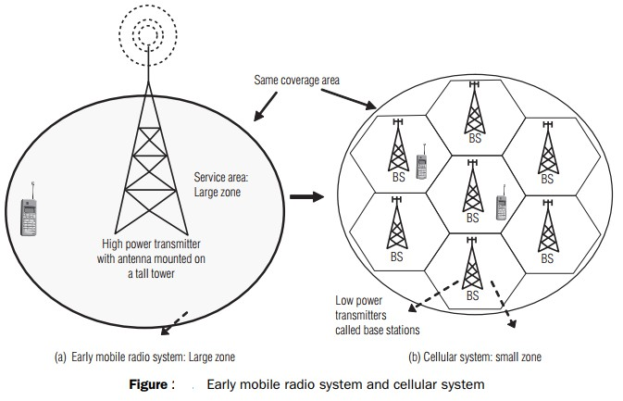

Slide 58
(a) Early Mobile Radio System – Large Zone
Uses a high-power transmitter with a tall antenna tower.
Covers a large area using just one base station.
All users in the zone connect to the same transmitter.
Limitations:
Signal quality degrades with distance.
Supports fewer users due to spectrum limitations.
Harder to reuse frequencies efficiently.
(b) Cellular System – Small Zone
Entire area is divided into multiple small zones (cells).
Each cell has a Base Station (BS) with a low-power transmitter.
Same overall coverage area as the large zone system.
Advantages:
Efficient frequency reuse (adjacent cells use different frequencies).
Supports more users within the same area.
Better signal quality and call reliability.
Allows seamless handoff of mobile users between cells.

Slide 59
Feature | Early Mobile Radio | Cellular System
Coverage | Single large zone | Multiple small zones
Power | High | Low
Scalability | Limited | High
Frequency Reuse | Poor | Efficient
User Capacity | Low | High
The cellular concept revolutionized mobile communication by improving coverage, capacity, and spectral efficiency.

Slide 60
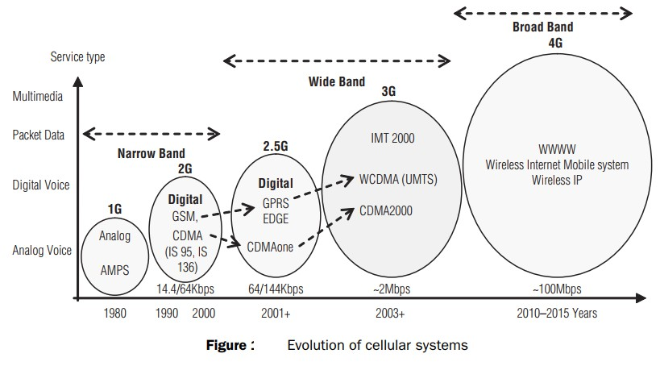

Slide 61
1G – Analog Voice (1980s)
Technology: AMPS (Advanced Mobile Phone System)
Service: Analog voice only
Data Rate: Very low (no digital data)
Limitations: Poor voice quality, no security, no data
2G – Digital Voice (1990s)
Technology: GSM, CDMA (IS-95, IS-136)
Service: Digital voice, basic SMS
Data Rate: 14.4 to 64 kbps
Advantage: Better security, efficiency, battery life
2.5G – Packet Data (2001+)
Technology: GPRS, EDGE, CDMAone
Service: Voice + Packet Data (Internet, email)
Data Rate: 64–144 kbps
Role: Bridge between 2G and 3G, introduced mobile data

Slide 62
3G – Wide Band (2003+)
Technology: IMT-2000, WCDMA (UMTS), CDMA2000
Service: Voice, SMS, multimedia, video calling
Data Rate: ~2 Mbps
Advancement: Global roaming, faster internet, mobile apps
4G – Broad Band (2010–2015+)
Technology: Wireless Internet Mobile System, Wireless IP (e.g., LTE)
Service: High-speed data, HD video streaming, VoIP
Data Rate: ~100 Mbps
Revolution: Internet-first approach, enabled mobile broadband

Slide 63
Generation | Service Type | Data Rate | Key Feature
1G | Analog voice | Very low | Basic mobile voice
2G | Digital voice, SMS | 14.4–64 kbps | Better quality & security
2.5G | Voice + Packet Data | 64–144 kbps | Internet access introduced
3G | Multimedia, Internet | ~2 Mbps | Video calling, faster data
4G | Broadband Internet | ~100 Mbps | Streaming, VoIP, full mobile internet

Slide 64
Cellular Network- 1G
Goal: To develop a working system that could provide basic service
Time frame: 1980s in US Technology: FDMA/FDD Speed: 2.4Kbps
voice
1G network used Analogue circuit-switched technology with FDMA
800–900 MHz frequency bands.
Example Systems:
Analogue Mobile Phone System (AMPS-USA)
Total Access Communication System (TACS-UK)
Nordic Mobile Telephone (NMT-Europe)
37

Slide 65
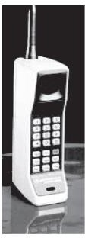
In AMPS, two 25-MHz bands are allocated. One 25-MHz band is for communication from BS to mobile unit and the other for communication from mobile unit to BS.
The following are the limitations of 1G:
Supports only speech
Low traffic capacity
Unreliable handover
Long-call setup time and frequent call drops
Inefficient use of bandwidth and poor battery life
Poor voice quality and large phone size
Allows users to make voice calls in 1 country only
the first handheld device from Motorola Company which was available in 1984
38
in 1G network.

Slide 66
Cellular Network-2G
Goal: Digital voice service with improved quality and also provide better services
Time Frame: Launched in Finland in 1991
2G technology supports data, speech, FAX, SMS, and WAP services.
The frequency bands used by GSM are 890–960 MHz and
1710–1880 MHz. (890–915 MHz - uplink MS to BS, 935–
960 MHz downlink BS to MS)
Used digital signals

Slide 67

Digital modulation formats were introduced in this generation with the main technology as TDMA/FDD
Data Speed: upto 64kbps
Services like text message, picture message was included. Example Systems:
Global System for Mobile Communications (GSM) (TDMA and FDMA)
IS-95(Interim Standard) (CDMA)
Ericsson GH218 which was introduced in 1994 and
operated in 2G networks.

Slide 68
The following are limitations of 2G:
Provides low data rates ranging from 9.6 kbps to 28.8 kbps.
Circuit-switched network, where the end systems are dedicated for the entire call session. This causes reduction in usage of bandwidth and resources.
Too many 2G standards globally (e.g. GSM, CDMA, PDC,
and PHS )

Slide 69
Interim generation (2.5G )
Goal: To provide better data rates and wider range of data services and it was a transition from 2G to 3G
Time frame: 2000-2002
The mobile technology using GPRS standard has been termed as 2.5G.
The 2.5G was started in 1998 with added GPRS and enhanced
data rates for GSM evolution (EDGE).

Slide 70
Cellular Network- 3G
The aim of 3G systems is to provide communication services from person-to-person at any place (global roaming) and at any time through any medium with guaranteed quality of service.
high-speed internet access, live video communications, and simultaneous data and voice transmission .
The 3G technology has added multimedia facilities to 2.5G
phones.
3G operates in the frequency band of 1710–2170 MHz.
It provides high transmission rates from 348 Kbps in a moving vehicle to 2 Mbps for stationary or mobile users.

Slide 71
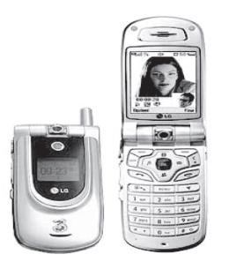
Examples of 3G system are universal mobile telecommunication systems (UMTS) and international mobile telecommunications at 2,000 MHz (IMT-2000).
UMTS are designed to provide different types of data rates, based on the following circumstances:
up to 144 kbps for moving vehicles 384 kbps for pedestrians
2 Mbps for indoor or stationary users
LG U8110 that was introduced in 2004 and is operating in 3G networks.

Slide 72
The following are the drawbacks of 3G system:
High bandwidth requirement
High spectrum licensing fees
Expense and bulk size of 3G phones
Lack of 2G mobile user buy in for 3G wireless service
Lack of network coverage because it is still a new service
High prices of 3G mobile services in some countries

Slide 73
Cellular Network- 4G
Goal: High mobility, High data rate
Frequency Band: 2 to 8 Ghz.
Download speed is upto 100 Mbps for moving users and 1GPS for stationary users.
The following modulation techniques are proposed to be used in the 4G cellular phones.
Variable spreading factor-orthogonal frequency and code
division multiplexing (VSF-OFCDM).
Variable spreading factor code-division multiple access (VSF- CDMA).
LTE (Long Term Evolution)
Uses Orthogonal Frequency Division Multiplexing (OFDM)
Uses Multi-input Multi-output(MIMO) for enhanced throughput
46

Slide 74
Features of 4G
Support for interactive multimedia, voice, streaming video, Internet, and other broadband services
Fully IP based mobile system
High speed, high capacity, and low cost‐per‐bit
Global access, service portability, and scalable mobile services
Seamless switching, and a variety of Quality of Service
Better scheduling and call‐admission‐control techniques
Better spectral efficiency
Interoperability with existing wireless standards
Packet switched network

Slide 75
Advantages of 4G
Affordable communication services.
High speed, high capacity and low cost per bit.
Support for interactive multimedia, voice , streaming video, Internet and other broadband services.
Global access, Service portability and scalable mobile services and variety of quality of services provided.
Better spectral efficiency.
seamless network of multiple protocol and air interfaces.

Slide 76
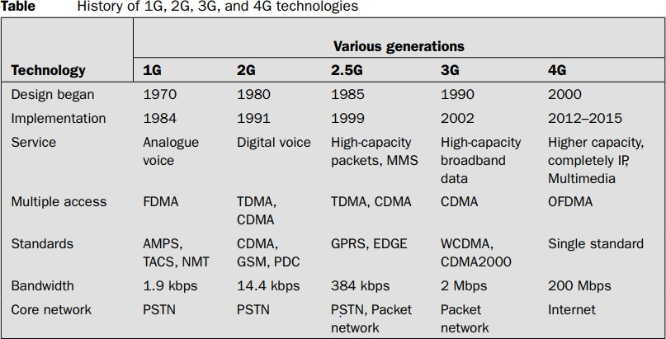

Slide 77
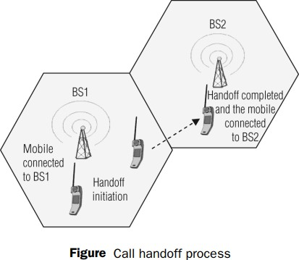
Handoff: A crucial component of the cellular concept is the notion of handoffs. Handoff is the process of transferring an active call from one cell to another as the mobile unit moves from one cell to the other.
Handoff operation involves identifying a new BS and
allocation of voice and
control signals associated.

Slide 78
Handoff (or handover) is the process of transferring an active call or data session from one cell (base station) to another without interrupting the service as the user moves.
Why Handoff is Needed
When a mobile user moves out of the coverage area of one cell and into another.
To maintain call quality and avoid dropped calls.
Steps in the Handoff Process
Detection: Mobile device or base station (BS1) detects weakening signal.
Initiation: System identifies a stronger signal from a nearby base station (BS2).
Transfer: Mobile switches connection from BS1 to BS2.
Completion: Mobile unit is now connected to BS2, call continues seamlessly.
Involves:
Identifying a new base station (BS)
Allocating voice and control signals
Maintaining call continuity

Slide 79
Step | Description
BS1 | Mobile initially connected to BS1
Handoff Initiation | Mobile moves away from BS1
BS2 | Handoff completed, mobile connected to BS2
Key Points to Remember
Seamless call experience is the goal.
It is triggered when signal quality drops.
Crucial for user mobility and network reliability.

Slide 80
Handoff –
high priority over call initiation requests
must be performed successfully
Infrequently
be imperceptible.
The margin ∆= 𝑃_{𝑟 ℎ𝑎𝑛𝑑𝑜𝑓𝑓} − 𝑃_{𝑟 𝑚𝑖𝑛𝑖𝑚𝑢𝑚 𝑢𝑠𝑎𝑏𝑙𝑒} cannot be
too large or too small.

Slide 81
Important Characteristics of a Good Handoff:
High Priority
Handoffs are given higher priority than new call initiations.
Reason: Ongoing calls must not be dropped.
Successful Execution
Handoffs must be executed reliably to avoid call drops or poor service.
Infrequent
They should not happen too often; frequent handoffs can degrade user experience.
Imperceptible to User
The transition should be smooth and unnoticed by the user.

Slide 82
Handoff Margin Concept
Handoff Margin (Δ):
Δ=Prhandoff​−Prminimumusable​
Explanation:
Prhandoff​: Received power level at which handoff is triggered.
Prminimumusable​: Minimum signal strength required for acceptable communication.
Design Rule:
This margin must not be too small or too large:
Too small → Late handoff, call might drop.
Too large → Unnecessary handoff, wasting resources.

Slide 83
Requirement | Why It's Important
High priority | To prevent ongoing calls from dropping
Successful & infrequent | For quality service and reduced signaling load
Imperceptible | Smooth user experience
Balanced margin (Δ) | Ensures handoff happens at the right time

Slide 84
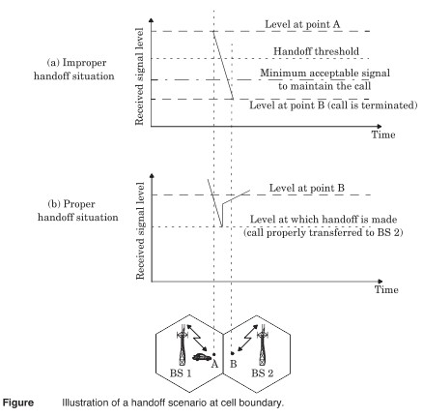

Slide 85
In deciding when to handoff, it is important to ensure that the drop in the measured signal level is not due to momentary fading.
Information about the vehicle speed is useful in handoff decisions.
Dwell time –The time over which a call may be maintained within a cell without handoff.
The statistics of dwell time are important in the practical design of handoff algorithm.

Slide 86
(a) Improper Handoff Situation
The handoff decision is delayed.
The signal strength from Base Station 1 (BS1) falls below the minimum acceptable signal level before a handoff is initiated.
As a result, the call is dropped at point B because the signal becomes too weak to maintain the call.
Conclusion: Handoff occurred too late, resulting in call termination.
(b) Proper Handoff Situation
The handoff is triggered in advance, before the signal drops below the minimum acceptable level.
When the signal from BS1 falls to the handoff threshold, the mobile is transferred to Base Station 2 (BS2).
The signal strength from BS2 at this point is sufficient to maintain the call.
Conclusion: Handoff occurred at the right time, allowing seamless call transfer and avoiding call drop.

Slide 87
Two adjacent cells are shown: one served by BS1 and the other by BS2.
A mobile user moves from point A (in BS1’s coverage) to point B (towards BS2).
Handoff must be performed near the cell boundary to ensure uninterrupted service.
Key Terms
Handoff Threshold: Signal level at which a handoff should ideally occur.
Minimum Acceptable Signal: Lowest signal level at which a call can still be maintained.
Call Dropped: Happens when the signal falls below the minimum acceptable level before handoff.
Proper handoff management ensures that the user experiences no service disruption while moving across cells. Delayed handoff may lead to call drops, affecting user experience.

Slide 88
In first generation analog cellular system, the locator receiver is used for handoff.
In second generation system, handoff decisions are mobile assisted –mobile assisted handoff (MAHO).
Intersystem handoff –different cellular systems –roamer.

Slide 89
Mobile Assisted Handoff (MAHO)
Mobile Assisted Handoff (MAHO) is a technique used in 2G cellular systems (like GSM) where the mobile device helps the network in making handoff decisions.
How it works:
The mobile station (MS) continuously measures:
Signal strength of the serving base station (BS).
Signal strength of neighboring base stations.
The mobile sends this measurement data to the serving base station at regular intervals.
The network (Base Station Controller or BSC) uses these reports to decide:
Whether a handoff is needed.
Which neighboring BS has the strongest signal for a smooth transition.
If the signal of a neighbor BS is stronger than the current one, the handoff is triggered to that BS.
Why MAHO is useful:
Reduces the handoff delay, as signal strength is monitored in advance.
Provides better decision-making as the mobile has a better view of its surrounding signal environment.
Improves call quality and reduces the chances of call drops.

Slide 90
Prioritizing Handoffs
Guard channel concept –can be used with dynamic channel assignment strategies to increase spectrum utilization.
Queuing of handoff –possible due to the fact that there is a finite time interval between handoff threshold time and call- terminated time

Slide 91
Prioritizing Handoffs
To maintain call continuity and improve network efficiency, handoffs are often prioritized using specific techniques:
1. Guard Channel Concept
A certain number of channels in each cell are reserved only for handoffs.
These reserved channels are not used for new call initiations.
This ensures that ongoing calls can be handed off smoothly without dropping, especially in high-traffic areas.
Can be combined with dynamic channel assignment to improve spectrum utilization.
2. Queuing of Handoff Requests
Not all handoff requests need to be processed instantly.
There is a small time interval between when a handoff is needed (handoff threshold) and when the call would actually drop (call-terminated time).
During this interval, handoff requests can be queued, especially if no channel is currently available.
If a channel becomes available shortly, the handoff can be executed in time to avoid call drop.

Slide 92
Practical Handoff Considerations
Several handoff schemes have been devised to handle the simultaneous traffic of high speed and low speed users – minimizing the handoff intervention from the MSC
Guard channels protect ongoing calls during handoff.
Handoff queuing uses the delay tolerance between threshold and drop.
Both techniques prioritize handoffs over new calls to minimize call drops.

Slide 93
HOME WORK
1.2 If 0 dBm is equal to 1 mW (10⁻³ W) over a 50Ω load; express 10W in units of dBm.
1.5 In simulcasting paging systems, there usually is one dominant signal arriving at the paging receiver. In most, but not all cases, the dominant signal arrives from the transmitter closest to the paging receiver. Explain how the FM capture effect could help reception of the paging receiver. Could the FM capture effect help cellular radio systems? Explain how
1.9 Assume a I Amp-hour battery is used on a cellular telephone (often called a cellular subscriber unit). Also assume that the cellular telephone draws 35 mAin idle mode and 250 mA during a call. How long would the phone work (i.e., what is the battery life) if the user leaves the phone on continually and has one 3-minute call every day? Every 6 hours? Every hour? What is the maximum talk time available on the cellular phone in this example?

Slide 94
1.16 Discuss the similarities and differences between a conventional cellular radio system and a space-based (satellite) cellular radio system. What are the advantages and disadvantages of each system? Which system could support a larger number of users for a given frequency allocation? Why? How would this impact the cost of service for each subscriber?

Slide 95
In your place of work, how many modern wireless communications networks are available to you? Identify the types of services, the types of technologies, the commercial names of the service providers, and the commercial names of the equipment manufacturers that offer these wireless access capabilities.
In your home, how many modern wireless communications networks are available to you? Identify the types of services, the types of technologies, the commercial names of the service providers, and the commercial names of the equipment manufacturers that offer these wireless access capabilities.
2.8 How would multicarrier transmissions impact an operator’s approach to allocating resources to accommodate a growing subscriber database that increasingly desires data connectivity over voice? How would heavy HSCSD usage impact a cellular carrier’s strategy in allocating channels in the base stations of a cellular network? How would the rapid adoption of
Voice over Internet Protocol (VoIP) impact cellular congestion? Explain.

