Slide 1

Industry 4.0
1. Origin & Definition
The Fourth Industrial Revolution is a term coined by Klaus Schwab, the founder of the World Economic Forum (WEF). He introduced this concept in his book titled The Fourth Industrial Revolution, and first presented it at the World Economic Forum’s annual meeting in Davos in 2016.
This revolution is characterized by the blurring of boundaries between the physical, digital, and biological worlds, driven by advanced technologies like Artificial Intelligence (AI), the Internet of Things (IoT), robotics, 3D printing, and biotechnology. Unlike previous industrial revolutions, which introduced new machines and production methods, this revolution is integrating technology directly into human lives, industries, and even the human body.

Slide 2

Industry 4.0
2. Comparison with Previous Industrial Revolutions
To understand the Fourth Industrial Revolution, it is essential to look at the three previous industrial revolutions:
First Industrial Revolution (1760s - Early 1800s)
Started in Great Britain and spread to Europe and North America.
Powered by the steam engine, which led to the creation of factories.
Key industries: Textiles, iron production, mechanized agriculture.
Second Industrial Revolution (Late 1800s - Early 1900s)
Introduced mass production and new sources of energy like electricity, oil, and steel.
Innovations included the light bulb, telephone, and internal combustion engine.
Led to the expansion of railroads, automobiles, and industrialization.
Third Industrial Revolution (Mid-20th Century - 2000s)
Known as the Digital Revolution, marked by the invention of computers, semiconductors, and the Internet.
Allowed for automation in industries, leading to increased efficiency and connectivity.
Fourth Industrial Revolution (2000s - Present)
Characterized by AI, IoT, cloud computing, robotics, biotechnology, and 3D printing.
Technology is becoming deeply integrated into human life, including smart assistants, autonomous vehicles, and wearable health sensors.
The pace of change is faster than ever before.

Slide 3
Industry 4.0
3. Key Technologies in the Fourth Industrial Revolution
The Fourth Industrial Revolution is fueled by several cutting-edge technologies, including:
Artificial Intelligence (AI): AI is being used in self-driving cars, smart virtual assistants (Alexa, Siri), and predictive analytics.
Autonomous Vehicles: Cars, drones, and even robots are becoming self-operating using AI-based decision-making.
Internet of Things (IoT): Everyday objects (smartphones, smartwatches, home security cameras) are connected to the Internet and can communicate with each other.
3D Printing: Advances in 3D printing have made it possible to create prosthetic limbs, bionic arms, and even houses.
Biotechnology: Innovations like gene editing, lab-grown organs, and AI-assisted drug discovery are transforming healthcare.

Slide 4
Industry 4.0
4. Speed of Technological Adoption
One of the biggest differences between the Fourth Industrial Revolution and previous ones is the speed at which technology is being adopted. The following statistics highlight this rapid growth:
The telephone took 75 years to reach 100 million users.
Instagram reached 100 million users in just 2 years.
Pokémon Go achieved 100 million users in 1 month.

Slide 5
Industry 4.0
5. Business & Economic Impact
The Fourth Industrial Revolution has significant effects on businesses and economies:
Increase in Patents & Innovation: The number of patents related to AI, 3D printing, and automation has rapidly increased since the early 2000s.
Automation in Industries: Businesses are adopting automation and AI-based systems to increase efficiency, reduce costs, and improve decision-making.
Challenges in Keeping Up: While some businesses are quick to adopt these technologies, many struggle to keep pace with rapid advancements. Companies that fail to innovate risk falling behind.

Slide 6
Industry 4.0
6. Challenges & Risks of the Fourth Industrial Revolution
Despite its many benefits, the Fourth Industrial Revolution also poses several challenges:
a. Job Displacement & Workforce Skills Gap
AI and automation are replacing low-skilled jobs, leading to job losses in traditional industries.
New technologies create demand for new skills, but many workers lack the necessary training.
A highly skilled workforce is required to benefit from these innovations.
b. Economic Inequality
The wealth generated by new technologies is concentrated among a small percentage of people (tech innovators, investors, and business owners).
A study found that billionaires have driven nearly 80% of major innovations in the last 40 years.
The richest 1% of households own nearly half of the world’s wealth, leading to a winner-takes-all economy.

Slide 7
Industry 4.0
c. Privacy & Security Concerns
As industries move towards digitalization, companies are collecting large amounts of personal data.
Many users fear that corporations know too much about their private digital lives.
Cybersecurity threats are increasing, with hacking, identity theft, and data breaches becoming major risks.

Slide 8
Industry 4.0
7. Future Outlook & Need for Adaptation
The Fourth Industrial Revolution is unstoppable, and organizations need to prepare for continuous technological evolution:
Governments, businesses, and individuals must adapt to rapid changes by investing in education, training, and digital literacy.
Ethical considerations need to be addressed, ensuring that AI and automation benefit everyone, not just a few.
Regulations and policies must be updated to protect user data, ensure job security, and reduce inequality.
As technology continues to advance, staying informed and adapting is the key to thriving in the era of the Fourth Industrial Revolution.

Slide 9
What is IoT?
1. Definition & Meaning
The Internet of Things (IoT) refers to the interconnection of physical devices through the Internet, allowing them to collect, share, and analyze data. These devices can range from smartphones, home appliances, and cars to industrial machines, healthcare equipment, and city infrastructure.
IoT is considered an evolution of mobile, home, and embedded applications, integrating greater computing power and advanced data analytics to extract valuable insights.

Slide 10
What is IoT?
2. Growth of IoT – Billions of Devices
Currently, billions of devices are connected to the Internet.
In the near future, hundreds of billions of devices are expected to be connected.
As devices interact, they form an intelligent system of systems, enabling automation, efficiency, and real-time decision-making.

Slide 11
What is IoT?
3. How IoT Works – The Intelligent System of Systems
IoT is not just about connecting devices, but about creating intelligent networks that communicate, share data, and make decisions.
Step 1: Devices collect real-time data from their surroundings (e.g., sensors in smart homes, health monitors, or smart traffic cameras).
Step 2: Data is sent to a centralized system or cloud for storage and processing.
Step 3: Advanced analytics and AI process the data to extract useful insights.
Step 4: The system takes automated actions or provides recommendations to users.
This process can optimize industries, improve daily life, and enhance overall efficiency.

Slide 12
What is IoT?
4. Applications of IoT – Transforming the World
IoT is revolutionizing multiple industries by enabling data-driven decision-making and automation:
a) Healthcare
Smart medical devices can monitor patients' health in real time and send data to doctors.
Wearable fitness trackers help users manage their physical activity and detect health issues early.
AI-based diagnostic tools can analyze medical data for faster disease detection.
b) Manufacturing & Business
Smart factories use IoT sensors to monitor equipment, reduce maintenance costs, and prevent breakdowns.
Supply chain tracking allows businesses to monitor shipments, reduce losses, and improve efficiency.
Retail stores use IoT for automated inventory tracking and smart checkout systems.

Slide 13
What is IoT?
c) Smart Cities & Infrastructure
Smart traffic management systems can monitor road congestion and accidents to improve city traffic flow.
IoT-enabled streetlights adjust brightness based on real-time activity, reducing energy consumption.
Waste management systems use sensors to optimize garbage collection and reduce pollution.
d) Transportation & Logistics
Autonomous vehicles rely on IoT to communicate with roads, traffic signals, and other vehicles.
Fleet management systems optimize delivery routes using real-time traffic data.
Airports and railways use IoT to track passengers, luggage, and schedules.
e) Energy & Environment
Smart grids improve electricity distribution by predicting energy demand.
IoT sensors help detect leaks in water pipelines to prevent wastage.
Agriculture benefits from IoT through automated irrigation systems, monitoring soil conditions and weather patterns.

Slide 14
What is IoT?
5. Real-Life IoT Example – Smart Traffic System
To illustrate the power of IoT, consider a smart traffic system:
Smart Traffic Cameras:
Cameras monitor the road for congestion, accidents, and weather conditions.
They send real-time updates to a central traffic management system.
Citywide Intelligent Traffic Network:
The system combines data from multiple cameras, traffic sensors, and GPS devices.
AI analyzes this data to detect problems and predict future congestion.
Integration with Other Systems:
If an accident occurs, the system automatically updates digital road signs to guide drivers around the blocked area.
The system can inform airports, schools, and emergency services to adjust schedules accordingly.
This example shows how IoT forms an ever-expanding "system of systems", making cities smarter and more efficient.

Slide 15
What is IoT?
6. The Big Picture – Benefits of IoT
The real power of IoT comes from analyzing end-to-end data across multiple connected systems. This enables real-time decision-making, resulting in:
Improved safety & security – Smart surveillance, emergency alerts, and predictive analytics reduce risks.
Better resource management – Optimized energy, water, and traffic systems save costs.
Enhanced user experiences – Personalized shopping, healthcare, and transportation improve convenience.
Faster problem detection & resolution – Predictive maintenance prevents failures in critical infrastructure.

Slide 16
What is IoT?
7. Challenges & Future Outlook of IoT
While IoT offers huge benefits, it also presents challenges:
Privacy & Security Risks
IoT devices collect vast amounts of personal data, raising concerns about data privacy.
Hacking threats increase, as cybercriminals can target connected systems.
High Implementation Costs
Businesses and cities need significant investment to install and maintain IoT infrastructure.
Interoperability Issues
Different IoT devices and systems must be able to communicate seamlessly, but lack of standardization can create compatibility problems.
Data Overload & Processing Challenges
IoT generates massive amounts of data, requiring powerful cloud computing and AI systems to process and extract insights efficiently.
Despite these challenges, IoT will continue to grow, shaping the future of smart homes, industries, healthcare, and cities.

Slide 17
What is IoT?
The Internet of Things (IoT) is revolutionizing the way devices, industries, and systems interact. By integrating sensors, AI, and cloud computing, IoT enables real-time decision-making, automation, and efficiency improvements. From smart cities and healthcare to transportation and energy, IoT is reshaping industries and daily life.
However, to fully utilize IoT’s potential, challenges like privacy concerns, cybersecurity, and high implementation costs must be addressed. As IoT continues to advance, it will play a critical role in the future of technology and human life.

Slide 18
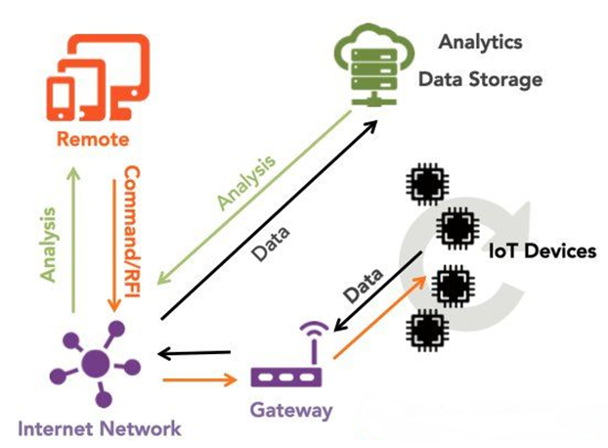
IoT Ecosystem
1. IoT Devices (Edge Devices)
These are the physical sensors, actuators, and smart devices that collect real-world data.
Examples: Smart thermostats, wearable health monitors, industrial machines, security cameras.
These devices generate data and send it to the gateway.

Slide 19
IoT Ecosystem
2. Gateway
The gateway acts as a bridge between IoT devices and the cloud.
It collects data from multiple IoT devices and forwards it to cloud-based analytics platforms.
Sometimes, it performs basic processing to filter unnecessary data before sending it to the cloud.
Examples: Edge computing hubs, local processing units, industrial IoT gateways.
3. Internet Network
IoT devices communicate over the Internet or private networks using different protocols such as Wi-Fi, Bluetooth, Zigbee, LPWAN, and 5G.
This network ensures seamless connectivity between all components of the IoT system.
It transmits data from IoT devices to the cloud and remote applications.

Slide 20
IoT Ecosystem
4. Analytics & Data Storage (Cloud)
IoT data is stored and analyzed in cloud-based platforms.
The cloud enables:
Big data processing for identifying trends, patterns, and insights.
AI & Machine Learning for predictive analytics.
Scalability to handle large volumes of IoT-generated data.
Example: AWS IoT Core, Google Cloud IoT, Microsoft Azure IoT.
5. Remote Monitoring & Control
The Remote section (represented by mobile/tablet icons) refers to users or administrators who access IoT data remotely.
Users can:
Monitor device status in real-time (e.g., checking smart home cameras).
Control IoT devices remotely (e.g., adjusting a thermostat).
Receive alerts & notifications about important events (e.g., security breach alerts).
Example: Smartphone apps for smart homes, industrial dashboards for factory monitoring.

Slide 21
IoT Ecosystem
6. Data Flow and Communication
Data is first generated by IoT devices and sent to the gateway.
The gateway transmits data via the Internet network to the cloud analytics & storage.
The cloud processes the data and sends analysis results to remote users.
Based on analysis, users can send commands back to IoT devices for control actions.
Key Takeaways from the Image
IoT Devices collect and send data.
Gateways process and transmit data.
Internet Network facilitates communication.
Cloud Storage & Analytics process data for insights.
Remote Control & Monitoring allows users to interact with IoT devices.
This ecosystem enables automation, efficiency, and real-time decision-making in smart homes, healthcare, industries, and cities.

Slide 22
IoT Layers
Visualization (representation in graphs)
Storage, Analytics and Query (also called Edge IT)
Data integration (data cleaning, normalization and structuring)
Network & Connectivity elements (wired/ wireless gateways, protocol converters)
Devices / sensors / things / remote data providers

Slide 23
IoT Layers
1. Devices / Sensors / Things / Remote Data Providers
This is the lowest layer in the IoT architecture.
It includes physical devices such as:
Sensors (temperature, humidity, motion, etc.)
Actuators (motors, relays)
Embedded systems (Raspberry Pi, Arduino)
Smart devices (wearables, industrial machines)
These components collect real-world data and send it to the next layer for processing.

Slide 24
IoT Layers
2. Network & Connectivity Elements
This layer ensures communication between IoT devices and cloud systems.
It includes:
Wired networks (Ethernet, Fiber optics)
Wireless networks (Wi-Fi, Bluetooth, Zigbee, LoRaWAN, 5G)
Gateways (IoT edge devices that manage data traffic)
Protocol converters (translate data formats for compatibility)
This layer transmits data from IoT devices to storage and processing systems.

Slide 25
IoT Layers
4. Storage, Analytics, and Query (Edge IT)
Once the data is structured, it needs to be stored and analyzed.
This layer consists of:
Databases (SQL, NoSQL)
Cloud storage (AWS S3, Google Cloud Storage)
Edge computing (processing data closer to the source, reducing latency)
Data query systems (searching and retrieving data efficiently)
The main goal is to extract useful insights from IoT data.

Slide 26
IoT Layers
5. Visualization (Representation in Graphs)
The final layer is data representation for decision-making.
It includes:
Graphs & dashboards (for real-time monitoring)
Reports & charts (for business insights)
AI-powered predictions (future trend analysis)
This layer helps users and businesses interpret IoT data effectively

Slide 27
IoT Layers
Key Takeaways from the Image
Devices & Sensors collect real-world data.
Network & Connectivity ensures data transmission.
Data Integration cleans and structures raw data.
Storage & Analytics processes and analyzes IoT data.
Visualization presents data insights for decision-making.
This layered approach ensures efficient IoT system operations in industries like smart cities, healthcare, agriculture, and industrial automation.

Slide 28
IoT Model
Devices
Send and receive data interacting with the
Network
Where the data is transmitted, normalised and filtered using
Edge Computing
Before landing in
Data Storage / Databases
Accessible by
Applications
Which process it and provide it to people who will
Act & Collaborate

Slide 29
IoT Model
1. Devices
Role: These devices send and receive data while interacting with their environment.
Examples:
Sensors (temperature, motion, humidity, GPS, etc.)
Actuators (motors, relays, robotic arms)
Smart appliances (wearables, industrial machines)
Purpose: These devices generate real-time data for processing.
2. Network
Role: Ensures data transmission, normalization, and filtering before processing.
Examples:
Wireless networks (Wi-Fi, Zigbee, LoRaWAN, Bluetooth)
Wired connections (Ethernet, fiber optics)
Protocols (MQTT, CoAP, HTTP)
Purpose: Transfers data from devices to the computing layer securely and efficiently.

Slide 30
IoT Model
3. Edge Computing
Role: Performs local data processing before sending it to centralized storage.
Examples:
Edge devices (Raspberry Pi, NVIDIA Jetson, industrial controllers)
AI/ML models for real-time decision-making
Purpose: Reduces latency, bandwidth usage, and dependency on cloud processing.
4. Data Storage / Databases
Role: Stores processed IoT data for future retrieval and analytics.
Examples:
Cloud databases (AWS RDS, Google BigQuery)
Local databases (PostgreSQL, MongoDB, InfluxDB)
Time-series databases (for IoT logs)
Purpose: Ensures scalability and accessibility of IoT data.

Slide 31
IoT Model
5. Applications
Role: Processes stored data and provides insights to users.
Examples:
IoT dashboards for visualization
AI-driven predictive analytics
Automation applications (smart homes, industrial IoT)
Purpose: Helps businesses and users make data-driven decisions.
6. Act & Collaborate
Role: Enables human decision-making and automated responses based on processed data.
Examples:
Smart agriculture (automatically watering plants based on soil moisture data)
Healthcare monitoring (alerting doctors in case of abnormal vitals)
Industrial automation (predicting and preventing machine failures)
Purpose: Ensures that data insights lead to real-world actions.

Slide 32
IoT Model
Key Takeaways from the IoT Model
Devices collect data.
Network transmits data securely.
Edge Computing pre-processes data in real-time.
Data Storage organizes and stores IoT data.
Applications analyze and visualize IoT data.
Act & Collaborate transforms insights into real-world actions.
This IoT model ensures efficient data processing and decision-making across industries like healthcare, smart cities, industrial automation, and agriculture.

Slide 33
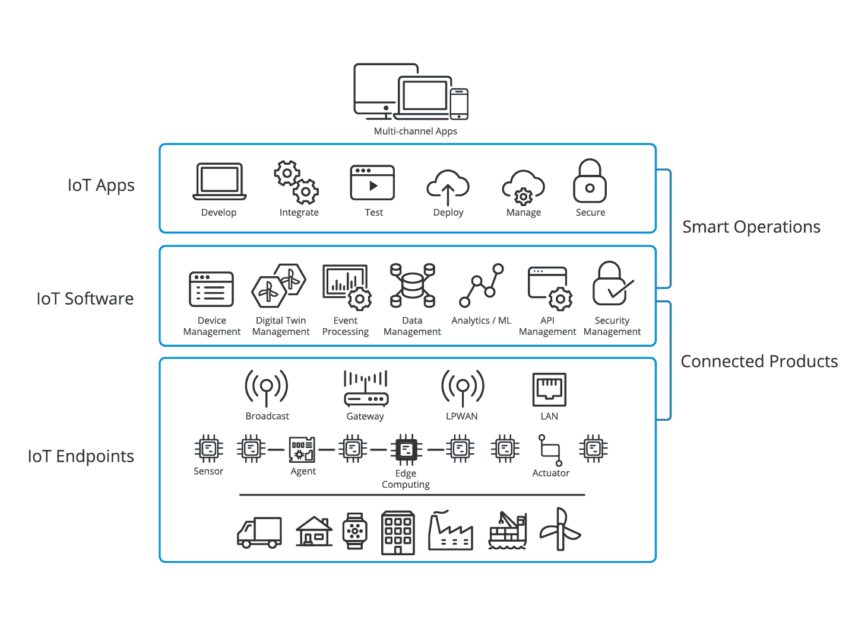
IoT 3 Layer model

Slide 34
IoT 3 Layer model
The image represents the IoT 3-Layer Model, which explains how IoT systems function by dividing them into three main layers: IoT Endpoints, IoT Software, and IoT Apps. Below is a detailed breakdown of each layer and its role in the IoT ecosystem.
1. IoT Endpoints (Connected Products)
Role: This layer consists of physical IoT devices that collect and transmit data.
Examples:
Sensors (temperature, motion, GPS, pressure)
Agents (IoT gateways that facilitate communication)
Edge Computing (processes data locally before sending it to the cloud)
Actuators (motors, valves, and other control devices)
Communication Technologies:
Broadcasting
Gateway connections
LPWAN (Low-Power Wide-Area Network)
LAN (Local Area Network)
Purpose: This layer captures real-world data and forwards it for processing.

Slide 35
IoT 3 Layer model
2. IoT Software (Connected Products)
Role: The software layer processes and manages IoT data collected from endpoints.
Key Functions:
Device Management (monitoring and controlling connected devices)
Digital Twin Management (creating virtual models of physical devices)
Event Processing (real-time data handling and triggers)
Data Management (storing and organizing IoT-generated data)
Analytics & Machine Learning (AI-powered insights from data)
API Management (enabling communication between IoT components)
Security Management (protecting IoT networks from cyber threats)
Purpose: This layer ensures that IoT data is structured, analyzed, and secure.

Slide 36
IoT 3 Layer model
3. IoT Apps (Smart Operations)
Role: The application layer provides user interfaces and tools to interact with IoT data.
Key Components:
Develop (creating IoT applications)
Integrate (connecting different IoT services)
Test (validating IoT applications)
Deploy (launching IoT solutions)
Manage (monitoring system health)
Secure (ensuring compliance and data protection)
Purpose: This layer enables businesses and users to visualize and act on IoT data via multi-channel applications.

Slide 37
IoT 3 Layer model
Key Takeaways from the IoT 3-Layer Model
IoT Endpoints: The foundation of IoT, consisting of sensors, actuators, and edge computing devices.
IoT Software: The intelligence layer that processes, analyzes, and secures IoT data.
IoT Apps: The interface layer that allows users to interact with and manage IoT solutions.
This model helps in scaling IoT systems efficiently, ensuring seamless data flow and secure communication across devices and applications.

Slide 38

Sensors
Types of Sensors:
Digital Sensors (Binary Sensors)
Return ON/OFF signals.
Used for limit detection, such as position, fullness, and operational status.
Examples:
Limit switches – Mechanical contact switches.
Proximity sensors – Detect metal objects using magnetic fields.
Optical sensors – Use light, but can be affected by dirt.
Capacitive sensors – Detect non-conductive materials but are sensitive to contamination.
Ultrasonic sensors – Use sound waves to detect objects.
Auxiliary contacts – Indicate relay status.
Push buttons – Detect operator input.

Slide 39
Sensors
RTD = Resistance Temperature Device
Analog Sensors
Convert physical quantities (e.g., temperature, pressure) into electrical signals (voltage or current).
Examples:
Thermocouples – Produce millivolt signals for temperature measurement.
Resistance Temperature Detectors (RTDs) – More accurate, use resistance changes.
Pressure sensors, humidity sensors, distance sensors, speed sensors – Convert values into standard electrical signals (often 4-20mA for noise immunity).
Industrial Applications:
Digital sensors help with detecting positions, operational status, and presence of objects.
Analog sensors allow precise measurement of environmental factors like temperature and pressure.
The combination of these sensors, hardware, and software enables automation and control of industrial processes.

Slide 40
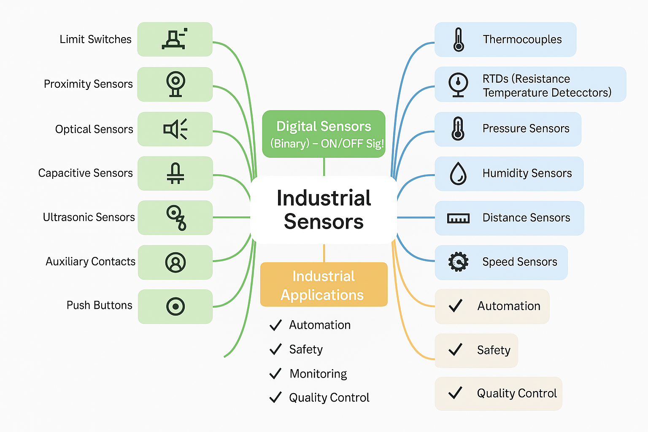
Sensors

Slide 41
IoT Sensors
15 IoT sensors used in Industry->
1. Temperature Sensors
Temperature sensors are designed to monitor the temperature of various devices, including smartphones, industrial machinery, and medical equipment. They help prevent overheating by providing real-time data for temperature regulation. These sensors use thermistors, thermocouples, or resistance temperature detectors (RTDs) to measure heat variations.
2. Proximity Sensors
Proximity sensors emit electromagnetic radiation or an infrared beam to detect the presence of nearby objects without physical contact. These are commonly used in touchscreens, automotive parking sensors, and industrial automation to detect objects' positions.
3. Pressure Sensors
Pressure sensors measure the pressure of gases or liquids and are also used to monitor the flow of fluids and gases. They find applications in automotive systems (e.g., tire pressure monitoring), industrial processes, and medical devices like blood pressure monitors.
4. Water Quality Sensors
Water quality sensors detect pH levels and other properties of water, making them useful for ion monitoring in environmental studies, water treatment plants, and laboratory research. They help ensure safe drinking water and maintain chemical balance in industrial processes.
5. Chemical Sensors
Chemical sensors identify changes in liquids to detect air chemical changes. These sensors are commonly used in industrial safety, environmental monitoring, and medical diagnostics, where they help detect pollutants, toxins, and other hazardous chemicals.

Slide 42
IoT Sensors
6. Gas Sensors
Gas sensors function similarly to chemical sensors but specifically detect the presence and concentration of gases. They are widely used in industrial safety, air quality monitoring, and gas leakage detection to prevent hazardous situations.
7. Smoke Sensors
Smoke sensors detect airborne particulates and gases, making them essential components of fire detection systems. They are commonly found in residential and commercial fire alarms, using either ionization or photoelectric technology to detect smoke levels.
8. Infrared (IR) Sensors
Infrared sensors detect infrared radiation, which is emitted by objects based on their temperature. These sensors play a significant role in healthcare, especially in laparoscopic surgery, thermal imaging, and remote temperature monitoring.
9. Level Sensors
Level sensors are used to detect the level of fluids or other substances in tanks and reservoirs. They are widely used in hydraulic systems, fuel storage tanks, and industrial applications to monitor and control liquid levels.
10. Image Sensors
Image sensors convert optical images into electronic signals, enabling digital cameras and vision-based applications to capture and process images. They are used in smartphones, security cameras, medical imaging, and industrial automation.

Slide 43
IoT Sensors
11. Motion Detectors
Motion detectors sense movement using various technologies, including microwave, infrared, and ultrasonic waves. They are used in security systems, automatic doors, smart lighting, and other applications that require movement detection.
12. Accelerometer Sensors
Accelerometer sensors measure acceleration forces, which may be static (gravity) or dynamic (movement). Their adoption in defense applications has significantly increased, particularly in the development of small-diameter missiles, as well as in smartphones and fitness tracking devices.
13. Gyroscope Sensors
Gyroscope sensors detect angular velocity and orientation, making them essential for navigation purposes. These sensors are widely used in smartphones, gaming controllers, aerospace systems, and navigation apps.
14. Humidity Sensors
Humidity sensors measure moisture levels in the air and are primarily used in heating, ventilation, and air conditioning (HVAC) systems. They help regulate indoor air quality, prevent mold growth, and optimize industrial drying processes.
15. Optical Sensors
Optical sensors detect light rays and convert them into electrical signals for electronic devices. They are widely used in fiber optics, automatic lighting systems, medical diagnostics, and barcode scanning technology.

Slide 44
Wireless Sensor Networks
Wireless Sensor Networks are networks that consists of sensors which are distributed in an ad hoc manner.
These sensors work with each other to sense some physical phenomenon and then the information gathered is processed to get relevant results.
Wireless sensor networks consists of protocols and algorithms with self-organizing capabilities.

Slide 45
Wireless Sensor Networks
Wireless Sensor Networks (WSNs) are networks composed of spatially distributed sensors that collect, process, and transmit data wirelessly. These sensors communicate with each other to monitor and analyze environmental or physical conditions such as temperature, humidity, pressure, motion, and pollutants.
2. Key Characteristics of WSNs
Ad hoc Deployment: Sensors are randomly deployed without a fixed infrastructure.
Self-Organizing: Nodes (sensors) autonomously form a network, adjusting to changes dynamically.
Energy Efficiency: Since sensors run on limited battery power, energy-efficient communication and processing are crucial.
Scalability: Can support a large number of sensor nodes.
Fault Tolerance: The network continues functioning even if some sensors fail.

Slide 46
Wireless Sensor Networks
3. Components of WSNs
Sensor Nodes: Small, energy-efficient devices that detect and transmit data.
Sink Node (Base Station): Collects data from multiple sensor nodes and forwards it to a central system for analysis.
Communication Module: Uses wireless protocols like Zigbee, Bluetooth, or Wi-Fi for data transmission.
Processing Unit: Performs basic computations on collected data before transmission.
Power Supply: Typically battery-powered with energy-harvesting options like solar cells.
4. Working Mechanism
Sensors detect changes in environmental conditions.
The detected data is processed locally at the node level.
Data is transmitted wirelessly through multi-hop routing.
The sink node aggregates and forwards data to a central server or cloud.
Data is analyzed for decision-making or further processing.

Slide 47
Wireless Sensor Networks
5. Communication Protocols in WSNs
MAC Protocols: Optimize power consumption by controlling when nodes transmit/receive data.
Routing Protocols: Determine efficient data transfer paths (e.g., LEACH, Directed Diffusion).
6. Applications of Wireless Sensor Networks
Environmental Monitoring: Weather prediction, pollution control, forest fire detection.
Industrial Automation: Monitoring machinery, detecting leaks or faults.
Smart Cities: Traffic monitoring, smart street lighting, waste management.
Healthcare: Remote patient monitoring, wearable health devices.
Military and Surveillance: Border security, intrusion detection.
Agriculture: Soil moisture monitoring, precision farming.
7. Challenges in Wireless Sensor Networks
Limited Energy: Battery-powered sensors require efficient energy management.
Security Issues: Vulnerable to hacking, jamming, and data breaches.
Data Reliability: Wireless transmission may cause data loss or corruption.
Scalability: Managing large-scale deployments can be complex.
Wireless Sensor Networks are intelligent and efficient systems used for remote monitoring and automation in various industries. Their self-organizing, energy-efficient, and scalable nature makes them an essential technology for IoT (Internet of Things) and smart infrastructure development.

Slide 48
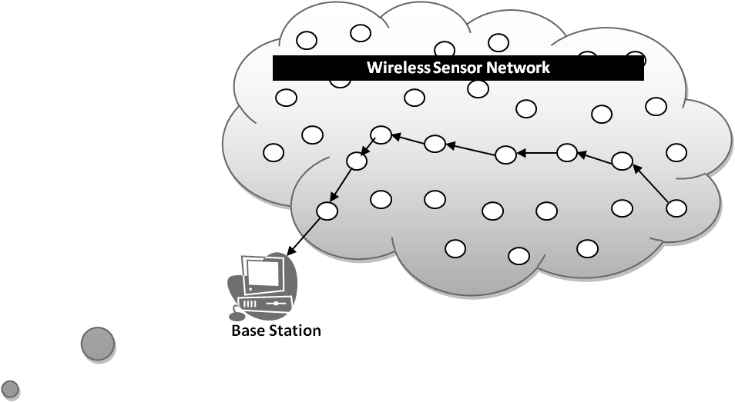
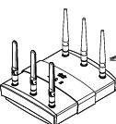
Wireless Sensor Network
Base station
A sensor network is a wireless network that consists of thousands of very small nodes called sensors.

Slide 49
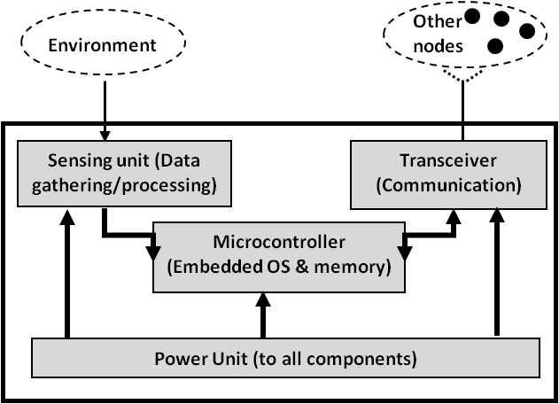
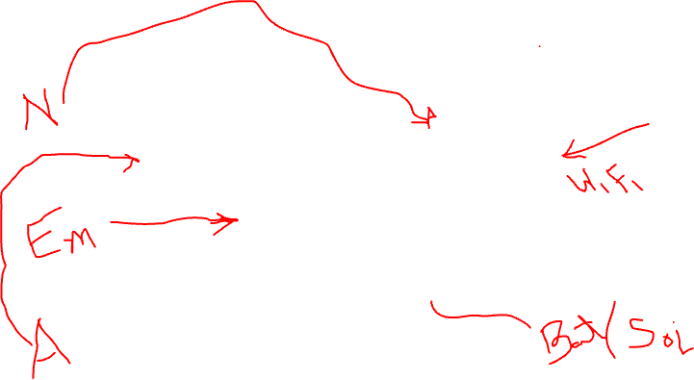
Wireless Sensor Network
WSN Sensors are equipped with sensing, limited computation, and wireless communication capabilities.

Slide 50
WSN V/S Ad-Hoc network
Wireless sensor networks mainly use broadcast communication while ad hoc networks use point-to-point communication.
Unlike ad hoc networks wireless sensor networks are limited by sensors limited power, energy and computational capability.
Sensor nodes may not have global ID because of the large amount of overhead and large number of sensors.

Slide 51
WSN V/S Ad-Hoc network
Both Wireless Sensor Networks (WSNs) and Ad-Hoc Networks are decentralized networks that operate without a fixed infrastructure. However, they differ in communication methods, resource constraints, and network structure.
1. Communication Method
WSN: Uses broadcast communication, where sensor nodes send data to multiple nodes in the network, typically to a central base station or sink node.
Ad-Hoc Networks: Use point-to-point communication, where data is transmitted between specific nodes in a more structured routing manner.
2. Resource Constraints
WSN: Nodes have limited power, energy, and computational capacity since they are small, battery-operated, and often deployed in remote areas.
Ad-Hoc Networks: Devices (such as mobile phones or laptops) have higher power and processing capabilities, making them more suitable for direct communication.

Slide 52
WSN V/S Ad-Hoc network
3. Node Identification
WSN: Sensor nodes may not have a global ID because of the large number of nodes and the high communication overhead required to maintain unique identifiers.
Ad-Hoc Networks: Nodes usually have a global or unique ID, making it easier to manage communication and routing.
4. Network Purpose
WSN: Primarily designed for data collection, environmental monitoring, and event detection. The focus is on sensing and transmitting data efficiently.
Ad-Hoc Networks: Designed for general communication between devices, such as military applications, emergency response, or mobile peer-to-peer networking.
5. Network Structure & Scalability
WSN: Highly scalable but lacks complex routing due to power constraints. Nodes communicate in a multi-hop fashion to forward data to a base station.
Ad-Hoc Networks: May have a structured routing mechanism with predefined communication paths, but scalability is dependent on device capacity and network load.

Slide 53
WSN V/S Ad-Hoc network
6. Energy Efficiency
WSN: Energy consumption is a major concern, and protocols are designed to minimize power usage (e.g., sleep modes, data aggregation techniques).
Ad-Hoc Networks: While energy efficiency is considered, devices often have rechargeable batteries, making power management less critical compared to WSNs.
Wireless Sensor Networks (WSNs) and Ad-Hoc Networks share some similarities but serve different purposes. WSNs are optimized for sensing and data collection with limited resources, whereas Ad-Hoc Networks are more flexible for peer-to-peer communication with better computational capabilities.

Slide 54
Characteristics of WSN
Wireless Sensor Networks mainly consists of sensors. Sensors are -
low power
limited memory
energy constrained due to their small size.
Wireless networks can also be deployed in extreme environmental conditions and may be prone to enemy attacks.
Although deployed in an ad hoc manner they need to be self organized and self healing and can face constant reconfiguration.

Slide 55
Design Challenges
Heterogeneity
The devices deployed maybe of various types and need to collaborate with each other.
Distributed Processing
The algorithms need to be centralized as the processing is carried out on different nodes.
Low Bandwidth Communication
The data should be transferred efficiently between sensors

Slide 56
Design Challenges
Design Challenges in Wireless Sensor Networks (WSN)
Wireless Sensor Networks (WSNs) face several challenges due to their unique structure, resource constraints, and operational requirements. Below are some key challenges:
1. Heterogeneity
The devices deployed may belong to different types, manufacturers, or have varied hardware and software configurations.
These diverse devices need to collaborate efficiently to form a functional network.
2. Distributed Processing
Unlike traditional networks, processing in WSNs is distributed across multiple sensor nodes.
Algorithms must ensure data processing is efficient while minimizing power consumption.
3. Low Bandwidth Communication
Wireless sensors operate on limited bandwidth, making data transmission a challenge.
Efficient data compression and aggregation techniques are needed to optimize communication.

Slide 57
Design Challenges…
Large Scale Coordination
The sensors need to coordinate with each other to produce required results.
Utilization of Sensors
The sensors should be utilized in a ways that produce the maximum performance and use less energy.
Real Time Computation
The computation should be done quickly as new data is always being generated.

Slide 58
Design Challenges…
8. Security & Privacy
WSNs are vulnerable to attacks such as eavesdropping, data tampering, and node compromise.
Secure communication protocols are required to protect data integrity and confidentiality.
9. Fault Tolerance & Scalability
Nodes in WSNs may fail due to battery depletion or harsh environmental conditions.
The network should be resilient and adaptive to node failures while maintaining functionality.
10. Data Redundancy & Aggregation
Sensors often generate overlapping data, leading to redundancy.
Data aggregation techniques help reduce redundancy and improve efficiency.
Addressing these challenges requires innovative solutions in network design, routing, energy management, and security. By overcoming these limitations, WSNs can be effectively deployed for applications like smart cities, healthcare monitoring, industrial automation, and environmental sensing.

Slide 59
Operational Challenges
Energy Efficiency
Limited storage and computation
Low bandwidth and high error rates
Errors are common
Wireless communication
Noisy measurements
Node failure are expected
Scalability to a large number of sensor nodes
Survivability in harsh environments
Experiments are time- and space-intensive

Slide 60
Operational Challenges
Operational Challenges in Wireless Sensor Networks (WSN)
Wireless Sensor Networks (WSNs) face several operational challenges due to their limited resources and harsh deployment environments. Below are key challenges:
1. Energy Efficiency
Sensor nodes have limited battery power, and replacing or recharging them is difficult.
Energy-efficient communication protocols and duty-cycling mechanisms are essential.
2. Limited Storage and Computation
Sensor nodes have restricted memory and processing power.
Optimization techniques are needed to handle data efficiently with minimal processing.
3. Low Bandwidth and High Error Rates
Wireless communication in WSNs often operates at low bandwidth, limiting data transfer rates.
High error rates occur due to interference, congestion, and weak signals.

Slide 61
Operational Challenges
4. Errors in Data Collection
Wireless Communication Errors: Packet loss and delays due to weak signals.
Noisy Measurements: Sensor readings can be inaccurate due to environmental factors.
Node Failures: Sensor nodes may fail due to battery depletion or hardware issues.
5. Scalability Challenges
WSNs need to support a large number of nodes while maintaining efficiency.
Managing data flow and routing becomes complex as the network size grows.
6. Survivability in Harsh Environments
Many WSNs are deployed in extreme conditions (e.g., industrial sites, underwater, or disaster zones).
The network must withstand temperature variations, moisture, and physical damage.
7. Time- and Space-Intensive Experimentation
Real-world testing of WSNs requires significant time and physical deployment space.
Simulations and testbeds are often used but may not fully replicate real conditions.

Slide 62
Operational Challenges
8. Security and Privacy Risks
WSNs are vulnerable to eavesdropping, jamming, and node compromise.
Secure authentication and encryption methods must be implemented.
9. Network Latency and Synchronization
Due to low processing power and wireless interference, delays in data transmission can occur.
Synchronizing nodes efficiently is a challenge, especially in time-sensitive applications.
Addressing these operational challenges requires innovative solutions in network architecture, power management, error detection, and security. Continuous research and development are essential to enhance the reliability and efficiency of WSNs in real-world applications.

Slide 63
WSN Enablers
Embed numerous distributed devices to monitor and interact with physical world
Network devices to coordinate and perform higher-level tasks
Embedded
Networked
Control system w/
Small form factor
Untethered nodes
Exploit collaborative
Sensing, action
Sensing
Tightly coupled to physical world
Exploit spatially and temporally dense, in situ, sensing and actuation

Slide 64
WSN Enablers
Wireless Sensor Network (WSN) Enablers
Wireless Sensor Networks (WSNs) consist of numerous distributed devices designed to monitor and interact with the physical world. The key enablers of WSNs can be categorized into three main components:
1. Embedded Systems
Small form-factor control systems that integrate sensors, processors, and actuators.
Operate as untethered nodes (battery-powered and autonomous).
Designed for low power consumption and high efficiency.
2. Sensing
Tightly coupled with the physical world to capture real-time data.
Sensors collect environmental parameters such as temperature, humidity, motion, and pressure.
Spatially and temporally dense sensing for accurate data acquisition and processing.
3. Networked Communication
Enables coordination between sensor nodes for higher-level tasks like data aggregation and decision-making.
Exploits collaborative sensing and action to improve system efficiency.
Uses wireless protocols such as Zigbee, Bluetooth, LoRa, and Wi-Fi for data transmission.

Slide 65
WSN Enablers
Key Benefits of WSN Enablers
✔ Real-time monitoring of environmental and industrial conditions. ✔ Scalability for large deployments in IoT, healthcare, smart cities, and industrial automation. ✔ Energy-efficient designs to ensure long-term operation with minimal maintenance.
By integrating these enablers, WSNs enhance automation, precision monitoring, and efficient decision-making across various applications.

Slide 66
WSN Application
Wireless Sensor Network (WSN) Applications
Wireless Sensor Networks (WSNs) have a wide range of applications across different domains due to their ability to collect, process, and transmit data efficiently. Some of the key applications include:
1. Environmental Monitoring
Weather forecasting: Monitoring temperature, humidity, and air pressure.
Disaster detection: Early warning systems for earthquakes, landslides, and floods.
Air and water quality monitoring: Detecting pollution levels in urban areas.
2. Industrial Automation
Smart factories: Real-time machine monitoring and predictive maintenance.
Supply chain management: Tracking goods and assets using RFID sensors.
Energy efficiency: Automated lighting, heating, and power management.
3. Smart Cities & Infrastructure
Traffic management: Intelligent transportation systems for optimizing routes.
Smart grids: Efficient power distribution and fault detection.
Building automation: Smart HVAC (heating, ventilation, and air conditioning).

Slide 67
WSN Application
4. Healthcare & Wearables
Patient monitoring: Wireless biosensors for tracking vitals like heart rate and glucose levels.
Smart prosthetics: Wearable sensor technology for rehabilitation.
Remote health monitoring: Assisting elderly and disabled individuals.
5. Agriculture & Precision Farming
Soil and crop monitoring: Measuring moisture, nutrients, and pest detection.
Livestock tracking: Monitoring health and movement of animals.
Automated irrigation: Efficient water usage based on real-time soil conditions.
6. Defense & Surveillance
Border security: Wireless sensors for intrusion detection.
Battlefield monitoring: Real-time soldier health and environmental analysis.
Drone surveillance: Coordinated aerial monitoring of critical areas.

Slide 68
WSN Application
7. Home Automation & IoT
Smart homes: Automated security, lighting, and appliances.
Voice-assisted systems: Integration with AI-based home assistants.
Energy conservation: Real-time usage tracking for better efficiency.
Key Benefits of WSN Applications
✔ Real-time decision making with automated data collection. ✔ Cost-effective solutions for large-scale monitoring. ✔ Scalability and adaptability for various industries.
WSNs are revolutionizing how we interact with technology, making systems more intelligent, efficient, and responsive to real-world challenges.

Slide 69
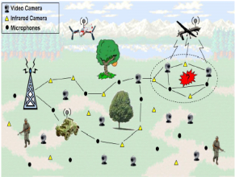
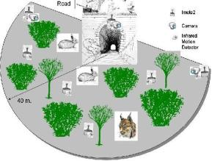
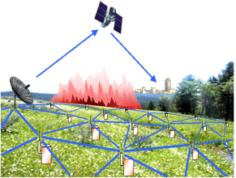
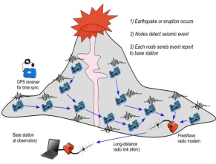
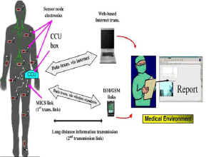
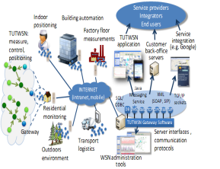

WSN Applications

Slide 70
WSN Applications…
The applications can be divided in three categories:
Monitoring of objects.
Monitoring of an area.
Monitoring of both area and objects.

Slide 71
WSN Applications…
Categories of WSN Applications
Wireless Sensor Network (WSN) applications can be classified into three main categories:
1. Monitoring of Objects
Asset tracking: Monitoring the location and status of goods in supply chains.
Structural health monitoring: Detecting stress and damage in buildings and bridges.
Industrial machine monitoring: Predictive maintenance in manufacturing.
2. Monitoring of an Area
Environmental sensing: Measuring temperature, humidity, and air pollution.
Disaster prevention: Detecting early signs of landslides, earthquakes, and floods.
Smart agriculture: Monitoring soil moisture, weather conditions, and crop health.
3. Monitoring of Both Area and Objects
Surveillance and security: Motion and intrusion detection in restricted areas.
Wildlife tracking: Observing animal movements and behaviors in natural habitats.
Healthcare monitoring: Remote patient monitoring combined with environmental conditions.
WSNs enable real-time data collection, efficient decision-making, and automation across multiple fields, improving safety, productivity, and environmental sustainability.

Slide 72
Area Monitoring
Environmental and Habitat Monitoring
Precision Agriculture
Indoor Climate Control
Military Surveillance
Treaty Verification
Intelligent Alarms

Slide 73
Area Monitoring
Area Monitoring Using WSN
Wireless Sensor Networks (WSNs) are widely used for area monitoring in various fields:
Environmental and Habitat Monitoring
Detects changes in ecosystems, wildlife behavior, and pollution levels.
Helps in biodiversity conservation and early disaster warnings.
Precision Agriculture
Monitors soil moisture, temperature, and nutrient levels.
Optimizes irrigation and fertilizer use to improve crop yield.
Indoor Climate Control
Regulates temperature, humidity, and air quality in smart buildings.
Enhances energy efficiency and occupant comfort.
Military Surveillance
Deploys sensors for perimeter security and enemy movement detection.
Enables real-time battlefield monitoring and intelligence gathering.

Slide 74
Area Monitoring
5. Treaty Verification
Ensures compliance with arms control and disarmament agreements.
Detects unauthorized activities in restricted areas.
6. Intelligent Alarms
Uses sensor-based alerts for fire, gas leaks, or intrusion detection.
Enhances safety in industrial, residential, and commercial spaces.
WSNs make area monitoring cost-effective, scalable, and efficient, enabling real-time data collection and automated responses across different applications.

Slide 75
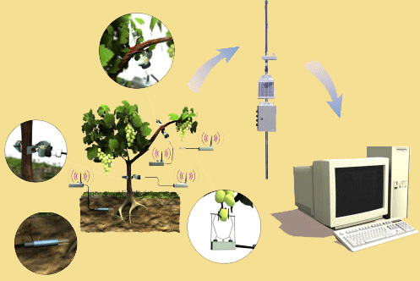
Area monitoring Example
Precision agriculture aims at making cultural operations more efficient, while reducing environmental impact.
The information collected from sensors is used to evaluate optimum sowing density, estimate fertilizers and other input needs, and to more accurately predict crop yields.

Slide 76
Monitoring Objects
Structural Monitoring
Eco-physiology
Condition-based Maintenance
Medical Diagnostics
Urban terrain mapping

Slide 77
Monitoring Objects
Monitoring Objects
Monitoring objects refer to various domains where continuous observation, data collection, and analysis are performed to ensure safety, efficiency, and performance. The key areas of monitoring include:
Structural Monitoring Structural monitoring involves tracking the health and stability of infrastructure such as bridges, buildings, and dams. Sensors are used to detect stress, vibrations, and possible damages to prevent failures and ensure safety.
Eco-physiology This field focuses on studying the physiological responses of living organisms to environmental conditions. It helps in understanding how plants and animals adapt to climate changes, pollution, and other ecological factors.
Condition-based Maintenance Condition-based maintenance is a proactive approach where machinery and equipment are continuously monitored to predict failures before they occur. This technique improves efficiency, reduces unexpected breakdowns, and minimizes maintenance costs.

Slide 78
Monitoring Objects
4. Medical Diagnostics Medical diagnostics involve using monitoring technologies like wearable devices, imaging systems, and biosensors to track vital signs, detect diseases, and assist in early diagnosis. This plays a crucial role in improving patient care and treatment outcomes.
5. Urban Terrain Mapping Urban terrain mapping involves the use of technologies like LiDAR, satellite imagery, and GIS (Geographic Information Systems) to analyze and map urban areas. It is widely used in urban planning, disaster management, and infrastructure development.
Monitoring objects play a crucial role in various fields by providing real-time data, improving efficiency, and enhancing decision-making processes.

Slide 79
Monitoring Interactions between Objects and Space
Wildlife Habitats
Disaster Management
Emergency Response
Ubiquitous Computing
Asset Tracking
Health Care
Manufacturing Process Flows

Slide 80
Monitoring Interactions between Objects and Space
Monitoring Interactions between Objects and Space
Monitoring interactions between objects and space refers to tracking and analyzing how different entities interact with their environment. This monitoring is crucial for improving safety, efficiency, and decision-making in various fields. The key areas include:
Wildlife Habitats Monitoring wildlife habitats helps track animal movements, population changes, and environmental conditions. It aids in conservation efforts, studying biodiversity, and preventing human-wildlife conflicts.
Disaster Management This involves monitoring natural disasters like earthquakes, floods, and hurricanes using sensors and satellite data. It helps in early warning systems, risk assessment, and efficient disaster response.
Emergency Response Emergency response monitoring ensures quick and effective actions during critical situations such as accidents, medical emergencies, or fire outbreaks. Technologies like GPS tracking and real-time communication enhance response efficiency.

Slide 81
Monitoring Interactions between Objects and Space
4. Ubiquitous Computing Ubiquitous computing refers to embedding computing devices in everyday objects to enable continuous monitoring. Examples include smart homes, wearable technology, and IoT-based automation.
5. Asset Tracking Asset tracking involves monitoring the location and status of valuable resources, such as vehicles, equipment, or shipments. RFID, GPS, and IoT sensors are commonly used for real-time tracking and inventory management.
6. Health Care Healthcare monitoring includes tracking patient health through wearable devices, remote monitoring systems, and smart medical equipment. It improves diagnosis, treatment, and personalized healthcare services.
7. Manufacturing Process Flows In manufacturing, monitoring process flows helps optimize production efficiency, detect defects, and ensure quality control. Technologies like automation, sensors, and AI-driven analytics enhance productivity and reduce downtime.
Monitoring these interactions enables better decision-making, increased efficiency, and improved safety across various domains.

Slide 82
Example
1. Car-to-X Communication
Car-to-X (C2X) communication is an advanced vehicle communication technology that extends the capabilities of traditional onboard sensors. Unlike conventional sensors that detect obstacles within a limited range, Car-to-X allows vehicles to exchange information in real time. This means that vehicles can share data about road conditions, traffic congestion, accidents, or hazards ahead, improving road safety and driving efficiency.
For example, if a car detects slippery roads due to ice, it can transmit this information to other vehicles approaching the same route, allowing them to slow down or take necessary precautions in advance.

Slide 83
Example
2. Cellular Network-Based Technology
This system operates over a cellular communication network, such as 4G or 5G, to ensure a seamless exchange of information between vehicles. Unlike traditional Vehicle-to-Vehicle (V2V) systems, which may rely on short-range wireless communication, cellular-based Car-to-X technology enables broader coverage, allowing cars to receive alerts even from vehicles that are not directly nearby.
For instance, if an accident occurs a few kilometers ahead, a connected vehicle will receive an alert in real-time through the cellular network, helping the driver take necessary actions beforehand.

Slide 84
Example
3. Vehicle as Transmitter and Receiver
A key aspect of Car-to-X technology is that a vehicle does not only receive information but also transmits it. Every vehicle in the network acts as both a sensor and a data source, making the system more effective in detecting and preventing road hazards.
For example:
If a vehicle detects fog or heavy rain, it can send a warning to nearby vehicles.
Similarly, if a driver experiences a breakdown, their car can send an automatic alert to other road users to warn them of a potential obstruction.
This interconnected network ensures that real-time data is shared efficiently, reducing accidents and improving traffic flow.

Slide 85
Example
4. Cloud-Based Data Exchange
To ensure seamless communication, detected hazards are uploaded to a cloud server (such as the Mercedes-Benz cloud in this case). The cloud acts as a central data repository where all warning messages and road condition reports are stored and distributed to other vehicles in the network.
Advantages of cloud integration:
Faster communication: Vehicles do not need to be directly connected; they can access hazard information from any connected car via the cloud.
Data persistence: Important data (such as accident reports) remains available for a longer duration, even if the original sender moves away.
Scalability: The cloud can aggregate data from multiple sources, including other vehicles, traffic management centers, and weather stations.

Slide 86
Example
5. Navigation and Voice Alerts
To assist drivers, warning messages are displayed directly on the navigation system’s map. This allows drivers to visually see the location of reported hazards, helping them make informed decisions about their route.
Additionally, some warnings are provided via voice output to minimize distraction while driving. This is particularly useful in situations where the driver needs to focus on the road, such as in foggy conditions or when navigating sharp turns where visibility is low.
For example, if there is an accident around a blind curve, the system will warn the driver using voice alerts before they reach the hazard.

Slide 87
Example
6. Hazard Detection and Reporting
One of the most critical applications of Car-to-X technology is automatic hazard detection. The system is designed to detect various road hazards, including:
Accidents (e.g., a car crash ahead)
Weather hazards (e.g., ice, fog, or heavy rain)
Traffic issues (e.g., stalled vehicles or sudden slowdowns)
Additionally, the system can incorporate data from external sources, such as:
Road construction agencies (to provide real-time information on mobile road works).
Traffic control centers (to update drivers on detours or lane closures).
This feature ensures that drivers are not only warned about natural hazards but also about human-made disruptions on the road, improving travel efficiency and safety.

Slide 88
Example
Car-to-X communication is a perfect example of Network Embedded Applications in action. It integrates real-time networking, cloud computing, and embedded sensor technologies to improve road safety and driving efficiency. The combination of cellular networks, cloud-based data exchange, onboard sensors, and hazard reporting creates a smarter, more connected transportation system.

Slide 89
LoRaWAN
1. LoRaWAN and the Internet of Things (IoT)
LoRaWAN (Long Range Wide Area Network) is a key networking standard that enables the Internet of Things (IoT). The goal of IoT is to create smarter, more efficient choices that contribute to sustainability in areas such as environmental monitoring, healthcare, and social well-being.
However, implementing IoT solutions requires efficient sensor communication, which is where LoRa technology plays a critical role. LoRa allows devices to communicate over long distances with minimal power consumption, making IoT networks scalable, cost-effective, and energy-efficient.

Slide 90
LoRaWAN
2. LoRa Technology for Sensor Communication
Every IoT system consists of three core components:
Sensors: Collect real-world data (e.g., temperature, air quality, or movement).
Network: Transmits the collected data to a central system.
Data Processing: Converts raw sensor data into actionable insights.
LoRa technology enables sensors to communicate wirelessly over long distances while consuming very little power. This makes LoRa the preferred choice for IoT applications where battery life and coverage area are critical.

Slide 91
LoRaWAN
3. LoRaWAN as a Global Standard
LoRaWAN is an open standard recognized by the International Telecommunication Union (ITU) and operates on an unlicensed radio spectrum. This means businesses and individuals can deploy their own LoRa networks without requiring a government license or relying on commercial network providers.
Key benefits include:
Global Adoption: Over 160 network operators and 3 million+ LoRa gateways are deployed worldwide.
Scalability: LoRaWAN can support up to 5 billion connected devices, making it ideal for large-scale IoT deployments.
Unlike Wi-Fi, which has a limited range, and cellular networks, which require high power consumption and costly provider services, LoRaWAN enables wide coverage with low power consumption, making it ideal for IoT networks.

Slide 92
LoRaWAN
4. LoRa for Asset Tracking
One of the most practical applications of LoRaWAN is asset tracking. Many businesses need to monitor the location and condition of their assets in supply chains, warehouses, and industrial operations.
Challenges with existing technologies:
Wi-Fi: Short range, not suitable for large-scale tracking.
Cellular networks: Higher power consumption and dependency on mobile network providers.
LoRa solves these issues by providing:
Long-range communication (even in remote areas).
Low power consumption, allowing sensors to last for years on a single battery.
GPS-free geolocation, enabling tracking without using energy-intensive GPS technology.
Example: A small business owner can attach LoRa-based sensors to their products to track them without needing expensive cellular connectivity.

Slide 93
LoRaWAN
5. LoRa’s Applications in Different Industries
LoRa technology is already being used in various industries to improve efficiency and sustainability.
✔ Environmental Monitoring
Helps monitor water systems to detect shortages, floods, and compliance with regulations.
Supports smart agriculture, where sensors track soil moisture, weather conditions, and irrigation efficiency.
✔ Healthcare
Provides real-time alerts for Alzheimer’s patients who wander outside designated safe zones, ensuring their safety.
Enables remote health monitoring for elderly and at-risk patients.
✔ Smart Cities & Infrastructure
Used in waste management systems to optimize garbage collection routes.
Helps reduce food waste in restaurants by monitoring storage conditions and minimizing spoilage.
✔ Industrial IoT & Smart Manufacturing
Used for predictive maintenance, where machines detect faults before they fail, reducing downtime.
Enables warehouse automation, where sensors track inventory levels and optimize supply chains.

Slide 94
LoRaWAN
6. The Growing LoRa Ecosystem
With over 200 million devices already using LoRa, the ecosystem is continuously growing. Businesses and governments worldwide are leveraging LoRa to build smart, connected solutions that enhance efficiency and sustainability.
Semtech, the company behind LoRa, envisions a future where IoT-powered insights help drive better decisions across industries. By reducing energy waste, optimizing resource use, and improving automation, LoRa contributes to a smarter and more sustainable world.
LoRaWAN is a prime example of Network Embedded Applications in action. It provides a scalable, low-power, and long-range IoT connectivity solution that enables real-time monitoring, automation, and efficiency across multiple industries.

Slide 95
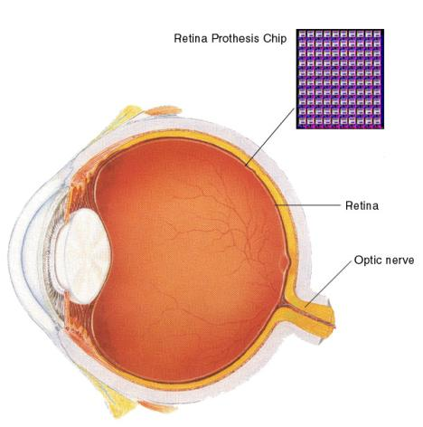
Biomedical
Health Monitors
Glucose
Heart rate
Cancer detection
Chronic Diseases
Artificial retina
Cochlear implants
Hospital Sensors
Monitor vital signs
Record anomalies

Slide 96
Biomedical
Biomedical Monitoring
Biomedical monitoring involves the use of technology to track and improve human health. It plays a crucial role in diagnosing diseases, managing chronic conditions, and enhancing hospital care. The key areas covered in the slide are:
Health Monitors
Glucose Monitoring: Devices that track blood sugar levels for diabetic patients, ensuring proper management and timely interventions.
Heart Rate Monitoring: Wearable devices and medical equipment that continuously measure heart rate to detect irregularities and cardiovascular risks.
Cancer Detection: Advanced imaging techniques and biosensors used for early diagnosis and monitoring of cancer progression.
Chronic Diseases
Artificial Retina: A retinal prosthesis chip that helps restore vision in visually impaired individuals by replacing damaged photoreceptor cells.
Cochlear Implants: Electronic devices that aid hearing by directly stimulating the auditory nerve, benefiting people with severe hearing loss.

Slide 97
Biomedical
4. Hospital Sensors
Monitor Vital Signs: Sensors used in hospitals to continuously track parameters such as blood pressure, oxygen levels, and temperature.
Record Anomalies: Systems that detect abnormalities in patient health and alert medical professionals for quick response.

Slide 98

Military
Remote deployment of sensors for tactical monitoring of enemy troop movements.

Slide 99
Military
Military Applications of Network Embedded Systems
Network Embedded Applications play a crucial role in modern military operations by enabling remote deployment of sensors for tactical monitoring. These systems can be used to track enemy troop movements in real-time, providing critical intelligence for strategic decision-making.
Deployment of Sensor Networks: Military aircraft or ground forces can disperse sensor nodes across a battlefield to monitor activity.
Data Collection & Communication: These sensors relay real-time data back to command centers for analysis.
Enhanced Surveillance: Enables continuous monitoring without direct human intervention, improving operational safety.

Slide 100
Traffic Management
Future cars could use wireless sensors to:
Handle Accidents
Handle Thefts
Sensors embedded in the roads to:
Monitor traffic flows
Provide real-time route updates

Slide 101
Traffic Management
Traffic Management using Network Embedded Applications
In the field of traffic management, Network Embedded Systems enhance road safety and efficiency through wireless sensor networks. These sensors help in monitoring, decision-making, and automation.
Sensors Embedded in Roads:
Monitor traffic flows.
Provide real-time route updates to vehicles and traffic control systems.
Future Cars & Wireless Sensors:
Improve accident detection and enable faster emergency responses.
Prevent thefts by integrating smart vehicle tracking and security features.
These applications contribute to smart city infrastructure, reducing congestion and enhancing road safety.
CS-2

