Slide 1

AIRLINE ANALYSIS
SF to LA

Slide 2
Topics
Business Problem Statement
Report analysis & Insights
Assumptions based on data
Additional Insights
Challenges
Appendix

Slide 3
Business Problem Statement
Our Client frequently travels between SF and LA. They have asked to build them a dashboard to help them in a decision using this available data.
The decisions to be made are:
Which carrier to book for travel
Which flight to book for travel
When to travel
Note: 2008 year data used

Slide 4
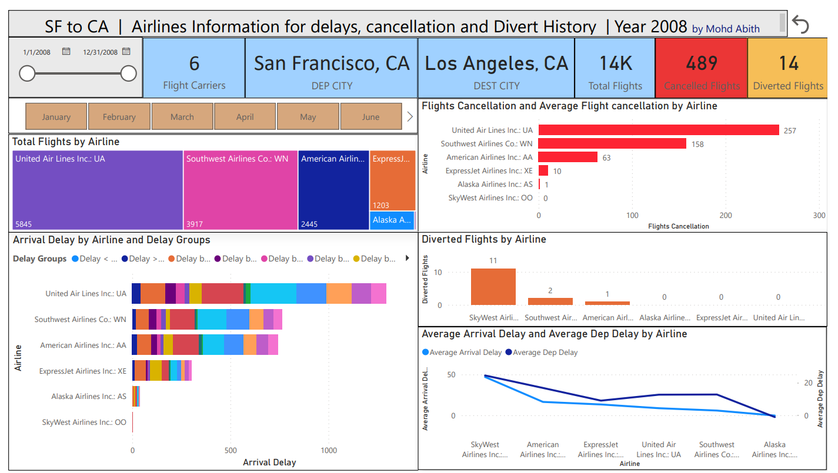
Report Analysis & Insights
Above Power Bi Reports gives the details of the flights from SA to LA for the year 2008.
Details on Total Flights, Cancellation, Diverted Flights, Arrival Delay by Delay timing groups, Average delay in min for Departure and Arrival by particular Airlines are Provided.
Report in Power bi is Interactive based on selection on Airlines, month, date, etc.

Slide 5
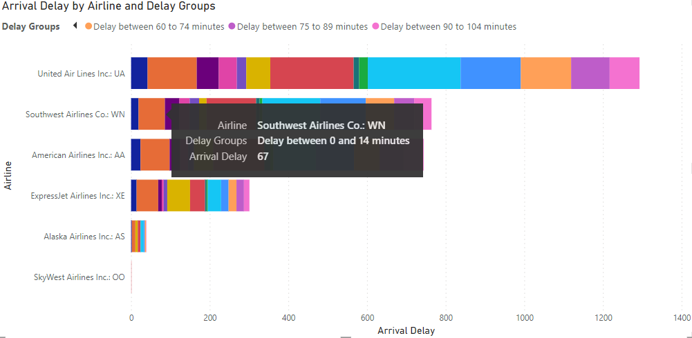
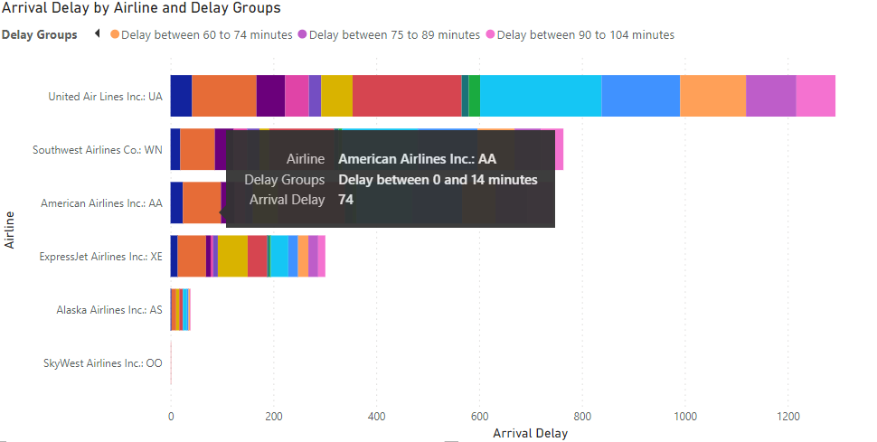
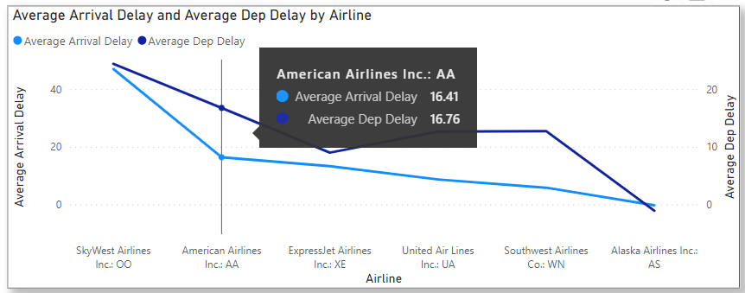
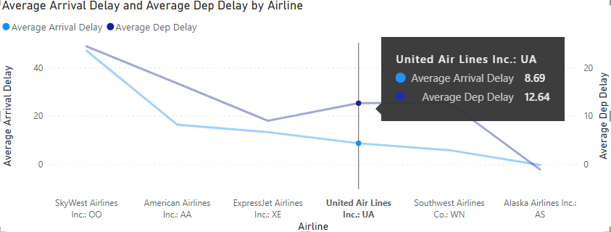
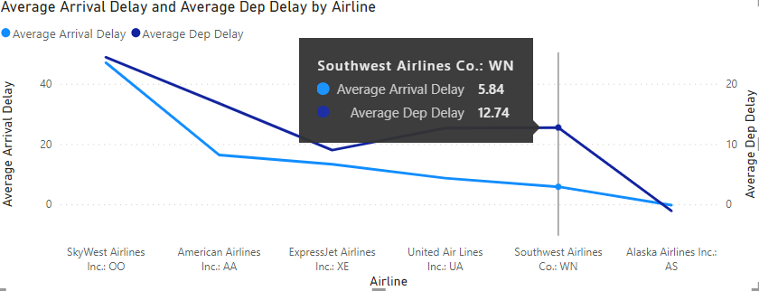
Based on the Arrival delay group data, Southwest Airlines and American Airlines are performing better on Early arrivals considering the no of flights that are being operated.
Comparing the Average Arrival and Departure delay with the line chart, the data shows that the above two airlines United and Southwest are preferable with Average arrival delay less than 13 min, while considering the frequency of flights operated American Airlines can also be considered with Average arrival delay less than 17 mins.

Slide 6
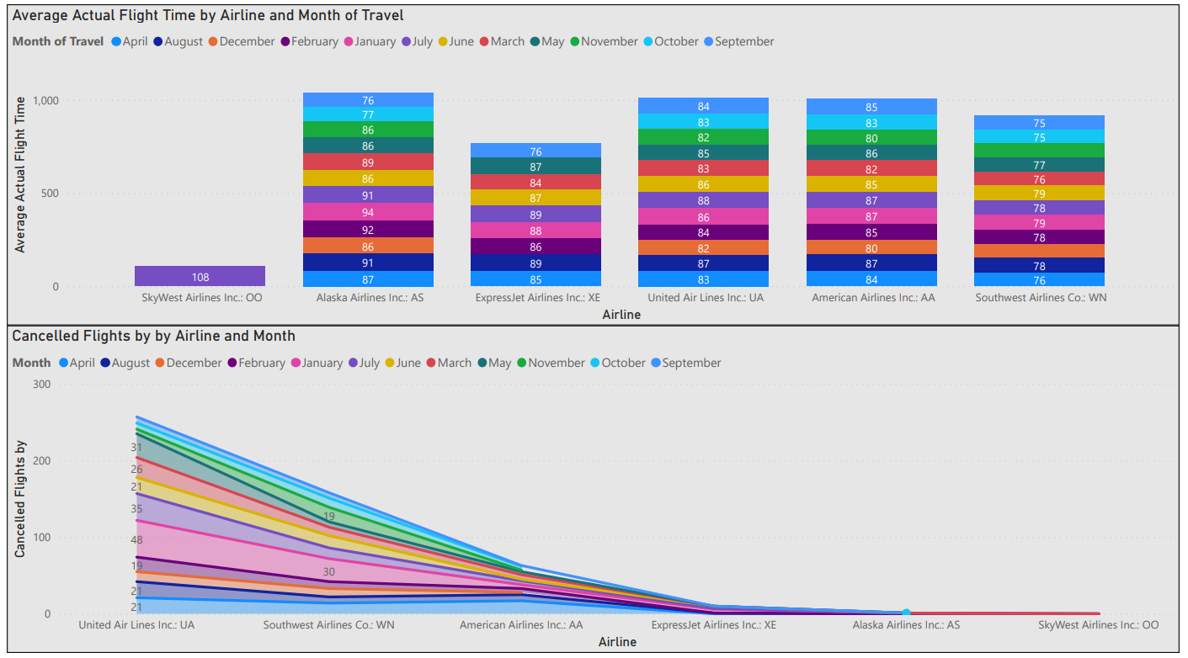
Our Company In Numbers
Considering the Elapsed flight time from departure to arrival, travelling time for all the airlines is around 75 to 85 min, with Southwest Airlines arriving 6 to 10 min earlier compared to the other airlines with reference to the stacked column chart.
With reference to Area chart above for cancelled flights, Month of January has the high no of cancellations, other months are preferable for all airlines.

Slide 7
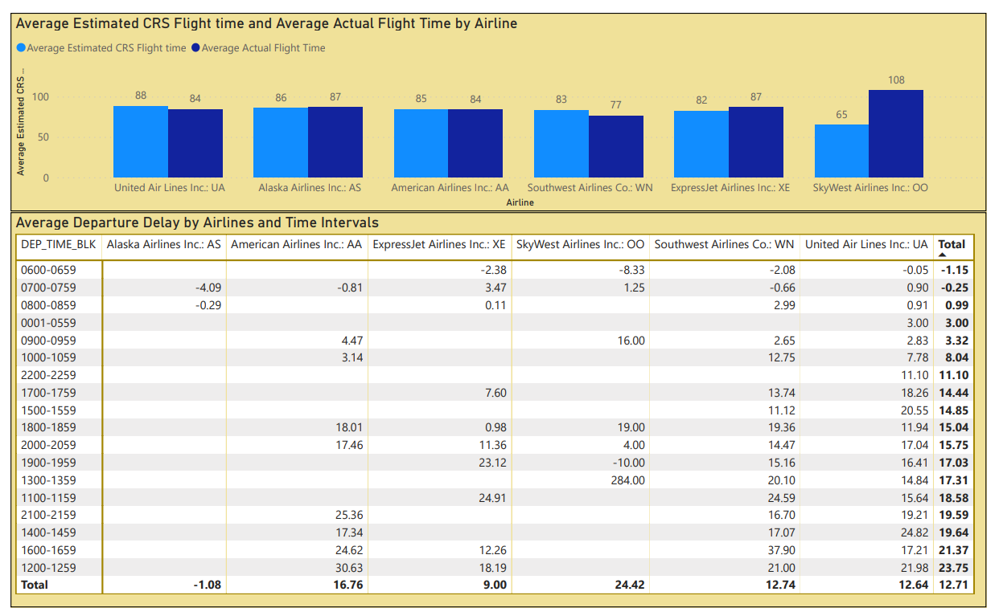
The Average CRS Estimated time and Actual flight time are almost same for all airlines. Southwest Airlines is 6 to 10 min earlier than other airlines as per data in the column chart.
The Departure delay is very less for scheduled flights between 6 AM to 9 AM, these flights can be preferred compared for the business meetings at late morning and afternoon as per the data showed in above table.

Slide 8
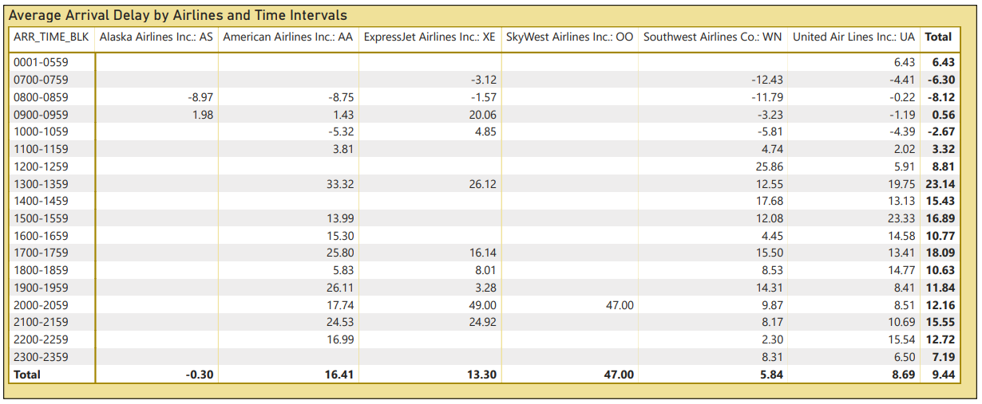
An b
The Arrival delay is very less for flights scheduled to arrive between 7 AM to 10 AM, these flights be preferred compared to the other timings.
Southwest Airlines arrivals is better compared to other airlines in the intervals specified above. This Airlines can be preferred.

Slide 9
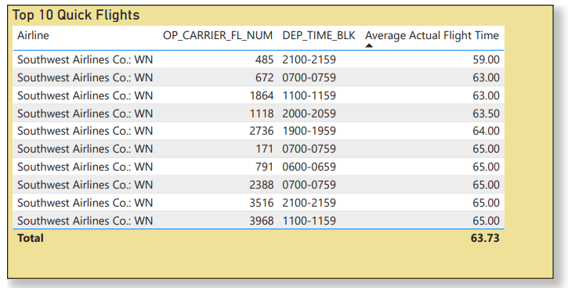
Comparing all airlines flights with respect to the Average Actual flight time, top 10 flights that can be taken into consideration is listed above are from Southwest Airlines.
As learned about the Departures and Arrivals having less delays in morning from the previous slides, these flights from Southwest Airlines Co can be considered for flying for mornings (672, 171,2388,791) from SF to LA.
Flights 485, 1118, 2736, 3516 can be considered for flying at evening SF to LA.

Slide 10
Assumptions:
Based on the data of cancellation (less than 0.5 percent), flight diverted, arrival and departure delay and on the no and flight frequencies below three airlines are considered for booking.
1, United Airlines
2, American Airlines
3, Southwest Airlines
Due to less no flights, other airlines are not considered in my analysis and to have wide options with the no of flights in the above airlines.
Considering less delays in Arrival and Departure with less flight times, Southwest airlines is preferred for bookings for client from SF to LA.
Additional Insights:
The data shows delay in the flights scheduled in the evening timings.
United Airlines operating highest no of flights and Skywest Airlines with lowest no of flights.
Month of September has the least no of Flight cancellations.

Slide 11
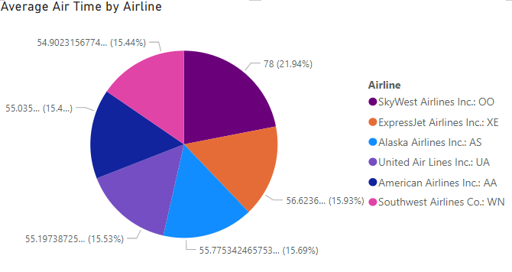
Challenges:
No challenges faced for reporting as the lookup tables provided the necessary information.
Appendix:
Average air time by operated airlines from SF to LA.

