Slide 1
Demonstration Of Rateit
By
Abid Saleh

Slide 2
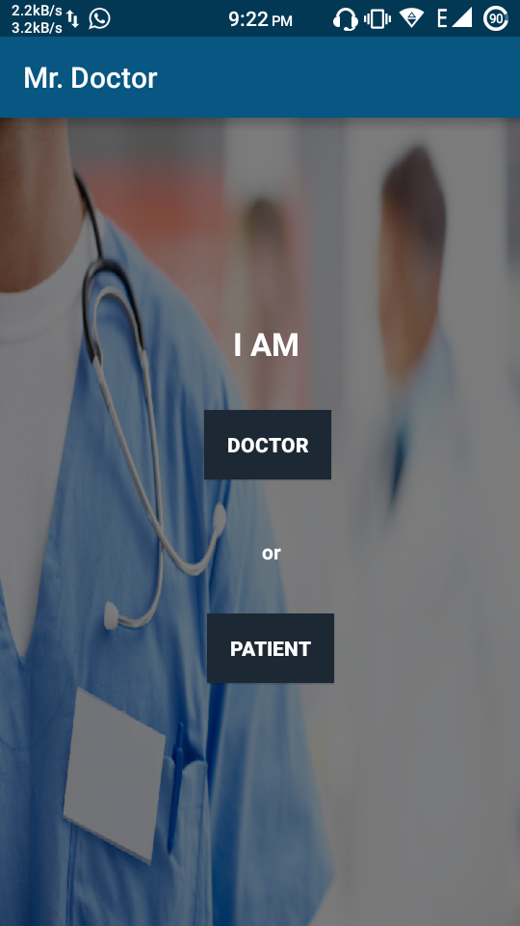
Homepage:

Slide 3
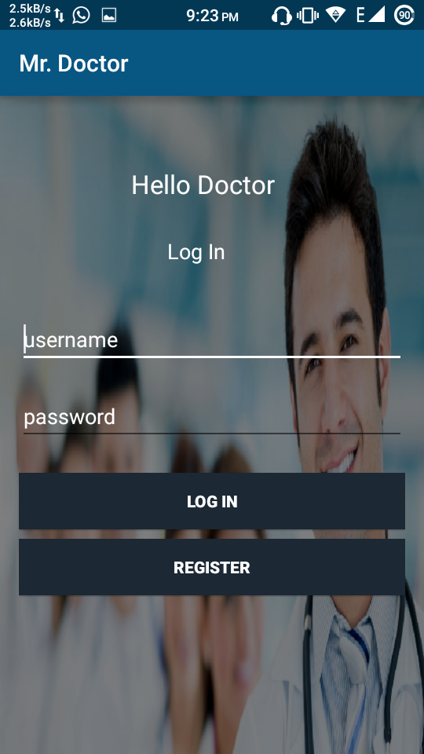
Songs list
Clicked on “Doctor”:

Slide 4
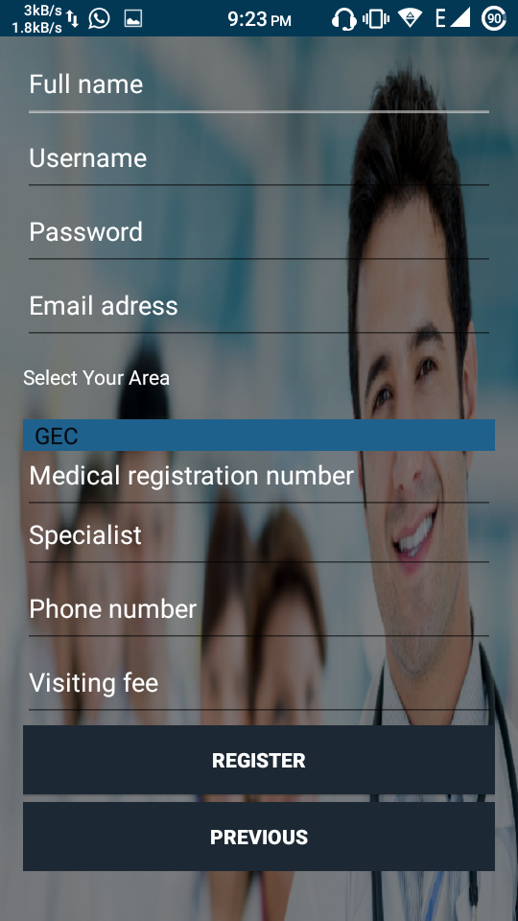
Drama series list
Clicked on “Register”:

Slide 5
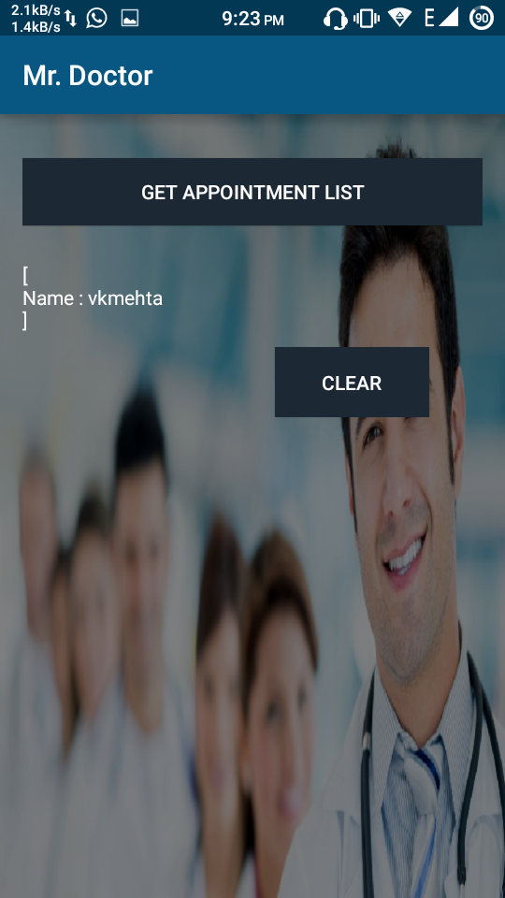
After Completing registration/login as a doctor:

Slide 6
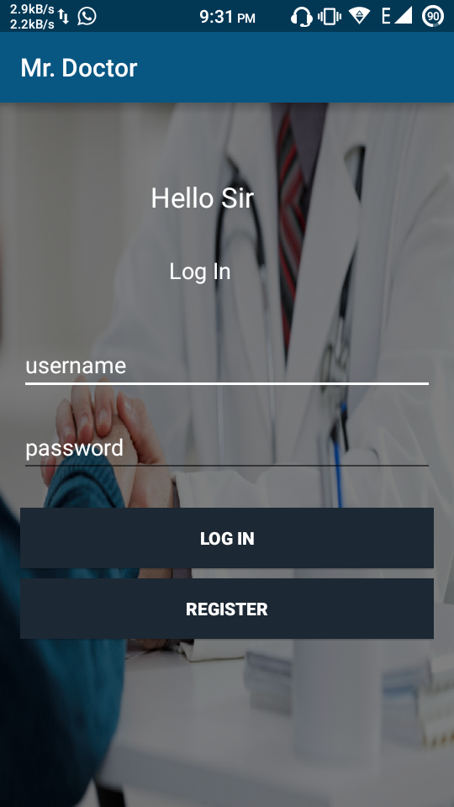
Clicked on “Patient” in home page:

Slide 7
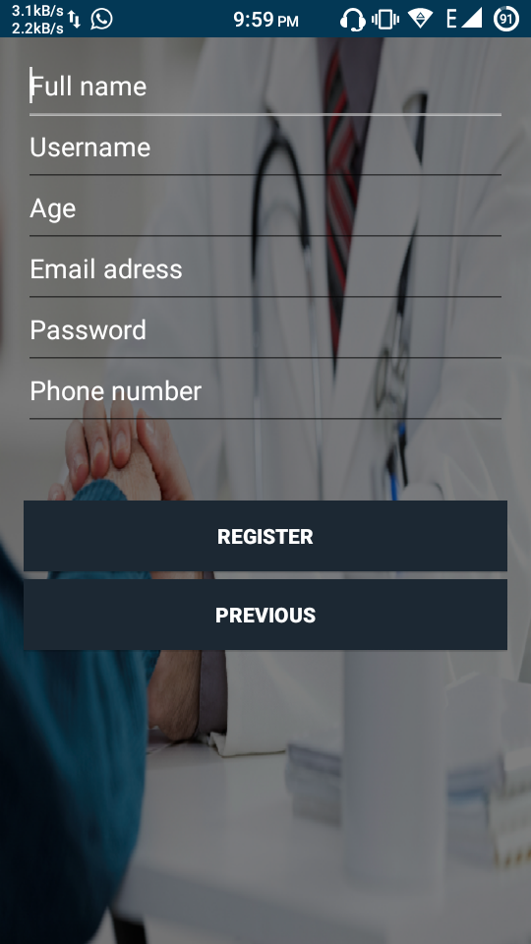
Clicked on “Register”

Slide 8
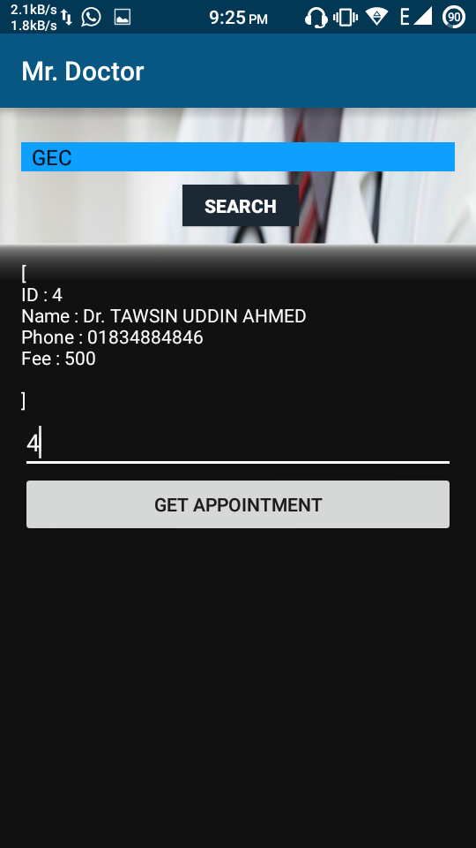
Review and Rating
After Completing registration/login as a patient and clicked search with an area:

Slide 9
Thank You

