Slide 1

FUTURETALE HOTEL RESERVATION ANALYSIS
BY ABIDEMI O.

Slide 2

CASE STUDY
A significant number of Futuretale hotel reservations are called-off due to no shows or cancellations. Customers find it easy to cancel because the cancellations are free of charge or at a low cost which is revenue-diminishing for Futuretale Hotel.
This analysis looked into the cancelled reservations and significant factors or circumstances around the cancelled reservations.
The charts below show the significant factors and recommendations drawn from the insights that can help to curb or reduce the cancellations.

Slide 3
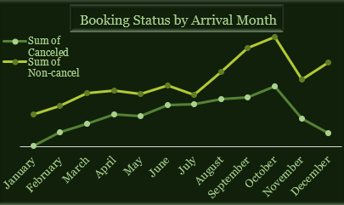
Booking Status by Arrival Month
Low number of cancellations in January, November, December
High number of cancellations in October, high number of non-cancellations also.
Number of cancellations in July is close to number of non-cancellations in July.
Reasons could be due to the seasons, festivities, prices/discounts during these months.

Slide 4
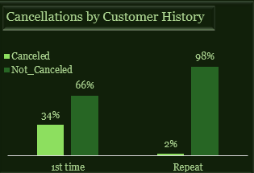
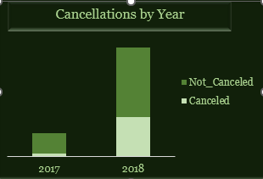
Cancellations by Year and Customer History
More reservations in 2018 than 2017 and more cancellations in 2018
More cancellations by 1st time guests, (34% cancelled vs 2% for repeat guests).
Recommendations –
Advertisements and customers reviews on online platforms.
Cancellation fee should be attached for 1st time customers.
Debit card/credit card details for offline and online reservations which can be charged for cancellation, if eventually cancelled.

Slide 5
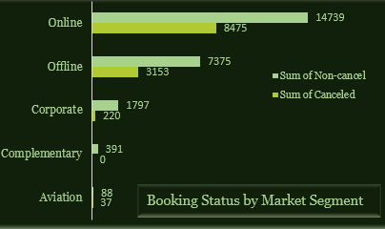
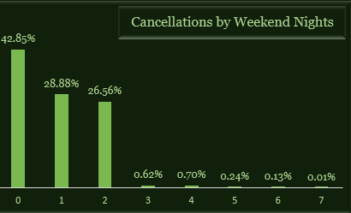
Market Segment Analysis
Online platform had the highest reservation and highest cancellation, followed by Offline Segment.
Complementary segment had no cancellation.
No weekend night had the highest cancellation.
There was little cancellation for bookings with 3 or more weekend nights.
Recommendations:
In addition to the above, complementary segment can be encouraged, through special offers.
Ads, positive guest online reviews promote the image of the hotel. Thus, encourage 1st time customers to check in.
Discounts for > three weekend night reservations

Slide 6
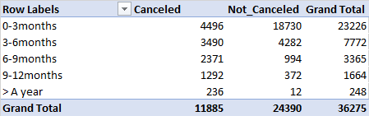
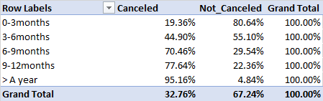
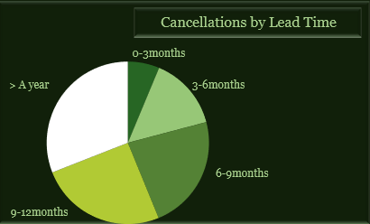
Lead Time Analysis
Reservations for over a year were mostly cancelled, which is 95% of all the reservations.
Reservations within 90days had 19% cancellation, cancellations increased as the lead time increased.
This shows that:
Reservations >3months (90days) should be discouraged, and a cancellation fee can be attached.
Timely reminders about bookings and cancellation charges should be sent to guests to keep them updated, this will reduce last minute cancellations.

Slide 7
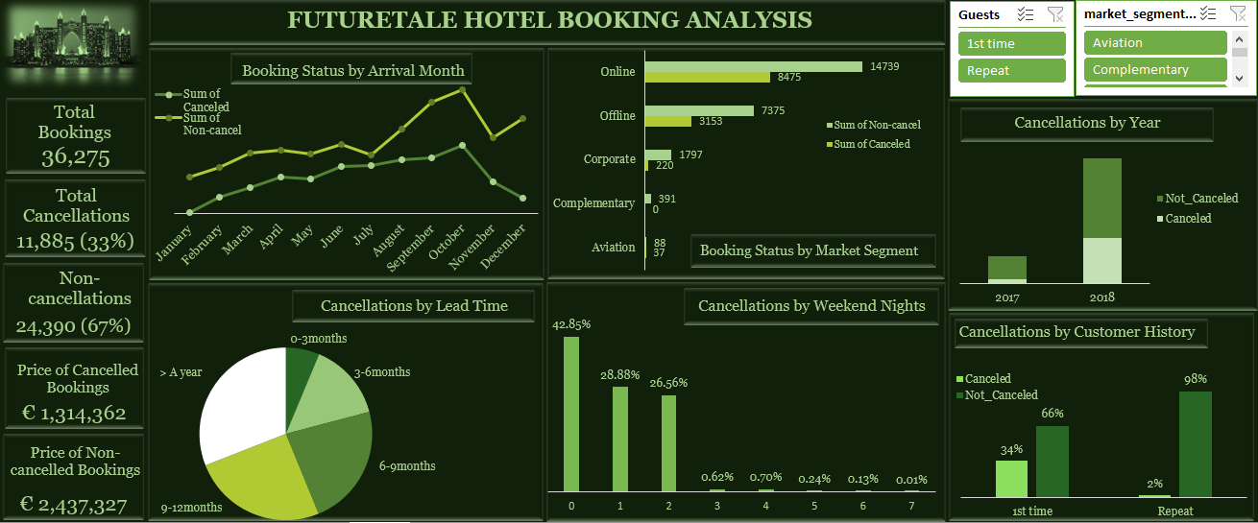

Slide 8
Summary
In summary, the following recommendations can reduce the cancellations of guest reservations:
Non-refundable deposits can be accepted for bookings above three months, a fraction of the booking price.
Card details of customers should be used for reservations.
Efforts to get more complementary segment bookings.
Ads, customer reviews on online platforms should be encouraged.
Bookings for more than three weekend nights can be discounted.
Timely reminders should be sent to guests.
Cancellations should be charged.

