Slide 1
Touchstone 5: Client Website Final Project
North Star Bakery Website
Taufiq Uddin
Client: North Star Bakery
Live Website:
https://abidhussain2330.github.io/north-star-bakery-touchstone-3/
Notes:
This presentation summarizes the completed North Star Bakery website. The live link on this slide opens the deployed root website, where navigation, responsive layout, media, product favorites, validation, and saved customer details are available for review.

Slide 2
Client Goals & Audience
Client Goal: Promote a neighborhood bakery and encourage pre-orders and inquiries.
Target Audience: Local customers, commuters, families, and event planners.
Design Choice: A clear Contact and Pre-Order navigation link appears on every page.
Notes:
North Star Bakery needs to feel warm and dependable while helping customers find products and make an inquiry quickly. Keeping the Contact and Pre-Order link in the same place on every page supports customers who may arrive through the home, product, or about page and then want to take action.

Slide 3
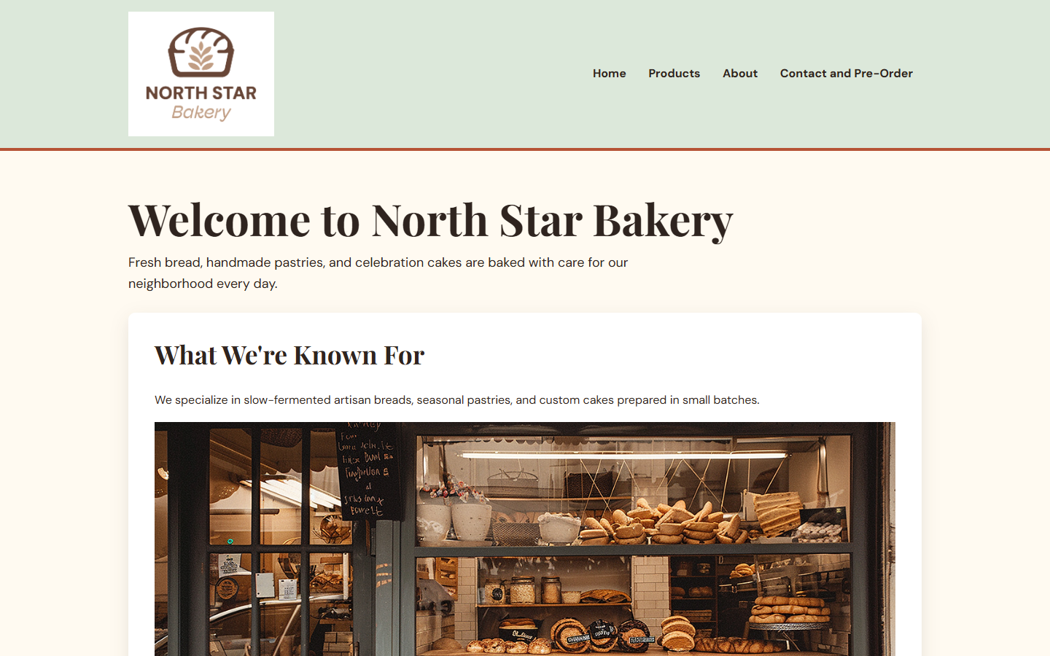
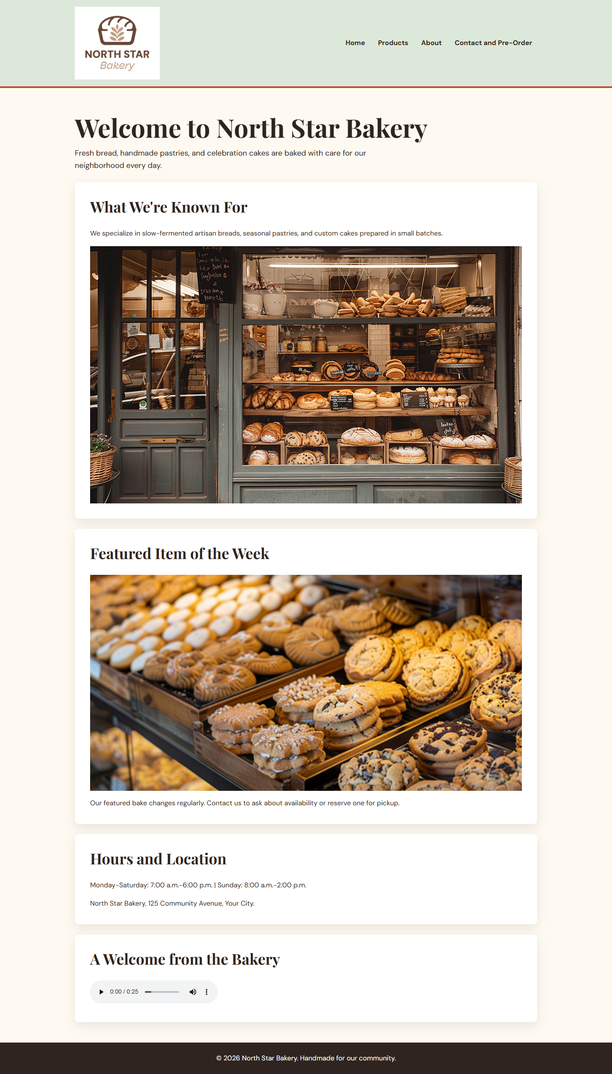
Site Structure & Content
Pages: Home, Products, About, and Contact and Pre-Order.
Navigation: The shared header keeps the same links on every page.
Structure: One H1, clear headings, and grouped cards help customers scan quickly.
Desktop homepage: branding, navigation, and grouped content
Notes:
The desktop homepage screenshot shows the same header and navigation used throughout the site. The logical heading order and card-style sections let customers scan for the bakery’s specialties, featured item, hours, and welcome message instead of reading one large block of text.

Slide 4
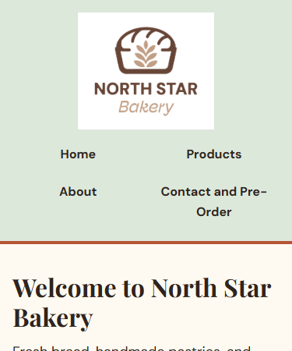
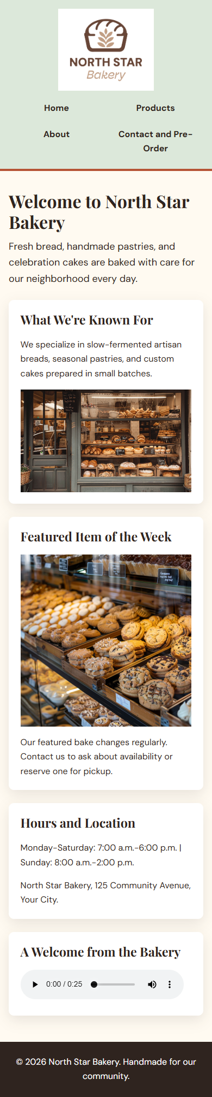
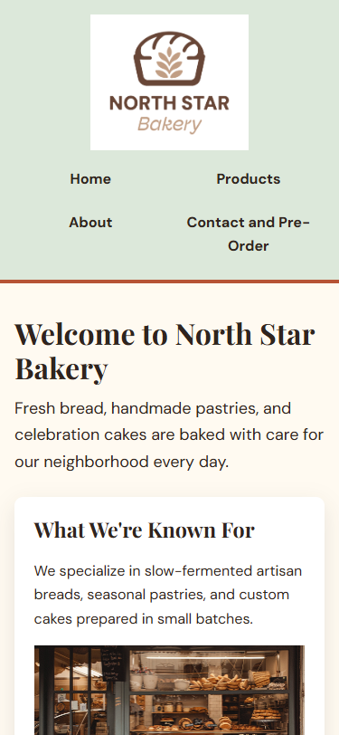
Visual Design System
Color: Cream, dark ink, sage, and terracotta create a warm, high-contrast palette.
Typography: Playfair Display distinguishes headings; DM Sans keeps forms readable.
Layout: Mobile-first cards and responsive images create a clear single-column mobile flow.
Desktop and genuine 375px mobile homepage views
Notes:
The cream background and white cards create a calm reading surface, while the dark ink text has strong contrast. On mobile, the logo and navigation stack above a single-column content flow, so the same information remains readable without horizontal scrolling.

Slide 5
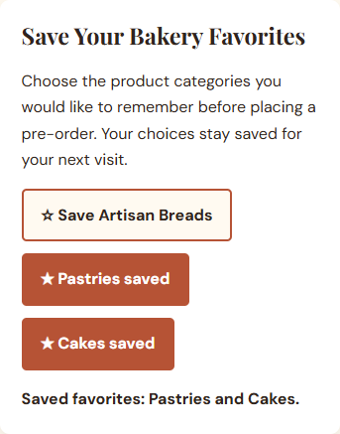
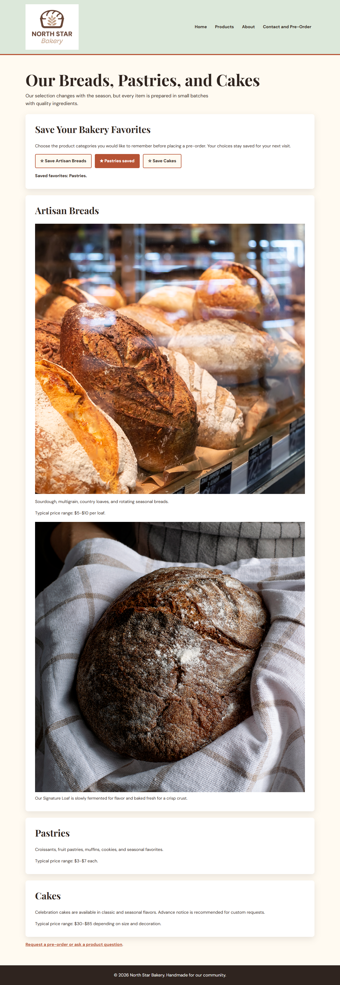
Interactive Feature
Feature: Save Your Bakery Favorites remembers product categories.
User Action: Click a category button, such as Save Pastries.
Result: The button changes to a saved state and a live message confirms the selection.
Pastries and Cakes selected with an immediate status update
Notes:
The favorites feature supports customers who may be comparing breads, pastries, and cakes before starting a pre-order. A clear saved state and confirmation message make the result visible immediately, which avoids forcing the customer to remember a category manually.

Slide 6
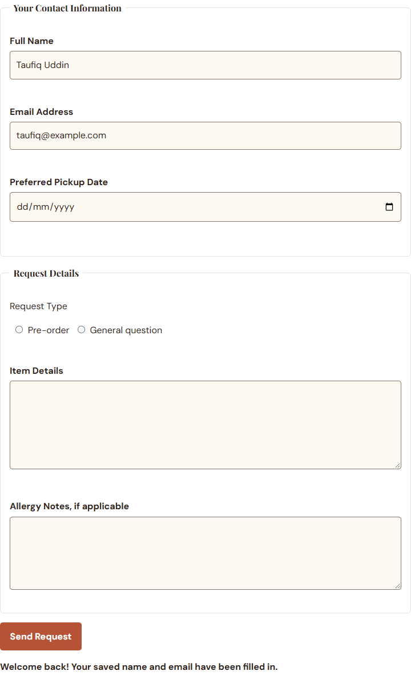
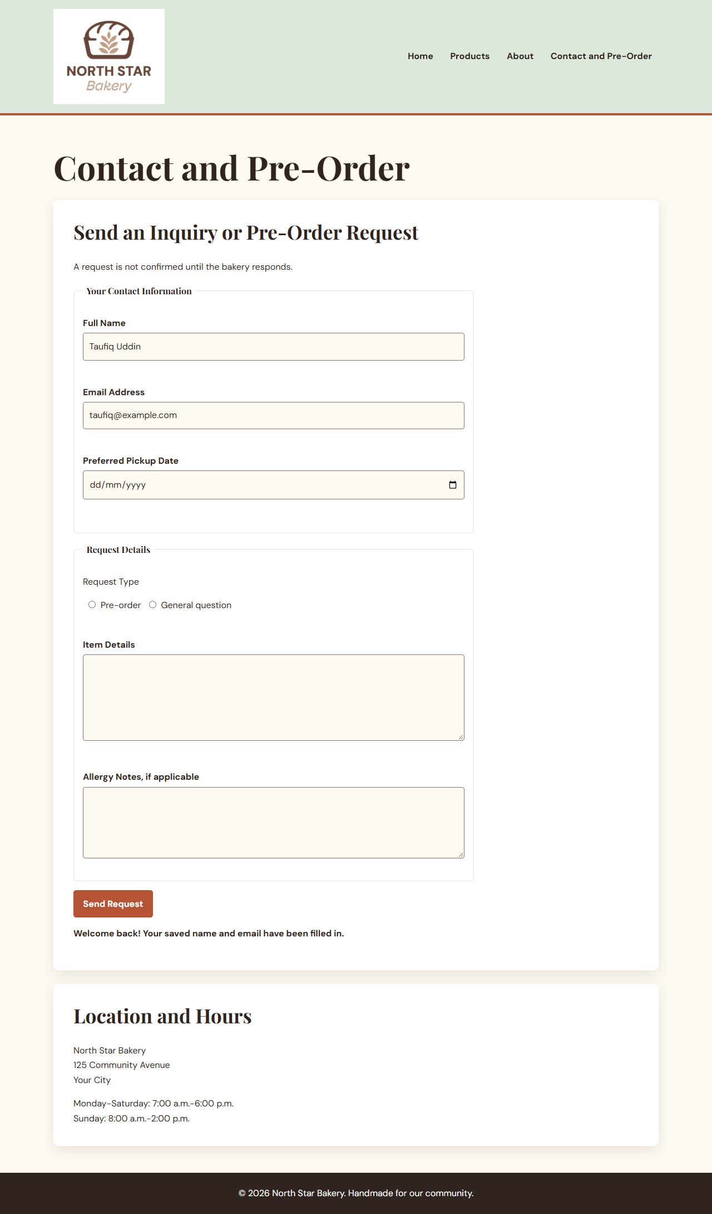
Data Storage
Storage: localStorage.
Saved: Favorite categories plus a customer’s name and email after valid local demonstration input.
Timing: Button clicks save favorites; validation saves and restores contact details.
Restored contact details after reload
Notes:
localStorage was selected because the bakery benefits from remembering simple return-visit details across browser sessions. The saved values are limited to product category preferences and the customer’s name and email; this reduces repetitive typing while leaving pickup dates and order details for each new visit. The form does not transmit an order or request, which keeps the class demonstration accurate and avoids unnecessary collection of information.

Slide 7
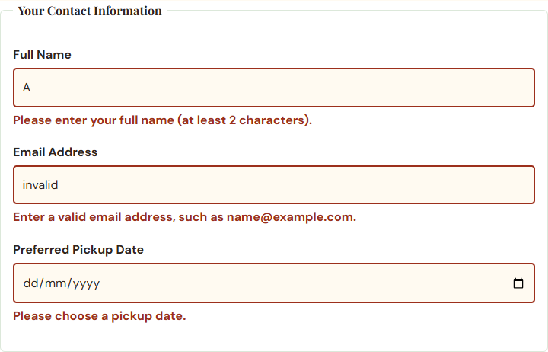
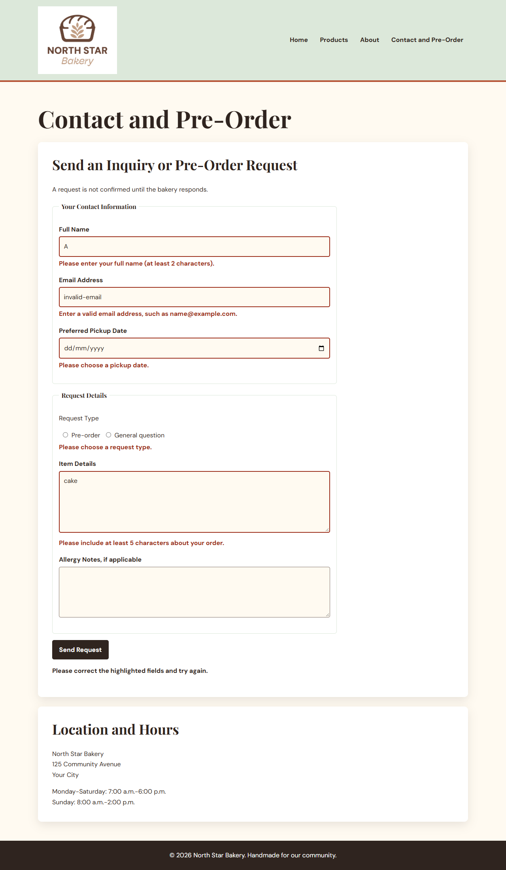
Accessibility
Verified features: Skip link, semantic landmarks, descriptive alt text, visible keyboard focus, form labels and fieldsets, and aria-live validation feedback.
Focus: Field-specific feedback is announced beside the relevant input.
Field-specific feedback with visible error states
Notes:
The inline validation feedback is useful for customers who navigate with a keyboard or assistive technology because the message is announced and located beside the field that needs correction. The skip link, visible focus styles, descriptive image alternatives, and clear headings also support people who navigate without a mouse or who need to scan the page quickly.

Slide 8
Self-Evaluation
Strength: The site combines a consistent visual system with clear task-focused interactions.
Evidence: The Contact and Pre-Order form shows specific errors while preserving entered information.
User Impact: Customers know exactly what to fix and can return more quickly because their name and email are remembered.
Improvement: Add a real server-side order system so valid requests can be securely delivered and confirmed.
Notes:
A major strength is that form validation is specific instead of generic: customers see messages such as the correct email format and do not lose the rest of their order information. The next improvement would be a secure backend or third-party ordering service, because the current project intentionally demonstrates client-side behavior without actually sending an order to the bakery.

Slide 9
Process Reflection
Planning: I planned four audience-focused pages, shared navigation, accessible forms, and a warm bakery visual system early.
Change: I added saved favorites and remembered contact details after identifying repeat customers as a key user need.
Why It Changed: The interactive elements make returning to products and starting another inquiry faster.
Notes:
The original structure prioritized clear content and a usable pre-order form. Later development added favorites and localStorage because a bakery customer may browse products once, leave, and return later; preserving a small amount of useful information makes that second visit more efficient.

Slide 10
Challenges & Lessons Learned
Challenge: Browser-native validation did not provide consistent, nearby feedback for every field.
Solution: I used JavaScript validation functions, dedicated error elements, aria-live messaging, and tests for invalid and valid data.
Lesson: Plan validation feedback as part of the interface, not as an afterthought.
Notes:
The main challenge was showing errors clearly while keeping valid information in place. Building small validation and rendering functions made the behavior easier to test and correct; in future work, I would plan error states, return-visit data, and screen-reader feedback earlier in the wireframing stage.

