Slide 1


Rhythm and Intonation: Chunking Part 1

Slide 2
Kon'nichiwa, hajimemashite. Torēningu e yōkoso. Watashinonamaeha Sherirudesu. Watashi wa Firipin hito to chūgokujin no hāfudesu. Watashi wa San jū kyū-saidesu. Watashi wa jissō manējādesu. Watashi wa roku-nenkan nihongo o manande imasu. Watashi wa Nihon ni sunde itanode, nihongo o benkyō shimashita. Yoroshiku Onegai shimasu.
Notes:
こんにちは、はじめまして。トレーニングへようこそ。私の名前はシェリルです。私はフィリピン人と中国人のハーフです。私は39歳です。私は実装マネージャーです。私は6年間日本語を学んでいます。私は日本に住んでいたので、日本語を勉強しました。私をよく扱ってください。

Slide 3
Hello, Nice to meet you guys. Welcome to our Training. My name is Sheryll. I'm Half Filipino and half Chinese. I'm thirty nine years old. I'm the Implementations Manager. I've been learning Japanese for six years. I studied Japanese because I lived in Japan. Nice to meet you.

Slide 4

Chunking
What is chunking (noun) – a way of dealing with or remembering information by separating it into small groups or chunks:
Creating ‘chunks’ in your message that are separated by a pause or a change in tone.
Gives variety to your speaking voice
Helps your listeners understand what you are saying much easier

Slide 5

Chunking
“Today I’d like to talk to you about a concept called Chunking. Chunking is a strategy that great speakers use very effectively. It sounds effortless, but in fact, it takes a lot of practice.”

Slide 6

How I do it?
Identify the Chunks
“Today / I’d like to talk to you about a concept / called Chunking. / Chunking is a strategy / that great speakers use / very effectively. / It sounds effortless, / but in fact, / it takes a lot of practice.”

Slide 7
How I do it?
2. Each Chunk has a stressed word
“Today / I’d like to talk to you about a concept / called Chunking. / Chunking is a strategy / that great speakers use / very effectively. / It sounds effortless, / but in fact, / it takes a lot of practice.”

Slide 8
How I do it?
3. Be aware of your pace
“Today / I’d like to talk to you about a concept / called Chunking. / Chunking is a strategy / that great speakers use / very effectively. / It sounds effortless, / but in fact, / it takes a lot of practice.”

Slide 9
How I do it?
4. Practice, Practice, Practice
“Today / I’d like to talk to you about a concept / called Chunking. / Chunking is a strategy / that great speakers use / very effectively. / It sounds effortless, / but in fact, / it takes a lot of practice.”

Slide 10
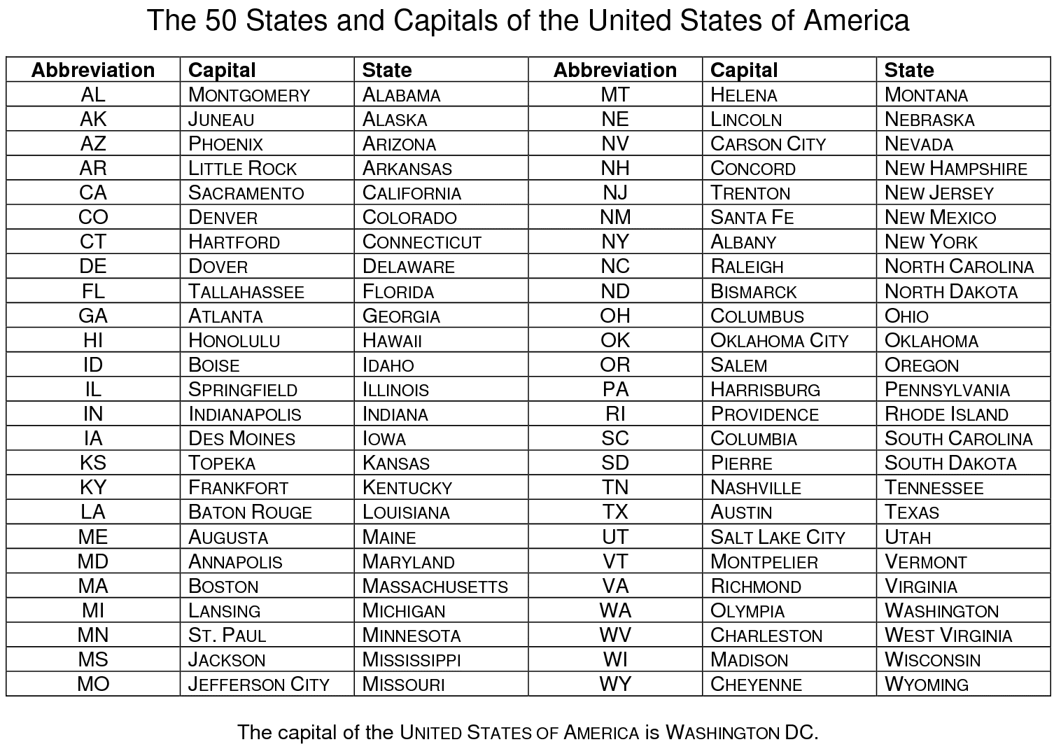


Slide 11

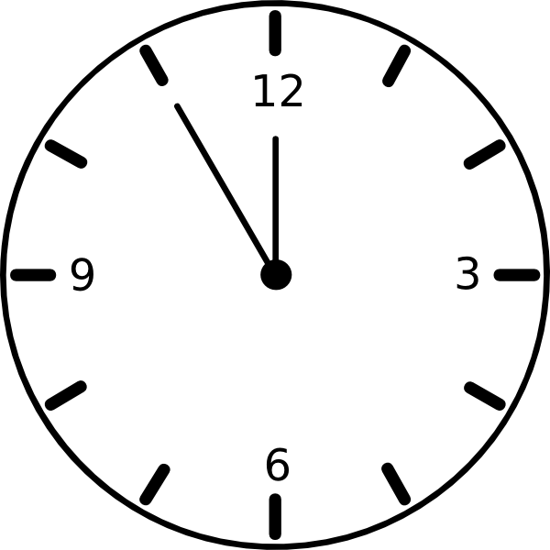
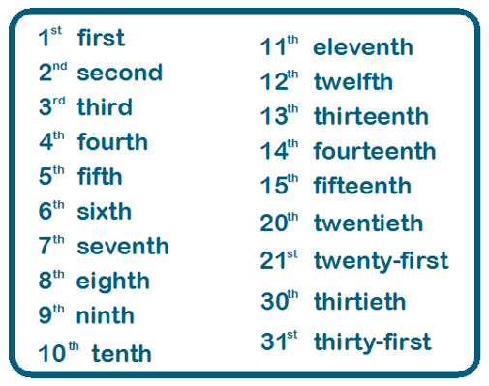
How to say Date and Time in American English
Ordinal Number
What time should I give you a call?
Does 10:00am sounds good? Or
10:00 o’clock in the morning?
Example: August 2, 2021
I will call you back on August 2nd at 10:00 o’clock.

Slide 12

How to say telephone number and price quotes in American English
This is how American say/write phone numbers
Phone Numbers 123-456-7890
(123) 456-7890
Instead of saying zero – you can substitute it with the letter “o”.
How to talk about prices.
$10.75
$2.50
$18.25
$187.42
$1807.87

Slide 13
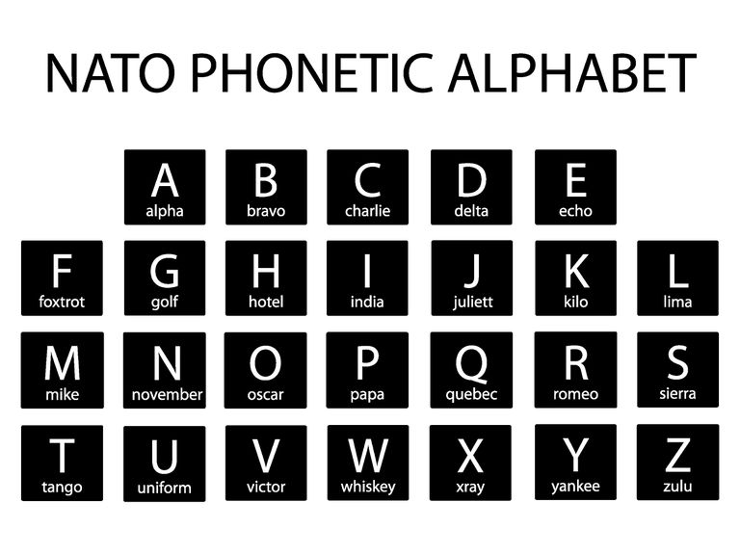

Slide 14

apprecyet tok broth entayer eth-na mutual of Umaha hu-ma-na sinyohrr bahnafits perporm rebyu spik rely mom konpeerm covehreyj and among others
Commonly mispronounced words in OPs:
appreciate
talk
brought
entire
Aetna
Mutal of Omaha
Humana
senior
benefits
perform
review
speak
relay
Ma’am
Confirm
coverage
Among others

Slide 15
Chunking
Let’s Review:
Creating ‘chunks’ in your message that are separated by a pause or a change in tone.
Gives variety to your speaking voice – more engaging for your listeners.
Helps your listener understand you much easier.

Slide 16
Chunking
Steps to Chunk:
Identify the Chunks
Each chunks has stressed word
Be aware of your pace
Practice, Practice, Practice

Slide 17

The End

