Slide 1


CEG FABLESS RISC-V SUMMER INTERNSHIP 2025
PROJECT REVIEW
PERFORMANCE EVALUATION OF STAGE0 VARIANTS IN
C-CLASS CORE RTL

Slide 2

MENTORS : SRIRAM & NITYA
SHAKTHI Team,
Indian Institute of Technology,Madras
TEAM NO: CF-RV-25-04
TEAM MEMBERS:
ABIELA MARIA Y - 2022105503 B.E ECE
SWETHA V - 2022105013 B.E ECE
College of Engineering Guindy

Slide 3
PROJECT STATEMENT
The Program Counter Generator (PCGen) and Branch Predictor in Stage 0 play a crucial role in determining how efficiently instructions are fetched in the Shakti C-Class RISC-V core.
The default configuration may not provide optimal performance for all use cases.
Since these components are configurable, their impact on performance can vary.
Therefore, it's important to analyze how different parameter settings affect core efficiency and identify the most optimal setup.

Slide 4
GOAL
To perform an in-depth analysis of Stage 0 in the Shakti C-Class RISC-V core, specifically targeting the Program Counter Generator (PCGen) and Branch Predictor modules.
To identify and modify key configuration parameters within the core’s design files that influence instruction flow and prediction accuracy.
To rebuild the core with various configurations and evaluate performance using standardized test suites including RISC-V benchmarks, CoreMark, and microbenchmarks provided by the Shakti team.
To compare and analyze performance metrics such as CPI, IPC, and cycle count across different configurations.

Slide 5
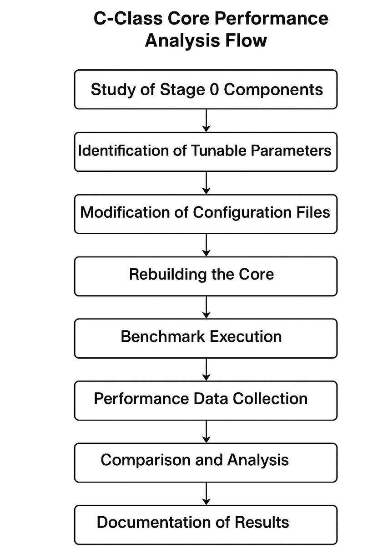
PROJECT FLOW

Slide 6
BUILDING THE SHAKTI C-CLASS CORE
The C-Class core source code was obtained from the official Shakti GitLab repository, which contains all the necessary files for SoC development and simulation.
After setting up the environment, all Python dependencies listed in the project were installed to ensure compatibility with tools like soc_config and repomanager.
The RepoManager tool was used to resolve and manage the SoC-level dependencies defined in YAML configuration files. This included pulling in required modules such as the memory system, peripherals, and interconnects.
The SoC configuration process involved using multiple YAML specification files, which define:the ISA specification (RV64I),any custom instruction extensions used,the core architecture parameters (like pipeline depth, width),the CSR (Control and Status Register) grouping and the debug module configuration.
These configuration files were passed to the soc_config tool, which generates the final RTL and support files tailored to the specified architecture.

Slide 7
CORE GENERATION AND BENCHMARK EXECUTION
Verilog code for the core was generated after setting the appropriate environment.
Verilator was linked to allow simulation of the RTL design.
Boot files were created to support program execution on the core.
The Spike simulator and GNU RISC-V toolchain were used to run performance benchmarks.
Benchmarks executed included CoreMark, standard RISC-V tests, and additional microbenchmarks provided by the Shakti team.
Performance was evaluated based on instruction counts, execution cycles, and CPI for different configurations.

Slide 8
STAGE-0 CONFIGURATION
Reduces control hazards by predicting branch direction & target.
Working: Combines global history with PC bits (XOR) → index into Branch History Table (BHT).
Parameters:
Type: GShare, BTB Depth: 32, BHT Depth: 512
History Length: 8 bits, History Bits: 5
RAS Depth: 8, Instantiate: True
Balanced design for good accuracy with low hardware cost.
Baseline setup for later branch misprediction & CPI analysis.

Slide 9
BASELINE PERFORMANCE (BEFORE CONFIGURATION CHANGE)
Source: RTL simulation (rtl1.dump) before core64.yaml changes
Performance Stats:
Retired Instructions: 13,011,486
Cycles: 16,167,244 → CPI ~1.24 (acceptable throughput)
Branches: 2,147,474
Mispredictions: 8,622,991* (exceeds branch count → likely cumulative counter)
Jumps: 151,559
MUL/DIV: 375,896

Slide 10
BASELINE PERFORMANCE – C-CLASS CORE (AFTER CONFIGURATION CHANGE)
Change: Reduced BHT depth from 512 → 500 in gshare predictor.
Reason: Test sensitivity of branch prediction accuracy to small table size changes.
Expected Effect: Smaller table → more aliasing → higher mispredictions.
Results:
Retired Instructions: 69,632
Cycles: 70,400 → IPC ~0.99
Branch Mispredictions: 70,412 (↑ due to increased collisions)
Jumps: 1
MUL/DIV: 70,412

Slide 11
INFERENCE
BHT Depth Modification (512 → 500)
Even a small BHT depth reduction caused a clear rise in branch mispredictions due to increased aliasing (multiple branches mapping to the same table index).
IPC remained nearly unchanged in this test.
More pipeline flushes → potential performance drop in branch-heavy workloads.
Branch predictor accuracy is highly sensitive to history table size.
Undersized BHT can reduce execution efficiency.
Careful tuning of microarchitectural parameters like BHT depth is essential for balancing hardware cost and performance.

Slide 12
REFERENCE
https://github.com/vyomasystems/uptickpro_examples
https://github.com/B-Lang-org/bsc.
https://github.com/riscv/riscv-gnu-toolchain.
https://gitlab.com/shaktiproject/cores/benchmarks
https://gitlab.com/shaktiproject/cores/c-class

Slide 13
THANK YOU

