Slide 1

Introduction to Programming in R
Przemyslaw (Pshemek) Pawluk MSc. Eng.

Slide 2
Introduction
Basic programming concepts in R
Tools - RStudio

Slide 3
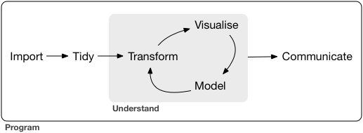
Data Science / Data Analysis

Slide 4
Why do we use programming tools if we can do so much in Excel?

Slide 5
About R
R is an interpreted language, not a compiled one, meaning that all commands typed on the keyboard are directly executed without requiring to build a complete program like in most computer languages (C, Java, C#, . . .).
R’s syntax is very simple and intuitive.

Slide 6
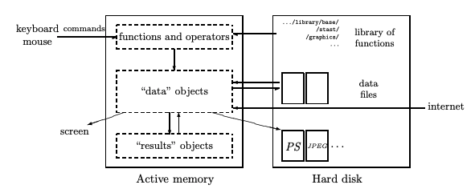
About R
When R is running, variables, data, functions, results, etc., are stored in the active memory of the computer in the form of objects which have a names.
The user can do actions on these objects with operators (arithmetic, logical, comparison, . . .) and functions (which are themselves objects).

Slide 7
Basic commands
help(): prints documentation for a given R command
example(): view some examples on the use of a command
c() or scan(): enter data manually to a vector

Slide 8
Running Calculations
You can run/calculate expressions directly in the R console
Results are printed in the console
This approach is good for testing
1 / 200 * 30
#> [1] 0.15
(59 + 73 + 2) / 3
#> [1] 44.66667
sin(pi / 2)
#> [1] 1

Slide 9
Objects
In the console, you can also store results in the object (some call it a variable, it is a named space in the memory)
It allows you to reuse the value
Assignment does not print value
Expression can be simply a value or some calculation
name <- expression
x <- 3 * 4
(x <- 3 * 4)
#> [1] 12

Slide 10
Objects’ Names
Object name must start with a letter
It can only contain letters, numbers, _ and ..
You want your object names to be descriptive, so you’ll need a convention for multiple words. We recommend snake_case where you separate lowercase words with _.
Alternative is camelCase where each word starts with a capital letter
use_snake_case
orUseCamelCase
some.people.use.periods
And_aFew.People_RENOUNCEconvention

Slide 11
Objects’ Names
Object name must start with a letter
It can only contain letters, numbers, _ and ..
You want your object names to be descriptive, so you’ll need a convention for multiple words. We recommend snake_case where you separate lowercase words with _.
Alternative is camelCase where each word starts with a capital letter
use_snake_case
orUseCamelCase
some.people.use.periods
And_aFew.People_RENOUNCEconvention

Slide 12
R is case sensitive
R is a case sensitive language
Be careful with naming as in programming there is no guessing
If you want to see the value assigned to the variable surround the whole line with ()
r_rocks <- 2 ^ 3
r_rock
#> Error: object 'r_rock' not found
R_rocks
#> Error: object 'R_rocks' not found

Slide 13
Functions
R has a large collection of built-in functions
You can call them using name of the function and parenthesis ( and )
In parenthesis you can provide parameters for the function (if it requires them)
function_name(arg1 = val1, ...)
seq(1, 10)
#> [1] 1 2 3 4 5 6 7 8 9 10

Slide 14
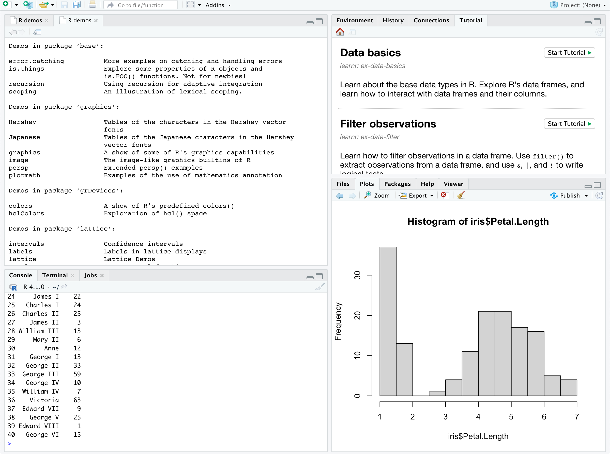
Demos
Console
Help etc.
Results & Graphs

Slide 15
Demos
Console
Help etc.
Results & Graphs

Slide 16
Demos
Console
Help etc.
Results & Graphs

Slide 17
Demos
Console
Help etc.
Results & Graphs

Slide 18
Working with data
data(): load built-in dataset
View(): view loaded datasets
read.csv() – requires a path or url to the csv file
read.table()

Slide 19
Data Types
Basic data types
int stands for integers.
dbl stands for doubles, or real numbers.
chr stands for character vectors, or strings.
dttm stands for date-times (a date + a time).
lgl stands for logical, vectors that contain only TRUE or FALSE.
fctr stands for factors, which R uses to represent categorical variables with fixed possible values.
date stands for dates.

Slide 20
Data Transformation in R
Pick observations by their values (filter()).
Reorder the rows (arrange()).
Pick variables by their names (select()).
Create new variables with functions of existing variables (mutate()).
Collapse many values down to a single summary (summarise()).

Slide 21
Filter
filter() allows you to subset observations based on their values. The first argument is the name of the data frame.
The second and subsequent arguments are the expressions that filter the data frame.
jan1 <- filter(flights, month == 1, day == 1)
filter(flights, month == 11 | month == 12)
filter(flights, !(arr_delay > 120 | dep_delay > 120))
filter(flights, arr_delay <= 120, dep_delay <= 120)

Slide 22
Arrange
arrange() works similarly to filter() except that instead of selecting rows, it changes their order. It takes a data frame and a set of column names (or more complicated expressions) to order by.
If you provide more than one column name, each additional column will be used to break ties in the values of preceding columns
arrange(flights, year, month, day)

Slide 23
Select
select() allows you to rapidly zoom in on a useful subset using operations based on the names of the variables.
select(flights, year, month, day)

Slide 24
Mutate
mutate() always adds new columns at the end of your dataset so we’ll start by creating a narrower dataset so we can see the new variables.
You can use the columns added in definitions of other columns that you add (be careful with cycles)
mutate(flights,
gain = dep_delay - arr_delay,
speed = distance / air_time * 60
)

Slide 25
Summarize
summarise() is not terribly useful unless we pair it with group_by().
This changes the unit of analysis from the complete dataset to individual groups. Then, when you use the dplyr verbs on a grouped data frame they’ll be automatically applied “by group”.
by_day <- group_by(flights, year, month, day)
summarise(by_day, delay = mean(dep_delay, na.rm = TRUE))

Slide 26
Hands-on

Slide 27
Task 1 – Code analysis
Why does this code not work?
my_variable <- 10
my_varıable
#> Error in eval(expr, envir, enclos): object 'my_varıable' not found

Slide 28
Task 2 – Code analysis
What is wrong with this two function calls?
fliter(mpg, cyl = 8)
filter(diamond, carat > 3)

Slide 29
Task 3 – Filter data
Find all diamonds in the diamonds data set that are smaller than 3 carats and cost more than 15,000
filter(diamonds,…)

Slide 30
References
https://cran.r-project.org/doc/contrib/Paradis-rdebuts_en.pdf

