Slide 1
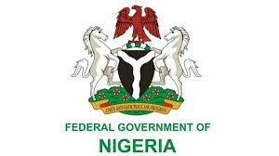
Nigeria’s 2026 Budget: What It Means for Citizens
A Data-Driven Analysis of Spending, Debt, and Economic Impact

Slide 2
Overview
This project analyzes Nigeria’s 2026 federal budget to understand:
How big is Nigeria’s 2026 budget compared with previous years?
How much of the budget goes to debt servicing?
Is capital spending large enough to support real development?
Can projected revenue realistically fund the budget?
What does the budget mean for ordinary Nigerians after inflation?
Are health, education, jobs, and poverty receiving enough attention?
02

Slide 3
Data Sources
Key variables:
Total Budget
Debt Servicing
Capital vs Recurrent Spending
Revenue Projection and Funding Gap
Headline and Food Inflation
Health, Education, Jobs and Poverty Indicators
Budget Office of the Federation (Nigeria)
National Bureau of Statistics (NBS)
World Bank Indicators
Debt Management Office (DMO)
03

Slide 4
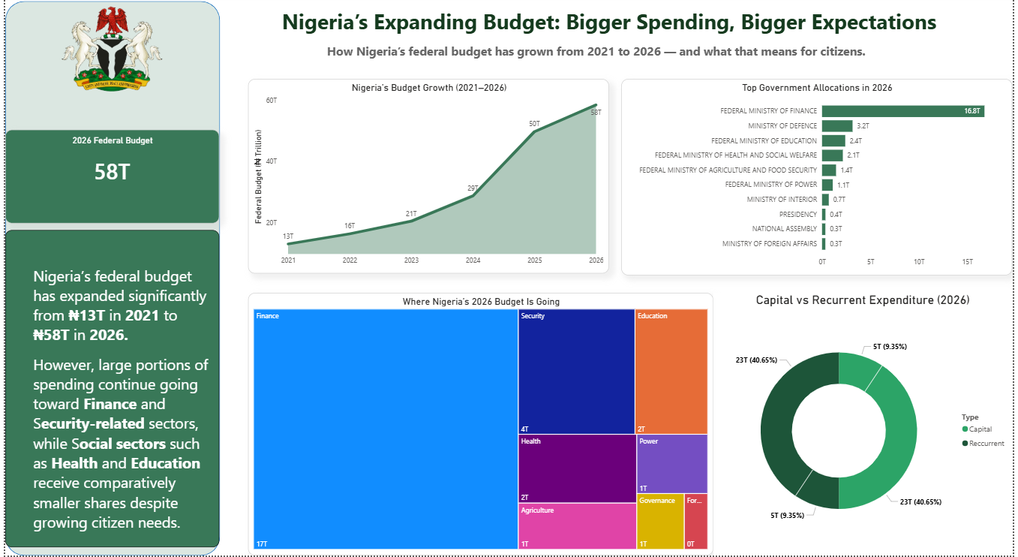
Nigeria’s Budget Growth
Question 1: How big is Nigeria’s 2026 budget compared with previous years?
Nigeria’s federal budget has grown significantly from ₦13T in 2021 to ₦58T in 2026.
The 2026 budget is over 4 times larger than the 2021 budget.
INSIGHT
2026 is the largest in Nigeria’s history but impact depends on where the money goes..

Slide 5
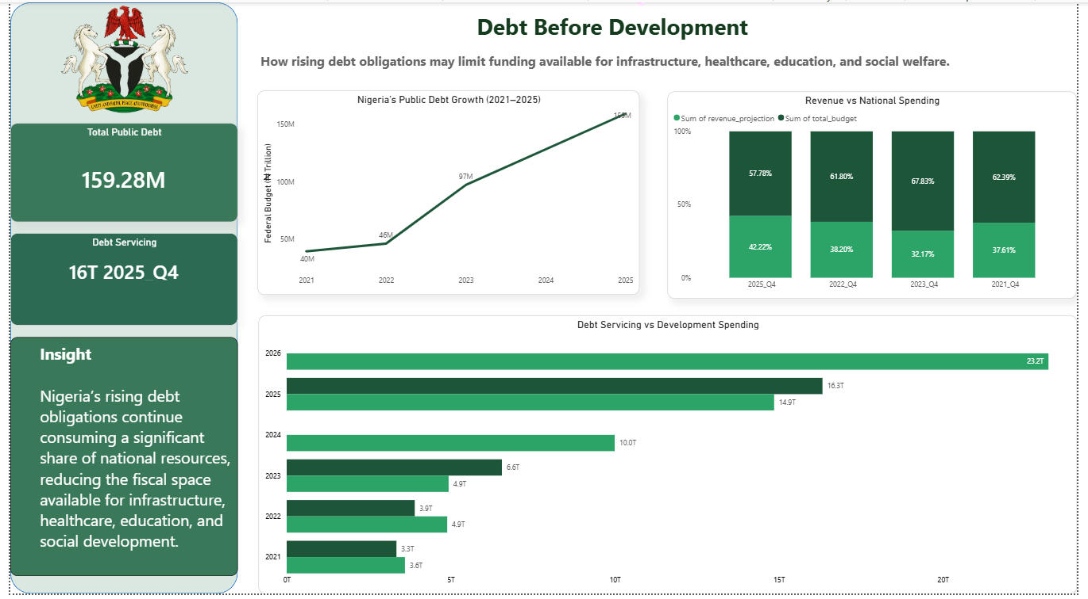
Debt Before Development
Question 2: How much of the budget goes to debt servicing?
• Debt servicing accounts for about 23% of the adjusted 2026 budget
• 1 out of every 4 naira is used to pay old debt
• Debt obligations come before new roads, hospitals, schools and jobs
INSIGHT
Debt servicing seriously limit citizen-focused spending

Slide 6
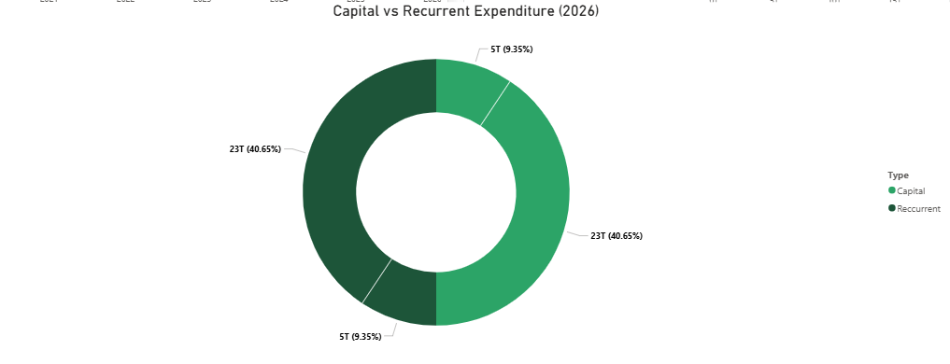
Development or Government Survival?
Question 3: Is capital spending large enough to support real development?
Recurrent expenditure takes a large share of the budget.
This means more money is used to run government operations rather than invest in long-term development.
This limits infrastructure growth and job creation.
INSIGHT
Capital spending is significant, but not enough on its own to guarantee real development.

Slide 7
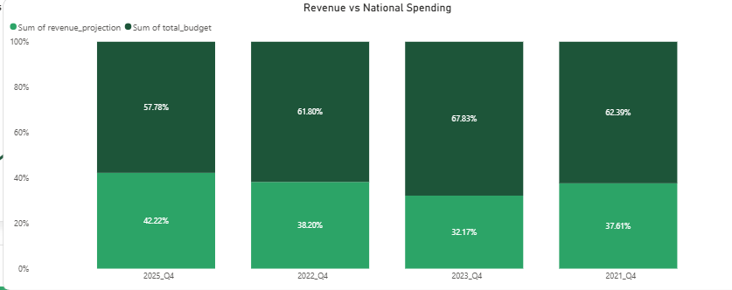
Revenue vs Spending
Question 4: Can projected revenue realistically fund the budget?
• Revenue covers less than half of planned expenditure
• The funding gap means the budget depends heavily on borrowing and deficit financing
INSIGHT
Projected revenue is not enough to fully fund the budget

Slide 8
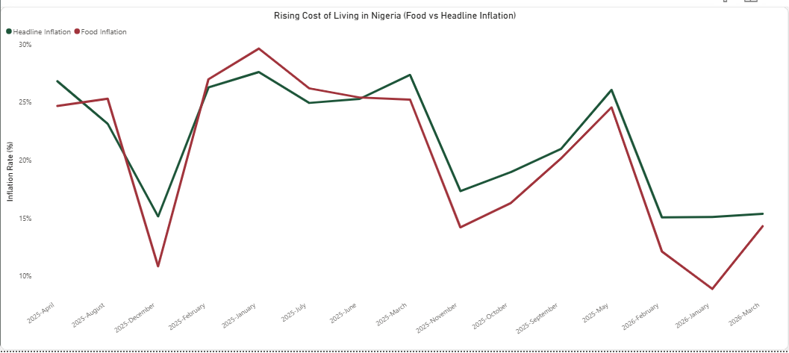
The Budget vs Cost of Living
Question 5: What does the budget mean for ordinary Nigerians after inflation?
Inflation reduces the real value of wages, household income and public spending.
• Food inflation reached over 39% in 2024
• Even a bigger budget may not feel like relief if food, transport and school costs keep rising.
INSIGHT
Inflation turns a big budget into a smaller benefit for households

Slide 9
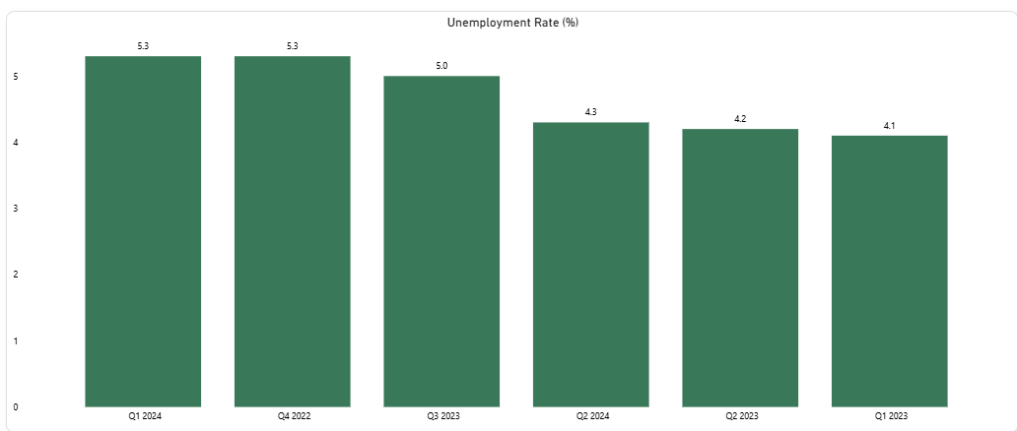
What This Means for Nigerians…
Question 6: Are health, education, jobs, and poverty receiving enough attention?
• Reduced purchasing power
• Increased financial pressure
• Limited access to quality services
• Slower infrastructure development
Despite higher government spending, many citizens are not yet feeling the benefits.
INSIGHT: Citizen-impact sectors need stronger priority if Nigerians are to feel the budget.

Slide 10
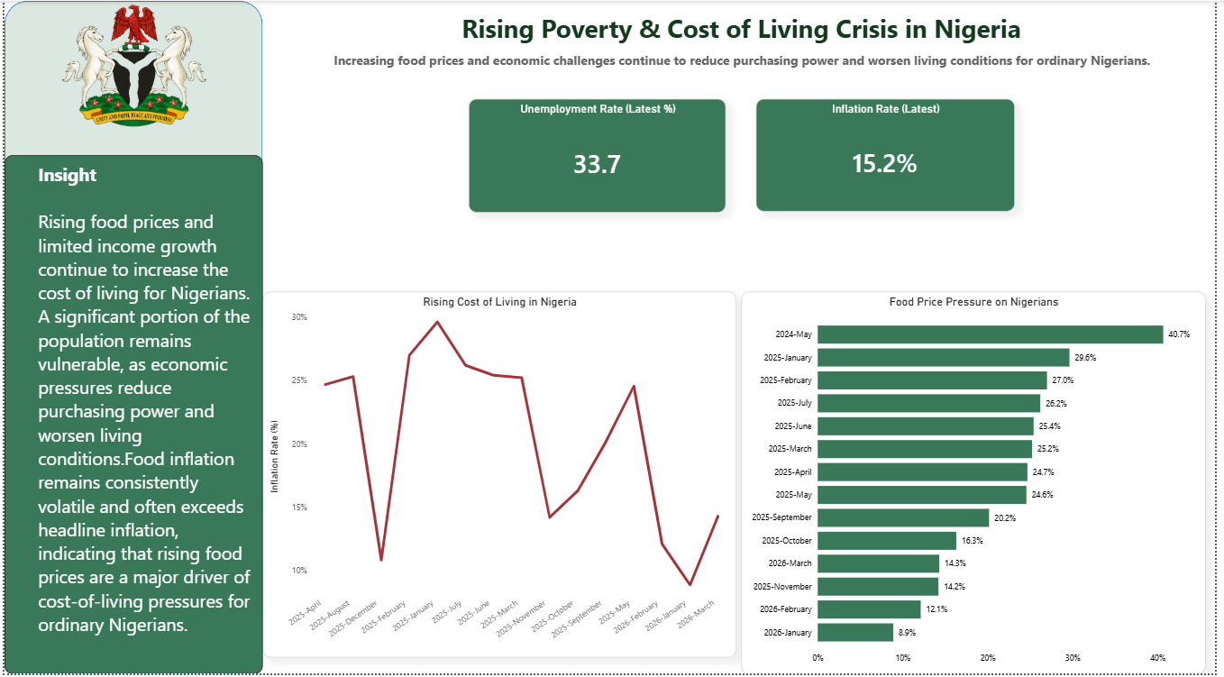
Final Insight
Nigeria is spending more than ever, but the benefits are not fully reaching citizens.
Without deliberate changes, increased government spending may continue to grow on paper while everyday living conditions remain largely unchanged.
FINAL VERDICT: Big spending only matters if it becomes visible improvement in daily life.

Slide 11

THANK YOU

