Slide 1
Bank Marketing Campaign Analysis
Executive summary and business insights
PrePARED BY: ABIGAIL BANTANG

Slide 2
Project Overview
Objective: Understand factors influencing customer subscriptions.
Tools: Pandas, Seaborn and Matplotlib .
Business Questions :
1. Who subscribes?
2. Do more calls help?
3. Do longer calls help?
4. Which months work best?
5.Does past campaign history matter?

Slide 3
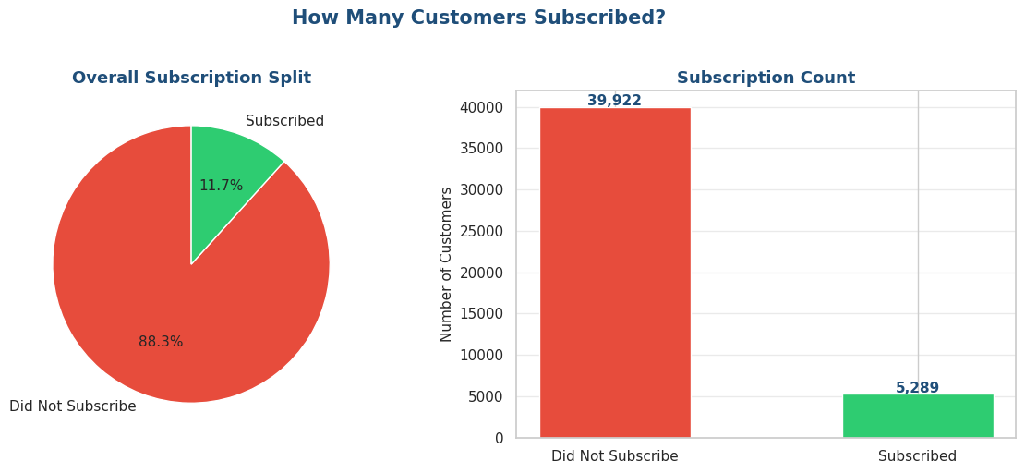
Overall Subscription Performance
5,289 subscribed out of 45,211 customers.
Subscription rate: 11.7%.

Slide 4
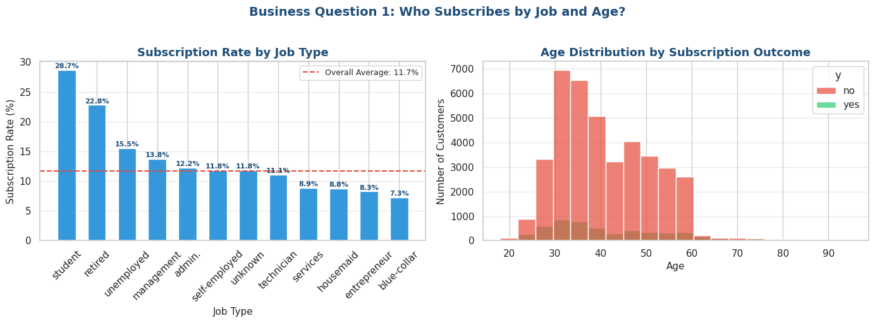
Who Subscribes by Job Type and Age?
Students and retirees showed the highest subscription rates.

Slide 5
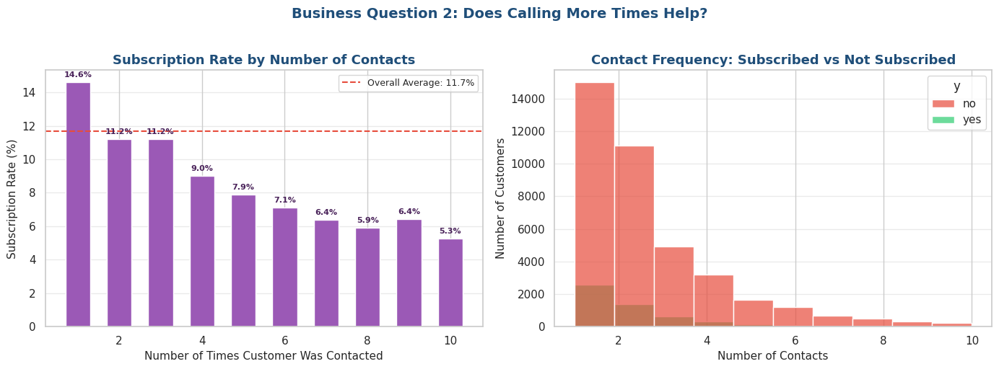
Does Calling More Times Help?
Subscription rates generally declined as contact frequency increased.

Slide 6
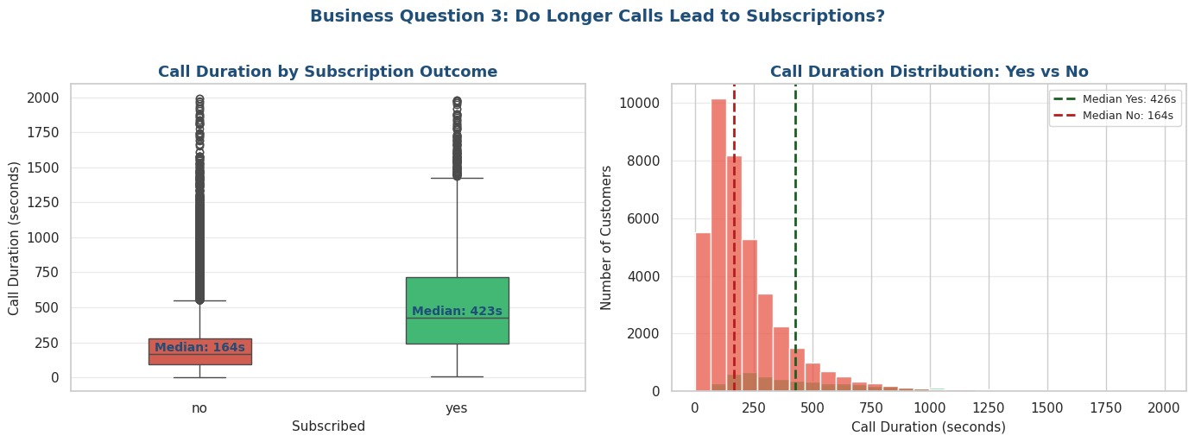
Do Longer Calls Lead to Subscriptions?
Subscribers had much longer call durations than non-subscribers.

Slide 7
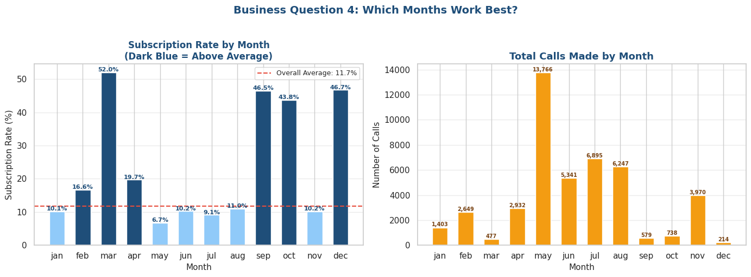
Which Months Perform Best?
March, September, October and December had the highest subscription rates.

Slide 8
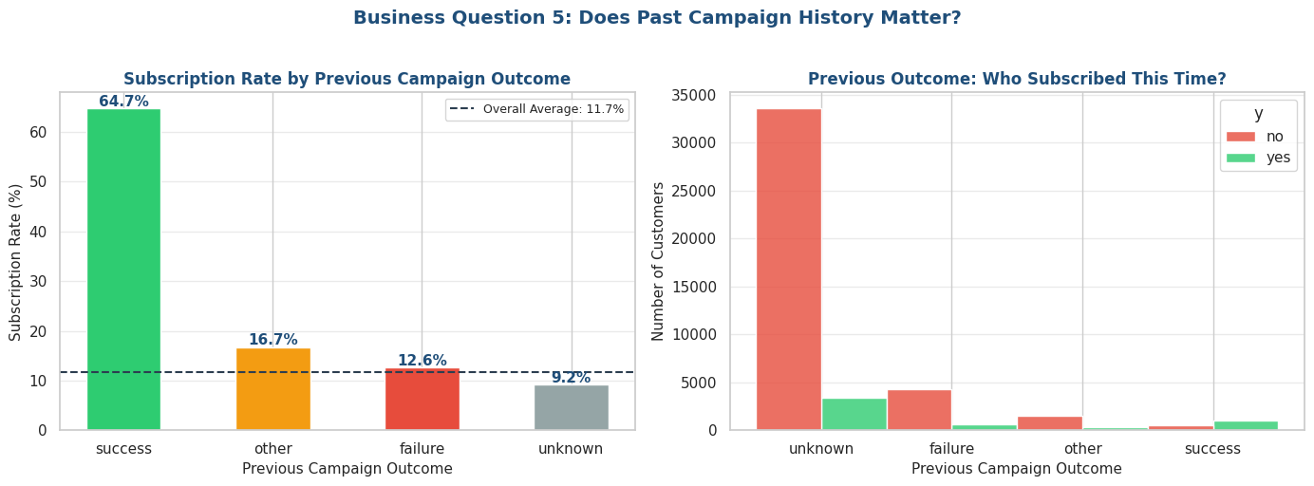
Whether past campaign history matters
Customers who said yes in a previous campaign subscribe at 64.7% — nearly 6 times the overall rate. The bank should prioritise re-contacting customers who previously subscribed.

Slide 9
Key Findings
• Overall subscription rate is 11.7%.
• Students and retirees show the highest conversion rates.
• Longer call durations are strongly associated with subscriptions.
• Excessive contact attempts do not improve outcomes.
• March, September, October, and December had the strongest subscription rates.

Slide 10
Recommendations
• Target high-performing customer segments.
• Focus on quality conversations rather than frequent contacts.
• Allocate campaigns to high-performing months.
• Use call duration and engagement indicators for lead scoring.
•Bank should priotise re-contacting customers who previously subscribed

Slide 11
Conclusion & Next Steps
The analysis identifies key customer, operational, and seasonal drivers of subscriptions. Applying these insights can improve campaign efficiency, customer targeting, and subscription rates.

