Slide 1

Analysis of POLICE SHOOTINGS
A Case Study of the United States
Notes:
NOTE: Want a different image on this slide? Select the picture and delete it. Now click the Pictures icon in the placeholder to insert your own image.

Slide 2
​
'Concerns about the interaction between race and policing are not new......basic fairness, racial discrimination, and the excessive use of force of all forms against non-Whites in the United States remains a pressing national issue.'​
- National Academies of Sciences, Engineering, and Medicine. (2018). Proactive Policing Effects on Crime and Communities. Washington, DC: The National Academies Press. ​
​

Slide 3
Execution Process
Understanding the Data
Data Description
Cleaning the Data
Modification of Data
Exploratory Data Analysis
Visualization
Conclusion
Key Findings
Recommendation
Insights
Hypothesis Statement & Research Questions

Slide 4

Understanding the Data Data Description
There are 4895 observations and 15 variables in the dataset.
Variables include name, age, race, gender...
The youngest victim is aged 6
The oldest victim is aged 91
Data is not normally distributed.

Slide 5
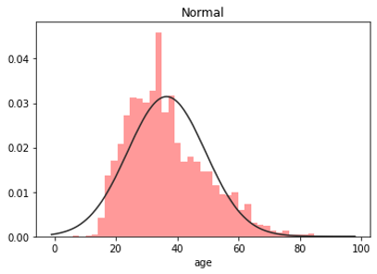
Data Description Based On Age
The distribution of age is positively skewed.
The mean age is 37.
As seen in the diagram to the right, most of the shooting victims fall within the age range 20 and 45.

Slide 6
Count of age | Column Labels
 | shot |  | shot Total | shot and Tasered |  | shot and Tasered Total | Grand Total
Row Labels | F | M |  | F | M
Asian | 3 | 82 | 85 | 1 | 7 | 8 | 93
Black | 45 | 1184 | 1229 | 2 | 67 | 69 | 1298
Hispanic | 26 | 827 | 853 |  | 49 | 49 | 902
Native | 5 | 72 | 77 |  | 1 | 1 | 78
Other | 4 | 39 | 43 |  | 5 | 5 | 48
White | 133 | 2227 | 2360 | 3 | 113 | 116 | 2476
Grand Total | 216 | 4431 | 4647 | 6 | 242 | 248 | 4895

Slide 7

Cleaning the Data

Slide 8
Data Cleaning Procedure & Outcome
Check for missing values, duplicates and outliers in the dataset
There are no missing values in the dataset.
There are no duplicates in the dataset
Outliers in the data are from age 72 to 87. Extreme outliers fall around ages 6 and 91.
Check for inconsistent values and less important features in the dataset
Inconsistent values in are corrected

Slide 9
Hypothesis Statements
There is a significant county-level racial bias in US police shootings
There are more armed persons shot by the US police than unarmed persons across different races

Slide 10
Research Questions
What is the state-level absolute population size as compared to the police shootings?
What is the state-level racial composition and killings per race?
What is the probability of being {black, and shot by police} per million to the probability of being {white, and shot by police} per million (in comparison to the US population)?
What is the probability of being {black, armed, and shot by police} to the probability of being {white, armed, and shot by police}?

Slide 11
Research Questions
What is the probability of being {Hispanic, armed, and shot by police} to the probability of being {white, armed, and shot by police}?
What is the probability of being {Black, unarmed, and shot by police} to the probability of being {white, unarmed, and shot by police}?
What is the probability of being {Hispanic, unarmed, and shot by police} to the probability of being {white, unarmed, and shot by police}?

Slide 12
Exploratory Data Analysis

Slide 13
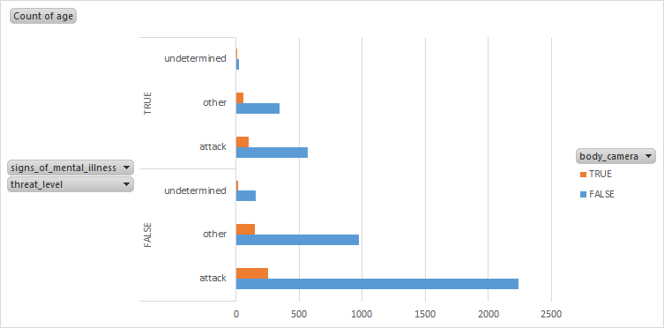
Visualization
True on the vertical axes means the person shot had signs of mental illness
False means otherwise
Body cameras were usually off for most of the shooting incidents

Slide 14
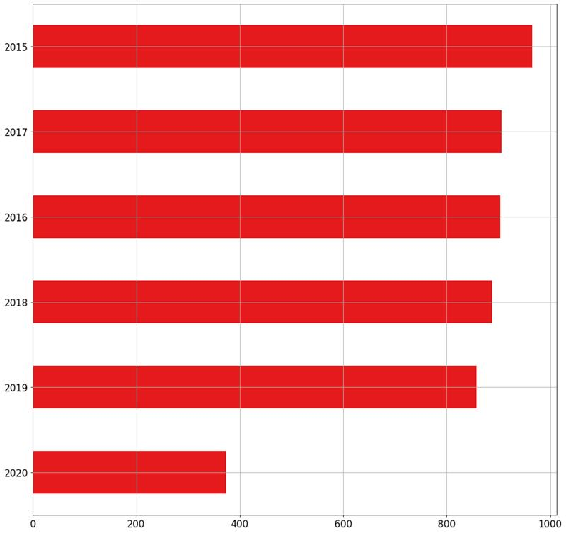
Cont'd of Visualization​
Number of deaths in each year
Highest number of police shootings occurred in the year 2015 with about 950 victims.
The least number of police shootings was recorded in 2020 with about 380 victims. This may be because the year 2020 has not ended yet.
The number of police shootings recorded in 2016, 2017, 2018 and 2019 did not vary greatly.

Slide 15
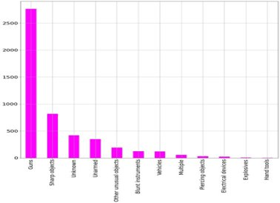
Cont'd of Visualization
Count of Arms Category
Guns record the highest number of arms category. Over 2500 victims were armed with guns.
This is followed by sharp objects. About 760 victims were armed with sharp objects.
About 280 and 270 victims were armed with unknown objects and unarmed, respectively.
The least arms used by victims were explosives and hand tools.

Slide 16
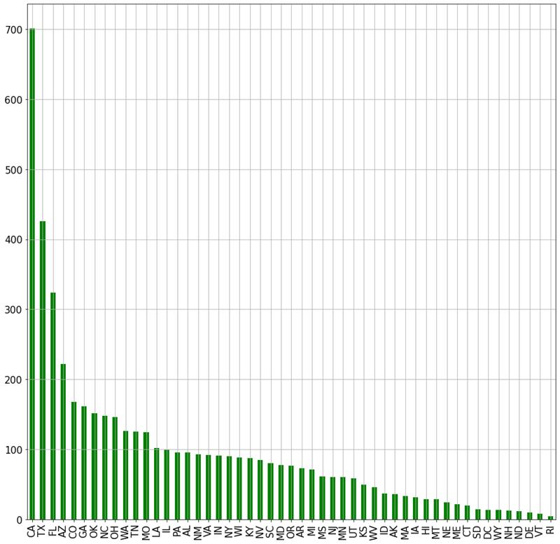
Cont'd of Visualization
Number of Deaths per State
California has the highest incidence of Police Shootings.
Texas, Florida and Arizona follow closely as States with next highest Police shooting incidence.
Delaware, Vermont, River Islands are listed among the States with the least Police Shooting incidents.

Slide 17
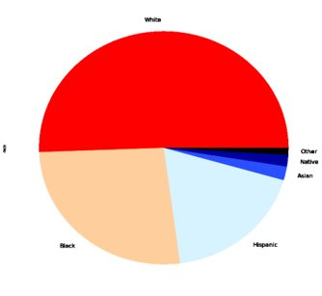
Cont'd of Visualization
Count of Deaths per Race
Most of the victims were of White descent
Blacks and Hispanics also had several people being shot by the police.
This means that the rate of killing is not totally based on racism.

Slide 18
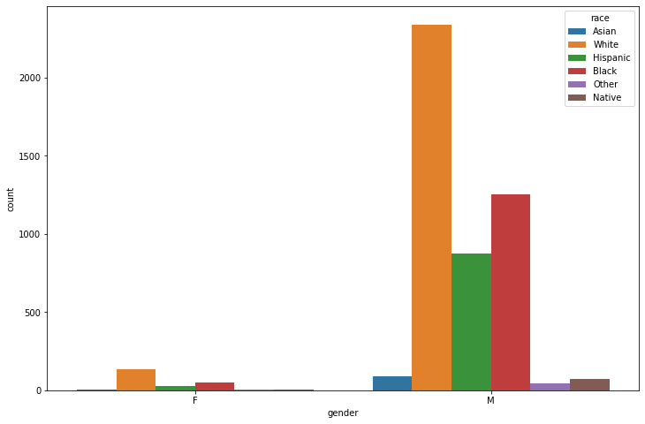
Cont'd of Visualization
Race And Gender Relationship with Police Shooting
Highest incidence of police shootings occurred amongst white males with over 2000 victims.
This is followed closely by black males with about 1250 victims.
The next highest number of shootings is recorded among Hispanic males.
Females of all races and males of Asian, native and other races record minimal shooting incidences compared to all others.

Slide 19
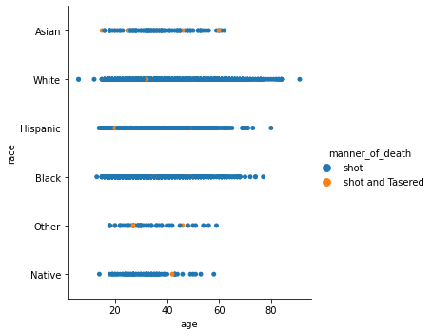
Cont'd Of Visualization
Race, Gender And Manner Of Death Relationship
This shows that the number of people killed irrespective of race are usually shot by the police.
Also, it depicts that the age range that are usually killed are those within the ages of 20 and 40 for all races.

Slide 20
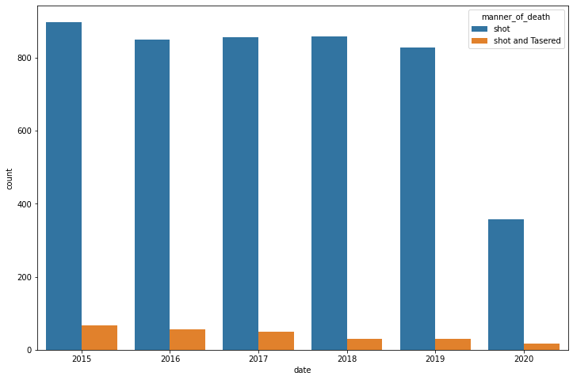
Cont'd Of Visualization
Year of Shooting And Manner Of Death Relationship
This is an in-depth relationship between the year of shooting and the manner of death.
This shows clearly that 2015 has the highest number of recorded deaths and the other years are also close.
2020 looks smaller because the year is not yet over.

Slide 21
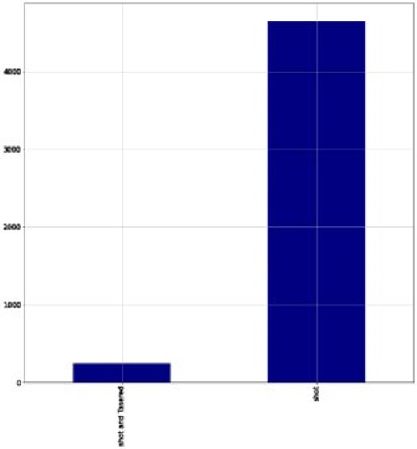
Cont'd Of Visualization
Victims Shot vs Shot and Tasered
This diagram shows that the number of people that were shot only by the police exceeds 4000.
The victims who were shot and tasered represents only a small number.
A high incidence of people shot could be because the people involved attacked the police directly. For instance, they pulled out guns towards the police.

Slide 22

Conclusion

Slide 23
Key Findings
The ratio of the probability of being an unarmed Hispanic person and shot by the police to the probability of being an unarmed white person and shot by the police is 0.4 or 2:5
The ratio of the probability of being an unarmed black person and shot by the police to the probability of being an unarmed white person and shot by the police is 0.8 or 4:5.
Putting the body camera off and shooting victims is more of a deliberate action to get the people killed.

Slide 24
Key Findings
The number of shootings compared to the total number of the USA population is 0.0015 percent. This means the total number of deaths compared to the overall population of USA is smaller and hence this cannot be considered a massacre yet.
The ratio of the probability of being an armed black person and shot by the police to the probability of being an armed white person and shot by the police is 1:2.
The shooting incidents is not totally based on racism.

Slide 25
Recommendations
To accurately prove the case that blacks are killed more than all other races in the US, the population of each race in the US, particularly in each State will be needed. This way, we can compare the number of race per million population involved in police shootings.
Body cameras should always be turned on to track the operations of the police force. This is because, true evidence of police shooting is mostly generated from their camera recordings.

Slide 26
Recommendations
Policemen who shoot people who do not try to resist arrest should be punished and face the consequences of their actions.
There should be accountability sessions where the policemen who killed people without a major reason will be questioned.

Slide 27

Team Members
Joana Lartey
Jemima Denteh
Jeffrey Larbi-Akor
James Owusu-Appiah

