Slide 1

Department of Computer Science and Engineering
IBA4431 – MINI PROJECT
Ornithopter Control System for Defense and Rescue
Final Review
Abihassan K 21137024

Slide 2
Agenda for the review
Introduction
Goals and Motivation
Literature review
Problem Definition
Objective
Proposed System/Work
Architecture Diagram
Module List
Modular Description
Result and Discussion
Future work
References

Slide 3
Abstract
The Ornithopter Control System for Defense and Rescue is designed to mimic the flight of birds, providing a highly agile and efficient aerial platform. This system is intended for defense operations and disaster rescue missions, offering surveillance, threat detection, and victim identification. Equipped with advanced controls and sensors, it can access difficult terrains, monitor real-time situations, and support emergency teams. Future developments include incorporating machine learning for autonomous navigation and live threat detection, enhancing its utility in critical operations.

Slide 4
Introduction
The Ornithopter Control System for Defense and Rescue is an innovative aerial vehicle designed to mimic the flight mechanics of birds. Combining agility with advanced control mechanisms, it is highly suited for defense surveillance and rescue missions in challenging environments. This system aims to enhance operations in areas where conventional drones or helicopters face limitations. By incorporating sensors and advanced control features, it offers real-time monitoring and navigates complex terrains, providing valuable support in both military and civilian emergency situations.

Slide 5
Goals and Motivation
The primary goal of the Ornithopter Control System for Defense and Rescue is to create a highly maneuverable aerial platform for real-time surveillance, threat detection, and rescue missions. Inspired by bird flight, it aims to access challenging terrains where conventional aircraft struggle. The motivation behind this project is to enhance defense operations and improve disaster response efficiency, ultimately saving lives by delivering faster, more precise support in critical situations and hard-to-reach areas.

Slide 6
Literature review
S. No | Title of the paper/System | Authors | Publication (Name of the Journal/Conference proceedings with Year) | Algorithm/Methodology adopted | Limitations
1. | Real-Time Obstacle Avoidance for Flapping-Wing Drones Using Computer Vision | E. Martinez, F. Gomez, A. Delgado | IEEE Robotics and Automation Letters, 2023 | The study integrates computer vision with real-time obstacle avoidance algorithms, enabling the ornithopter to navigate complex environments while avoiding collisions. | The system's effectiveness may be reduced in low-light conditions or highly cluttered environments, requiring further adaptation for robustness.
2 | Advanced Materials for Flapping-Wing Ornithopters: A Review | A. B. Smith, H. J. Lee, K. M. Brown | Composite Structures, 2023 | This review paper focuses on the use of advanced composite materials in the design of flapping-wing ornithopters, evaluating their impact on flight performance and durability. | The review primarily discusses material properties without delving deeply into specific flight control algorithms or real-world application challenges

Slide 7
Problem Definition
Conventional drones struggle in difficult terrains like forests, mountains, or collapsed structures during rescue operations.
Current surveillance systems may not provide immediate identification of threats in defense missions.
Many aerial systems require constant human intervention, reducing efficiency in critical situations.
Efficiently locating and identifying survivors in disaster areas remains a challenge for current rescue technologies.

Slide 8
Objective
To design an ornithopter that mimics bird flight for high agility in defense and rescue missions.
To enable the ornithopter to navigate complex terrains for real-time surveillance in defense operations.
To equip the system with sensors for identifying survivors and detecting threats in disaster zones.
To ensure the ornithopter can operate autonomously with minimal human intervention.
To enhance rescue operations by providing live data, reducing response time, and improving efficiency in critical situations.

Slide 9
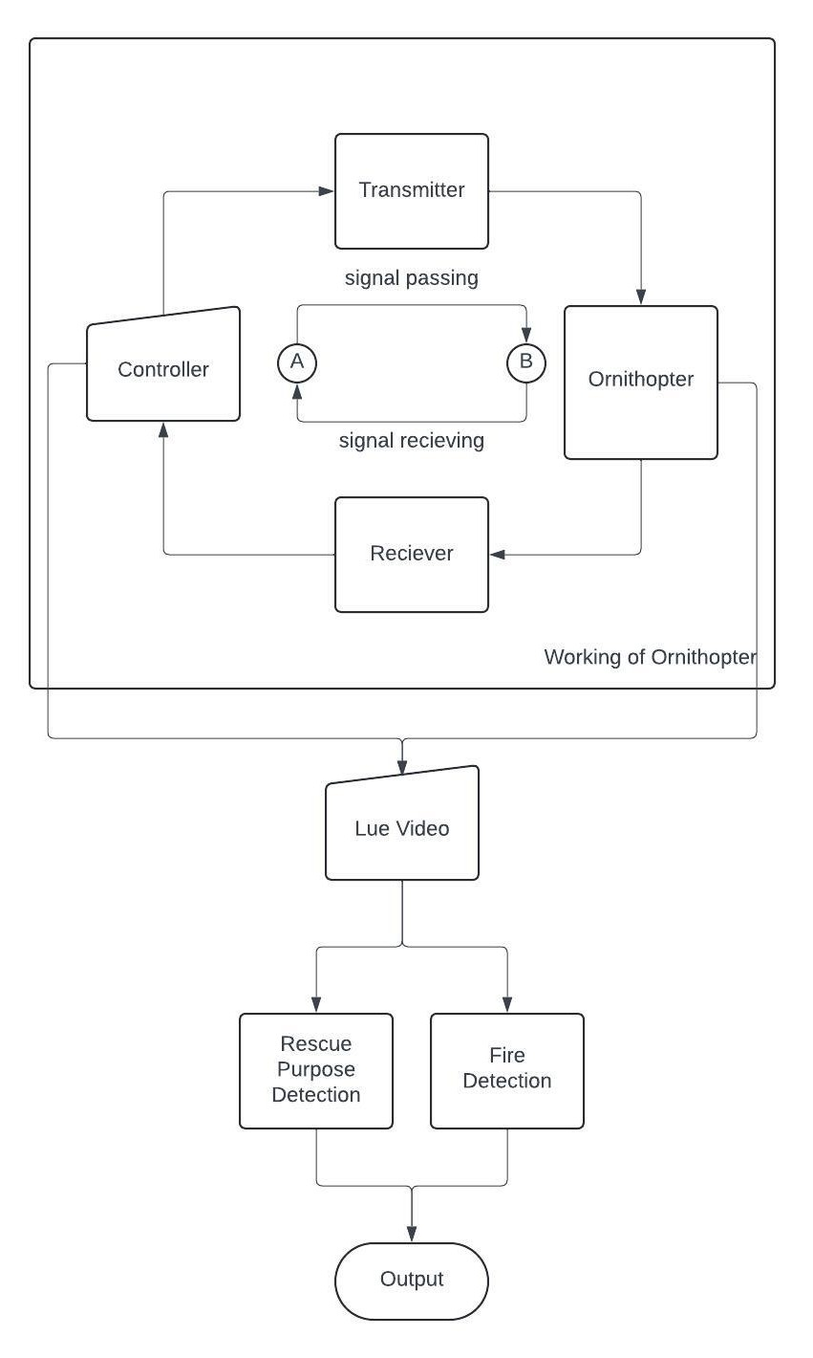
Architecture Diagram

Slide 10
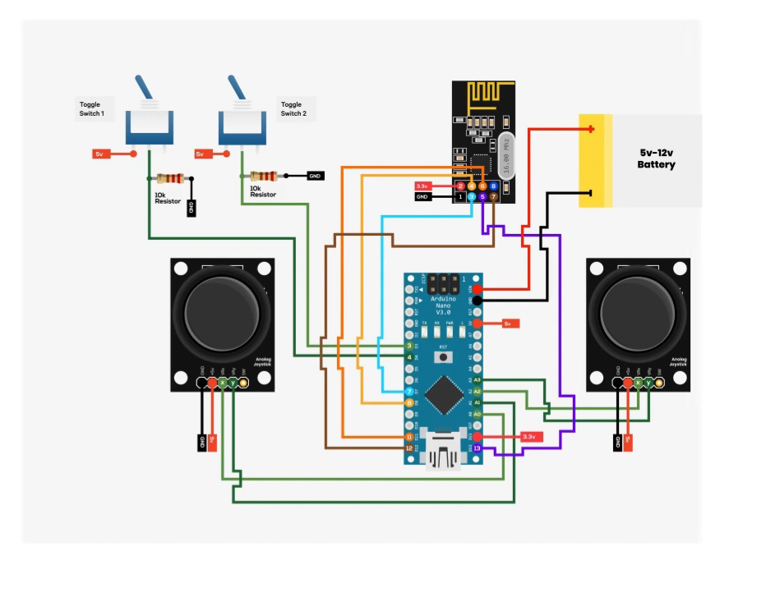
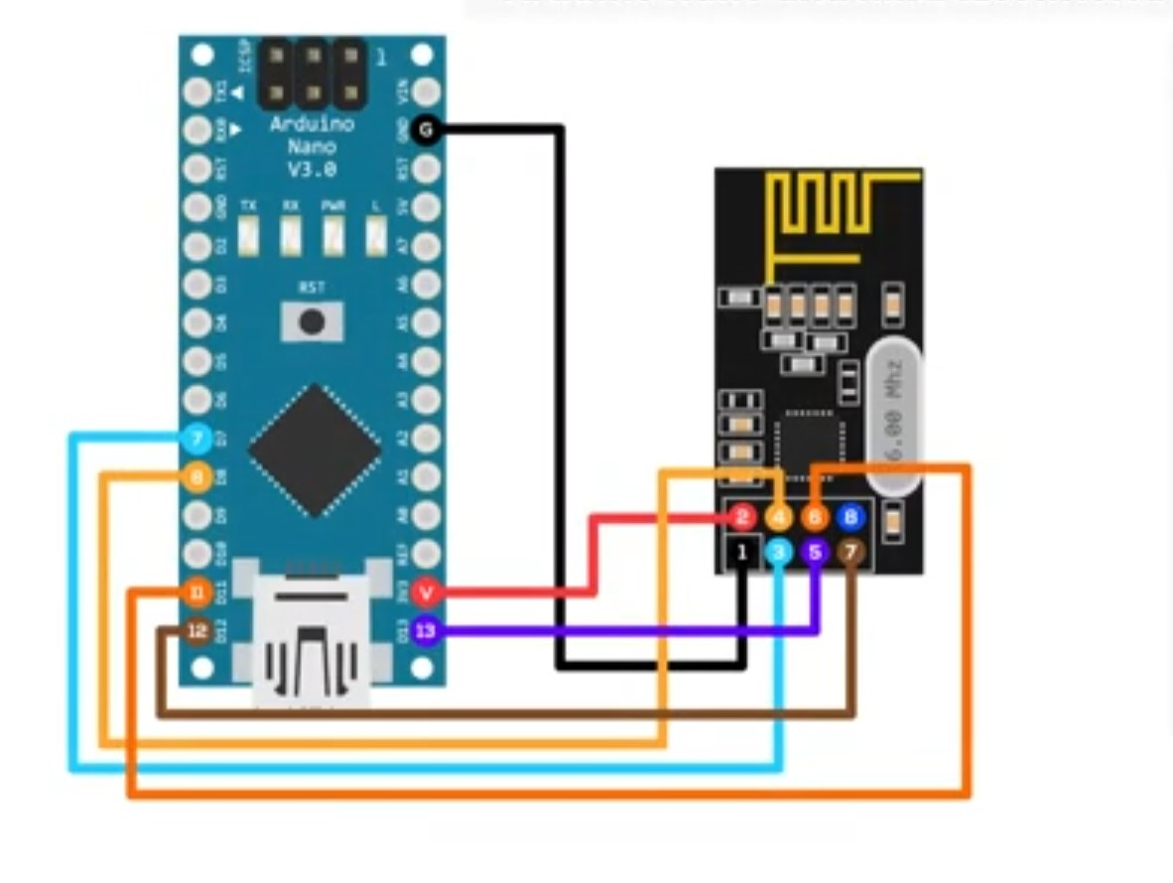
Proposed system

Slide 11
Component requirements
HARDWARE REQUIREMENTS
Arduino nano
Coreless Motor with Propeller
IRF520 MOSFET Driver Module
TP4056 Charging Module
Electronic Spices DC-DC 0.9V to 5V Converter
Lithium-ion Battery 3.7V/1.8Ah
PS2 Joystick Module Breakout Sensor
NRF24L01 with Antenna
10K Pot potentiometer
Pin Toggle Switch
OLED display
SOFTWARE REQUIREMENTS
Arduino IDE
Python

Slide 12
Module description
Flight Control System
Surveillance and Monitoring System
Threat Detection System
Rescue and Victim Detection System

Slide 13
Module description
Flight Control System:
The flight control system is responsible for managing the ornithopter’s movements, including takeoff, navigation, and landing. It uses advanced algorithms to mimic the flapping flight of birds, allowing for agility and stability in various conditions. The system also handles inputs from sensors and adjusts the ornithopter's motion based on environmental factors, ensuring precise maneuvering in challenging terrains and real-time responsiveness to mission requirements.

Slide 14
Module description
Surveillance and Monitoring System:
This module includes a high-resolution camera and real-time video streaming capabilities for surveillance during defense and rescue operations. It provides live feedback to the control station, allowing operators to monitor activities and detect potential threats or survivors. The system can be further enhanced with machine learning algorithms for automated object detection and recognition, enabling the ornithopter to identify targets, survivors, or hazards autonomously.

Slide 15
Module description
Threat Detection System:
The threat detection system uses sensors and machine learning algorithms to identify potential dangers during defense missions. It can recognize suspicious objects, movements, or environmental hazards, alerting operators in real-time. By incorporating image recognition and environmental data analysis, the ornithopter can autonomously assess risks, enhancing the overall safety and effectiveness of the mission.

Slide 16
Module description
Rescue and Victim Detection System:
This module is designed for disaster rescue operations, using infrared sensors and cameras to detect survivors in challenging environments, such as collapsed buildings or forests. The system uses pattern recognition and thermal imaging to locate individuals, even in low-visibility conditions. It helps rescue teams pinpoint locations quickly, reducing the time taken to find survivors and providing critical information for planning rescue operations.

Slide 17
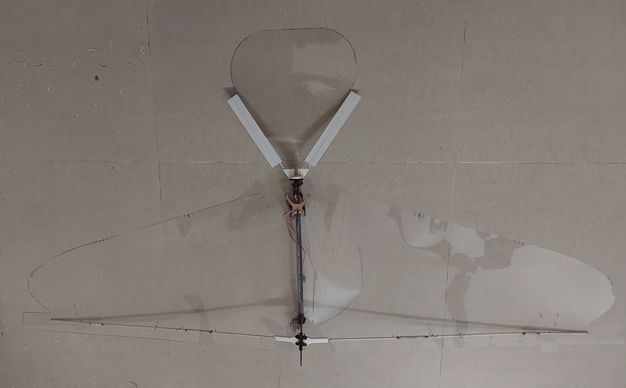
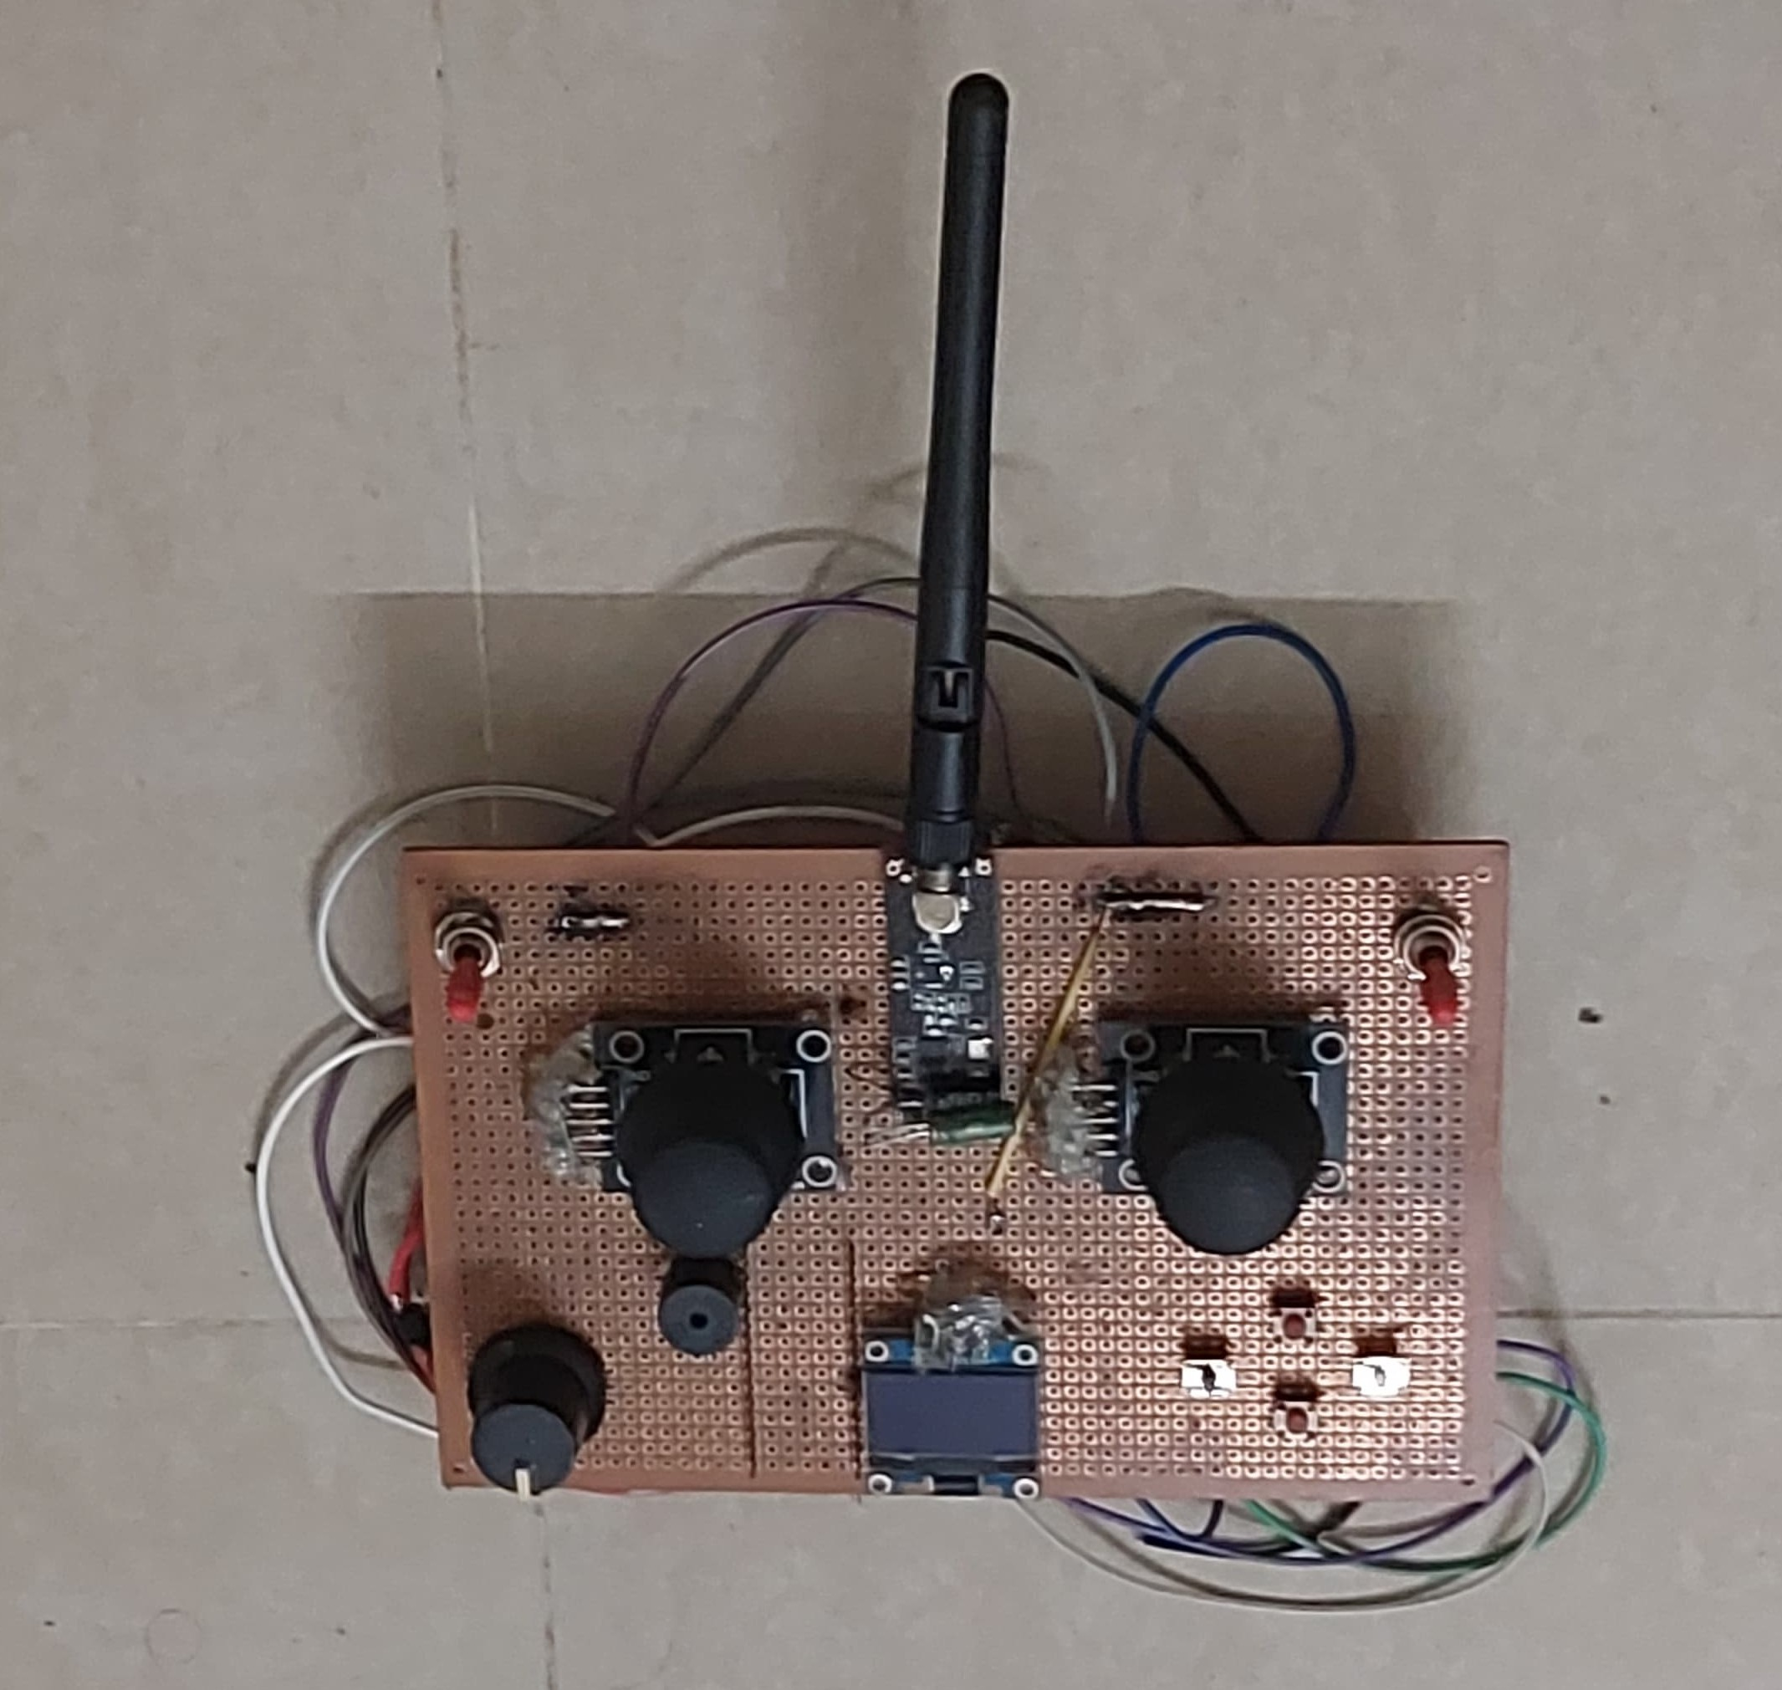
Results and discussion
Fire and smoke detection figure
Ornithopter figure
Controller figure

Slide 18
Conclusion and future work
Conclusion:
The Smart Cradle and Feeding System revolutionizes infant care through advanced technology. Integrating Raspberry Pi 4, webcam, microphone, and sensors, it ensures precise monitoring. Servo motors enable timely feeding upon face detection. OpenCV, sound analysis, and a mobile app enhance intelligence and user-friendliness. Parents benefit from remote monitoring and control, easing childcare stress. This innovative solution, addressing feeding, soothing, and monitoring, exemplifies the transformative potential of technology in enhancing family well-being.

Slide 19
Conclusion and future work
Future Work:
In future developments, the Smart Cradle and Feeding System can benefit from AI integration, enhancing cry recognition and adapting soothing motions. Health monitoring features like heart rate and oxygen level tracking offer valuable insights, ensuring prompt action in case of concerns. Advanced environmental control, including climate and air quality monitoring, maintains an optimal setting. Mobile app upgrades with analytics, growth tracking, and sleep pattern analysis enhance the user experience. Voice activation and recognition add intuitive control. Strengthening security measures, integrating with the IoT ecosystem, cost optimization, clinical validation, and global adaptability ensure broader accessibility and impact.

Slide 20
References
[1] Ali, M., Rehman, M. U., Zaman, M., Khan, S. A., & Anjum, S. (2021). Machine Learning-Based Object Detection for Autonomous UAVs in Disaster Management. IEEE Access, 9, 90257–90268. https://doi.org/10.1109/ACCESS.2021.3097436
[2] Patel, K. S., & Rathi, N. (2022). AI-Powered Drone Systems for Surveillance and Rescue Operations: A Comprehensive Review. IEEE Transactions on Industrial Informatics, 18(7), 4776–4784. https://doi.org/10.1109/TII.2022.3146678
[3] Sharma, R., Gupta, V., & Rathore, V. S. (2022). A Deep Learning Approach for Real-Time Object Detection in UAV-Based Rescue Operations. International Journal of Advanced Robotics Systems, 19(1), 1–12. https://doi.org/10.1177/1729881422110157
[4] Zhou, Y., Li, Q., & Wang, H. (2023). Real-Time Detection and Classification of Hazards in Search and Rescue Missions Using UAVs. IEEE Transactions on Aerospace and Electronic Systems, 59(2), 1215–1225. https://doi.org/10.1109/TAES.2023.3232762
[5] Johnson, D. M., & Taylor, J. K. (2023). Autonomous Flight and Threat Detection for Defense Applications Using Drones: A Survey. Journal of Defense Technology and Innovation, 23(4), 295–311. https://doi.org/10.1109/JDTI.2023.3216779

Slide 21
Thank You

