Slide 1
FLOWCHART
Presenting my Task to CMO and CEO

Slide 2
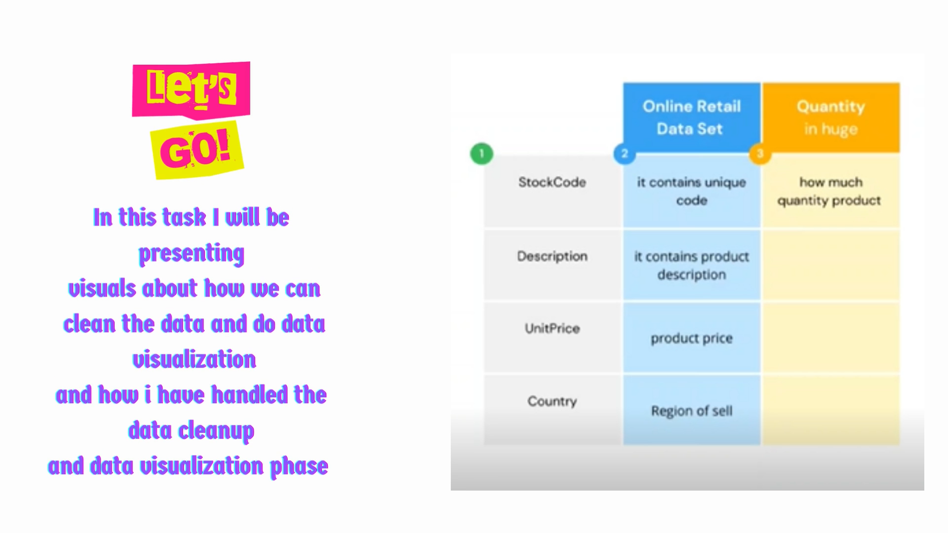

Slide 3
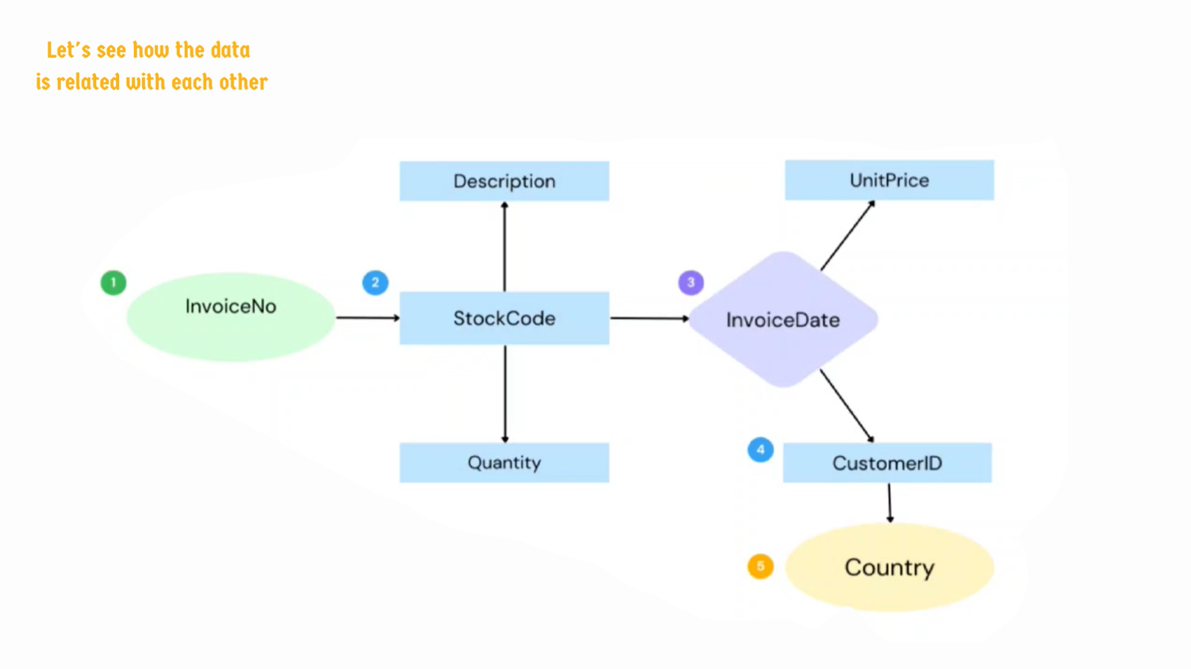

Slide 4


Slide 5






130.8bn
Total Revenue by Month
Power BI Desktop
140bn
Sum of Revenue jumped from 34bn to 130bn during its steepest incline between June 2011 and
November 2011.
Sum of Revenue trended down, resulting in a 7.60% decrease between January 2011 and December 2011.
Sum of Revenue started trending up on July 2011, rising by 98.16%
(7,47,756.43) in 4 months.
120bn
106.3bn
100bn
Total Revenue
80bn
67.7bn
60bn
46.2bn
40bn
33.1bn
33.7bn
25.4bn
19.7bn
20bn
10.2bn
0bn
January
February
March
April
May
June
July
August
Septemb…
October
November December
Month

Slide 6


Slide 7






Sum of Quantity and total Sum of REVENUE are negatively correlated with each other.
Sum of REVENUE and Sum of Quantity diverged the most when the Country was Netherlands.
Total Revenue and Sum of Quantity by Country
Total Revenue Sum of Quantity
Power BI Desktop
5.2bn
200K
5bn
200K
4.7bn
4.4bn
4bn
136K
150K
Total Revenue
117K
Sum of Quantity
3bn
110K
100K
84K
2bn
1.3bn
50K
1bn
27K
30K
23K
16K
0.3bn
0.3bn
0.2bn
0.2bn
0.2bn
0.1bn
S…
0bn
EIRE
France
Germany
Netherlands
Australia
Spain
Country
Portugal
Switzerland
Belgium
Singapore
0K

Slide 8


Slide 9
Total Revenue by CustomerID
Power BI Desktop
17450
15311 3.42% 3.32%
18102 4.79%
12748 5.3%
14911 34.69%
CustomerID
14911
14646
16029
14096
17841
14156
12748
18102
15311
17450
14156 5.4%
17841 6.73%
14096 9.78%
16029 11.22%
14646 15.37%

Slide 10


Slide 11
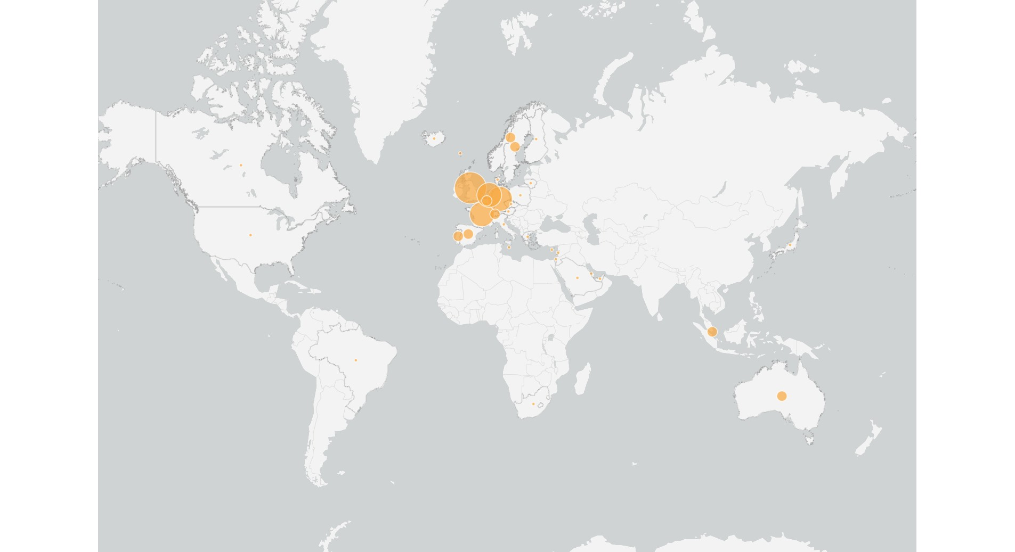

Total Revenue by Country
Power BI Desktop

Slide 12
THANK YOU

