Slide 1
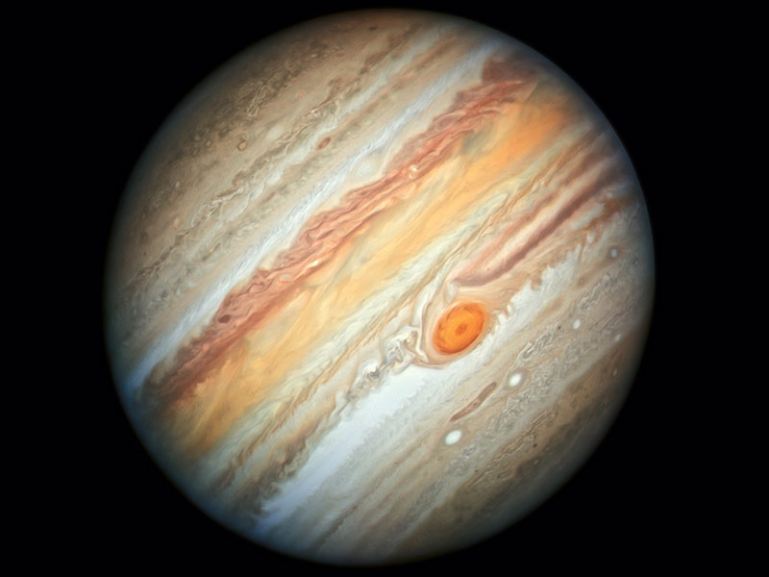
Jupiter

Slide 2
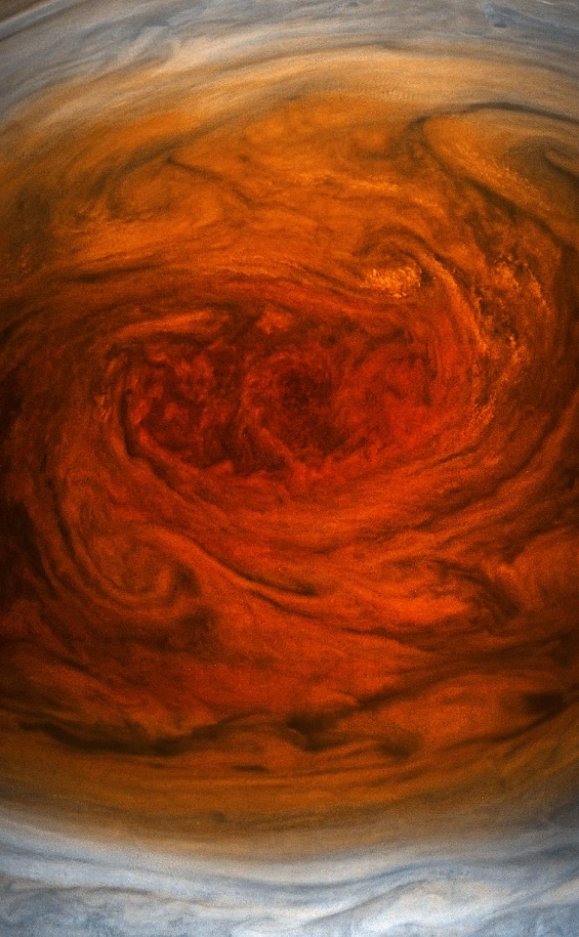
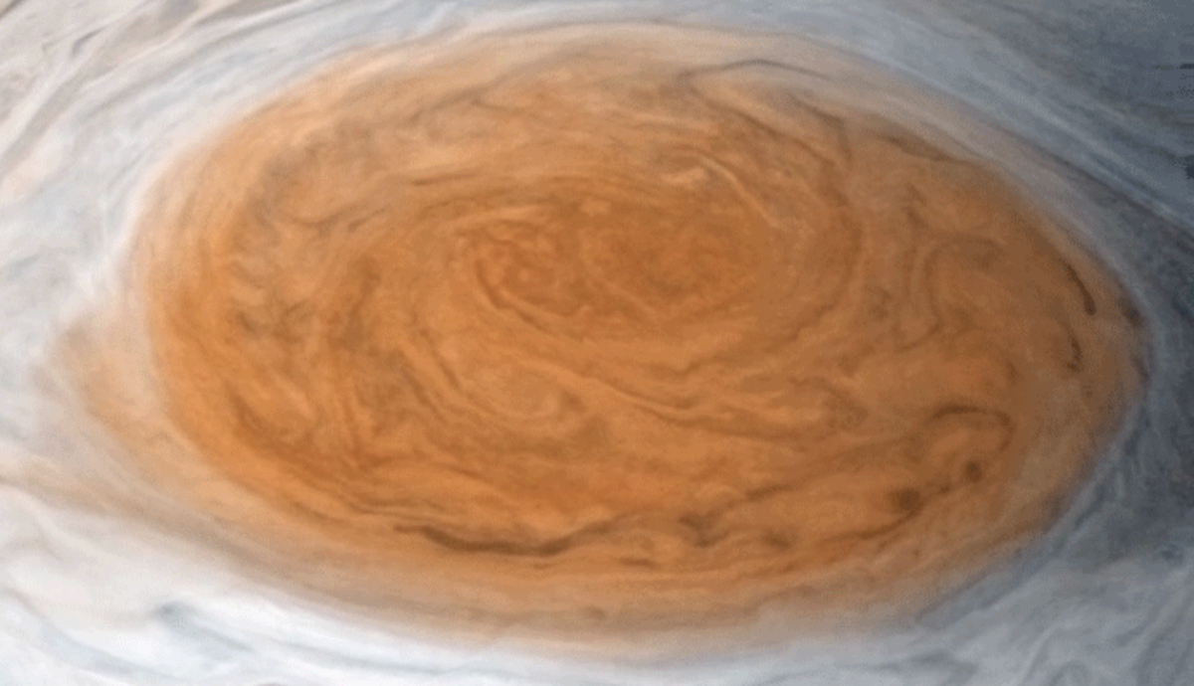
The Red Spot
High Pressure region; Centered 22 degrees south of Jupiter's equator; Approximately 16,350 km (10,159 miles); moves in longitude with respect to the clouds as Jupiter rotates; winds peaking at about 400 mph
Close up of the Great Red Spot taken from about 8,000 km (5,000 mi) above it

Slide 3
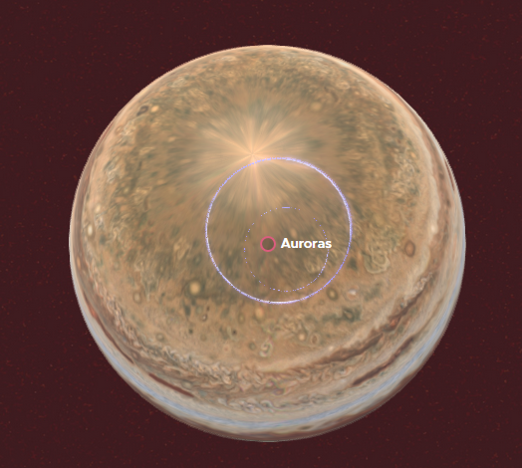
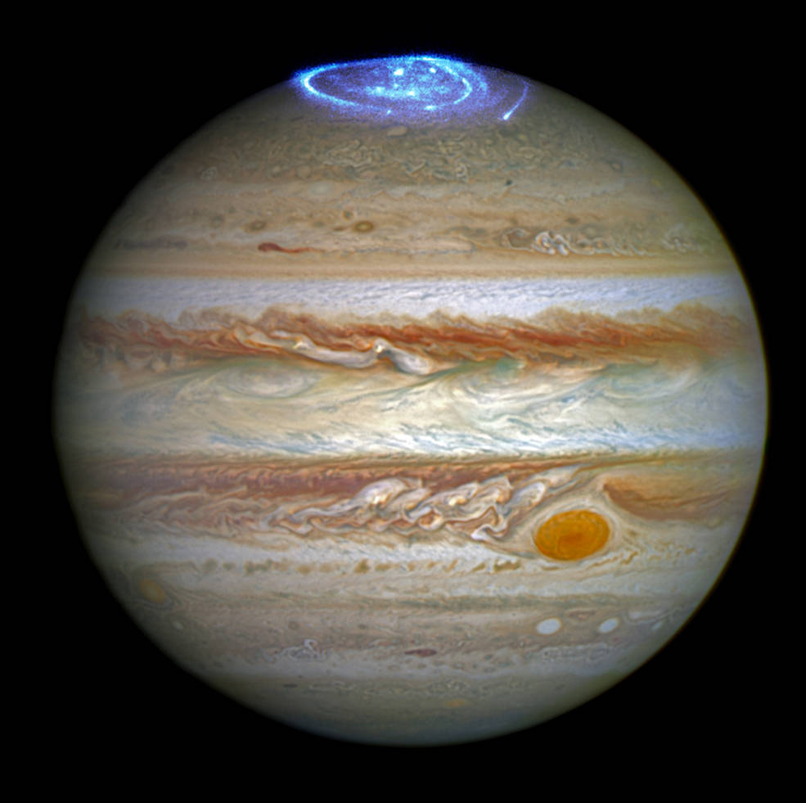
Aurora
Spectrum : Radio, near-IR, UV and X-ray
Total power: 100 TW
Radio emission frequencies:0.01–40 MHz

Slide 4
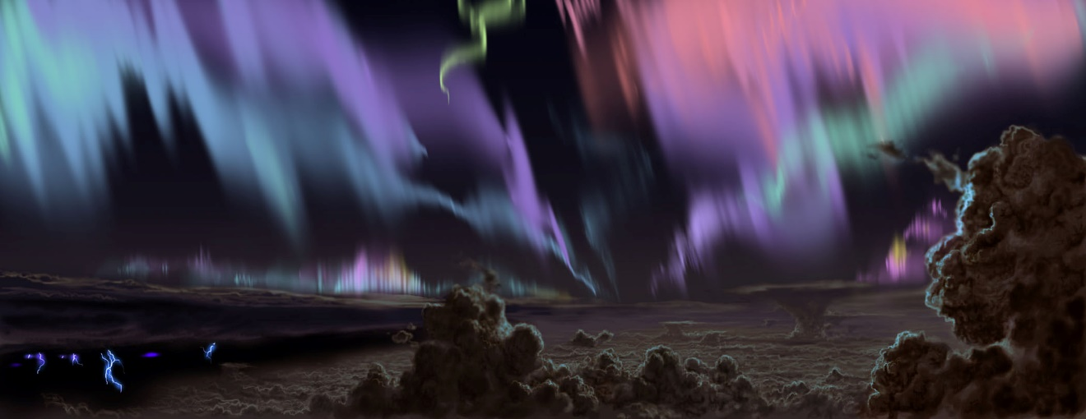
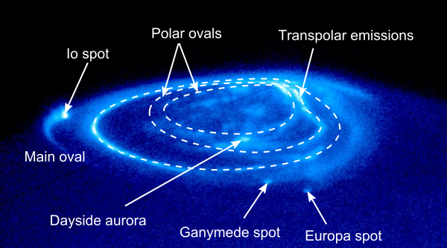
Artist's rendering of Jupiter's auroras seen from within the Jovian cloudscape.
Image of Jupiter's northern aurorae, showing the main auroral oval, the polar emissions, and the spots generated by the interaction with Jupiter's natural satellites

Slide 5
The Red Spot
High Pressure region; Centered 22 degrees south of Jupiter's equator; Approximately 16,350 km (10,159 miles); moves in longitude with respect to the clouds as Jupiter rotates; winds peaking at about 400 mph
Close up of the Great Red Spot taken from about 8,000 km (5,000 mi) above it

