Slide 1
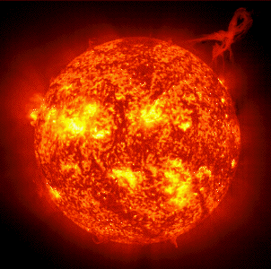
SUN

Slide 2
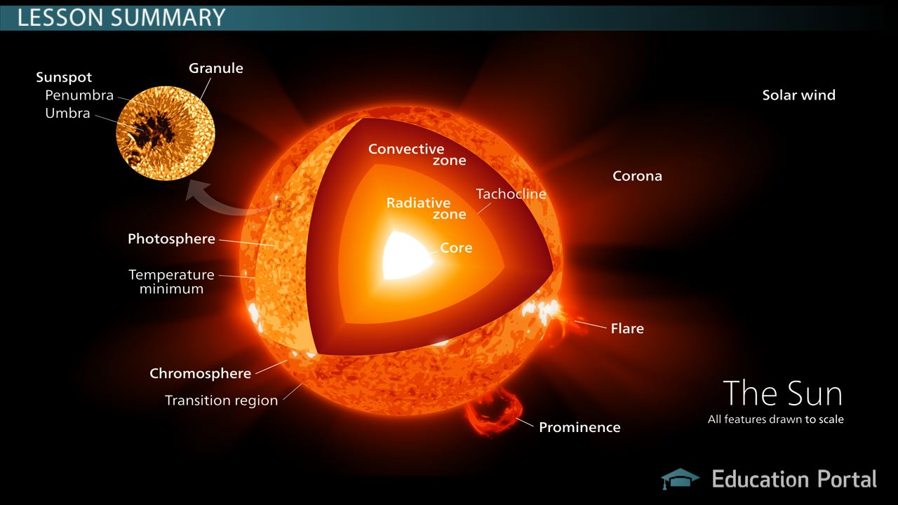
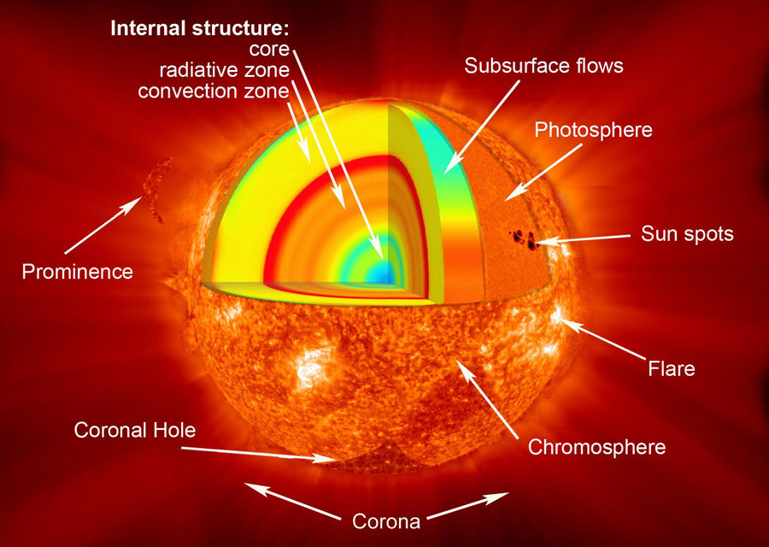
Regions of Sun:

Slide 3
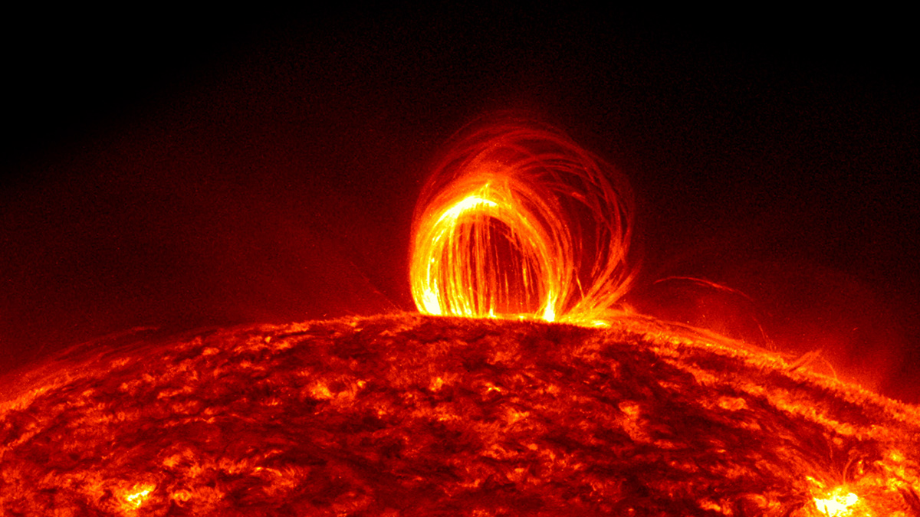
Raindrops Falling on the Sun:
On July 19, 2012, million-degree plasma in the sun's atmosphere began to cool and fall to the surface, resulting in a dazzling magnetic display known as coronal rain.

Slide 4
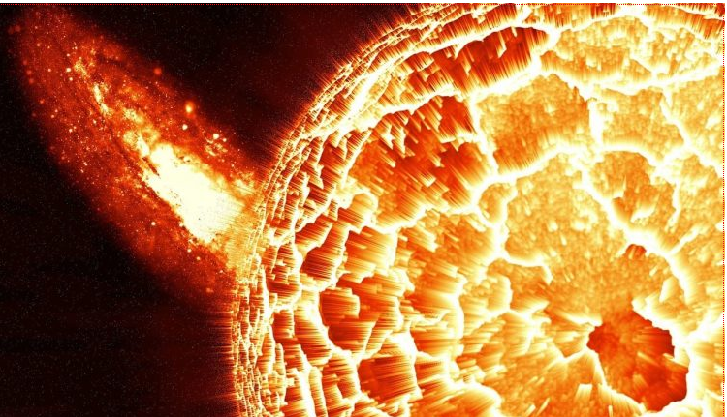
Nanojets:
Thin bright light perpendicular to the solar’s atmosphere magnetic structures called corona.

Slide 5
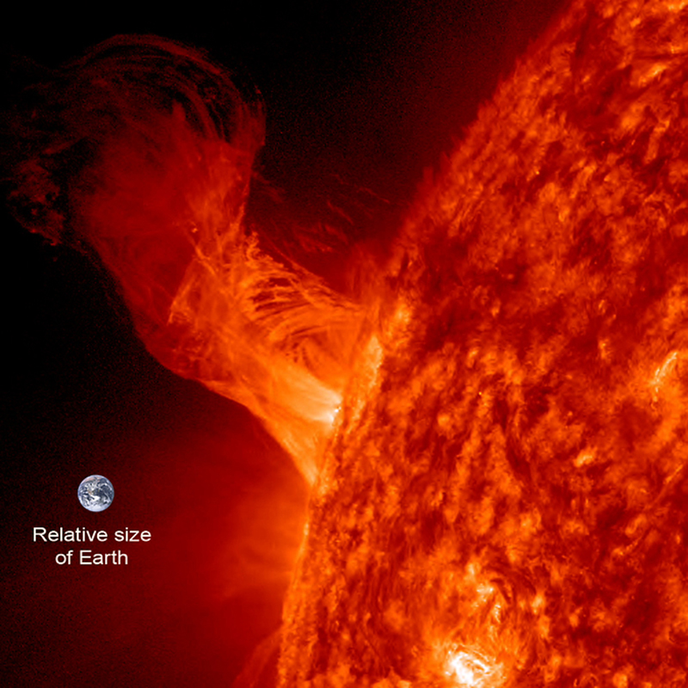
Solar Ballet on Earth:
On Dec 31,2012 solar eruption rose. The length of the eruption extends about 160,000 miles out from the Sun. With Earth about 7,900 miles in diameter, this relatively minor eruption is about 20 times the diameter of our planet.

Slide 6
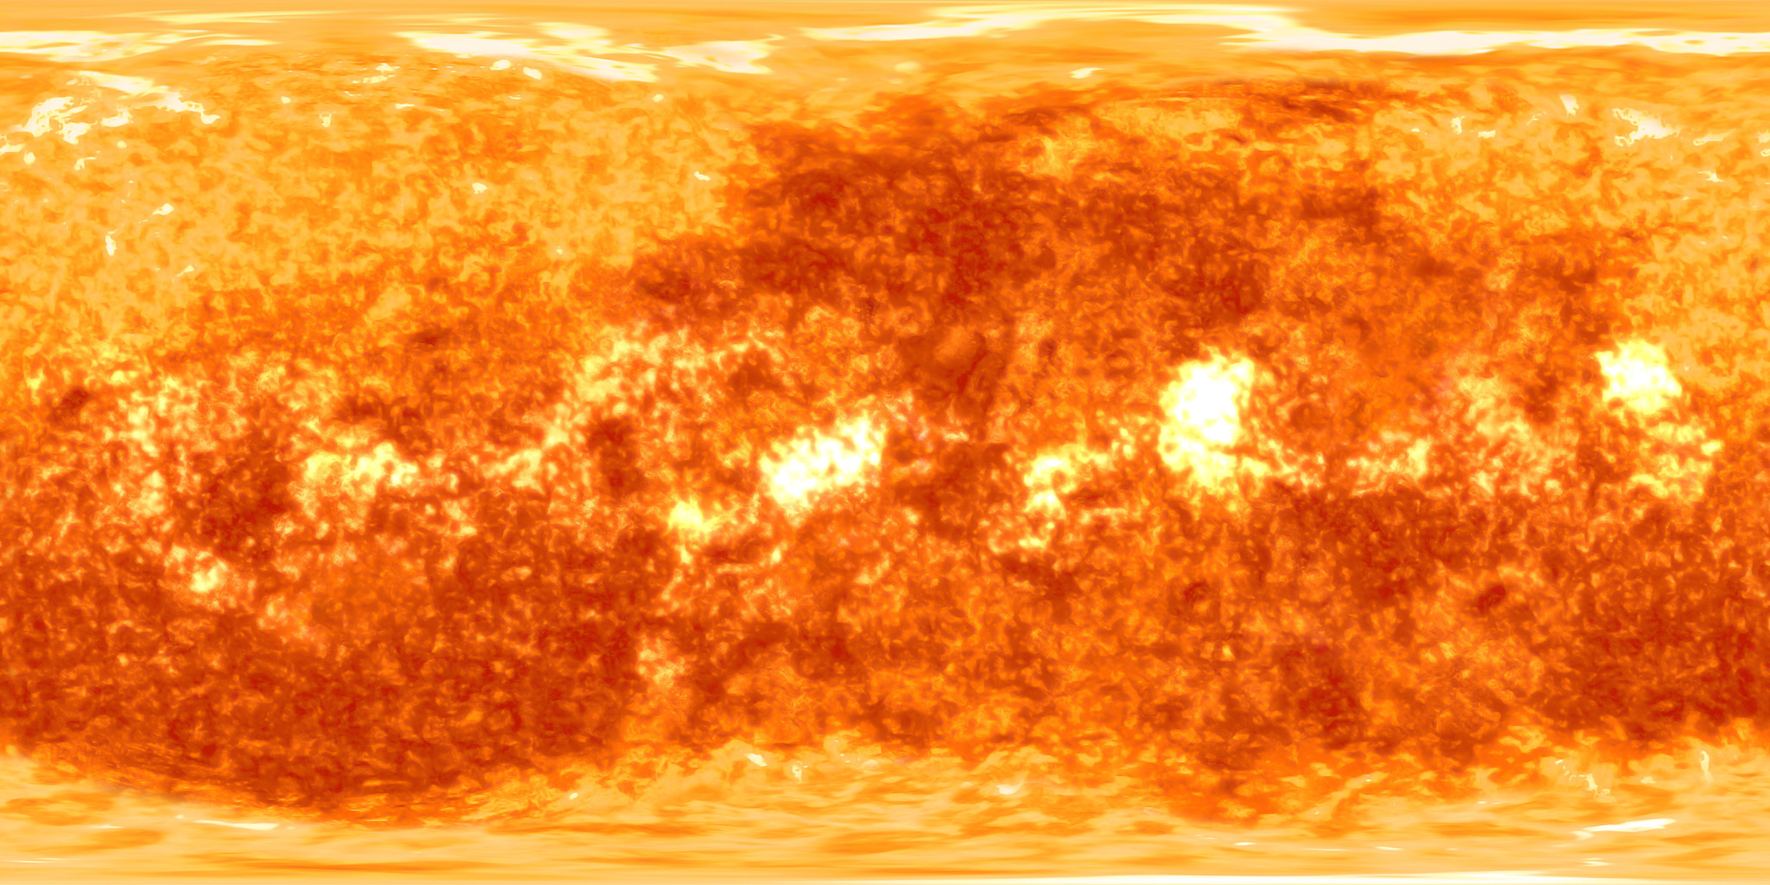
Sun Texture:

Slide 7
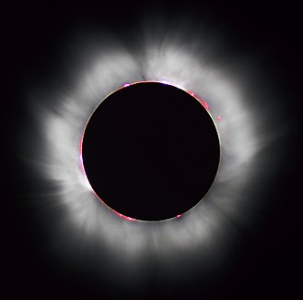
Corona of Sun during solar eclipse:

