Slide 1
Smart public restroom
IOT _Phase 5 Project

Slide 2
Final submission
Context:
Introduction
Project Objectives
Device setup
Platform development
Code implementation
Conclusion

Slide 3
Introduction
IOT (Internet Of Things)
The Internet of Things (IoT) refers to a network of physical devices, vehicles, appliances and other physical objects that are embedded with sensors, software and network connectivity that allows them to collect and share data. These devices — also known as “smart objects” — can range from simple “smart home” devices like smart thermostats, to wearables like smartwatches and RFID-enabled clothing, to complex industrial machinery and transportation systems. Technologists are even envisioning entire “smart cities” predicated on IoT technologies.

Slide 4
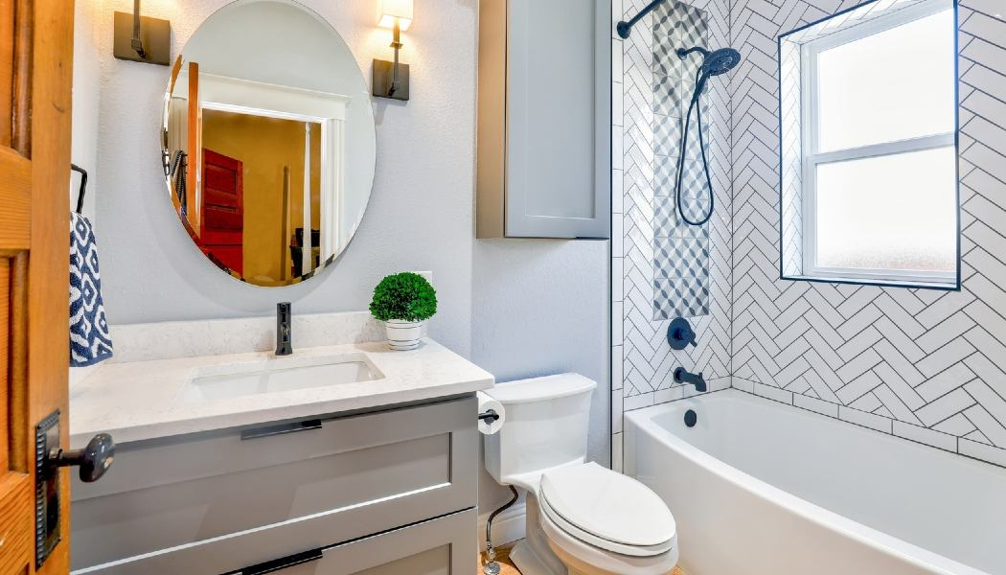

Slide 5
Smart Public Restroom
Smart public restrooms are among recent IoT solutions that are very soon to be implemented here and there. Such new generation restrooms are expected to significantly improve customer experience and employee well-being while also lower costs allocated to maintain equipment.
Smart washrooms products do a lot. In particular, they maintain lavatory in the best condition by:
Optimizing refills: no more worries that towels or soap will run out at the worst moment.
Sending notifications when maintenance is needed: no need for employees to check the state of things every 30-60 minutes as they get alerted as soon as supervision is required.

Slide 6
Tracking presence: less time in queues since users always know when there is an unoccupied cubicle, which guarantees that all cubicles are used more or less equally.
Detecting and reporting smoking activities at no smoking area.
Notifying when bins are full.
Providing predictive analytics based on real time information tracking.

Slide 7
WHAT ARE PREDICTIVE ALGORITHMS?
PREDICTIVE ALGORITHMS ARE COMPUTER PROGRAMS THAT USE STATISTICALMODELS AND
MACHINE LEARNING TECHNIQUES TO ANALYZE DATA AND MAKE PREDICTIONSABOUT FUTURE
EVENTS.IN THE CASE OF SMART PUBLIC
RESTROOMS, PREDICTIVE ALGORITHMS CAN BE USED TO ANTICIPATE MAINTENANCE NEEDS AND IMPROVE USER EXPERIENCE.
BENEFITS OF PREDICTIVE MAINTENANCE
BY USING PREDICTIVE ALGORITHMS, FACILITY MANAGERS CAN ANTICIPATEMAINTENANCE NEEDS BEFORE THEY BECOME URGENT, REDUCING DOWNTIME AND IMPROVINGUSER SATISFACTION. PREDICTIVE MAINTENANCE CAN ALSO HELP MANAGERS PRIORITIZE TASKS AND ALLOCATE RESOURCES MORE EFFICIENTLY, SAVING TIME AND MONEY.

Slide 8
DATA COLLECTION AND ANALYSIS
TO IMPLEMENT PREDICTIVE ALGORITHMS, DATA MUST BE COLLECTED FROM VARIOUS SOURCES, SUCH AS SENSORS, CAMERAS, AND USER FEEDBACK. THIS DATA IS THEN ANALYZED USING MACHINE LEARNING ALGORITHMS TO IDENTIFY PATTERNS AND PREDICT FUTURE EVENTS. THE ACCURACY OF THE PREDICTIONS IMPROVES OVER TIME AS MORE DATA IS COLLECTED AND ANALYZED.
PRIVACY AND SECURITY CONCERNS
IMPLEMENTING PREDICTIVE ALGORITHMS IN PUBLIC RESTROOMS RAISES PRIVACY AND SECURITY CONCERNS.IT IS IMPORTANT TO ENSURE THAT DATA IS COLLECTED AND STORED SECURELY AND THAT USER PRIVACY IS PROTECTED. FACILITIES MUST ALSO BE TRANSPARENT ABOUT THEIR DATA COLLECTION PRACTICES AND OBTAIN CONSENT FROM USERS WHERE NECESSARY. SMART BATHROOMS COLLECT A LOT OF DATA, WHICH RAISES CONCERNS ABOUT PRIVACY
AND SECURITY.IT'S IMPORTANT TO ENSURE THAT ALL DATA IS ENCRYPTED AND STORED SECURELY. ADDITIONALLY, USERS SHOULD BE NOTIFIED OF ANY DATA COLLECTION AND HAVE THE OPTION TO OPT-OUT.

Slide 9
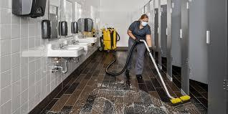
CHALLENGES IN PUBLIC RESTROOM MAINTENANCE
PUBLIC RESTROOMS ARE HIGH-TRAFFIC AREAS THAT REQUIRE
FREQUENT MAINTENANCE TO ENSURE CLEANLINESS AND FUNCTIONALITY. HOWEVER, TRADITIONAL MAINTENANCE METHODS ARE OFTEN REACTIVE AND INEFFICIENT, LEADING TO COMPLAINTS
FROM USERS AND INCREASED COSTS FOR FACILITY MANAGERS.

Slide 10
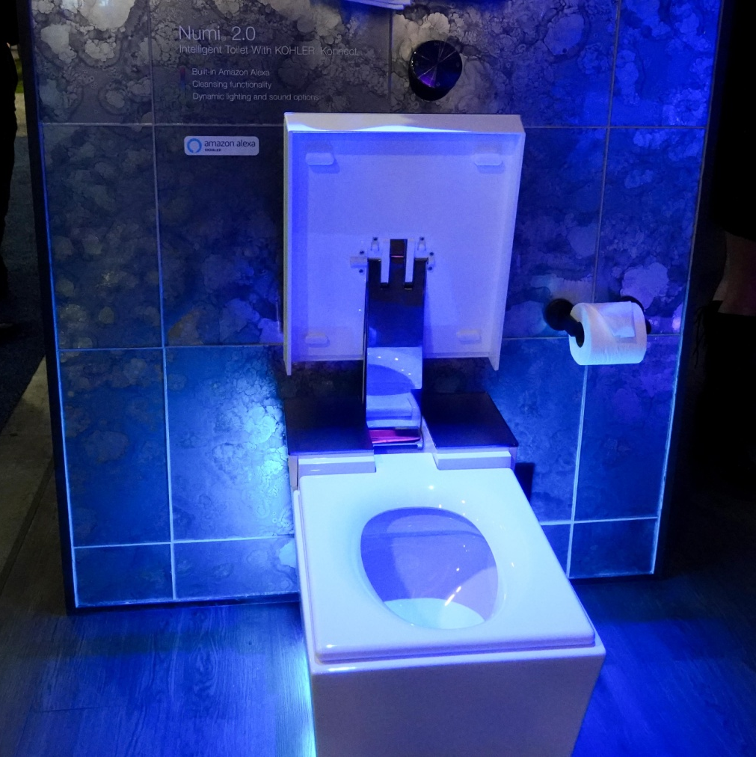
Smart toilets
SMART TOILETS USE SENSORS TO DETECT WHEN THE USER IS FINISHED AND AUTOMATICALLY FLUSH. THEY CAN ALSO DETECT ANY ISSUES WITH THE PLUMBING AND ALERT THE HOMEOWNER TO PREVENT POTENTIAL DAMAGE. ADDITIONALLY,
SMART TOILETS CAN ANALYZE WASTE TO DETECT ANY HEALTH ISSUES AND PROVIDE FEEDBACK TO THE USER.

Slide 11
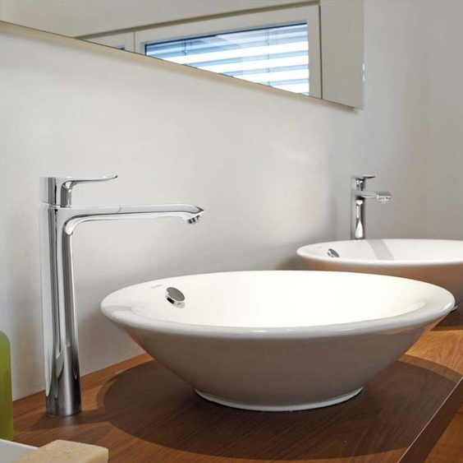
WATER CONSERVATION
SMART BATHROOMS CAN HELP CONSERVE
WATER BY USING LOW-FLOW FIXTURES AND
LEAK DETECTION SENSORS. THESE SENSORS CAN DETECT LEAKS AND AUTOMATICALLY SHUT OFF THE WATER SUPPLY TO PREVENT WASTE. ADDITIONALLY, SMART SHOWERS CAN MONITOR WATER USAGE AND ADJUST FLOW RATES TO ENSURE OPTIMAL WATER CONSERVATION.

Slide 12
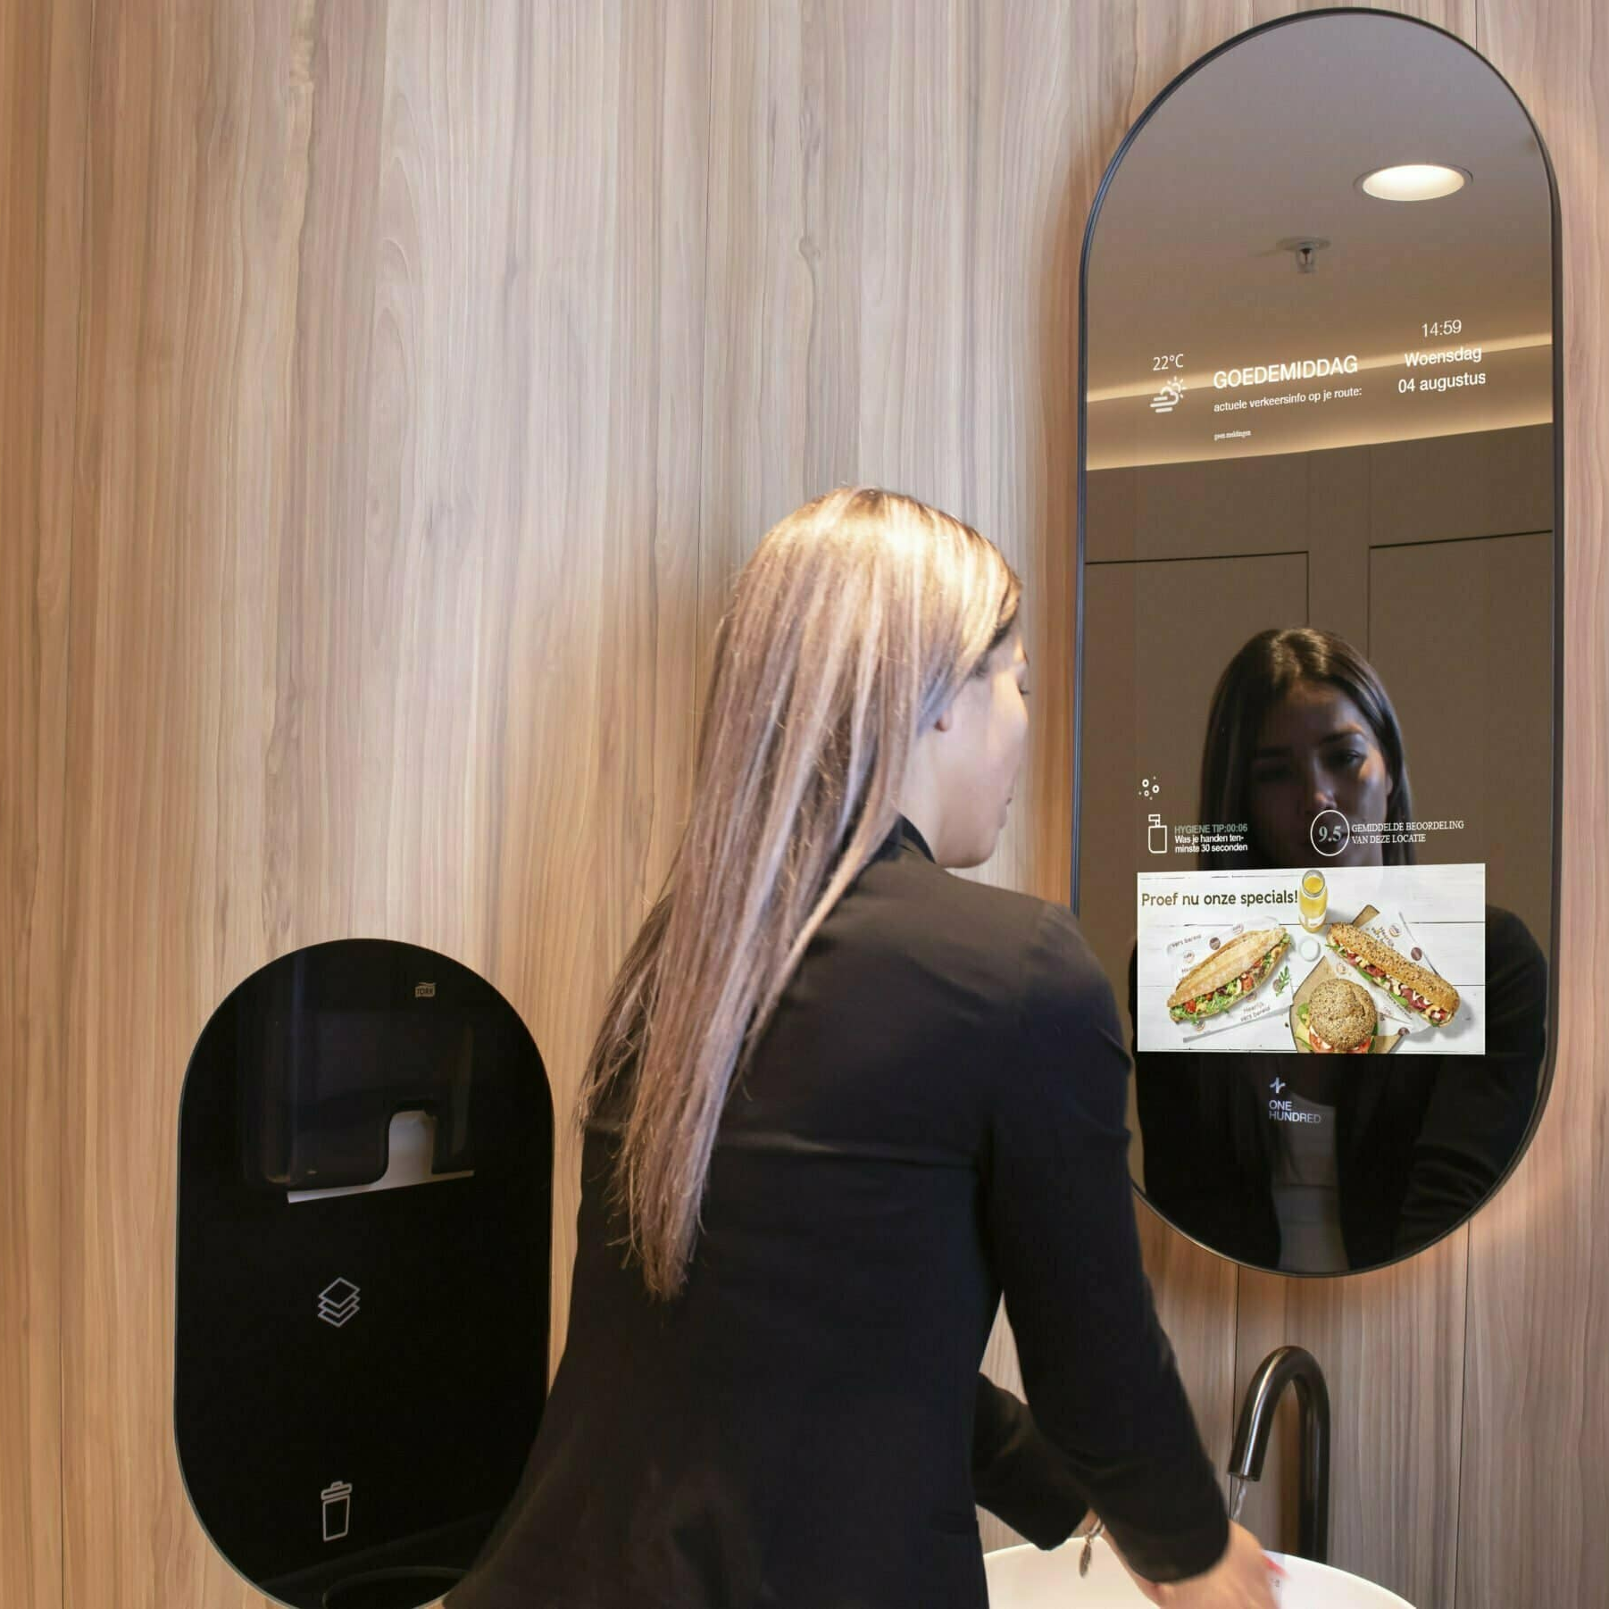
SMART MIRRORS
SMART MIRRORS CAN PROVIDE
PERSONALIZED LIGHTING AND VOICE
ACTIVATED CONTROLS. THEY CAN ALSO
ANALYZE THE USER'S SKIN AND PROVIDE
PERSONALIZED SKINCARE
RECOMMENDATIONS. ADDITIONALLY,
SMART MIRRORS CAN DISPLAY THE USER'S
CALENDAR AND WEATHER FORECAST TO
HELP THEM PLAN THEIR DAY.

Slide 13
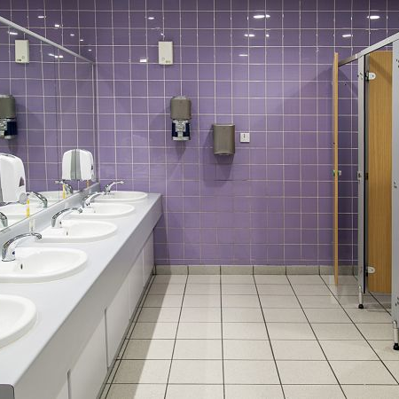
ENERGY EFFICIENCY
SMART BATHROOMS CAN ALSO HELP REDUCE ENERGY CONSUMPTION BY USING LED LIGHTING AND MOTION SENSORS. LED LIGHTING IS MORE ENERGY-EFFICIENT THAN TRADITIONAL LIGHTING AND CAN BE CONTROLLED REMOTELY. MOTION
SENSORS CAN DETECT WHEN A ROOM IS
UNOCCUPIED AND TURN OFF LIGHTS AND
APPLIANCES TO SAVE ENERGY.

Slide 14
PROJECT DEFINITION:
The project aims to enhance public restroom management by installing IoT sensors to
monitor occupancy and maintenance needs. The goal is to provide real-time data on
restroom availability and cleanliness to the public through a platform or mobile app. This
project includes defining objectives, designing the IoT senor system, developing the
restroom information platform, and integrating them using IoT technology and python

Slide 15
Project objective:
Real-Time restroom availability information.
Cleanliness monitoring.
Improved user experience.
Efficient restroom

Slide 16
REAL-TIME RESTROOM AVAILABILITY INFORMATION.
Real-time restroom availability information in smart public restrooms can significantly
improve user satisfaction, reduce wait times, and enhance restroom management
efficiency. It can also be a valuable feature in smart cities and public spaces where
providing a high level of convenience to residents and visitors is a priority.
CLEANLINESS MONITORING
Cleanliness monitoring in smart public restrooms not only helps maintain a clean and hygienic environment but also contributes to cost efficiency by optimizing cleaning schedules and resource allocation. It enhances the overall user experience and public health, making it an essential feature in modern public facilities.

Slide 17
IMPROVED USER EXPERIENCE.
Real-time availability information, cleanliness monitoring, touchless features , hand hygiene
stations, accessibility features, baby changing station, multilingual signage , amenities and
comfort, privacy considerations, emergency feature , maintenance alerts, queue
management feedback mechanism , energy efficiency, security , smart notifications, hygiene
supplies, green feature , regular maintenance, user education By focusing on these aspects,
public restrooms can become more user-friendly and contribute to a positive overall
experience, which is especially important in busy public spaces, transportation hubs,
shopping centers, and smart city initiatives.

Slide 18
IOT SENSOR DESIGN.
Select the appropriate sensors for the parameters you want to monitor. Common sensor types for smart restrooms include:Occupancy sensors (infrared, ultrasonic, or weight sensors) to detect user presence.
Environmental sensors (temperature, humidity, air quality) for monitoring comfort and cleanliness.
Fluid level sensors for soap, water, and sanitizer dispensers.
Image sensors or cameras for cleanliness assessment and occupancy tracking.
Acoustic sensors for measuring noise levels and detecting issues.
RFID or NFC sensors for tracking restroom supplies and equipment.
REAL-TIME TRANSIT INFORMATION PLATFORM
Creating a real-time transit information platform in a smart public restroom can be a valuable service for users, especially in busy transportation hubs. This platform can provide up-to-date information about public transportation options, schedules, delays, and nearby services.

Slide 19
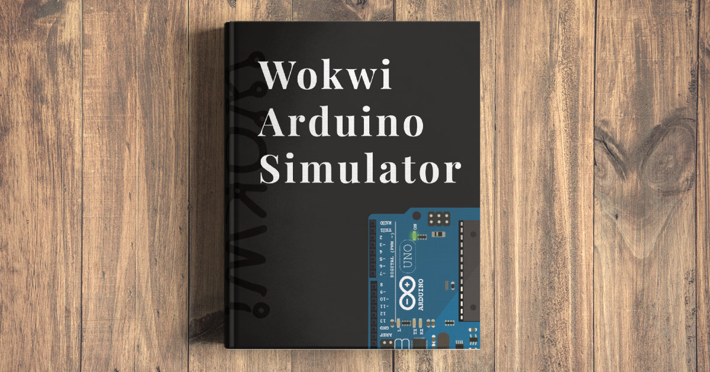
Components
Ardunio uno
Breadboard
LED
Push button
DS18B20
Resistor
Servo

Slide 20
Program : Occupancy indicater
#include <Servo.h>
const int buttonPin = 4;
const int ledPin = 12;
const int servoPin = 9; // Digital pin for the servo
int buttonState = 1;
Servo doorServo;
void setup() {
pinMode(ledPin, OUTPUT);
pinMode(buttonPin, INPUT);
doorServo.attach(servoPin);//Attaching the servo to the pin
}
void loop() {
buttonState = digitalRead(buttonPin);
if (buttonState == HIGH) {
// Restroom is occupied
digitalWrite(ledPin, HIGH);
// Open the door (rotate the servo)
doorServo.write(90); // Angle to open the door
} else {
// Restroom is vacant
digitalWrite(ledPin, LOW);
// Close the door (return the servo to its initial position)
doorServo.write(0); // Angle to close the door
}
}

Slide 21
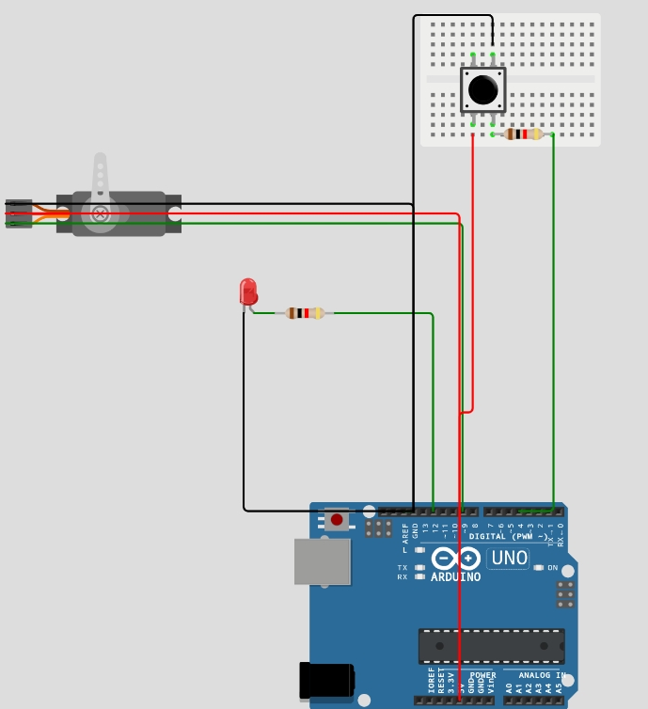
OUTPUT LINK in WOKWI: https://wokwi.com/projects/378898578284772353

Slide 22
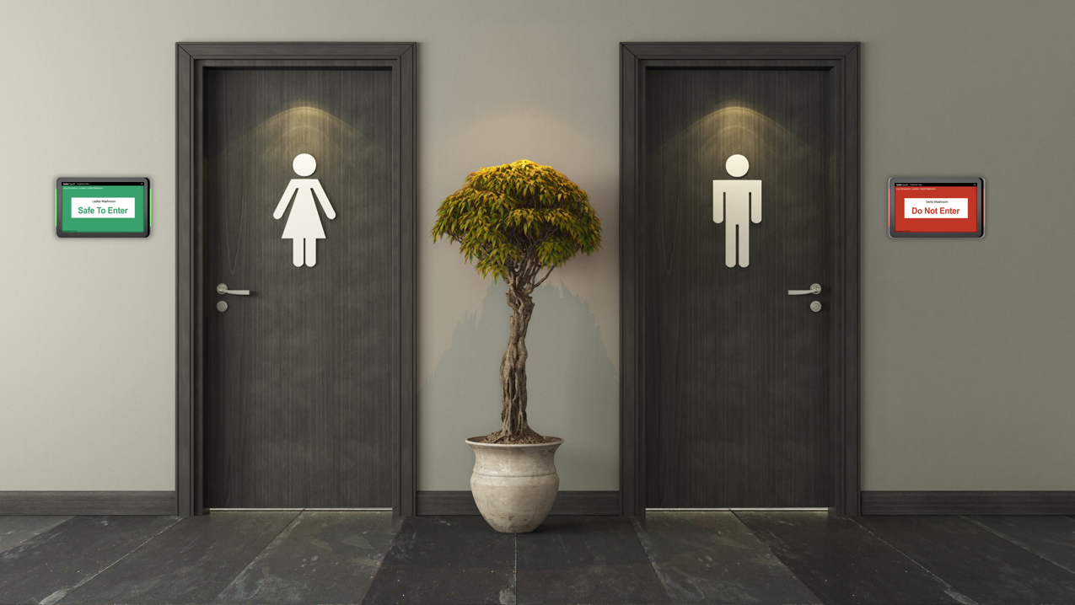

Slide 23
Program : Temperature sensor
const int DS18B20_pin = A1; /* DS18B20 O/P pin */
void setup() {
Serial.begin(9600);
}
void loop() {
int temp_adc_val;
float temp_val;
temp_adc_val = analogRead(DS18B20_pin); /* Read Temperature */
temp_val = (temp_adc_val * 4.88); /* Convert adc value to equivalent voltage */
temp_val = (temp_val/10); /* DS18B20 gives output of 10mv/°C */
Serial.print("Temperature = ");
Serial.print(temp_val);
Serial.print(" Degree Celsius\n");
delay(1000);
}

Slide 24
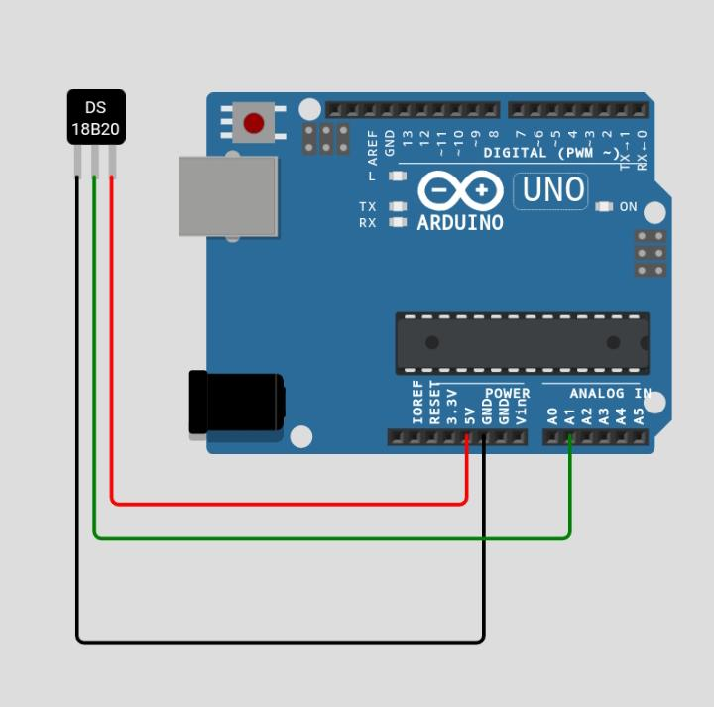
Output link: https://wokwi.com/projects/379628162270992385

Slide 25
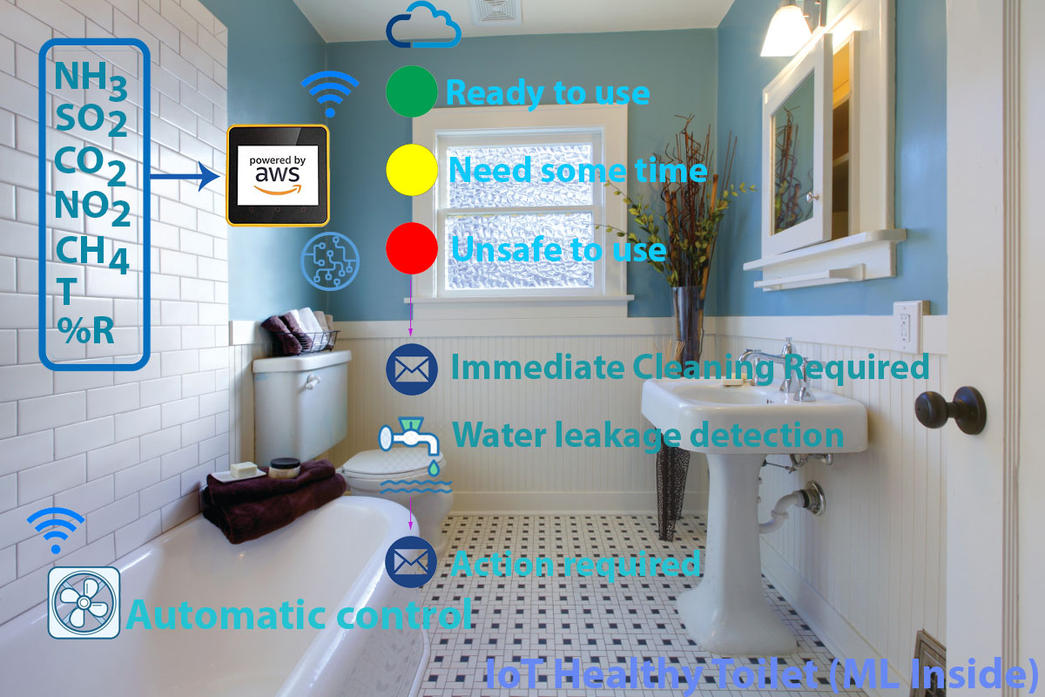

Slide 26
Program : Automatic Flush
#include <Servo.h>
Servo servo1;
int sensor=0;
int sensorPin=5; //distance sensor on analog pin 5
int PreparingToFlush=0;
void setup() {
Serial.begin(9600);
servo1.attach(10); //servo data line on pin 10
servo1.write(3);
}
void loop() {
sensor=analogRead(sensorPin);
if (sensor > 100){ //if distance sensor detects someone
delay(2000); // wait
sensor=analogRead(sensorPin);
if (sensor > 100){ // check again to make sure someone is actually there
PreparingToFlush=1;
}
}
if (PreparingToFlush==1){ //if a person has been detected
if (sensor < 100){ // if the person has now left
servo1.write(175); //FLUSH
delay(5000);
servo1.write(3);
delay(1000);
PreparingToFlush=0; //reset the trigger
}
}
delay(10);
}

Slide 27
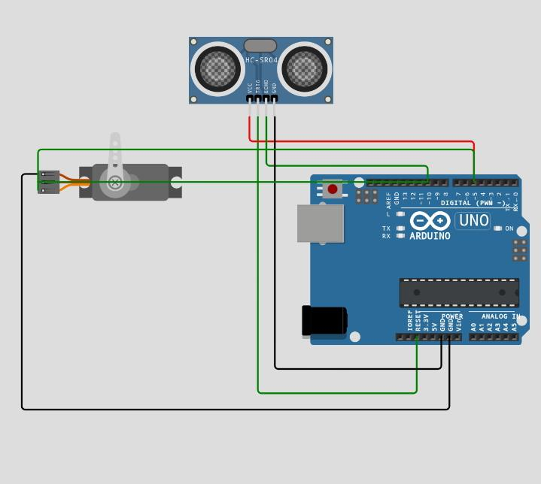
Output link: https://wokwi.com/projects/379630700498494465

Slide 28
Benefits of using smart public restroom:
Smart bathrooms are the future of hometechnology. With predictive maintenance, water conservation, energy efficiency, and personalized features, they offer a unique and efficient bathroomexperience. Homeowners can save money and reduce their environmental impact with this innovativetechnology.
Restroom users can easily feedback on any problems they spot.
Equipment is well-maintained due to real time data usage.
Improvement of hand hygiene: each is encouraged to wash hands when leaving the washroom.
Hand disinfection by sanitizer usage in hospitals to track hand hygiene compliance to help prevent hospital-acquired infections.
Anonymity: separate individuals are not tracked, the system only counts the number of people entering and washing hands.
Availability of statistics on the number of employees who skip hand washing when leaving a restroom, which is crucial for any business, healthcare organization, and food industry.

Slide 29

By team:
A.Anbuselvi
D.Arthi
S.Abirami
R.Abirami
C.Aarthi

