Slide 1
DDSAnalytics
Frito Lay Employee Attrition Analysis
By: Ryan Herrin

Slide 2
Executive Summary
Missing salary data was generated using a linear regression model
Common profile with attrition is young, early career, single with overtime
Three attributes to focus on: Job Level, Overtime, Stock Options
Random Forest was the optimal Model for predicting Attrition
Identified 4 employees that are predicted to have attrition

Slide 3
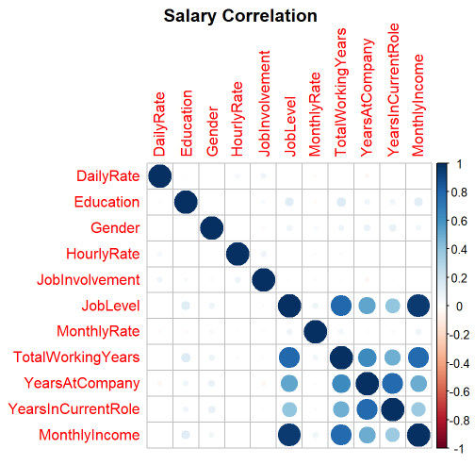
Calculating Salary
Missing Data
Part of the data set provided had no salary information
Solution
Used Linear Regression to fill in the missing data
Used the highest correlating variables to define my function
Results
7% Median and 9.8% Mean difference of generated salary data as compared to the test data
RMSE of $1,376.95

Slide 4
Common Trends Related to Attrition

Slide 5
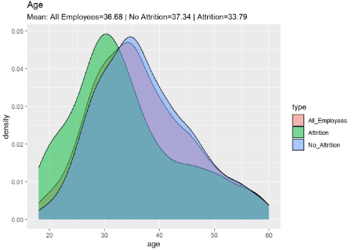
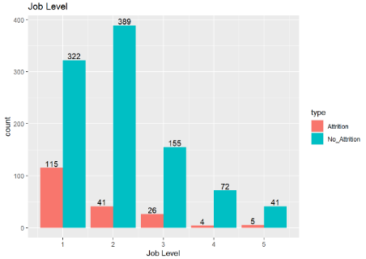
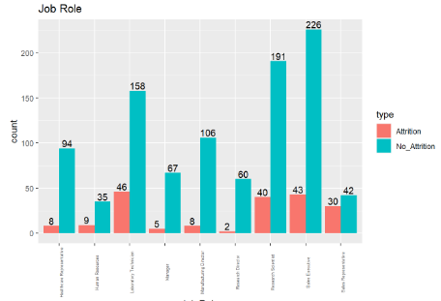
Initial Discovery / Common Trends (1/2)
Age
Mean
Attrition: 33.79
No Attrition: 37.34
The age of employees with attrition is noticeably lower
Job Level
Employees with the highest attrition are level 1 with 26.3% of all level 1’s having attrition
The next highest isn’t until level 3 with 13.4%
Job Role
Roles with the highest attrition rate
Sales Rep: 41.6%
Lab Tech: 22.5%
HR: 20.45%
Research Scientist: 17.3%
Sales Executive: 15.9%

Slide 6
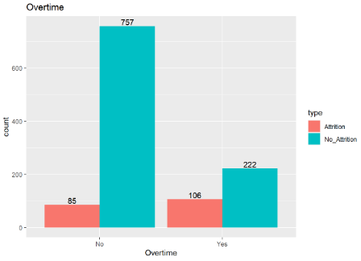
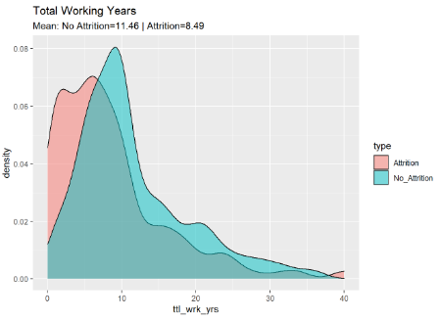
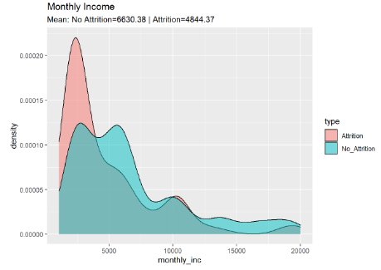
Initial Discovery / Common Trends (2/2)
Overtime
No: 10.1%
Yes: 32.3%
Big increase in attrition from employees who work overtime
Total Working Years
Mean
Attrition: 8.49 years
No-Attrition: 11.46
Those in their early career are likely to have more attrition
Monthly Income
Mean
Attrition: $4,844.37
No-Attrition: $6,630.38
Lower monthly incomes seems to learn more towards higher attrition

Slide 7
Attrition Profile

Slide 8
Quick Profile of Employee Attrition
Employees with attrition have this most in common
Young/Early Career
Single (possibly have no family “tie” them in one location)
Tend to have longer commutes
Low Environment Satisfaction
Low Job Involvement
Most come from in Sales, HR, Lab Tech, or Research Scientist
Work Overtime
No stock option
Low Work Life Balance
Of course, this is just what is in common and not a conclusion that if an employees has all these, they will have attrition or not

Slide 9
Creating an Attrition Formula from Correlation

Slide 10
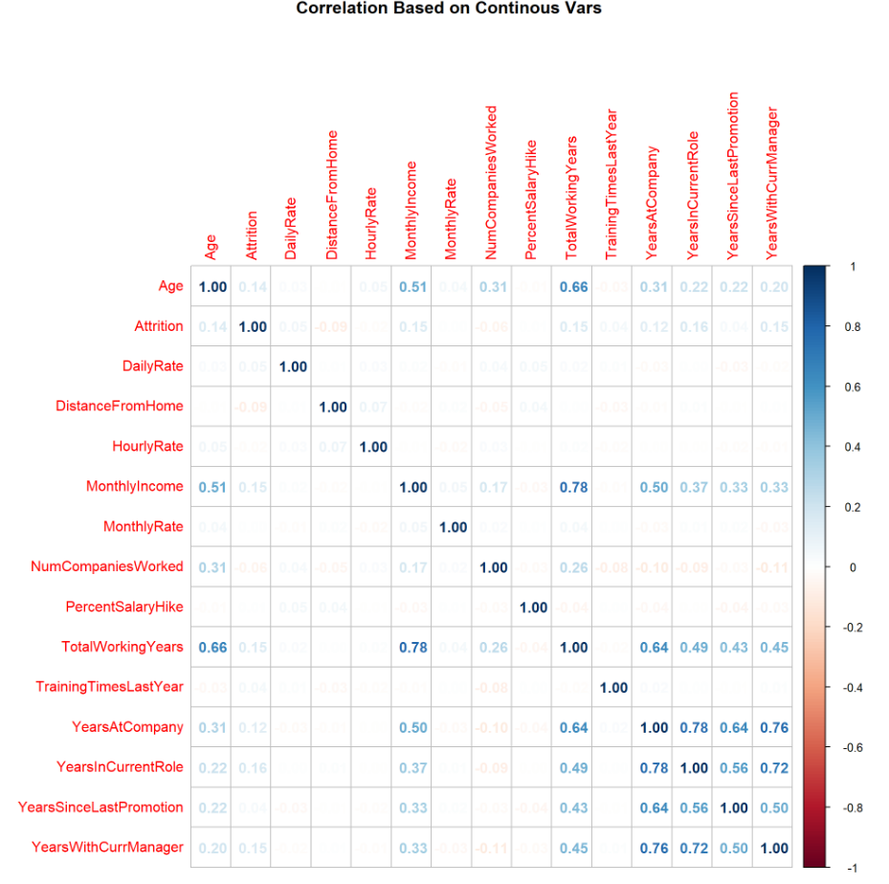
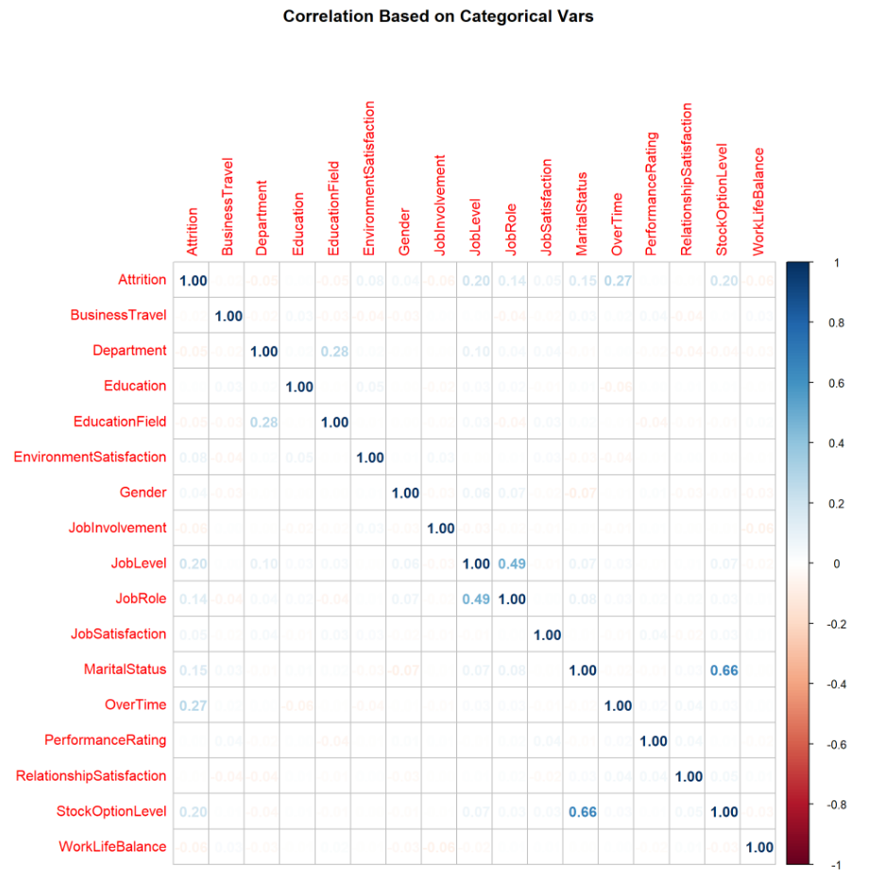
Correlation for Predicting Attrition
Biggest factors
Age, Monthly Income, Total Working Years, Years at Company, Years in Current Role, Years With Current Manager, Job Level, Job Role, Marital Status, Over Time, Stock Option Level

Slide 11
Top 3 Factors

Slide 12
Top 3 Factors leading to Attrition
Job Level
Attrition happens early in the career
Overtime
Reduce Overtime where possible
Stock Option Level
Offer some sort of stock option for new employees
Note: Most attributes correlate around an employee in the early years of their career.
Determined by value on correlation table cross checked by the charts generated for attrition vs non-attrition

Slide 13
Prediction Models

Slide 14

KNN Model
Using the KNN classifier I was able to achieve an accuracy of 86%
Unfortunately, the specificity only achieved a value of 0.3019
After many attempts at optimizing the formula and changing the K value, the highest I could get the specificity was ~.4
KNN suffered from Overfitting and do not recommend for predicting attrition
Accuracy: 86%
P-Value: 0.0001491
Sensitivity: 0.9664
Specificity: 0.3019

Slide 15

Random Forest Model
Using the Random Forest, I was able to achieve an accuracy of 83%
May be slightly lower than KNN, but it is more consistent
The specificity only achieved a value of 0.7895
After using the same formula as KNN the random forest model was able to achieve a more consistent and reliable prediction model
I recommend using the Random Forest Model as the method of predicting attrition
Accuracy: 83%
P-Value: 1.243e-10
Sensitivity: 0.8373
Specificity: 0.7895

Slide 16
Results

Slide 17
Employees with Possible Attrition
Employee by Number:
1079
1016
1108
1458
What do they have in common?
Low Job Level
No Stock Option
All have Overtime
Low Job Satisfaction
Low Monthly Income
Same Department
Low Job Involvement

Slide 18
Extra Information

Slide 19
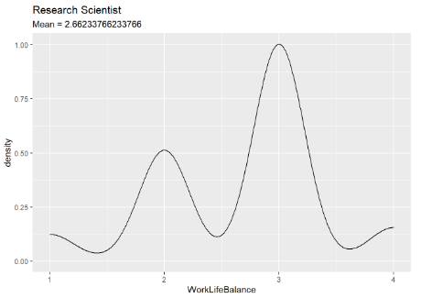
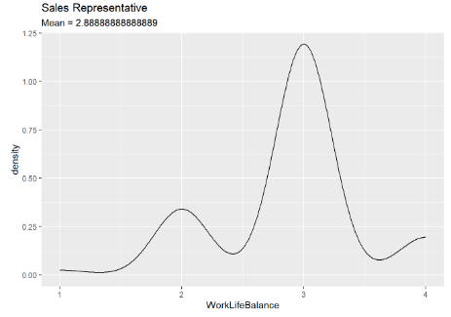
Other Information
Work Life Balance by Role
Sales Representatives have the highest Work Life Balance
Research Scientist have the lowest Work Life Balance

Slide 20
Thank You!

