Slide 1
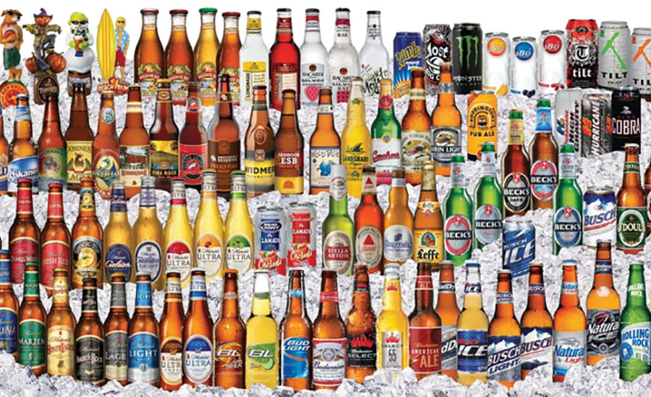
Exploratory Data Analysis
Data Analysis Team 4
Celia Banks
Ryan Herrin
Akib Hossain
Budweiser® Products

Slide 2
Executive Summary
An exploratory analysis of Budweiser brand beers focused on the Alcohol by Volume (ABV) and the International Bitterness Unit scale (IBU). Namely, ABV and IBU content were explored across a number of variables. Summarized statistics are provided that may be helpful in identifying prediction indicators. Analysis highlights include:
There is a mild positive correlation between ABV and IBU (0.379)
DC consumes the highest median ABV (.0625), and WV consumes the highest median IBU (57.5)
Barleywine and Malt Liquor products contain the highest amount of ABV (> .09), while Mild Ale products contain the lowest amount (<.045)
Russian Imperial Stout contains the highest IBU count (>75.0)
On average, more products with higher ABV are consumed in the Midwest
On average, more products with higher IBU are consumed in the West
The West region accounts for a majority of brewery locations

Slide 3
Data Assumptions
Multiple data sets were created to address specific questions
Only data that required the comparison of ABV to IBU had observations with the value of <NA> for those values were dropped
Considers the beer created by the breweries and not by sales data
Considers only beer created inside of the 51 states (and DC)
No historical data was provided

Slide 4
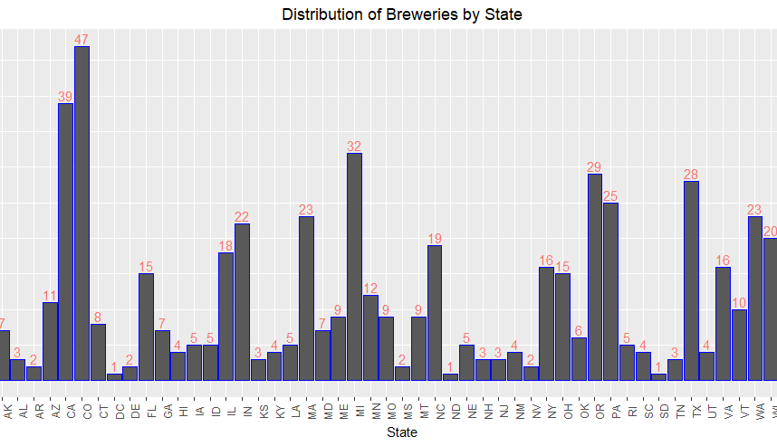
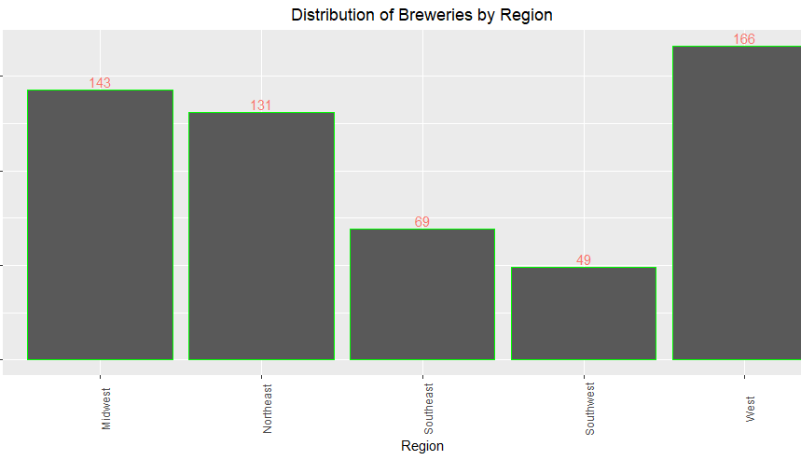
Distribution of Breweries
[Top] Distribution by state
Most Breweries are in California, Colorado and Michigan
[Bottom] Distribution by Region
Majority are in the West
Only a fraction are in the Southwest
This can be due to the growing climate of hops for breweries. Hops grow better in temperate climate and do not acclimate as well to hot and dry climates

Slide 5
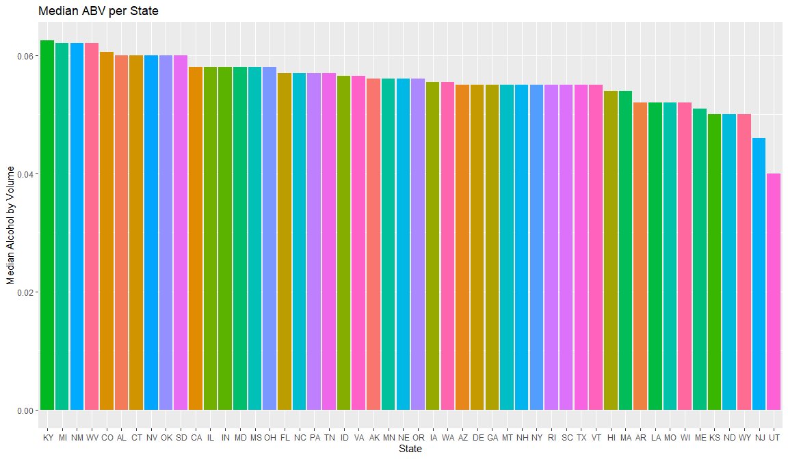
Median ABV by State
Kentucky has the highest ABV
A state where a majority of the world's bourbon is created
Utah has the lowest ABV
State law limits ABV to %5
Has some of the strictest liquor laws in the USA
* https://utah.com/state-liquor-laws

Slide 6
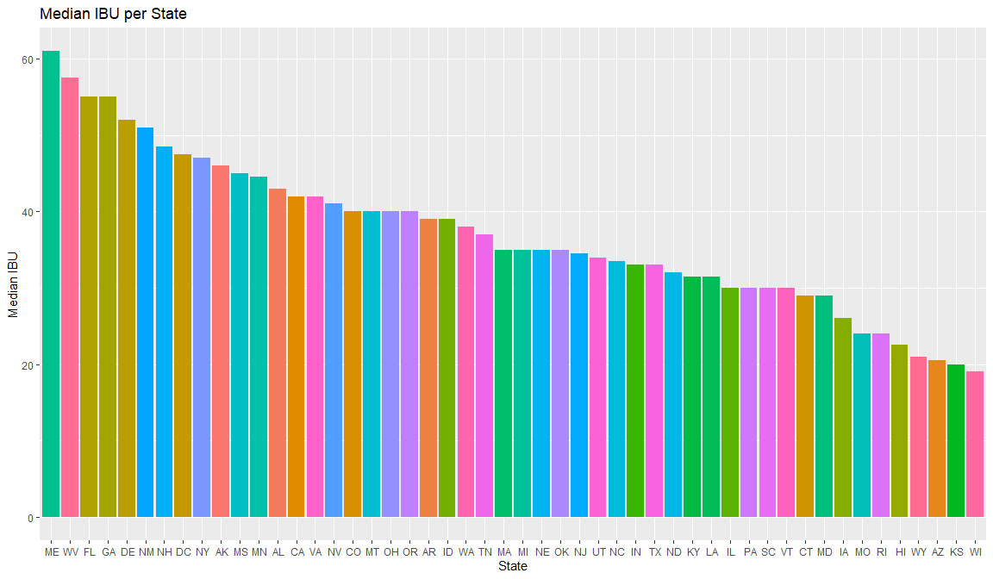
Median IBU by State
Maine has the highest IBU of any state
Today, more Maine farmers are growing hops (used for bittering and aroma) and grains (used for flavor 'backbone', color, mouthfeel, and body) to supply Maine brewers

Slide 7
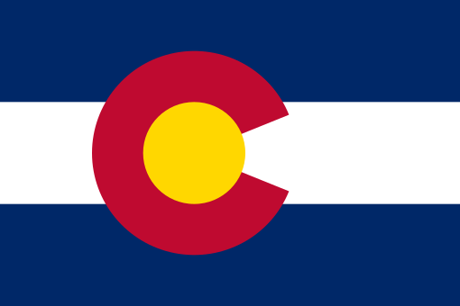
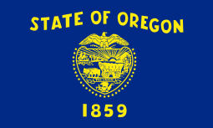
States with Highest ABV and IBU
ABV
IBU
Colorado
ABV: 12.8%
Oregon
IBU: 134

Slide 8
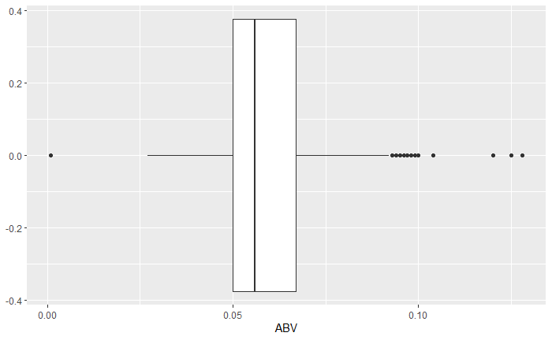
Summary of AVB Distribution
AVB Distribution
Majority of Beer ABV fall in between 5% - 6.7%
Lowest ABV (of alcoholic beer): 0.1%
Highest ABV: 12.8%
Median ABV: 5.6%

Slide 9
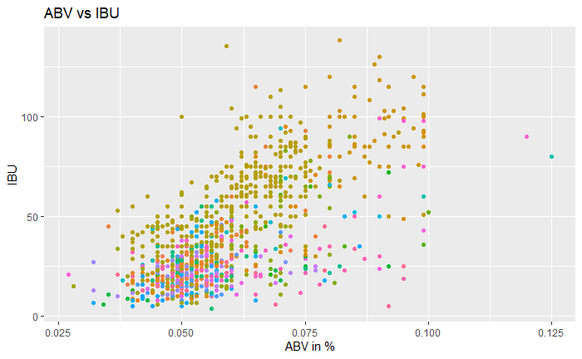
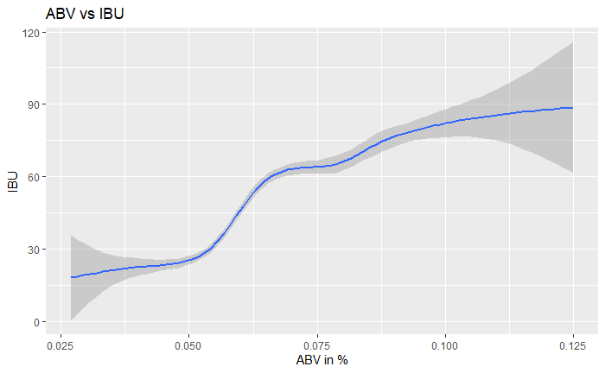
IBU vs. ABV
As shown in the charts there is a positive correlation between the IBU relative to ABV

Slide 10
[Closing slide – Summation]
The Western region with states like California , Colorado and Michigan lead the country with
highest number of Breweries. This is possibly due to a better climate in the western region.
Unlike states like Utah where ABV is regulated to 5%, we can utilize western states to manufacture
a product with a higher ABV.
California would be the most optimum possibility for us in deciding a product with a high ABV and
most suitable climate.
IBU is not as high in California in consideration to states like Maine.

Slide 11
Appendix

Slide 12
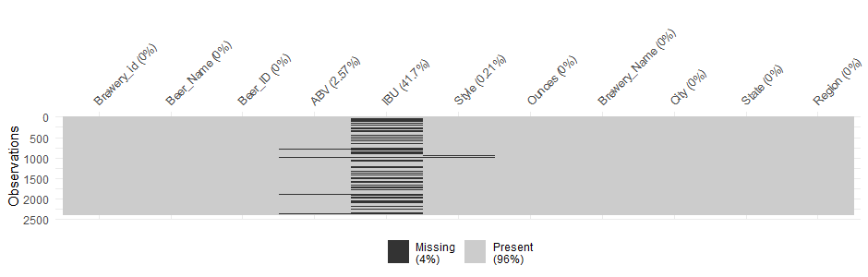
Missing Values
Count of missing values
table(is.na(df$ABV))
FALSE TRUE
2348 62
table(is.na(df$IBU))
FALSE TRUE
1405 1005
table(is.na(df$Style))
FALSE TRUE
2405 5

Slide 13
Beers with Missing Styles
Brewery_id Beer_Name Beer_ID ABV IBU Style Ounces
227 30 Special Release 2210 NA NA <NA> 16
455 67 OktoberFiesta 2527 0.053 27 <NA> 12
946 161 Kilt Lifter Scottish-Style Ale 1635 0.060 21 <NA> 12
992 167 The CROWLERâ„¢ 1796 NA NA <NA> 32
993 167 CAN'D AID Foundation 1790 NA NA <NA> 12

Slide 14
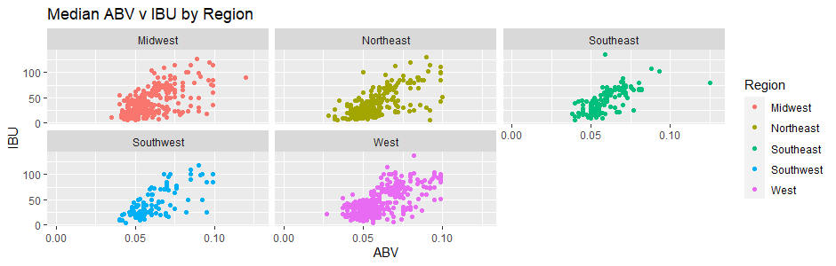

Slide 15
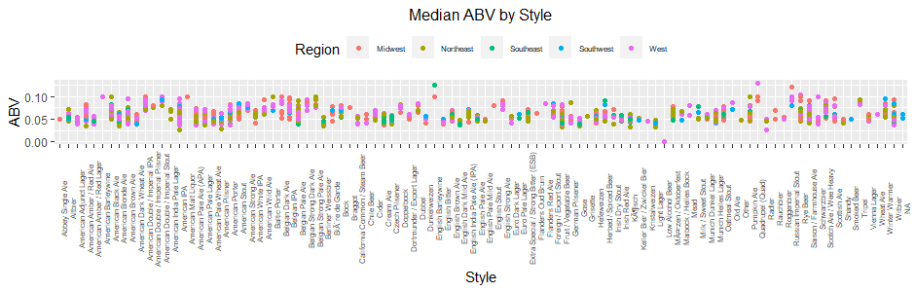
ABV by Beer Classification (Style)

Slide 16
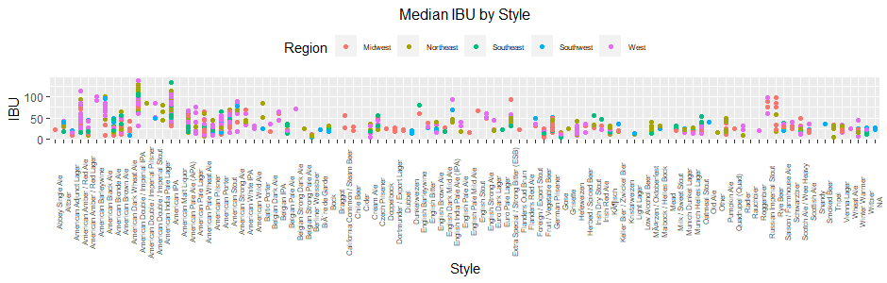
IBU by Beer Classification (Style)

