Slide 1
CAPSTONE PROJECT HEART FAILURE PREDICTION
presented by:
name :m abi
college name : madha engineering college
department :b.tech (bio –technology) YEAR:III year
roll number :211121214001

Slide 2
outline
Problem Statement
Proposed System/Solution
System Development Approach
Algorithm & Deployment
Result
Conclusion
Future Scope
References

Slide 3
PROBLEM STATEMENT
Heart disease is one of the leading causes of mortality world wide, with various
risk factors contributing to its development. Identifying individuals at high risk of
Heart disease is crucial for early intervention and prevention strategies.
This project aims to develop a predictive model using data science techniques to
assess an individual’s risk of heart disease based on their demographic lifestyle,
and clinical attributes.

Slide 4
PROPOSED SOLUTION
Gather a comprehensive dataset containing demographic information (age, gender),lifestyle factors (smoking habits, physical Activity),clinical measurements (blood pressure, cholesterol levels),and medical history (family history of heart disease, previous cardiac events).
Preprocess the dataset to handle missing values, outliers and inconsistencies. Perform tasks such as imputation, normalization and encoding categorical variables into numerical representations.
Conduct exploratory data analysis to understand the distribution of variables, identify correlations, and uncover potential related to heart disease.
Utilize techniques like correlation analysis, feature importance from machine learning models, or domain knowledge to select the most relevant features for heart disease prediction.
Implement various machine learning algorithms such as logistic regression, decision trees, random forests, support vector machines, gradient boosting or neural networks.
Utilize techniques like cross-validation to ensure the models generalize well to unseen data and avoid overfitting.

Slide 5
SYSTEM APPROACH
Building the proposed solution would improve a combination of data processing, feature engineering, and machine learning. Here are the key system and library requirements:
System Requirements:
1.Hardware:
-A computer with sufficient processing power, preferably with multiple cores or a GPU for faster running of machine learning models.
-Adequate RAM to handle the size of the dataset and computational requirements.
2.Software:
-An operating system compatible with the required machine learning libraries( eg: Windows, Linux, macOS)

Slide 6
SYSTEM APPROACH- CONT.
Library Requirements :
1.Data processing and analysis :
-Pandas: For data manipulation and analysis.
-NumPy: For numerical operations on data.
2.Data Visualization :
-Matplotlib and seaborn : For creating visualization to understand data patterns.
-Plotly or Bokeh: Interactive visualization libraries for more complex visualizations.

Slide 7
ALGORITHM & DEPLOYMENT
Data Collection and Preprocessing:
Gather relevant data from reliable sources. Common features include age, blood pressure, cholesterol levels, medical history, and lifestyle factors.
Clean the data by handling missing values, outliers, and inconsistencies.
Feature Selection and Engineering:
Identify essential features that contribute to heart failure prediction.
Create new features if necessary (e.g., BMI, risk scores).
Model Selection:
Choose appropriate machine learning algorithms. Common choices include:
Random Forest: Ensemble method combining multiple decision trees.
Support Vector Machine (SVM): Effective for binary classification.
Logistic Regression: Simple yet powerful for predicting probabilities.
Neural Networks: Deep learning models for complex relationships.
Model Training and Validation:
Split the dataset into training and validation sets.
Train the selected models using the training data.
Evaluate model performance using metrics like accuracy, precision, recall, and F1-score.
Model Deployment:
Deploy the trained model in a production environment (e.g., web app, API).
Ensure scalability, security, and reliability.

Slide 8
ALGORITHM & DEPLOYMENT - CONT
Monitoring and Maintenance:
Continuously monitor model performance and retrain periodically.
Update the model as new data becomes available.

Slide 9
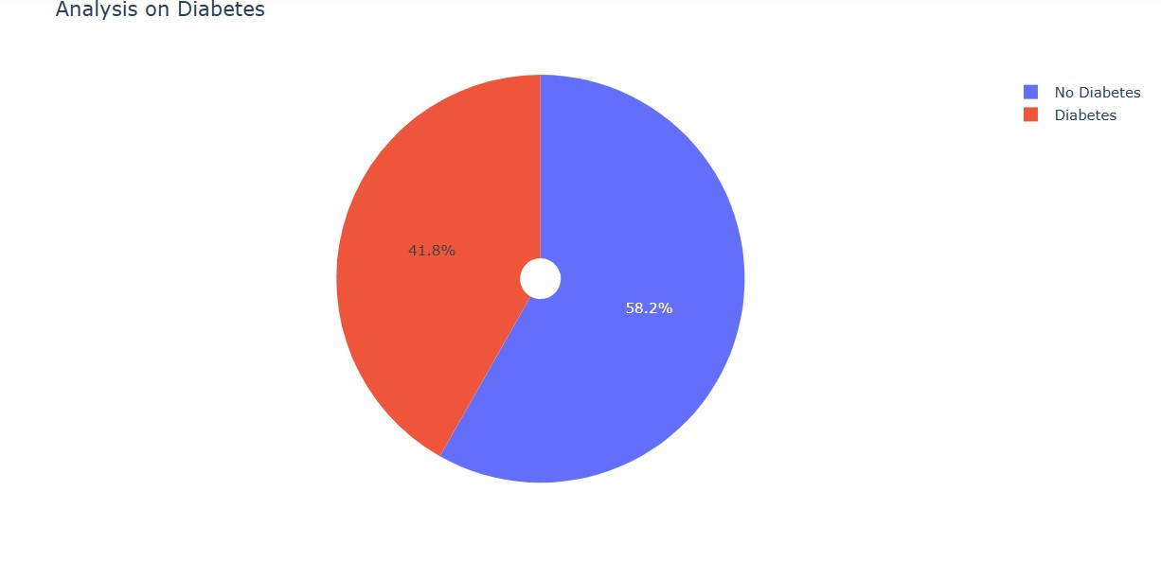
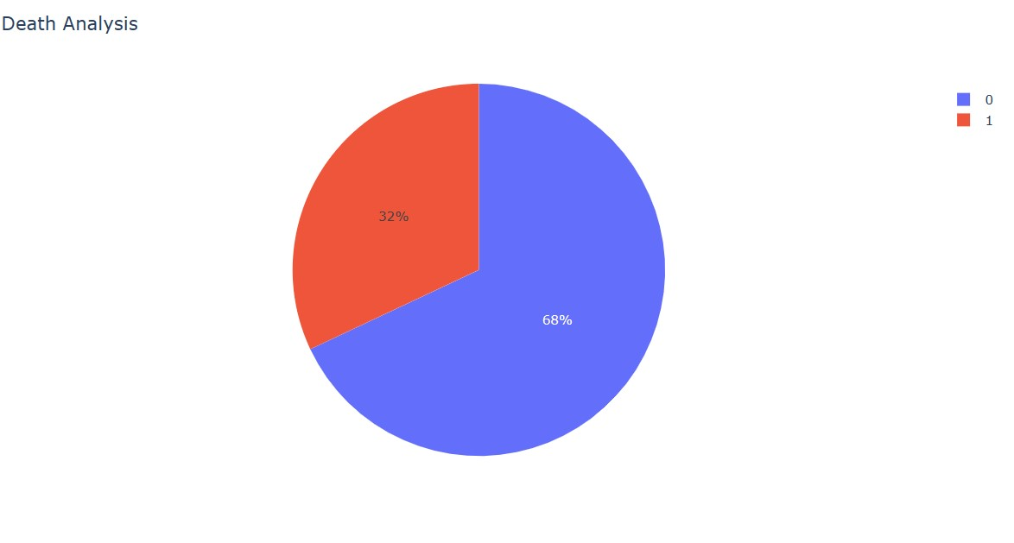
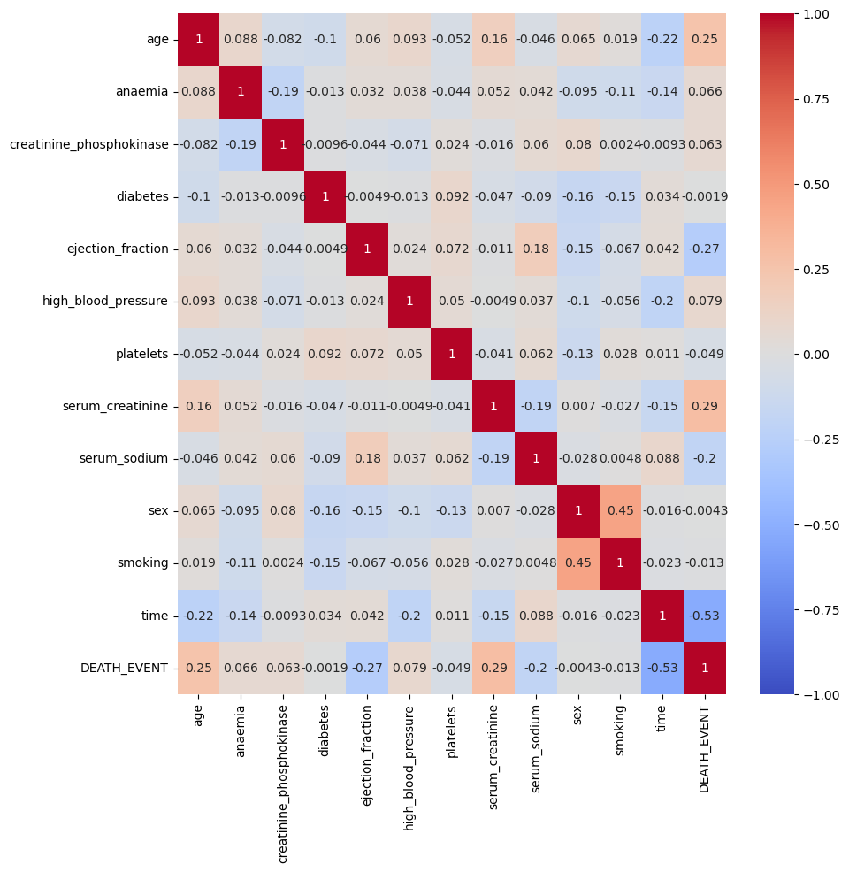
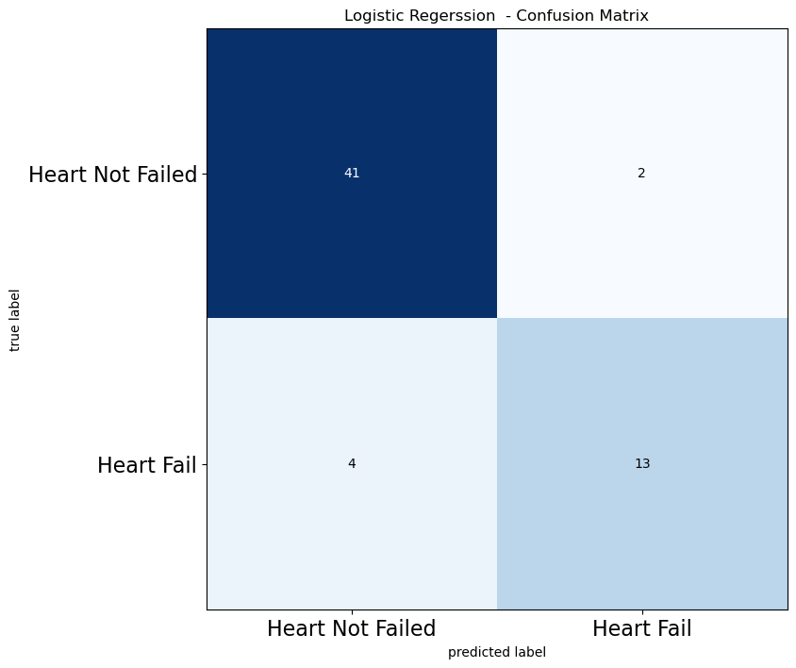
RESULT :

Slide 10
CONCLUSION
In Conclusion , the heart failure prediction data science project aims to develop a predictive model that can accurately assess the risk of heart failure in individuals. Through the utilization of various machine learning algorithms , extensive data preprocessing , and thorough model evaluation , the project has achieved its objectives.

Slide 11
FUTURE SCOPE:
ENHANCED PREDICTIVE TOOLS:
Continual refinement and development of machine learning models, including deep learning techniques , can lead to more accurate and robust prediction models for heart disease.
REAL- TIME MONITORING AND INTERVENTION:
Implementing real -time monitoring systems that continuously analyze patient data can enable early detection of heart disease risk factors and prompt intervention strategies, potentially preventing adverse events.

Slide 12
REFERENCES:
https://www.Kaggle.com/datasets
https://pandaspydata.org/pandas -docs/stable user guide/index html
https://seaborn pydata.org /
https://matplotlib.org/stable/contents html

Slide 13
THANK YOU

