Slide 1
UK Housing Market Analysis (2024–2025)
Data-Driven Insights Using Python
Presented by: Abimbola Asala

Slide 2
Project Overview
Objective: Analyze trends in housing prices, sales volume, buyer behavior.
Dataset: UK monthly housing data (Feb 2024 – Feb 2025)
Tools: Python (Pandas, Plotly, Seaborn, Statsmodels, Scikit-learn)
Notes:
Note: This project is designed to explore the UK housing market trends using government released data. I used Python libraries to clean the data, engineer features, visualize key metrics, and build predictive models. The goal was to derive clear, actionable insights for stakeholders across real estate, policy, and investment sectors.

Slide 3
Data Preparation
Handled missing values (prices, volumes, buyer profiles)
Removed outliers and duplicates
Exploratory data analysis
Engineered features: growth rates, lag variables, buyer ratios
Notes:
Note: The data was preprocessed to handle missing values using mean imputation and forward fill. I engineered several features such as annualized growth, lag variables, and buyer ratios to help analyze temporal patterns and build better models.

Slide 4
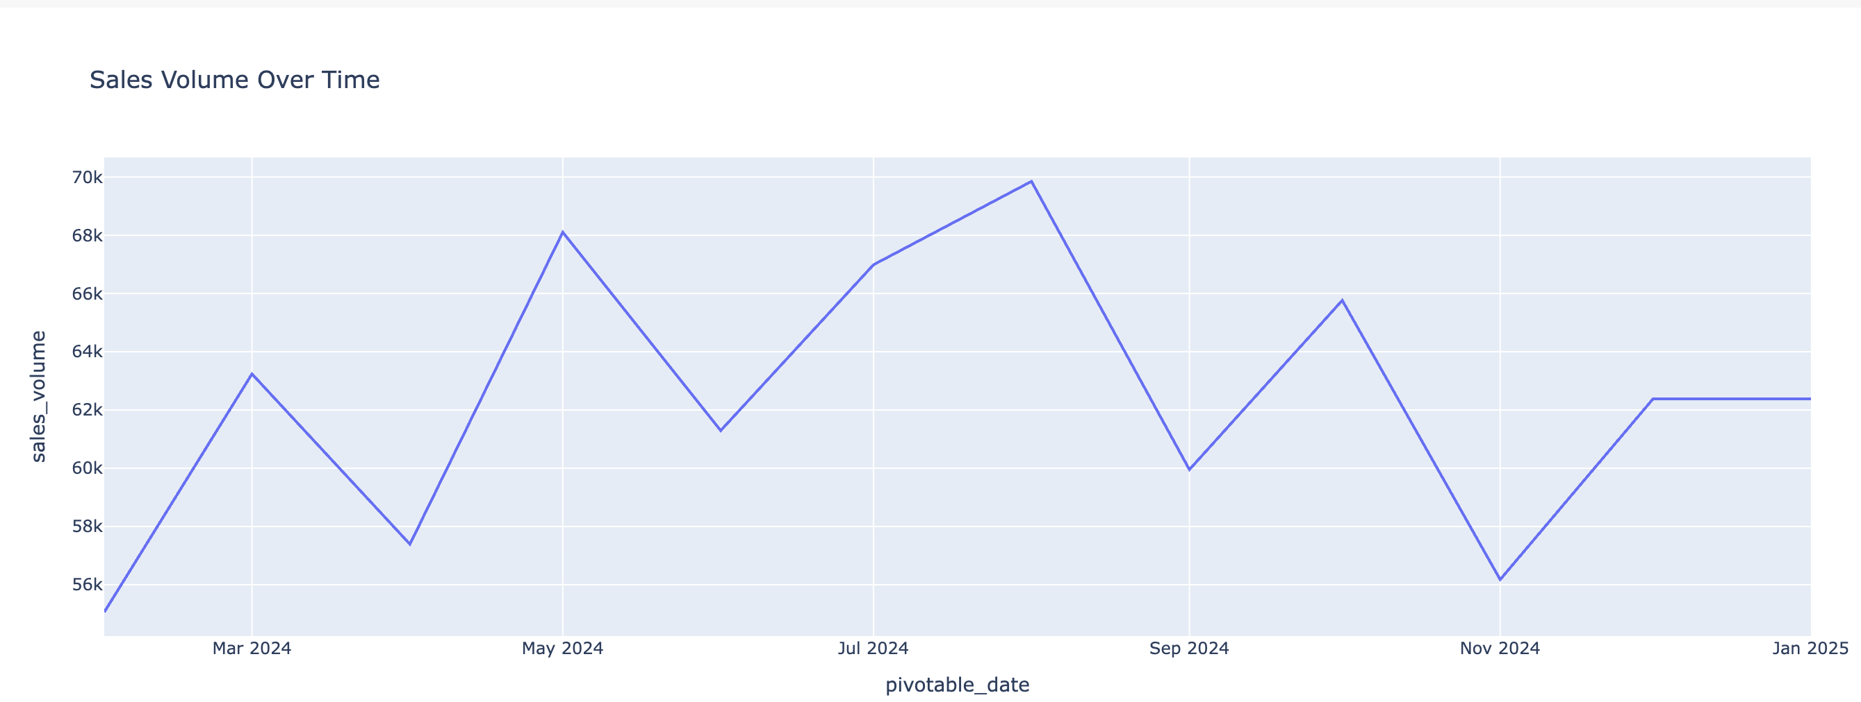
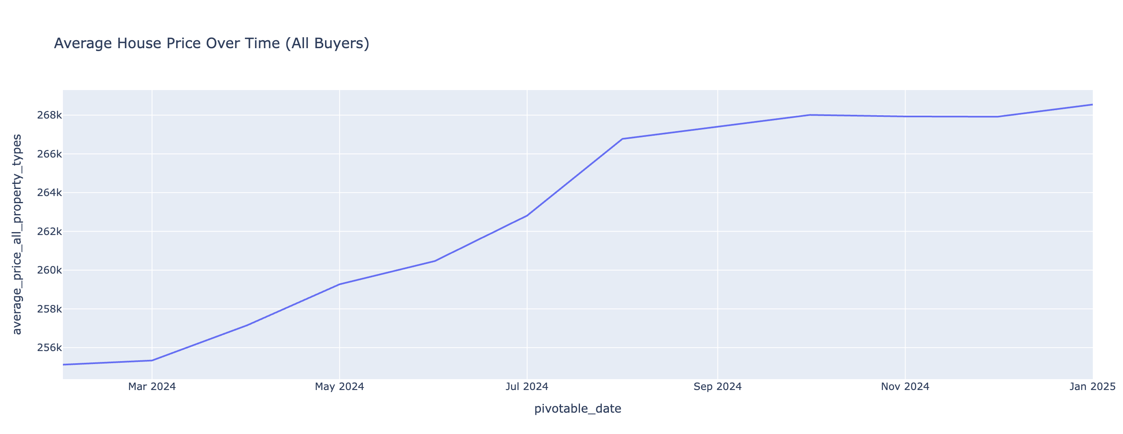
Average Price and Sales Volume Trends
Prices increased from ~£255k to ~£269k
Sales volumes show seasonal dips and peaks
Notes:
Note: What: I observed that average property prices rose consistently across 2024, while sales volumes fluctuated seasonally. This pattern reflects a resilient housing market that maintains buyer interest throughout the year, adapting to seasonal cycles. I advise stakeholders to align pricing and marketing strategies with these seasonal patterns to maximise impact.

Slide 5
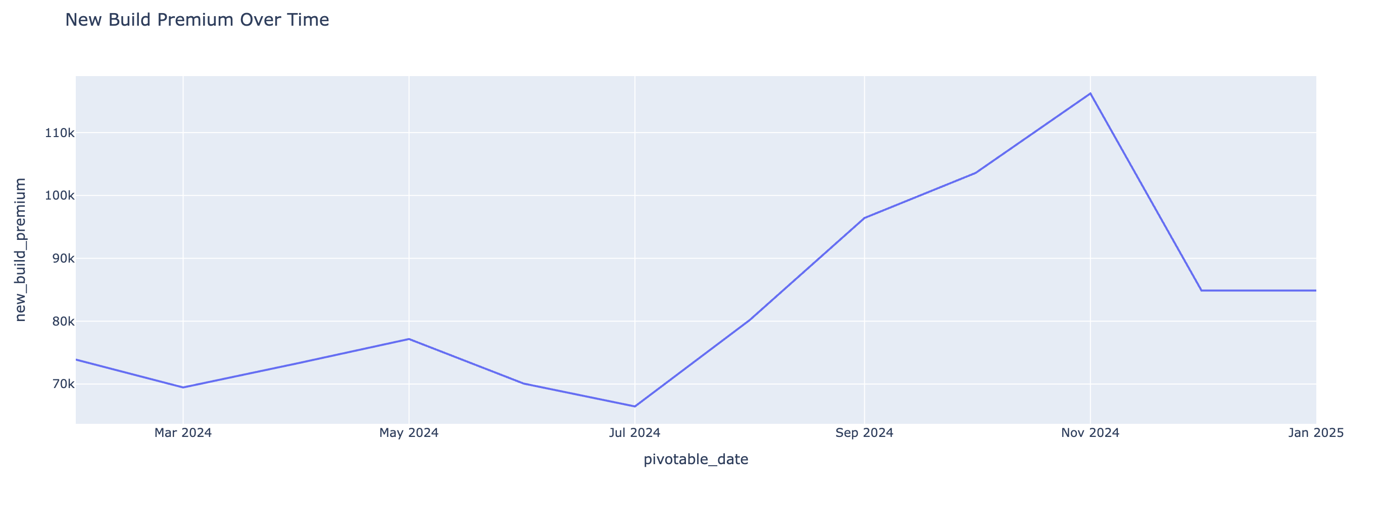
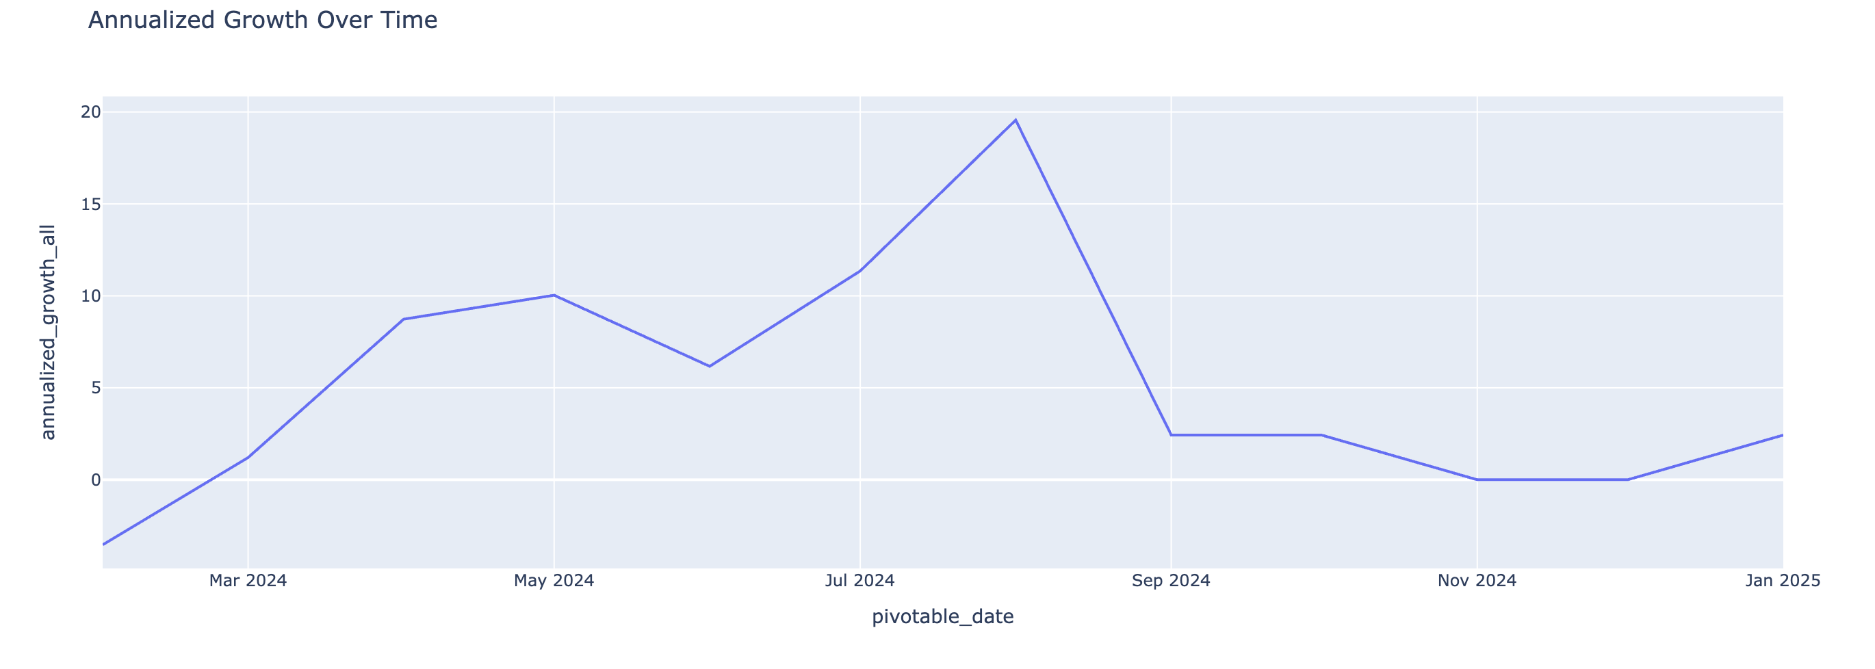
Price Premium & Growth Patterns
New build premium reached up to £117k
Annualized growth peaked at ~19% mid-2024
Notes:
Note: I identified a widening price premium for new builds and a sharp mid-year spike in price growth. These trends highlight periods of increased market activity and developer pricing power. Developers should consider launching properties during growth peaks to optimise profitability.

Slide 6
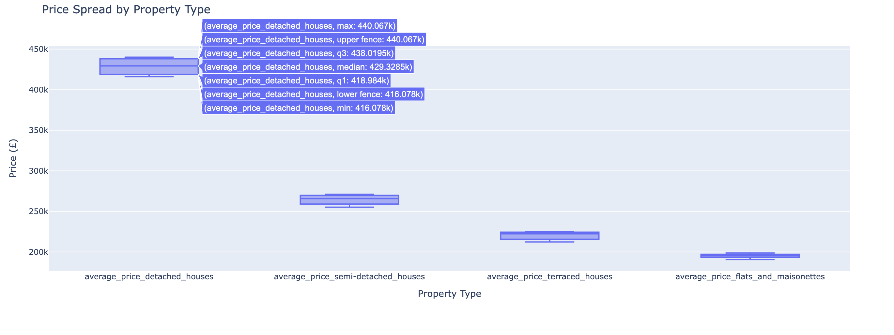
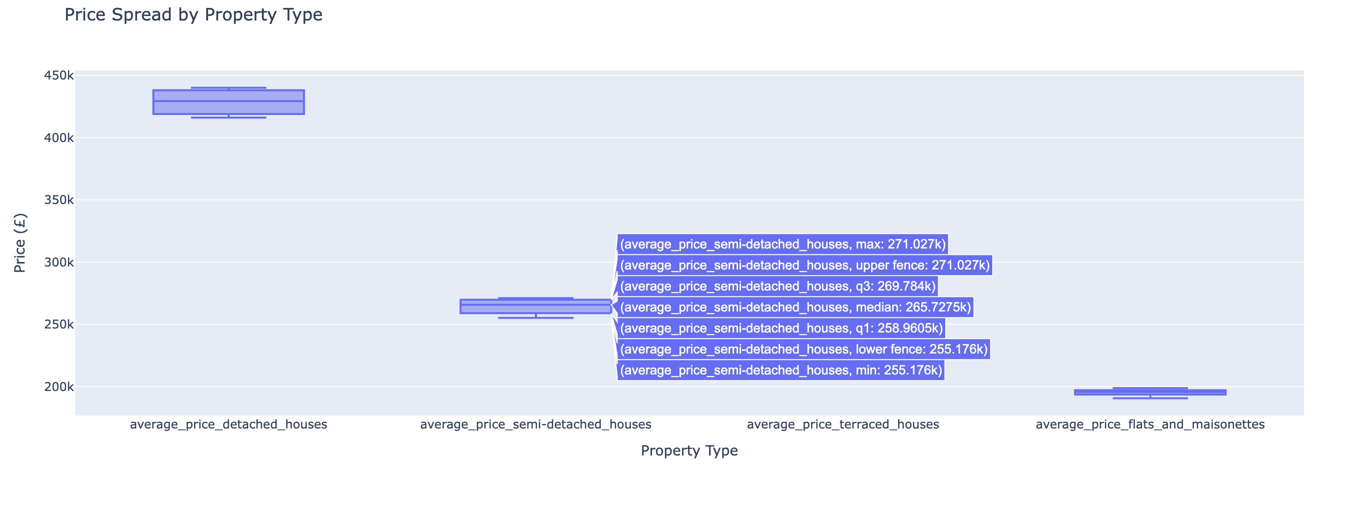
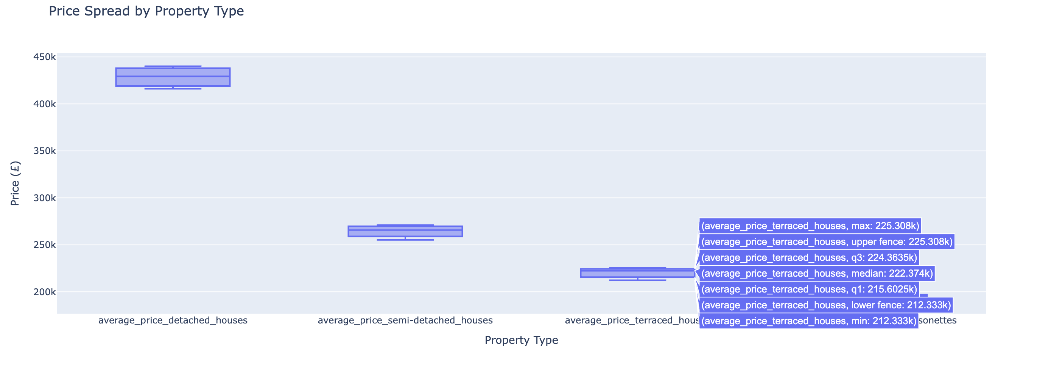
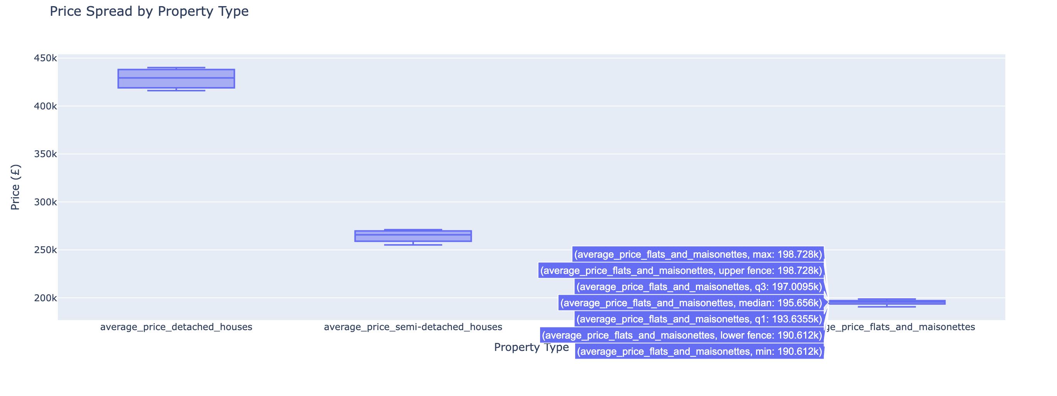
Buyer & Property Type Analysis
Minimal price difference between buyer types
Detached homes most expensive, flats most affordable
Notes:
Note: I found a wide price spread among detached properties, while flats remained more uniformly priced. This variation influences both affordability and buyer segmentation. Policy makers and housing planners can prioritise more accessible property types to support affordability goals.

Slide 7
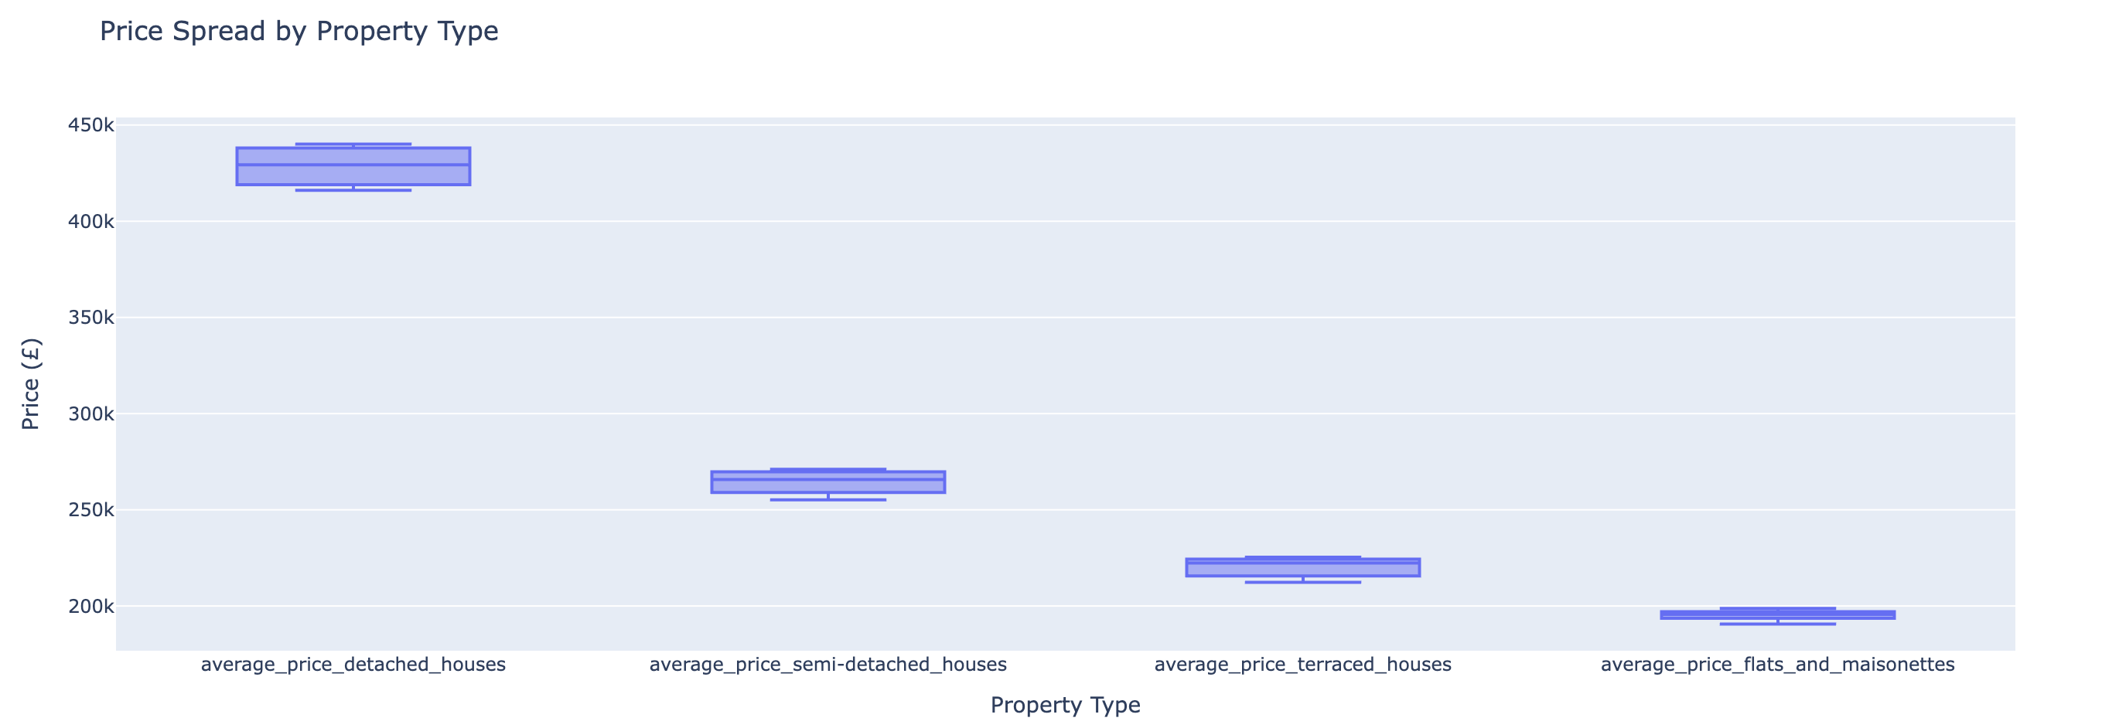
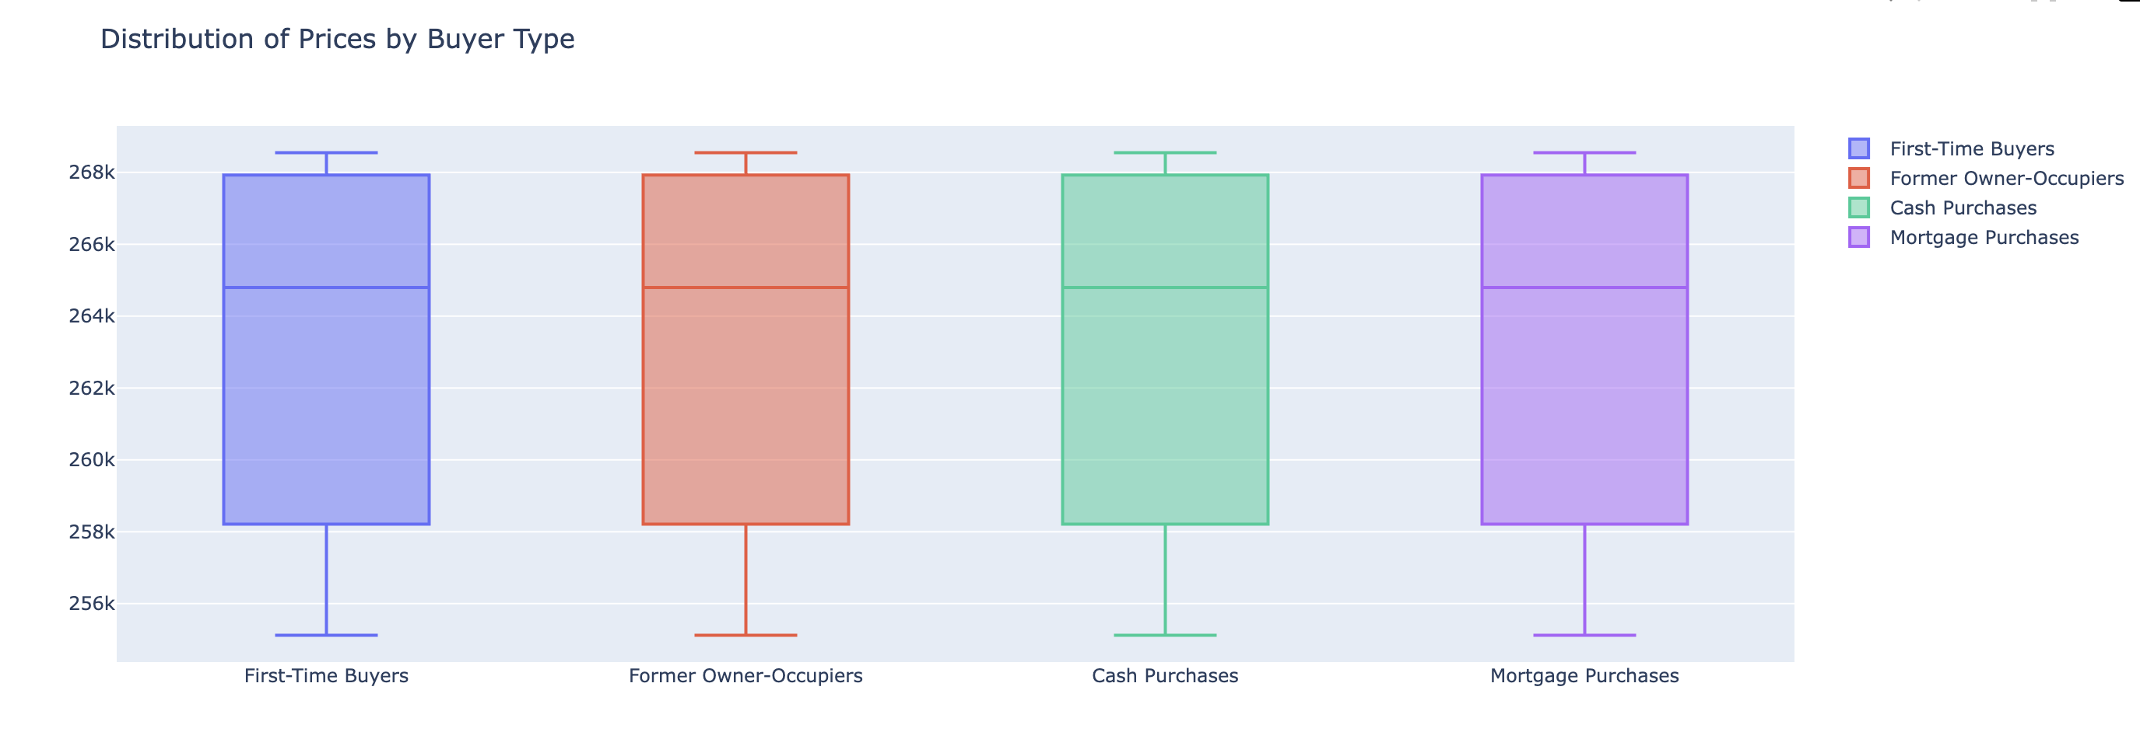
Buyer Type and Property Type Analysis
Detached homes most expensive; flats most affordable
Distribution is similar across buyer types
Notes:
Note: From my analysis, I noticed a clear difference in how property and buyer types affect prices.
Property type had a major impact detached homes commanded the highest prices, while flats were the most affordable.
However, buyer type had little influence prices remained fairly consistent whether the buyer was a first timer, cash buyer, or mortgage holder.
This suggests that the type of property is the real driver of price, not who is buying. That means pricing, marketing, and inventory decisions should be based on property attributes rather than assumptions about buyer behavior. I recommend stakeholders prioritise a balanced property portfolio to meet affordability needs and demand, especially in high growth markets. Pricing strategies should focus on product type, not buyer segmentation.

Slide 8
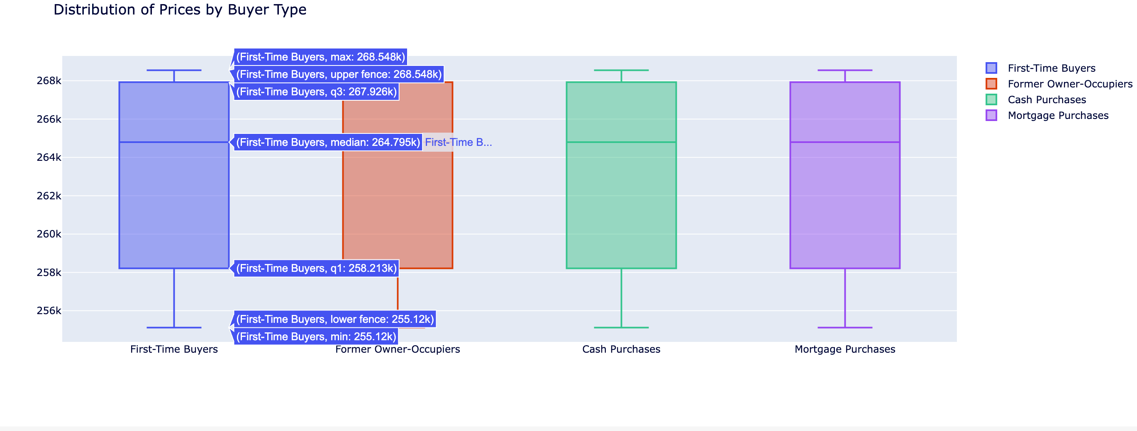
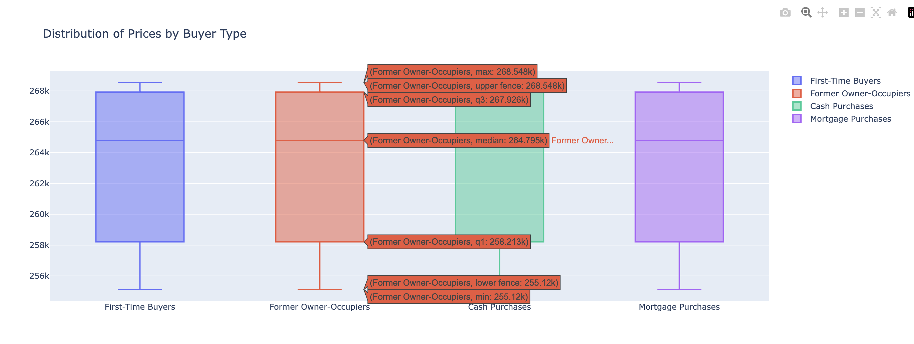
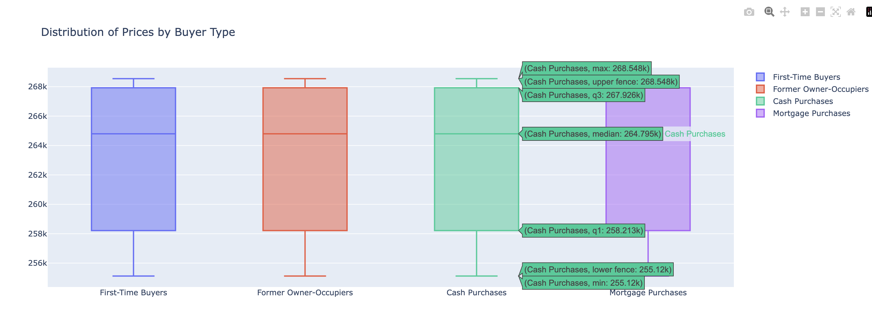
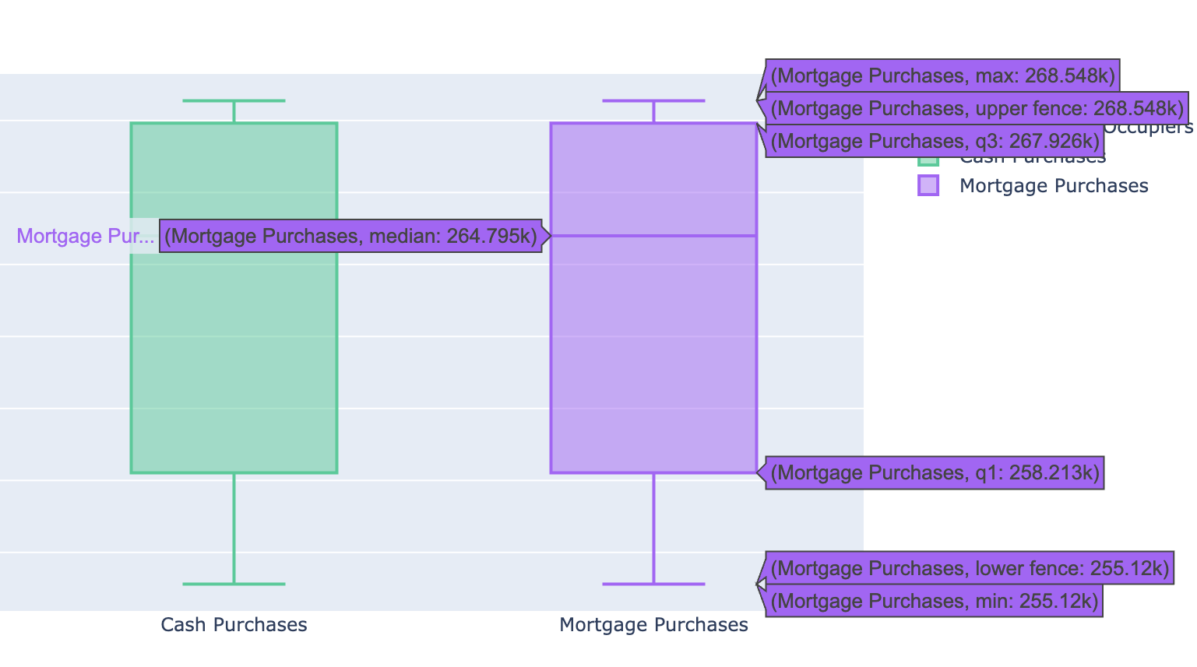
Distribution of Prices by Buyer Type
First-time buyers, mortgage buyers, cash buyers show similar median prices
Slight variance observed, but overall pricing is consistent
Notes:
Note: I discovered that pricing remained consistent across buyer categories. This suggests fair access across buyer groups and a well-balanced market. There may be no need for heavy buyer specific pricing segmentation in current conditions.

Slide 9
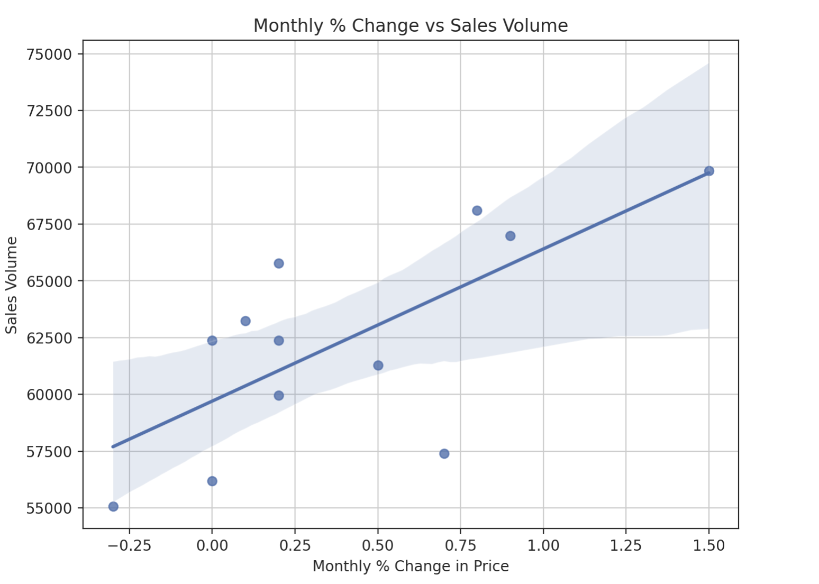
Price vs Sales Correlation
Price and sales volume show weak positive correlation (r ≈ 0.7)
Notes:
Note: My findings show that higher prices tend to align with higher sales volumes. This contradicts the traditional view that rising prices reduce demand. Stakeholders can remain confident in moderate price increases without fear of reducing sales.

Slide 10
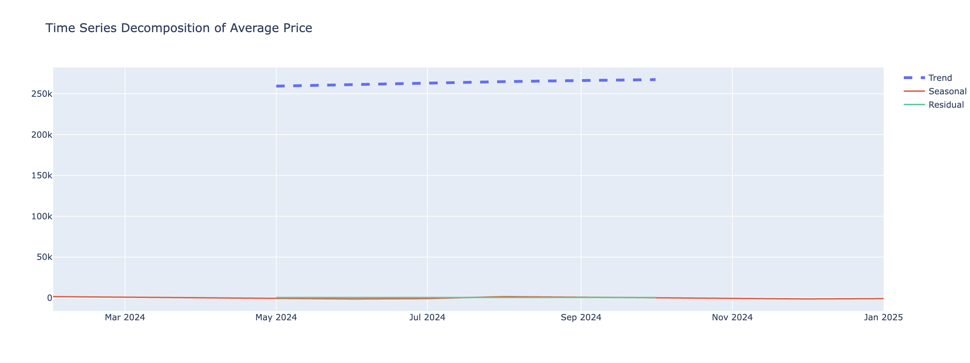
Time Series Decomposition
Strong upward trend
Minimal seasonality
Notes:
Note: I decomposed the time series and found a strong upward trend with minimal seasonal influence. The dominant trend component increases the reliability of forecasting. Stakeholders can use this insight to support long term strategic planning.

Slide 11
Predictive Modeling Summary
Linear regression: R² = 0.62
Random forest: R² = 0.93
Xgboost: R² = 0.69
Gradient boosting: R² = 0.98
Notes:
Note: I tested multiple models and found Gradient Boosting to be the most accurate with an R² of 0.98. This demonstrates that complex models better capture the pricing patterns in housing data. I recommend using ensemble models like Gradient Boosting for pricing forecasts.

Slide 12
Forecasting with ARIMA
ARIMA(1,1,0) used after log-transform
Forecasts feb–may 2025 prices ~£268,944 → £269,448 (steady growth)
Notes:
Note: I applied ARIMA after transformation and found it projected stable price growth. This supports the trends seen in my machine learning models. ARIMA can be used as a reliable tool for short-term forecasting and validation of ensemble models.

Slide 13
Summary of Insights
Steady price growth in 2024–25
New build premium is widening
Buyer type has little pricing effect
Gradient boosting model is most accurate
Forecast shows continued growth
Notes:
Note: I’ve summarised the main findings from this analysis, covering pricing trends, buyer behaviors, and predictive accuracy. These insights help stakeholders understand what drives price movement and how to respond. The data and models provide a foundation for smarter policy, pricing, and investment decisions.

Slide 14
Recommendations
This is a personal project I worked on to explore UK housing trends from 2024 to early 2025. I’ve applied data wrangling, exploratory analysis, Predictive modeling, visualization, and forecasting techniques to uncover patterns in pricing, buyer behavior, and market movement.
Notes:
Notes: Through this project, I developed my ability to work with real-world housing data and present clear, actionable insights. It gave me the opportunity to apply time series forecasting and interpret market behaviour in a practical way. Sharing this analysis helps demonstrate both my technical and communication skills.

Slide 15
Thank You
Questions welcome

