Slide 1


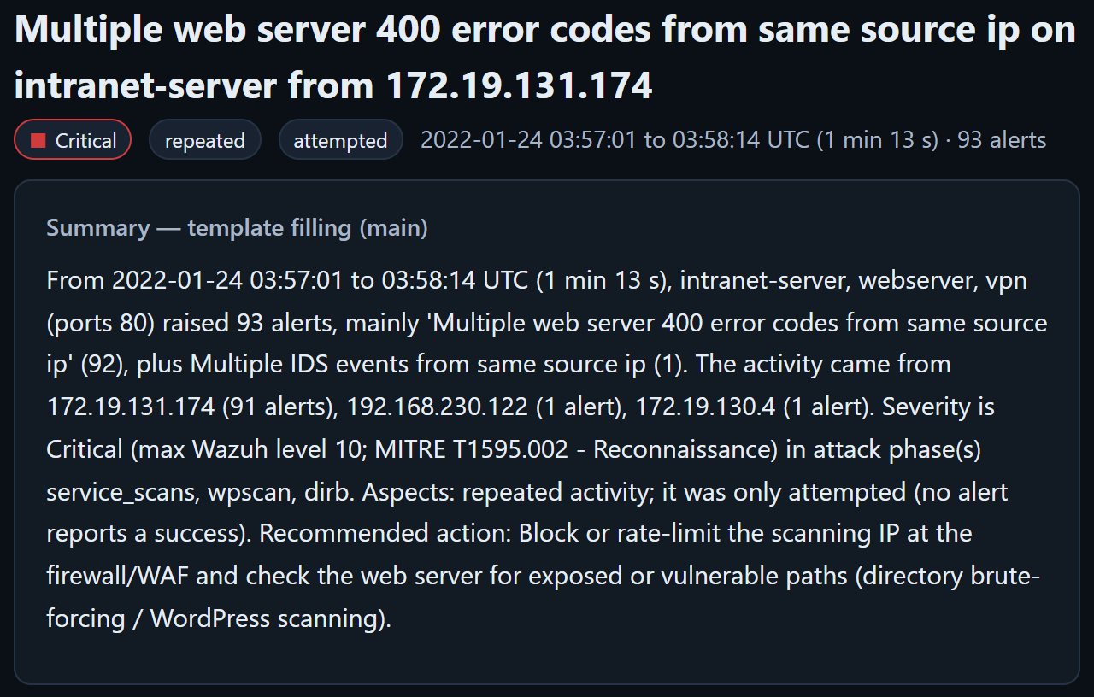
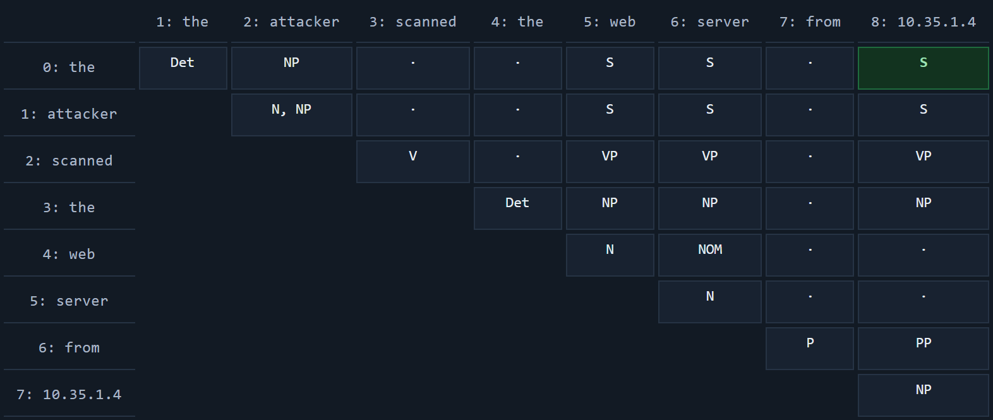


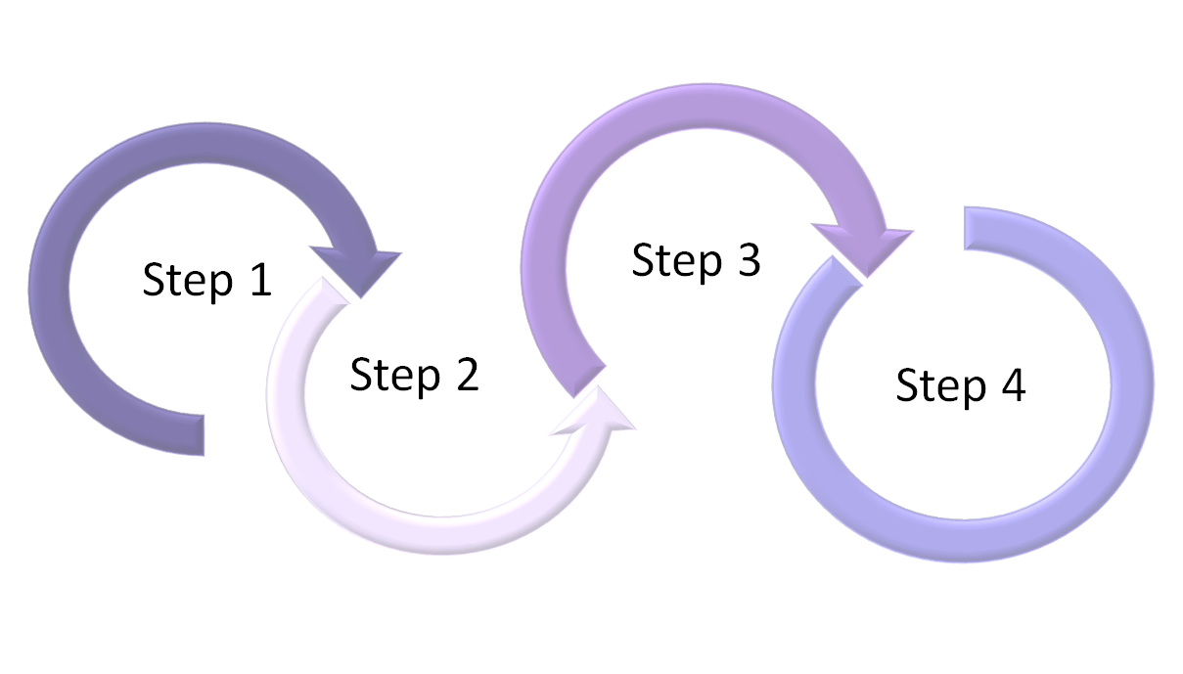
Cybersecurity Alert Summarizer
Abin Shaji Thomas URK24CS6007; Jinto Joseph URK24CS1210; BÉAL Elouan ISK26CS1005
Supervisor: Dr. Brindha D, Assistant Professor, Division of Computer Science and Engineering
Division of Computer Science and Engineering, Karunya Institute of Technology and Sciences | Course: 26CS301 Natural Language Processing
Introduction
Methods
Problem: SIEM and IDS tools raise thousands of near-identical alerts for a single attack, so analysts suffer alert fatigue and the real incident is easy to miss.
Data: AIT Alert Data Set (Landauer et al.): real Wazuh + Suricata alerts with labelled attack phases; scenarios russellmitchell (41,488 alerts) and shaw (68,539 alerts).
Objectives: group alerts into incidents; summarise each one (what, who, target, when, severity, next step); answer questions; run offline on a CPU.
Scope: all five NLP units in a React + FastAPI + SQLite web app, with an NLP Lab that shows every step.
Alert → sentence: each JSON alert becomes English, e.g. “At 09:40:06, host mail reported 'sshd: authentication success' for user jhall from 172.19.131.174 (level 3).”
Incidents: TF-IDF + k-means (k chosen by silhouette), split at 30-minute gaps.
Summary: template filling, with extractive and DistilBART baselines; a QA chatbot over the facts.
Own code: edit distance, bigram LM, Viterbi, CKY, Chu-Liu/Edmonds, PMI.
1 Unit I
Mask + bigram LM
2 Unit II
POS + security NER
3 Unit III
Parse + triples
4 Unit IV
TF-IDF incidents
5 Unit V
Summaries + QA
JSON alerts → sentences → NLP pipeline → SQLite → React UI
Results
Key findings
Alerts → incidents: russellmitchell 41,488 raw → 21,354 unique alerts → 214 incidents; shaw 68,539 → 30,732 → 444; bundled sample 1,515 → 1,467 → 18.
Purity: incidents match the attack phases with purity 0.835 and 0.974, above the one-group baseline of 0.624 and 0.822 (Fig. 4).
Language model: held-out perplexity is ∞ without smoothing and 8.31 / 11.30 with Laplace smoothing.
Faithful summaries: template summaries keep IPs, times and counts exact; DistilBART once shortened an IP address.
Speed: a full scenario runs in 37.3 s and 40.4 s on a laptop CPU.
Ask tab + PDF: questions are answered with supporting alerts; each incident exports as a PDF report.
React + Vite
web UI
FastAPI
REST API
NLP pipeline
Units I–V
SQLite
6 tables
Summary quality (ROUGE F1)
Summary | R-1 | R-2 | R-L
Template | 0.4630 | 0.1804 | 0.3095
Extractive | 0.3293 | 0.1621 | 0.2456
DistilBART | 0.3489 | 0.1661 | 0.2457
Fig. 1 System architecture (local, CPU only)
Mean F1 over 25 hand-written reference summaries; template row highlighted.
NER: micro F1 0.994 on 50 sentences.
Triples: precision = recall = 0.65 on 20 gold sentences.
HMM vs spaCy: POS agreement 0.678 (our Viterbi).
Tests: 19 pytest tests pass.
Fig. 2 Incident page with its template summary
Fig. 3 NLP Lab, Unit II: our CKY parse table
Fig. 4 Incident purity vs one-group baseline
Discussions
Conclusion
A local, explainable pipeline turns tens of thousands of raw alerts into a few hundred incidents with summaries that keep the facts exact.
Template filling beat the extractive and DistilBART summaries on every ROUGE score.
Limitations
Gold data was labelled by one annotator.
The NER score is optimistic: most test sentences follow our own template.
Two attackers doing the same thing at the same time merge into one incident.
Future work
Live alert streams instead of uploaded files.
Attacker-aware clustering.
Domain-trained models, plus translation and speech for Unit V.
Scan for the code and results
Dataset: Landauer et al., AIT Alert Data Set (AIT-ADS), Zenodo 8263181, CC BY 4.0. Code: github.com/Abin-Shaji-Thomas/Cybersecurity-Alert-Summarizer

