Slide 1
Secure Vault Password Manager
Presented by:
Abin Shaji Thomas

Slide 2
Abstract
SecureVault is a Java + SQLite based password manager. It securely stores login credentials, implements SHA-256 hashing with unique salt for authentication, provides a password generator and password strength checker.

Slide 3
Problem Statement
Users reuse weak passwords and often store them in insecure formats such as text files or browser autofill. This leads to unauthorized access and data breaches. SecureVault solves this problem by offering offline, secure credential storage.

Slide 4
Objectives
→ Secure storage of credentials
→ SHA-256 + Salt based authentication
→ Password generator
→ Password strength analyzer
→ User-friendly GUI using Swing

Slide 5
Methodology
Requirement Analysis → System Design → Implementation → Testing
Java Swing (UI Layer)
Application Logic Layer (Authentication, CRUD)
SQLite DB (Persistent Storage)

Slide 6
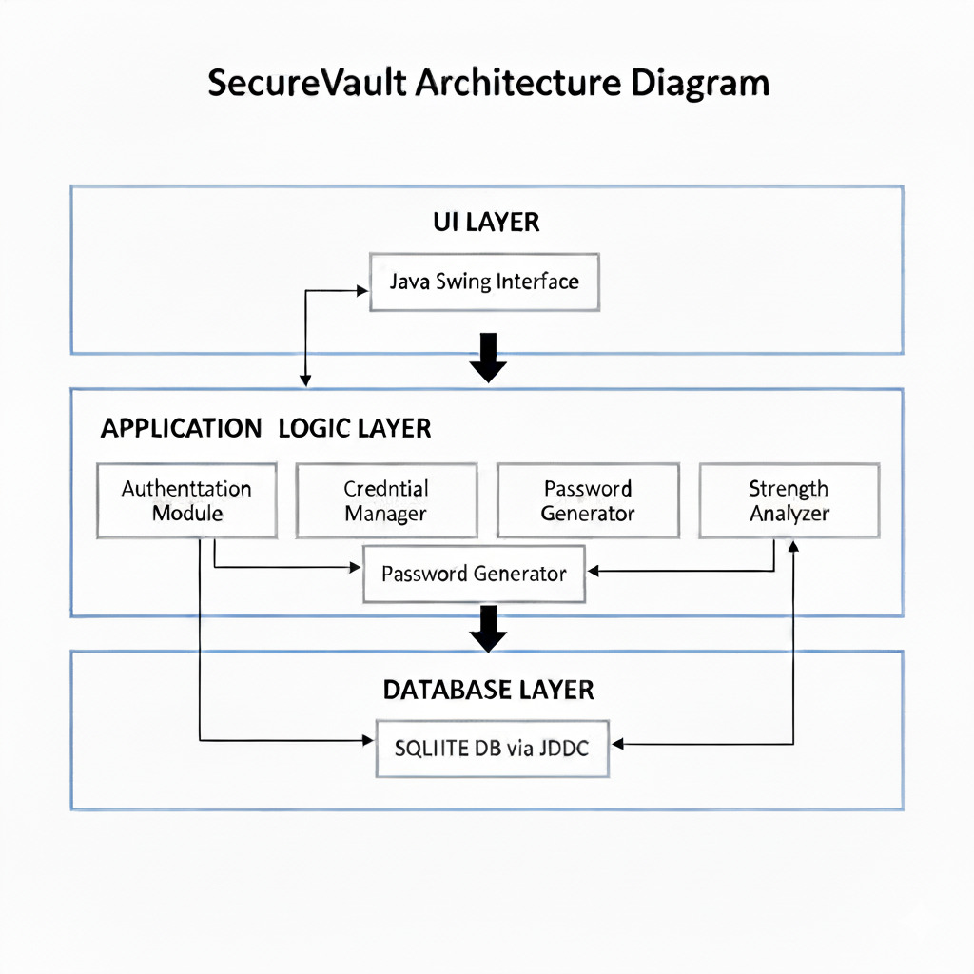
Architecture Diagram

Slide 7
CONCEPTS APPLIED
Object-Oriented Programming (OOP)
Classes like UserManager, Database, CredentialDialog, and StrengthChecker demonstrate encapsulation and modular design.
Graphical User Interface (GUI)
DesignBuilt using Java Swing components (JFrame, JPanel, JTextField, JTable, etc.) with layout managers for form-based UI.
Database Integration (SQLite + JDBC)
Application interacts with SQLite database using JDBC; credentials are stored permanently.
Security Concepts
Password hashing with SHA-256 + salt, password strength analysis, SecureRandom password generation.
Exception Handling
Used to avoid crashes while dealing with database connections, invalid input, and runtime errors.

Slide 8
Technologies Used
Technology / Tool | Purpose | Why Used
Java (JDK 17+) | Programming language | Platform independent, strong OOP support, rich Swing GUI library.
Java Swing | GUI framework | Desktop UI
SQLite Database | Credential storage | Lightweight, file-based
JDBC (sqlite-jdbc.jar) | Database connectivity layer | To connect and execute SQl queries
SecureRandom (Java security package) | Password generation | Generates Strong Secure Passwords
SHA-256 hashing + Salt | Secure authentication | Protects Passwords

Slide 9
Core Modules
Module | Description
User Authentication Module | Uses SHA-256 + unique salt to authenticate users securely without storing the password in plain text.
Credential Manager Module (CRUD) | Allows adding, editing, deleting, and viewing stored credentials from the SQLite database.
Password Generator Module | Generates strong random passwords using SecureRandom with customizable rules (length, characters, symbols).
Password Strength Analyzer Module | Analyzes password strength dynamically while typing and displays visual indicator (weak/medium/strong).
Clipboard Copy + GUI Interaction Module | Allows copying username/password securely using right-click context actions.

Slide 10
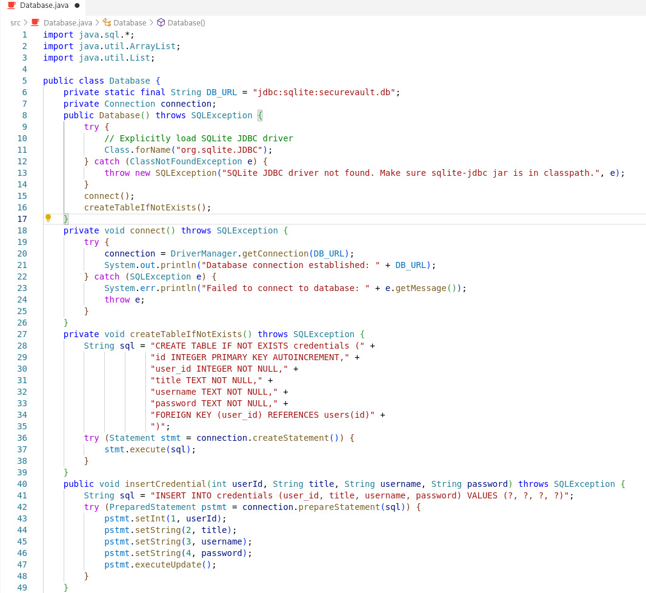
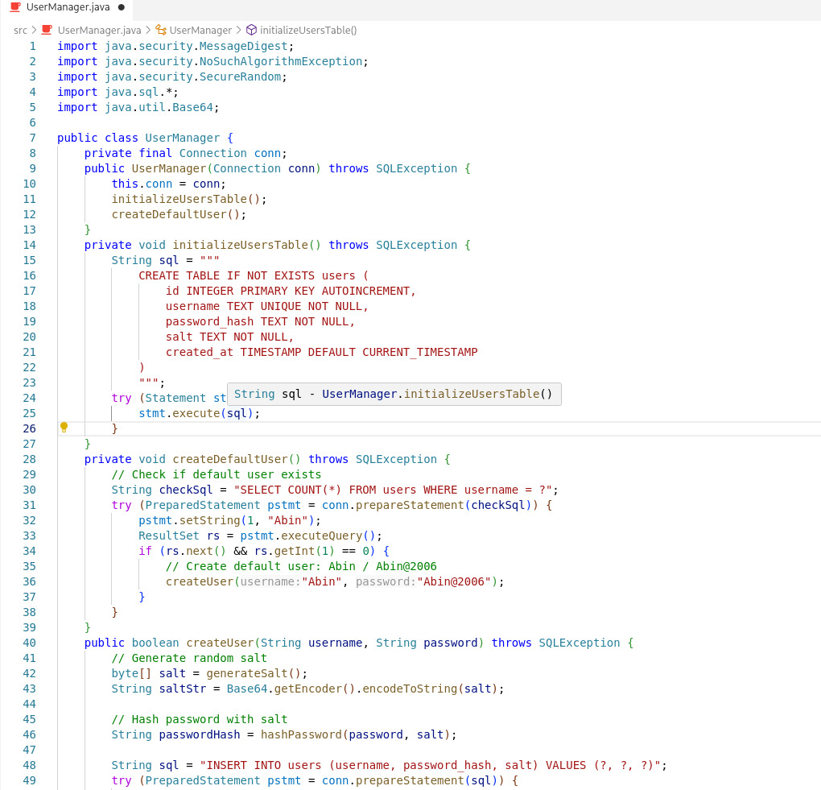
Coding Implementation
FOR DATABASE MANAGEMENT
FOR USER MANAGMENT

Slide 11

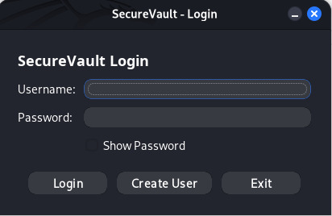
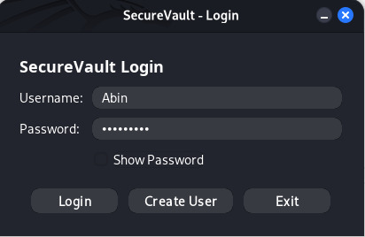
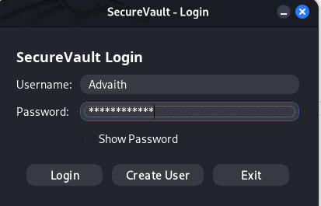
Output - Login Page

Slide 12

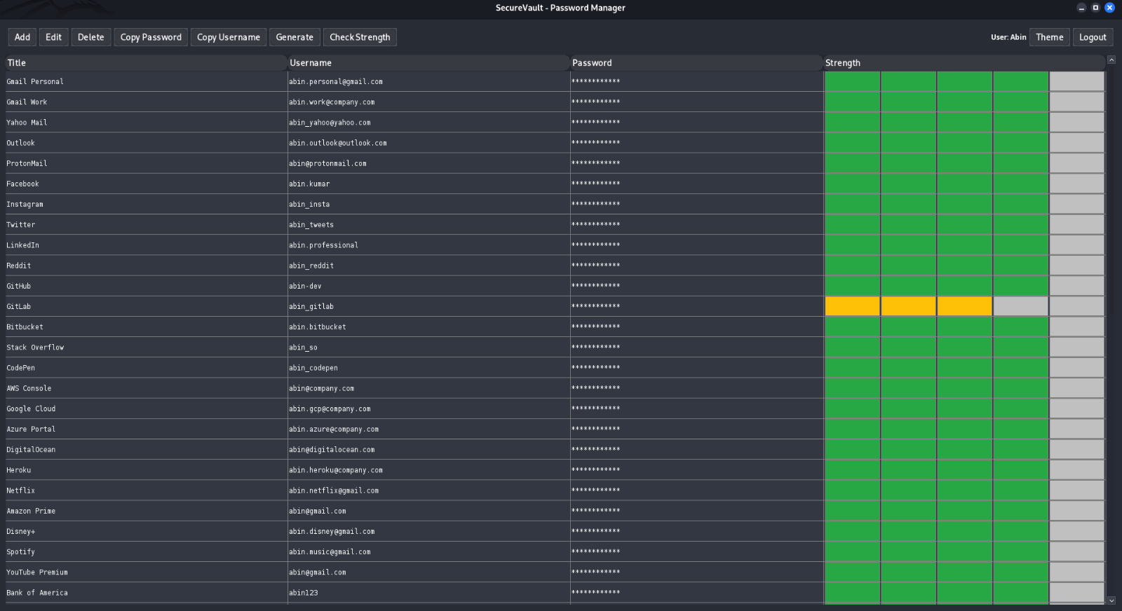
Output - Home Dashboard

Slide 13
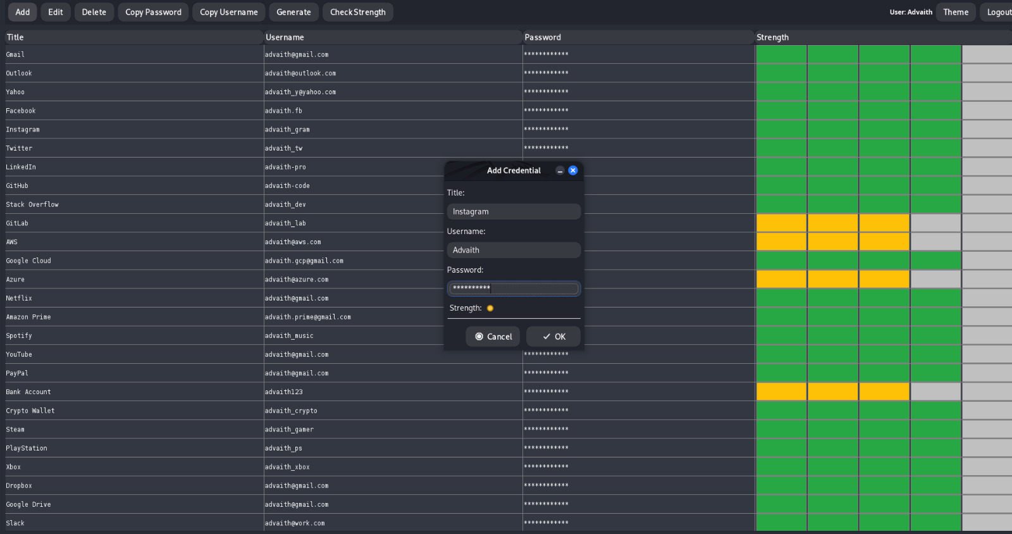
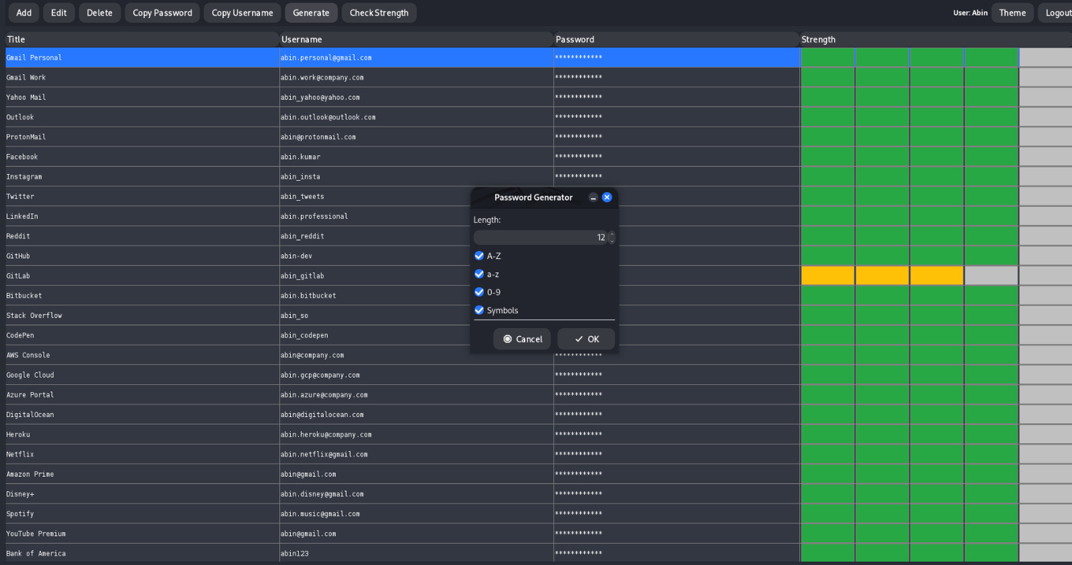
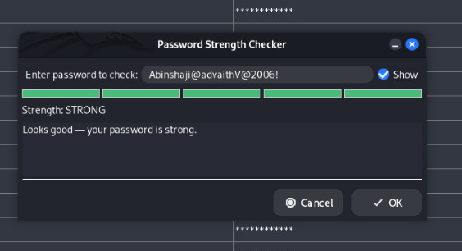
Output - Add Credential / Generator / Strength
ADD CREDENTIAL
PASSWORD GENERATOR
PASSWORD STRENGTH CHECKER

Slide 14
FUTURE ENHANCEMENTS
Add Multi-Factor Authentication (MFA) for improved account security during login.
Implement encrypted export/import of saved credentials for secure backup and restoration.
Support biometric authentication (fingerprint/Face ID) where supported by OS.
Build a browser extension (Chrome/Firefox) to auto-fill credentials directly on websites.

Slide 15
Conclusion
SecureVault successfully provides secure password storage, a strong authentication system, password generation, and easy-to-use GUI. Future enhancements include encrypted database password storage and multi-factor authentication.

Slide 16

Thank You

