Slide 1


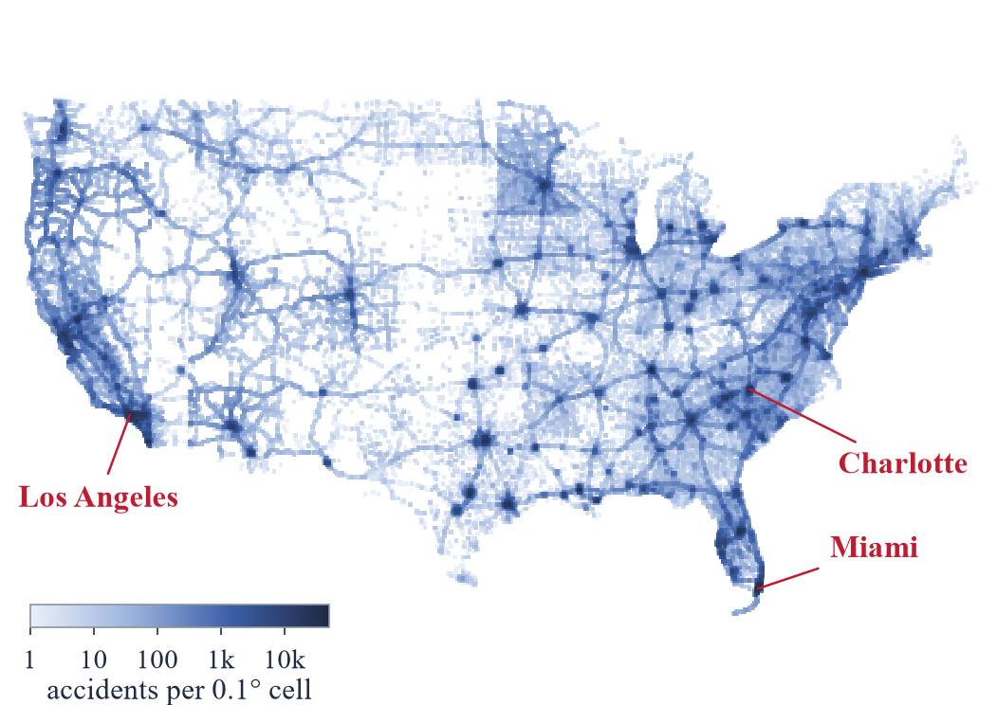
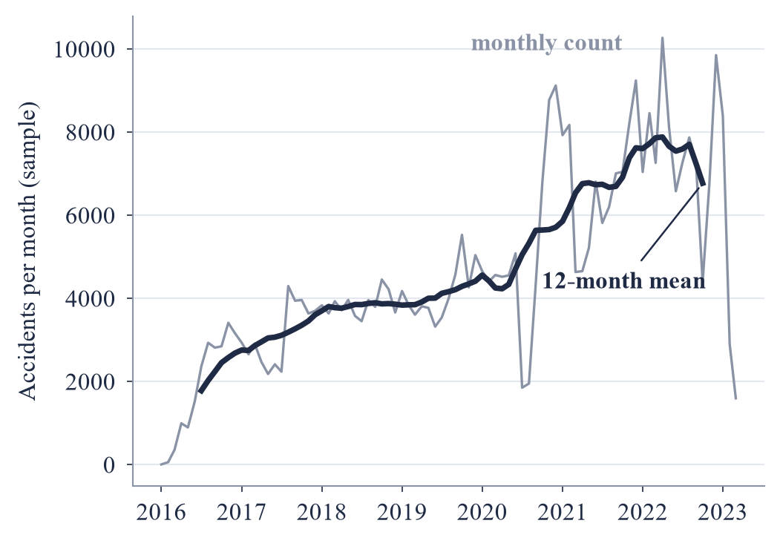
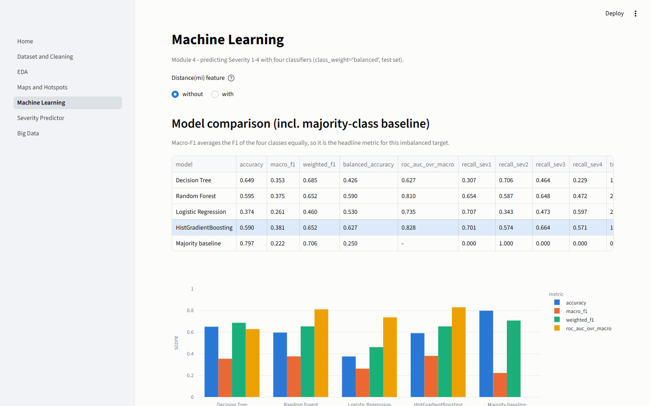



Smart Traffic Accident Analysis and Severity Prediction
Abin Shaji Thomas (URK24CS6007) | Jinto Joseph (URK24CS1210) | BÉAL Elouan (ISK26CS1005)
Supervisor: Dr. Anusha Bamini A M, Assistant Professor, Division of Computer Science and Engineering
Karunya Institute of Technology and Sciences | Course: Data Science Ecosystem (25CS305)
Introduction
Methods
Problem: road accidents block traffic and slow emergency response; estimating early how much an accident will disrupt traffic helps target police and recovery crews.
Data: US Accidents (Moosavi et al., Kaggle): 7,728,394 accident records, 2016-01-14 to 2023-03-31, with GPS, weather, time and road-feature attributes.
Objectives: clean the records and handle missing GPS values; measure weather influence; find accident hotspots; run correlation analysis; predict crash Severity (1–4).
Scope: five modules: Data Science Concepts, Exploratory Data Analysis, Data Visualization, Machine Learning, Big Data Analytics.
Ingest: 3.06 GB CSV read in chunks; stratified sample of 399,999 rows (random_state = 42).
Clean & features: duplicates and impossible values removed, outliers winsorized, End GPS imputed from Start, weather by State + month.
Models: Decision Tree, Random Forest, Logistic Regression, HistGradientBoosting; class-balanced, stratified 80/20 split, CV tuning.
Big data: MongoDB (2dsphere) and Hadoop-style MapReduce, cross-checked.
1
Data Science
Concepts
2
EDA
3
Visuali-
zation
4
Machine
Learning
5
Big Data
Analytics
CSV → Parquet → MongoDB / MapReduce → ML → Streamlit dashboard
Results
Key findings
Model comparison (test set)
Hotspots (accidents per 0.1° cell): Los Angeles, CA (50,254), Miami, FL (42,955), Charlotte, NC (36,259), Baton Rouge, LA (33,612)
Weather: Rain has the highest severe share (22.9%), Fog/Haze the lowest (15.8%); weak link (Cramér's V = 0.039).
Time pattern: Peak hours are 07:00 and 16:00; a weekend day averages 53% fewer accidents than a weekday.
Predictors: Start_Lng, City and Start_Lat lead the permutation importance; Year excluded as a collection artifact.
Missing GPS: no Start GPS was missing; 176,088 End coordinates (44.1% of 399,581 records) were imputed from the Start point.
Model | Accuracy | Macro-F1 | ROC-AUC
Decision Tree | 64.9% | 0.353 | 0.627
Random Forest | 59.5% | 0.375 | 0.810
Logistic Regression | 37.4% | 0.261 | 0.735
HistGradientBoosting | 59.0% | 0.381 | 0.828
Majority baseline | 79.7% | 0.222 | n/a
MongoDB: 399,581 documents, 2dsphere index; 10 queries timed with / without indexes.
MapReduce: 4 splits, 4 maps, 2 reducers; all 3 jobs match pandas and MongoDB.
Fig. 1 Accident density, all 7.7 million records
Fig. 2 Monthly accidents, 12-month mean
Fig. 3 Streamlit dashboard (ML page)
Discussions
Conclusion
Limitations
Future work
HistGradientBoosting gave the best result (macro-F1 0.381, accuracy 59.0%).
All models fall below the 79.7% baseline accuracy, so macro-F1 is used; it finds 66% of Severity 3 and 57% of Severity 4 accidents.
Severity classes are imbalanced, so macro-F1 is reported next to accuracy.
Models were trained on a sample, not on all records.
Weather is taken from the nearest weather station, so it is approximate.
Real-time severity alerts from streaming data.
Spark MLlib on all records instead of a sample.
Add road-network and traffic-volume features.
Scan for the code and results
Dataset: Moosavi et al., US Accidents (Kaggle), CC BY-NC-SA 4.0. Code: github.com/Abin-Shaji-Thomas/Smart-Traffic-Accident-Analysis-and-Severity-Prediction

