Slide 1



NITK-CMU JOINT WINTER SCHOOL IPTSE TEXT BASED EMOTION RECOGNITION SYSTEM
DHRUV GOEL JINANK JAIN SKAND ARORA SATISH

Slide 2
APPROACH TILL NOW..
Test our smaller dataset and classify them on the basis of emotions
Use word2vec tool and try to come up with some similarity/pattern between semantically similar words such that they are similar on an emotional level as well.

Slide 3
ANALYSIS USING NLTK TOOL
EMOTION | TRAINING DATA SIZE | TESTING DATA SIZE | ACCURACY
JOY | 1107 | 540 | 76.59%
DISGUST | 611 | 540 | 16.60%
SADNESS | 821 | 540 | 36.67%
ANGER | 903 | 540 | 27.60%
GUILT | 1075 | 540 | 60%
FEAR | 741 | 540 | 40.87%

Slide 4
ANALYSIS OF PARTS OF SPEECH
Concept
Not all words contribute to the level emotion in a sentence.
Certain parts of speech specifically contribute to the emotion level in a sentence.
Means of Analysis
POS Tagger- It tokenizes as well as indicate various parts of speech.

Slide 5
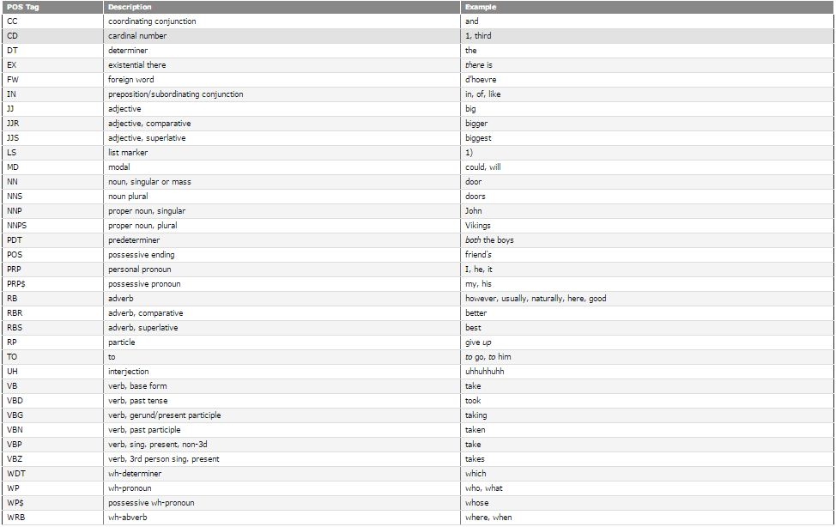

Slide 6
ANALYSIS OF PARTS OF SPEECH
PARTS OF SPEECH TO BE CONSIDERED | PARTS OF SPEECH NOT TO BE CONSIDERED
Adjectives-(superlative, comparative) | Cardinal Numbers
Adverbs-(superlative, comparative) | Determiners
Verbs (root verbs) | Foreign Words
Personal/Possessive Pronouns | Preposition
Particles (eg: give up, broke down) | List marker
Interjections (Alas, Hooray) | Modal
Punctuations | Pre-determiner
Conjunctions | Proper Nouns
Nouns | Stop Words

Slide 7
IMPLEMENTATION
POS Tagging
Stop words elimination (without eliminating conjunctions)
Lemmatization
Data set expansion using word2vec
Separate heuristics for:
Conjunctions
Punctuators
Particles secondary
Interjections indicators
Personal/Possessive Pronouns

Slide 8
IMPLEMENTATION
Assigning Weights (based on analysis)
Verbs, Adjectives, Adverbs
Secondary indicators
Nouns
Calculating the percentage contribution to every emotion by summing up the scores of each word.
If a particular word is found not to be present in our extended dataset then we feed that word into word2vec and get the words which are semantically closest and assign emotional weights to them.

