Slide 1



NITK-CMU JOINT WINTER SCHOOL IPTSE TEXT BASED EMOTION RECOGNITION SYSTEM
TEAM MAP
DHRUV GOEL SKAND ARORA SATISH

Slide 2
APPROACH
We tokenized sentence input and assigned emotions to each of the words.
In our previous approach we assigned emotions based on word2vec tool.
In our approach to expand the dataset we fed words of known emotions to the word2vec tool and got its semantically similar word and based on its degree of positivity/negativity we classified them into the emotion of the input word.

Slide 3
LIMITATIONS
Out of the 6 emotions 4 were more negative in nature compared to the other 2 as a result of which the classifier was not able to differentiate between these 4 emotions.
Hence we were not able to successfully expand the dataset.
Moreover, this approach was more static in nature and was against our objective of finding emotions based on the intensity of sentiments.
For example: differentiating between anger and disgust

Slide 4
OBJECTIVE-CONTEXT BASED APPROACH
Input any unknown word to the word2vec tool and find out its context based vector representations by using CBOW/SG models.
Map these vector representations to the vector representations of our emotionally classified dataset.
On comparing the vectors we minimized the distance between the vectors to assign their emotional class.
This approach is similar to reverse mapping

Slide 5
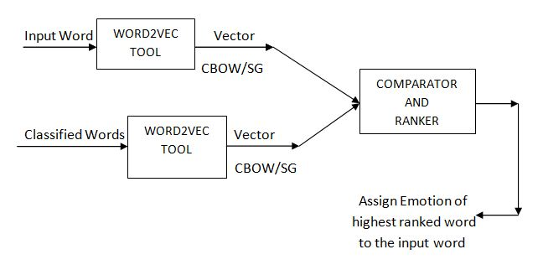
EXPERIMENTATION

Slide 6
IMPROVISATION
We observed that certain unknown words didn’t have a likely match to any of the classified words in our dataset.
We tried to learn more emotionally similar words by feeding a list of words from various datasets that had unclassified words.
From this we made our system learn the emotion expressed by those words.
We need an approach to correct the words that have been incorrectly classified based on our initial assumption that the least distant word vectors are emotionally closer.

Slide 7
WEIGHTING SCHEMES
We now have the emotions of words, however to find overall emotion of a sentence based on the context we need to assign weights to each of the words.
We plan to use a neural network based approach in which the appropriate weights are learnt by the network based on the already classified sentence dataset that we have.

