Slide 1



NITK-CMU JOINT WINTER SCHOOL IPTSE TEXT BASED EMOTION RECOGNITION SYSTEM
TEAM MAP
DHRUV GOEL SKAND ARORA SATISH

Slide 2
TASKS
Formulate the results obtained by emotion recognition using word2vec
Study of recursive neural vectors and of how they can be used in emotion recognition
Expanding the dataset

Slide 3
Results
EMOTION | % DATASET 1 | % DATASET 2
Joy | 80.49 | 69.64
Anger | 24.11 | 23.01
Disgust | 18.41 | 22.20
Sadness | 23.40 | 23.21
Fear | 28.11 | 36.26
Surprise | 14.44 | 17.73
After POS (SET2)
59.87
32.55
19.20
30.98
33.64
24.52

Slide 4
Recursive neural tensor networks
They have a tree-like structure with a neural net at each node.
Word vectors are used as features and serve as the basis of sequential classification. They are then grouped into sub-phrases, and the sub-phrases are combined into a sentence that can be classified by emotions or any other metrics.

Slide 5
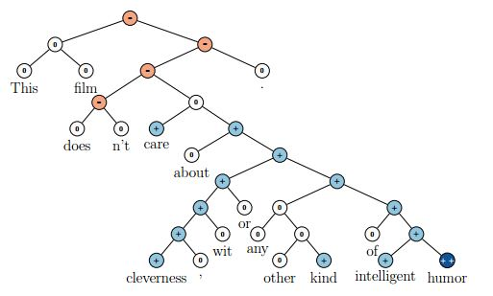

Slide 6
IMPLEMENTATION STEPS
Convert words into vectors
Tokenize sentences
Read certain parts of speech only
Parse sentences into their constitutional sub-phrases
Binarize the tree
Combine the word vectors with neural network
Classification

Slide 7
Expanding the dataset
2 datasets that have words that purely express emotions
Dataset 1 is from movie reviews, electronic gadgets reviews and cooking recipes
Dataset 2 has 2178 words that can express emotions.
However, these are not classified into different emotions.

Slide 8
MISCELLANEOUS
Cleaning our present database. Eliminating the ambiguities, grammatical errors.
Formulating sentences and asking fellow participants to classify them into different emotions. 20 sentences per person will make it 800 sentences approximately.
Using sentences acquired by We Feel Fine and classify them into emotions.

