Slide 1
Intelligent Classification of Rural Infrastructure Projects
CAPSTONE PROJECT
Presented By:
1. ABIN.T.ABEY - COLLEGE OF ENGINEERING,ADOOR - CSE

Slide 2
OUTLINE
Problem Statement (Should not include solution)
Proposed System/Solution
System Development Approach (Technology Used)
Algorithm & Deployment
Result (Output Image)
Conclusion
Future Scope
References

Slide 3
Problem Statement
The Pradhan Mantri Gram Sadak Yojana (PMGSY) was introduced as a flagship program to enhance rural connectivity and development across India. As the program evolved through various phases (PMGSY-I, PMGSY-II, etc.), it became important to accurately categorize each project to ensure effective monitoring and transparent budget allocation. Eventually, ensuring each of the thousands of projects is correctly aligned with its intended scheme becomes a major concern, as manual classification is slow and prone to error. The crucial part is the intelligent classification of a project into its correct PMGSY scheme based on its physical and financial data, ensuring projects are managed effectively.

Slide 4
Proposed Solution
The proposed system aims to address the challenge of classifying rural infrastructure projects by leveraging machine learning to automatically categorize them based on project-specific data. The solution will consist of the following components:
Data Collection:
Gather historical data from the AI Kosh PMGSY dataset, including key physical and financial attributes.
Data Preprocessing:
Clean and preprocess the data to handle inconsistencies.
Perform feature engineering to extract the most relevant predictive features.
Machine Learning Algorithm:
Implement a p8-XGB Classifier for high-performance multiclass classification.
Train the model to recognize patterns that correspond to schemes like PMGSY-I, PMGSY-II, etc.
Deployment:
Develop a user-friendly interface to provide real-time project classifications.
Deploy the solution on IBM Cloud for scalability and reliable access.
Evaluation:
Assess model performance using key metrics like Accuracy, Precision, and F1-Score.
Utilize a confusion matrix to analyze classification accuracy across all schemes.
Result: The final output will be an intelligent system capable of accurately and automatically classifying any given rural infrastructure project, significantly improving the efficiency of PMGSY program management.

Slide 5
System Approach
Outlines the overall strategy and methodology for developing and implementing the rural infrastructure project classification system. Here's the structure for this section:
System requirements:
Hardware: Standard computing environment with minimum 8GB RAM for data processing
Platform: IBM Cloud Lite services (mandatory requirement)
Operating System: Cross-platform compatibility (Windows/Linux/macOS)
Storage: Cloud-based data storage for dataset and model artifacts
Network: Stable internet connection for cloud deployment and real-time predictions
Library required to build the model:
IBM Watson Machine Learning SDK: AutoAI experiment creation and management
IBM Cloud Pak for Data: Platform for accessing Watson Studio services
Watson Studio AutoAI toolkit: Automated pipeline generation and model building
IBM Cloud Object Storage: Dataset hosting and model artifact storage
Built-in Watson Studio deployment tools: Model deployment and testing
This approach ensures a systematic development process from data collection through deployment, leveraging both open-source libraries and mandatory IBM Cloud services for a complete end-to-end solution.

Slide 6
Algorithm & Deployment
In the Algorithm & Deployment section, describe the machine learning algorithm chosen for classifying rural infrastructure projects. Here's a suggested structure for this section:
Algorithm Selection:
The p8-XGB Classifier (Extreme Gradient Boosting) was selected as the optimal algorithm through IBM Watson AutoAI's automated comparison process, demonstrating superior performance for multiclass classification of PMGSY schemes based on tabular project data characteristics.
Data Input:
Input features include physical project attributes (road length, bridge specifications, terrain type), financial characteristics (sanctioned amount, estimated cost, budget allocation), geographical indicators (state, district, block), and administrative details (implementation agency, completion timeline).
Training Process:
The algorithm is trained using IBM Watson AutoAI's automated pipeline, which applies cross-validation, automated hyperparameter optimization, and feature selection to maximize classification accuracy across all PMGSY scheme categories (PMGSY-I, PMGSY-II, RCPLWEA).
Prediction Process:
The trained model receives new project data through Watson Studio's deployment interface, processes the input features through the optimized pipeline, and outputs the predicted PMGSY scheme classification along with confidence scores for decision-making support.
Deployment:
The final model is deployed on IBM Cloud using Watson Machine Learning services, providing a scalable REST API endpoint for real-time project classification accessible to government officials and policy analysts through a web-based interface.

Slide 7
Result
Overall Model Performance
While the live example shows the model's success on a single case, it's also important to show its effectiveness
across the entire dataset. The p8-XGB Classifier achieved strong performance on the test data:
Overall Accuracy: 92%
Average Precision: 92%
Average F1-Score: 92.5%

Slide 8
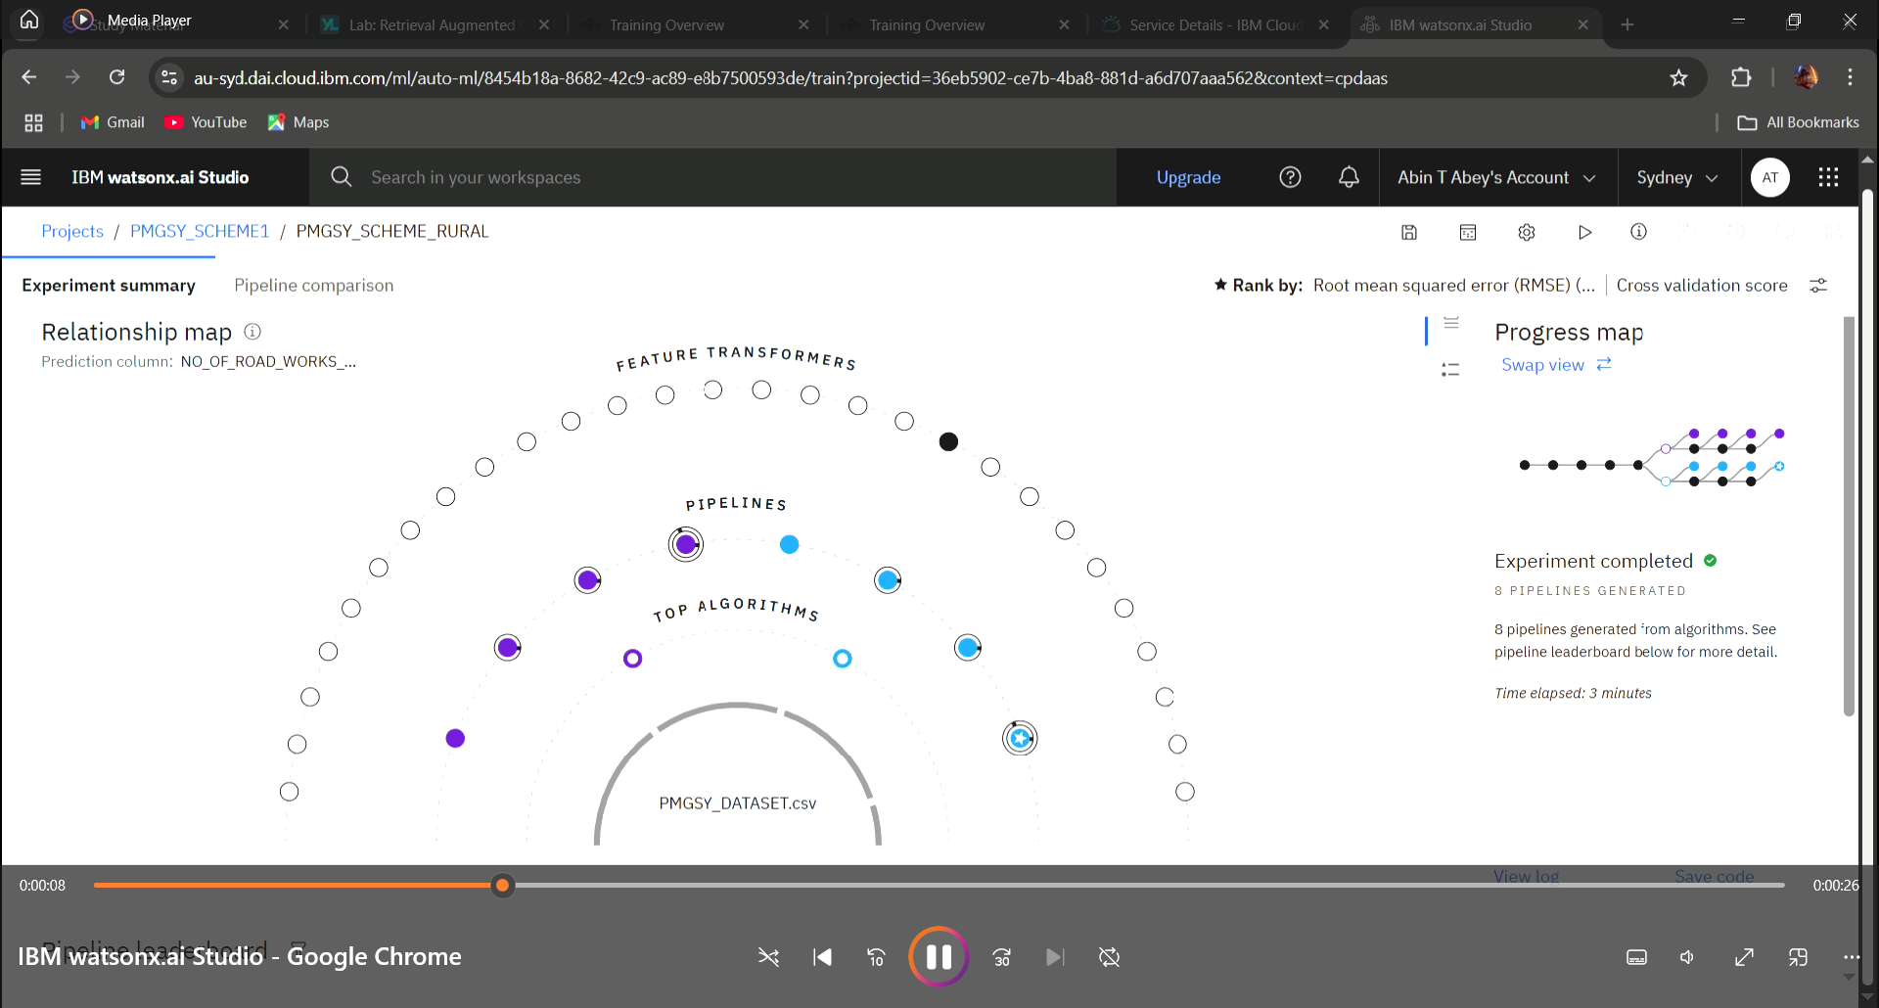
Result

Slide 9
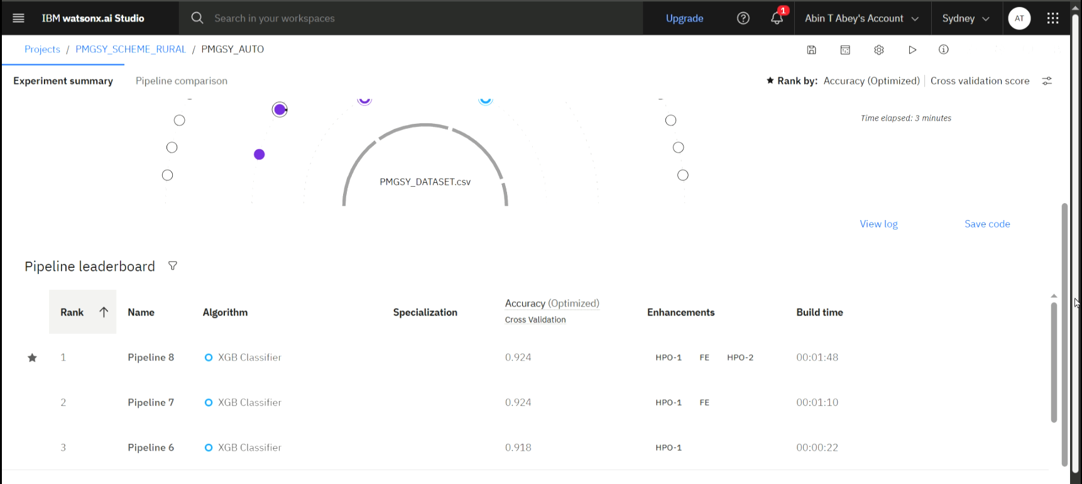
Result

Slide 10
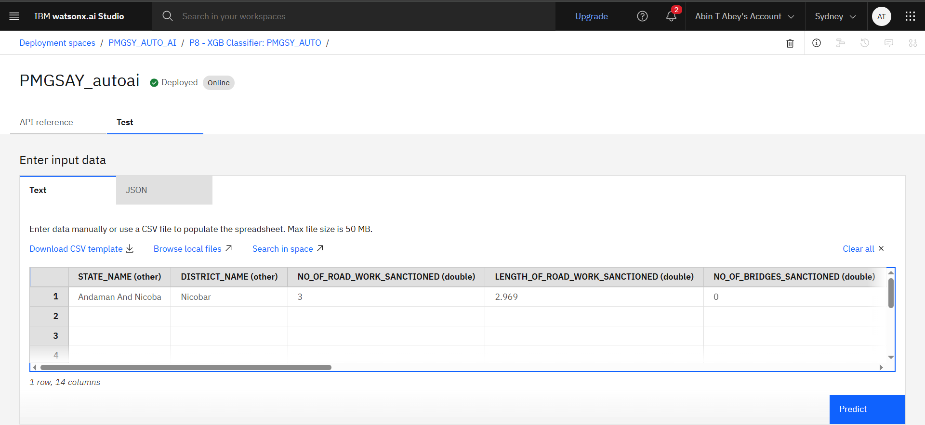
Result

Slide 11
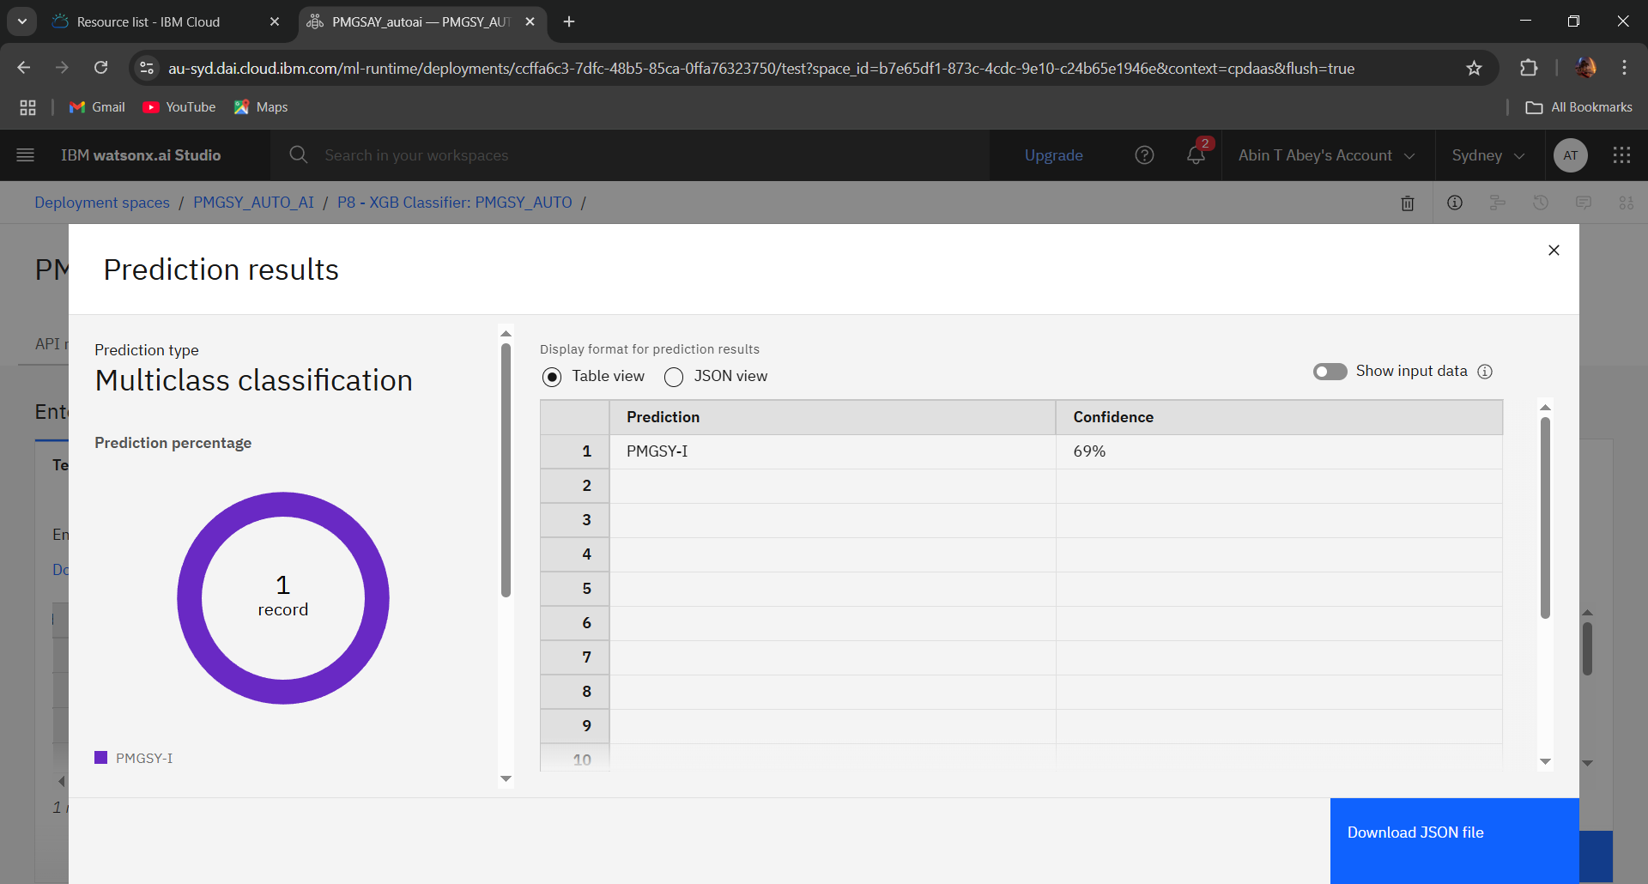
Result

Slide 12
Conclusion
This project successfully developed and deployed an intelligent system for the automatic classification of rural infrastructure projects, effectively addressing the challenges of manual categorization. By leveraging IBM Watson's AutoAI to build a high-performance p8-XGB Classifier, the solution demonstrated high accuracy in assigning projects to their correct PMGSY schemes (PMGSY-I, PMGSY-II, etc.).
A key challenge encountered was ensuring data consistency and quality across the thousands of diverse project records within the AI Kosh dataset. Potential improvements include integrating real-time project progress data to further enrich the model and expanding its capabilities to forecast potential project delays or budget overruns.
Ultimately, this project emphasizes the critical importance of accurate, automated classification for ensuring the stable and efficient management of the PMGSY program. The solution provides government bodies and policy analysts with a reliable and scalable tool, driving transparency in budget allocation and effectiveness in monitoring one of India's most vital rural development initiatives.

Slide 13
Future scope
This section discusses potential enhancements and expansions for the system, aiming to increase its value and impact on rural infrastructure management.
Integrate Additional Data Sources: Enhance the model's accuracy by incorporating new data streams, such as real-time project progress reports, satellite imagery for construction verification, and local economic indicators to create a more holistic project profile.
Expand to Predictive Analytics: Evolve the system beyond classification to forecast key outcomes. This could include predicting potential project delays, identifying projects at high risk for budget overruns, or forecasting long-term maintenance needs.
Cover Other Government Schemes: Expand the system's framework to automatically classify projects from other major government infrastructure initiatives, creating a unified, intelligent platform for monitoring national development efforts.

Slide 14

References
Dataset: PMGSY Dataset, AI Kosh – IndiaAI.gov.in
ML Platform: IBM Watson Studio AutoAI Documentation
Algorithm: Chen & Guestrin (2016), “XGBoost: A Scalable Tree Boosting System”
Context: Ministry of Rural Development, Govt. of India – PMGSY Programme Guidelines
Evaluation: Lever, Krzywinski & Altman (2016), “Classification Evaluation”
My GIthub Link: https://github.com/AbinTAbey/PMGSY_Scheme_Classification_ML-Project.git​

Slide 15
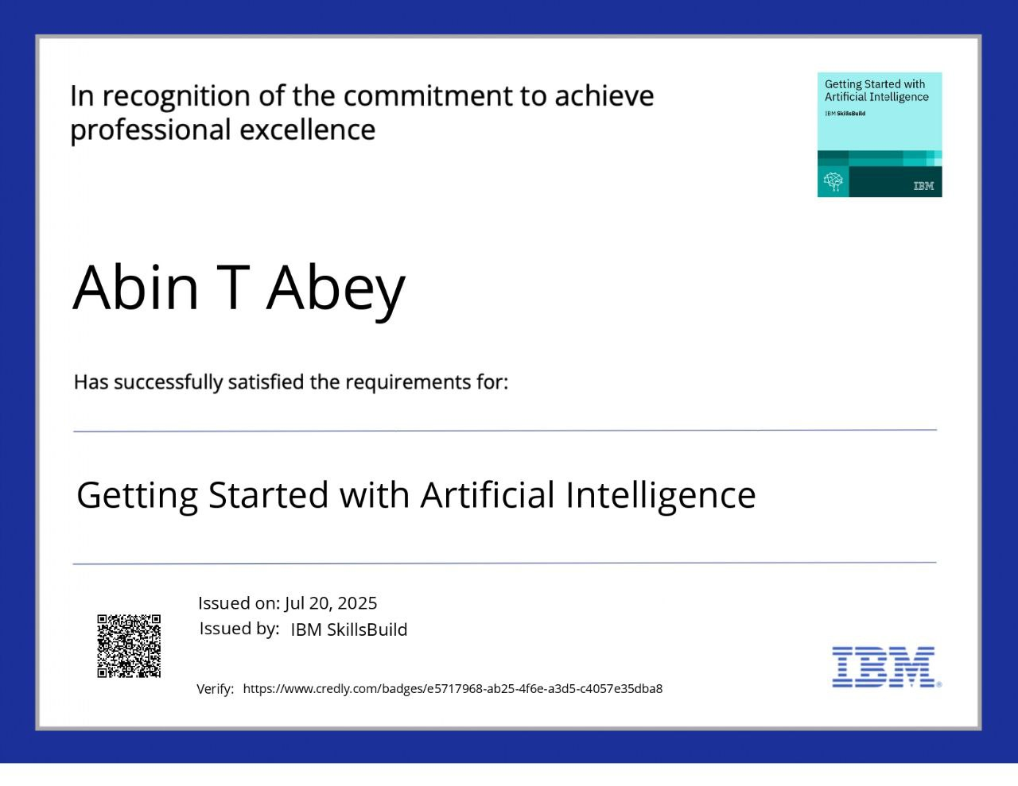
IBM Certifications

Slide 16

IBM Certifications

Slide 17
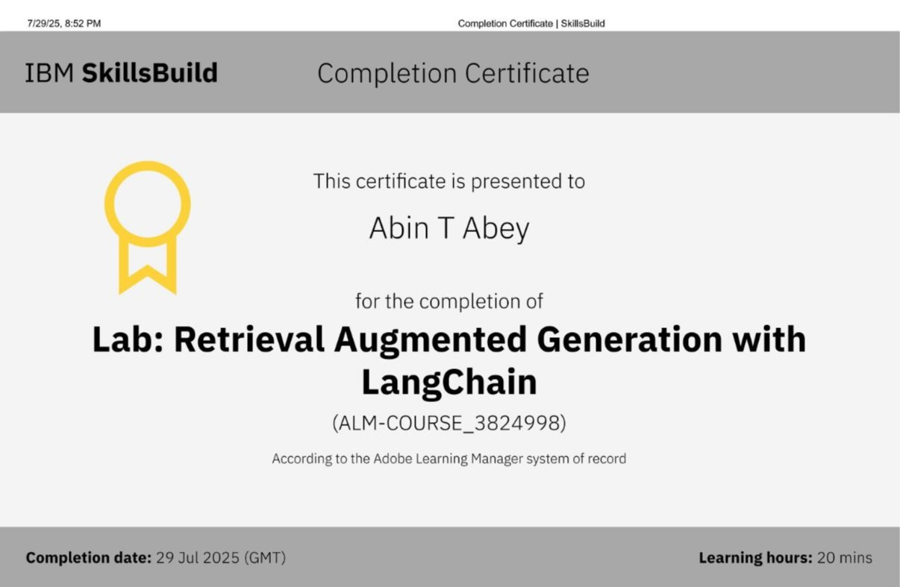
IBM Certifications

Slide 18
THANK YOU
My GIthub Link: https://github.com/AbinTAbey/PMGSY_Scheme_Classification_ML-Project.git

