Slide 1
Swarm Intelligence for Disaster Response
ENGINEERING SEMINAR
Seminar Title
Swarm Intelligence for Disaster Response: Adaptive Coalition-Based Task Assignment and Path Planning in Multi-UAV Systems Using Meta-Reinforcement Learning
Presented by
Abin Varghese
Adaptive Coalition-Based UAV Coordination with Meta-Reinforcement Learning
Roll Number
AJC23CS006
Guide
Dr. Jacob John
Department
Computer Science and Engineering
Institution
Amal Jyothi College of Engineering (Autonomous), Kanjirappally
Date
October 2026
Based on: Poudel & Moh, Internet of Things 37 (2026) 101930
Notes:
Good morning. I am Abin Varghese, S7 CSE. My seminar covers adaptive coalition-based UAV coordination for disaster response, under Dr. Jacob John, based on Poudel and Moh, Internet of Things, March 2026.

Slide 2
Contents
1
Introduction
6
Methodology — Experimental Setup
2
Existing Works / Literature Survey
7
Results — Reward, Convergence & Speed
3
Objectives
8
Results — Energy, Fairness, Safety & Comparison
4
Methodology — System Model & Coalition Formation
9
Conclusion & Future Work
5
Methodology — Pipeline Architecture & Learning
10
References
Notes:
Roadmap: motivation, literature gaps, objectives, the RCTP method, results, and conclusion with future work.

Slide 3
Introduction
SECTION 1
Why Autonomous UAV Swarms Matter
Golden window: survival odds drop sharply after about 72 hours; blocked roads and rubble slow ground teams.
Single-drone limits: short battery endurance, narrow sensing, and a single point of failure.
Swarm advantage: heterogeneous UAVs search, assess and deliver in parallel across large zones.
Research gap: existing methods need centralised control, fixed task sets, or stable links, and fail under UAV loss.
72 hrs
Critical window for locating survivors
10–30 UAVs
Heterogeneous swarm size in the simulations
30–40%
Faster mission completion than RL baselines
Notes:
In the first 72 hours after a disaster survival chances fall sharply, while roads and communications are damaged. A single drone has limited endurance and is a single point of failure. A heterogeneous swarm covers ground in parallel, but coordinating it without a central server under intermittent links is the open problem this paper addresses.

Slide 4
Existing Works / Literature Survey
SECTION 2
Paradigm | Main idea | Key limitation
Coalition games [4, 14, 19–22] | Fair, distributed team formation | Static assumptions; no real-time learning or path planning
Priority heuristics [10, 12] | Urgency-based task assignment | No dynamic reassignment or learning
PSO / GA path planning [30, 31] | Metaheuristic routing and sequencing | Weak real-time replanning; ignore coordination
DQN / PPO / MADDPG [13, 25–27] | Learned task and path policies | Slow adaptation; no meta-learning
Joint MARL [32, 35] | Task assignment + path planning together | Single-level training; no explicit fault tolerance
Proposed RCTP (2026) | MAML + MA-DDPG, coalitions, priorities, 3D paths | End-to-end, few-shot adaptation, self-healing
Bracketed numbers are reference indices from the base paper (Table 1).
Notes:
Prior work treats coalition formation, task assignment and path planning in isolation. Heuristics and games assume static settings; RL methods train on fixed task distributions and need retraining. RCTP unifies all three with meta-learning.

Slide 5
Objectives
SECTION 3
1
2
3
Rapid meta-adaptation
Dynamic coalitions
Priority scheduling
Use MAML so swarms adapt to new disaster scenarios with only a few gradient updates.
Form resource-aware teams using an interpretable suitability score.
Serve urgent tasks first while balancing workload (Jain’s fairness).
4
5
6
Continuous 3D control
Online fault tolerance
Real-time feasibility
Use MA-DDPG for smooth speed, heading and climb actions, avoiding discretisation.
Detect UAV failures and reassign tasks immediately, with connectivity-aware replanning.
Keep onboard inference lightweight: below 20 ms per control step on an ARM processor.
Notes:
Six goals: rapid adaptation via MAML, resource-aware coalitions, priority scheduling with fairness, continuous 3D control, online fault tolerance, and millisecond-level inference on embedded hardware.

Slide 6
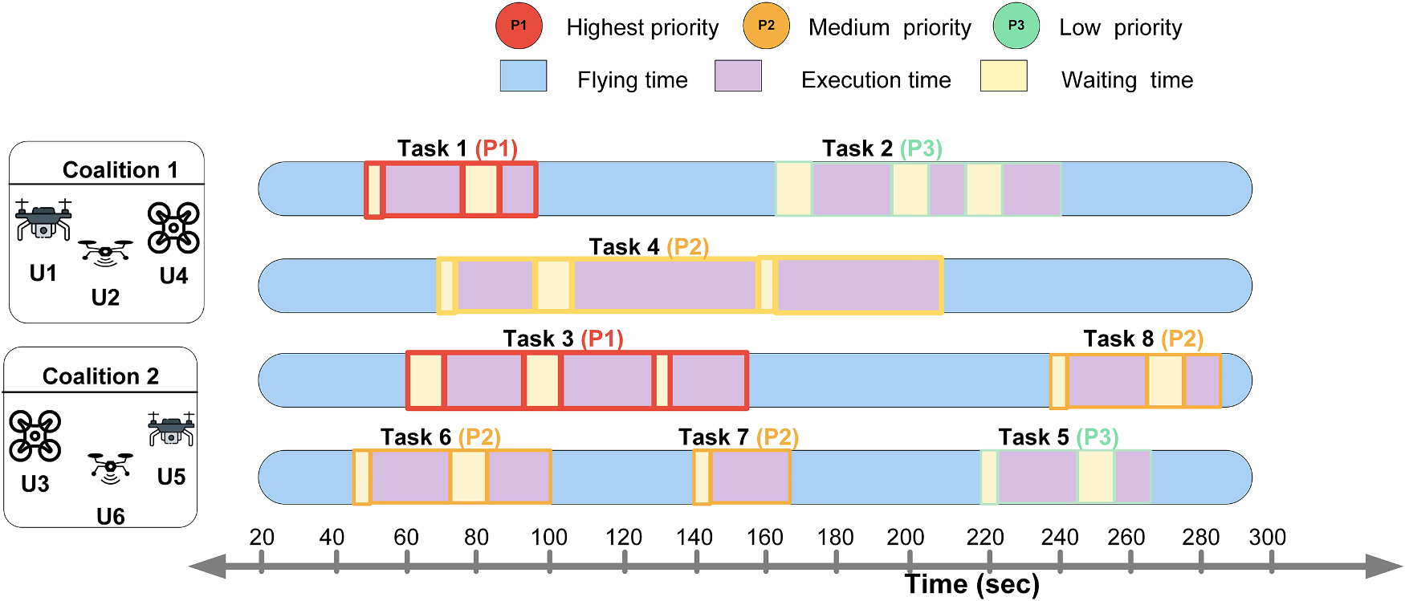
System Model: Heterogeneous Fleet
SECTION 4 · METHODOLOGY
1 Local sensing
Position, velocity, battery, obstacles, task states; noisy and partial.
2 Status exchange
Short-range neighbour sharing over intermittent LoS/NLoS links.
3 Suitability & coalitions
Score UAV-task pairs online; form teams without a ground station.
Fig. 2 (base paper): task sequences for coalitions with priority levels P1–P3.
Heterogeneous fleet
Differs in payload, speed, sensing, comm. range and energy
Example roles: scout, thermal life-detection, heavy-lift delivery
4 Continuous execution
MA-DDPG actor outputs speed, heading, climb; avoid obstacles.
Notes:
UAVs differ in payload, speed, sensing, communication and energy. Fig. 2 shows task sequences per coalition by priority. Each UAV senses locally, shares status over lossy LoS/NLoS links, scores tasks, forms coalitions and flies with a local MA-DDPG policy.

Slide 7
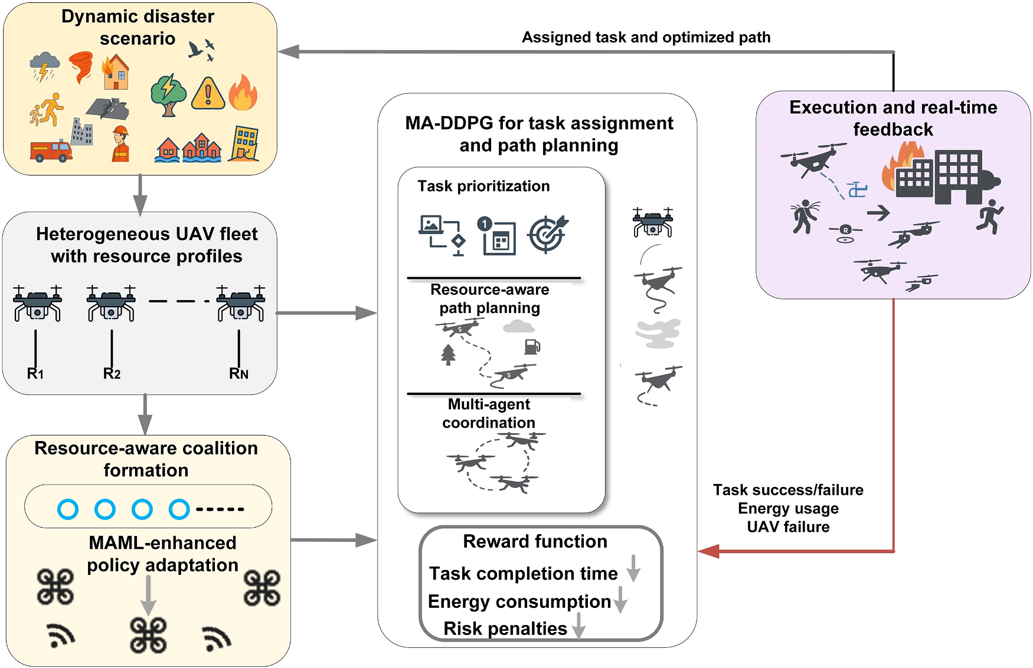
Coalition Formation & Suitability Score
SECTION 4 · METHODOLOGY
S_{ij} = w₁·PL_{i} + w₂·B_{i} + w₃·ReqMatch_{ij} − w₄·D̃_{ij}
PLᵢ payload
Lift/sensor capacity; keeps heavy tasks off light UAVs.
Bᵢ battery
Residual energy; avoids mid-task power starvation.
Fig. 1 (base paper): RCTP architecture.
ReqMatch
Capability-to-task compatibility (e.g. right sensor).
D̃ᵢⱼ distance
Normalised UAV-task distance; favours nearby UAVs.
Allocation objective
Maximise α·Priority + β·Sᵢⱼ minus assignment and path cost
Subject to energy, capacity, connectivity
Notes:
S_ij scores how suitable UAV i is for task j: payload, battery, capability match, minus distance. All terms are min-max normalised and weights sum to one, so the score is interpretable. It is updated online, which triggers coalition reformation without retraining.

Slide 8
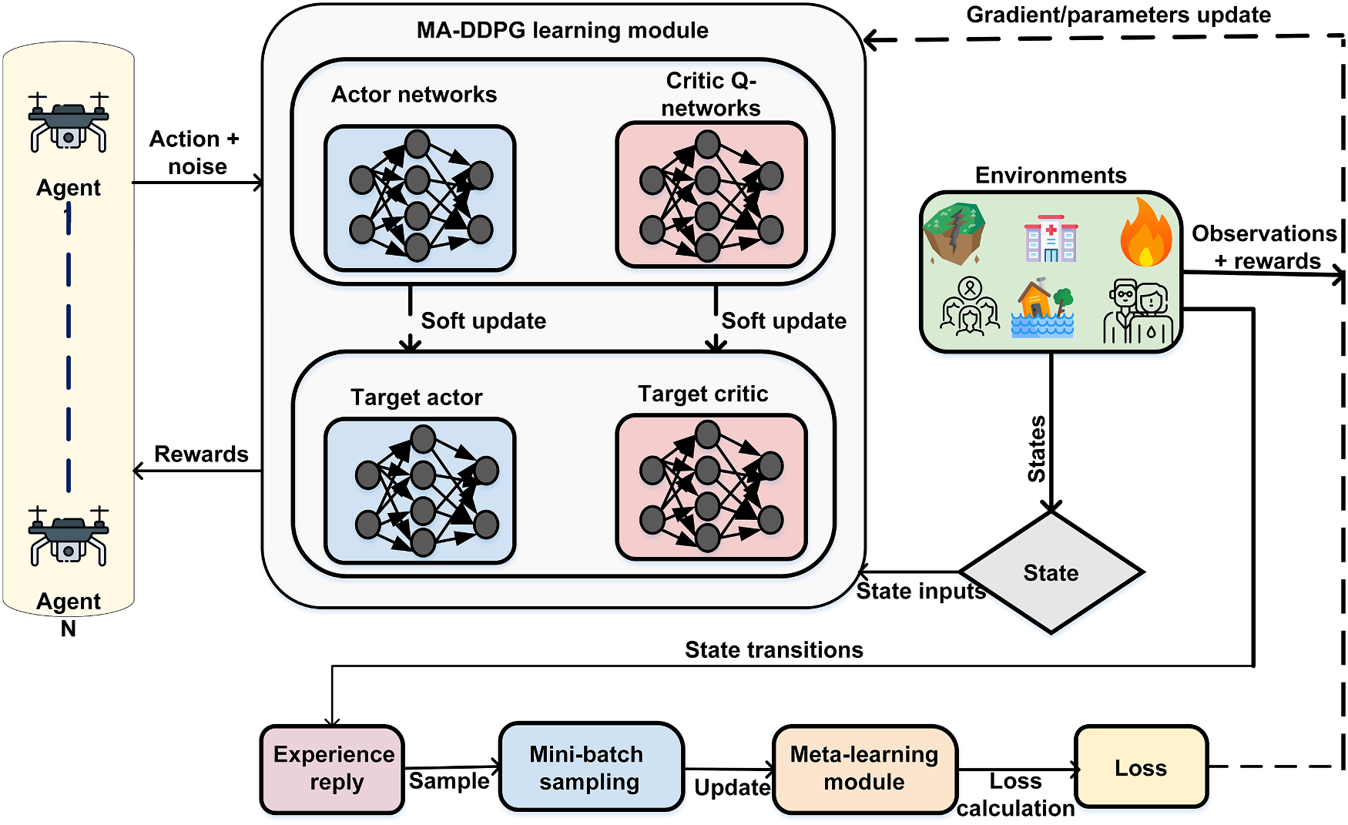
Proposed RCTP Pipeline Architecture
SECTION 4 · METHODOLOGY
Offline meta-training
MAML learns an initialisation over varied obstacles, tasks, links and UAV states.
Planning layer
Suitability scores, urgent-first assignment, load balancing, replanning.
Online decentralised execution
Local actors only; centralised critic is used just in training (CTDE).
Self-healing recovery
Failed UAV’s tasks are released and re-scored across healthy UAVs.
Fig. 3 (base paper): MAML-based MA-DDPG framework for coalition formation, task assignment and path planning.
Notes:
Offline: MAML meta-trains on diverse disaster scenarios. Online: each UAV runs a lightweight actor; a planning layer scores suitability, assigns urgent tasks first and replans paths. Health monitoring releases and reassigns tasks when a UAV fails. Centralised critic is used only in training (CTDE).

Slide 9
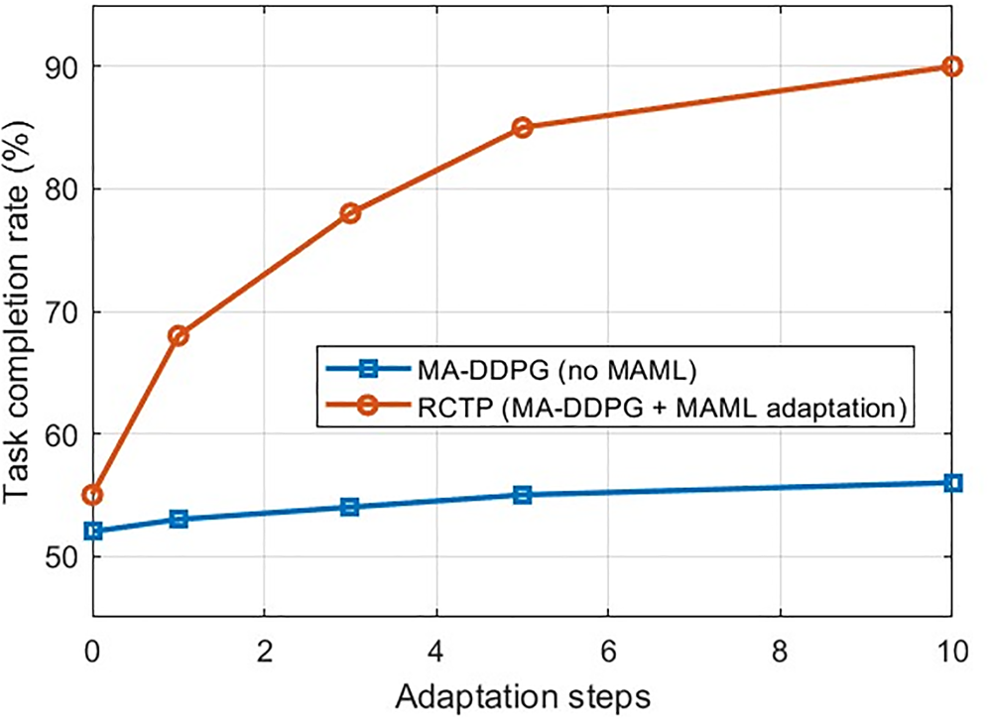
Continuous Flight (MA-DDPG) & Fast Adaptation (MAML)
SECTION 4 · METHODOLOGY
MA-DDPG: continuous control
Actions: speed, heading, climb plus task, coalition, path and comm preferences
Decentralised actors, centralised critic during training
Collision risk modelled with Gaussian position error
MAML: learning to adapt
Meta-train over diverse disaster scenarios
Inner loop: θ′ = θ − α∇L(θ); outer loop updates θ across scenarios
Few gradient updates at deployment, not retraining
Fig. 7 (base paper): task completion vs adaptation steps. RCTP ≈ 55% → ≈ 90%; MA-DDPG ≈ 52% → ≈ 56%.
Notes:
MA-DDPG gives continuous actions, so no grid discretisation. MAML trains an initialisation that adapts with a few gradient steps. In Fig. 7 both start near 52-55% task completion, but RCTP rises to about 90% by step 10 while MA-DDPG without MAML barely improves.

Slide 10
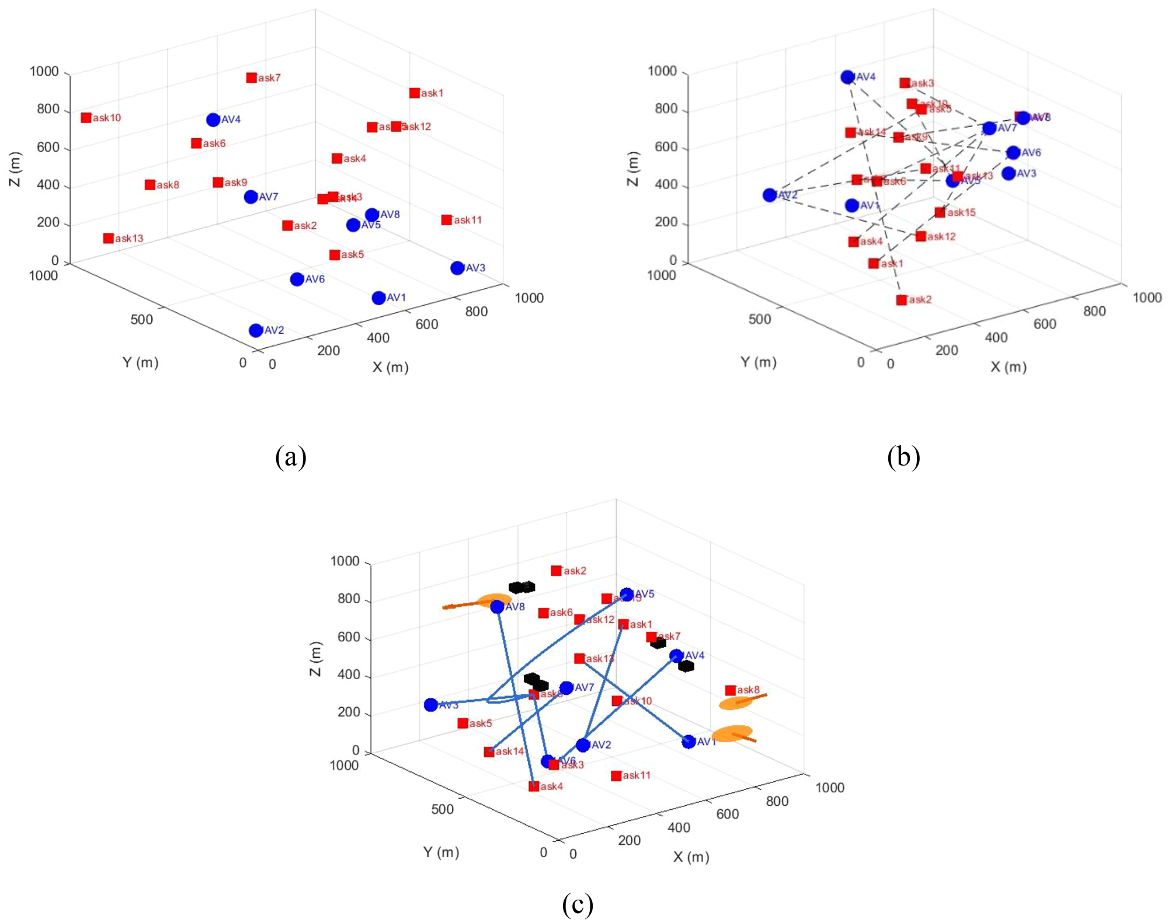
Simulation Parameters & Experimental Setup
SECTION 4 · METHODOLOGY
Parameter | Value
Environment | 3D, 1000 × 1000 × 1000 m
UAVs / tasks | 10–30 UAVs; 6–20 tasks
Altitude / speed | 50–250 m; 20–40 m/s
Battery capacity | 101–160 Wh
Channel | Probabilistic LoS / NLoS
Training | 2500 episodes, 300 steps each
Learning | γ = 0.95; lr 0.0001; batch 64
Networks | 4 FC layers (400–300–200–200)
Fig. 4 (base paper): (a) random deployment, (b) assignment, (c) obstacle-aware paths.
Baselines compared: DQN, PPO and MA-DDPG. Adam optimiser; Ornstein–Uhlenbeck exploration noise.
Notes:
MATLAB R2023b with the Reinforcement Learning Toolbox. 3D 1000 m cube, 10 to 30 heterogeneous UAVs, 6 to 20 tasks, static and dynamic obstacles. Fig. 4 shows deployment, assignment and obstacle-aware paths.

Slide 11
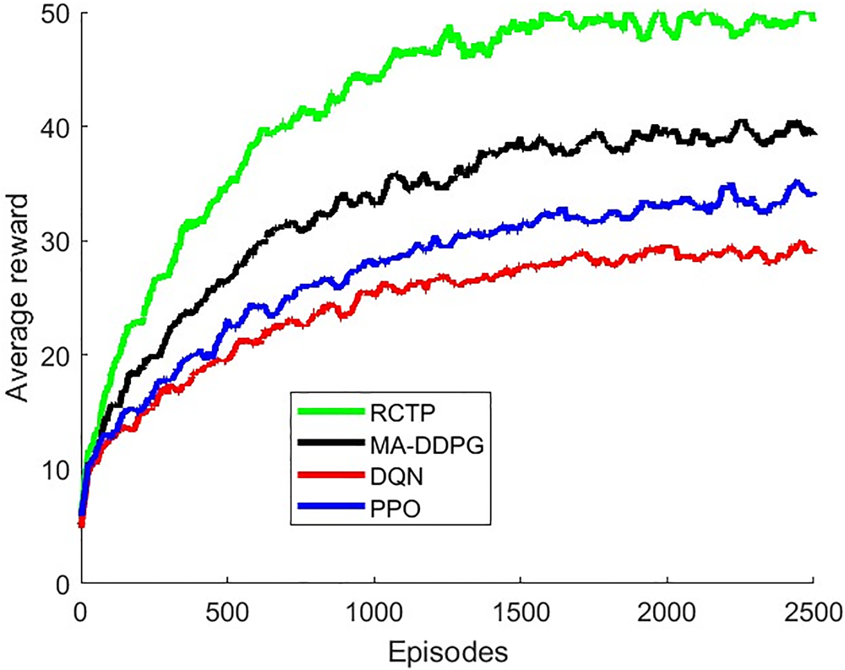
Results: Reward, Convergence & Speed
SECTION 5 · RESULTS
Fig. 5 (base paper): average reward vs episodes.
+28.57%
reward vs MA-DDPG
28.5%
faster convergence vs MA-DDPG
30–40%
shorter task completion time
Notes:
Fig. 5 shows RCTP collects the highest average reward. RCTP improves reward by 28.57, 50 and 60.71 percent over MA-DDPG, PPO and DQN, and cuts convergence time by 28.5, 42.86 and 50 percent. Task completion time drops 30 to 40 percent.

Slide 12
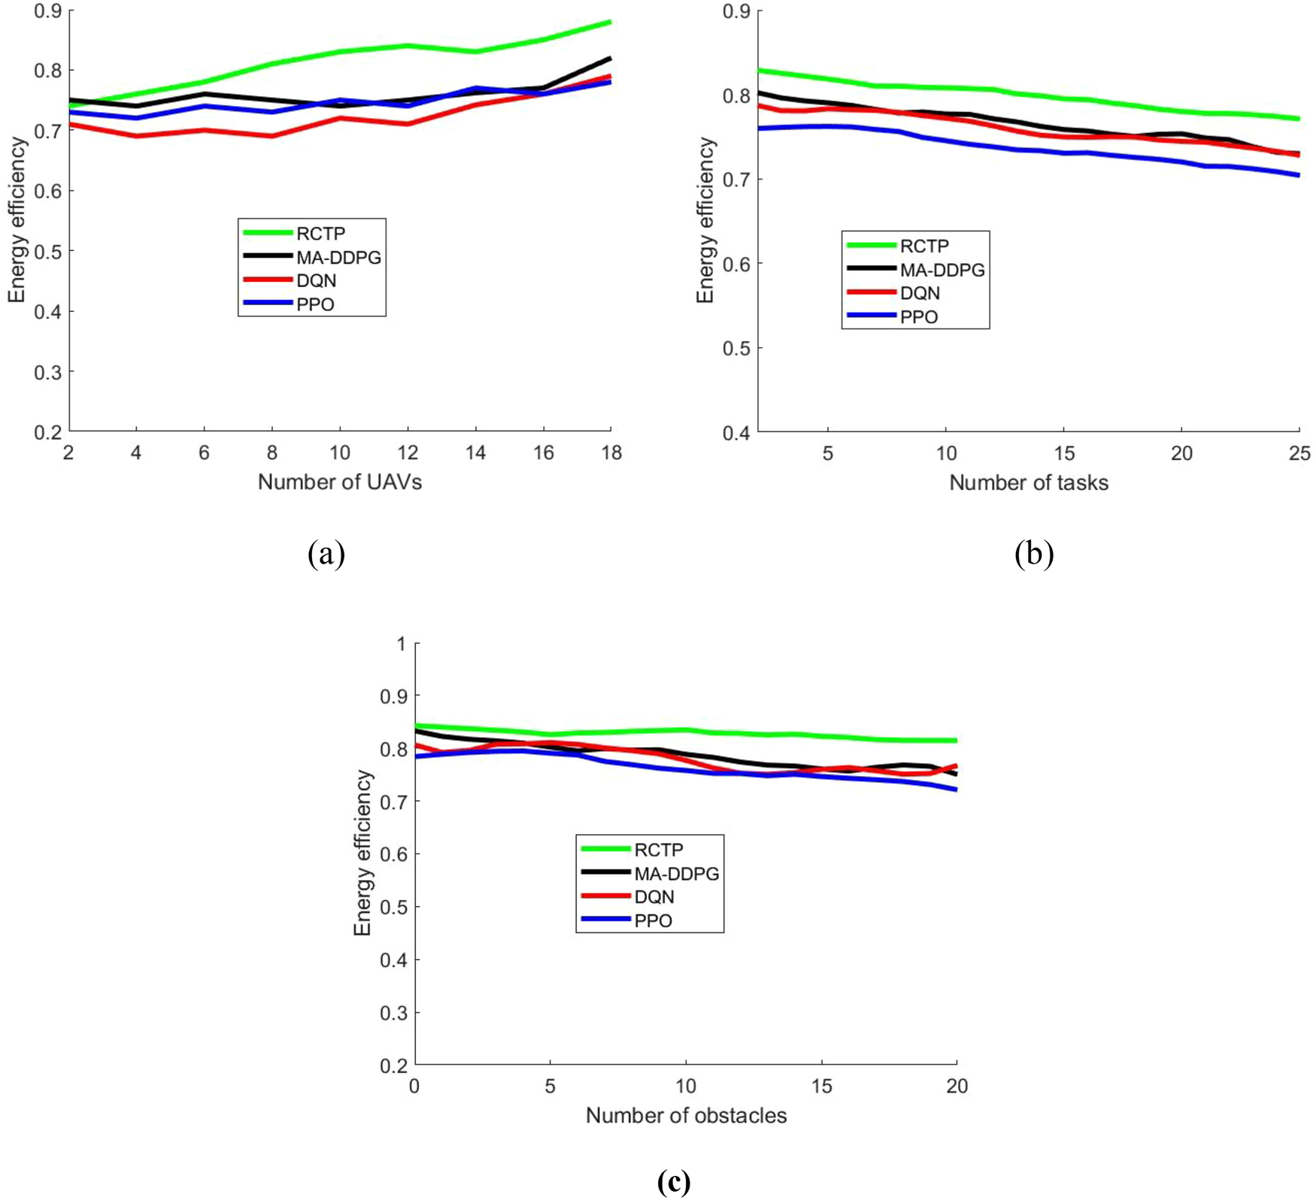
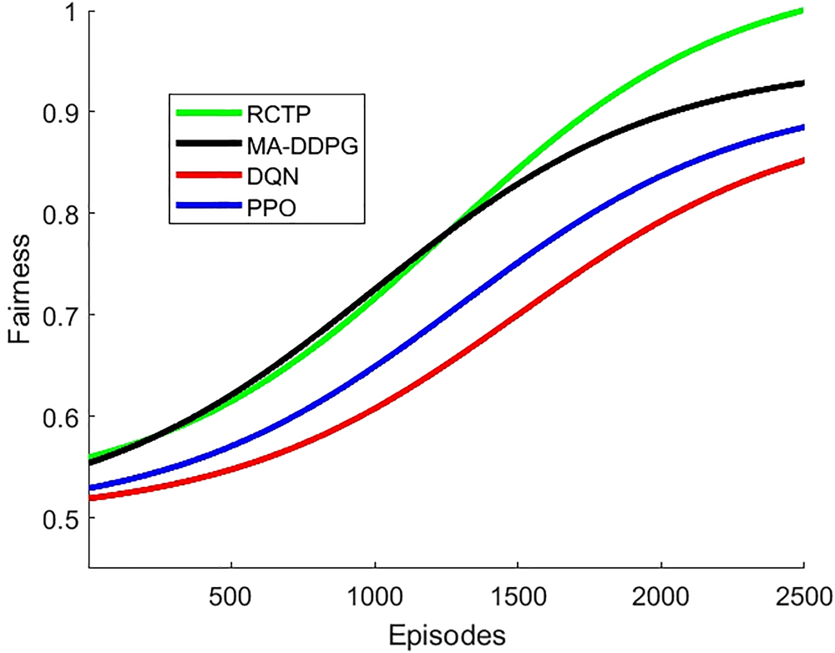
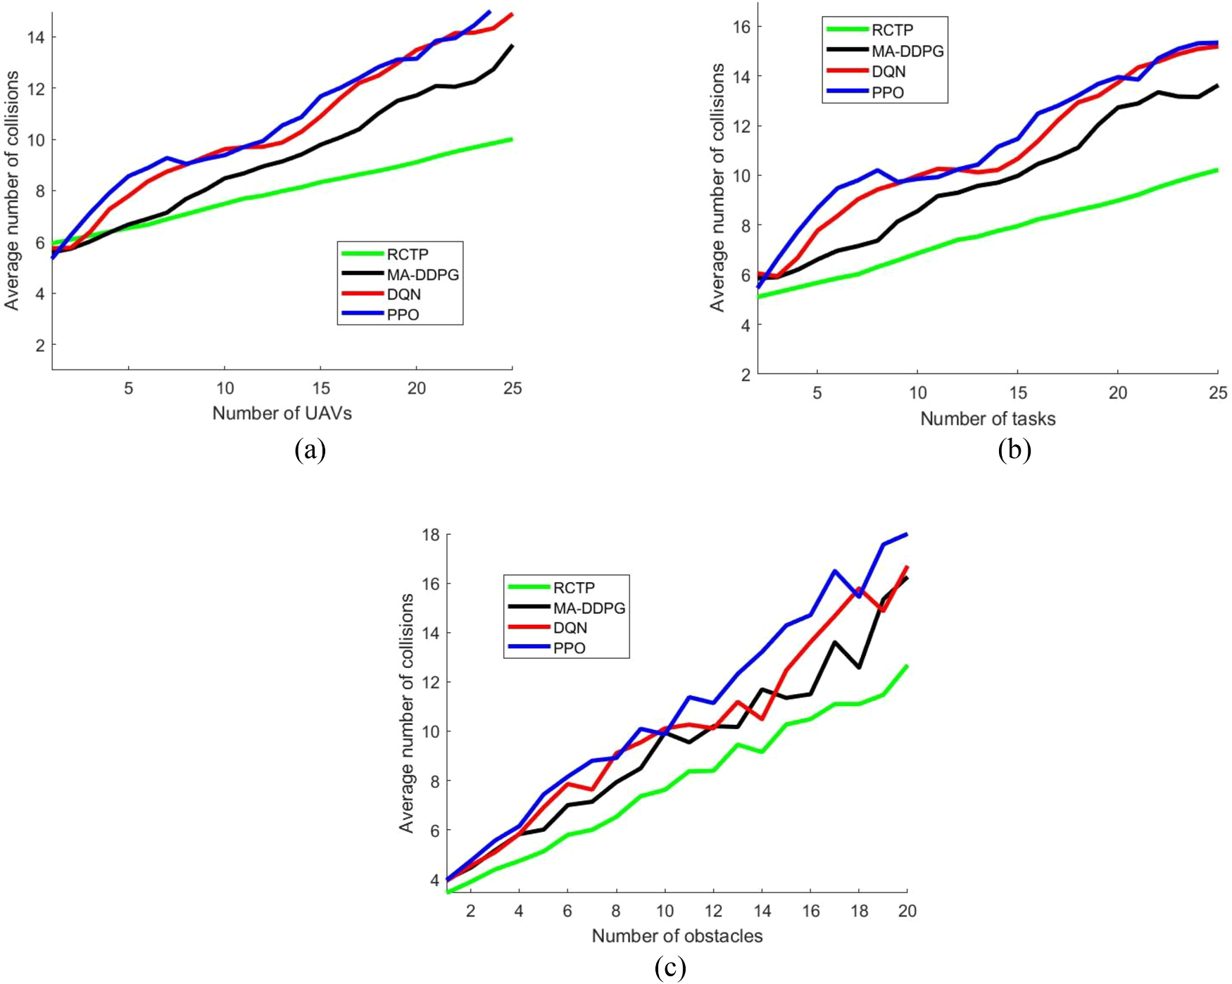
Results: Energy, Fairness & Safety
SECTION 5 · RESULTS
10–20%
lower energy consumption
+8.7%
Jain’s index vs MA-DDPG
30–50%
fewer collisions across scenarios
Self-healing fault tolerance
Health status vector detects failure → tasks released immediately → reassigned to feasible UAVs with enough energy, links and capability → connectivity-aware replanning
Notes:
Energy efficiency is 8 to 20 percent better depending on baseline. Jain fairness ends 8.7 percent above MA-DDPG. Collisions drop 30 to 50 percent. Failure handling: health status vector detects a failed UAV, its tasks are released and reassigned using updated suitability scores.

Slide 13
Comparison with Baselines
SECTION 5 · RESULTS
RCTP improvement | vs MA-DDPG | vs DQN | vs PPO
Average reward gain | +28.57% | +60.71% | +50%
Convergence-time reduction | 28.5% | 42.86% | 50%
Fairness gain (Jain’s index) | 8.7% | 16.3% | 20.5%
Energy-efficiency gain | 8–12% | 12–18% | 15–20%
Task execution delay reduction | 25–35% | 40–50% | 40–50%
Reading the table
Delay figures come from the task and obstacle sweeps (Fig. 9); energy ranges from the task and obstacle sweeps (Fig. 6)
Results are simulation-only; real-world field trials are future work
Notes:
All numbers are the paper’s reported simulation gains of RCTP over each baseline. Comparison covers DQN, PPO and MA-DDPG; MAPPO is listed by the authors as future work.

Slide 14
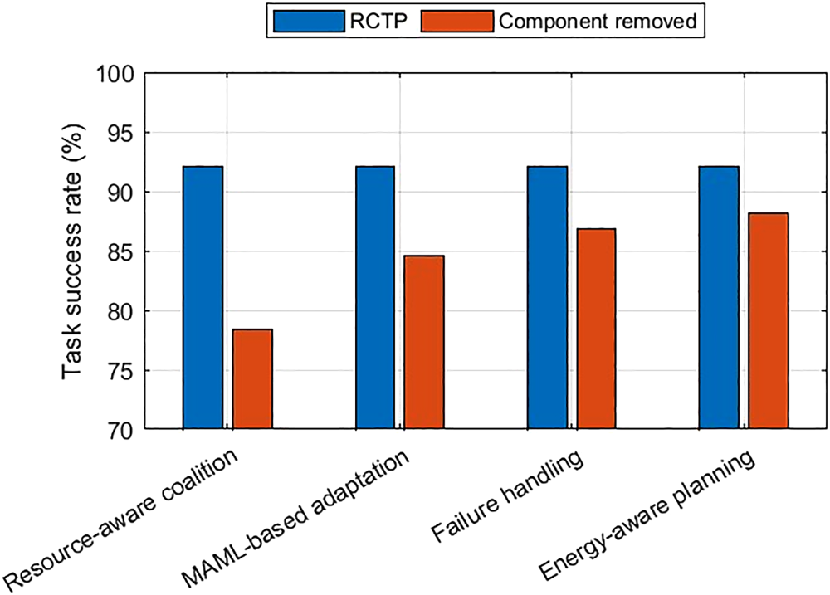
Ablation Analysis
SECTION 5 · RESULTS
Each component matters (full RCTP ≈ 92%)
Coalition formation: largest drop (≈ 78%)
MAML adaptation: ≈ 85%; slower adaptation to new scenarios
Failure handling: ≈ 87%; hurts under UAV failures
Energy-aware planning: ≈ 88%; gradual degradation
Fig. 12 (base paper): task success rate with each component removed. Values read from chart, approximate.
Notes:
Fig. 12: full RCTP reaches about 92 percent task success. Removing resource-aware coalition formation causes the largest drop, then MAML adaptation, failure handling, and energy-aware planning. Each component contributes.

Slide 15
Conclusion & Future Work
SECTION 6
Key Takeaways
RCTP unifies coalition formation, task assignment and path planning
30–40% faster mission completion; 10–20% lower energy
MAML enables few-shot adaptation to unseen scenarios
Decentralised execution with online fault tolerance; under 20 ms inference
Future Scope
Stronger meta-learning for out-of-distribution disasters
Larger, more heterogeneous, multi-agency swarms
Model wind, severe weather and reduced visibility
Real-world field experiments and a direct MAPPO comparison
Limitations: simulation-only evaluation; performance may degrade on strongly out-of-distribution scenarios; weather effects not explicitly modelled.
Notes:
Conclusions: unified coalition, assignment and path planning; 30-40% faster completion and 10-20% lower energy; few-shot adaptation. Limits: possible degradation out of distribution, weather not explicitly modelled, simulation only. Future work: stronger meta-learning, larger multi-agency swarms, wind/visibility modelling, field trials, MAPPO comparison.

Slide 16
References
SECTION 7
[1] S. Poudel and S. Moh, “MAML-integrated multi-agent reinforcement learning for adaptive coalition-based UAV coordination in disaster scenarios,” Internet of Things, vol. 37, 101930, 2026. doi:10.1016/j.iot.2026.101930
[2] S. Poudel and S. Moh, “Priority-aware task assignment and path planning for efficient and load-balanced multi-UAV operation,” Vehicular Communications, vol. 42, 100633, 2023.
[3] H. Qie et al., “Joint optimization of multi-UAV target assignment and path planning based on multi-agent reinforcement learning,” IEEE Access, vol. 7, pp. 146264–146272, 2019.
[4] J. Chen et al., “Joint task assignment and spectrum allocation in heterogeneous UAV communication networks: a coalition formation game-theoretic approach,” IEEE Trans. Wireless Commun., vol. 20, pp. 440–452, 2021.
[5] X. Tang et al., “Digital-twin-assisted task assignment in multi-UAV systems: a deep reinforcement learning approach,” IEEE Internet Things J., vol. 10, pp. 15362–15375, 2023.
[6] Y. Guan et al., “Cooperative UAV trajectory design for disaster area emergency communications: a multiagent PPO method,” IEEE Internet Things J., vol. 11, pp. 8848–8859, 2024.
[7] L. Vig and J. A. Adams, “Multi-robot coalition formation,” IEEE Trans. Robotics, vol. 22, pp. 637–649, 2006.
Notes:
Base paper and the key works it builds on.

Slide 17
Acknowledgements
1
My seminar guide, Dr. Jacob John, for guidance and feedback throughout this seminar.
2
The Department of Computer Science and Engineering, for the opportunity to present this seminar.
3
Poudel & Moh, the authors of the base paper, for publishing their work as open access.
4
My classmates and peers, for their support and helpful discussions.
Notes:
Thank the guide, department, authors, and peers.

Slide 18
Questions & Discussion
?
Thank you for your attention
Notes:
Thank you. I am happy to take questions.

