Slide 1
LOW-CODE APPLICATION
PARKING SLOT
RESERVATION &
MANAGEMENT SYSTEM
A centralized platform for managing parking slots, reservations, approvals and payment records.
Presented by Abinash G
Computer Science & Engineering | Rajalakshmi Engineering College
PROJECT PRESENTATION
Notes:
Introduce the project as a Zoho Creator low-code application for managing parking information and reservation activities.

Slide 2
01 / CONTEXT
Problem Statement
Why a structured parking reservation application is useful
Manual coordination
Fragmented records
Limited visibility
Users may need to ask staff to check availability and confirm a suitable parking slot.
User, vehicle, slot, reservation and payment information can be difficult to track when handled separately.
Administrators need a consistent view of pending reservations, payment status and cancellations.
Project response
Bring the core parking operations into one application with linked forms, reports, approvals, workflows and a dashboard.
CENTRALIZED DATA
ROLE-BASED ACCESS
CONTROLLED APPROVALS
Notes:
Explain the pain points the project addresses: finding slots, maintaining linked records, tracking the lifecycle and keeping administrators informed.

Slide 3
02 / PROJECT GOALS
Objectives & Scope
The application focuses on structured parking operations and traceable records
Maintain user, vehicle and parking-slot information in one system.
IN SCOPE
Capture reservation date, time, selected slot and parking fee.
• 6 application forms
• 6 reports
• Admin and User roles
• Reservation approval
• Reservation lifecycle blueprint
• Daily administrative summary
• AI assistant & recommendation interfaces
Track payment and cancellation records against reservations.
Support administrators with approval, blueprint and workflow controls.
Provide reports and a dashboard for operational visibility.
LOW-CODE DEVELOPMENT
ZOHO CREATOR
Notes:
Describe what the current application contains and what it aims to manage. Be clear that recommendations need to be validated against live slot and reservation data.

Slide 4
03 / APPLICATION OVERVIEW
Users & Functional Modules
Two main roles use different parts of the same parking application
USER
ADMIN
Register details and vehicles; view parking options; submit reservations; track payment and cancellation records.
Maintain master data; review reservations; manage payments and cancellations; monitor reports and dashboard.
Registration
Reservation
User & vehicle details
Slot, date, start & end time
Payment
Cancellation
Amount, method & status
Reason, refund & status
Notes:
Explain that User and Admin are the application roles. Avoid calling the user a customer or introducing an Operator role unless one is actually configured.

Slide 5
04 / DATA CAPTURE
Application Forms & Data
Six linked forms make up the main data structure
User_Details
Vehicle_Details
Parking_Slots
Name, email, phone, role
Vehicle number, type, model, owner
Slot number, area, type, status, hourly rate
Parking_Slot_Reservation
Parking_Payment_Details
Booking_Cancellation
User, vehicle, slot, date, time, status, fee
Reservation, amount, method, payment status
Reservation, reason, refund amount, status
Lookup relationships connect the reservation to its user, vehicle and selected parking slot.
Notes:
Walk through the six forms and point out the key lookup links. The reservation form is the central transaction record.

Slide 6
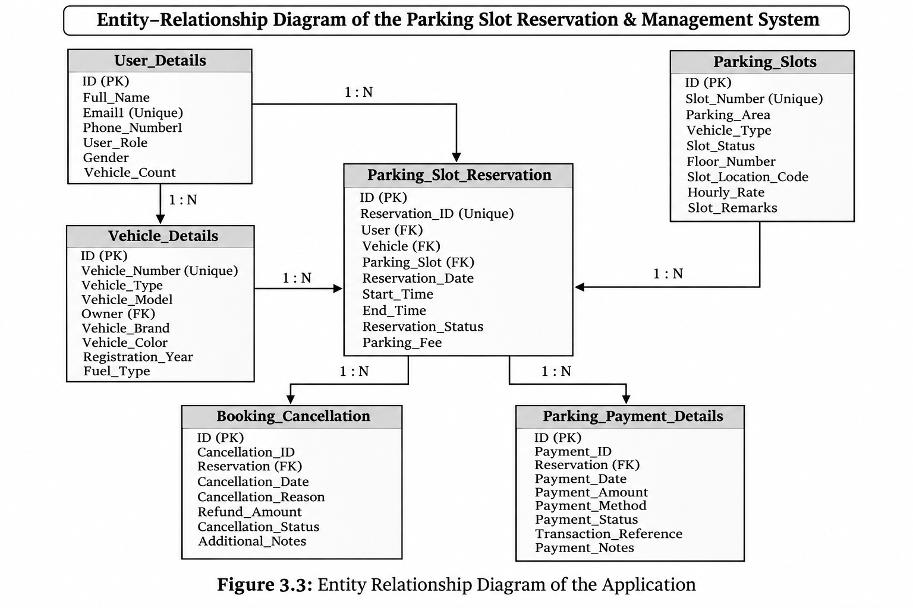
05 / DATA RELATIONSHIPS
Entity Relationship Model
Reservation is the central record linking users, vehicles, slots, payments and cancellations
1 USER → MANY RESERVATIONS
A user can make multiple reservations.
1 SLOT → MANY RESERVATIONS
A slot can be referenced across different booking periods.
RESERVATION LINKS
Payment and cancellation records refer back to a reservation.
Notes:
Use this slide to explain primary keys and lookup-based relationships. Each payment or cancellation record references a reservation. Cardinality in the diagram is a logical model; multiple entries per reservation depend on application rules.

Slide 7
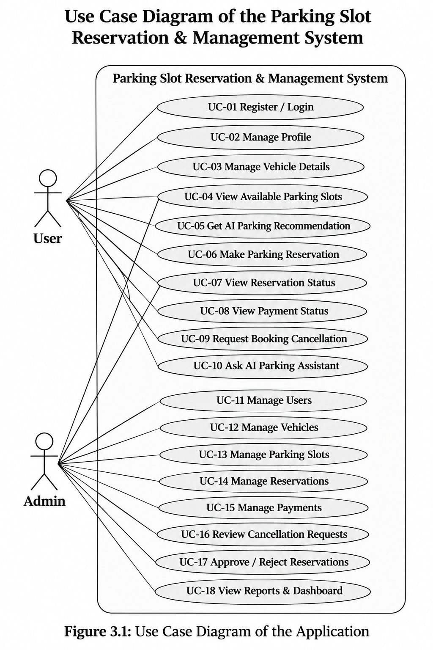
06 / USER INTERACTION
Use Case Model
Main actions available to User and Admin
USER USE CASES
ADMIN USE CASES
Register / log in and manage profile
Manage users and vehicles
Manage vehicle details
Manage parking slots
View available parking slots
Review reservations and approvals
Get parking recommendations
Make reservation and check status
Manage payment and cancellation records
View payment information and request cancellation
View reports and dashboard
Ask the AI Parking Assistant
Notes:
Explain the major interactions rather than reading every use case ID. The diagram includes the two roles and the main system functions.

Slide 8
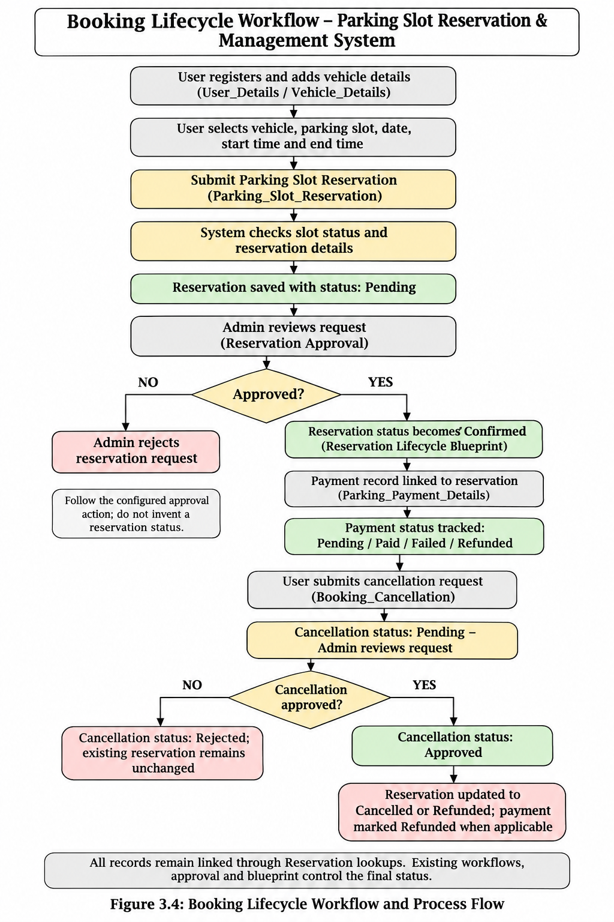
07 / PROCESS FLOW
Booking Lifecycle Workflow
From user submission through approval, payment tracking and cancellation
01
User selects vehicle, slot and time
02
Reservation is submitted as Pending
03
Admin reviews and approves or rejects
04
Payment record tracks amount and status
05
Cancellation request is reviewed separately
Existing approval and blueprint controls determine the final reservation state.
Notes:
Clarify that the approval process is part of the reservation lifecycle. Payment status and cancellation status are tracked in their own forms linked to a reservation.

Slide 9
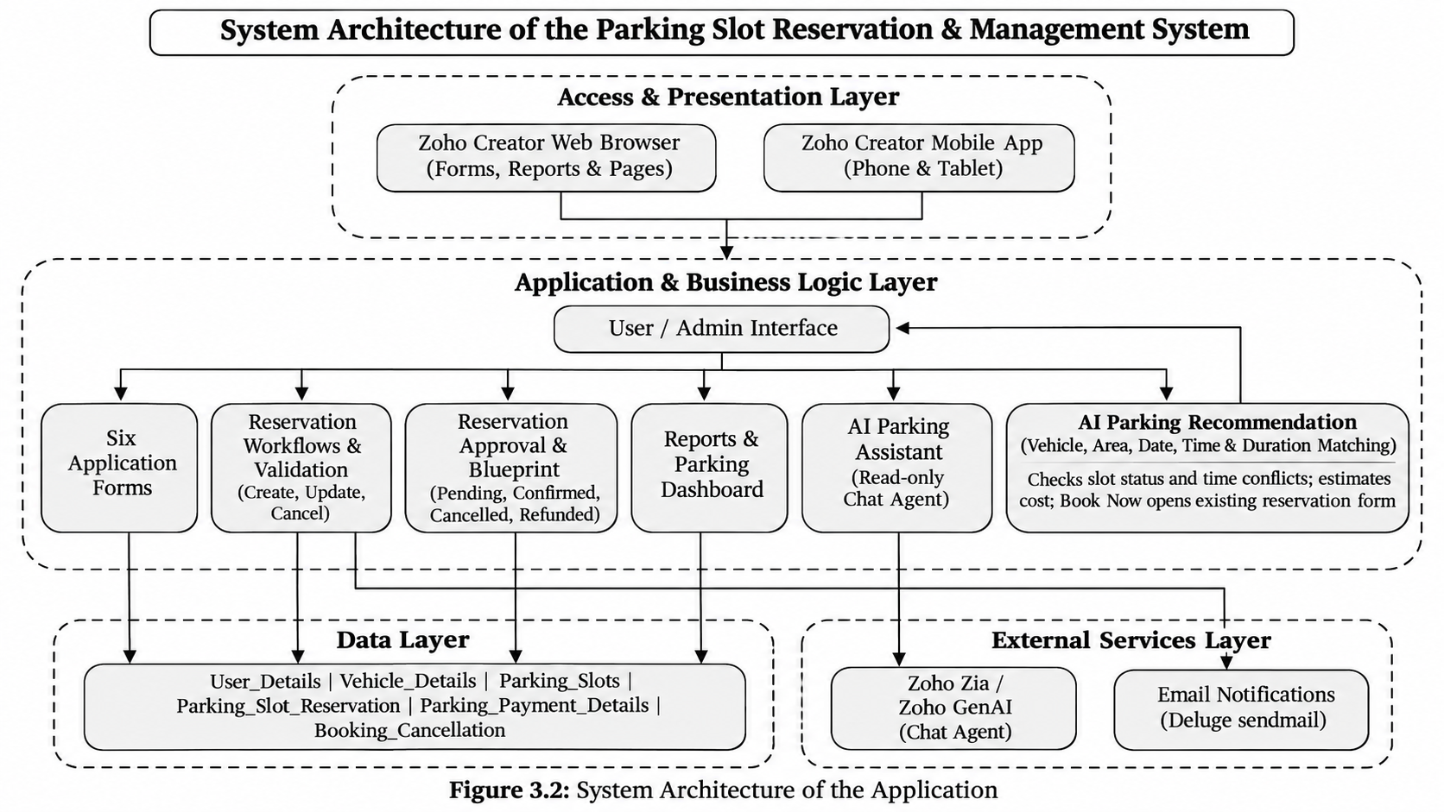
08 / TECHNICAL DESIGN
System Architecture
Zoho Creator provides the presentation, application logic and data layers
Notes:
Describe access through the Creator browser/mobile interface, business rules through forms and workflows, structured data in the six forms, and external services for notifications and AI.

Slide 10
09 / AI FEATURE 1
AI Parking Assistant
A conversational helpdesk for common parking-related questions
WHAT IT HELPS WITH
CONFIGURATION SHOWN
Registration, vehicle details, reservation steps, payment status, cancellation guidance and reservation-status explanations.
Chat Agent named “AI Parking Assistant”; read-only access selected; parking application modules included.
Question
Context
Answer
→
→
User asks in natural language
Agent uses its instructions and permitted application modules
Simple, guided response with follow-up context
Safety note: Read-only behavior and private-data guardrails are configured; test record-level access before live deployment.
Notes:
Present the assistant as a conversational helpdesk. The configured profile is read-only and the private-data/file guardrails were switched on. Do not say it has been validated against every user permission unless testing has been done.

Slide 11
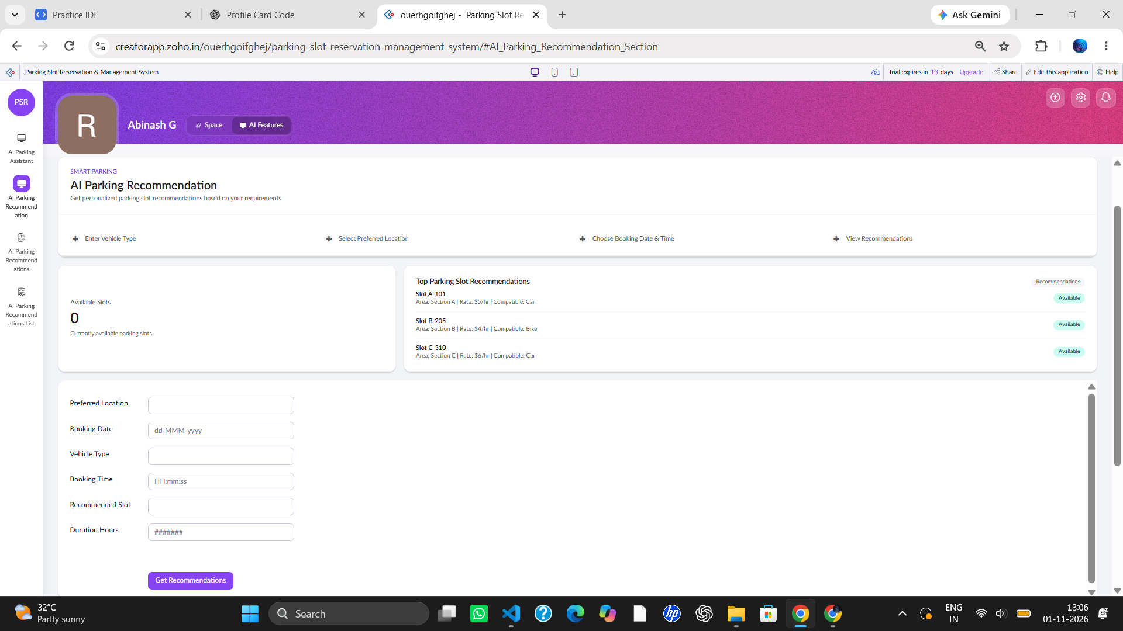
10 / AI FEATURE 2
AI Parking Recommendation
A smart parking finder that matches user requirements with available slots
USER INPUTS
Vehicle type • preferred area • booking date • entry time • duration
RECOMMENDATION LOGIC
Match vehicle and location; check slot status and overlapping reservations; estimate cost.
BOOKING HANDOFF
Show ranked options and route “Book Now” to the existing reservation form with selected details prefilled.
Current UI is a prototype; live filtering, genuine slot results and Book Now navigation must be tested before claiming full functionality.
Notes:
Show the current recommendation page screenshot. Explain the intended input and filtering steps. Be transparent that the visible UI includes placeholder recommendation cards and still needs validation against real Parking_Slots and Parking_Slot_Reservation records.

Slide 12
11 / MONITORING
Reports, Dashboard & Navigation
Administrators can review records and operational summaries
All_User_Details
All_Vehicle_Details
PARKING DASHBOARD
All_Parking_Slots
All_Parking_Slot_Reservations
Reservations
Slot availability
Payment tracking
Cancellation overview
All_Parking_Payment_Details
All_Cancellations
AI FEATURES
AUTOMATION
6 FORMS
6 REPORTS
1 DASHBOARD
AI Parking Assistant and AI Parking Recommendation.
Reservation Approval • Reservation Lifecycle • Daily Summary.
Notes:
Explain the six operational reports and the Parking Dashboard. The dashboard and reports provide an administrator-oriented view of the underlying records.

Slide 13
12 / VALIDATION
Demo Data & Testing
A linked sample dataset was loaded for application demonstration
15
User records
15
Vehicle records
15
Parking slots
15
Reservations
15
Payment records
15
Cancellation records
90 sample records in total
Test coverage
Form/report record visibility and lookup links
Reservation approval and status transitions
Payment and cancellation record tracking
Role permissions, notifications and schedules
Notes:
The six reports were verified to contain 15 records each after loading sample data. Explain that these are fictional demonstration records. Workflows and schedules were skipped during API import to avoid triggering real notifications or approval automations; test automations separately.

Slide 14
13 / READINESS
Security, Limitations & Future Work
What is in place and what should be validated before production use
ACCESS & GUARDRAILS
PAYMENT SCOPE
AI RECOMMENDATION
Admin/User permissions; Chat Agent profile configured as read-only; private-data and file-access restrictions enabled.
Payment details and statuses are tracked in the app. A live payment-gateway integration is not claimed.
UI prototype exists; validate real-time time-conflict filtering, slot ranking and Book Now form prefill.
Next improvements
Complete and test slot availability and overlap logic for requested date/time/duration.
Connect recommendation results to existing reservation form and approval flow.
Test Chat Agent with Admin and User accounts for record-level privacy.
Complete deployment checklist, email testing and backup export.
Notes:
Be honest about implementation maturity. The payment form stores status records but does not mean a live payment gateway is integrated. The recommendation screen needs genuine data-driven results and a verified booking handoff.

Slide 15
CONCLUSION
A centralized way to
manage parking operations.
The project brings user, vehicle, slot, reservation, payment and cancellation records together in Zoho Creator, with approvals, workflows, reporting and AI-assisted features.
THANK YOU
Questions & Discussion
Abinash G | CSE | Rajalakshmi Engineering College
Notes:
Close by summarizing the application’s operational value and invite questions.

