Slide 1

SMART INDIA HACKATHON 2026
Problem Statement ID : SIH26167
Problem Statement Title :SatQuery AI - An Interactive Vision-Language Assistant for Multimodal Remote Sensing Image Analysis through Text Queries
Theme : Space Technology
PS Category : Software
Team ID : SIH26-A0H-T037
Team Name : Astra Nova

Slide 2
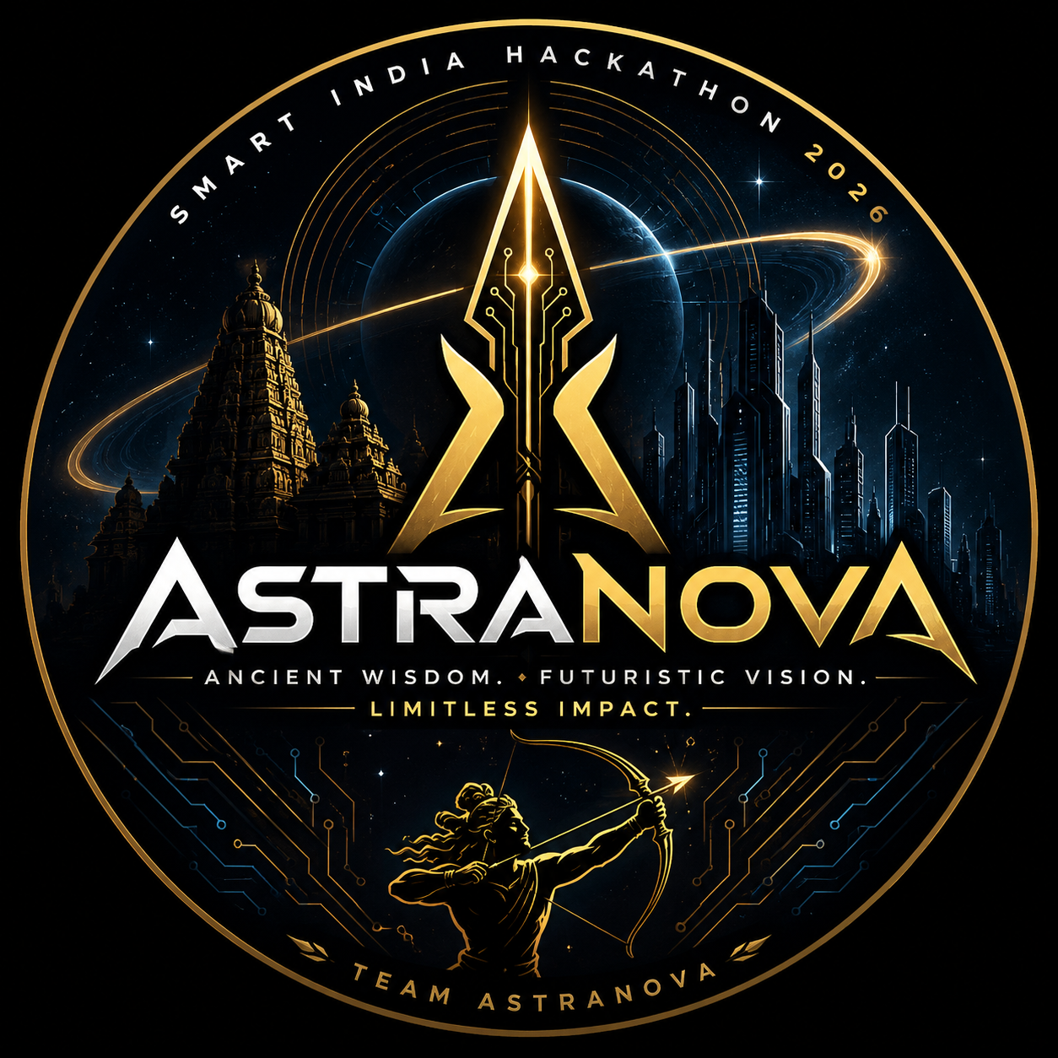
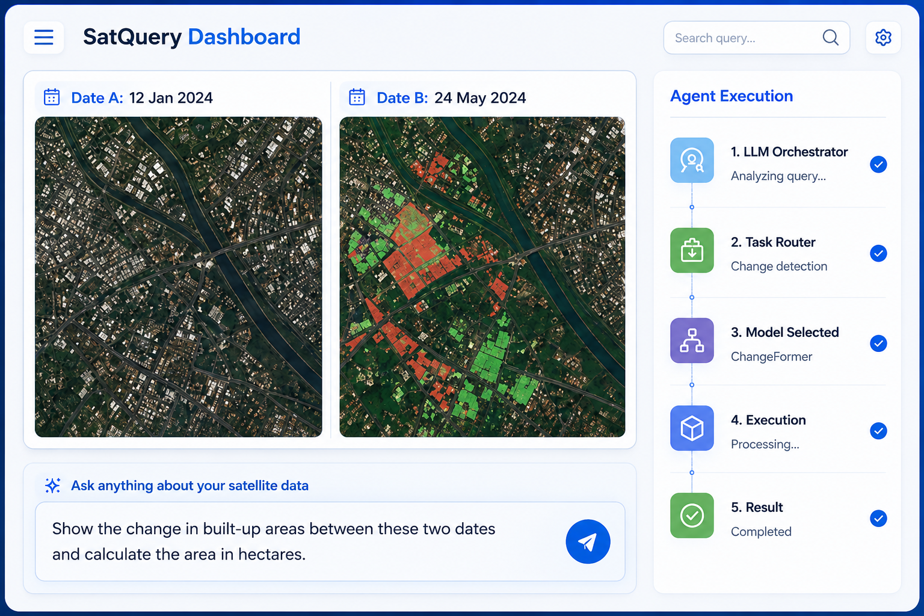
SatQuery AI — Agentic Multimodal Satellite Intelligence Assistant
SatQuery AI — An Agentic Vision-Language Assistant for Optical + SAR Remote Sensing
Challenge We're Solving
How It Addresses the Problem
Innovation & Uniqueness
Silo problem: Every RS AI tool does one task only, so an analyst juggles six of them to answer one question.
Expertise wall: Users must know sensor, bands, resolution and file format before they can ask anything.
Cloud blindness: Optical fails during floods and monsoon, exactly when answers matter. SAR sits unused because it needs specialists.
Each mandated query maps to an automatic tool chain:
“Describe the land-cover and major objects.”
→ captioning + LULC segmentation + object detector, returning a narrative with a class-wise area table.
“Highlight the water body referred to.”
→ referring-expression segmentation, returning a mask on the map plus extent in hectares.
“What changed between these two dates, and where?”
→ bi-temporal change VQA plus a spatial change map (the mandatory capability) and change captioning.
“Use optical and SAR together for built-up and water.”
→ co-registration, then SAR backscatter thresholding fused with optical indices into a two-class map.
“Has built-up area increased, decreased or stayed same?”
→ class-wise change quantification giving direction, Δ km² and percentage, computed from pixels.
1. SAR is first-class, not an afterthought.
Nearly every RS vision-language model (GeoChat, RS-LLaVA, EarthDial) is optical-only. We add a dedicated SAR chain: speckle filtering, Otsu backscatter water extraction, texture-based built-up, polarimetric decomposition. Answers survive cloud and night.
2. Grounded, not generative.
The LLM never invents a number. Areas come from mask pixel-count × ground sample distance, coordinates from the raster CRS. Below a confidence threshold the system abstains.
3. Glass-box agent.
The tool chain is streamed live and exportable, so an analyst can audit which model produced which claim.
4. Runs fully air-gapped.
All weights local; zero cloud API, zero recurring cost, deployable inside ISRO/NRSC networks.
5. Indian-data native.
Built on Bhoonidhi — NISAR S-SAR, EOS-04 C-SAR, Resourcesat LISS-III/AWiFS — plus Bhuvan thematic layers, not just Sentinel.
Our Solution — SatQuery AI
One conversational assistant over a registry of specialist models. Ask in plain English (or Any language), the system plans the pipeline, runs it, and returns a verified answer.
1. Agentic Orchestrator
LangGraph + Qwen2.5-7B function calling auto-selects, sequences and executes the right tools for the query and input pair.
2. Specialist Tool Registry
RS-VQA, referring segmentation, bi-temporal change detection and captioning, SAR water and built-up analytics.
3. Cross-Modal Fusion Engine
Co-registers optical/multispectral with SAR and fuses complementary evidence into a single answer.
4. Evidence Layer (never bare text)
Every reply ships a mask and GeoJSON overlay, a change map, area in km²/ha, a confidence score and the full agent trace.
Beyond the Problem Statement
Multilingual querying in Hindi and regional languages for district-level users · standing alerts such as “tell me when built-up grows in this ward” · batch district reports from one query · MCP tool exposure so other ISRO systems can call the same specialist registry.
2
Notes:
Lead with the silo problem. Emphasise that all five ISRO representative queries are handled by automatic tool routing, and that SAR + pixel-grounded numbers + offline operation are our three defensible differentiators.

Slide 3
TECHNICAL APPROACH
System Architecture — from satellite archive to a grounded answer on the map
DATA
SOURCES
Bhoonidhi / NRSC (ISRO)
Copernicus + Bhuvan
User upload
NISAR S-SAR · EOS-04 C-SAR · Resourcesat LISS-III/AWiFS
· STAC catalogue
Sentinel-1 SAR & Sentinel-2 MSI via STAC · Bhuvan WMS thematic layers
GeoTIFF / COG / SAFE / HDF5 · single scene, bi-temporal pair or optical+SAR pair
PRE-
PROCESSING
Radiometric & calibration
Speckle & geometry
Optical ↔ SAR co-registration
Tiling & COG
TOA/BOA correction · SAR sigma-nought
Refined-Lee filter · orthorectification
tie-points + RANSAC · common CRS grid
512×512 chips · overview pyramids
AGENTIC ORCHESTRATOR
Natural-Language Query → intent classification (RemoteCLIP embeddings) → slot filling (scene / date-pair / modality / region of interest) → tool-DAG planning → execution → verification → answer synthesis
Router: Qwen2.5-7B-Instruct (function calling, runs local via Ollama/vLLM) · Graph: LangGraph · the LLM chooses and sequences tools — it never computes a measurement itself
SPECIALIST
TOOL
REGISTRY
RS-VQA & Captioning
Referring Segmentation
Change Detection
Change VQA & Captioning
SAR Analytics & Fusion
GeoChat-7B (LoRA)
scene description,
land-cover narrative,
object counting
RMSIN · GroundingDINO
+ SAM2 fallback
→ mask + GeoJSON
+ area (km²/ha)
ChangeFormer · AnyChange
(zero-shot, SAM-based)
→ spatial change map
+ Δ area & direction
CDVQA-tuned VLM
· Chg2Cap
→ “what changed,
where and how much”
Otsu backscatter water
· GLCM built-up
· m-δ decomposition
· EarthMind-style fusion
EVIDENCE
& DELIVERY
Verified answer object
Web application
Graceful degradation
text answer + mask/GeoJSON + change map + area in km² + confidence + agent trace
React + MapLibre GL · FastAPI + Celery/Redis · TiTiler COG tiles · PostGIS · WebSocket streaming
cloud → SAR fallback · missing modality → single-sensor chain · model fail → classical method · offline mode
TECH
STACK
Python | PyTorch | Hugging Face
LangGraph | Qwen2.5-7B | GeoChat
SAM2 | ChangeFormer | Prithvi-EO-2.0
GDAL/rasterio | SNAP & pyroSAR | pystac - client
FastAPI | Celery+Redis | PostGIS
TiTiler | React/MapLibre GL | Docker | Ollama
3
Notes:
Walk the diagram top-down. Stress two things: co-registration in preprocessing is what makes optical+SAR fusion honest, and the orchestrator picks tools but never computes numbers - measurements always come from masks.

Slide 4
FEASIBILITY AND VIABILITY
Technical Feasibility
Potential Challenges & Risks
Strategies for Overcoming Them
No model trained from scratch. Every specialist is an open pretrained checkpoint — GeoChat-7B, RMSIN, ChangeFormer, SAM2, Prithvi-EO-2.0 (CC-BY-4.0). Only LoRA adaptation is needed.
Single-GPU build. 4-bit 7B router + specialist inference fits a 16–24 GB GPU; no cluster required for the prototype.
Data already exists and is free. Bhoonidhi open tier + Copernicus STAC for imagery; RSVQA, CDVQA, RRSIS-D, LEVIR-CD/CC and SEN12MS for training and evaluation.
1. Optical–SAR misregistration
Different geometry and terrain distortion make pixel-level fusion drift, corrupting every downstream mask.
2. Vision-language hallucination
VLMs confidently invent object counts and areas — unacceptable for an operational space product.
3. Domain gap
Public models are trained largely on US/European imagery; Indian landscapes, field sizes and settlement patterns differ.
4. Cloud cover & missing inputs
Monsoon optical scenes are unusable, and a required modality or date may simply be absent.
5. Latency on full scenes
A multi-GB scene through a chain of deep models is far too slow for interactive questioning.
6. Integration risk (36 hours)
Many moving parts; most hackathon failures happen at the seams, not inside a single model.
7. “Is this real space data or a demo set?”
Evaluators discount systems demonstrated on curated toy imagery rather than operational products.
Start from terrain-corrected ARD
Bhoonidhi EOS-04/NISAR products are already ortho-normalised; we refine with tie-point + RANSAC matching and report registration RMSE with every fused answer.
Numbers come from pixels, never the LLM
Area = mask pixel count × ground sample distance; coordinates from the raster CRS. Below a confidence threshold the agent abstains and says so.
LoRA on Indian scenes + honest evaluation
Adapt on Bhoonidhi imagery and validate on a hand-labelled Indian eval set, reporting mIoU, F1 and VQA accuracy rather than demo screenshots.
SAR as the designed fallback
Cloud detected → automatic switch to the SAR chain; missing modality → single-sensor path; model failure → classical thresholding. The system degrades, it does not break.
Tile-level inference and caching
Run models on the requested tiles only, cache in Redis, stream partial results — COG lets the browser fetch kilobytes instead of gigabytes.
Contract-first, integrate early
Every tool implements one typed interface behind a stub, so the end-to-end path runs in hour six and real models are swapped in one by one.
Provenance shown on screen
Every demo scene is pulled from Bhoonidhi or Copernicus with its product ID, sensor and acquisition date displayed beside the answer.
Economic Viability
Fully open-source stack — no per-query LLM API cost and no vendor lock-in. Marginal cost per query on an on-prem node is effectively electricity only. One GPU node serves a departmental pilot; scaling is horizontal via Celery workers and cached COG tiles.
Operational & Legal Viability
Air-gapped deployment keeps sensitive imagery inside ISRO/NRSC networks — no data leaves the premises. Aligned with the Indian Space Policy 2023 and the National Geospatial Policy 2022. Model licences are checked per component (Apache-2.0 router, CC-BY-4.0 encoder) so the stack stays deployable.
Notes:
The centre column is the honest risk list; the right column is the mitigation. The single most important line: the LLM never computes a measurement, so numbers cannot be hallucinated.

Slide 5
IMPACT AND BENEFITS
TARGET AUDIENCE — WHO BENEFITS AND HOW
ISRO / NRSC analysts
Disaster management (NDMA,
state cells)
Agriculture & water resources
Urban bodies & forestry
Turn a multi-tool GIS workflow into one sentence. Query the Bhoonidhi archive conversationally instead of scripting per-task pipelines.
Flood extent from SAR through cloud, day or night — inundated area in km² within minutes of a pass, not hours.
Crop-area and water-body change tracking for PMFBY assessment, reservoir monitoring and command-area planning.
Built-up growth quantified between two dates for AMRUT/Smart Cities master-plan review and forest-cover change reporting.
BENEFITS OF THE SOLUTION
Social
Economic
Environmental
Strategic
Democratises satellite intelligence. A district officer or farmer-producer group gets an answer without learning remote sensing, widening who can act on ISRO data.
Zero recurring API cost on an open stack. Feeds a national EO market projected to reach roughly $8 bn of India's $44 bn space-economy target by 2033 (FICCI-EY, 2025).
Faster detection of deforestation, encroachment on water bodies, and unplanned urban sprawl — with measured extents that stand up in a review.
Indigenous, air-gapped capability on Indian sensors (NISAR, EOS-04, Resourcesat). Supports Atmanirbhar Bharat and the Indian Space Policy 2023.
How We Will Measure That It Actually Works — After Deployment, Not Just At Demo Time
Time-to-answer
Accuracy vs reference
Expert independence
Operational uptake
Minutes from query to verified map layer, against the current multi-tool GIS baseline
mIoU / F1 on change and segmentation masks; area error against reference masks where available
Share of queries resolved with no remote-sensing specialist in the loop
Queries per week per department and repeat usage after the pilot period ends
Notes:
Judges usually ask who benefits and how you would measure it post-deployment. The bottom band answers exactly that with four concrete metrics.

Slide 6
RESEARCH AND REFERENCES
ISRO / Government Data & Policy
Vision-Language & Foundation Models
Agentic Orchestration for Geospatial AI
Bhoonidhi — ISRO EO Data Hub (NRSC): bhoonidhi.nrsc.gov.in
NISAR S-SAR product release, Bhoonidhi: bhoonidhi.nrsc.gov.in/NISAR/NisarProducts.html
NISAR Data User Guide (ASF DAAC): nisar-docs.asf.alaska.edu
Bhuvan Geoportal — WMS/WMTS thematic services: bhuvan.nrsc.gov.in
MOSDAC (SAC) data download API: mosdac.gov.in · VEDAS vAPI: vedas.sac.gov.in
Indian Space Policy 2023 · National Geospatial Policy 2022 · IN-SPACe: inspace.gov.in
Kuckreja et al., “GeoChat: Grounded Large Vision-Language Model for Remote Sensing”, CVPR 2024 (arXiv:2311.15826)
Shu et al., “EarthMind: Leveraging Cross-Sensor Data … Unified Multimodal LLM”, 2025 (arXiv:2506.01667) — optical + SAR fusion
Liu et al., “RemoteCLIP: A Vision Language Foundation Model for Remote Sensing”, IEEE TGRS 2024 (arXiv:2306.11029)
Szwarcman et al., “Prithvi-EO-2.0: A Versatile Multi-Temporal Foundation Model for Earth Observation” (arXiv:2412.02732)
Zhang et al., “RS5M and GeoRSCLIP: A Large-Scale Vision-Language Dataset and Model for Remote Sensing”, IEEE TGRS
Xu et al., “RS-Agent: Automating Remote Sensing Tasks through Intelligent Agents” (arXiv:2406.07089)
Liu et al., “Change-Agent: Towards Interactive Comprehensive Remote Sensing Change Interpretation and Analysis”, IEEE TGRS 2024
Guo et al., “Remote Sensing ChatGPT: Solving Remote Sensing Tasks with ChatGPT and Visual Models”
Danish et al., “GeoBench-VLM: Benchmarking Vision-Language Models for Geospatial Tasks” (arXiv:2411.19325)
LangGraph documentation — stateful multi-actor agent graphs: langchain.com/langgraph
Datasets & Benchmarks
Change Detection, Segmentation & SAR
Engineering Stack & Market Context
RSVQA — visual question answering for remote sensing (arXiv:2003.07333)
CDVQA — change-detection VQA (arXiv:2112.06343); CDQAG/VisTA (arXiv:2410.23828)
RRSIS-D & RefSegRS — referring RS image segmentation (arXiv:2312.12470, 2306.08625)
LEVIR-CD / LEVIR-CC — change detection & change captioning: justchenhao.github.io/LEVIR
SEN12MS — Sentinel-1 SAR + Sentinel-2 optical fusion corpus (arXiv:1906.07789)
DIOR-RSVG — visual grounding · RSICD, NWPU-Captions — RS captioning
Zheng et al., “Segment Any Change” (AnyChange), NeurIPS 2024 (arXiv:2402.01188)
Fang et al., “Changer: Feature Interaction is What You Need for Change Detection” (arXiv:2209.08290)
Liu et al., “Rotated Multi-Scale Interaction Network for Referring RS Image Segmentation” (RMSIN), CVPR 2024
Chang & Ghamisi, “Changes to Captions: An Attentive Network for RS Change Captioning” (Chg2Cap, arXiv:2304.01091)
Review of multi-resolution SAR–optical image registration methods (arXiv:2502.01002)
Cloud-Optimized GeoTIFF specification: cogeo.org · STAC specification: stacspec.org
TiTiler — dynamic COG tile server (Development Seed): developmentseed.org/titiler
Copernicus Data Space Ecosystem APIs: documentation.dataspace.copernicus.eu
MapLibre GL JS · GDAL/rasterio · ESA SNAP & pyroSAR — SAR preprocessing toolchain
FICCI-EY, “Unlocking India's Space Economy”, March 2025: ficci.in/press_release_details/5033
Geospatial World, “Geospatial Artha” Report 2021 — Indian geospatial economy sizing
6
Notes:
References grouped by role: ISRO data and policy, benchmark datasets, the vision-language models we build on, the change/segmentation/SAR methods, the agentic orchestration literature, and the engineering stack plus market sizing.

