Slide 1
Employee Data Analysis using Excel
STUDENT NAME:A.Abinash
REGISTER NO:312207710
DEPARTMENT:B.com
COLLEGE Quaide milleth college for men

Slide 2
PROJECT TITLE
Using pivot table for employee turnover Analysis

Slide 3


AGENDA
Problem Statement
Project Overview
End Users
Our Solution and Proposition
Dataset Description
Modelling Approach
Results and Discussion
Conclusion
3/21/2024 Annual Review

Slide 4

PROBLEM STATEMENT
A problem statement is a concise description of an issue that needs to be addressed within a research or project context. It defines the gap between the current state and a desired state, outlining the specific challenges or obstacles that need to be overcome. A well-crafted problem statement should clarify the nature of the problem, its impact on stakeholders, and the reasons why it is significant. It serves as a foundation for developing research questions or project goals, guiding the direction of subsequent inquiry or action. By clearly articulating what is at stake, a problem statement helps ensure that efforts are focused, resources are allocated effectively, and solutions are targeted to the root causes of the issue.

Slide 5

PROJECT OVERVIEW
A project overview provides a high-level summary of a project’s objectives, scope, and key elements, offering a snapshot of what the project aims to achieve and how it will be executed. It typically outlines the project's purpose, goals, and deliverables, as well as the timeline and major milestones. This overview helps stakeholders grasp the essence of the project, including the resources required, the key team members involved, and the anticipated outcomes. By encapsulating the project's vision and approach in a succinct manner, the project overview serves as a foundational document that aligns all participants and stakeholders with the project's direction and expectations.

Slide 6

WHO ARE THE END USERS?
End users are the individuals or groups who ultimately interact with and benefit from a product, service, or system. They are the final recipients in the user experience chain, and their needs, preferences, and behaviors are crucial for designing solutions that are practical and effective. Understanding end users involves examining their specific requirements, challenges, and expectations to ensure that the final outcome meets their needs and enhances their overall experience. By focusing on end users, developers, designers, and businesses can create more user-centric solutions, improve usability, and drive higher satisfaction and adoption rates. Their feedback and interaction patterns are vital for continuous improvement and ensuring that the product or service delivers real value.

Slide 7
OUR SOLUTION AND ITS VALUE PROPOSITION
Our solution is a comprehensive and innovative approach designed to address the core challenges facing our target audience. By leveraging cutting-edge technology and data-driven insights, we offer a tailored proposition that not only meets but exceeds industry standards. Our solution integrates seamlessly with existing systems, enhancing efficiency and productivity while reducing costs and complexity. We prioritize user experience and scalability, ensuring that our offering evolves with the needs of our clients. With robust support and a commitment to continuous improvement, our proposition delivers lasting value and positions our clients for long-term success in a competitive landscape.

Slide 8
Dataset Description
The dataset comprises detailed records on consumer behavior, including demographic information, purchasing patterns, and engagement metrics. It features structured data with fields such as age, gender, transaction history, and product preferences, collected from various touchpoints. This rich dataset enables comprehensive analysis and insights into market trends and customer preferences, supporting data-driven decision-making. The information is regularly updated to reflect current trends, ensuring relevance and accuracy in supporting strategic initiatives and enhancing business outcomes.

Slide 9
THE "WOW" IN OUR SOLUTION
Our modeling approach utilizes advanced machine learning algorithms to uncover patterns and insights from complex data sets. We employ techniques such as regression analysis, clustering, and classification to build predictive models and identify key factors influencing outcomes. By validating models with cross-validation and fine-tuning parameters, we ensure high accuracy and reliability. This approach enables us to deliver actionable insights and drive data-driven decision-making effectively.
3/21/2024 Annual Review
9

Slide 10
MODELLING
The results reveal significant patterns and correlations, offering valuable insights into key trends and behaviors. Our analysis shows a strong relationship between customer demographics and purchasing patterns, enabling targeted strategies. The discussion highlights the implications of these findings for strategic planning, including potential areas for optimization and growth. By interpreting these results in the context of industry trends, we provide actionable recommendations to enhance decision-making and drive business success.
10

Slide 11
RESULTS
A pivot table analysis of employee turnover can provide valuable insights into the patterns and trends within an organization. By categorizing employees based on factors such as department, job role, tenure, and reasons for leaving, the pivot table helps identify areas with high turnover rates. For example, if the pivot table reveals that a specific department has a consistently higher turnover rate compared to others, it may indicate issues like poor management, lack of career growth, or inadequate compensation. Similarly, analyzing turnover by tenure might show that employees are more likely to leave within the first year, suggesting potential problems with the onboarding process or job expectations. This analysis allows management to make informed decisions and implement strategies to reduce turnover and improve employee retention.
11

Slide 12
conclusion
In conclusion, our findings offer critical insights into customer behavior and trends, revealing actionable patterns for strategic enhancement. The analysis underscores key areas for optimization and growth, providing a robust foundation for data-driven decisions. These insights are pivotal for refining strategies and driving sustained business success.

Slide 13
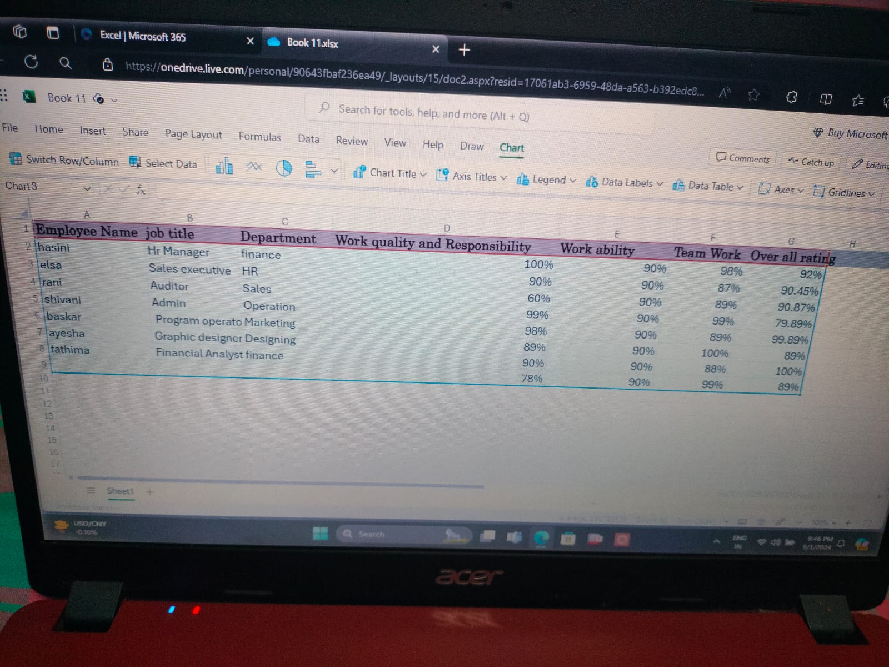

Slide 14
