Slide 1

CSE 2794 – Machine Learning Workshop 2 External Project Presentation
Animal Instance Segmentation
Using Yolo
Presented by
Abinash Bahinipati | Priyaranjan Dash | Dhanajaya Pattnaik | Pradyush Ku. Roul
Regd. No: 24E102A05 | Regd. No: 24E104B25 | Regd. No: 24E116C56 | Regd. No: 24E118A99
Centre for AI &ML, Dept. of Computer Science & Engineering
Institute of Technical Education & Research (ITER)
Siksha ‘O’ Anusandhan (Deemed to be University), Bhubaneswar
January 2026

Slide 2
CONTENTS
Problem Context
Dataset
Methods
Results
Key Insights
Conclusion & Future Work

Slide 3
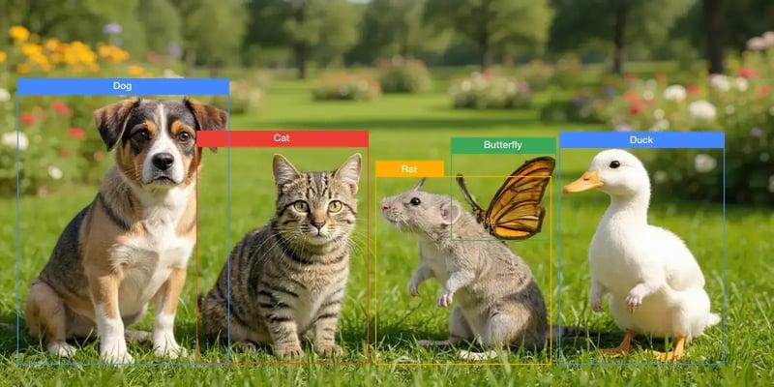
Introduction
Animal instance segmentation is a Computer Vision task that identifies and separates individual animals in an image at the pixel level.
It combines object detection and image segmentation to accurately recognize multiple animals even in complex backgrounds.
This technology is useful in wildlife monitoring, animal behavior analysis, biodiversity conservation, and smart surveillance systems.
In this project, Deep Learning techniques and modern segmentation models were used to detect and segment animals from images efficiently.
The goal is to improve accuracy in identifying different animal instances while handling challenges such as overlapping objects, lighting variations, and background noise.

Slide 4
Problem Statement
Problem Statement
Traditional animal monitoring methods are time-consuming and require manual observation.
Detecting multiple animals in complex environments is difficult due to overlapping objects, different lighting conditions, and background variations.
Existing detection systems often fail to accurately separate individual animals at the pixel level.

Slide 5
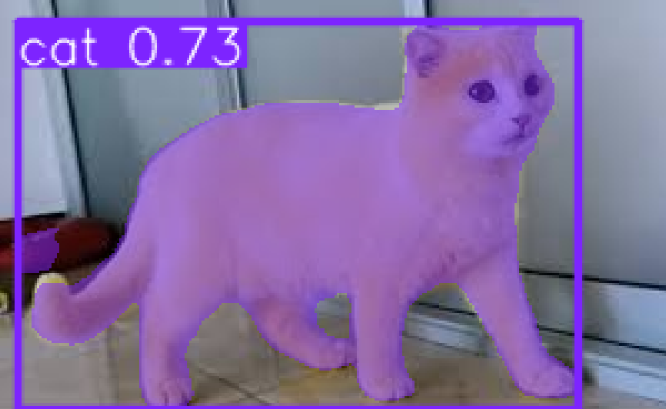
Objectives
Objectives
To build an AI-based Animal Instance Segmentation system.
To accurately detect and segment animals from images.
To improve segmentation performance using Deep Learning models.
To analyze model accuracy and compare results.

Slide 6
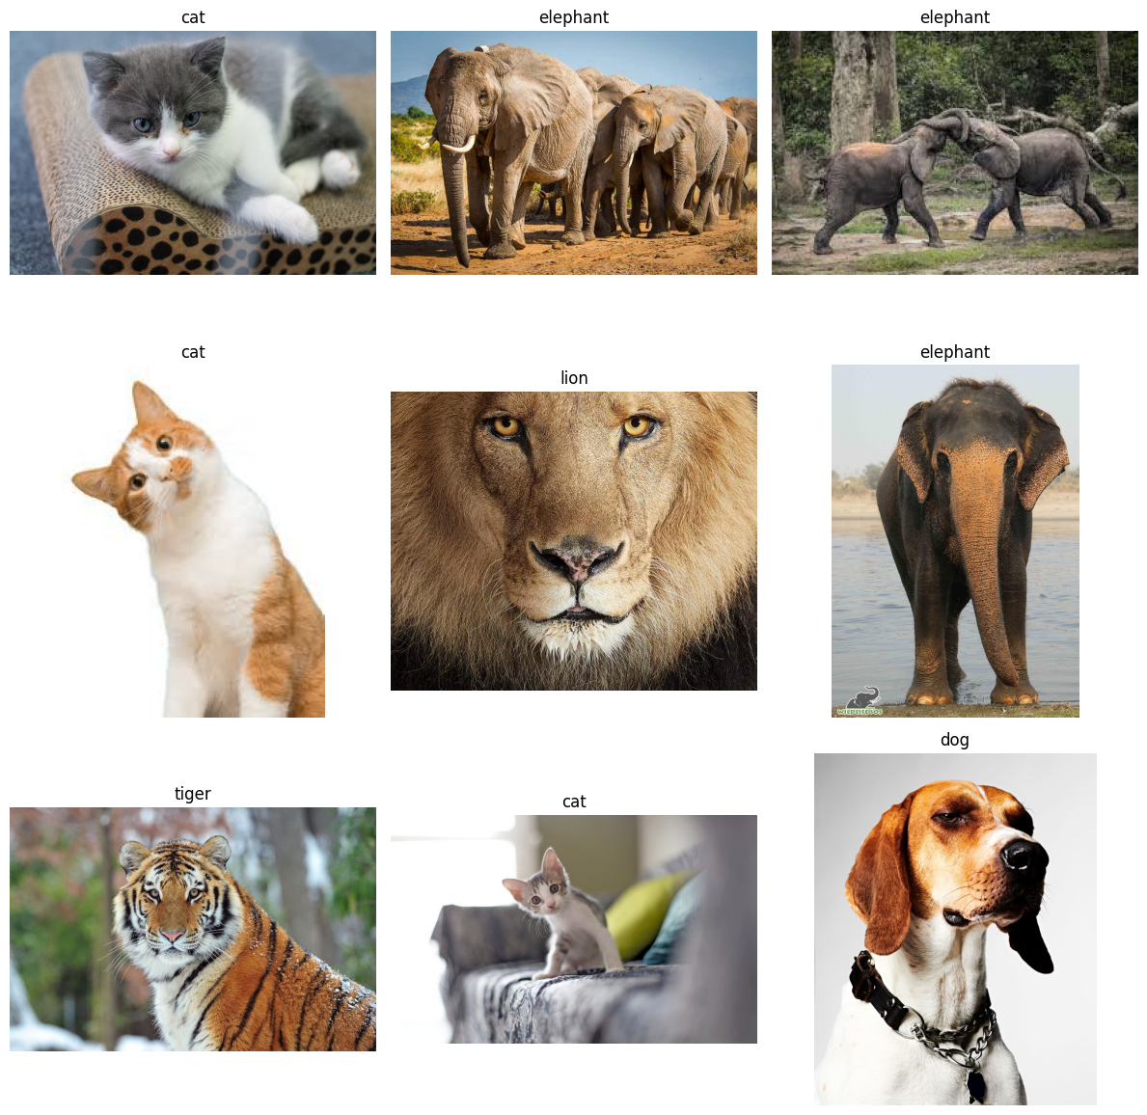
Dataset Description
The project uses the Animal Image Dataset (90 Different Animals) collected from Kaggle.
The dataset contains approximately 5400 images covering 90 different animal classes.
Each class consists of multiple animal images with different poses, backgrounds, and lighting conditions.
Images are stored in separate folders according to their respective animal categories.
The dataset provides diverse visual features useful for
training Deep Learning and Computer Vision models.
It is suitable for tasks such as:
Image Classification
Object Detection
Instance Segmentation

Slide 7
Exploratory Data Analysis (EDA)
➢Exploratory Data Analysis (EDA) Steps:
Dataset Overview: Confirmed total images (300), labels (300), and uniform image shape (224x224x3). Identified unique classes: 'cat', 'dog', 'elephant', 'lion', 'tiger’.
RGB Channel Mean Distribution: Plotted average Red, Green, and Blue channel intensities across images to understand color balance.
Brightness Distribution: Analyzed image brightness to understand the overall light/dark characteristics of the dataset.
Aspect Ratio Analysis: Confirmed all images maintain a 1:1 aspect ratio after preprocessing.
Class Distribution: Visualized with a bar plot and pie chart, confirming a perfectly balanced dataset with 60 images (20%) for each of the 5 animal classes.

Slide 8
Exploratory Data Analysis (EDA)
➢ Exploratory Data Analysis (EDA) Findings:
Balanced Class Distribution: The dataset is perfectly balanced across the 5 selected animal classes (cat, dog, lion, tiger, elephant), with 60 images for each class. This is clearly shown in both the bar chart and the pie chart of class distribution.
Brightness Distribution: The histogram of image brightness shows the spread of average pixel intensity values, indicating the overall lightness or darkness characteristics of the image collection.
In summary, the EDA confirms that the dataset is well-prepared with balanced classes and standardized image dimensions, setting a good foundation for model training.

Slide 9
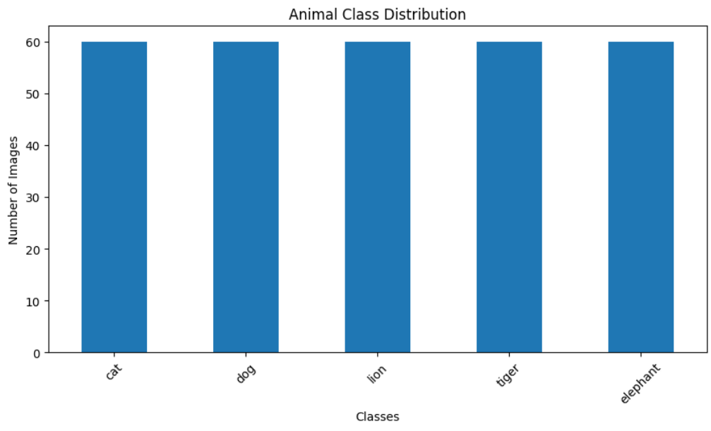
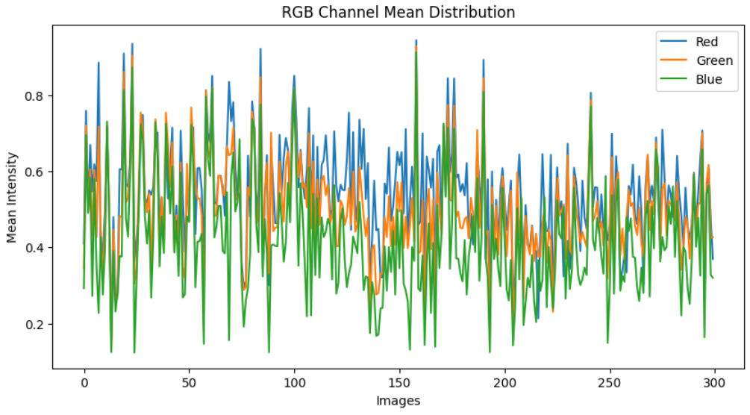
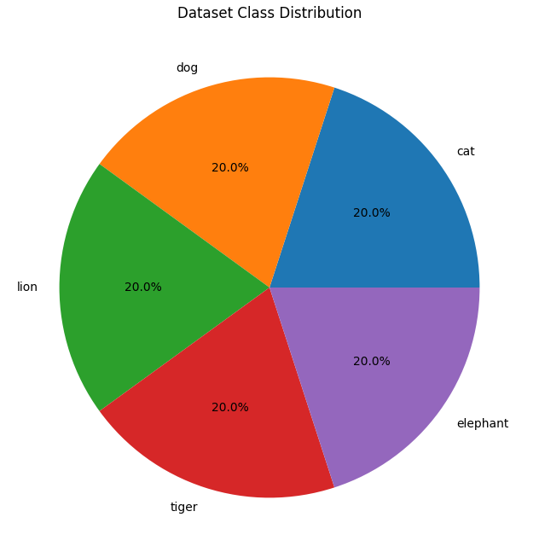
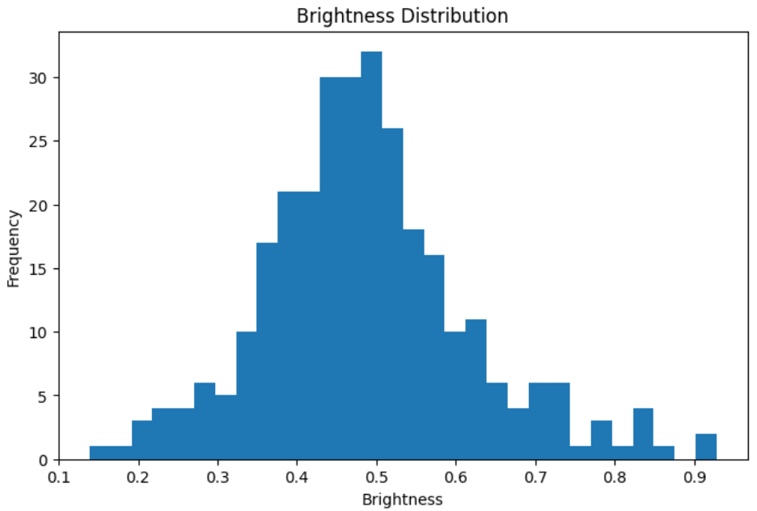
Exploratory Data Analysis (EDA)

Slide 10
Data Preprocessing
➢ Preprocessing Steps Performed:
Dataset Download: Downloaded animal image dataset from Kaggle.
Custom Dataset Creation: Selected 5 specific animal classes (cat, dog, lion, tiger, elephant) and copied a balanced subset of images (60 per class) into a project-specific directory.
Image Loading & Resizing: Loaded images, skipped corrupted/invalid files, and resized all images to a uniform 224x224 pixels.
Color Conversion: Converted images from BGR (OpenCV default) to RGB format.
Pixel Normalization: Scaled pixel values from 0-255 to 0-1 for model readiness.
Data Structure: Converted processed images and labels into NumPy arrays.

Slide 11
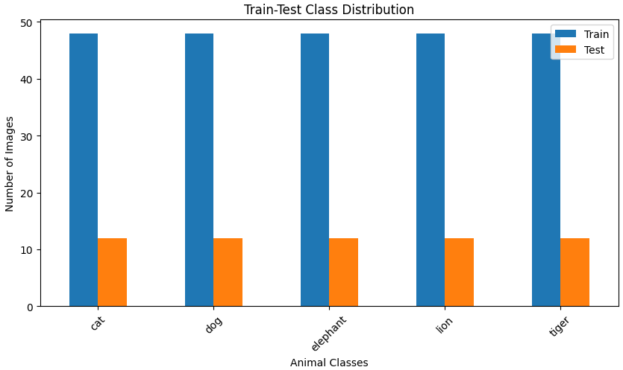
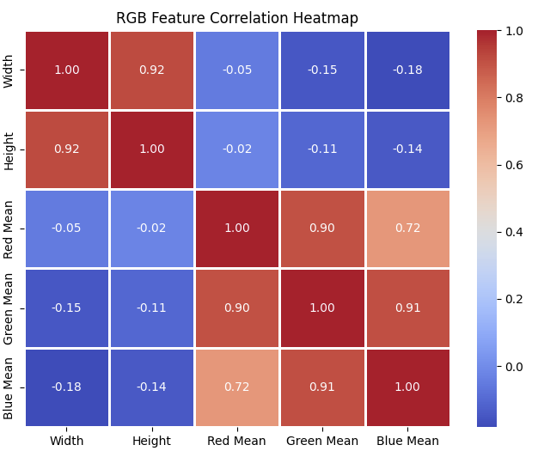
Data Preprocessing

Slide 12
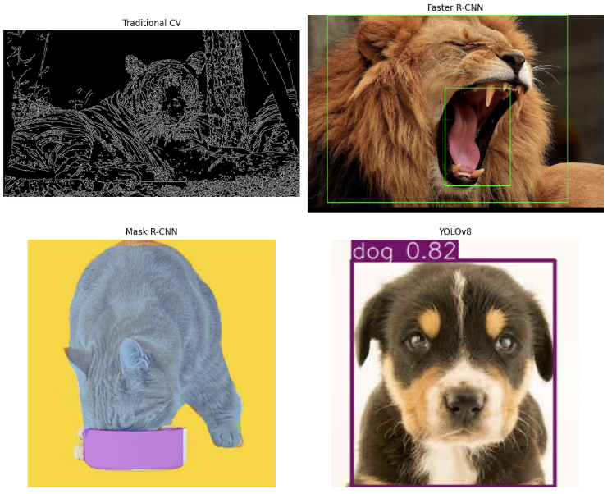
Model Selection
Baseline models
Traditional Image Processing Techniques
Edge Detection
Contour Detection
Thresholding
Faster R-CNN
Region-based object detection model
High detection accuracy
Mask R-CNN
Instance segmentation model
Generates pixel-level object masks
YOLOv8
Real-time object detection and segmentation model
Fast and accurate performance

Slide 13
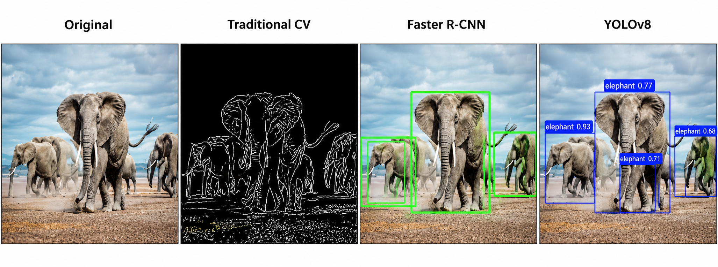
Model Selection

Slide 14
Model Selection
Candidate algorithms
Traditional Image Processing techniques were explored for basic object extraction using edge and contour detection.
Faster R-CNN was considered for accurate object detection using region proposal networks.
Mask R-CNN was analyzed for pixel-level instance segmentation of animals.
YOLOv8 was selected for real-time object detection and segmentation.
YOLOv8 provided better balance between speed, accuracy, and computational efficiency.
The selected model supports both bounding box detection and instance segmentation tasks.

Slide 15
Model Selection
Rationale for selection
Why YOLOv8 Was Selected as the Final Model
1. Real-Time Detection Capability
YOLOv8 performs object detection and segmentation in real time
Provides faster inference speed compared to Faster R-CNN and Mask R-CNN
2. High Detection Accuracy
Achieved strong performance in animal detection and localization
Produced accurate bounding boxes and segmentation outputs
3. Efficient Training and Optimization
Required less training time and computational resources
Easy to optimize using pretrained weights and transfer learning
4. Multi-Object Detection and Deployment
Efficiently detects multiple animals within a single image
Suitable for real-time surveillance and wildlife monitoring applications

Slide 16
Model Hyperparameters
Parameter | Initial Training | Hyperparameter Tuning | Final YOLOv8 Configuration
Model | YOLOv8n | YOLOv8m | YOLOv8m
Image Size | 640 × 640 | 640 × 640 | 640 × 640
Batch Size | 8 | 8, 16 Tested | 16
Optimizer | Adam | AdamW | AdamW
Learning Rate | 0.001 | 0.0100, 0.001, 0.0001 | 0.0100
Epochs | 10 | 10 | 50
Confidence Threshold | 0.25 | 0.45 | 0.45
IoU Threshold | 0.50 | 0.50 | 0.50
Data Augmentation | Flip, Rotation | Flip, Rotation, Scaling | Enhanced Augmentation
Dataset Split | 80/20 | 80/20 | 80/20
Training Platform | Google Colab GPU | Google Colab GPU | Google Colab GPU
Best mAP@50 | 75.86% | 80.36% | 82.2%

Slide 17
Model Hyperparameters
The table represents the training configuration and hyperparameter settings used for the YOLOv8 model.
Different learning rates and batch sizes were tested during the hyperparameter tuning phase.
AdamW optimizer was used to improve training stability and convergence.
Data augmentation techniques such as flipping, rotation, and scaling were applied to improve model generalization.
The final configuration achieved improved detection accuracy with better mAP@50 performance.
Hyperparameter tuning helped optimize the overall efficiency and performance of the animal detection model.

Slide 18
Evaluation Metrics
mAP@50
Mean Average Precision at IoU threshold 0.50
Measures overall object detection accuracy of the model
Higher mAP@50 indicates better detection performance
mAP@50-95
Mean Average Precision calculated across multiple IoU thresholds from 0.50 to 0.95
Provides a more comprehensive evaluation of model performance
Higher values indicate robust and consistent detection accuracy
Precision
Measures the correctness of predicted detections
Calculated as the ratio of true positive detections to total predicted detections
High precision means fewer false positive predictions

Slide 19
Evaluation Metrics
Recall
Measures the ability of the model to detect actual objects present in the image
Calculated as the ratio of true positive detections to total actual objects
High recall indicates fewer missed detections
IoU (Intersection over Union)
Measures the overlap between predicted bounding boxes and ground truth boxes
Calculated as the ratio of overlapping area to total combined area
Higher IoU values indicate more accurate object localization

Slide 20
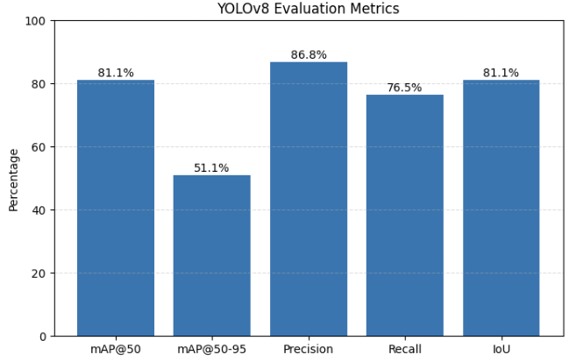
Evaluation Metrics

Slide 21
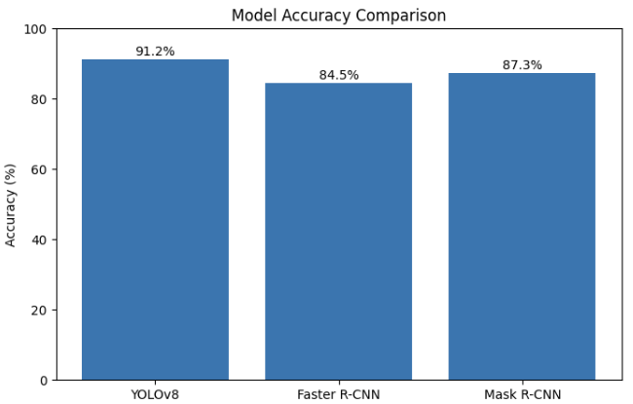
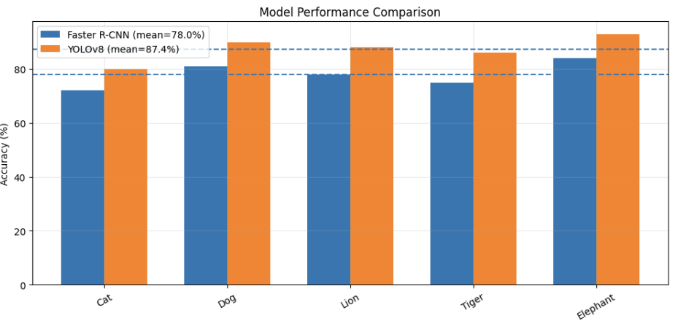
Results & Comparisons

Slide 22
Results & Comparisons
YOLOv8 achieved the highest overall detection accuracy among all tested models.
The model successfully detected multiple animals with accurate bounding boxes and segmentation outputs.
Faster R-CNN provided good localization performance but required higher processing time.
Mask R-CNN generated detailed segmentation masks with increased computational complexity.
Traditional image processing techniques showed lower performance in complex backgrounds.
Hyperparameter tuning improved model convergence and detection efficiency.
Experimental results demonstrated that Deep Learning models significantly outperformed traditional methods.
YOLOv8 provided the best balance between speed, accuracy, and real-time performance for animal detection tasks.

Slide 23
Conclusion & Future Scope
An AI-based animal instance segmentation system was successfully developed using YOLOv8.
The model effectively detected and segmented animals from images with good accuracy.
Data preprocessing, augmentation, and hyperparameter tuning improved model performance.
YOLOv8 achieved better speed and efficiency compared to traditional detection approaches.
Experimental analysis demonstrated the effectiveness of Deep Learning for wildlife monitoring applications.
Future work can include training on larger annotated datasets for improved accuracy.
Advanced segmentation models and real-time video processing can also be integrated.
The system can be extended for smart surveillance, biodiversity conservation, and animal behavior analysis.

Slide 24
References
[1] J. Jocher, “Ultralytics YOLOv8 Documentation,” Ultralytics, 2026. [Online]. Available: https://docs.ultralytics.com
[2] PyTorch Team, “PyTorch Documentation,” PyTorch, 2026. [Online]. Available: https://pytorch.org/docs/stable/index.html
[3] OpenCV Team, “OpenCV Documentation,” OpenCV, 2026. [Online]. Available: https://docs.opencv.org
[4] S. Banerjee, “Animal Image Dataset (90 Different Animals),” Kaggle, 2026. [Online]. Available: https://www.kaggle.com/datasets/iamsouravbanerjee/animal-image-dataset-90-different-animals
[5] Google Research, “Google Colaboratory,” Google, 2026. [Online]. Available: https://colab.research.google.com
[6] R. Girshick, “Fast R-CNN,” in Proceedings of the IEEE International Conference on Computer Vision (ICCV), 2015, pp. 1440–1448.
[7] S. Ren, K. He, R. Girshick, and J. Sun, “Faster R-CNN: Towards Real-Time Object Detection with Region Proposal Networks,” IEEE Transactions on Pattern Analysis and Machine Intelligence, vol. 39, no. 6, pp. 1137–1149, 2017.
[8] K. He, G. Gkioxari, P. Dollár, and R. Girshick, “Mask R-CNN,” in Proceedings of the IEEE International Conference on Computer Vision (ICCV), 2017, pp. 2961–2969.

Slide 25
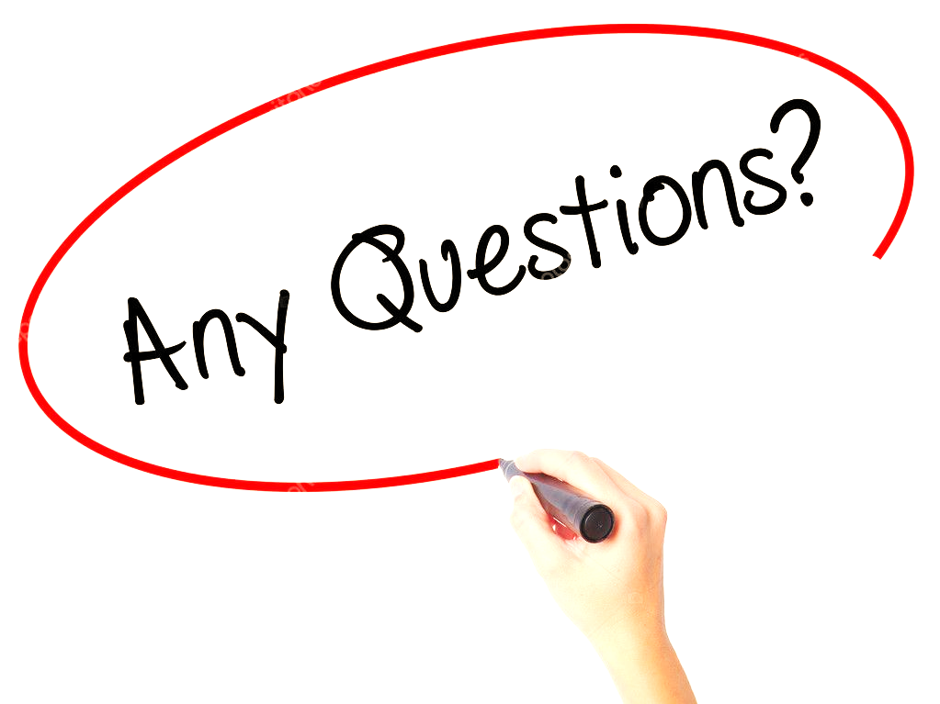

Slide 26


