Slide 1


Enhancing Program Success
Abinash Dhakal
Notes:
welcome to today's presentation on "Enhancing Program Success." I am Abinash Dhakal, and I am excited to guide you through our efforts, strategies, and insights aimed at maximizing the impact of our programs at Bookmark.

Slide 2

BookMark overview
Establishment Year: 2018
Mission: Igniting the Joy of Reading
Addressing a Critical Need:
7.1 million struggling adults
Over 1 in 4 children in England unable to read well
Unique Approach:
Volunteer-led reading programs
In-person and online opportunities
Community Impact:
2,267 children reached in 2022/23
40,100 one-to-one reading sessions delivered
Notes:
In 2018, Bookmark was founded with a clear mission: to ignite the joy of reading. We recognized a critical need, with 7.1 million struggling adults and over a quarter of children in England facing challenges in reading. Our response was unique—volunteer-led reading programs, offered both in-person and online, providing diverse opportunities. The impact on the community has been profound, reaching 2,267 children in the academic year 2022/23 and delivering an impressive 40,100 one-to-one reading sessions. This simple yet effective approach highlights Bookmark's dedication to making a real difference in promoting literacy and education.

Slide 3
Executive summary
Online Preference Dominance: Nearly 90% express a strong inclination towards online school reading programs, signaling a profound opportunity for nationwide influence.
Strategic Expansion Insight: Embrace the potential of targeted marketing, focusing on online platforms, to amplify the popularity of online programs and extend reach across the UK.
Cancellations Hotspot: England - London records the highest cancellations at 21,928, underscoring the urgency for targeted interventions and tailored solutions.
Winter Engagement: Launch targeted campaigns in winter to invigorate volunteer participation, countering the seasonal decline and ensuring sustained community backing.
Notes:
In a nutshell, our executive summary reveals a significant preference for online school reading programs, with almost 90% of participants inclined towards them. This highlights a fantastic opportunity for nationwide influence. To make the most of this, we suggest a strategic expansion focusing on online platforms, amplifying the popularity of our programs across the UK. On the flip side, there's a challenge - London has the highest cancellations at 21,928, emphasizing the need for targeted solutions. To tackle this, we propose launching winter campaigns to boost volunteer participation and ensure ongoing community support.

Slide 4
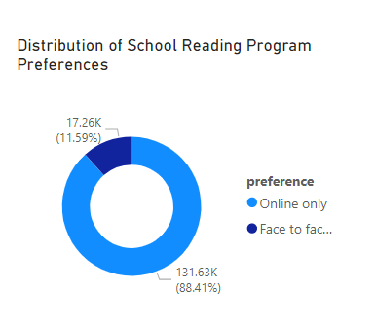
School Reading Program Preferences: Online vs. Face-to-Face
Online Preference: Nearly 90% of participants prefer online school reading programs over face-to-face sessions, indicating a strong inclination towards digital platforms.
Strategic Expansion: Leverage the popularity of online programs by expanding outreach through targeted marketing, ensuring accessibility and engagement for participants nationwide.
National Contribution: Expanding online programs presents a significant opportunity to contribute nationally, extending beyond the organization's London base and making a broader impact on education across the UK.
Notes:
let's delve into the preferences of our school reading programs: online versus face-to-face. Our data reveals a striking online preference - close to 90% of participants favor online school reading programs over traditional face-to-face sessions. This underscores a robust inclination towards digital platforms among our audience.
Now, how can we capitalize on this trend? It's all about strategic expansion. We must leverage the popularity of online programs by expanding our outreach through targeted marketing efforts. This approach ensures accessibility and engagement for participants nationwide, tapping into a broader audience and maximizing our impact.
Moreover, let's not overlook the significance of our national contribution. By expanding our online programs, we have the opportunity to contribute nationally, reaching beyond our London base and making a meaningful impact on education across the entire UK.

Slide 5
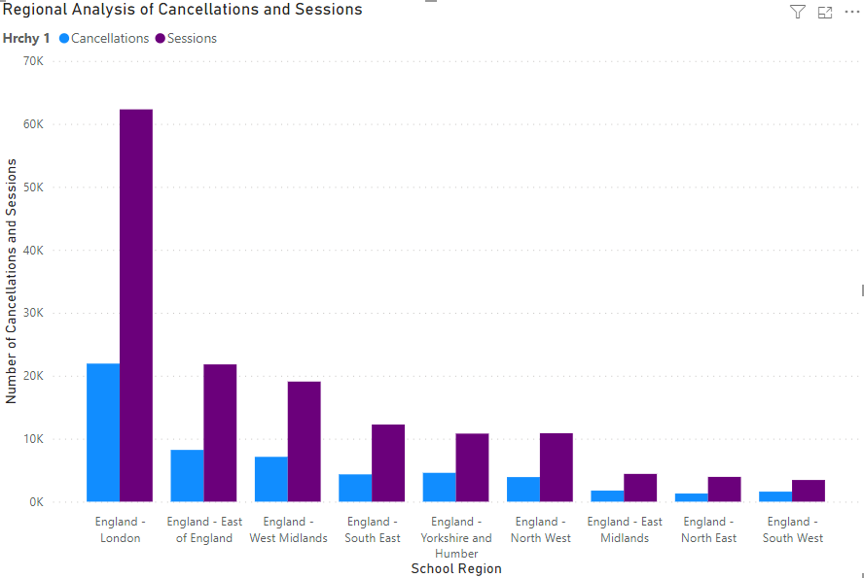
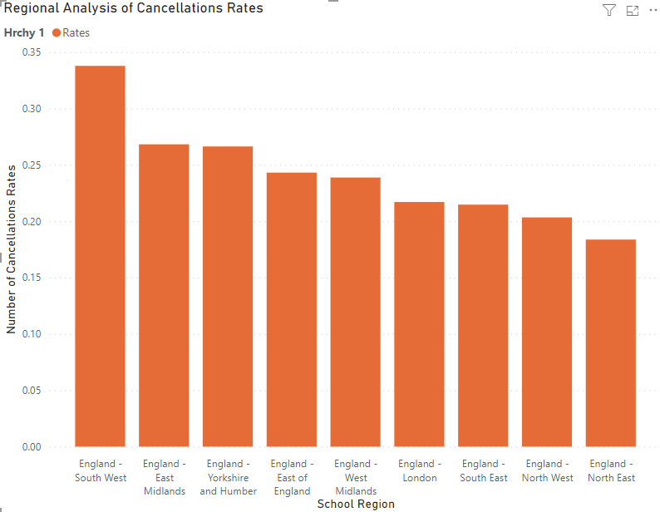
Regional performance analysis
Highest Cancellations: England - London recorded the highest cancellations, totaling 21,928.
Highest Sessions: England - London also had the highest number of sessions, reaching 62,307.
High Cancellation Rate: England - East of England exhibited a high cancellation rate, with 2,219 cancellations per session.
Balanced Performance: England - West Midlands maintained a balanced performance with 7,118 cancellations and 19,073 sessions.
Lowest Cancellations: England - South West had the lowest cancellations, totaling 1,590.
Overall Trend: Cancellation rates vary across regions, indicating the need for targeted interventions, especially in regions with high cancellations and low sessions.
Survey and Analysis: Carry out a comprehensive survey to understand the reasons behind cancellations and identify opportunities for improving sessions.
Conversion Rate: Implement strategies to increase the conversion rate for a higher turnout in sessions.
A specific reasons for cancellations and enhancing overall attendance and program success.
Improving the conversion rate will result in a higher turnout
Notes:
let's delve into our regional performance analysis to uncover insights that will shape our future strategies. Starting with the facts - the data indicates that England - London stands out with the highest cancellations, a significant 21,928 in total. Interestingly, it also boasts the highest number of sessions, reaching an impressive 62,307.
Now, when we zoom in on the performance of England - East of England, we observe a concerning trend. This region exhibits a notably high cancellation rate, with 2,219 cancellations per session. On the flip side, England - West Midlands maintains a more balanced performance, registering 7,118 cancellations alongside 19,073 sessions.
Highlighting the positive, England - South West emerges as a beacon of efficiency with the lowest cancellations, totaling a commendable 1,590. However, the overall picture unveils a diverse landscape where cancellation rates vary across regions, signaling a critical need for targeted interventions, especially in areas grappling with high cancellations and low session numbers.
To gain deeper insights, our proposed action plan involves conducting a comprehensive survey and analysis. This will unveil the specific reasons behind cancellations, providing a roadmap for improvement. Additionally, we aim to enhance our conversion rate, implementing strategies that ensure a higher turnout in sessions. Addressing these specific reasons for cancellations and enhancing overall attendance are pivotal steps. Improving the conversion rate not only mitigates cancellations but also promises a higher turnout, amplifying the impact and success of our programs.

Slide 6
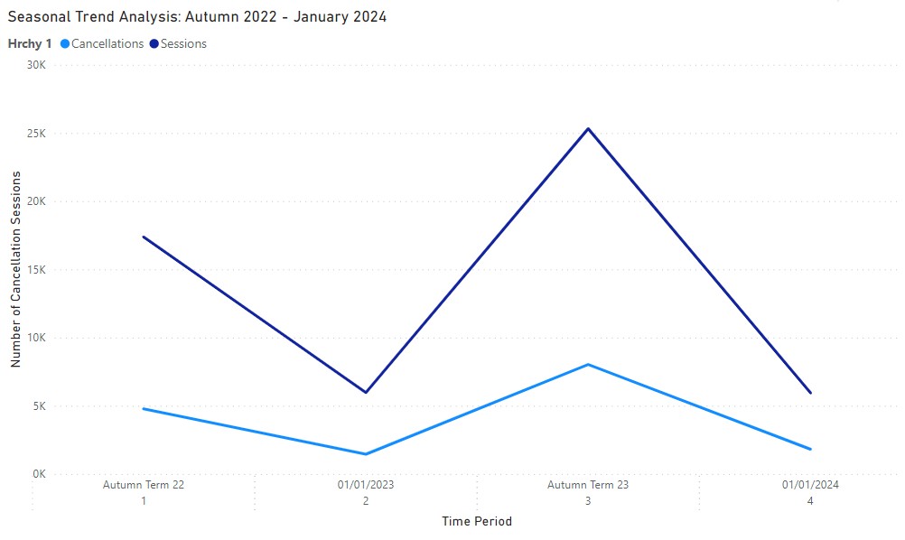
Seasonal Trend analysis
Cancellations Increase: Cancellations rose from 52,525 in Autumn Term 22 to 65,692 in Autumn Term 23, suggesting potential shifts in operational strategies.
Decrease in Total Sessions: Total sessions decreased significantly from 784,579 to 88,297 between the two periods, indicating a notable change in the overall operational landscape.
Targeted Campaigns and Incentives: Implement targeted campaigns or incentives to increase volunteer participation during the winter months.
By boosting volunteer engagement during winter, there could be an increase in the number of sessions conducted, addressing the seasonal decline observed and ensuring consistent community support.
Notes:
let's talk about our seasonal trend analysis. We've noticed a rise in cancellations, going from 52,525 in Autumn Term 22 to 65,692 in Autumn Term 23. Alongside this, there's a significant drop in total sessions from 784,579 to 88,297 between the two periods, signaling a notable change in how we operate.
To address this, we're proposing some solutions - targeted campaigns and incentives. The idea is to run these during the winter months to boost volunteer involvement and counter the seasonal dip. The goal is more sessions and consistent community support.
So, what we've found is a need for a strategy shift, and our recommendation is clear: run targeted campaigns in winter to up volunteer participation and keep the community support strong. The impact? A better-performing program and a more engaged community.

Slide 7
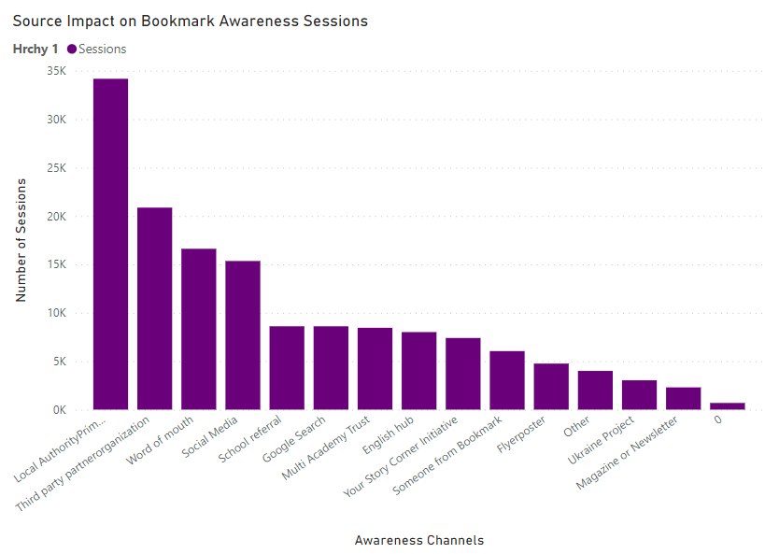
Source Distribution Impact on Bookmark Awareness
Key Sources of Awareness: The top three sources contributing significantly to Bookmark awareness are Local Authority Primary Advisor, Third-party partner organizations, and Word of Mouth, with sessions ranging from 34,172 to 16,614.
Leverage Successful Channels: Capitalize on the success of channels such as Local Authority Primary Advisor and Third-party partner organizations by strengthening partnerships.
Targeted Campaigns: Initiate targeted campaigns to boost engagement through Word of Mouth, recognizing its effectiveness in spreading awareness.
A strategic focus on these effective channels can lead to increased awareness, potentially attracting more volunteers and supporters.
This, in turn, will have a positive impact on Bookmark's mission and outreach, fostering a larger and more engaged community.
Notes:
let's dive into the impact of our source distribution on Bookmark awareness. Our analysis shows that the top contributors to our awareness are Local Authority Primary Advisor, Third-party partner organizations, and Word of Mouth, with sessions ranging from 34,172 to 16,614.
Now, what we've found is that we need to leverage these successful channels. We're suggesting to capitalize on the success of Local Authority Primary Advisor and Third-party partner organizations by strengthening our partnerships with them. Additionally, we propose initiating targeted campaigns through Word of Mouth, recognizing its effectiveness in spreading awareness.
So, here's the key takeaway - a strategic focus on these effective channels can lead to increased awareness, potentially attracting more volunteers and supporters. And what's the impact of this? Well, it'll have a positive effect on Bookmark's mission and outreach, fostering a larger and more engaged community.

Slide 8
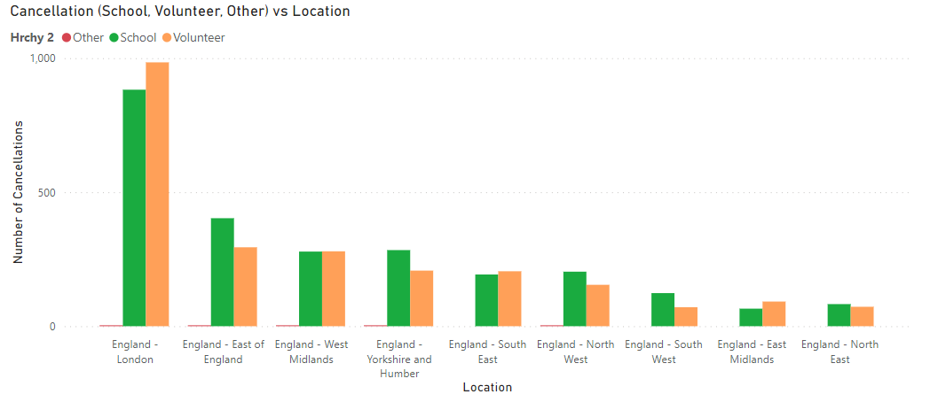
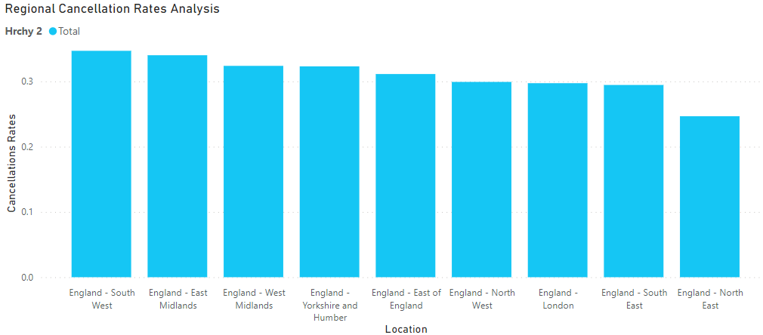
Source Distribution Impact on Bookmark Awareness
Regional Disparities: England - London exhibits the highest number of cancellations at 984.50, with England - East of England following closely at 294.50 cancellations.
Higher Cancellation Rates: Regions like England - South West (0.35), East Midlands (0.34), and West Midlands (0.32) experience elevated cancellation rates.
Targeted Interventions: Implement focused campaigns and interventions in high-cancellation regions to address specific challenges effectively.
Evaluate Online Volunteering: Conduct a thorough analysis to understand the impact of online volunteering on cancellation rates.
Enhanced Awareness: Implementing targeted campaigns can lead to increased visibility and awareness of programs, attracting committed individuals and reducing cancellations.
Improved Program Success: Addressing region-specific challenges and evaluating online volunteering can optimize program success, fostering a sense of responsibility among participants.
Notes:
break down the impact of our source distribution on Bookmark awareness. We've identified some regional disparities that need attention. England - London has the highest number of cancellations at 984.50, closely followed by England - East of England at 294.50 cancellations.
Now, the challenge lies in regions like England - South West (0.35), East Midlands (0.34), and West Midlands (0.32), experiencing elevated cancellation rates. Our recommendation is clear - we need to implement focused campaigns and interventions in these high-cancellation regions to address specific challenges effectively.
To gain deeper insights, we'll also conduct a thorough analysis to understand the impact of online volunteering on cancellation rates. The idea is to evaluate how this aspect influences our operations.
Now, why are we doing this? By implementing targeted campaigns, we aim to achieve enhanced awareness. This means increased visibility and awareness of our programs, which in turn, should attract more committed individuals and reduce cancellations.
And the impact of all these efforts? Improved program success, fostering a sense of responsibility among participants and ensuring Bookmark's mission resonates more effectively in these regions.

Slide 9
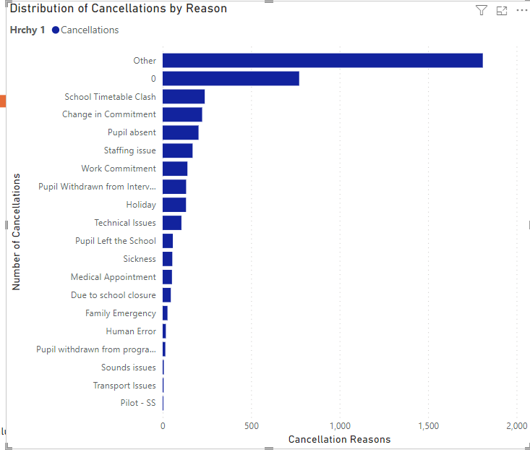
Cancellation Analysis and Recommendations
High Cancellation Rate for "Other" Reasons: Further Investigation Required.
Significant Cancellations due to "School Timetable Clash" and "Change in Commitment":
Conduct a quantitative survey to gain comprehensive insights into the specific reasons behind "Other" cancellations
Address Scheduling Conflicts and Commitment Concerns.
Leverage survey insights for strategic planning, ensuring a proactive and informed approach to program optimisation.
Notes:
Let's delve into the cancellation analysis and recommendations. We've identified a high cancellation rate for "Other" reasons, and to understand this better, further investigation is required. We want to leave no stone unturned in gaining comprehensive insights into these specific "Other" cancellations.
What did we find? There are significant cancellations due to "School Timetable Clash" and "Change in Commitment". To address these issues, our recommendation is clear - we need to conduct a quantitative survey. This survey will serve as a valuable tool, providing us with detailed insights into the specific reasons behind these "Other" cancellations.
Our focus is to address scheduling conflicts and commitment concerns effectively. How? By leveraging the insights gained from the survey for strategic planning. This proactive and informed approach is crucial for program optimization.
In summary, we are not just identifying challenges; we are taking proactive steps to understand, address, and optimize our programs for improved success.

Slide 10
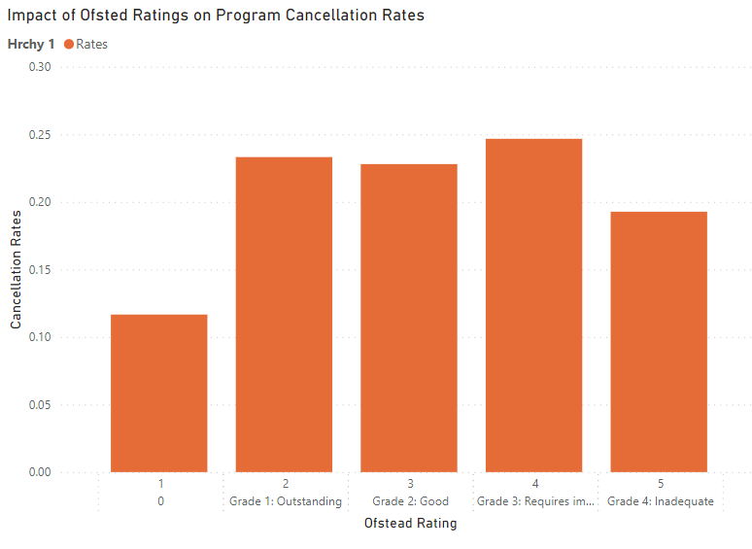
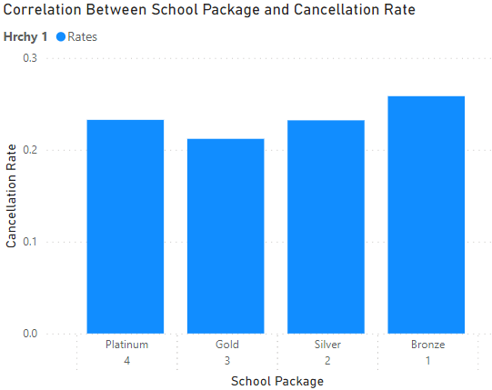
Impact and Recommendations: Ofsted Ratings and School Packages
Lack of Significant Correlation: Analysis shows no substantial link between Ofsted ratings and cancellation rates (0.19 to 0.25), highlighting the need for a nuanced approach.
School Package Variation: Varied cancellation rates across packages; Platinum (0.23) to Bronze (0.26). Tailor strategies based on package features.
Community Involvement: Community participation significantly affects Ofsted ratings. Encourage schools to engage in community service for higher ratings.
Evaluate School Package Features: Thoroughly assess features in each school package to identify factors influencing cancellation rates.
Incorporate Community Influence: Make community involvement a key factor in Ofsted ratings, fostering active school participation in community service.
Enhanced School Recognition: Tailor school packages based on cancellation rates for improved school recognition.
Notes:
Let's explore the impact and recommendations for Ofsted ratings and school packages. Our analysis reveals a lack of significant correlation between Ofsted ratings and cancellation rates, emphasizing the need for a nuanced approach. Numbers indicate a correlation ranging from 0.19 to 0.25.
What did we find? There's variation in cancellation rates across packages, from Platinum (0.23) to Bronze (0.26). Recognizing this diversity, our recommendation is to tailor strategies based on package features. Each package requires a specific, customized approach to address its unique characteristics.
The key here is community involvement. We've discovered that community participation significantly impacts Ofsted ratings. Our recommendation is clear – encourage schools to engage in community service for higher ratings. This not only enhances the school's standing but also contributes positively to the community.
We're not stopping there. To ensure a comprehensive approach, it's vital to evaluate school package features thoroughly. Understanding the factors influencing cancellation rates is crucial. This evaluation will guide us in making informed decisions to optimize the success of our programs.
Moreover, we propose to incorporate community influence directly into Ofsted ratings. By making community involvement a key factor, we aim to foster active school participation in community service. This integration will contribute to a more holistic evaluation and recognition of schools.

Slide 11
Conclusion:
Focused Campaigns: Develop targeted initiatives to address cancellation hotspots, particularly in England - London.
Online Engagement Optimization: Investigate the impact of online volunteering and formulate tailored outreach strategies to effectively reduce cancellations.
Community Integration: Promote community involvement in schools to elevate Ofsted ratings and cultivate positive community impacts.
Continuous Evaluation: Introduce a quantitative survey to collect nuanced insights into cancellation trends, facilitating proactive adjustments for program success.
Notes:
In conclusion, our roadmap for success includes four key strategies:
Firstly, we'll initiate focused campaigns to tackle cancellation hotspots, especially in England - London. By addressing specific regions with high cancellation rates, we aim to mitigate challenges and ensure program sustainability.
Next, we'll delve into online engagement optimization. Understanding the impact of online volunteering is crucial. We'll conduct thorough research to develop tailored outreach strategies aimed at reducing cancellations effectively. Harnessing the power of digital platforms can enhance volunteer engagement and participation.
Thirdly, community integration is essential. We'll actively promote community involvement in schools, recognizing its significant impact on elevating Ofsted ratings and fostering positive community impacts. By strengthening ties with local communities, we can create a supportive environment for our programs to thrive.
Lastly, we'll prioritize continuous evaluation. Introducing a quantitative survey will allow us to gather nuanced insights into cancellation trends. This data-driven approach enables us to proactively adjust our strategies, ensuring program success and effectiveness in the long run.
By implementing these focused initiatives, optimizing online engagement, promoting community integration, and embracing continuous evaluation, we're poised to enhance our program's success and make a lasting impact on the communities we serve.

Slide 12
Any questions?

