Slide 1
Structural Effects of Metallicity on Circumstellar Discs
Abinash Dhakal
University of Bath
Department of Physics and Astronomy
Theoretical and Computational Physics
David Tsang
Notes:
Good morning, everyone.
My name is Abinash, and I am a student at the University of Bath, studying physics. For the past 15 weeks, I have been working on a project under the guidance of David Tsang, focusing on the impact of metallicity on circumstellar discs.

Slide 2
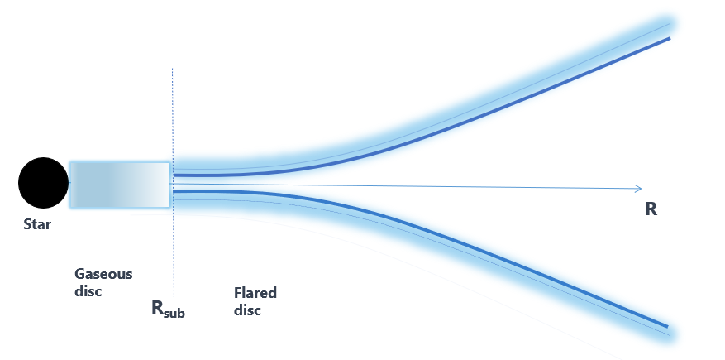
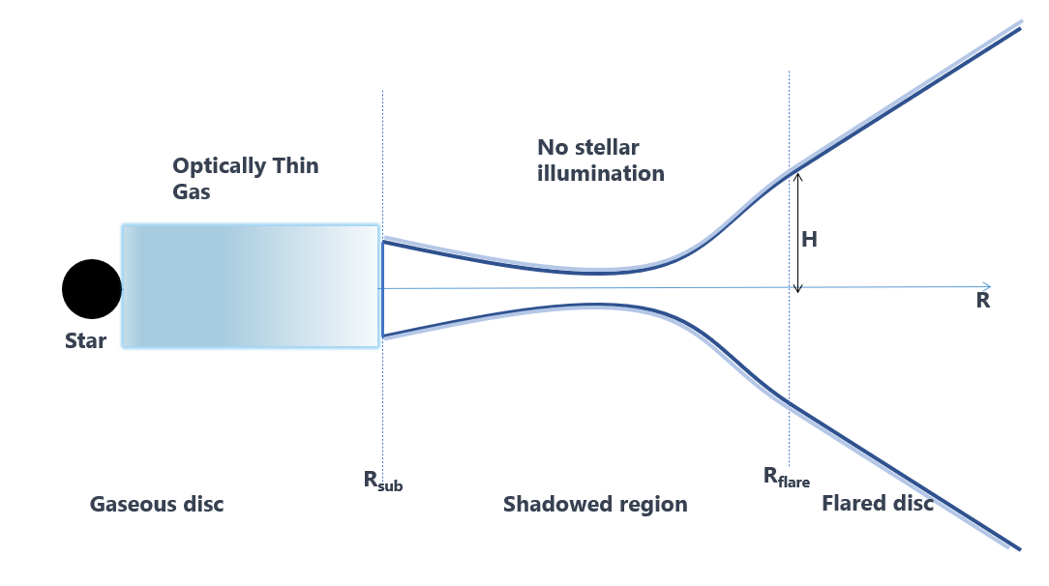
Aim
The aim of this presentation is to explore the relationship between metallicity and the shape of circumstellar discs.
Focus:
Absorption of stellar photon
Radiative transport in the disc
Notes:
Our study aims to explore whether an increase in the metallicity in the gaseous disc can have an impact on the shadowed region of the disc. An increase in metallicity may potentially eliminate the shadowed region.
Where did this theory come about?
While David was researching the excitation of giant planets and how the eccentricity of the planet's orbit is affected by the presence of the disk. During his research, he noticed a lack of giant planet population observations within a certain range, between 0.1 AU and 1 AU, in metal poor environments. This led him to theorize the existence of a shadowed region in which the observation of planets is more difficult since there is no direct stellar illumination.

Slide 3
Presentation Outline
Context
Aims
Relevant Background
Dusty Disc
Gaseous Disc
Method
1+1D radiative transfer
Diffusive heating
Radiative hydrodynamics
Metallicity
Result
Limitation
Conclusion
Notes:
Before we begin, let me quickly outline the structure of our presentation.
First, I will start by introducing the background and context of our topic.
Then, we will dive into the main body of our presentation, where we will cover the simulation set up and result for dusty disc. Following that, we will re-evaluate the simulation set up and result to include gaseous discs. After that, we will move on to a discussion of the limitations within our model. Finally, we will move on to the conclusion, where we will summarize the key takeaways from our simulations .
The initial vertical line in this dusty disc shows where the sublimation of dust takes place. This separates the regions for the gaseous disc and dusty disc in a circumstellar disc.

Slide 4
Dusty disc Background
Motivation
Method
1+1D radiative transfer
Inner disc clearing mechanism
Photoevaporation
Giant planet formation
Inside out disc formation
Exoplanet
Self-consistent surface density profile
Notes:
The discovery of exoplanets and the availability of data on protoplanetary discs have greatly expanded our understanding of planet formation, revealing wide range of configurations.
In our study, we evaluated the accuracy of models using 1+1D radiative transfer and self-consistent surface density profiles to calculate the vertical structure of the circumstellar disc. However, this method can become challenging to use for two- and three-dimensional problems.
So, what creates the inner hole in circumstellar discs?
There have been several theories proposed to explain the existence of holes within circumstellar discs. These include the idea that stellar radiation can provide enough energy to the gas to exceed the gravitational potential, formation of giant planets , and magneto-rotational instability leading to inside-out evacuation resulting in inner hole and dust-free region.

Slide 5
Gaseous disc Background
Optically thick gaseous disc
Planck mean opacity
Determine gas equilibrium temperature
Model
Dusty Disc: Dullemond et al.
Extinction under different metallicities
Opacity: Malygin, Draine & Lee
Total absorption of gas
Notes:
There is evidence that the inner gaseous part of the disc around Herbig star are optically thick. Studies by Malygin found that the gas opacity in a optically thin gas disc can significantly impact the extinction of stellar radiation at different metallicities. This effect is particularly pronounced when the equilibrium temperature of the gas is higher than the local dust sublimation temperature.
To understand this, we use the two-temperature Planck mean to determine the equilibrium temperature of an optically thin gas and measure the total absorption of gas.
Our model is based on the work of Dullemond for the structure of the dusty disc, and Malygin and Draine & lee for the opacities of the gaseous and dusty regions respectively.

Slide 6
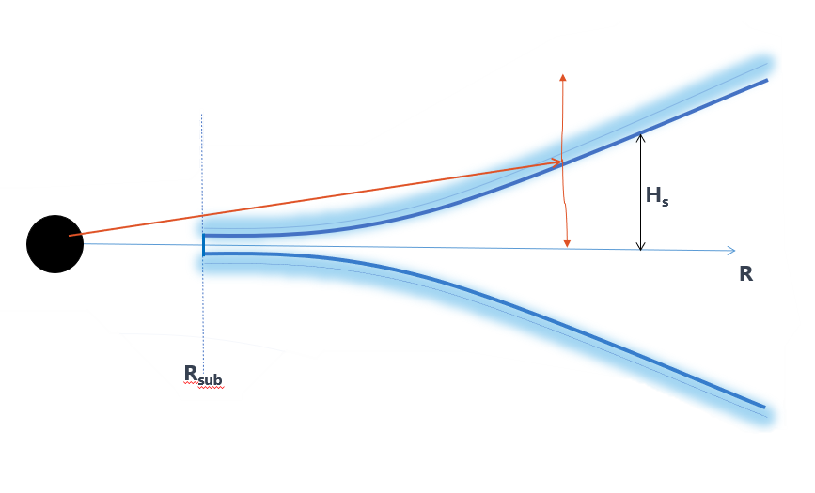

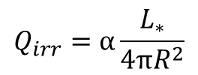

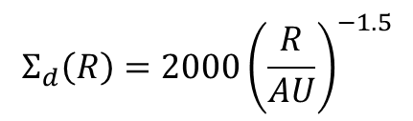

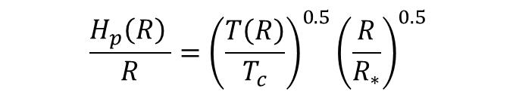

Flared Disc: Dullemond Model
Flaring angle
$$α≈\frac{0.4R_{∗}}{R}+\left(γ−1\right)\frac{H_{s}}{R}$$
Irradiation Flux
$$Q_{irr}=α\frac{L_{∗}}{4πR^{2}}$$
Cooling Flux
$$Q_{cool}=σT^{4}$$
Flaring geometry
$$\frac{1}{2}Q_{irr}=Q_{cool}$$
$$H_{s}\left(R\right)=χ\left(R\right)H_{p}\left(R\right)$$
Surface density profile
$$\frac{H_{p}\left(R\right) }{R}={\left(\frac{T\left(R\right)}{T_{c}}\right)}^{0.5}{\left(\frac{R}{R_{∗}}\right)}^{0.5}$$
$$Σ_{d}\left(R\right)=2000{\left(\frac{R}{AU}\right)}^{−1.5}$$
Notes:
This is a Dullemond model for dusty disc. The angle at which stellar radiation impinges on the disc surface affects the amount of energy transferred to the midplane of a disc. This can be estimated
using the vertical parallel-plane radiative transfer method. The second terms gradually vary to account for energy conservation.
Irradiation flux is the stellar flux along the midplane of the disc. This equation assumes that the surface of the disc is visible to the direct stellar photon emitted from the star. However, we will discuss later where this assumption may not hold true. Half of stellar radiation that impinge on the surface is emitted upward into surrounding while other half is re-emitted downward toward the midplane.
So what links the temperature with vertical height?
The χ(R) parameter lies between 2 and 6, but can be self-consistently determined from the grazing angle , the surface density and the Planck mean opacity at the stellar temperature.
The surface density follows power law of proportional to -1.5. The disk will be almost isothermal in the vertical direction, leading to a Gaussian density distribution with a constant pressure scale height.

Slide 7
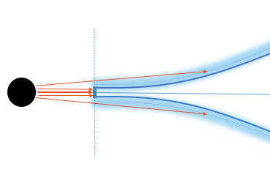
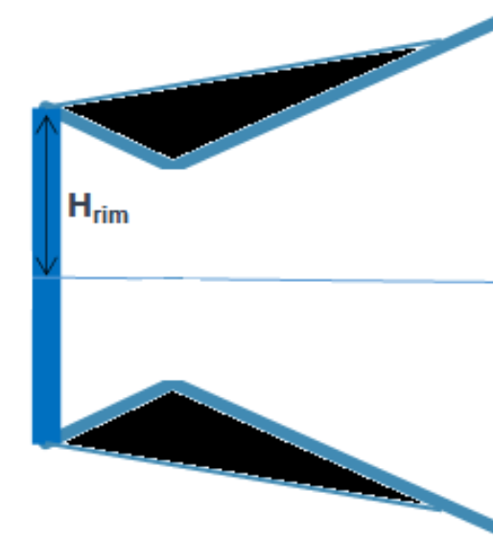

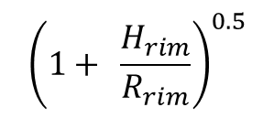
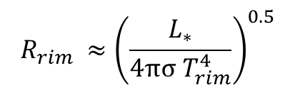
Dust evaporation and disc inner rim
Pure gas disc: Cleared by dust evaporation
Puffed-up rim: Face-on irradiation
Shadow region: Puffed-up rim casts shadow
Irradiation under small angle: Warm, not hot
Further out: Normal flaring disc
$$T_{evp}=1500 K$$
$$R_{rim} ≈{\left(\frac{L_{∗}}{4πσ T_{rim}^{4}}\right)}^{0.5}$$
$${\left(1+ \frac{H_{rim}}{R_{rim}}\right)}^{0.5}$$
No stellar
Illumination
Notes:
The interior of a circumstellar disc is made up of gas and extend up to the sublimation radius. For the time being, the gas inside the rim is considered transparent, so its influence on disc`s structure is ignored.
The vertical rim, exposed to direct stellar radiation, puffs up the inner rim because it is much hotter than the flaring disc at the same radius. This puffed-up rim casts a shadow and causes the temperature to rapidly drop below the inner rim of the disc. However, this drop in temperature is substantially lower than the temperature of optically thin dust at the same radius.
This rim radius is determined by equating the emitted black body flux, to the received flux from direct star radiation. The factor (1 + H_s R_{rim})^{0.5}) accounts for self-irradiation explains why the rim is much hotter than the flaring disc surface.
so what prevents disc from becoming unstable?
This is where diffusive heating comes in. Additional to stellar radiation, there is viscous heating and thermal conduction through the rim. This would prevent temperature from falling to zero and becoming unstable.

Slide 8
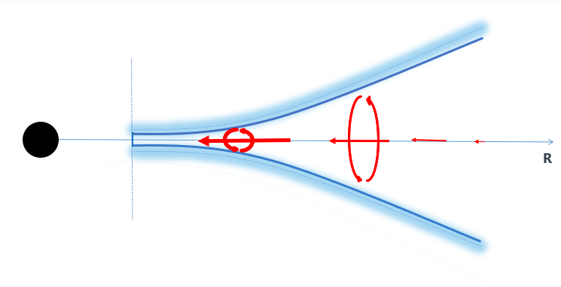

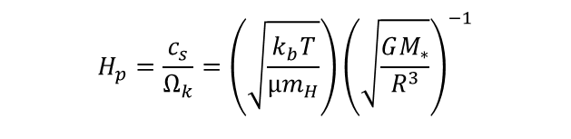
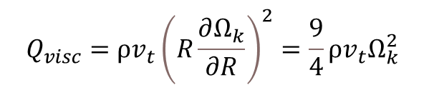

Viscous accretion
Viscous dissipation occurs due to vertical gradient of rotational frequency
Vertical convection may generate turbulence and dissipation
Viscous-prescription parameterised
$$α_{visc}={10}^{−2}$$
Viscous heating (derived from Navier-Stokes equation)
$$Q_{visc}=ρv_{t}{\left(R\frac{∂Ω_{k}}{∂R}\right)}^{2}=\frac{9}{4}ρv_{t}Ω_{k}^{2}$$
$$H_{p}=\frac{c_{s}}{Ω_{k}}=\left(\sqrt{\frac{k_{b}T}{μm_{H}}}\right){\left(\sqrt{\frac{GM_{∗}}{R^{3}}}\right)}^{−1}$$
$$v_{t}=α_{visc}H_{p}c_{s}$$
Notes:
So where does this viscous dissipation come from?
Vertical convection in circumstellar disc may generate turbulence and viscous dissipation through vertical motion. It is parametrised by Shakura-Sunyaev prescription of 10 to power of -2 for steady state accretion in passive circumstellar disc.
The presence of significant turbulent viscosity suggests that viscous dissipation must be considered in the energy balance. The viscous heating term can be derived from the Navier-Stokes equation by taking the scalar product in spherical coordinates with the dominant azimuthal velocity field.

Slide 9
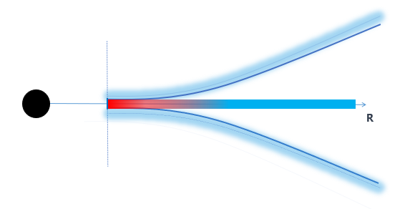


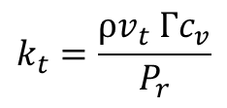
Thermal conduction
1D heat conduction equation for steady-state conduction and no internal heat generation
$$Q_{cond}=k_{t}∇T$$
Thermal conductivity
$$k_{t}=\frac{ρv_{t} Γc_{v}}{P_{r}}$$
Boundary conduction
$T(R_{rim})$ = 1500K
Prandtl number = 1
Notes:
The classical expression for thermal conductivity assumes a high-temperature gradient near the inner rim of the disc. This plays a significant role in the energy transport of hot gases in the inner region of discs.
The effect of thermal conduction on the internal energy of a system is linked to the influence of momentum eddy diffusivity and heat transfer eddy diffusivity through the turbulent Prandtl number. The Prandtl number describes how well heat is transferred in a fluid. The Prandtl number can be rearranged to derive the thermal conductivity (kt). In the context of protoplanetary discs, it is common to assume that the Prandtl number is equal to 1.
Why do we make this assumption?
One reason is that it simplifies the calculations and allows us to better understand the processes occurring within the disc. Another reason is that the disc is made up of gases, which tend to have Prandtl numbers close to 1.

Slide 10
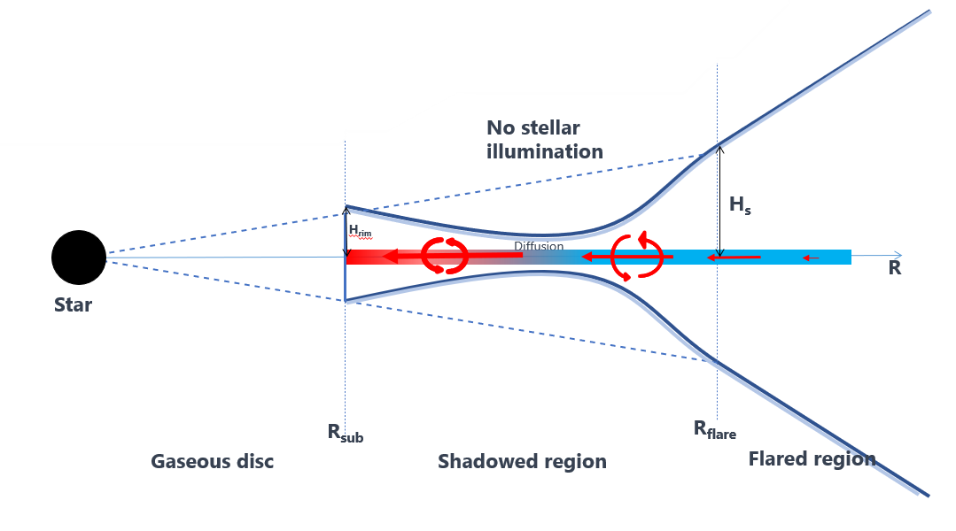
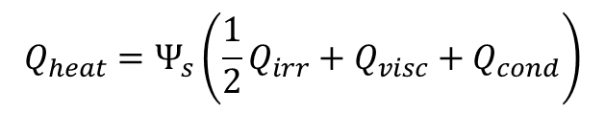


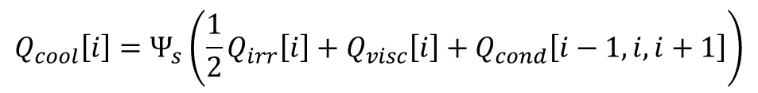

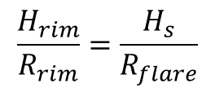



Heating term
$$FI<1$$
$$FI>1$$
$$Q_{heat}=Ψ_{s}\left(\frac{1}{2}Q_{irr}+Q_{visc}+Q_{cond}\right)$$
$$Q_{cool}=Ψ_{i}σT^{4}$$
$Ψ_{i}$ = $Ψ_{s}$= 1
$$Q_{cool}\left[i\right]=Ψ_{s}\left(\frac{1}{2}Q_{irr}\left[i\right]+Q_{visc}\left[i\right]+Q_{cond}\left[i−1,i,i+1\right]\right)$$
Flaring Index
$$\frac{H_{rim}}{R_{rim}}=\frac{H_{s}}{R_{flare}}$$
$FI=\frac{H_{s}}{R_{flare}}$ $\frac{R_{rim}}{H_{rim}}$
Notes:
As you may now know, the temperature of a circumstellar disc can be influenced by various heating sources such as viscous heating, thermal conduction, stellar irradiation and radiative cooling. To accurately calculate the midplane temperature of the disc, it is necessary to consider both the vertically integrated heating term and the radiative losses from the surface.
The dimensionless parameters Ψs and Ψi are incorporated into the model to consider the possibility of the disc not being fully opaque to both the surface layer emission and the disc's own emission. For our model, we assume optically thick disc meaning, Ψs = Ψi = 1.
The puffed-up rim of the disc intercepts the stellar radiation, casting a shadow on the outer disc and causing the temperature behind the shadow to drop significantly. At larger radii, the disc flares and re-emerges into the stellar heating. We can calculate the flaring radius using similar triangle properties.
To find the temperature of the entire disc, we use an iterative process which involves consistently recalculating the flaring index (FI ). This process involves identifying the shadowed region and flaring region of the disc.
For the flaring region, we equate the heating and cooling terms. For the shadowed region, we equate the heating and cooling equations but omit the irradiation term. The temperature profiles of both regions are then added to find the temperature profile of the whole disc.
We continue this process until the relative temperature difference between current and previous iterations falls below a certain threshold, typically set at < 1K.

Slide 11
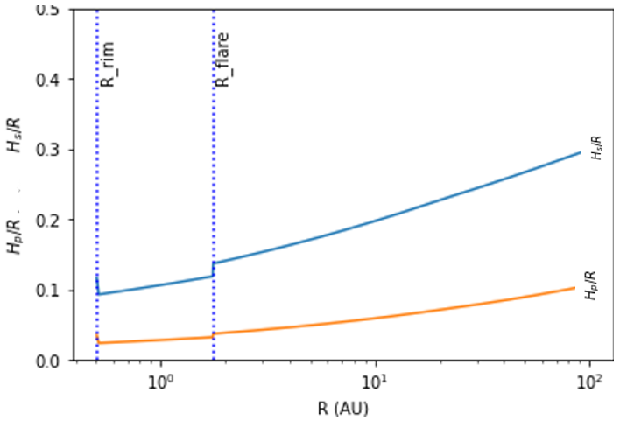
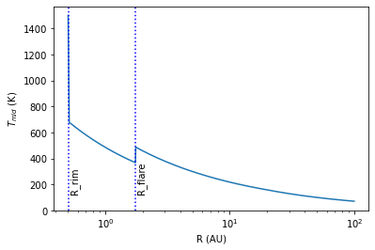

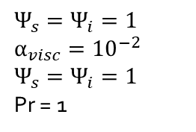
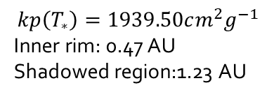
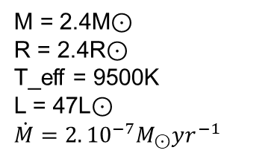
Results
M = 2.4M⊙
R = 2.4R⊙
T_eff = 9500K
L = 47L⊙
$$\dot{M}=2.{10}^{−7}M_{⊙}yr^{−1}$$
$$Ψ_{s}=Ψ_{i}=1$$
$$α_{visc}={10}^{−2}$$
$$Ψ_{s}=Ψ_{i}=1$$
Pr = 1
$$kp\left(T_{∗}\right)=1939.50cm^{2}g^{−1}$$
Inner rim: 0.47 AU
Shadowed region:1.23 AU
Notes:
The effect of viscous dissipation on the vertical structure of passive discs was calculated assuming a constant accretion rate of 2 x 10^-7 M yr^-1.The Planck mean opacity at the stellar temperature was calculated using the Draine & Lee opacity table and found to have an opacity of kp(T ) = 1939.50 cm2 g−1. The resulting temperatures in the circumstellar disc typically range from sublimation temperature of 1500K to ambient temperature of 30K. The inner edge of the disc is at 0.47 AU, and beyond this point the height of the disc declines rapidly. The inner edge of this region has a sharp temperature differential, which creates a large gradient and makes it harder for diffusive heating to converge.
Dullemond and others predicted a smooth curve in the temperature profile, including right behind the puffed rim, indicating appropriate heat transfer between consecutive grids. While a sudden change in the temperature profile may indicate an unstable system. This may be due to an inability to find the appropriate grid length to resolve the initial large gradient or the use of initial boundary conditions. The potential presence of shadowing effects can lead to numerical instability, which can be resolved by increasing the radial resolution. However, this resolution increase may also increase the risk of computational instability and require longer computational times.
The disc's outer edge gradient exhibits a typical flare, which is identified by a kink in the temperature.
The shadow encompasses all points on the disc up to the flaring radius, which has a radius of 1.23 AU. Later in this presentation, we will see how the inclusion of an interior gaseous disc changes the temperature profile of the disc.

Slide 12
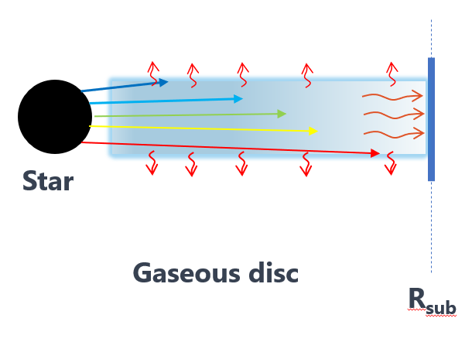
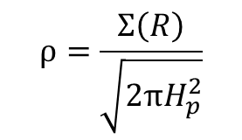
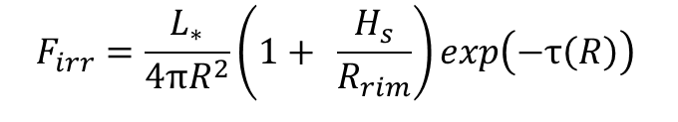
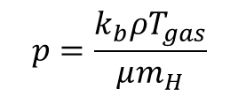
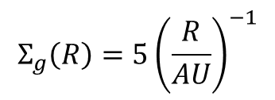
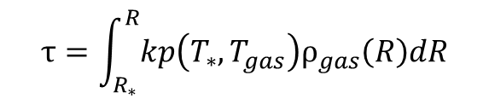
Radiative Transport
$$Σ_{g}\left(R\right)=5{\left(\frac{R}{AU}\right)}^{−1}$$
$$F_{irr}=\frac{L_{∗}}{4πR^{2}}\left(1+ \frac{H_{s}}{R_{rim}}\right)exp\left(−τ\left(R\right)\right)$$
$$τ=\int_{R_{∗}}^{R}{kp\left(T_{∗},T_{gas}\right)ρ_{gas}\left(R\right)dR}$$
$$p=\frac{k_{b}ρT_{gas}}{μm_{H}}$$
$$ρ=\frac{Σ\left(R\right)}{\sqrt{2πH_{p}^{2}}}$$
Notes:
The surface density of gas in a gaseous disc follows a power law relationship with radius, similar to that of a dusty disc. To model the radiative hydrodynamics of the gas in the disc, we use ideal gas equation, to relates the temperature and density of the gas through the pressure equation.
The Energy exchange between the gas and radiation depends on the relative temperatures, gas density, and gas absorption opacity. The gas absorption opacity is calculated using LinearNDInterpolator with publicly available data sets. It plays a crucial role in determining absorbed energy.
The sublimation radius, which was determined earlier in the presentation, is an upper bound estimate based on the assumption that dust grains at the puffed-up rim absorb all of the unabsorbed radiation from the star. However, if some of the stellar energy is absorbed by the gas, the outer distance can decrease by a scale factor of e−τ for small optical depth.

Slide 13
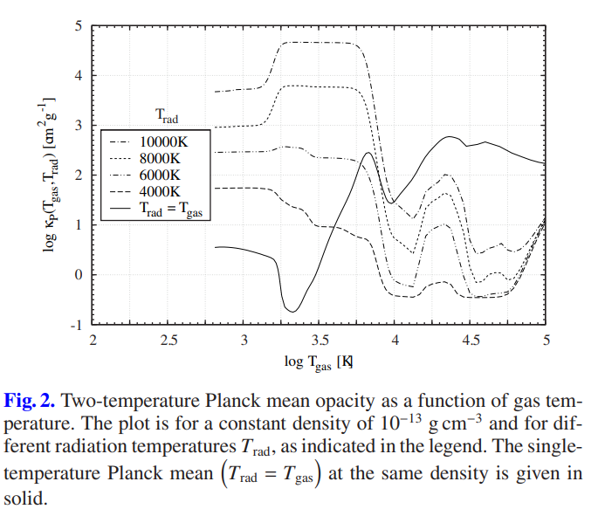
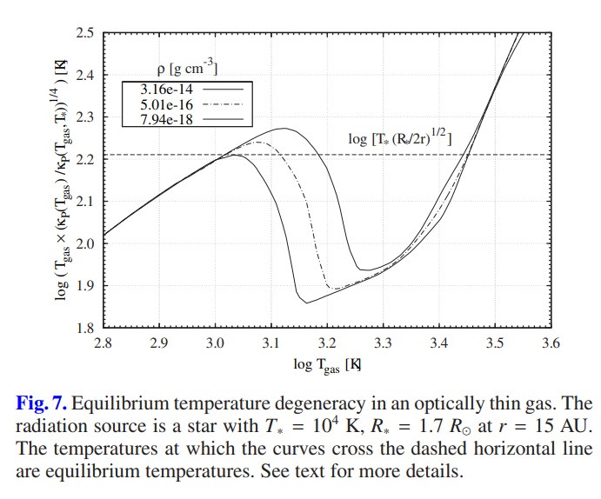
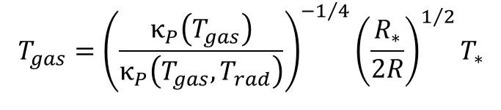
Equilibrium temperature
$$T_{gas}={\left(\frac{κ_{P}\left(T_{gas}\right)}{κ_{P}\left(T_{gas},T_{rad}\right)}\right)}^{−1/4}{\left(\frac{R_{∗}}{2R}\right)}^{1/2}T_{∗}$$
High Temperature (T> 6000 K)
Free –free absorption
Atomic metal absorption
(Sensitive to density and Metallicity)
Intermediate Temperature
(6000K < T < 1500 K)
Bound-bound transition
Bound-free transition
Free-free absorption
Transition temperature
Decrease in number density
Formation of complex molecules.
(CH4, NH3, and CO2 are present)
Low Temperature
Dust grains can absorb and scatter light
Dust extinction
Malygin (2016)
Notes:
This equation calculates the equilibrium temperature using the ratio of two-temperature to one temperature Planck mean opacity, without the need to solve radiative transfer. The two temperature Planck mean account for different temperature between gas and radiation, while the one- temperature Planck mean assumes same for both. As you can see from the plot, for given
density, this ratio results in multiple solution for equilibrium temperature.
As the temperature drops radially outward, the thermodynamic conditions change, and the opacity decreases. At high temperatures, the mean opacity is primarily caused by atomic metal absorption. In the intermediate temperature range, the mean gas opacity increases with number density and is caused by continuum species. At transition temperatures, the number densities of most line opacity molecules decrease, while complex molecules such as Methane (CH4), Ammonia (NH3), and carbondioxide are present, but continuum absorption is due to hydrogen ion (H2−) and carbon oxide (CO).

Slide 14
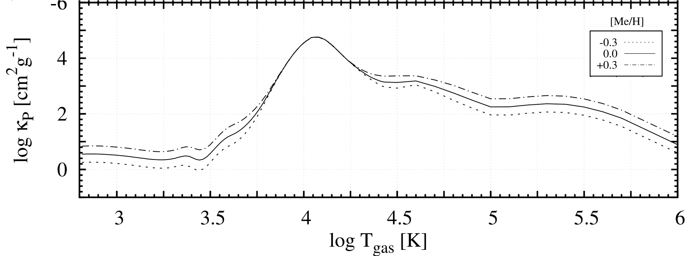
Revised Puffed Rim
Metallicity
Different chemical Reaction
Lower metallicity
Higher temperature profile
Over abundance: CN, CO, H2O and N2H+
Malygin (2016)
High Metallicity
Thick gaseous disc
Low rim flux
smaller rim height
Smaller shadowed region
Low Metallicity
Thin gaseous disc
Higher rim flux
Larger rim height
Large shadow region
Notes:
It is important to note that different chemical cycle processes may occur in systems of varying metallicity. In particular, low metallicity systems may have efficient chemical reactions due to high temperatures, which can alter the formation and destruction of various species. This may lead to an overabundance of certain gaseous species, such as cyanide (CN), carbon monoxide (CO), and water (H20) that may be more easily detectable in these environments. The change in metallicity is prominent in high temperature above 3000 K.
The photoevaporation rate of a disc decreases with increasing metallicity due to the effectiveness of dust shielding in preventing photons from heating the rim. This leads to a smaller vertical height of the rim. The decrease in the height of the rim, effectively reduces the shadowed region. On the other hand, low metallicity systems may have optically thin gaseous discs and higher flux at the rim, resulting in larger vertical height. The larger vertical height of the rim effectively increases the shadowed region.

Slide 15
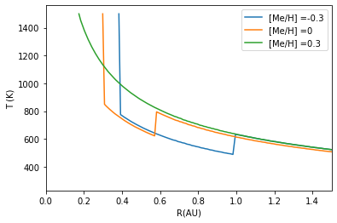
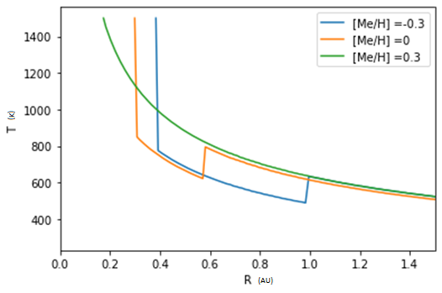
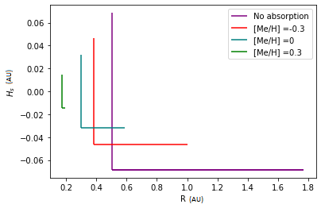
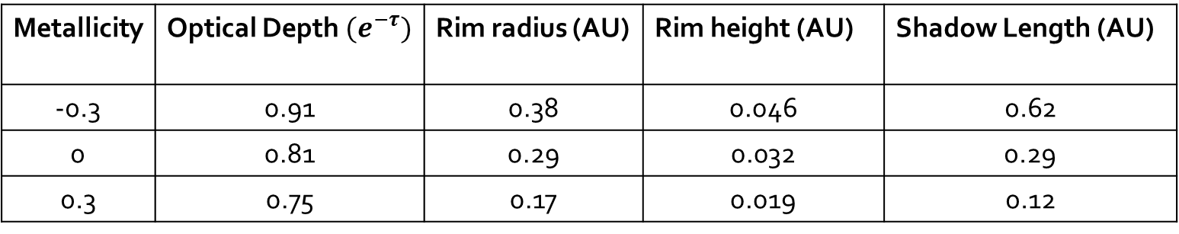
Results
Metallicity | Optical Depth$(e^{−τ})$ | Rim radius (AU) | Rim height (AU) | Shadow Length (AU)
-0.3 | 0.91 | 0.38 | 0.046 | 0.62
0 | 0.81 | 0.29 | 0.032 | 0.29
0.3 | 0.75 | 0.17 | 0.019 | 0.12
Notes:
Our results showed that disc with metallicity values of 0.3 had a flared disc profile with a lack of a kink in the temperature profile. However, discs with metallicity values of -0.3 and 0 had similar temperature profiles that were shifted along the radial plane. The similarity may be due to the initial boundary condition of thermal conduction, which typically produces a similar initial temperature profile. The temperature profile does depends on the radial position of the sublimation radius, but the slight difference in sublimation radius of 0.017 AU between discs with metallicity values of -0.3 and 0 did not significantly affect the temperature profile. The temperature profile above 1 AU was the same for different metallicities.
The optical thickness of a disc increases with increasing metallicity, with values of 0.91, 0.81, and 0.75 for metallicity values of -0.3, 0, and 0.3, respectively. As you can see from the results, increasing the metallicity reduces the sublimation radius, vertical height, and consequently the shadowed region. The shadowed region of a disc with no absorption is more than double that of a disc with a metallicity of -0.3 (the lowest value examined). It was found to be 1.26 AU compare to 0.62 AU for “no absorption” and metallicity of -0.3. This shows the importance of considering the presence of an optically thin gaseous disc when calculating properties of a circumstellar disc.
Despite a calculated shadowed length of 0.12 AU for a metallicity of 0.3, the temperature profile does not show a kink in the gradient. This may be due to the dominance of diffusive heating being similar to that of a flared disc. Further investigation is needed to understand the cause of this discrepancy.

Slide 16
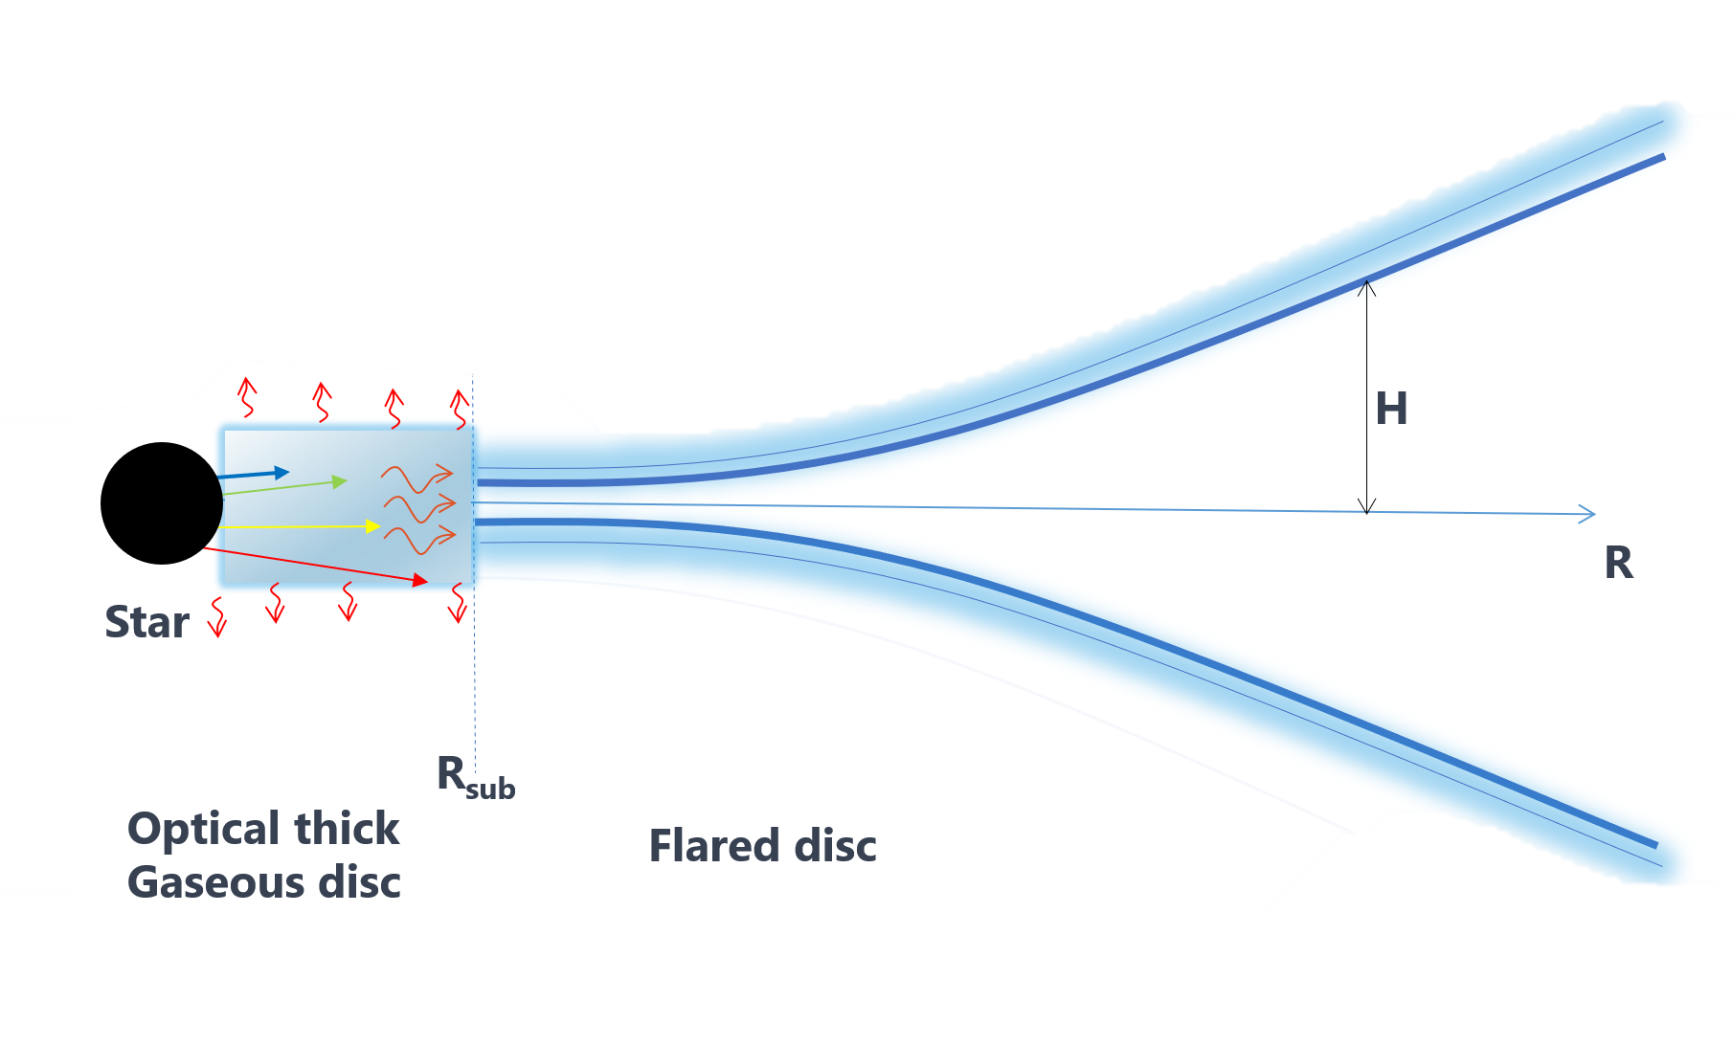
Flaring Disc
“One might expect the extent of the shadowed region to decrease smoothly with increasing metallicity, as the height of the disk rim varies.”
Tsang et al. 2015
Notes:
The result does demonstrate that, in line with David Tsang's theory, an increase in metallicity does results in the extinction of the shadowed region.

Slide 17
Caveats
Lack of knowledge
Gaseous disc profile
Distribution of dust size
Puffed rim
Rounded Rim
Density dependence
Dust-to-gas coupling
Rim opacity
Simultaneous calculation
Opacity table
Variation in chemical equilibrium
Limited range
Static gaseous disc
Constant dust-to-gas ratio
Notes:
Lack of knowledge about the inner disc and puff-up rim structure is a major source of uncertainty when studying circumstellar discs.
In our model, we assume dust evaporates independent of density. But incorporating the unique sublimation temperature of different density can improve the precision of the model. This allows the rim front to have a more rounded form, rather than a uniform vertical puffed rim.
Modelling often assumes dust and gas in the disc are fully coupled and have equal temperatures, but this may not always be true, particularly near the disc surface where gas temperature is higher than dust. However, the gas can quickly adjust to the dust's temperature, resulting in similar temperatures for both, reducing overall energy transfer to the midplane.
Gas and dust opacities are treated separately, with gas opacity primarily affecting gaseous discs and dust extinction primarily affecting dusty discs. However, in the puffed rim, it's important to consider both dust and gas opacity simultaneously as both opacities are likely to be significant.
Opacity tables from the Malygin Project can simplify calculation of gas opacities, but the use of different tables can result in variation in temperature measurement because of differing interpretation of chemical equilibrium.
In our study, we used a gas surface density profile from Ayliffe and Bate, but the constant was adjusted through trial and error. This adjustment was necessary due to the limited density range of data in the Malygin`s opacity table. The refined constant was found to be about three orders of magnitude smaller than its original value, and uncertainty of this constant was the primary source of error in the calculations. When calculating the gas density at the vertical rim using the original surface density constant, it was found to be 10^{-20} g/cm^3, much smaller than the expected value of 10^{-12} g/cm^3.
Our model calculates gas Planck mean opacities under the assumption of a static gaseous disc cloud, however, the presence of magneto-hydrodynamic wind accretion in the gaseous disc can affect overall opacity.
Increasing the metallicity of a system is expected to increase the dust-to-gas ratio, potentially changing the midplane density profile and temperature profile. However, this model kept the dust composition, size distribution, and slope constant across all metallicities, which may oversimplify the dust growth process. This may explain the similarity in temperature profile beyond the shadowing region.

Slide 18

Conclusion
The structure of circumstellar discs is affected by metallicity, with higher metallicity resulting in a thicker gaseous disc, smaller puffed rim, and shorter shadowed region. Flaring disc is observed at metallicity [Me/H] of 0.3, but temperature above the shadowed region are consistent across different metallicities.
Notes:
In conclusion, our study has shown that metallicity plays a significant role in shaping the structure of circumstellar discs. We observed that higher metallicity leads to a thicker gas disc, smaller puffed rim, and shorter shadowed region. In addition, we found that flaring is more pronounced at metallicity > 0.3. However, the temperature profile and vertical structure above the shadowed region remained consistent across different metallicities.

Slide 19

Thank you for listening

Slide 21
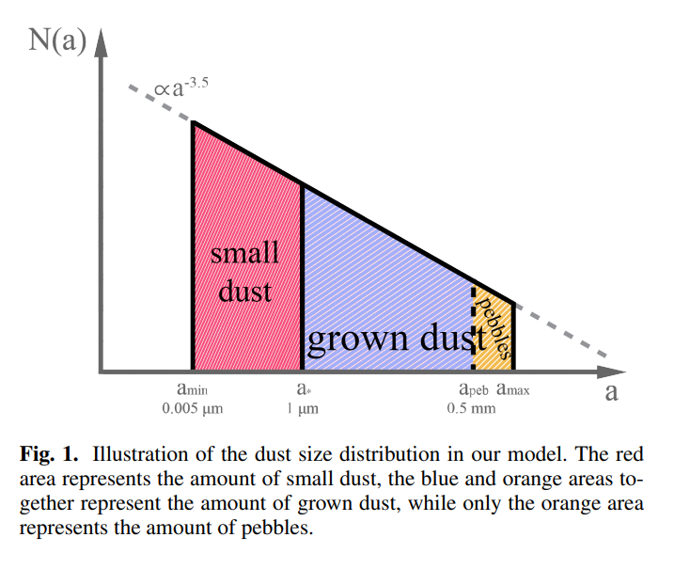
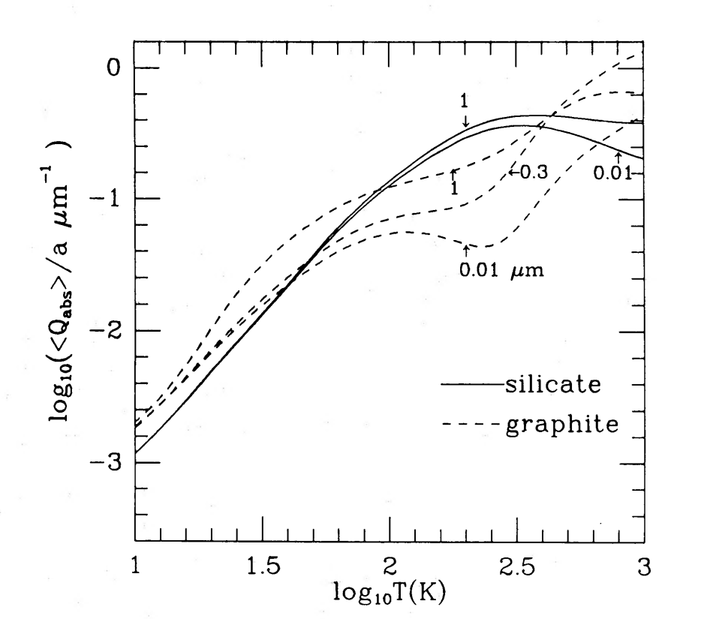



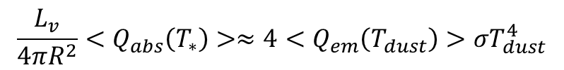

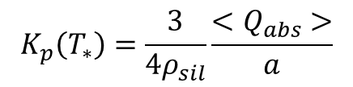




Interstellar dust
$Grain size and distribution$
$Grain composition$
$$n\left(a\right)da∝n^{−3.5}da$$
“Astronomical silicate” 70% of the Mg, 45% of the Si, and 75% of the Fe
$$a_{min }=\text{0.005}\text{μm}$$
$a_{max}$= 0.25μm
$$ρ_{sil}=3 gcm^{−3}$$
< a >= 1μm
$Dust grain at radiative equilibrium$
$$\int_{0}^{∞}{\frac{πa^{2}L_{v}}{4πR^{2}}}Q_{abs}\left(m,a,v\right)dv=4πa^{2}\int_{0}^{∞}{Q_{em}\left(m,a,v\right)πB_{v}\left(T_{dust}\right)dv}$$
$$\frac{L_{v}}{4πR^{2}}<Q_{abs}\left(T_{∗}\right)>≈4<Q_{em}\left(T_{dust}\right)>σT_{dust}^{4}$$
$$K_{p}\left(T_{∗}\right)=\frac{3}{4ρ_{sil}}\frac{<Q_{abs}>}{a}$$
$$K_{p}\left(T_{dust}\right)=1$$
Notes:
Observations of millimeter continuous emission spectra have revealed that these dust particle are primarily composed of silicate material.
The size of dust grains is often modelled using a power-law distribution, with a range of 0.005 micrometres to 0.25 micrometres and a number density given by n(a) proportional to a to the power of -3.5. "Astronomical silicate," which consists of Mg1.1 Fe0.9SiO4 with a density of 3.3 g/cm^3 and an average size of 1 micrometer, is often used to calculate their opacity using Mie's theory.
To understand the temperature of a dust particle, we must consider the heating and cooling processes that occur within the particle. However, this does not provide insight into the midplane temperature profile of the disc. The "steady-state" grain temperature can be calculated by equating the grain heating with photon absorption and the grain cooling with photon emission.
The Planck mean opacity of the star is calculated by assuming that interstellar dust has a spherical shape and a fixed characteristic radius. This means that the opacity and temperature of dust grains are dependent on the stellar effective temperature and mean size, and are independent of the grain's own heat. The extinction of dust is much higher than that of gas, so the gas's contribution to the coefficient can be ignored.

Slide 22
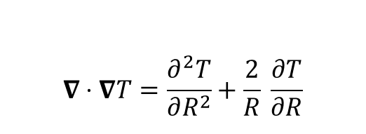
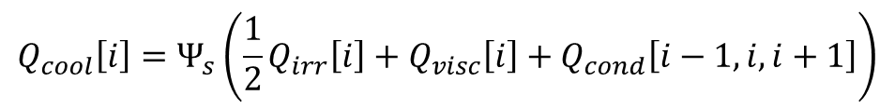
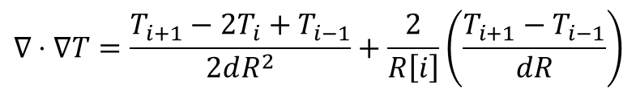
Temperature Profile
$$∇⋅∇T=\frac{∂^{2}T}{∂R^{2}}+\frac{2}{R} \frac{∂T}{∂R}$$
Initial guess
Inverse square law temperature profile
Constant accretion rate
Initial boundary condition
Thermal conduction
Set boundary condition
Appropriate gird size
irradiation flux
Self consistently determining flaring angle
$$∇⋅∇T=\frac{T_{i+1}−2T_{i}+T_{i−1}}{2dR^{2}}+\frac{2}{R\left[i\right]}\left(\frac{T_{i+1}−T_{i−1}}{dR}\right)$$
$$Q_{cool}\left[i\right]=Ψ_{s}\left(\frac{1}{2}Q_{irr}\left[i\right]+Q_{visc}\left[i\right]+Q_{cond}\left[i−1,i,i+1\right]\right)$$
Notes:
Viscous dissipation in a circumstellar disc occurs in both the radial and vertical directions. Viscosity is a measure of the resistance of a fluid to flow and it is caused by the friction and collisions between the particles in the fluid. In a circumstellar disc, the gas and dust particles interact with each other and with the magnetic fields, generating turbulent motion and friction, which results in viscous dissipation.
In the radial direction, viscous dissipation is caused by the friction between the gas particles as they move radially inward or outward. This friction generates heat, and the heat generated by the viscosity is known as the viscous heating. This process is responsible for the accretion of material onto the central star and the transport of angular momentum outward.
In the vertical direction, the gas particles move in a circular motion around the central star. The friction between these particles generates heat and causes the gas to lose energy. This process is known as vertical convection, it generates turbulence and viscous dissipation through vertical motion. This is an important process in the energy balance of the circumstellar disc, as it determines the temperature distribution of the disc.
In summary, Viscous dissipation occurs in both the radial and vertical directions in a circumstellar disc. The radial viscosity causes accretion and transport of angular momentum, while the vertical viscosity causes the generation of turbulence and affects the temperature distribution of the disc.

Slide 23
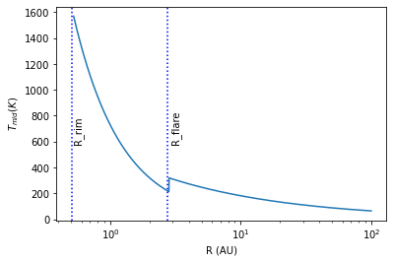
Temperature Profile

Slide 24



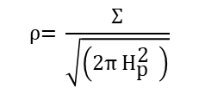


Data sets
Pressure
Metallicity | T_gas | P_gas | Rho_gas | kR | kp
-0.3 | 700 | 1.00E-09 | 3.99E-20 | 5.72E-07 | 1.76E+00
-0.3 | 700 | 1.39E-09 | 5.55E-20 | 5.71E-07 | 1.77E+00
-0.3 | 700 | 1.93E-09 | 7.71E-20 | 5.71E-07 | 1.77E+00
-0.3 | 700 | 2.68E-09 | 1.07E-19 | 5.70E-07 | 1.77E+00
-0.3 | 700 | 3.73E-09 | 1.49E-19 | 5.69E-07 | 1.77E+00
$$P =\frac{k_{b}T_{gas} ρ\left(R\right)}{μm_{H}}$$
$$\left({10}^{−20}−{10}^{−2}\right)gcm^{−3}$$
Density
$$\text{ρ}\text{= }\frac{\text{Σ}}{\sqrt{\left(\text{2}\text{π} {\text{H}}_{\text{p}}^{\text{2}} \right)}}$$
$$gcm^{−3}$$
Metallicity | T_stellar | T_gas | P_gas | Rho_gas | kp
-0.3 | 3000 | 700 | 1.00E-09 | 3.99E-20 | 7.77E+00
-0.3 | 3000 | 700 | 1.39E-09 | 5.55E-20 | 7.77E+00
-0.3 | 3000 | 700 | 1.93E-09 | 7.71E-20 | 7.77E+00
-0.3 | 3000 | 700 | 2.68E-09 | 1.07E-19 | 7.76E+00
-0.3 | 3000 | 700 | 3.73E-09 | 1.49E-19 | 7.76E+00
Single- Temperature Planck Mean
$$κ_{P}\left({{T_{∗},T}_{gas}=T}_{∗} \right)$$
Two- Temperature Planck Mean
$$κ_{P}\left({T_{∗},T}_{gas}\right)$$
Notes:
The ideal gas equation is a fundamental thermodynamic relationship that relates the temperature, density, and pressure of a gas. In order to model the radiative hydrodynamics of a gaseous disc, this equation is used to determine the pressure and temperature of the gas at different points within the disc.
One important aspect of modelling the radiative hydrodynamics of a gaseous disc is the calculation of the gas absorption opacity. To do this, we use the Malygin opacity table, which provides information on the opacity of a gas as a function of stellar temperature, gas temperature, pressure, and density. Using the ideal gas law, we accurately connect these parameters to find the closest match for opacity for a given set of input values. We then interpolate this opacity value using a LinearND interpolator. The Malygin table also provides separate tables for single and two-temperature Planck mean opacity.
To find the equilibrium temperature of the gas, we use an iterative method. An initial guess for the equilibrium temperature is inputted into the function and it iterates until the relative difference between the previous and current iterations is less than 10^-2. Once the equilibrium temperature is identified, the function outputs the two-temperature Planck mean, density, and gas temperature to calculate the optical depth.
Another important aspect of modelling the radiative hydrodynamics of a gaseous disc is the calculation of the sublimation radius and the vertical height of the disc. To do this, we use the Newton-Raphson method to calculate the sublimation radius. Once the sublimation radius is known, we create a new function that uses non-linear equations and self-consistently calculates values for H_rim, H_p, X_cg and R_rim. The function iterates until the relative difference between the H_rim/R_rim current and previous iterations is less than 10^-5.
Finally, to include the effects of the gaseous disc on the sublimation radius and vertical height, we add a gray constant or optical depth value to the existing function. This allows us to easily switch between models that include or exclude the gaseous disc, simply by adjusting the gray constant or optical depth value.

Slide 25
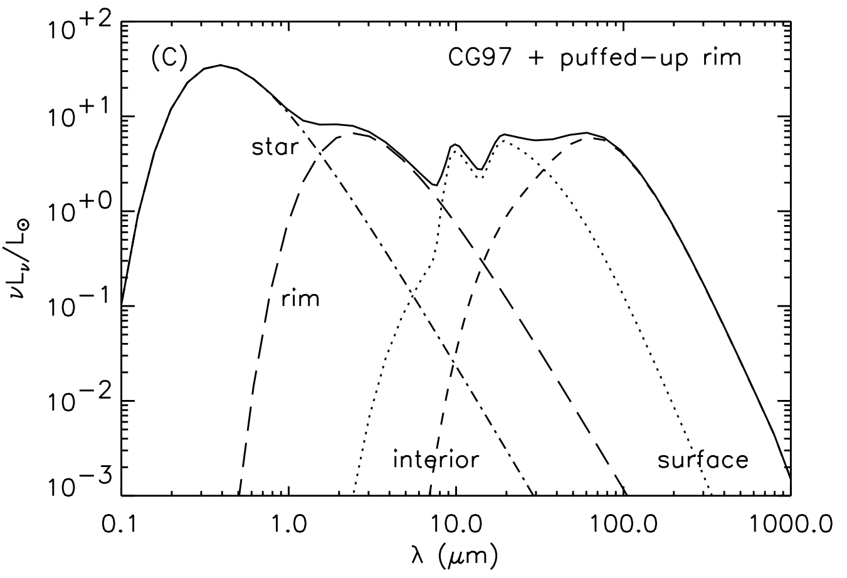
SED

Slide 26
Uncertainty in gaseous disc
Uncertainty in gas surface density profile
Variation in gas surface density profile
Refined constant to match Issella et al. 2015
Does acknowledge optically thin gaseous disc
Does not acknowledge Metallicity
Original surface density profile
Optically thick gaseous disc
Negligible Impact of metallicity on shadowed region
Notes:
The uncertainty in gas surface density impacted the disc structure . The error in gas surface density is travelled through the optical depth.
While researching, I noticed a variation in gas surface density as it characterises at different stages of evolution from a minimum mass nebula to a protoplanetary disc to a circumstellar disc. The major uncertainty within my model is to identify the appropriate surface density profile.
Additionally, when using the original surface density profile, the density of the inner region of the disc may be much higher, which can block the stellar radiation from reaching the vertical rim, making it difficult to determine the impact of metallicity on the shadowed region.
I used gas surface density profile from Allyief and Bate but the constant were refined in order to match the stated density given by Issela. This paper calculated puffed midplane density and found to 10^-12g/cm^3. This paper calculated under the optically thin regime . This paper didn’t mention any relation between metallicity and effect of density at rim.
The uncertainty in the surface density constant can affect gas density calculations in circumstellar disc models by impacting the accuracy of the density profile. This is caused by variations in the provided surface density profile across different research, which can change at different stages of evolution from a minimum mass nebula to a protoplanetary disc to a circumstellar disc. When calculating the vertical density of the rim at the midplane using the original surface density profile, we found that the surface density was much smaller than the anticipated value as stated in a paper by Issela. To resolve this discrepancy, we refined the surface density constant in order to match the stated density given by Issela. However, this refinement may not be accurate due to the uncertainty in the surface density constant.
Additionally, when using the original surface density profile, the density of the inner region of the disc may be much higher, which can block the stellar radiation from reaching the vertical rim, making it difficult to determine the impact of metallicity on the shadowed region. This highlights the importance of accurately determining the surface density constant in order to improve the accuracy of gas density calculations in circumstellar disc models.

Slide 27
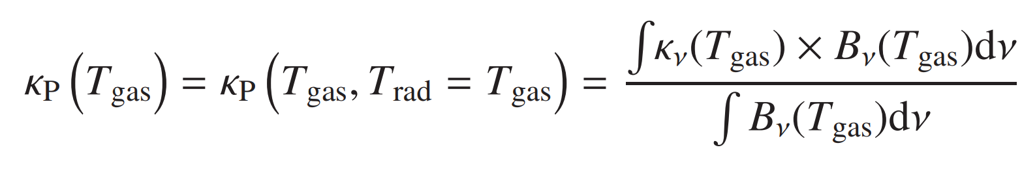

Planck Mean opacity
Single- Temperature Planck Mean
Two- Temperature Planck Mean
Notes:
Planck mean opacity is a measure of the ability of a material to absorb and scatter radiation. It is calculated by taking the average of the absorption and scattering coefficients of the material weighted by the Planck function, which describes the distribution of radiation energy as a function of temperature. The Planck mean opacity is dependent on the temperature, density and composition of the material, as well as the frequency of the radiation being absorbed or scattered. It is used in a variety of fields, such as the study of stars and planetary atmospheres, the calculation of the equilibrium temperature in a gaseous disc and in the study of the dynamics and structure of gaseous discs. The Planck mean opacity provides a way to understand how the material in a system interacts with the radiation present, which helps to determine the temperature and energy balance of the system.
This allows for the existence of different temperature gases in a given density gaseous disc. However, it's important to note that these multiple solutions often have short lifetimes and can quickly change into different stable positions.

Slide 28




Equilibrium temperature
Notes:
The condition of radiative equilibrium in an optically thin gas, where local net flux of radiation is |Frad| reads κP Tgas × aT4 gas = κF × |Frad| c , (6) where a is the radiation constant and κF = |Frad| −1 κν|Fν|dν is the flux averaged opacity. If the source of radiation is a black body with temperature Trad and the gas is in LTE with Tgas, κF becomes the two-temperature Planck mean: κP Tgas × aT4 gas = κP Tgas, Trad × |Frad| c · (7) The equilibrium gas temperature, therefore, depends on |Frad| and Trad. If the radiation source is a star with effective temperature T∗ and radius R∗, located at distance r R∗ from the point under consideration, the flux drops with distance as |Frad| = ac 4 T4 ∗ × R∗ r 2 , (8) if extinction is neglected. Then, the equilibrium gas temperature satisfies

Slide 29
Chemical equilibrium (K)
Same Metallicity system
Same abundance of element
Chemical equilibrium
Pressure
Temperature (cold and hot gaseous disc)
Stellar radiation
Notes:
For a system with the same metallicity, the chemical processes that occur should be similar, as the abundance of elements is the same. However, the exact chemical equilibrium will depend on other factors such as temperature, pressure, and radiation fields.
For example, two clouds with the same metallicity but different temperatures may have different chemical equilibrium states. In a colder cloud, more molecules will be in their ground state, while in a hotter cloud, more molecules will be in excited states. Similarly, two clouds with the same metallicity but different pressures may have different chemical equilibrium states, as the reaction rates are pressure-dependent.
In summary, while having the same metallicity would mean that the same elements are present, the chemical equilibrium across different clouds in the same metallic environment can be different because the chemical equilibrium is dependent on temperature, pressure and radiation fields.

Slide 30

Increase in Metallicity increases dust-to-gas ratio
Increase in metallicity, should Increase in dust to gas ratio
This relation can be interpreted in terms of dust grain growth in the ISM as galaxies evolve from lower to higher metallicity. In low-metallicity galaxies, dust grains are thought to form primarily through supernovae explosions, which do not produce enough dust to match the observed DGRs. As metallicity increases, dust grains can form through other processes such as accretion of metals in the ISM, which increases the total dust mass.
More heavy elements present in disk can form dust grains
Dust grains can stick together to form larger particles
Higher metallicity means more solid materials for dust particles to collide with
Dust particles can grow through accretion by attracting and collecting small dust particles and gas molecules by gravity
Garcia et al. 2020

Slide 31




Sublimation Radius
$$1 = \frac{9ΣK_{p}\left(T_{∗}\right)}{\sqrt{π}}\int_{χ}^{∞}{exp({−x^{2})}dx}$$

Slide 32
Misinterpretation as a depletion of density.
There are two main techniques used to measure the opacity of the gas and dust within circumstellar discs: the Rosseland mean and the Planck mean.
The Rosseland mean measures the rate of radiative transport (diffusion) in a thick optical gas. In contrast, the Planck mean measures the coupling between the opacity carrier (dust or gas) and radiation, and is more sensitive to the metal abundance and the strength of absorption lines compared to the Rosseland mean.

Slide 33



Slide 34
Limitation
However, it is expected that increasing the metallicity will result in a decrease in the dust-to-gas ratio, leading to concentrated midplane density profile and potentially a different temperature profile.The dust composition, its maximum and minimum sizes, and the slope of the dust size distribution were assumed to be identical for all metallicities. However, this may be an oversimplification as the process of dust growth in low-metallicity discs is still poorly understood \citep{ Chemical..equilibrium}. These findings suggest that metallicity plays a role in determining the temperature profile of a circumstellar disc, but other factors such as the initial boundary (type of dust material) condition of thermal conduction and the distance from the star are also important. In the present model, the dust-to-gas ration is kept constant at 1:100, which may be the reason for observed similarity in the temperature profile beyond the shadowing region.

Slide 35
Limitation
The initial gas surface density profile was taken from Ayliffe & Bate (2009), but the gas surface density constant was later adjusted through a trial and error process to improve the accu- racy of the model.This was necessary because the data used to calculate the interpolated opacity values was limited in its den- sity range. The refined gas surface density constant was about an order of 10−3 magnitude smaller than its original value. When calculating the gas density at the vertical rim using the original surface density constant, it was found to be 10−20g/cm3, much smaller than the expected value. The uncertainty of the gas sur- face density constant is the primary source of error in this cal- culation. This error was carried through to calculate the optical depth at the inner edge of the rim. The manipulation of the arti- ficial dust and gas density also affects the reliability of the tem- perature profile. It was found that using a wider range of density values than those in the table from Malygin (2016) can improve the accuracy of the equilibrium gas temperature model. How- ever, the specific expression of the surface density constant did not significantly impact the overall findings of the analysis of the distribution of gas and dust in the disc. In this study, we also ex- amined the properties of rims in discs with low surface densities, assuming that the rims are formed by the evaporation of silicate dust particles of size 1 micron. We found that the surface density of gas is 10−14, while the density measured by Benisty, M. et al. (2010) is 10−11. These differences in density measurements are due to the different treatment of gas and dust opacities, the sim- plification of radiative hydrodynamics in 1+1D structures, and a lack of knowledge within Astrophysics society. Our results sug- gest that a low-density region is consistent with the location and characteristics of the rim.

Slide 36


Finite difference
$$∇⋅∇T=\frac{∂^{2}T}{∂R^{2}}+\frac{2}{R} \frac{∂T}{∂R}$$
$$∇⋅∇T=\frac{T_{i+1}−2T_{i}+T_{i−1}}{2dR^{2}}+\frac{2}{R\left[i\right]}\left(\frac{T_{i+1}−T_{i−1}}{dR}\right)$$
By increasing the resolution, the second-order finite term often becomes negligible and the first-order finite difference can result in a negative answer for thermal conduction.

Slide 37
Relative contributions are controlled by vertical profiles of temperature and absorbing gases.
Consider a 1D atmosphere
Specifiy solar radaiton at the top, emissivity of each layer.
Claculate radiative equilibrium temperature for each layer.
Check for static stability.
IF layers are unstable, mix them
Add clouds and absorbing gases to taste

Slide 38
Structure of the disc
Notes:
The circumstellar disc is divided into two parts: a gaseous disc and a dusty disc. The inner region of the disc is pure gas. The initial vertical line in this dusty disc shows where the sublimation of dust takes place. The dusty disc has a complex structure, with fluctuations in its structure that will be explained later in the presentation.

Slide 39

Presentation Outline
Context
Aims
Relevant Background
Gaseous Disc
Dusty Disc
Method
1+1D radiative transfer
Diffusive heating
Radiative hydrodynamics
Metallicity
Result
Limitation
Conclusion
Notes:
Before we begin, let me quickly outline the structure of our presentation.
First, I will start by introducing the background and context of our topic.
Then, we will dive into the main body of our presentation, where we will cover the simulation set up and result for dusty disc. Following that, we will re-evaluate the simulation set up and result for gaseous discs. We will also discuss the key results of our simulations.
After that, we will move on to the conclusion, where we will summarize the key takeaways from our simulations
Finally, we will open up the floor for questions and discussion. I encourage you to ask any questions you may have about our simulations or the results we have presented.

Slide 40


Optical depth
Pure radiative equilibrium is way too hot at surface
The quantity Tau = 1 has a geometrical interretation in terms of the mean free path of a photon.
Tau =
Where s is the distance a photon will travel before it get absorbed. In the stellar atmosphere the absorbed will get re-emitted and thus will undergo a “random walk”.

Slide 41
Limitation
The struc- ture of this puff-up rim is very complex to model, depending on the detailed 1+ 1D radiation transport effects on the structure of the disc (Habart, E. et al. 2004). Including the density depen- dence of the sublimation, temperature allows the model to be precise by giving the rim front in a disc a rounded form. (Flock et al. 2016).In reality, dust is made of different materials evapo- rating at different temperatures.
At higher radii, where the scale height and surface density of a disc increase, it is noted that the equilibrium temperature of the dust grains in that region may drop below the sublimation threshold, leading to dust condensation. Additionally, there may be a region where dust can condense but is not necessarily opti- cally thick between the dust destruction radius and the classical rim radius. The temperature of the dust, when the rim is optically thick, peaks before rapidly decreasing to a low value inside the disc (Kama, M. et al. 2009).This statement potential explain the possibility of shift in sublimation radius over time.
e Dullemond et al. (2001) model assumes that the dust and gas in a disc are fully coupled and their temperatures are equal, but this assumption may not hold in certain circumstances, such as near the disc’s surface (Dullemond, C. P. et al. 2007). The ther- mal coupling between the gas and dust influences the gas’s tem- perature in the disc’s upper layers. However, this model ignores this coupling. The rate of collisions between gas molecules in the optically thin regime is often higher than the rate of coupling be- tween dust and gas, resulting in the gas contributing to the high opacity of the disc Malygin (2016). The dust absorbs more radi- ation than the gas and is strongly heated by the star, leading to a thin boundary between vapor and condensed dustSchobert et al. (2019). The characteristics of the gas at the inner rim also play a role in shaping the inner rim. It is important to calculate the opacity of dust and gas simultaneously in the gas-to-dust transi- tion region (Nagel et al. 2012)(Semenov, D. et al. 2003). Despite this, the gas and dust already have similar temperatures, so its impact on the final temperature is relatively small and can be disregardedJonkheid et al. (2004)
Scale heights have been seen to decrease with decreasing grain opacity due to the enhanced radiative cooling that can hap- pen at lower opacities, resulting in cooler and flatter discs. The lowest grain opacity state, where gas and radiation may decouple and lessen the effectiveness of radiative cooling, is an exception to this trend. The "astronomical silicate" dust grain is considered homogeneously spherical and has a mean distribution of 1μm. Still, its scattering may be non-isotropic, potentially leading to lower temperature structure errors despite being believed to be isotropic
The drop in temperature in the shad- owed region is often misinterpreted as a depletion of density (Isella & Turner 2018). T
Notes:
The structure of the puff-up rim in circumstellar discs is complex and depends on the detailed 1+1D radiation transport effects on the structure of the disc. Including the density dependence of the sublimation temperature allows for more precise modelling of the rim, giving it a rounded shape (For now, we just used midplane density to derive vertical rim). In reality, dust is made up of different materials that evaporate at different temperatures.
At higher radii, where the scale height and surface density of the disc increase, the equilibrium temperature of the dust grains may drop below the sublimation threshold, leading to dust condensation. There may also be a region where dust can condense but is not necessarily optically thick between the dust destruction radius and the classical rim radius. The temperature of the dust, when the rim is optically thick, peaks before rapidly decreasing to a low value inside the disc.
The Dullemond et al. model assumes that the dust and gas in a disc are fully coupled and have equal temperatures, but this assumption may not always hold, particularly near the surface of the disc. The thermal coupling between the gas and dust can influence the gas temperature in the upper layers of the disc, but this model ignores this coupling. The rate of collisions between gas molecules in the optically thin regime is often higher than the rate of coupling between dust and gas, resulting in the gas contributing to the high opacity of the disc. The dust absorbs more radiation than the gas and is strongly heated by the star, leading to a thin boundary between vapor and condensed dust. The characteristics of the gas at the inner rim also play a role in shaping the inner rim, and it is important to calculate the opacity of both dust and gas simultaneously in the gas-to-dust

Slide 42
Optically thick gas
R
Star
Gaseous disc
R_{sub}
Flared disc

Slide 43
Structure of the disc
Notes:
The circumstellar disc is divided into two parts: a gaseous disc and a dusty disc. The inner region of the disc is pure gas. The initial vertical line in this dusty disc shows where the sublimation of dust takes place. The dusty disc has a complex structure, with fluctuations in its structure that will be explained later in the presentation.

Slide 44
No stellar illumination
Optically Thin Gas
H_{s}
H_{rim}
Diffusion
R
Star
R_{sub}
R_{flare}
Gaseous disc
Shadowed region
Flared disc

Slide 45
Optically thick gas
R
Star
Gaseous disc
R_{sub}
Flared disc

Slide 46
No stellar illumination
Optically Thin Gas
H_{s}
H_{rim}
Diffusion
R
Star
R_{sub}
R_{flare}
Gaseous disc
Shadowed region
Flared disc

Slide 47
Pure thin gas disc
No stellar illumination
H_{s}
H_{rim}
Diffusion
R
Star
R_{sub}
R_{flare}
Gaseous disc
Shadowed region
Flared disc

Slide 48
No stellar illumination
Gaseous disc
R
Star
R_{sub}
R_{flare}
Gaseous disc
Shadowed region
Flared disc

Slide 49



Slide 51
No stellar illumination
Optically Thin Gas
H
R
Star
R_{sub}
R_{flare}
Gaseous disc
Shadowed region
Flared disc
Notes:
Before I dive into the details of our findings, I want to provide some context by describing the structure of the circumstellar disc. Imagine that the disc can be divided into two parts: a gaseous disc and a dusty disc. The inner region of the disc is made up of pure gas (a region without dust). The temperature near the star is extremely high, and this causes all the dust to evaporate. The vertical line in this visualization represents the region where the sublimation of dust takes place. The structure of the dusty disc is complex, and I will explain why there are fluctuations in the structure of the disc later in the presentation.

Slide 52
H
R
Star
R_{sub}
Optical thick Gaseous disc
Flared disc

Slide 53
H_{s}
R
R_{sub}

Slide 54
R

Slide 55
R

Slide 56
H_{rim}

Slide 58
R

Slide 59
No stellar illumination
H_{s}
H_{rim}
Diffusion
R
Star
R_{sub}
R_{flare}
Gaseous disc
Shadowed region
Flared region

Slide 60
Star
Gaseous disc
R_{sub}

Slide 61
All these process occur in PMS disc and change them (Opacity, decoupling gas and dust, dynamical interactions, etc. Important effects (due to scattering and emission) on the heating of the outer disc.
Dust and gas well-mixed, vertical hydrostatic equilibrium
T = r^-3/4 -→ Flared surface.

Slide 62
This is just surface temperature. The midplane temperature depends alson on the optical depth.
To obtain full solutions, we must the midplane temperature as a function of the surface density. We can then express the midplane temperature as a function of the surface density. In the radial structure equations we can then eliminate the temperature in exchange for the surface density. We then have an equation entirely in term of the surface density.

Slide 63
Is there gas in the inner hole?
Direct imaging: accretion streams (CO, HCO^+) – Planet present
Velocity information:warps in the disc and other dynamical signatures
How much gas is there?
Measure of gas depeletion: planet formation or photoevaporation
Potentially, mass of hole in fairly large hole (inside CO freezeout) could be reasonably well determined with multiple tracers, CO , HCO , c18O, 12C17 )

Slide 64
Frequency dependent opacities
Gas opacities
T_rim <T<T_star
Appropriate densities
Rosseland or Planck-Mean gas opacities are valid only for optically thick meadius (Weight Factor: u(v,T) dBv(T)/dT
Within the rim gas is optically thin, externally illuminated.
Gas temperature is too low for contimuum opacity source (like H- ) except for tenous surface layer.
Billion of molecular and atomic lines
Calculated for T = 2000 K, Rho = 4*10^-9 gcm^-3
But molecules can be easily destroyed (collisions, UV). It would reduce opacity.

Slide 65
Epsilon: ratio of effectiveness of emission at the wavelength at which the dust radiate away its heat and absorption at stellar wavelength (T_dust – dependent)

Slide 66
Shadowing
Radiative diffusion is important
Disc will never collapse completely

Slide 67
. As you may know, the transport of a frequency-dependent radiation intensity, Iν, is a complex process that requires the consideration of many factors. However, under certain conditions, it may be possible to relax this requirement in favor of an integrated intensity, I.
To understand this concept, let's first consider the original, frequency-dependent formulations of the radiation transport equation. This equation takes into account the absorption and scattering of radiation at each frequency, as well as the emission of radiation by the source.
This mean opacity represents the average absorption of radiation over all frequencies, and it allows us to simplify the transport equation by eliminating the need to consider the frequency dependence of the absorption coefficient.
The two most common types of gray opacities are the "Planck mean," or "emission mean," and the "Rosseland mean" opacities. The Planck mean is useful for calculating the integrated emission of a source, while the Rosseland mean is useful for calculating the integrated energy flux in an optically thick plasma.
the Rosseland mean opacity is obtained using an inverse, or harmonic, average, which means that it will more heavily favor regions of low absorption. Additionally, the use of a harmonic average implies that the individual contributions to the mean, such as bound-bound, bound-free, free-free, and scattering, cannot be averaged first and then added together to obtain the proper mean value.
Unlike the Rosseland mean opacity, which is obtained using an inverse, or harmonic, average, the Planck mean is obtained using the familiar arithmetic mean. This means that the Planck mean will more heavily favor regions of high absorption. Additionally, the various contributions to the Planck mean opacity, such as bound-bound and bound-free processes, can be averaged separately and then added together to obtain the correct mean value.
It is important to note that the Planck mean opacity is obtained by averaging over only the absorption opacity, κABS. This means that it is not suitable for calculating the integrated energy flux in optically thick plasmas, for which the Rosseland mean is more appropriate.
in an LTE plasma at a high enough temperature such that all of the ions are completely ionized, there are only two possible sources of opacity: free-free absorption and Compton scattering. For low densities, Compton scattering dominates the Rosseland gray opacity, while for high densities, free-free absorption dominates. If the temperature is insufficient to completely ionize all bound electrons, then there can be strong contributions to the gray opacity from bound-bound and bound-free processes.

Slide 68
As you may know, opacity is a measure of the ability of a material to absorb or scatter radiation, and it plays a crucial role in the calculation of radiation transport.
There are several sources of uncertainty in opacity calculations, including uncertainties in the calculation of the fundamental atomic cross sections, plasma effects caused by perturbing ions, and computational limitations.
One major source of uncertainty is the measurement of fundamental cross sections, which are usually carried out on neutral atoms rather than on charged ions. This is because it is difficult to prepare a sample of ions in a specific ionization stage, and because of the many possible excited levels. However, the cross sections of neutral atoms are more difficult to calculate accurately due to the many-body, electron-electron interaction. Therefore, comparisons of calculations with measured cross sections for neutral species can provide an upper bound on uncertainties, at least as far as cross sections are concerned.
Most of the information about uncertainties in opacity comes from the astrophysics community, which has studied elements with atomic numbers up to 30.
As the temperature decreases and bound-free processes become important, the uncertainty in the Rosseland mean opacity increases to 15-20%. If the temperature decreases further and bound-bound processes can contribute, the uncertainty increases to around 30%.

Slide 69
The overall structure of the Planck mean gas opacities in a given system is determined by the interaction between continuum and molecular line opacities. Unless the temperature is so low that molecules are present, these mean opacities typically decrease as the temperature falls. The primary sources of both forms of mean gas opacities at high temperatures $(T > 6000 K)$ are continuum species, with scattering being the primary source at low densities. Depending on the density, the growth in molecular opacity species at intermediate temperatures $(3000 K <T <1500 K)$ causes an increase in both mean gas opacities. Mean gas opacities rise when molecular absorption takes over as the primary source of opacity at lower temperatures $(T < 1500 K)$\citep{Molecular.opacities}. At temperatures around 1500 K, the number densities of many molecules start to decrease, and more complex molecules like $CH_4$, $NH_3$, and $CO_2$ begin to appear. Still, there is insufficient data on their absorption and scattering properties to include them in calculations of line opacity. At lower temperatures, $H_2$, SiO, and $H_2O$ are the primary opacity sources in both metal-rich and metal-poor environments \citep{Molecular.opacities}.

Slide 70


Slide 71

It is still unclear as to why there is lack of molecular emission from the gaseous disc, given that the molecular emission is regulary seen in the surface layer of the disc in the dusty region of these disc.. There does seems to be evidence for molecuses right within the dust rim, where dust may be protected.

Slide 72
Various studies confirm the influence of metallicity on the chemical evolution of disks. For example, by observing the chemical abundances of HII regions in 12 nearby dwarf galaxies, Berg et al. (2016) suggests that there are different chemistry cycles in non-solar metallicity environments. This evidence hints at the fact that disk evolution and planet formation in protoplanetary disks may proceed differently in diverse metallicity environments. Certain aspects of the physical conditions considered by our model could change the way metallicity influences chemistry.
One of the important features is the usage of passive or active disks. For passive disks, the only heating source is stellar radiation and cosmic rays. Therefore, passive disks exhibit an increase in temperature with decreasing metallicity. In the case of active disks, the hydrodynamical processes provide additional heating via viscous and compressional heating, which operate predominantly in the disk midplane and depend on the assumed metallicity. A decrease in metallicity leads to a lower temperature in the midplane (see Fig. 5).

Slide 73
Star
Gaseous disc
R_{sub}

Slide 74
Our study aims to understand whether an increase in the metallicity of the gaseous disc can have an impact on the shadowed region of the disc and potentially lead to its irradiation. This could result in the formation of a flared disc, where the disc is thicker and warmer at the outer edges.
To investigate this, we will be analyzing the absorption of stellar radiation as it passes through the gaseous disc. We will then examine how much of this radiation reaches the midplane of the disc, as the temperature profile of the midplane will determine the structure of the disc

Slide 75
Limitation
Lack of knowledge
Uncertainty about gas disc profile
Distribution of dust size
Synthesis of artificial dust
Rounded Rim
1 +D radiative transport
Different material
Initial vertical inner wall set by temperature and radius
Dust evaporation temperature depends on density, a rounded rim is predicted.
Dust-to-gas coupling
Opacity at Rim
Calculate opacity simultaneously
Uncertain why disc always flare
Misinterpretation as a depletion of density.
Lack of data
Variation in the chemical equilibrium
Gaps in opacity
Static gaseous disc
Cross-section of gas
Non-monotonic emissivity of gas
Manipulation of dust-to-gas ratio at the transition region
Notes:
One major source of uncertainty is the lack of knowledge about the detailed structure of the inner disc. Previous calculations have shown that the disc is truncated at the dust sublimation radius and puffed up due to exposure to direct stellar radiation. However, the structure of this puff-up rim is very complex and difficult to model due to the 1+1D radiation transport effects on the disc structure.
To address this issue, some models have included the density dependence of the sublimation temperature, which allows for a more precise representation of the rim shape by giving it a rounded form. However, it is important to note that dust is made up of different materials that evaporate at different temperatures.
Cosmic dust analogues are essential for studying the characteristics of dust grains in different astrophysical environments. These dust grains can be produced using techniques such as pulsed laser ablation and gas-phase condensation.
Pulsed laser ablation involves vaporizing a silicate or metallic target using a laser and allowing the vaporized atoms, molecules, and clusters to condense in a quenching gas environment. This results in the production of nanometer-sized silicate particles.
It is important to note that the tiny particles that make up interstellar silicate may exhibit different optical properties due to collective processes, but small amorphous grains are expected to have the same properties as bulk material because they only show non-collective phenomena.
The dust and gas are fully coupled and have equal temperatures, but this may not always be the case, particularly near the surface of the disc. The rate of collisions between gas molecules in the optically thin regime is often higher than the rate of coupling between dust and gas, leading to the gas contributing to the high opacity of the disc.
The characteristics of the gas at the inner rim and the grain opacity of the dust can also play a role in shaping the inner rim. It is important to calculate the opacity of both the dust and gas simultaneously in the gas-to-dust transition region.
the interior of the disc is only heated by radiation from the surface layer that diffuses downward without considering the radial radiative transfer process. However, it is unclear why the disc would always flare, or emerge from the shadow, at certain radii in this scenario.
It is well known that the shape of the shadowed region depends on secondary heating sources, such as rim heating and viscous heating. However, the drop in temperature in the shadowed region is often misinterpreted as a depletion of density.
As you may know, opacity tables can make the process of determining gas opacities easier by providing data from multiple sources and potentially using computational methods to calculate line opacities. However, it's important to be aware that the chemical equilibrium of the gas can lead to differences in the measured gas temperature between the two opacities in the table. This emphasizes the need for caution when using these tables and the importance of considering the chemical composition of the gas.
In the temperature range of 1,000 to 3,000 K, there is a significant gap in the opacity spectrum between 1-50 micrometres due to the lack of strong absorption bands from any of the species in the gas mixture. This gap becomes more pronounced at low densities, but is filled in at high densities due to the pressure-broadening of lines, particularly from alkali atoms.
At high temperatures, the ionisation of hydrogen reduces its bound-bound source of opacity, resulting in a slight decrease in the Planck mean with density, but sensitivity to metallicity. In our model, the gas Planck mean opacities were calculated under the assumption of a static gaseous disc cloud. However, there is magneto-hydrodynamic wind accretion in the gaseous disc, which can affect the overall opacity.
The minimum values for wind parameters, including the mass loss rate, outflow velocity, and dust-to-gas ratio, can be estimated for a given metallicity using Planck models. These wind characteristics tend to lower the overall opacity for any metallicities.
There are uncertainties in estimating atomic cross-sections of neutral gases, which provide an upper bound uncertainty in opacity.
The two-temperature Planck opacity ratio can exhibit non-monotonic behavior when considering the equilibrium gas temperature as a function of temperature and density. This behavior can result in multiple solutions for the equilibrium gas temperature.
At low temperatures, the Planck mean opacity is determined by the mass fraction of dust and gas in the disc, which dictates the radiative transport. There is a significant difference in opacity at the transition between the outermost inner region and the puffed rim due to the sharp temperature differential. To smooth out this transition, the dust-to-gas ratio is chosen in such a way that no starlight is absorbed within a single cell. This helps to ensure a more accurate representation of the disc's temperature profile.

Slide 76
As you may know, Herbig Ae stars are a type of intermediate-mass young star that are still in the process of forming. They are surrounded by a circumstellar disc of gas and dust, which is thought to be the birthplace of planets.

