Slide 1
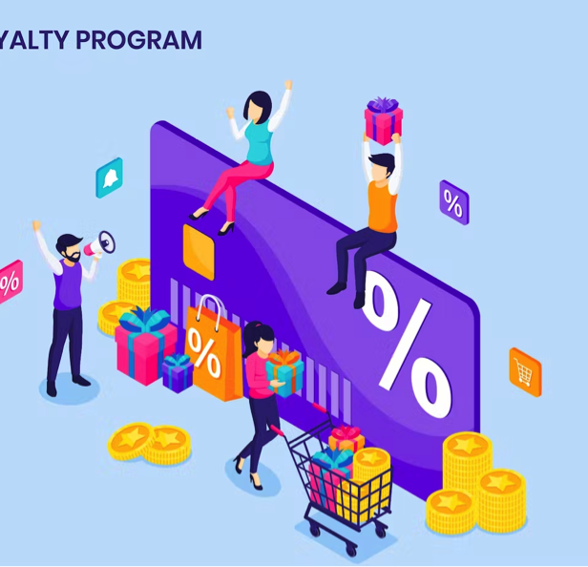
Re-aligning Prism+ Loyalty Experience
Abinash Dhakal

Slide 2
Executive Summary:
30% increase in average transaction count for Prism+ users compared to Non-Prism+, aligning with North Star metric.
Existing loyalty program challenges. Proposed tweaks to the loyalty program to enhance customer engagement and retention.

Slide 3

Challenges in current program
Bad tier system: Pseudo random assignment with unclear benefits
Churned Prism+ User: Nearly 50% of prism+ user didn’t make any purchase in 2022.
Wrong incentives: Prism`s best customers are not after discount- change the rewards.

Slide 4
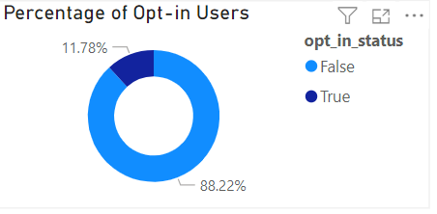
Encouraging Opt-ins
Consists of 10% of total opted in registered users.
Customer Journey Optimisation
Offer free trials (Free Shipping).
Offer email exclusive offer
With companywide 2022 email conversion rates of 5%, and from this segment 5267 opted in to emails with an average order value of £41.7.
We expect a targeted email campaign to generate £10,980.

Slide 5
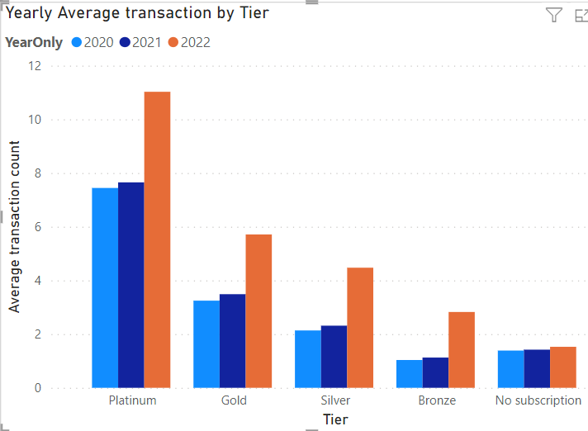
Analysing Transaction Growth and Coupon Usage: A Prism+ vs Control Study
Transaction Comparison - Prism+ vs Control:
Transactions per Prism+ member increased by 129%.
Control group's transaction growth was only 7.75%.
Coupon Usage and Purchase Patterns:
Higher transaction activity aligned with increased coupon usage.
Prism+ coupon usage rose from 44% (2021) to 179% (2022).

Slide 6
Re-aligning Prism+ Loyalty
Gold
Platinum
Bronze
Silver
Criteria | Registered & Opt in | Spend £40 - £75 | Above £ 75 | £ 10 yearly subscription
Benefit | Spend £25 Free 3-5 working Day Delivery | Discount on cross selling item | 5% off above £50 Next day Delivery | Free return Sneak peak on new release

Slide 7
Strategic Exit Strategy and Performance Benchmarks for Program Effectiveness
Quantitative Metrics:
Sales growth over time
Churn rates monitoring
Frequency of purchase
Qualitative Measurements:
Customer satisfaction evaluation
Assessing brand awareness

Slide 8
Conclusion
Reward:
Free deliver and exclusive discount
Encourage:
opt in for email campaigns
Re-engage:
Customer Satisfaction and Brand Awareness

