Slide 1

How is the website performing?
Team Turquoise

Slide 2
Executive Summary
Conversion rate for mobile – room for growth. Conversion rate of 0.39%, despite making up 85% of visits. Massive potential toward our North Star Metric.
Mobile most desirable to navigate. Bounce Rates for Mobile lowest, and View Rate highest suggesting site is easy to use on navigate, and our products have the most exposure there (45.88M views).
The drop off comes when adding to basket. ATC Rate much lower on Mobile vs Desktop, people don’t want to manage their basket on Mobile. Hypothesis testing needed to test tweaks to basket and purchase process.

Slide 3
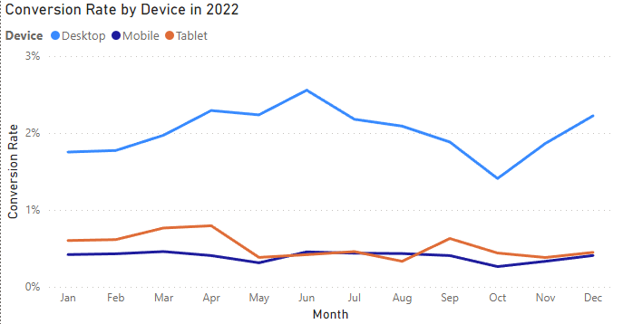
Conversion Rates for Mobile – room for growth
Mobile by far the biggest share of visits – 85%.
Conversion rate of 0.39% trailing behind the overall 0.61% rate (2% for Desktop).
Mobile saw biggest growth in visits for 2022 at 127%, with Desktop’s year-on-year at 47%.
Most growth coming from social media – 215% increase year-on-year, in comparison to 61.6% for other traffic sources.

Slide 4
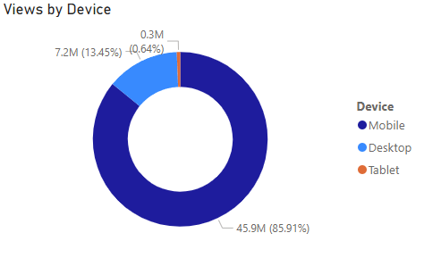
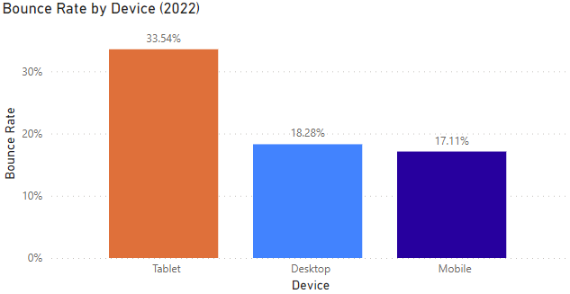
Mobile most desirable to navigate
Data suggests the site is most appealing on Mobile with the lowest bounce rate at 17.11%.
Our products have significantly more exposure on Mobile with the highest view rate – 83% (45.88M views).

Slide 5
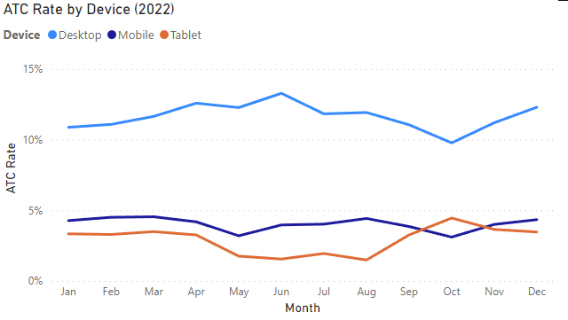
The drop off comes when adding to basket
The point in the funnel where Mobile drops off significantly is in the add to cart portion.
With an ATC rate of just 4% across 2022 vs Desktop’s 11.7%.
Improvement in the ATC and subsequent conversion rate in our largest market (mobile) would generate substantial revenue per user.

Slide 6
Conclusion: a/b test for tweaks to basket/purchase process
Create a size profile for each customer
Save shipping/payment information
One-click ordering

Slide 7
Any questions?
Thank you for listening!

